Slide 1


This page is now editable – all logos are individually placed
Just move the transparency box to the side and move logos as needed
The halo behind the main logo can be adjusted by resizing it
React User Group
March 2019

Slide 2
Component Architecture
Joey Kreft

Slide 3
Components
Any UI can be broken into smaller components
A component is a reusable chunk of code
They make it possible to divide any UI into independent, reusable pieces
They allow us to think about parts of the UI in isolation
Like a pure function, a component should ideally do just one thing

Slide 4
Components in React
React is declarative
Should know what a component is going to render based on its state
Allows us to think in snapshots in time
States change based on user interaction

Slide 5
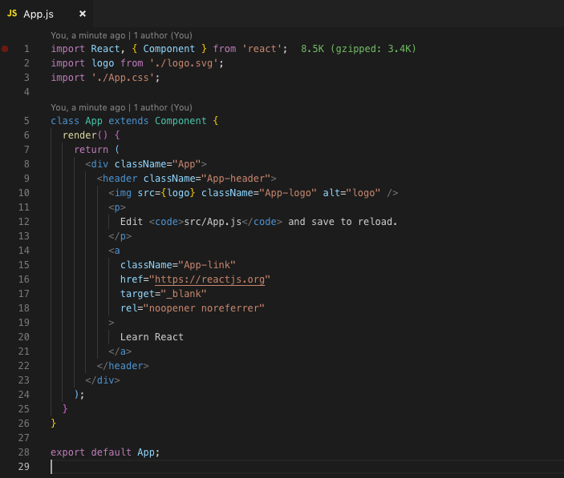
Needs of one vs many

Slide 6
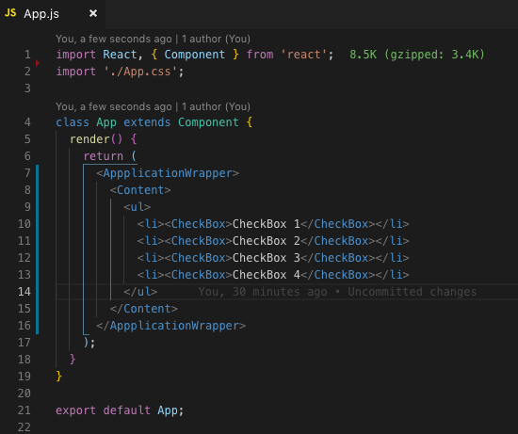
Needs of one vs many

Slide 7
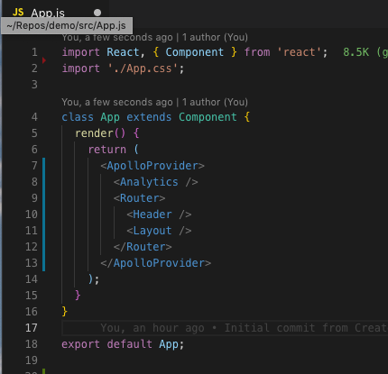
Needs of one vs many

Slide 8
Separating our Concerns
Design principle for separating an application or component into distinct sections
State Hoisting
Putting the state used by one component in a parent or grandparent
Gives us a single source of truth to work from
Likely already using this in practice
Container / Behavior and Presentation Components

Slide 9
Presentation Components
Concerned with how things look
Don’t contain state
Have no dependencies on local or global state
Don’t specify how the data is loaded or mutated
Primary use case for functional components (before hooks)
May contain both Presentational and Container components
Likely contain some DOM markup
Receive data and callbacks exclusively via props

Slide 10
Behavioral / Container Components
Concerned with how things work
Provide data and/or functionality using local and global state
Traditional use for class components (before Hooks)
May contain either Presentation or Container Components
Does not contain mark-up

Slide 11
What are the benefits?
Maintainability
Reusability
Composition
Easier to optimize
Easier to test!

Slide 12
Prop Drilling
Store

Slide 13
Pub Sub
Store

Slide 14
Takeaways
Components, like functions, should do one thing!
Components don’t have to add to the DOM!
Only need to provide composition boundaries between UI concerns
Testing and optimization are easier when concerns are separated
Everything talked about today is applicable for hook and classes

Slide 15
Questions?

Slide 16
Other Resources
State Hoisting
Hoisting State in React and Why?
Lifting State Up
Separating Concerns
Presentational and Container Components
Model-View-ViewModel
Separation of Concerns (Software Architecture)
Others
React Patterns

