Slide 1
Open Domain Question Answering
梁致銓
王彬宇

Slide 2
Outline
Motivation
Dataset: TriviaQA
Generative Method
Extractive Method
Experiment & Result
Conclusion

Slide 3
Motivation

Slide 4
Motivation
Since TA recommended "BERT" in Assignment 2: Question Answer, we would like to use the previously reported paper "Fid-PGN" for comparison.
In homework2, we use BERT to find answer spans from passages through text retrieval methods. In this project, we seek to use FiD-PGN for text generation with a replication mechanism for correct answers.

Slide 5
Dataset - TriviaQA

Slide 6
TriviaQA
TriviaQA is a reading comprehension dataset containing over 650K question-answer-evidence triples, includes 95K question-answer pairs authored by trivia enthusiasts and independently gathered evidence documents.
Standard of ODQA datasets.
Train: 99819
Valid: 13893
Test: 27248
Data sample:
context|||question|||answer

Slide 7
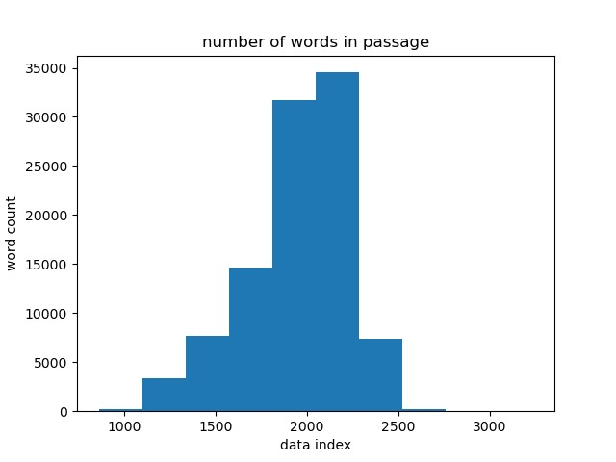
EDA
Average sentence: 49.6096334365201
Average words : 1948.9351225718551

Slide 8
Generative Method
FiD-PGN
bert2bert

Slide 9
FiD-PGN
A Copy-Augmented Generative Model for Open-Domain Question Answering
Author: Shuang Liu , Dong Wang , Xiaoguang Li , Minghui Huang , Meizhen Ding
ACL 2022
enhance the generative model FiD(fusion-in-decoder) with a pointer network

Slide 10
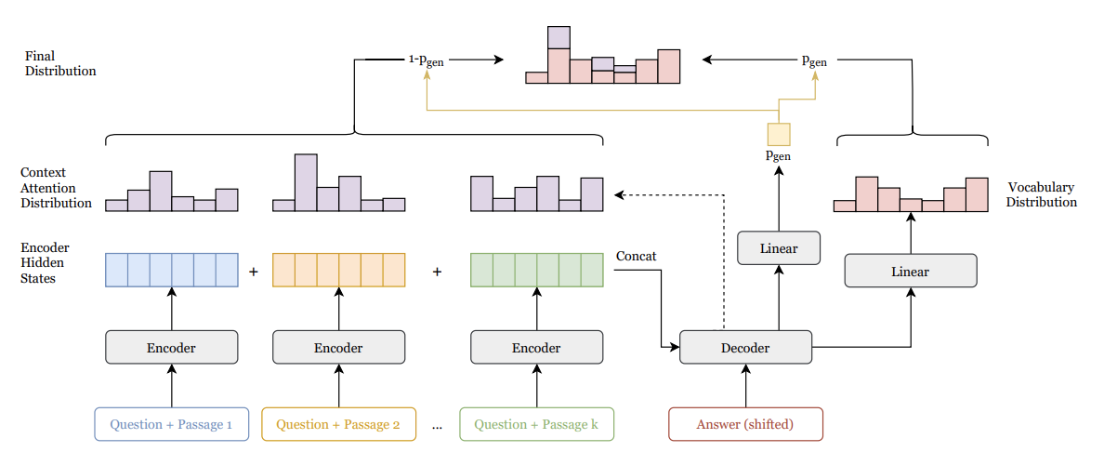
FiD-PGN
Encoder-Decoder model based on T5
Fused-in-decoder architecture with copy mechanism
Experiments are run on 8 Nvidia V100 32GB GPUs with batch size 64. (We have 3 Nvidia 8GB GPUs)
Due to computational limitation, failed to reproduce this model.

Slide 11
bert2bert
bert2BERT: Towards Reusable Pretrained Language Models
Author: Cheng Chen , Yichun Yin , Lifeng Shang , Xin Jiang , Yujia Qin, Fengyu Wang, Zhi Wang, Xiao Chen, Zhiyuan Liu, Qun Liu
ACL 2022
Encoder-Decoder model based on BERT
Both Encoder and Decoder are pretrained BERT

Slide 12
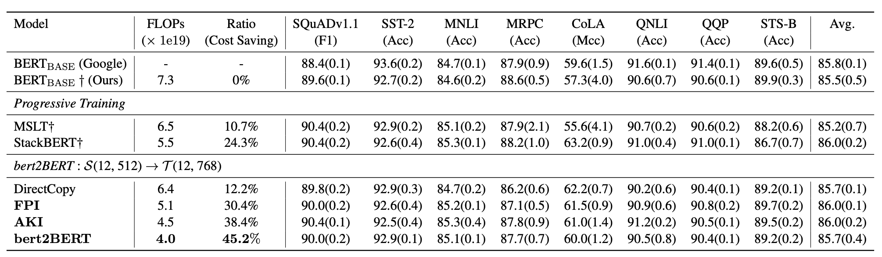
bert2bert

Slide 13
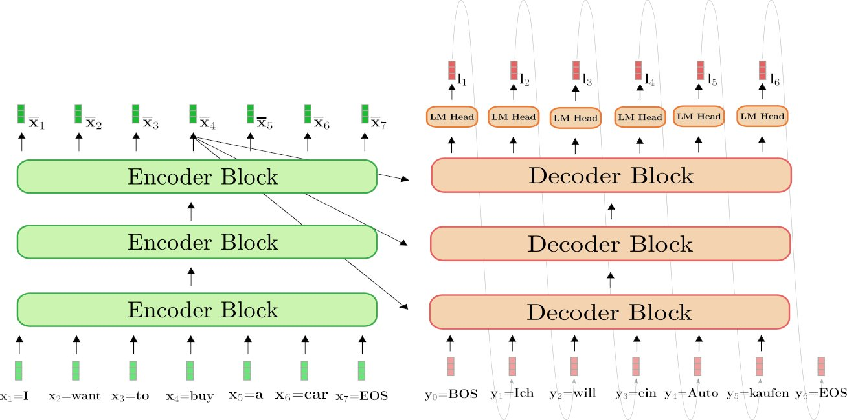
bert2bert
Model size is twice bigger than BERT.
Text retrieval is same as extractive method.
Due to computational limitation, we trained this model by half of the data.

Slide 14
Extractive Method
BM25
TF-IDF

Slide 15
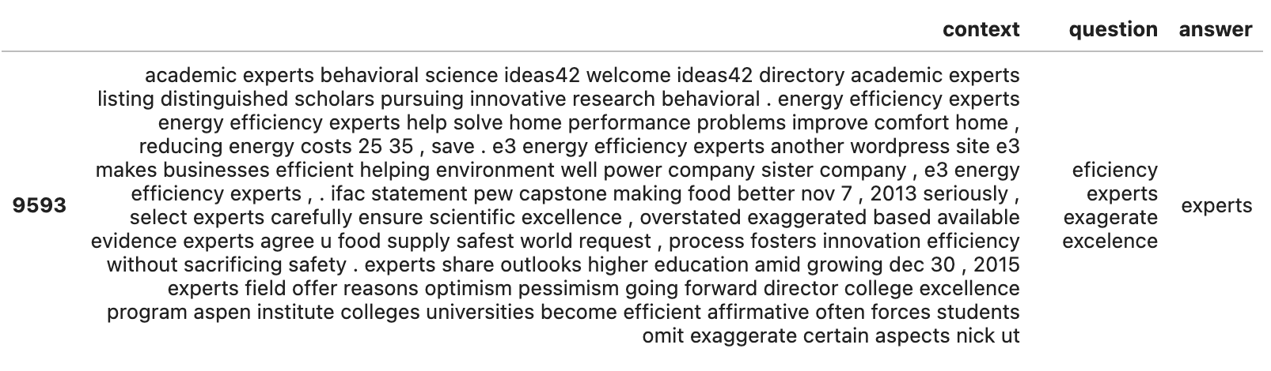
Text retrieval
Filter the context sentences by retrieve those contained answer.
Use BM25 or TF-IDF method to select Top K sentences.
Connect each selected sentences to our new context.

Slide 16
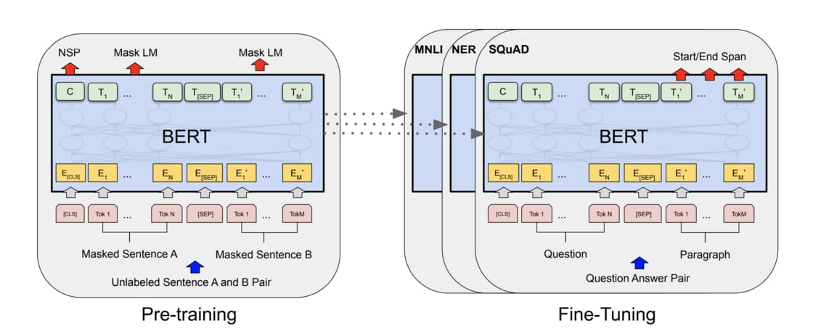
Model
We used bert-base-uncased as our model.

Slide 17
Experiment & Result

Slide 18
Metrics
LCS: longest common subsequence
F1: the harmonic mean of precision and recall
EM: the percentage of predictions that match any one of the ground truth answers exactly.
0< LCS, F1, EM <1

Slide 19
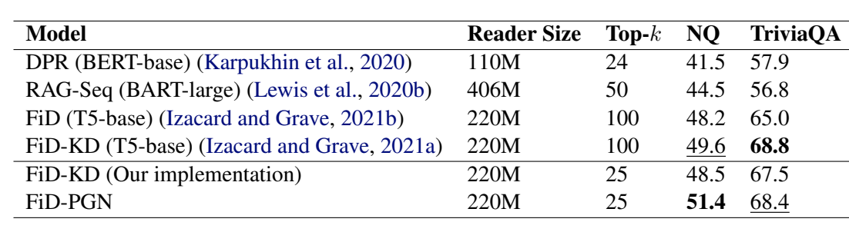
Generate Method (FiD-PGN)

Slide 20
Retrieval Method
score | TF-IDF |  |  |  |  | bert2bert | FiD-PGN
K | 1 | 2 | 3 | 4 | 5 | 5 | 25
LCS | 0.633 | 0.654 | 0.650 | 0.671 | 0.724 | 0.372 | None
F1 | 0.591 | 0.612 | 0.606 | 0.635 | 0.663 | 0.348 | None
EM | 0.524 | 0.538 | 0.536 | 0.547 | 0.578 | 0.312 | 0.684
score | BM25 |  |  |  |  | bert2bert | FiD-PGN
K | 1 | 2 | 3 | 4 | 5 | 5 | 25
LCS | 0.631 | 0.776 | 0.764 | 0.782 | 0.804 | 0.372 | None
F1 | 0.588 | 0.751 | 0.748 | 0.758 | 0.779 | 0.348 | None
EM | 0.514 | 0.676 | 0.632 | 0.681 | 0.697 | 0.312 | 0.684

Slide 21
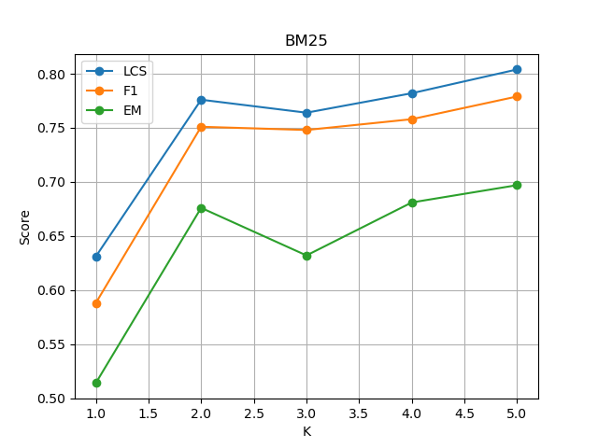
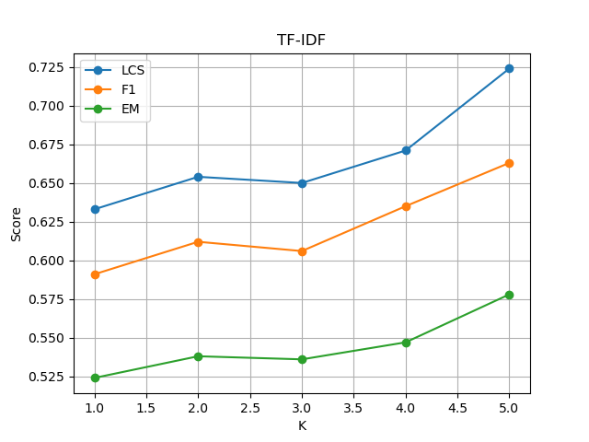
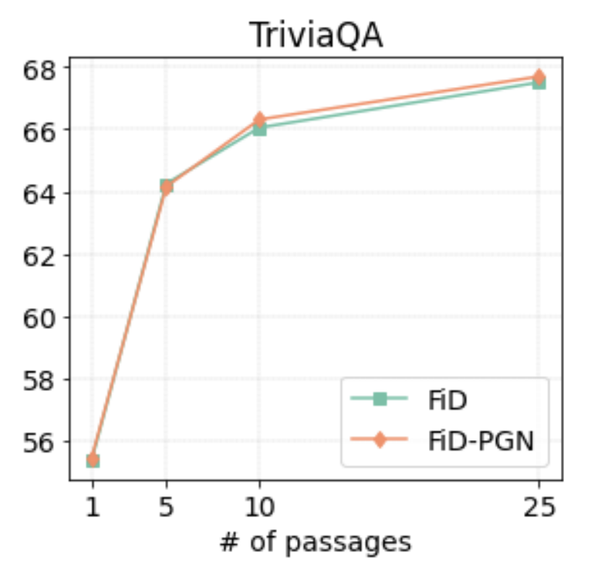
Accuracy according to K

Slide 22
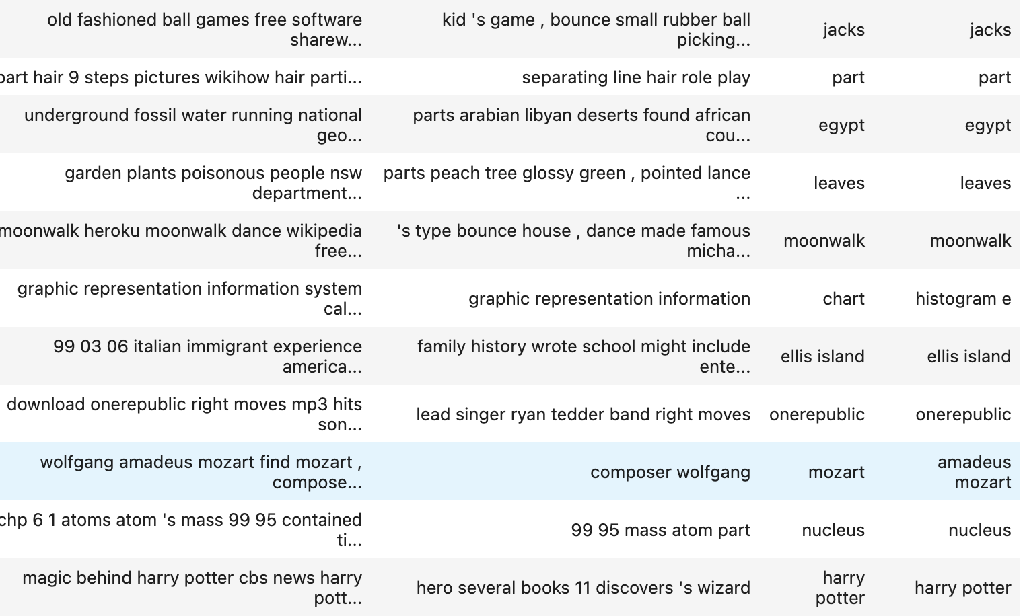
Result
Answer
predict

Slide 23
Conclusion

Slide 24
Conclusion
For text retrieval method, BM25 is better than TF-IDF.
Increasing the Top k sentences will increase the accuracy.
The insufficient of the data (bert2bert) really influence the accuracy.
For the dataset which the answers are in context, the extractive method performs better the generative by 1.3%

