Slide 1
QA accuracy comparison between BERT model and Fid-PGN model
Presenter: 梁致銓, 王彬宇

Slide 2
Motivation
Since TA recommends “BERT” in Assignment 2: Question Answer, we want to use “Fid-PGN” for comparison.
In homework2, we use BERT to find the answer span from the passages with text retrieval method. In this project, we seek to use FiD-PGN for text generation with copy mechanism to get the correct answer.

Slide 3
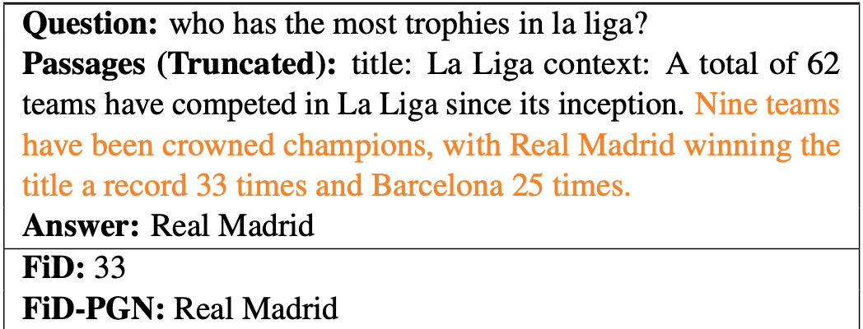
Expectation

Slide 4
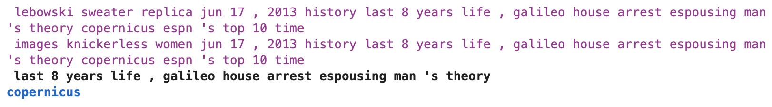
Data Format
Data field: passages, questions, answer
Data source: dataset from homework2
Number of records
Valid: 99819
Train: 13893
Passages
Question
Answer

Slide 5
Method
Proposed: FiD-PGN
enhance the generative model with a pointer network
fusion-in-decoder pointer-generator network (FiD-PGN) is built upon the state-of-the-art model FiD.
Enhancement of Language Decoder Prediction

Slide 6
What have we done?
By using BERT model with tf-idf and cosine similarity for text retrieval method, we have our baseline model with
f1 score: 0.7677
lcs accuracy: 0.796

Slide 7
What's next ?
12/4 | 12/5 | 12/6 | 12/7 | 12/8 | 12/9 | 12/10
Collecting data |  | proposal | Data preprocessing for FiD model
12/11 | 12/12 | 12/13 | 12/14 | 12/15 | 12/16 | 12/17
 |  |  | Implement FiD model for QA
2/18 | 12/19 | 12/20 | 12/21 | 12/22 | 12/23 | 12/24
 |  |  | Add point network in FiD model to make FiD-PGN
12/25 | 12/26 | 12/27 | 12/28 | 12/29 | 12/30 | 12/31
 |  |  | Compare two models and buffer time
1/1 | 1/2 | 1/3
 |  | presentation

Slide 8
THANK YOU!

