Slide 1
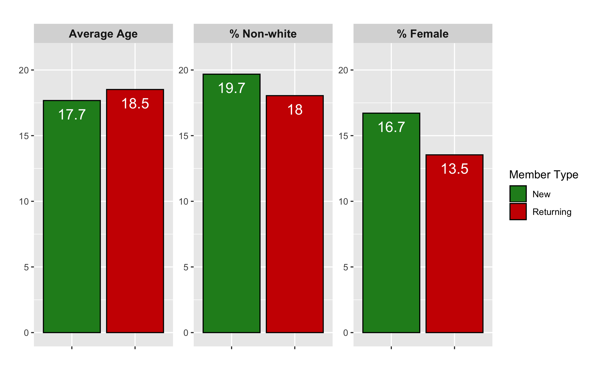
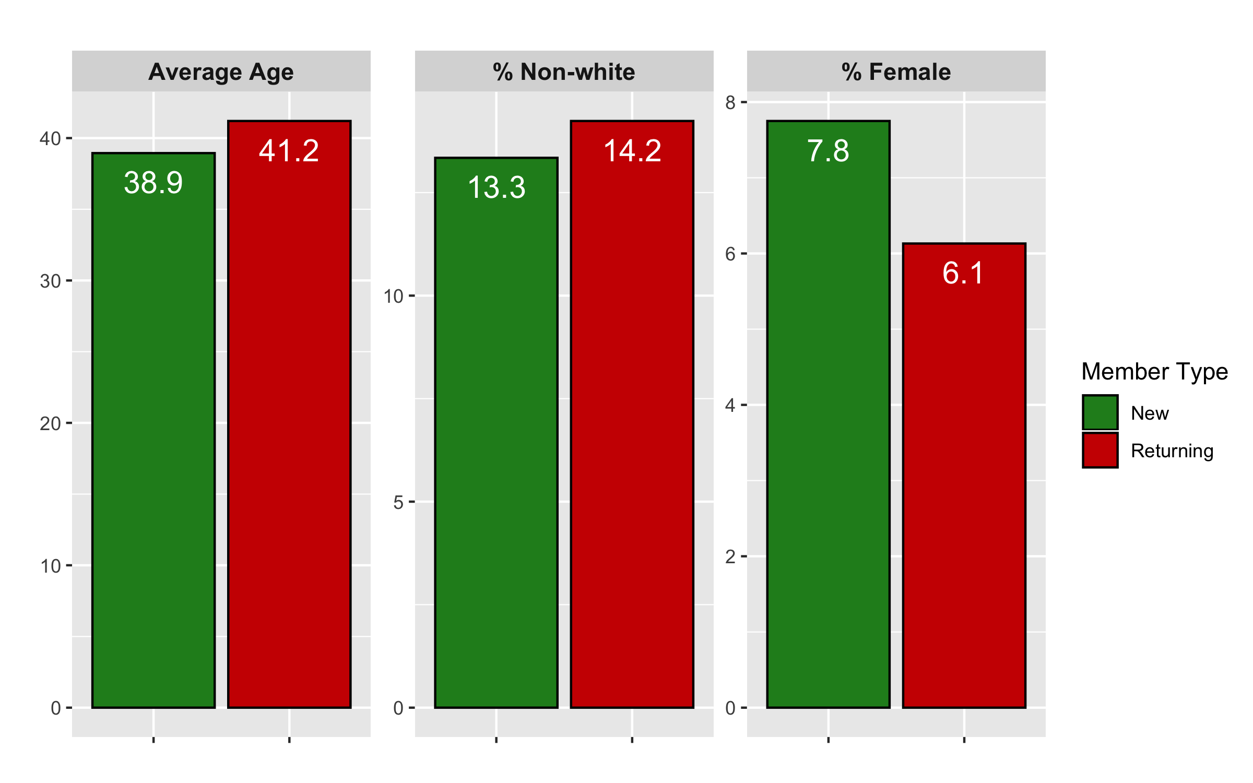
Membership Diversity
2018-19: New vs. Returning Players (Top) and Coaches (Bottom)
On average, new players are younger and have higher racial and gender diversity than returning players
Not only is female involvement trending up, the rate at which female players return for the following season is higher than males across nearly all ages
While new coaches are younger and a higher percentage female, they are less racially diverse than returning coaches
The percentage of new and returning coaches who are non-white has been on the decline in recent years
“Creating diversity in professional sports is not enough by itself. True leadership is essential, and sports organizations with effective leadership in diversity and inclusion often make the difference.” – Bold Business

Slide 2
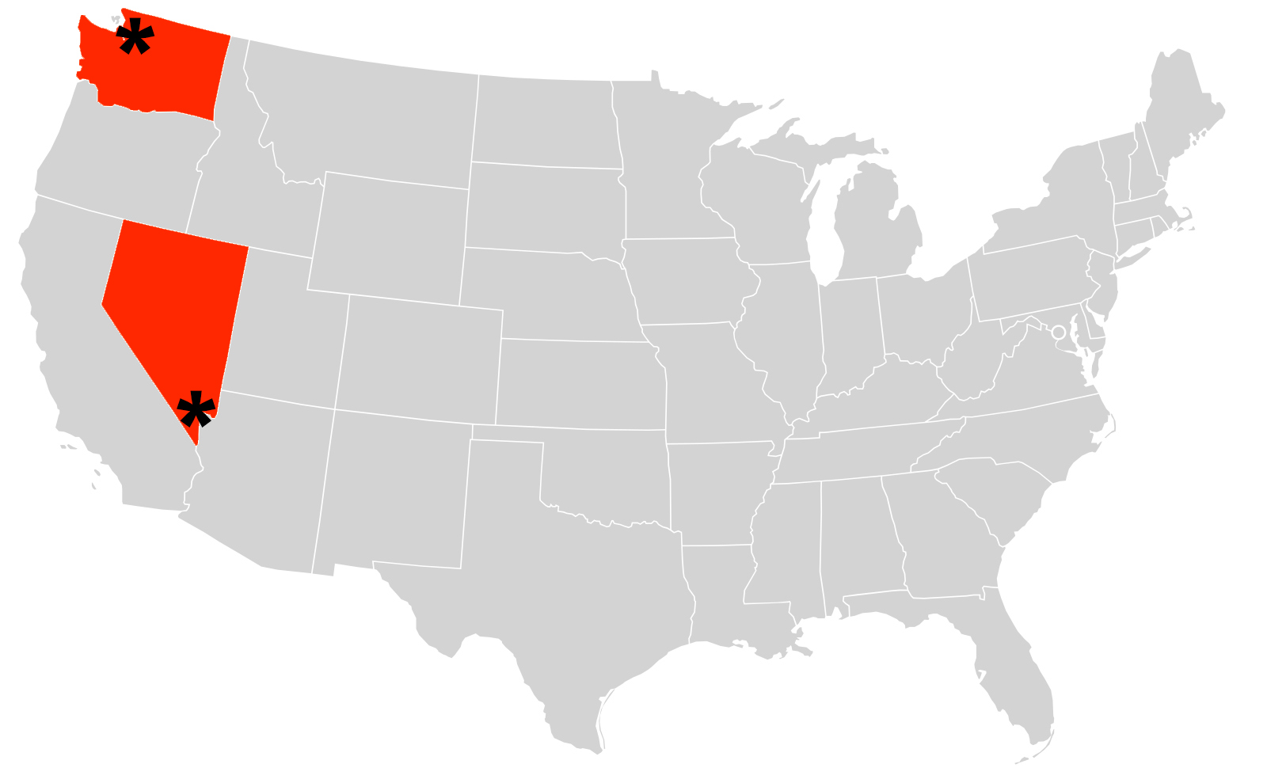
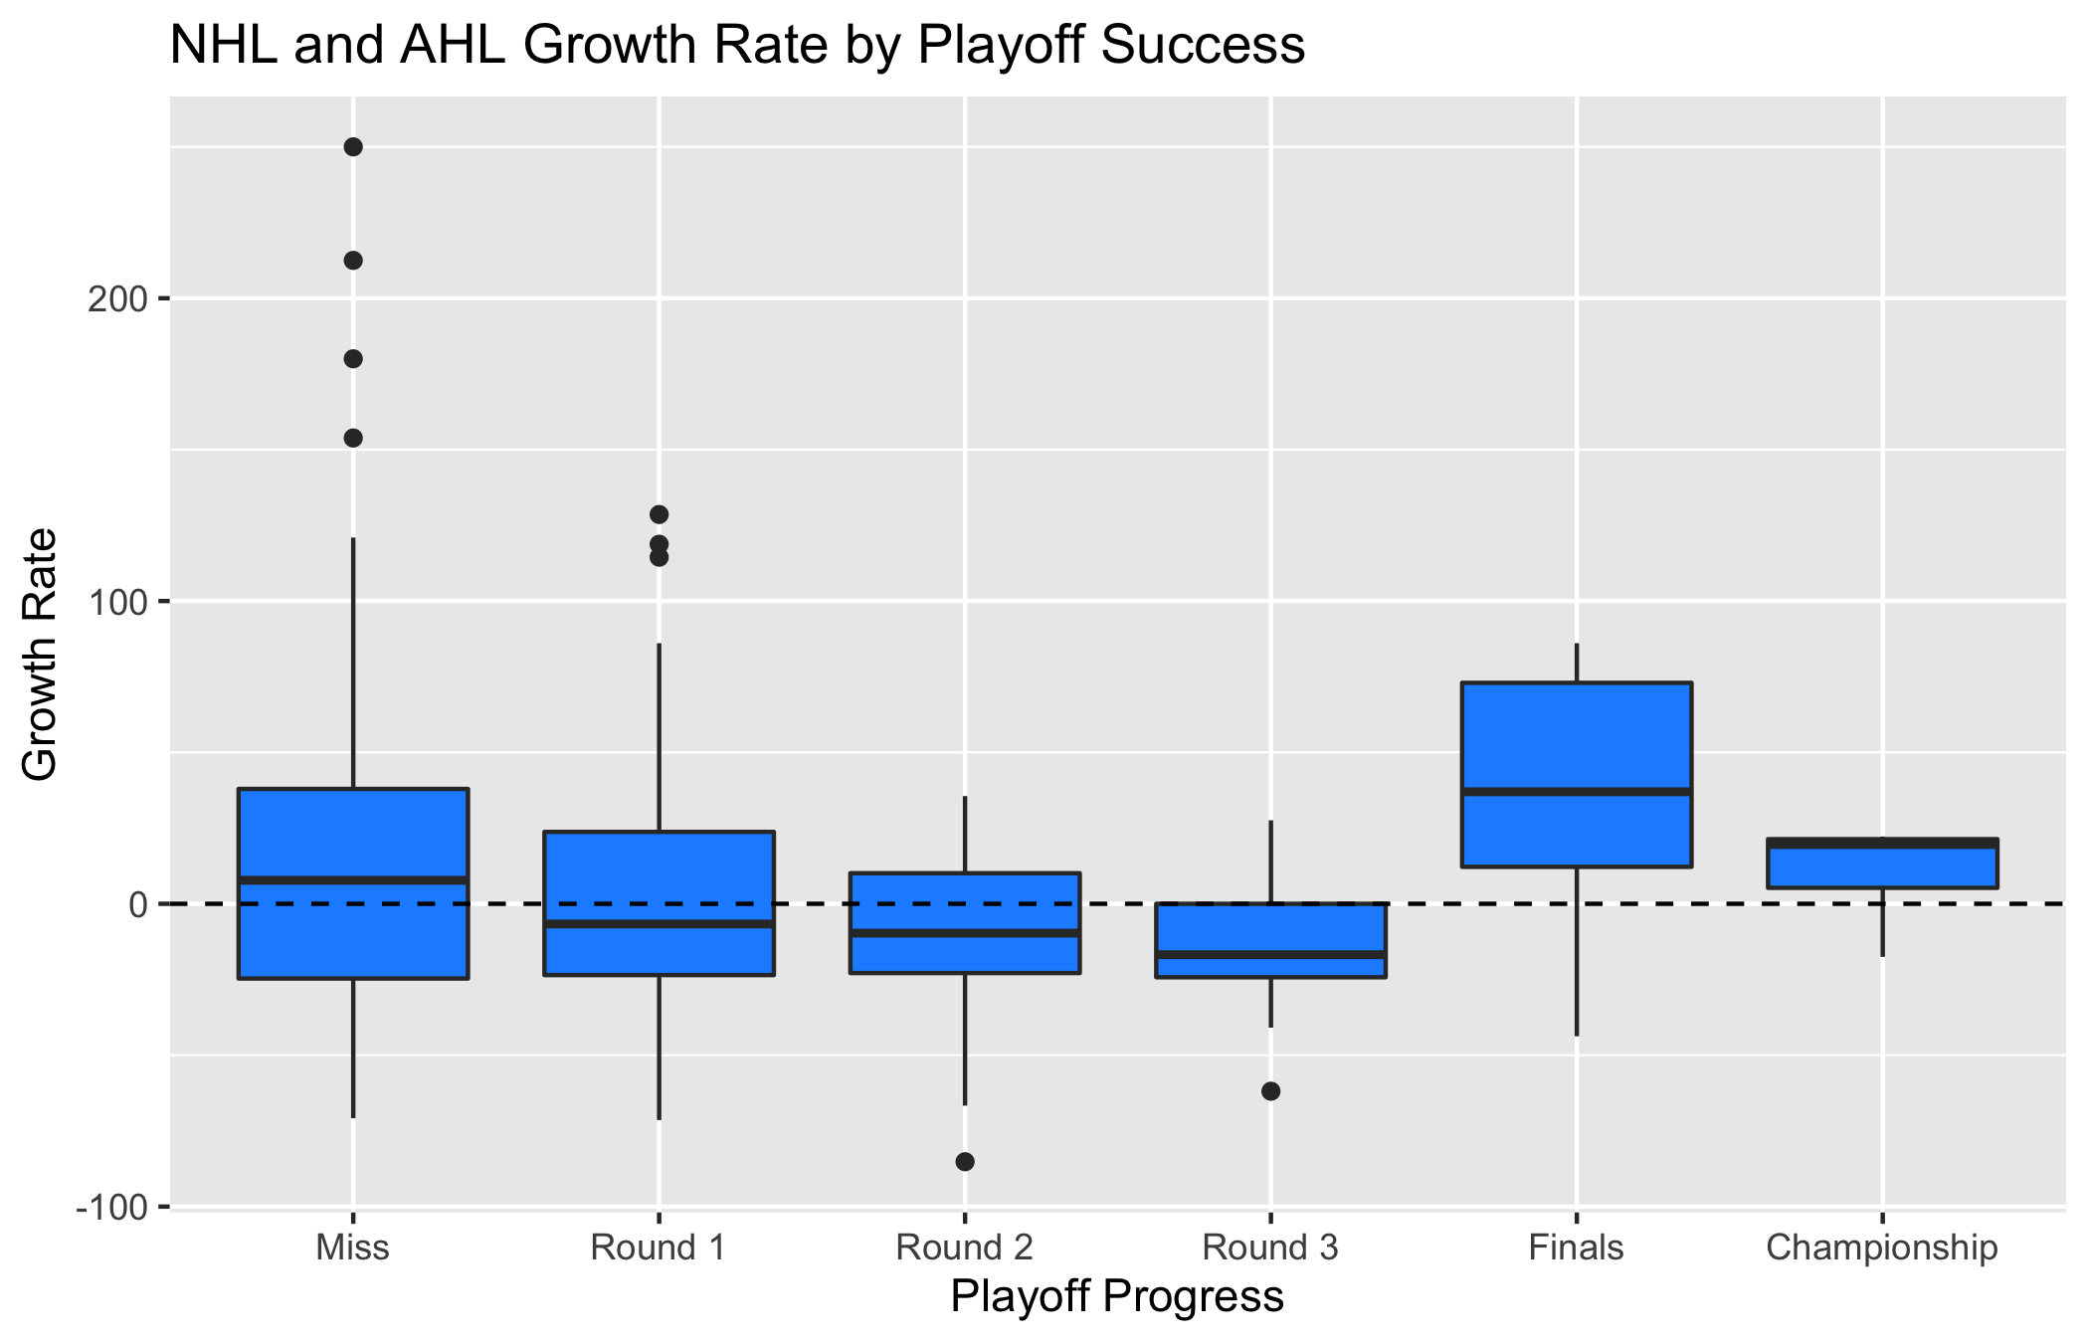
NHL Impact on USA Hockey
Seattle, WA
Expansion to Las Vegas brought about a 30% increase in new members in the city during their first regular season (2017-18) and an 84% increase after their Stanley Cup Final run
A breakdown by demographics could prove valuable to prepare for the upcoming NHL expansion to Seattle
The largest percentage growth of new members is seen in small-market teams that advance to the Finals
A higher growth rate was observed in cities like Las Vegas, San Jose, and Nashville
Cities that hosted an All-Star game had larger growth rates than those that hosted a Winter Classic
Las Vegas, NV
NHL and AHL City Growth Rate by Playoff Success (2016-2018)

Slide 3
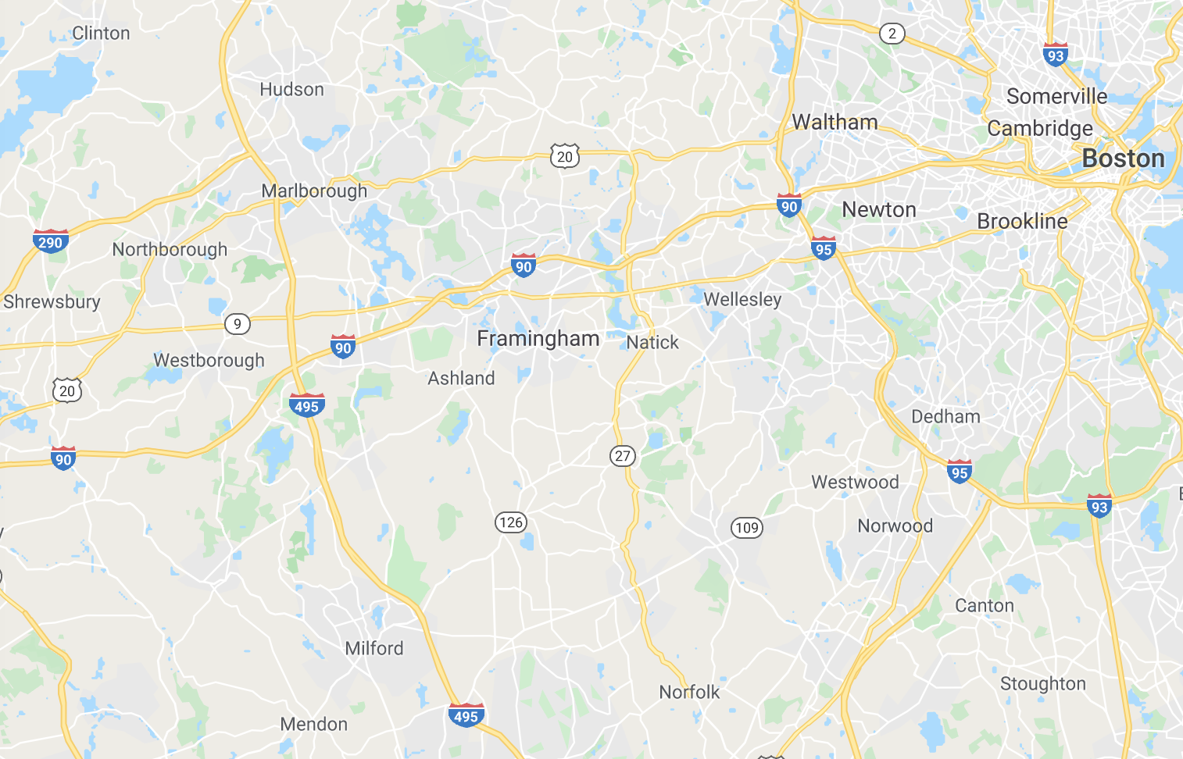
Analytics for Improved Business Practices
Map of Massachusetts
Statistical techniques can be utilized to increase efficiency in business practices
By analyzing officiating instructional course data, a pattern of individuals signing up in one location, only to cancel and register at a nearby location was found
The most common instance was people signing up in Canton, MA, but attending the course in Northborough, MA
Recognizing these events can lead to better planning and management of resources in the future
Modeling the effect of natural disasters on player membership levels
In 2017, player registration dropped in Houston likely due to the devastation of Hurricane Harvey
Knowledge of the potential impact of a disaster can drive programs to assist in the recovery process
Hurricane Harvey, 2017

