Slide 1


MerchReflex
Team: Finfold Growth Lab
Team leader: Yue Zhao
Retail & Commerce: evidence-backed page maintenance
Implementation draft · 13 October 2026

Slide 2
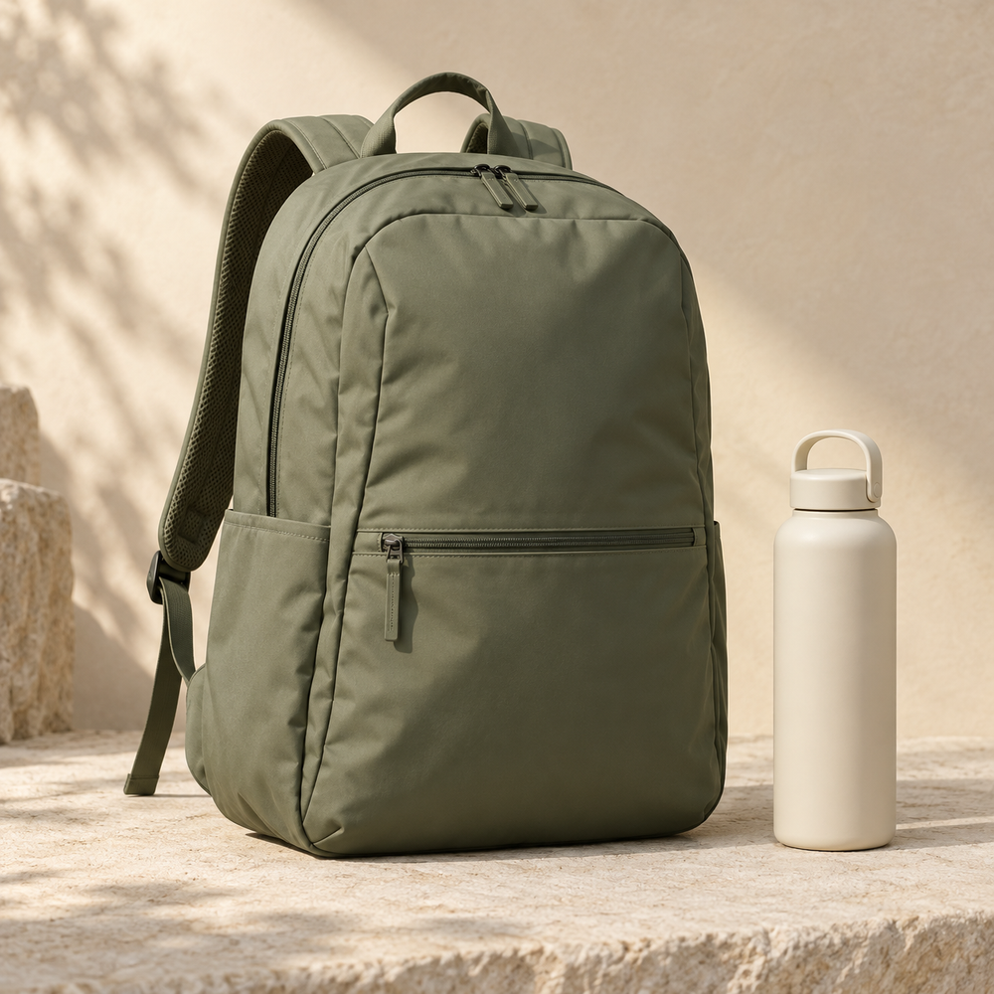
Fix the page.
Not just the ticket.
Customer feedback becomes a precise page repair, with visible evidence and a way back.
AI-generated image · synthetic product

Slide 3
Brief about the idea
A merchant receives the same product question again.
MerchReflex connects that question to the page, the product image and merchant-confirmed facts.
It proposes the smallest supported change, requests missing facts, and verifies the published version.

Slide 4
Opportunities
Existing assistants already edit products and request approval.
Our focus: distinguish page confusion from quality or delivery problems; resume after missing facts arrive; expire outdated approvals; verify the served result.
The hypothesis is less manual page-maintenance work. Merchant value remains to be measured.
Notes:
Competitive context: https://help.shopify.com/en/manual/ai-powered-tools/sidekick . We do not claim competitors lack every element of this workflow.

Slide 5
Features in the working prototype
One product. Three editable fields.
Source-linked classification and minimal field differences
Merchant-confirmed supplements and reassessment
Approval bound to evidence, content and page versions
Transactional publication, served-page checks and rollback
Price, inventory, policy and certification edits are blocked.

Slide 6
Repair workflow
01
Evidence
Feedback + specification + image
02
Judgment
Repair / request facts / conflict / human action
03
Review
Minimal patch + a separate semantic check
04
Approval
Merchant accepts exact text and source revision
05
Execution
Publish → read served page → verify or restore

Slide 7
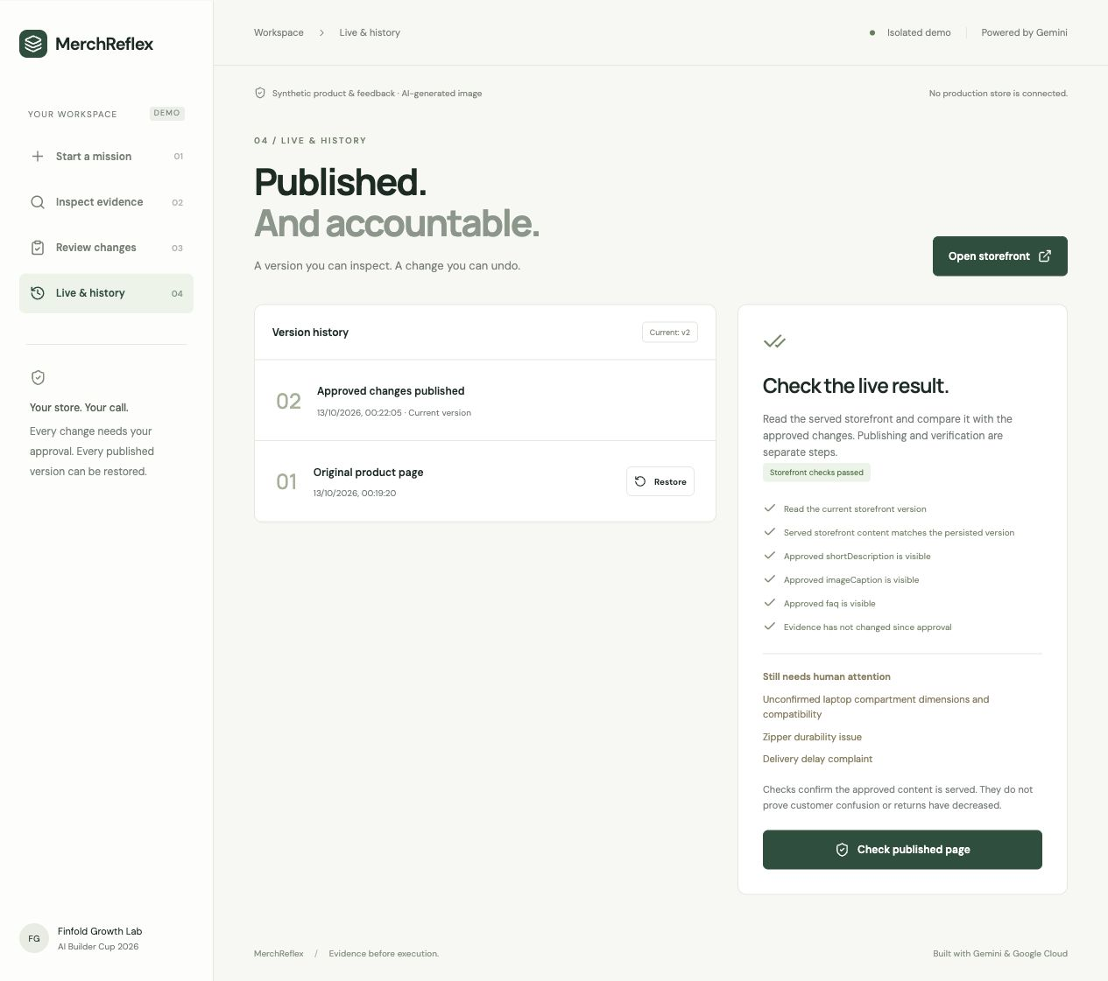
Verification interface
Published content is read back from the storefront.
Checks compare the actual served version with the approved changes.
Unresolved issues remain visible.

Slide 8
Google Cloud architecture
Browser
Isolated session
Cloud Run
Next.js + server API
Gemini 3.8 Flash
Read-only tools
→
↔
↓
↓
Firestore
Evidence, runs, approvals, versions
Private Cloud Storage
Validated product images
Cloud Run handles writes and verification. The model has no publish tool.
Notes:
Single application deployment in asia-southeast1; model location global. https://firebase.google.com/docs/firestore/manage-data/transactions . Model calls and HTTP verification are outside transaction callbacks.

Slide 9
Technologies used
Gemini 3.8 Flash through Google Gen AI SDK
Text, image, function calling and structured output
Next.js + TypeScript on Cloud Run
Firestore transactions + private Cloud Storage
Strict schemas, server-side limits, exact-origin checks, CSRF protection and HttpOnly session cookies
Notes:
Live text, image and function-call smoke tests performed on 2026-10-13 Shanghai time. https://docs.cloud.google.com/gemini-enterprise-agent-platform/models/gemini/3-8-flash .

Slide 10
Prototype operating budget
CNY 500 total planning allowance
CNY 200 Model development and evaluation
CNY 150 Deployment, storage and judging availability
CNY 150 Reserve
Global model quota, daily limits, maximum two instances.
Budget alerts are not hard billing caps. No credits assumed.

Slide 11
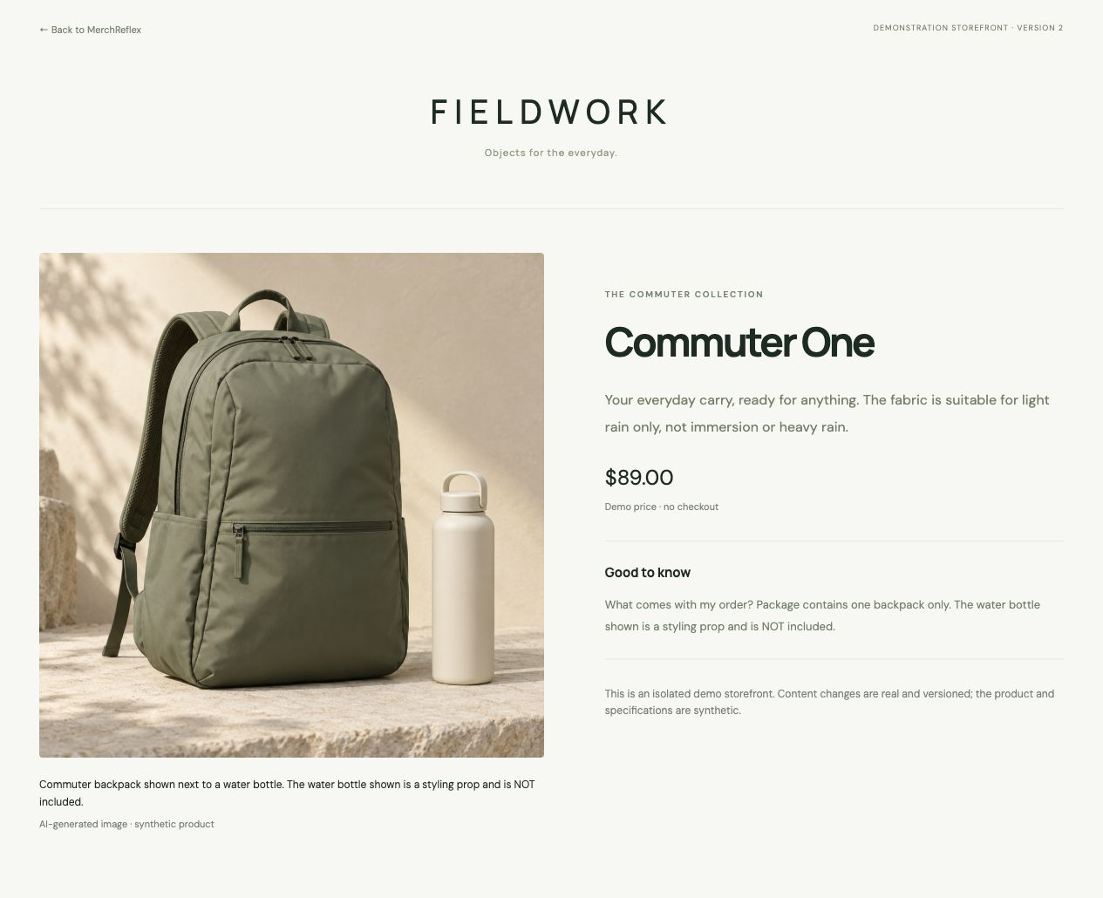
Published prototype
Observed on the live storefront:
The unsupported waterproof promise was replaced.
The image caption and FAQ clarify that the bottle is excluded.
Synthetic demo; no checkout.

Slide 12
Performance and evaluation
23 execution and integrity tests pass locally.
Live publication, served-page verification and restoration have been exercised in the browser.
30 semantic cases: 18 development, 12 frozen holdout.
Same-model, single-response baseline.
Human semantic grading and merchant task testing remain pending. No accuracy or revenue claim is made.
Notes:
Working draft as of 2026-10-13. Consult repository validation record and raw results for exact attempts, failures, runtime and prompt version. Automated completion is not semantic accuracy.

Slide 13
Future development
Before submission
Complete blind human grading, two task tests and merchant interviews; disclose failures.
After qualification
Use authorized merchant data, connect one development store, then test ongoing page maintenance.
Measure adoption and time saved before pricing or ROI claims.

Slide 14
Public prototype and source
GitHub
https://github.com/joeymilano/merchreflex
Live product
https://merchreflex-927668522599.asia-southeast1.run.app
English demonstration video
Recording and final public link pending

Slide 15
What the evidence does and does not show
Synthetic product facts are labelled as merchant-confirmed demo data, not certifications.
Published content can be read, checked and restored.
A passed check does not prove lower returns or higher revenue.
Same-model verification can share mistakes.
The merchant retains the final decision.
Notes:
All demonstration feedback and specifications are authored synthetic data. The backpack image was AI-generated, not an original product photograph. Human research is not complete.

Slide 16

Notes:
MerchReflex: Fix the page. Not just the ticket. Product: https://merchreflex-927668522599.asia-southeast1.run.app .

