Slide 1


Pagemi
Team: Finfold Growth Lab
Team leader: Yue Zhao
Retail & Commerce: evidence-backed page maintenance
Release evidence updated · 18 October 2026
Notes:
Evidence updated 2026-10-18. Sources: https://aibuildercup.com/themes.html ; https://aibuildercup.com/Faqs.html ; repository eval/results/vertex-release-2026-10-18.json and docs/HANDOFF_GOOGLE_CLOUD.md. Portal observed 2026-10-18: current video field requests 3–4 minutes, public FAQ remains conflicting. Synthetic demonstration.

Slide 2
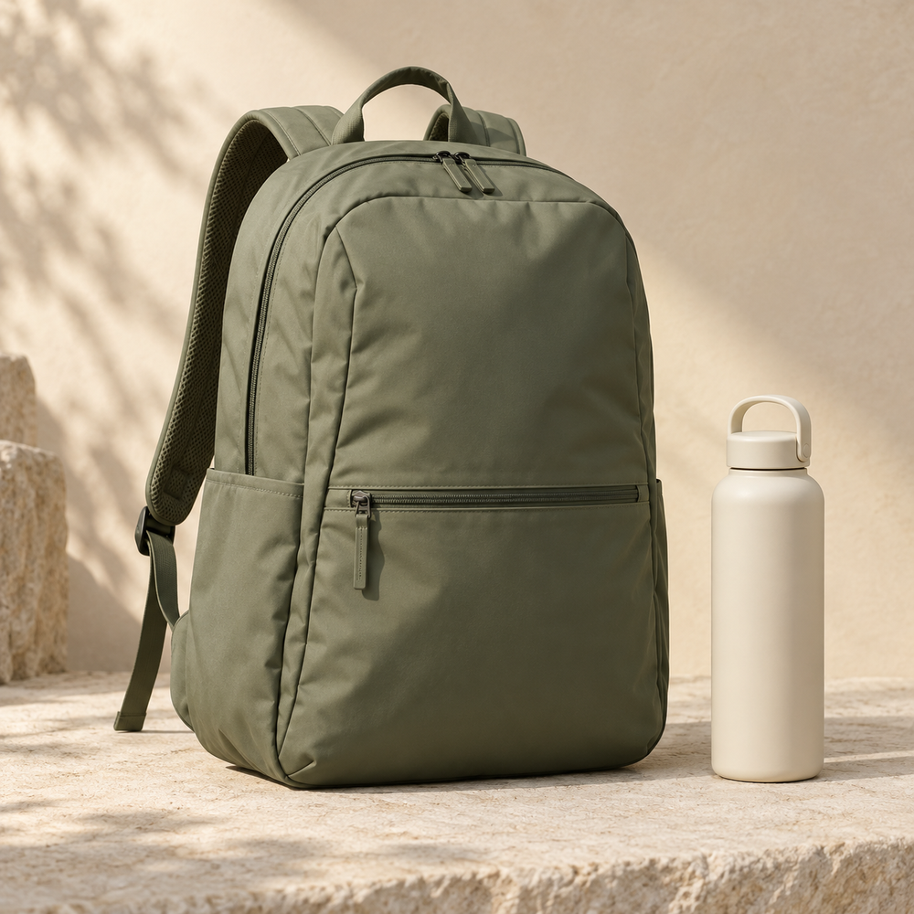
Fix the page.
Not just the ticket.
Customer feedback becomes a precise page repair, with visible evidence and a way back.
AI-generated image · synthetic product
Notes:
Evidence updated 2026-10-18. Sources: https://aibuildercup.com/themes.html ; https://aibuildercup.com/Faqs.html ; repository eval/results/vertex-release-2026-10-18.json and docs/HANDOFF_GOOGLE_CLOUD.md. Portal observed 2026-10-18: current video field requests 3–4 minutes, public FAQ remains conflicting. Synthetic demonstration.

Slide 3
Brief about the idea
A merchant receives the same product question again.
Pagemi connects that question to the page, the product image and merchant-confirmed facts.
It proposes the smallest supported change, requests missing facts, and verifies the published version.
Notes:
Evidence updated 2026-10-18. Sources: https://aibuildercup.com/themes.html ; https://aibuildercup.com/Faqs.html ; repository eval/results/vertex-release-2026-10-18.json and docs/HANDOFF_GOOGLE_CLOUD.md. Portal observed 2026-10-18: current video field requests 3–4 minutes, public FAQ remains conflicting. Synthetic demonstration.

Slide 4
Opportunities
A support reply can leave the confusing page unchanged.
Pagemi links repairable feedback to verified wording, pauses for missing facts, expires outdated approvals, and checks the served page.
Merchant interviews and measured time savings remain future validation.
Notes:
Evidence updated 2026-10-18. Sources: https://aibuildercup.com/themes.html ; https://aibuildercup.com/Faqs.html ; repository eval/results/vertex-release-2026-10-18.json and docs/HANDOFF_GOOGLE_CLOUD.md. Portal observed 2026-10-18: current video field requests 3–4 minutes, public FAQ remains conflicting. Synthetic demonstration.

Slide 5
Features in the working prototype
One product. Three editable fields.
Source-linked classification and minimal field differences
Merchant-confirmed supplements and reassessment
Approval bound to evidence, content and page versions
Transactional publication, served-page checks and rollback
Price, inventory, policy and certification edits are blocked.
Notes:
Evidence updated 2026-10-18. Sources: https://aibuildercup.com/themes.html ; https://aibuildercup.com/Faqs.html ; repository eval/results/vertex-release-2026-10-18.json and docs/HANDOFF_GOOGLE_CLOUD.md. Portal observed 2026-10-18: current video field requests 3–4 minutes, public FAQ remains conflicting. Synthetic demonstration.

Slide 6
Repair workflow
01
Evidence
Feedback + specification + image
02
Judgment
Repair / request facts / conflict / human action
03
Review
Minimal patch + a separate semantic check
04
Approval
Merchant accepts exact text and source revision
05
Execution
Publish → read served page → verify or restore
Notes:
Evidence updated 2026-10-18. Sources: https://aibuildercup.com/themes.html ; https://aibuildercup.com/Faqs.html ; repository eval/results/vertex-release-2026-10-18.json and docs/HANDOFF_GOOGLE_CLOUD.md. Portal observed 2026-10-18: current video field requests 3–4 minutes, public FAQ remains conflicting. Synthetic demonstration.

Slide 7
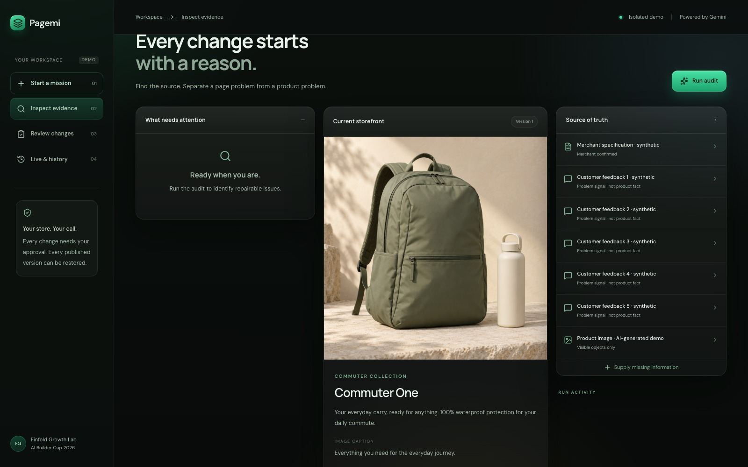
Evidence workbench
Live interface, 18 October 2026.
Feedback identifies the problem. Merchant facts support the repair.
This screenshot shows the input state before the audit.
Notes:
Evidence updated 2026-10-18. Sources: https://aibuildercup.com/themes.html ; https://aibuildercup.com/Faqs.html ; repository eval/results/vertex-release-2026-10-18.json and docs/HANDOFF_GOOGLE_CLOUD.md. Portal observed 2026-10-18: current video field requests 3–4 minutes, public FAQ remains conflicting. Synthetic demonstration. Screenshot provenance is explicitly identified on slide.

Slide 8
Google Cloud architecture
Browser
Isolated session
Cloud Run
Next.js + server API
Gemini 3.8 Flash
Read-only tools
→
↔
↓
↓
Firestore
Evidence, runs, approvals, versions
Private Cloud Storage
Validated product images
Cloud Run handles writes and verification. The model has no publish tool.
Notes:
Evidence updated 2026-10-18. Sources: https://aibuildercup.com/themes.html ; https://aibuildercup.com/Faqs.html ; repository eval/results/vertex-release-2026-10-18.json and docs/HANDOFF_GOOGLE_CLOUD.md. Portal observed 2026-10-18: current video field requests 3–4 minutes, public FAQ remains conflicting. Synthetic demonstration.

Slide 9
Technologies used
Gemini 3.8 Flash through official Vertex AI
Text, image, read-only tools and structured output
Next.js + TypeScript on Cloud Run
Firestore transactions + private Cloud Storage
Independent verification request, schema and permission gates, scoped sessions and exact-origin writes
Notes:
Evidence updated 2026-10-18. Sources: https://aibuildercup.com/themes.html ; https://aibuildercup.com/Faqs.html ; repository eval/results/vertex-release-2026-10-18.json and docs/HANDOFF_GOOGLE_CLOUD.md. Portal observed 2026-10-18: current video field requests 3–4 minutes, public FAQ remains conflicting. Synthetic demonstration.

Slide 10
Bounded prototype operation
18 October release verification
Conservative new workflow accounting: about USD 0.70
Shared per-request reservations, input/output limits,
daily capacity and maximum two Cloud Run instances.
Hosting, builds and storage are billed separately.
This estimate is not total development cost or an invoice.
Notes:
Evidence updated 2026-10-18. Sources: https://aibuildercup.com/themes.html ; https://aibuildercup.com/Faqs.html ; repository eval/results/vertex-release-2026-10-18.json and docs/HANDOFF_GOOGLE_CLOUD.md. Portal observed 2026-10-18: current video field requests 3–4 minutes, public FAQ remains conflicting. Synthetic demonstration.

Slide 11
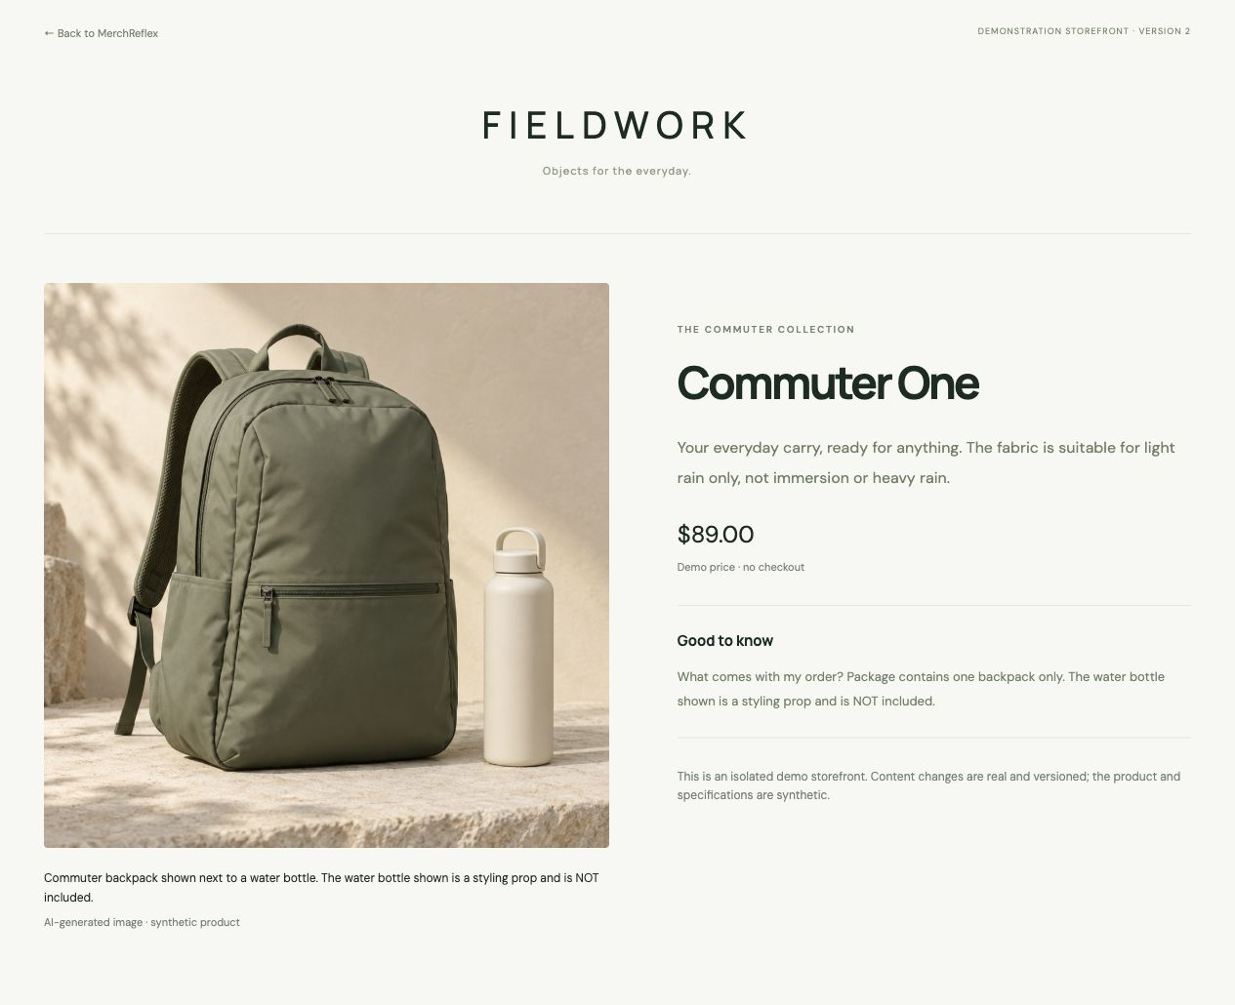
Published prototype
Historical storefront capture, 13 October 2026.
Bottle exclusion and supported rain wording appeared on the served page.
The current release passed publish, verify and restore in five public workflows.
Notes:
Evidence updated 2026-10-18. Sources: https://aibuildercup.com/themes.html ; https://aibuildercup.com/Faqs.html ; repository eval/results/vertex-release-2026-10-18.json and docs/HANDOFF_GOOGLE_CLOUD.md. Portal observed 2026-10-18: current video field requests 3–4 minutes, public FAQ remains conflicting. Synthetic demonstration. Screenshot provenance is explicitly identified on slide.

Slide 12
Performance and evaluation
5 consecutive public workflows passed on the release.
Full journey: 20.2–69.5 seconds across these five runs.
35 local tests passed; build and type-check passed.
Two earlier public attempts failed on provider timeouts.
Human accuracy grading and merchant testing: pending.
Synthetic tests. No revenue, return-rate or accuracy claim.
Notes:
Evidence updated 2026-10-18. Sources: https://aibuildercup.com/themes.html ; https://aibuildercup.com/Faqs.html ; repository eval/results/vertex-release-2026-10-18.json and docs/HANDOFF_GOOGLE_CLOUD.md. Portal observed 2026-10-18: current video field requests 3–4 minutes, public FAQ remains conflicting. Synthetic demonstration.

Slide 13
Future development
Next validation
Human-grade the frozen holdout, compare content with the baseline, and observe two non-developer task tests.
After qualification
Use authorized merchant records, connect one development store, then test repeat usage and time saved.
Measure adoption before setting a price or claiming ROI.
Notes:
Evidence updated 2026-10-18. Sources: https://aibuildercup.com/themes.html ; https://aibuildercup.com/Faqs.html ; repository eval/results/vertex-release-2026-10-18.json and docs/HANDOFF_GOOGLE_CLOUD.md. Portal observed 2026-10-18: current video field requests 3–4 minutes, public FAQ remains conflicting. Synthetic demonstration.

Slide 14
Public prototype and source
GitHub
https://github.com/joeymilano/pagemi
Live product
https://merchreflex-927668522599.asia-southeast1.run.app
English video: production handoff ready; public link pending.
Current portal requests 3–4 minutes; master target 3:15.
Notes:
Evidence updated 2026-10-18. Sources: https://aibuildercup.com/themes.html ; https://aibuildercup.com/Faqs.html ; repository eval/results/vertex-release-2026-10-18.json and docs/HANDOFF_GOOGLE_CLOUD.md. Portal observed 2026-10-18: current video field requests 3–4 minutes, public FAQ remains conflicting. Synthetic demonstration.

Slide 15
Evidence and limitations
Synthetic product facts and an AI-generated image.
Merchant confirmation is not third-party certification.
Published content can be read, checked and restored.
Customer understanding and business impact are unmeasured.
Same-model checking can repeat mistakes.
Human approval remains required.
Notes:
Evidence updated 2026-10-18. Sources: https://aibuildercup.com/themes.html ; https://aibuildercup.com/Faqs.html ; repository eval/results/vertex-release-2026-10-18.json and docs/HANDOFF_GOOGLE_CLOUD.md. Portal observed 2026-10-18: current video field requests 3–4 minutes, public FAQ remains conflicting. Synthetic demonstration.

Slide 16

Notes:
Evidence updated 2026-10-18. Sources: https://aibuildercup.com/themes.html ; https://aibuildercup.com/Faqs.html ; repository eval/results/vertex-release-2026-10-18.json and docs/HANDOFF_GOOGLE_CLOUD.md. Portal observed 2026-10-18: current video field requests 3–4 minutes, public FAQ remains conflicting. Synthetic demonstration.

