Slide 1
Chapter 10
Preparing The Systems Proposal
Systems Analysis and Design
Kendall & Kendall
Sixth Edition

Slide 2
Major Topics
Systems proposal
Determining hardware/software needs
Tangible and intangible costs and benefits
Systems proposal
Using tables, graphs, and figures

Slide 3
Systems Proposal
In order to prepare the systems proposal analysts must use a systematic approach to:
  Ascertain hardware and software needs.
  Identify and forecast costs and benefits.
  Compare costs and benefits.
  Choose the most appropriate alternative.

Slide 4
Ascertaining Hardware and Software Needs
Steps used to determine hardware and software needs:
    Inventory computer hardware currently available.
    Estimate current and projected workload for the system.
    Evaluate the performance of hardware and software using some predetermined criteria.
    Choose the vendor according to the evaluation.
    Obtain hardware and software from the vendor.

Slide 5
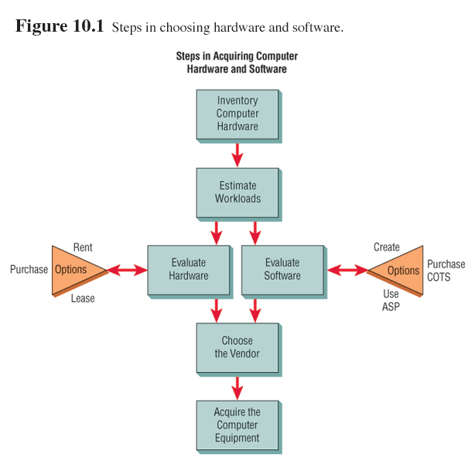
Steps in Acquiring Computer Hardware and Software

Slide 6
Hardware Inventory
When inventorying hardware check:
  Type of equipment.
  Status of equipment operation.
  Estimated age of equipment.
  Projected life of equipment.
  Physical location of equipment.
  Department or person responsible for equipment.
  Financial arrangement for equipment.

Slide 7
Evaluating Hardware
Criteria for evaluating hardware:
  Time required for average transactions (including time for input and output).
  Total volume capacity of the system.
  Idle time of the central processing unit.
  Size of memory provided.

Slide 8
People that Evaluate Hardware
The people involved:
  Management.
  Users.
  Systems analysts.

Slide 9
Purchasing, Leasing, or Renting Decision
There are three options for obtaining computer equipment:
  Buying.
  Leasing.
  Rental.

Slide 10
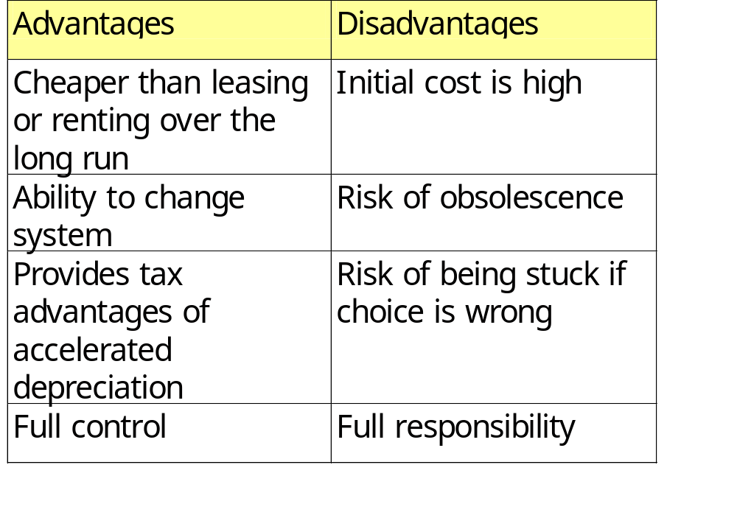
Buying

Slide 11
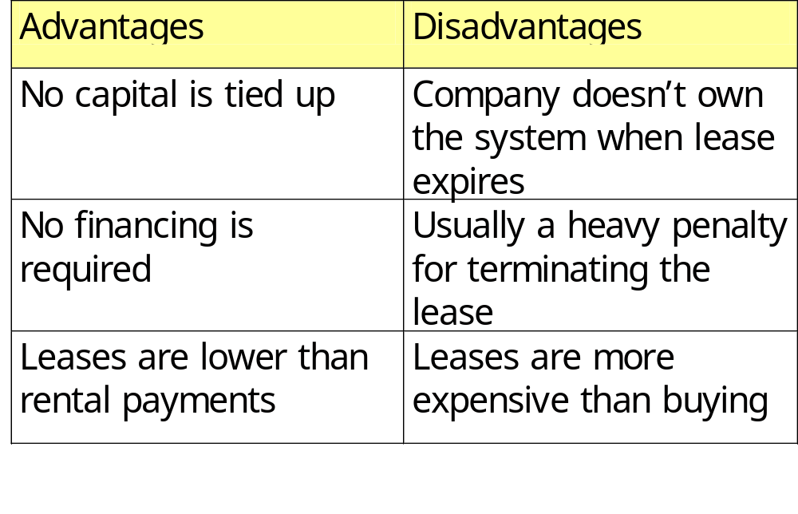
Leasing

Slide 12
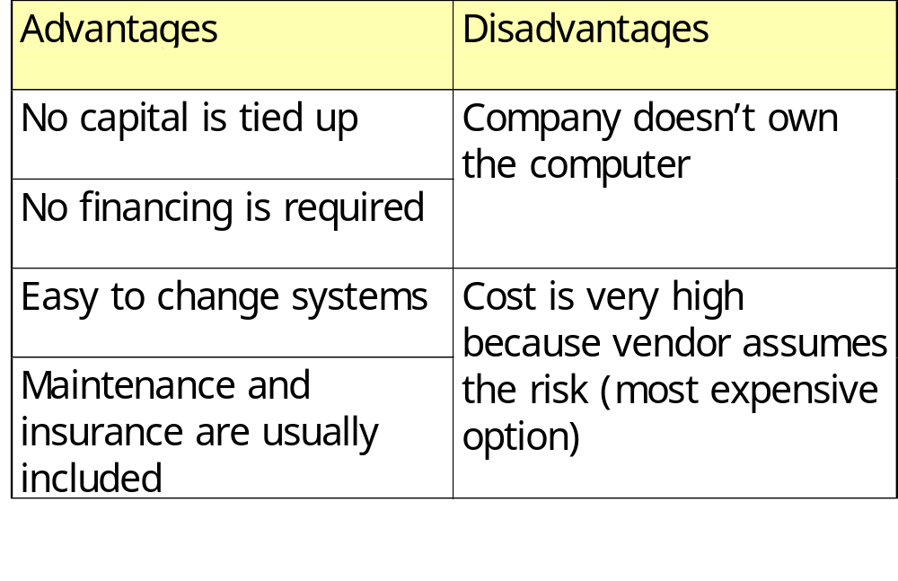
Renting

Slide 13
Evaluating Hardware Support
When evaluating hardware vendors, the selection committee needs to consider:
  Hardware support.
  Software support.
  Installation and training support.
  Maintenance support.
  Performance of the hardware.

Slide 14
Software Alternatives
Software may be:
  Custom created in-house.
  Purchased as COTS (commercial off-the-shelf) software.
  Provided by an application service provider (ASP).

Slide 15
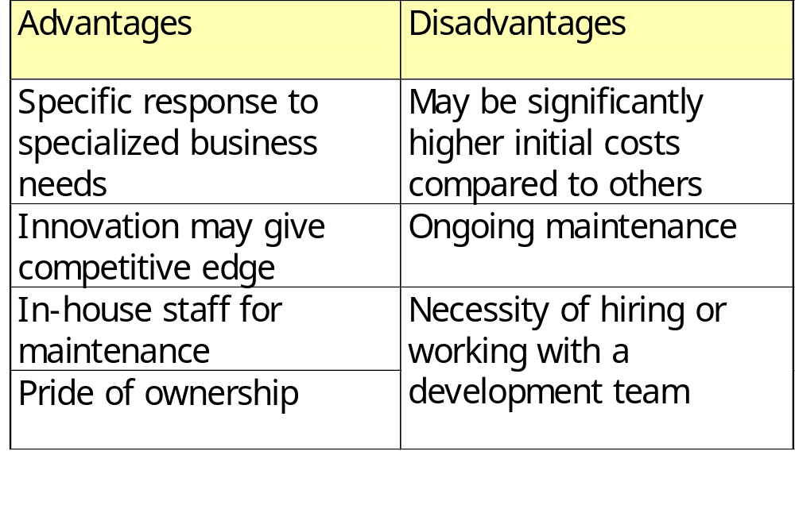
Creating Custom Software

Slide 16
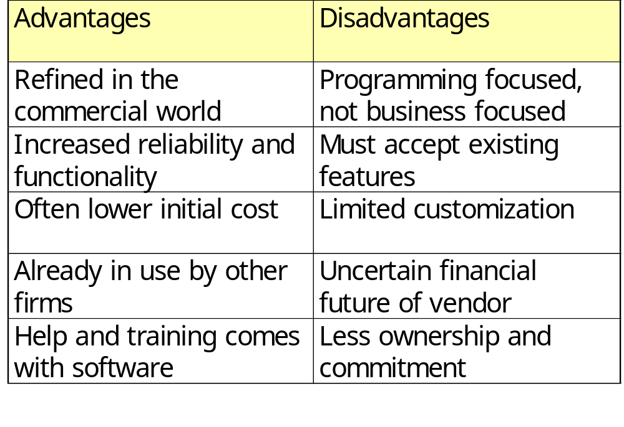
Purchasing COTS Packages

Slide 17
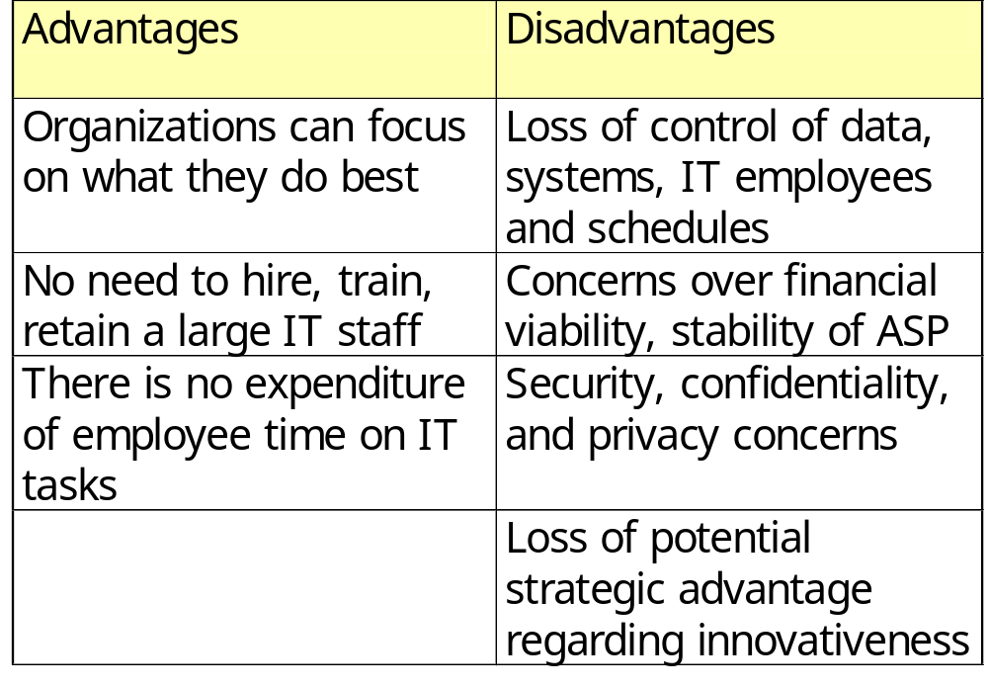
Using an ASP

Slide 18
Software Evaluation
Use the following to evaluating software packages:
  Performance effectiveness
  Performance efficiency
  Ease of use
  Flexibility
  Quality of documentation
  Manufacturer support

Slide 19
Analytic Hierarchy Processing (AHP)
Analytic Hierarchy Processing requires decision makers to judge the relative importance of each criteria and indicate their preference regarding the importance of each alternative criteria.
A disadvantage of AHP stems from the use of the pairwise method used to evaluate alternatives.

Slide 20
Expert Systems
Expert systems are rule-based reasoning systems developed around an expert in the field.

Slide 21
Neural Nets
Neural nets are developed by solving a number of specific type of problems and getting feedback on the decisions, then observing what was involved in successful decisions.

Slide 22
Recommendation Systems
Recommendation systems are software and database systems that reduce the number of alternatives by ranking, counting, or some other method.
A recommendation system does not use weights.
It simply counts the number of occurrences.

Slide 23
The Web and Decision Making
The World Wide Web may be used to extract decision-making information.
Push technologies automatically deliver new Internet information to a desktop.
Intelligent agents learn your personality and behavior and track topics that you might be interested in based on what it has learned.

Slide 24
Identifying and Forecasting Costs and Benefits
May forecast costs and benefits of a prospective system through:
  Graphical judgment.
  Moving averages.
  Analysis of time series.

Slide 25
Estimating Trends
Trends may be estimated using:
  Graphical judgment.
  The method of least squares.
  Moving average method.

Slide 26
Costs and Benefits
Systems analysts should take tangible costs, intangible costs, tangible benefits, and intangible benefits into consideration to identify cost and benefits of a prospective system.

Slide 27
Tangible Benefits
Tangible benefits are advantages measurable in dollars that accrue to the organization through use of the information system.
Examples:
  Increase in the speed of processing.
  Access to information on a more timely basis.

Slide 28
Intangible Benefits
Intangible benefits are advantages from use of the information system that are difficult to measure.
Examples:
  Improved effectiveness of decision-making processes.
  Maintaining a good business image.

Slide 29
Tangible Costs
Tangible costs are those that can be accurately projected by systems analysts and the business accounting personnel.
Examples:
  Cost of equipment.
  Cost of resources.
  Cost of systems analysts' time.

Slide 30
Intangible Costs
Intangible costs are those that are difficult to estimate, and may not be known
Examples:
  Cost of losing a competitive edge.
  Declining company image.

Slide 31
Selecting the Best Alternative
To select the best alternative, analysts should compare costs and benefits of the prospective alternatives using:
  Break-even analysis.
  Payback.
  Cash-flow analysis.
  Present value method.

Slide 32
Break-Even Analysis
Break-even analysis is the point at which the cost of the current system and the proposed system intersect.
Break-even analysis is useful when a business is growing and volume is a key variable in costs.

Slide 33
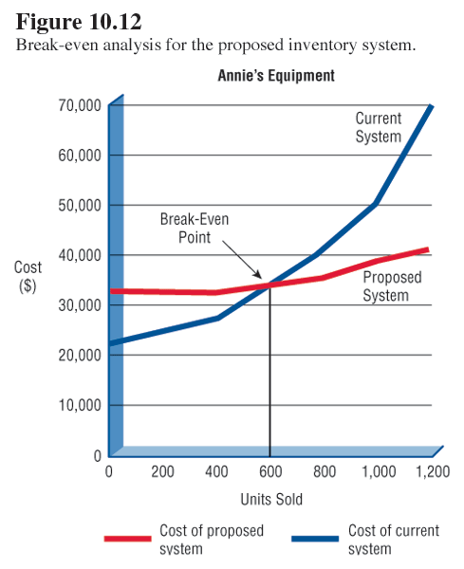
Break-Even Analysis

Slide 34
Payback
Payback determines the number of years of operation that the system needs to pay back the cost of investing in it.

Slide 35
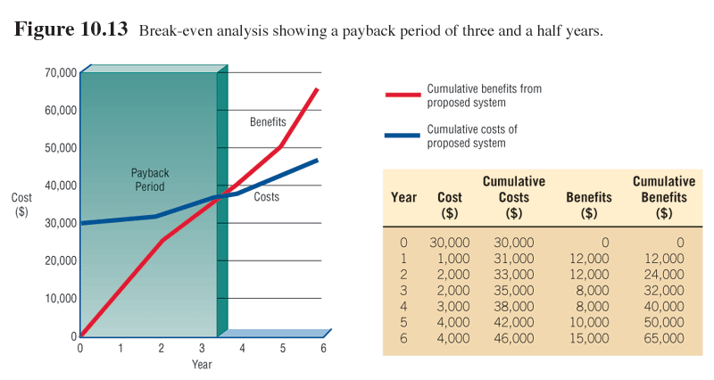
Break-Even Analysis Showing a Payback Period

Slide 36
Cash-Flow Analysis
Cash-flow analysis is used to examine the direction, size, and pattern of cash flow associated with the proposed information system.
Determine when cash outlays and revenues will occur for both:
  The initial purchase.
  Over the life of the information system.

Slide 37
Present Value Method
Way to assess all the economic outlays and revenues of the information system over its economic life and to compare costs today with future costs and today's benefits with future benefits.
Use present value when the payback period is long, or when the cost of borrowing money is high.

Slide 38
Selecting the Best Alternative
Guidelines to select the method for comparing alternatives:
  Use break-even analysis if the project needs to be justified in terms of cost, not benefits.
  Use payback when the improved tangible benefits form a convincing argument for the proposed system.

Slide 39
Selecting the Best Alternative
Guidelines to select the method for comparing alternatives (continued)
  Use cash-flow analysis when the project is expensive, relative to the size of the company.
  Use present value when the payback period is long or when the cost of borrowing money is high.

Slide 40
Items in the Systems Proposal
When preparing a systems proposal, systems analysts should arrange the following ten items in order:
  Cover letter.
  Title page of project.
  Table of contents.
  Executive summary (including recommendation).

Slide 41
Items in the Systems Proposal
  When preparing a system’s proposal, systems analyst should arrange the following ten items in order (continued):
  Outline of systems study with appropriate documentation.
  Detailed results of the systems study.
  Systems alternatives (three or four possible solutions).
  Systems analysts recommendations.
  Summary.

Slide 42
Items in the Systems Proposal (Continued)
  When preparing a system’s proposal,
  systems analyst should arrange the following ten items in order:
  Appendices
    Assorted documentation.
    Summary of phases.
    Correspondence.
    Other material as needed.

Slide 43
Guidelines for Using Tables
Some guidelines to use tables effectively are:
  Integrate it into the body of the proposal.
  Try to fit the entire table vertically on a single page.
  Number and title the table at the top of the page.

Slide 44
Guidelines for Using Tables
Some guidelines to use tables effectively are (continued):
  Make the title descriptive and meaningful.
  Label each row and column.
  Use a boxed table if room permits.
  Use footnotes if necessary to explain detailed information contained in the table.

Slide 45
Guidelines for Using Graphs
Some guidelines for using graphs are:
  Choose a style of graph that communicates your intended meaning well.
  Integrate the graph into the proposal body.
  Give the graph a sequential figure number and a meaningful title.
  Label each axis, any lines, columns, bars, and pieces of the pie on the graph.

Slide 46
Guidelines for Using Graphs
Some guidelines for using graphs are (continued):
  Include a key to indicate differently colored lines, shaded bars, or crosshatched areas.

Slide 47
Types of Graphs
Line graphs
Column charts
Bar charts
Pie charts

Slide 48
Line Graphs
Used to show change over time
Changes of up to five variables on a single graph
May show when lines intersect

Slide 49
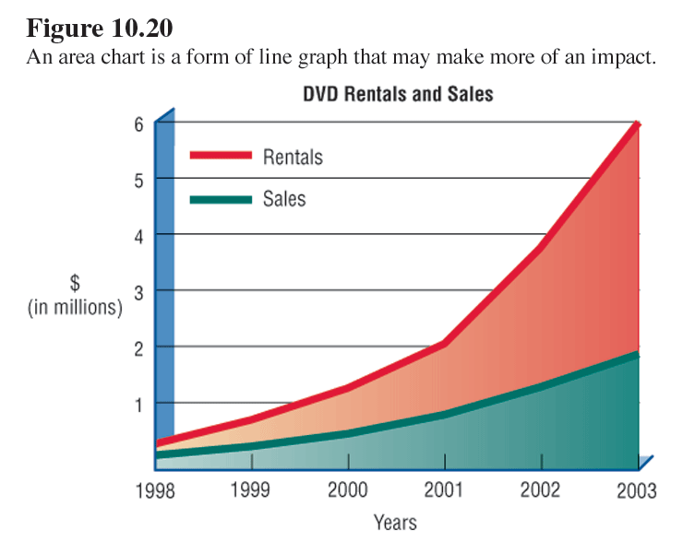
Line Chart Example

Slide 50
Column Charts
Show a comparison between two or more variables
Compare different variables at a particular point in time
Easier to understand than line graphs

Slide 51
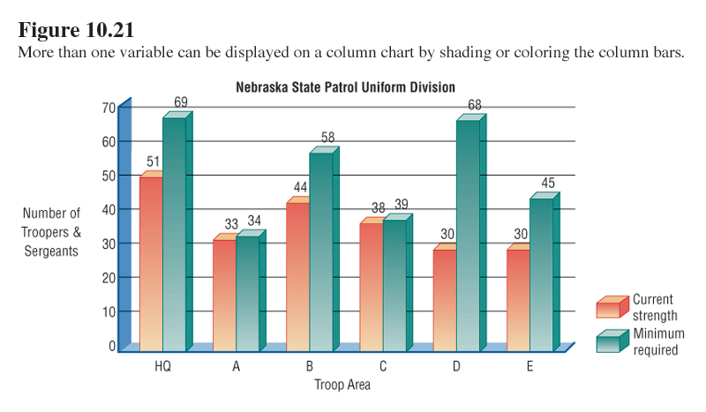
Column Chart Example

Slide 52
Variations of Column Charts
100 percent stacked chart
  Includes 100 percent stacked charts
  Show how different variables make up 100 percent of an entity
Deviation Column Chart
  Shows deviation from average

Slide 53
Bar Charts
Used to show one or more variables within certain classes or categories during a specific time period
May be sorted or organized by:
  Alphabetical.
  Numerical.
  Geographical order.
  Progressive order.

Slide 54
Pie Charts
Used to show how 100 percent of a commodity is divided at a particular point in time
Easier to read than 100 percent stacked column charts or 100 percent subdivided bar charts
Disadvantage is they take a lot of room on the page

Slide 55
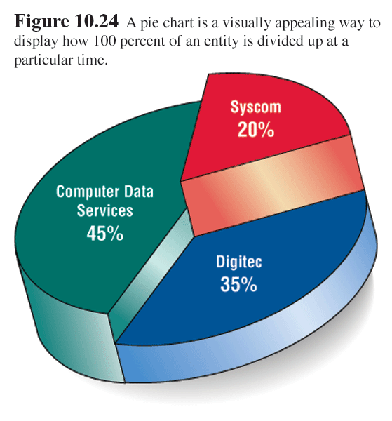
Pie Chart Example

Slide 56
Oral Presentations
When delivering the oral presentation, keep in mind the principles of delivery:
  Project loudly enough so that the audience can hear you.
  Look at each person in the audience as you speak.
  Make visuals large enough so that the audience can see them.

Slide 57
Oral Presentations (Continued)
When delivering the oral presentation, keep in mind the principles of delivery.
Use gestures that are natural to your
conversational style.
Introduce and conclude your talk confidently.

