Slide 1
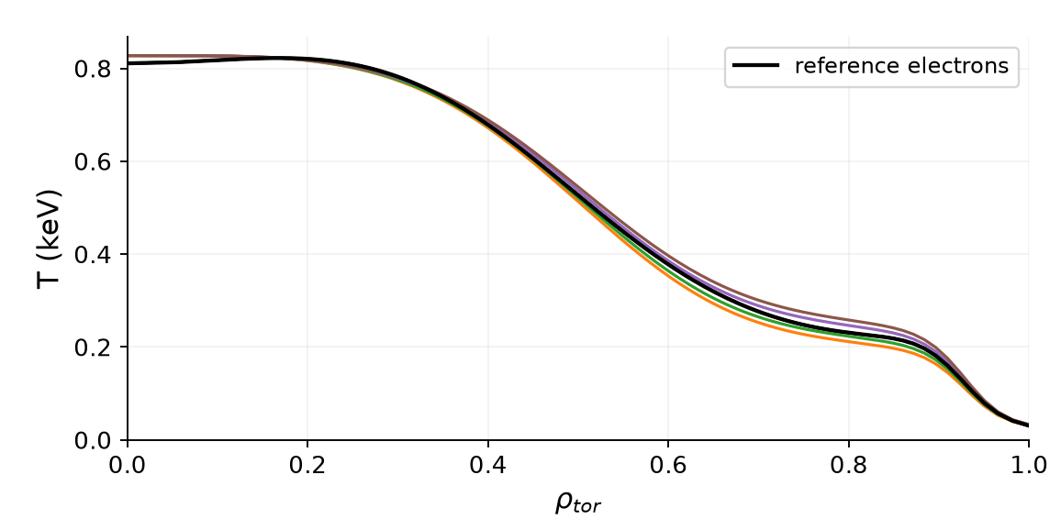
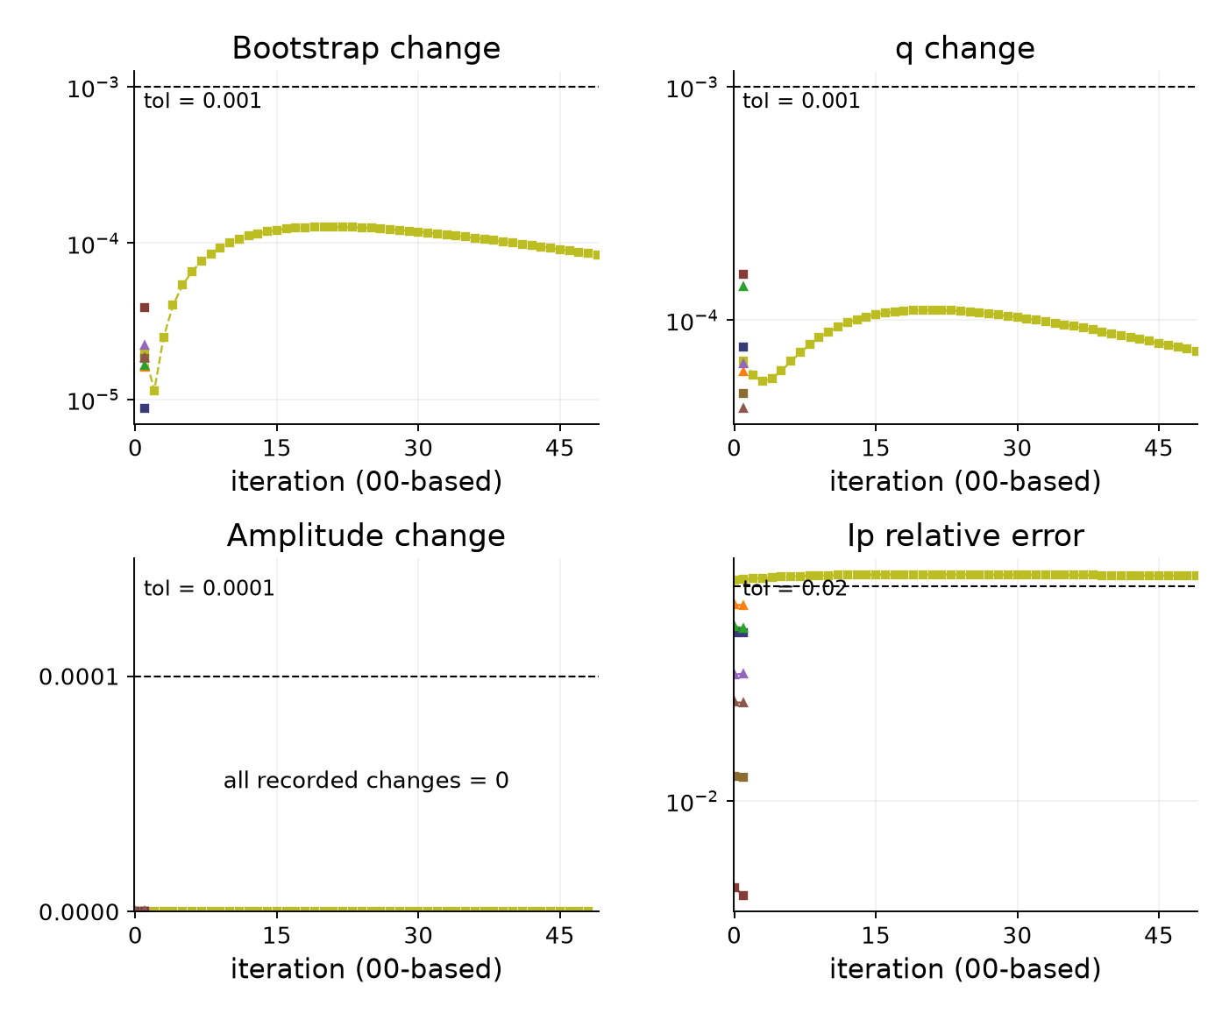
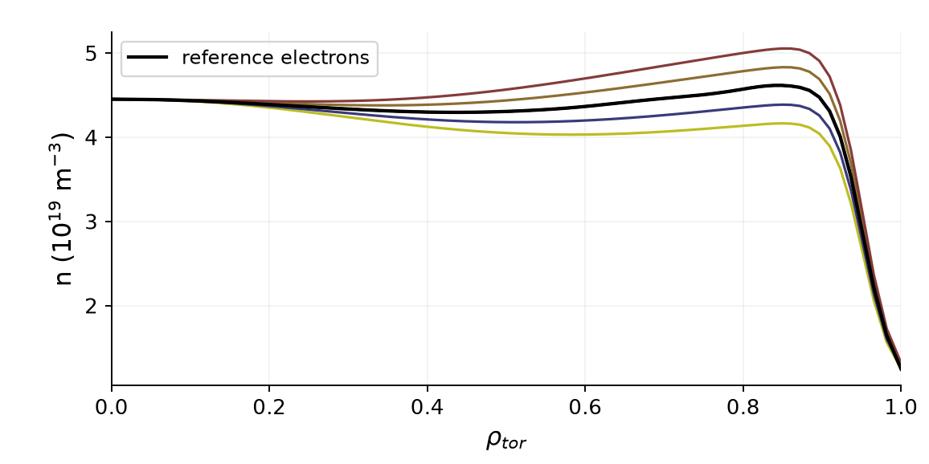
129015 mtanh NCSCAL = 1*, warmup = 2
Transformations and error traces 8 runs I-star mix 0.02 Ip tolerance 2% BS/q tolerance 0.1%
Saved transformation profiles
Iteration errors (relative fractions)
One color per scaling type/factor across all plots. Profiles: solid electrons, dashed ions where shown. Black curves: reference profiles.
*NCSCAL=1 inferred from the referenced preset. Amplitude change may be set to zero by the stopping rule. BS/q traces measure successive change.
1/14
Notes:
{
"family": "mtanh",
"part": "Transformations and error traces",
"variant": {
"id": "n1w2",
"title": "129015 NCSCAL = 1*, warmup = 2",
"color": "#0072B2",
"root": "C:\\Users\\joesc\\git\\NSTXU_lithium_study\\reshape_convergence\\runs_smallscale\\129015_20260901_13-45-25",
"original_profile_image": "C:\\Users\\joesc\\git\\NSTXU_lithium_study\\reshape_convergence\\runs_smallscale\\cheasebs_comparison_129015.png",
"n": 1,
"w": 2,
"count": 8,
"settings": {
"bootstrap_mix": 0.1,
"istar_mix": 0.02,
"tol_ip_rel": 0.02,
"tol_bs": 0.001,
"tol_q": 0.001,
"tol_a": 0.0001,
"max_iter": 50
},
"runs": [
{
"path": "C:\\Users\\joesc\\git\\NSTXU_lithium_study\\reshape_convergence\\runs_smallscale\\129015_20260901_13-45-25\\ne_ped_scale_0.900",
"axis": "ne_ped_scale",
"scale": 0.9,
"iterations": 50,
"converged": false,
"chain": [
{
"rho": 0.8425,
"point": "T_top",
"pressure_ratio": 0.8737707233815425,
"q": 6.95001531427286,
"shear": 3.9038841198128553
},
{
"rho": 0.8745,
"point": "n_top",
"pressure_ratio": 0.8718006813575321,
"q": 8.078234850971622,
"shear": 3.9796957605729535
},
{
"rho": 0.9515,
"point": "steep",
"pressure_ratio": 0.9090776458461888,
"q": 10.74064362756761,
"shear": 4.347767881084886
}
]
},
{
"path": "C:\\Users\\joesc\\git\\NSTXU_lithium_study\\reshape_convergence\\runs_smallscale\\129015_20260901_13-45-25\\ne_ped_scale_0.950",
"axis": "ne_ped_scale",
"scale": 0.95,
"iterations": 2,
"converged": true,
"chain": [
{
"rho": 0.8425,
"point": "T_top",
"pressure_ratio": 0.9195264805947838,
"q": 6.923709793183211,
"shear": 3.8881768481702927
},
{
"rho": 0.8745,
"point": "n_top",
"pressure_ratio": 0.9188496792617544,
"q": 8.046703917045958,
"shear": 3.9963397692815947
},
{
"rho": 0.9515,
"point": "steep",
"pressure_ratio": 0.9523079312159084,
"q": 10.700703152281449,
"shear": 4.444037192946588
}
]
},
{
"path": "C:\\Users\\joesc\\git\\NSTXU_lithium_study\\reshape_convergence\\runs_smallscale\\129015_20260901_13-45-25\\ne_ped_scale_1.050",
"axis": "ne_ped_scale",
"scale": 1.05,
"iterations": 2,
"converged": true,
"chain": [
{
"rho": 0.8425,
"point": "T_top",
"pressure_ratio": 1.0163954232559167,
"q": 6.883792193532971,
"shear": 3.8996908409677657
},
{
"rho": 0.8745,
"point": "n_top",
"pressure_ratio": 1.015312297344869,
"q": 8.004719912978015,
"shear": 4.011403517964364
},
{
"rho": 0.9515,
"point": "steep",
"pressure_ratio": 1.0307701764314061,
"q": 10.67366545168767,
"shear": 4.508654198445528
}
]
},
{
"path": "C:\\Users\\joesc\\git\\NSTXU_lithium_study\\reshape_convergence\\runs_smallscale\\129015_20260901_13-45-25\\ne_ped_scale_1.100",
"axis": "ne_ped_scale",
"scale": 1.1,
"iterations": 2,
"converged": true,
"chain": [
{
"rho": 0.8425,
"point": "T_top",
"pressure_ratio": 1.0657348935006479,
"q": 6.86373116882132,
"shear": 3.9057435283714956
},
{
"rho": 0.8745,
"point": "n_top",
"pressure_ratio": 1.064434046203744,
"q": 7.983728980830336,
"shear": 4.019779388029534
},
{
"rho": 0.9515,
"point": "steep",
"pressure_ratio": 1.070763847460663,
"q": 10.657342136259878,
"shear": 4.533213407970466
}
]
},
{
"path": "C:\\Users\\joesc\\git\\NSTXU_lithium_study\\reshape_convergence\\runs_smallscale\\129015_20260901_13-45-25\\Te_ped_scale_0.900",
"axis": "Te_ped_scale",
"scale": 0.9,
"iterations": 2,
"converged": true,
"chain": [
{
"rho": 0.8425,
"point": "T_top",
"pressure_ratio": 0.9071130160025593,
"q": 6.945863523976527,
"shear": 3.897790307365167
},
{
"rho": 0.8745,
"point": "n_top",
"pressure_ratio": 0.901212715153962,
"q": 8.073559374350113,
"shear": 3.9873299704436085
},
{
"rho": 0.9515,
"point": "steep",
"pressure_ratio": 0.9561632156366846,
"q": 10.727051559775711,
"shear": 4.440131525793459
}
]
},
{
"path": "C:\\Users\\joesc\\git\\NSTXU_lithium_study\\reshape_convergence\\runs_smallscale\\129015_20260901_13-45-25\\Te_ped_scale_0.950",
"axis": "Te_ped_scale",
"scale": 0.95,
"iterations": 2,
"converged": true,
"chain": [
{
"rho": 0.8425,
"point": "T_top",
"pressure_ratio": 0.9385804571654079,
"q": 6.932143754339909,
"shear": 3.9016715297913236
},
{
"rho": 0.8745,
"point": "n_top",
"pressure_ratio": 0.9319845846740067,
"q": 8.059442130735734,
"shear": 3.9960859842442504
},
{
"rho": 0.9515,
"point": "steep",
"pressure_ratio": 0.9739748859617795,
"q": 10.718417853437295,
"shear": 4.450458203306853
}
]
},
{
"path": "C:\\Users\\joesc\\git\\NSTXU_lithium_study\\reshape_convergence\\runs_smallscale\\129015_20260901_13-45-25\\Te_ped_scale_1.050",
"axis": "Te_ped_scale",
"scale": 1.05,
"iterations": 2,
"converged": true,
"chain": [
{
"rho": 0.8425,
"point": "T_top",
"pressure_ratio": 1.0018769834999302,
"q": 6.9046075189469915,
"shear": 3.9091413962806563
},
{
"rho": 0.8745,
"point": "n_top",
"pressure_ratio": 0.9938301689449511,
"q": 8.030920893040648,
"shear": 4.012834871926607
},
{
"rho": 0.9515,
"point": "steep",
"pressure_ratio": 1.0090345558828286,
"q": 10.706545232173186,
"shear": 4.499196841648801
}
]
},
{
"path": "C:\\Users\\joesc\\git\\NSTXU_lithium_study\\reshape_convergence\\runs_smallscale\\129015_20260901_13-45-25\\Te_ped_scale_1.100",
"axis": "Te_ped_scale",
"scale": 1.1,
"iterations": 2,
"converged": true,
"chain": [
{
"rho": 0.8425,
"point": "T_top",
"pressure_ratio": 1.0337746729773722,
"q": 6.8909255977354915,
"shear": 3.913077985421005
},
{
"rho": 0.8745,
"point": "n_top",
"pressure_ratio": 1.0250177626362305,
"q": 8.016856892693108,
"shear": 4.021799688840177
},
{
"rho": 0.9515,
"point": "steep",
"pressure_ratio": 1.0270062751725637,
"q": 10.697872858725443,
"shear": 4.511048441528468
}
]
}
],
"prefix": "mtanh_n1w2"
},
"chapman": [
{
"rho": 0.8425,
"point": "T_top",
"q": 6.886358711050888,
"shear": 3.849093755603565,
"fit_pressure_ratio": 0.99014717994203
},
{
"rho": 0.8745,
"point": "n_top",
"q": 8.008300508035049,
"shear": 3.9320542581423155,
"fit_pressure_ratio": 0.9886363282069752
},
{
"rho": 0.9515,
"point": "steep",
"q": 10.627539365150305,
"shear": 4.278473037196078,
"fit_pressure_ratio": 1.029936403893316
}
],
"limitations": "NCSCAL 1 inferred from the saved config reference to chease_namelist_nstx and the current preset. Original execution namelist unavailable. NCSCAL 4 is explicit in saved campaign namelists. Older/newer campaigns differ in mixing, tolerances and scale coverage. All runs use I-star. No new solves.",
"source": "prepare_split.py reuses the validated 46-run manifest. Pressure chains use the same TPED GFileData / shear interpolation as the prior review. Only this family is included. Transformation profiles replotted from the original saved files using the same fixed (scaling type, factor) color map as traces, bars and pressure points. Iteration counts use convergence_summary.json; traces use iteration_log.csv."
}

Slide 2
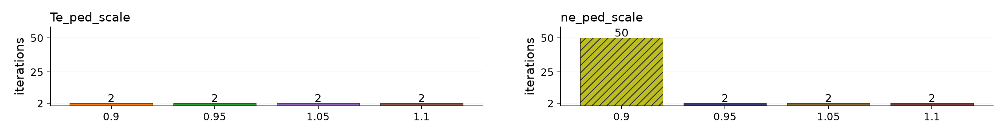
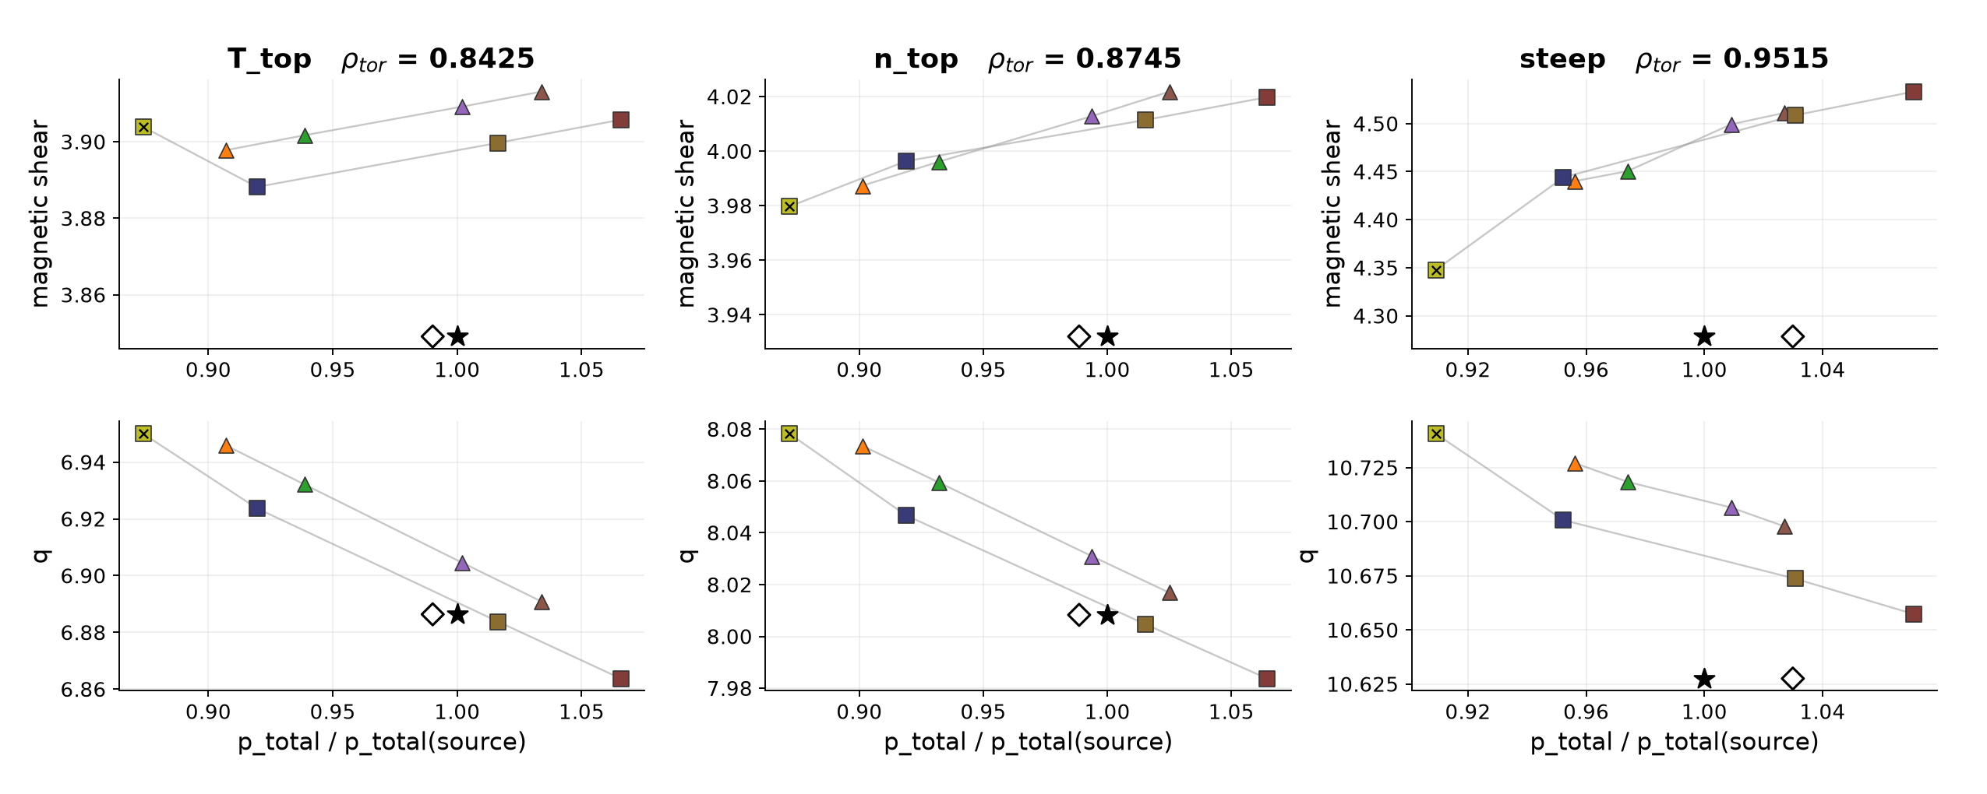
129015 mtanh NCSCAL = 1*, warmup = 2
Iteration counts and pressure response 8 runs Bars label the number of iterations, including 00 Hatched bars / × = nonconverged
Pressure chains: q and shear versus solved pressure / source pressure at the three Chapman points. Lines join each scaling type separately.
Star: source equilibrium. Hollow diamond: fitted baseline pressure at source q/shear. *NCSCAL=1 inferred from referenced preset.
2/14
Notes:
{
"family": "mtanh",
"part": "Iteration counts and pressure chains",
"variant": {
"id": "n1w2",
"title": "129015 NCSCAL = 1*, warmup = 2",
"color": "#0072B2",
"root": "C:\\Users\\joesc\\git\\NSTXU_lithium_study\\reshape_convergence\\runs_smallscale\\129015_20260901_13-45-25",
"original_profile_image": "C:\\Users\\joesc\\git\\NSTXU_lithium_study\\reshape_convergence\\runs_smallscale\\cheasebs_comparison_129015.png",
"n": 1,
"w": 2,
"count": 8,
"settings": {
"bootstrap_mix": 0.1,
"istar_mix": 0.02,
"tol_ip_rel": 0.02,
"tol_bs": 0.001,
"tol_q": 0.001,
"tol_a": 0.0001,
"max_iter": 50
},
"runs": [
{
"path": "C:\\Users\\joesc\\git\\NSTXU_lithium_study\\reshape_convergence\\runs_smallscale\\129015_20260901_13-45-25\\ne_ped_scale_0.900",
"axis": "ne_ped_scale",
"scale": 0.9,
"iterations": 50,
"converged": false,
"chain": [
{
"rho": 0.8425,
"point": "T_top",
"pressure_ratio": 0.8737707233815425,
"q": 6.95001531427286,
"shear": 3.9038841198128553
},
{
"rho": 0.8745,
"point": "n_top",
"pressure_ratio": 0.8718006813575321,
"q": 8.078234850971622,
"shear": 3.9796957605729535
},
{
"rho": 0.9515,
"point": "steep",
"pressure_ratio": 0.9090776458461888,
"q": 10.74064362756761,
"shear": 4.347767881084886
}
]
},
{
"path": "C:\\Users\\joesc\\git\\NSTXU_lithium_study\\reshape_convergence\\runs_smallscale\\129015_20260901_13-45-25\\ne_ped_scale_0.950",
"axis": "ne_ped_scale",
"scale": 0.95,
"iterations": 2,
"converged": true,
"chain": [
{
"rho": 0.8425,
"point": "T_top",
"pressure_ratio": 0.9195264805947838,
"q": 6.923709793183211,
"shear": 3.8881768481702927
},
{
"rho": 0.8745,
"point": "n_top",
"pressure_ratio": 0.9188496792617544,
"q": 8.046703917045958,
"shear": 3.9963397692815947
},
{
"rho": 0.9515,
"point": "steep",
"pressure_ratio": 0.9523079312159084,
"q": 10.700703152281449,
"shear": 4.444037192946588
}
]
},
{
"path": "C:\\Users\\joesc\\git\\NSTXU_lithium_study\\reshape_convergence\\runs_smallscale\\129015_20260901_13-45-25\\ne_ped_scale_1.050",
"axis": "ne_ped_scale",
"scale": 1.05,
"iterations": 2,
"converged": true,
"chain": [
{
"rho": 0.8425,
"point": "T_top",
"pressure_ratio": 1.0163954232559167,
"q": 6.883792193532971,
"shear": 3.8996908409677657
},
{
"rho": 0.8745,
"point": "n_top",
"pressure_ratio": 1.015312297344869,
"q": 8.004719912978015,
"shear": 4.011403517964364
},
{
"rho": 0.9515,
"point": "steep",
"pressure_ratio": 1.0307701764314061,
"q": 10.67366545168767,
"shear": 4.508654198445528
}
]
},
{
"path": "C:\\Users\\joesc\\git\\NSTXU_lithium_study\\reshape_convergence\\runs_smallscale\\129015_20260901_13-45-25\\ne_ped_scale_1.100",
"axis": "ne_ped_scale",
"scale": 1.1,
"iterations": 2,
"converged": true,
"chain": [
{
"rho": 0.8425,
"point": "T_top",
"pressure_ratio": 1.0657348935006479,
"q": 6.86373116882132,
"shear": 3.9057435283714956
},
{
"rho": 0.8745,
"point": "n_top",
"pressure_ratio": 1.064434046203744,
"q": 7.983728980830336,
"shear": 4.019779388029534
},
{
"rho": 0.9515,
"point": "steep",
"pressure_ratio": 1.070763847460663,
"q": 10.657342136259878,
"shear": 4.533213407970466
}
]
},
{
"path": "C:\\Users\\joesc\\git\\NSTXU_lithium_study\\reshape_convergence\\runs_smallscale\\129015_20260901_13-45-25\\Te_ped_scale_0.900",
"axis": "Te_ped_scale",
"scale": 0.9,
"iterations": 2,
"converged": true,
"chain": [
{
"rho": 0.8425,
"point": "T_top",
"pressure_ratio": 0.9071130160025593,
"q": 6.945863523976527,
"shear": 3.897790307365167
},
{
"rho": 0.8745,
"point": "n_top",
"pressure_ratio": 0.901212715153962,
"q": 8.073559374350113,
"shear": 3.9873299704436085
},
{
"rho": 0.9515,
"point": "steep",
"pressure_ratio": 0.9561632156366846,
"q": 10.727051559775711,
"shear": 4.440131525793459
}
]
},
{
"path": "C:\\Users\\joesc\\git\\NSTXU_lithium_study\\reshape_convergence\\runs_smallscale\\129015_20260901_13-45-25\\Te_ped_scale_0.950",
"axis": "Te_ped_scale",
"scale": 0.95,
"iterations": 2,
"converged": true,
"chain": [
{
"rho": 0.8425,
"point": "T_top",
"pressure_ratio": 0.9385804571654079,
"q": 6.932143754339909,
"shear": 3.9016715297913236
},
{
"rho": 0.8745,
"point": "n_top",
"pressure_ratio": 0.9319845846740067,
"q": 8.059442130735734,
"shear": 3.9960859842442504
},
{
"rho": 0.9515,
"point": "steep",
"pressure_ratio": 0.9739748859617795,
"q": 10.718417853437295,
"shear": 4.450458203306853
}
]
},
{
"path": "C:\\Users\\joesc\\git\\NSTXU_lithium_study\\reshape_convergence\\runs_smallscale\\129015_20260901_13-45-25\\Te_ped_scale_1.050",
"axis": "Te_ped_scale",
"scale": 1.05,
"iterations": 2,
"converged": true,
"chain": [
{
"rho": 0.8425,
"point": "T_top",
"pressure_ratio": 1.0018769834999302,
"q": 6.9046075189469915,
"shear": 3.9091413962806563
},
{
"rho": 0.8745,
"point": "n_top",
"pressure_ratio": 0.9938301689449511,
"q": 8.030920893040648,
"shear": 4.012834871926607
},
{
"rho": 0.9515,
"point": "steep",
"pressure_ratio": 1.0090345558828286,
"q": 10.706545232173186,
"shear": 4.499196841648801
}
]
},
{
"path": "C:\\Users\\joesc\\git\\NSTXU_lithium_study\\reshape_convergence\\runs_smallscale\\129015_20260901_13-45-25\\Te_ped_scale_1.100",
"axis": "Te_ped_scale",
"scale": 1.1,
"iterations": 2,
"converged": true,
"chain": [
{
"rho": 0.8425,
"point": "T_top",
"pressure_ratio": 1.0337746729773722,
"q": 6.8909255977354915,
"shear": 3.913077985421005
},
{
"rho": 0.8745,
"point": "n_top",
"pressure_ratio": 1.0250177626362305,
"q": 8.016856892693108,
"shear": 4.021799688840177
},
{
"rho": 0.9515,
"point": "steep",
"pressure_ratio": 1.0270062751725637,
"q": 10.697872858725443,
"shear": 4.511048441528468
}
]
}
],
"prefix": "mtanh_n1w2"
},
"chapman": [
{
"rho": 0.8425,
"point": "T_top",
"q": 6.886358711050888,
"shear": 3.849093755603565,
"fit_pressure_ratio": 0.99014717994203
},
{
"rho": 0.8745,
"point": "n_top",
"q": 8.008300508035049,
"shear": 3.9320542581423155,
"fit_pressure_ratio": 0.9886363282069752
},
{
"rho": 0.9515,
"point": "steep",
"q": 10.627539365150305,
"shear": 4.278473037196078,
"fit_pressure_ratio": 1.029936403893316
}
],
"limitations": "NCSCAL 1 inferred from the saved config reference to chease_namelist_nstx and the current preset. Original execution namelist unavailable. NCSCAL 4 is explicit in saved campaign namelists. Older/newer campaigns differ in mixing, tolerances and scale coverage. All runs use I-star. No new solves.",
"source": "prepare_split.py reuses the validated 46-run manifest. Pressure chains use the same TPED GFileData / shear interpolation as the prior review. Only this family is included. Transformation profiles replotted from the original saved files using the same fixed (scaling type, factor) color map as traces, bars and pressure points. Iteration counts use convergence_summary.json; traces use iteration_log.csv."
}

Slide 3
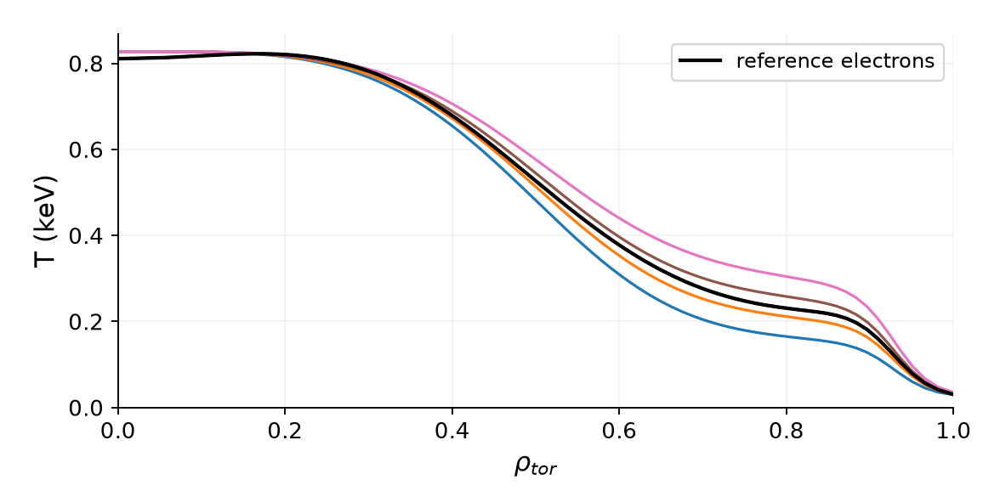
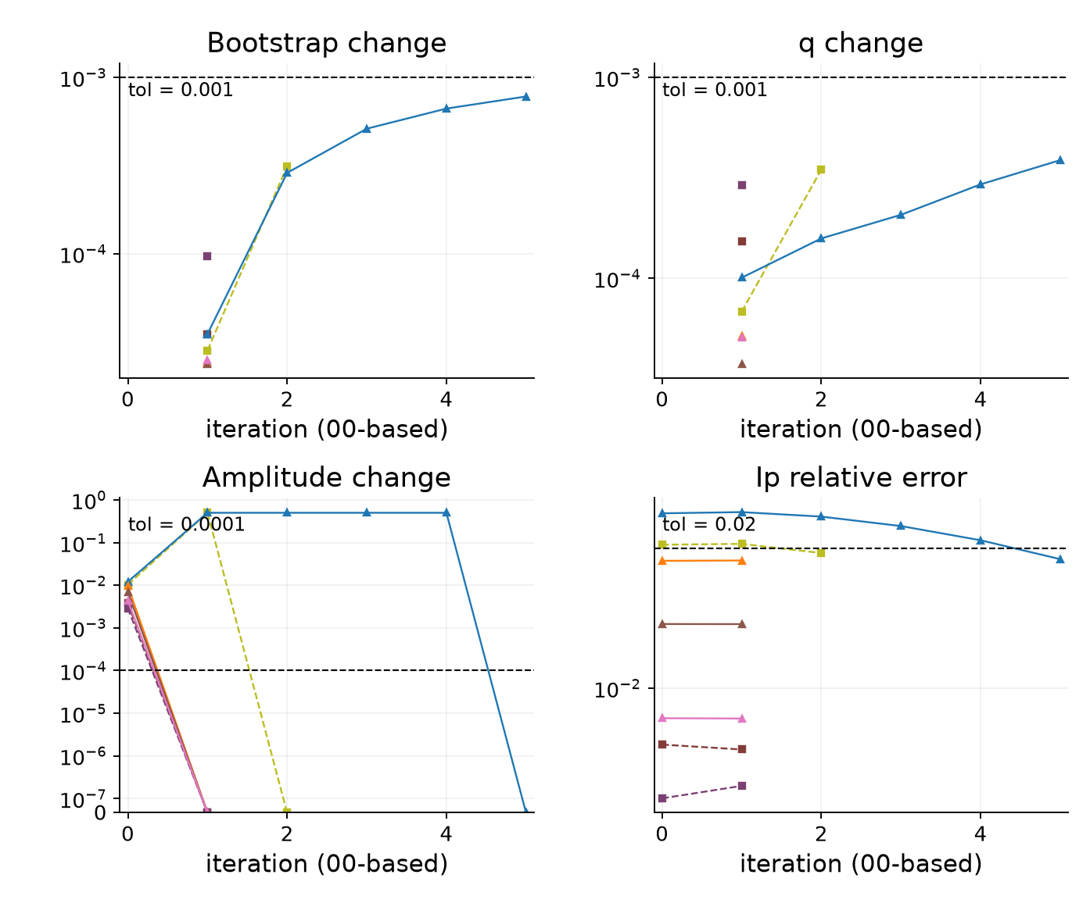
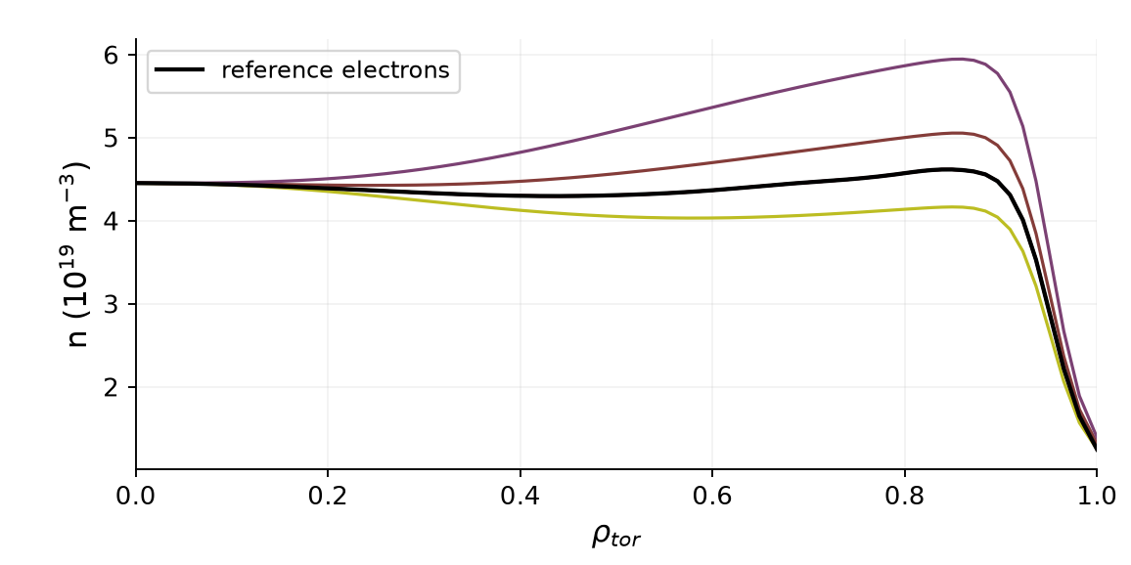
129015 mtanh NCSCAL = 1*, warmup = 0
Transformations and error traces 7 runs I-star mix 0.02 Ip tolerance 2% BS/q tolerance 0.1%
Saved transformation profiles
Iteration errors (relative fractions)
One color per scaling type/factor across all plots. Profiles: solid electrons, dashed ions where shown. Black curves: reference profiles.
*NCSCAL=1 inferred from the referenced preset. Amplitude change may be set to zero by the stopping rule. BS/q traces measure successive change.
3/14
Notes:
{
"family": "mtanh",
"part": "Transformations and error traces",
"variant": {
"id": "n1w0",
"title": "129015 NCSCAL = 1*, warmup = 0",
"color": "#009E73",
"root": "C:\\Users\\joesc\\git\\NSTXU_lithium_study\\reshape_convergence\\runs_amptest\\129015_20260903_15-51-42",
"original_profile_image": "C:\\Users\\joesc\\git\\NSTXU_lithium_study\\reshape_convergence\\runs_amptest\\cheasebs_comparison_129015.png",
"n": 1,
"w": 0,
"count": 7,
"settings": {
"bootstrap_mix": 0.1,
"istar_mix": 0.02,
"tol_ip_rel": 0.02,
"tol_bs": 0.001,
"tol_q": 0.001,
"tol_a": 0.0001,
"max_iter": 50
},
"runs": [
{
"path": "C:\\Users\\joesc\\git\\NSTXU_lithium_study\\reshape_convergence\\runs_amptest\\129015_20260903_15-51-42\\ne_ped_scale_0.900",
"axis": "ne_ped_scale",
"scale": 0.9,
"iterations": 3,
"converged": true,
"chain": [
{
"rho": 0.8425,
"point": "T_top",
"pressure_ratio": 0.8769897239600921,
"q": 6.936803809451767,
"shear": 3.881401357430047
},
{
"rho": 0.8745,
"point": "n_top",
"pressure_ratio": 0.8767945554024529,
"q": 8.059861354836517,
"shear": 3.993975505177117
},
{
"rho": 0.9515,
"point": "steep",
"pressure_ratio": 0.9204987371311943,
"q": 10.699289926901706,
"shear": 4.420926705273942
}
]
},
{
"path": "C:\\Users\\joesc\\git\\NSTXU_lithium_study\\reshape_convergence\\runs_amptest\\129015_20260903_15-51-42\\ne_ped_scale_1.100",
"axis": "ne_ped_scale",
"scale": 1.1,
"iterations": 2,
"converged": true,
"chain": [
{
"rho": 0.8425,
"point": "T_top",
"pressure_ratio": 1.0656607511248364,
"q": 6.863745497703431,
"shear": 3.905734509777414
},
{
"rho": 0.8745,
"point": "n_top",
"pressure_ratio": 1.0643589948945007,
"q": 7.983743740428266,
"shear": 4.019764584169859
},
{
"rho": 0.9515,
"point": "steep",
"pressure_ratio": 1.0706931099232782,
"q": 10.657504575379008,
"shear": 4.532939681241806
}
]
},
{
"path": "C:\\Users\\joesc\\git\\NSTXU_lithium_study\\reshape_convergence\\runs_amptest\\129015_20260903_15-51-42\\ne_ped_scale_1.300",
"axis": "ne_ped_scale",
"scale": 1.3,
"iterations": 2,
"converged": true,
"chain": [
{
"rho": 0.8425,
"point": "T_top",
"pressure_ratio": 1.2690655223305414,
"q": 6.782880581517629,
"shear": 3.9301294977724957
},
{
"rho": 0.8745,
"point": "n_top",
"pressure_ratio": 1.2662817915235969,
"q": 7.898784042564701,
"shear": 4.046377950836519
},
{
"rho": 0.9515,
"point": "steep",
"pressure_ratio": 1.232314439476373,
"q": 10.601497357670985,
"shear": 4.634510692237757
}
]
},
{
"path": "C:\\Users\\joesc\\git\\NSTXU_lithium_study\\reshape_convergence\\runs_amptest\\129015_20260903_15-51-42\\Te_ped_scale_0.700",
"axis": "Te_ped_scale",
"scale": 0.7,
"iterations": 6,
"converged": true,
"chain": [
{
"rho": 0.8425,
"point": "T_top",
"pressure_ratio": 0.81559081817211,
"q": 6.992313794428582,
"shear": 3.884577410096642
},
{
"rho": 0.8745,
"point": "n_top",
"pressure_ratio": 0.8120509599989438,
"q": 8.119760846594042,
"shear": 3.945482939308704
},
{
"rho": 0.9515,
"point": "steep",
"pressure_ratio": 0.9145686046211983,
"q": 10.709524670586092,
"shear": 4.3881532787485025
}
]
},
{
"path": "C:\\Users\\joesc\\git\\NSTXU_lithium_study\\reshape_convergence\\runs_amptest\\129015_20260903_15-51-42\\Te_ped_scale_0.900",
"axis": "Te_ped_scale",
"scale": 0.9,
"iterations": 2,
"converged": true,
"chain": [
{
"rho": 0.8425,
"point": "T_top",
"pressure_ratio": 0.9069545369383641,
"q": 6.945911530717166,
"shear": 3.897775582938245
},
{
"rho": 0.8745,
"point": "n_top",
"pressure_ratio": 0.9010544415678522,
"q": 8.073613767414118,
"shear": 3.9873395338273436
},
{
"rho": 0.9515,
"point": "steep",
"pressure_ratio": 0.956010911267731,
"q": 10.727428055464319,
"shear": 4.440650214072822
}
]
},
{
"path": "C:\\Users\\joesc\\git\\NSTXU_lithium_study\\reshape_convergence\\runs_amptest\\129015_20260903_15-51-42\\Te_ped_scale_1.100",
"axis": "Te_ped_scale",
"scale": 1.1,
"iterations": 2,
"converged": true,
"chain": [
{
"rho": 0.8425,
"point": "T_top",
"pressure_ratio": 1.0336409697026296,
"q": 6.890972920013801,
"shear": 3.9130671646604633
},
{
"rho": 0.8745,
"point": "n_top",
"pressure_ratio": 1.024884530682772,
"q": 8.016911664355073,
"shear": 4.021797464126857
},
{
"rho": 0.9515,
"point": "steep",
"pressure_ratio": 1.0268928146296654,
"q": 10.698097927859884,
"shear": 4.5104462523076725
}
]
},
{
"path": "C:\\Users\\joesc\\git\\NSTXU_lithium_study\\reshape_convergence\\runs_amptest\\129015_20260903_15-51-42\\Te_ped_scale_1.300",
"axis": "Te_ped_scale",
"scale": 1.3,
"iterations": 2,
"converged": true,
"chain": [
{
"rho": 0.8425,
"point": "T_top",
"pressure_ratio": 1.162625160091561,
"q": 6.836217063515389,
"shear": 3.9285245302653005
},
{
"rho": 0.8745,
"point": "n_top",
"pressure_ratio": 1.1508977820377886,
"q": 7.96038900986911,
"shear": 4.056013028218884
},
{
"rho": 0.9515,
"point": "steep",
"pressure_ratio": 1.0984020498937006,
"q": 10.670844367550982,
"shear": 4.568194895617097
}
]
}
],
"prefix": "mtanh_n1w0"
},
"chapman": [
{
"rho": 0.8425,
"point": "T_top",
"q": 6.886358711050888,
"shear": 3.849093755603565,
"fit_pressure_ratio": 0.99014717994203
},
{
"rho": 0.8745,
"point": "n_top",
"q": 8.008300508035049,
"shear": 3.9320542581423155,
"fit_pressure_ratio": 0.9886363282069752
},
{
"rho": 0.9515,
"point": "steep",
"q": 10.627539365150305,
"shear": 4.278473037196078,
"fit_pressure_ratio": 1.029936403893316
}
],
"limitations": "NCSCAL 1 inferred from the saved config reference to chease_namelist_nstx and the current preset. Original execution namelist unavailable. NCSCAL 4 is explicit in saved campaign namelists. Older/newer campaigns differ in mixing, tolerances and scale coverage. All runs use I-star. No new solves.",
"source": "prepare_split.py reuses the validated 46-run manifest. Pressure chains use the same TPED GFileData / shear interpolation as the prior review. Only this family is included. Transformation profiles replotted from the original saved files using the same fixed (scaling type, factor) color map as traces, bars and pressure points. Iteration counts use convergence_summary.json; traces use iteration_log.csv."
}

Slide 4
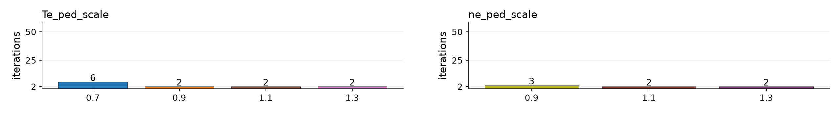
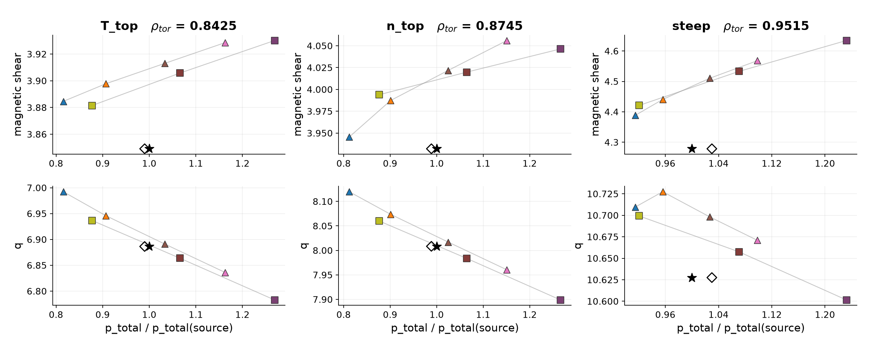
129015 mtanh NCSCAL = 1*, warmup = 0
Iteration counts and pressure response 7 runs Bars label the number of iterations, including 00 Hatched bars / × = nonconverged
Pressure chains: q and shear versus solved pressure / source pressure at the three Chapman points. Lines join each scaling type separately.
Star: source equilibrium. Hollow diamond: fitted baseline pressure at source q/shear. *NCSCAL=1 inferred from referenced preset.
4/14
Notes:
{
"family": "mtanh",
"part": "Iteration counts and pressure chains",
"variant": {
"id": "n1w0",
"title": "129015 NCSCAL = 1*, warmup = 0",
"color": "#009E73",
"root": "C:\\Users\\joesc\\git\\NSTXU_lithium_study\\reshape_convergence\\runs_amptest\\129015_20260903_15-51-42",
"original_profile_image": "C:\\Users\\joesc\\git\\NSTXU_lithium_study\\reshape_convergence\\runs_amptest\\cheasebs_comparison_129015.png",
"n": 1,
"w": 0,
"count": 7,
"settings": {
"bootstrap_mix": 0.1,
"istar_mix": 0.02,
"tol_ip_rel": 0.02,
"tol_bs": 0.001,
"tol_q": 0.001,
"tol_a": 0.0001,
"max_iter": 50
},
"runs": [
{
"path": "C:\\Users\\joesc\\git\\NSTXU_lithium_study\\reshape_convergence\\runs_amptest\\129015_20260903_15-51-42\\ne_ped_scale_0.900",
"axis": "ne_ped_scale",
"scale": 0.9,
"iterations": 3,
"converged": true,
"chain": [
{
"rho": 0.8425,
"point": "T_top",
"pressure_ratio": 0.8769897239600921,
"q": 6.936803809451767,
"shear": 3.881401357430047
},
{
"rho": 0.8745,
"point": "n_top",
"pressure_ratio": 0.8767945554024529,
"q": 8.059861354836517,
"shear": 3.993975505177117
},
{
"rho": 0.9515,
"point": "steep",
"pressure_ratio": 0.9204987371311943,
"q": 10.699289926901706,
"shear": 4.420926705273942
}
]
},
{
"path": "C:\\Users\\joesc\\git\\NSTXU_lithium_study\\reshape_convergence\\runs_amptest\\129015_20260903_15-51-42\\ne_ped_scale_1.100",
"axis": "ne_ped_scale",
"scale": 1.1,
"iterations": 2,
"converged": true,
"chain": [
{
"rho": 0.8425,
"point": "T_top",
"pressure_ratio": 1.0656607511248364,
"q": 6.863745497703431,
"shear": 3.905734509777414
},
{
"rho": 0.8745,
"point": "n_top",
"pressure_ratio": 1.0643589948945007,
"q": 7.983743740428266,
"shear": 4.019764584169859
},
{
"rho": 0.9515,
"point": "steep",
"pressure_ratio": 1.0706931099232782,
"q": 10.657504575379008,
"shear": 4.532939681241806
}
]
},
{
"path": "C:\\Users\\joesc\\git\\NSTXU_lithium_study\\reshape_convergence\\runs_amptest\\129015_20260903_15-51-42\\ne_ped_scale_1.300",
"axis": "ne_ped_scale",
"scale": 1.3,
"iterations": 2,
"converged": true,
"chain": [
{
"rho": 0.8425,
"point": "T_top",
"pressure_ratio": 1.2690655223305414,
"q": 6.782880581517629,
"shear": 3.9301294977724957
},
{
"rho": 0.8745,
"point": "n_top",
"pressure_ratio": 1.2662817915235969,
"q": 7.898784042564701,
"shear": 4.046377950836519
},
{
"rho": 0.9515,
"point": "steep",
"pressure_ratio": 1.232314439476373,
"q": 10.601497357670985,
"shear": 4.634510692237757
}
]
},
{
"path": "C:\\Users\\joesc\\git\\NSTXU_lithium_study\\reshape_convergence\\runs_amptest\\129015_20260903_15-51-42\\Te_ped_scale_0.700",
"axis": "Te_ped_scale",
"scale": 0.7,
"iterations": 6,
"converged": true,
"chain": [
{
"rho": 0.8425,
"point": "T_top",
"pressure_ratio": 0.81559081817211,
"q": 6.992313794428582,
"shear": 3.884577410096642
},
{
"rho": 0.8745,
"point": "n_top",
"pressure_ratio": 0.8120509599989438,
"q": 8.119760846594042,
"shear": 3.945482939308704
},
{
"rho": 0.9515,
"point": "steep",
"pressure_ratio": 0.9145686046211983,
"q": 10.709524670586092,
"shear": 4.3881532787485025
}
]
},
{
"path": "C:\\Users\\joesc\\git\\NSTXU_lithium_study\\reshape_convergence\\runs_amptest\\129015_20260903_15-51-42\\Te_ped_scale_0.900",
"axis": "Te_ped_scale",
"scale": 0.9,
"iterations": 2,
"converged": true,
"chain": [
{
"rho": 0.8425,
"point": "T_top",
"pressure_ratio": 0.9069545369383641,
"q": 6.945911530717166,
"shear": 3.897775582938245
},
{
"rho": 0.8745,
"point": "n_top",
"pressure_ratio": 0.9010544415678522,
"q": 8.073613767414118,
"shear": 3.9873395338273436
},
{
"rho": 0.9515,
"point": "steep",
"pressure_ratio": 0.956010911267731,
"q": 10.727428055464319,
"shear": 4.440650214072822
}
]
},
{
"path": "C:\\Users\\joesc\\git\\NSTXU_lithium_study\\reshape_convergence\\runs_amptest\\129015_20260903_15-51-42\\Te_ped_scale_1.100",
"axis": "Te_ped_scale",
"scale": 1.1,
"iterations": 2,
"converged": true,
"chain": [
{
"rho": 0.8425,
"point": "T_top",
"pressure_ratio": 1.0336409697026296,
"q": 6.890972920013801,
"shear": 3.9130671646604633
},
{
"rho": 0.8745,
"point": "n_top",
"pressure_ratio": 1.024884530682772,
"q": 8.016911664355073,
"shear": 4.021797464126857
},
{
"rho": 0.9515,
"point": "steep",
"pressure_ratio": 1.0268928146296654,
"q": 10.698097927859884,
"shear": 4.5104462523076725
}
]
},
{
"path": "C:\\Users\\joesc\\git\\NSTXU_lithium_study\\reshape_convergence\\runs_amptest\\129015_20260903_15-51-42\\Te_ped_scale_1.300",
"axis": "Te_ped_scale",
"scale": 1.3,
"iterations": 2,
"converged": true,
"chain": [
{
"rho": 0.8425,
"point": "T_top",
"pressure_ratio": 1.162625160091561,
"q": 6.836217063515389,
"shear": 3.9285245302653005
},
{
"rho": 0.8745,
"point": "n_top",
"pressure_ratio": 1.1508977820377886,
"q": 7.96038900986911,
"shear": 4.056013028218884
},
{
"rho": 0.9515,
"point": "steep",
"pressure_ratio": 1.0984020498937006,
"q": 10.670844367550982,
"shear": 4.568194895617097
}
]
}
],
"prefix": "mtanh_n1w0"
},
"chapman": [
{
"rho": 0.8425,
"point": "T_top",
"q": 6.886358711050888,
"shear": 3.849093755603565,
"fit_pressure_ratio": 0.99014717994203
},
{
"rho": 0.8745,
"point": "n_top",
"q": 8.008300508035049,
"shear": 3.9320542581423155,
"fit_pressure_ratio": 0.9886363282069752
},
{
"rho": 0.9515,
"point": "steep",
"q": 10.627539365150305,
"shear": 4.278473037196078,
"fit_pressure_ratio": 1.029936403893316
}
],
"limitations": "NCSCAL 1 inferred from the saved config reference to chease_namelist_nstx and the current preset. Original execution namelist unavailable. NCSCAL 4 is explicit in saved campaign namelists. Older/newer campaigns differ in mixing, tolerances and scale coverage. All runs use I-star. No new solves.",
"source": "prepare_split.py reuses the validated 46-run manifest. Pressure chains use the same TPED GFileData / shear interpolation as the prior review. Only this family is included. Transformation profiles replotted from the original saved files using the same fixed (scaling type, factor) color map as traces, bars and pressure points. Iteration counts use convergence_summary.json; traces use iteration_log.csv."
}

Slide 5
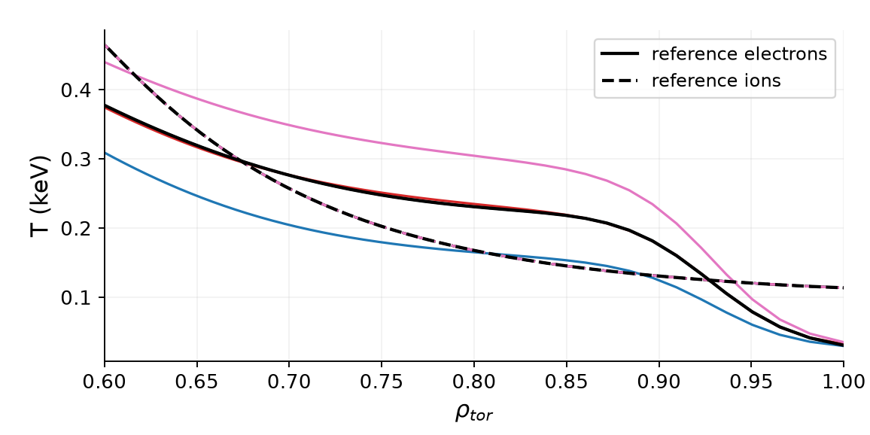
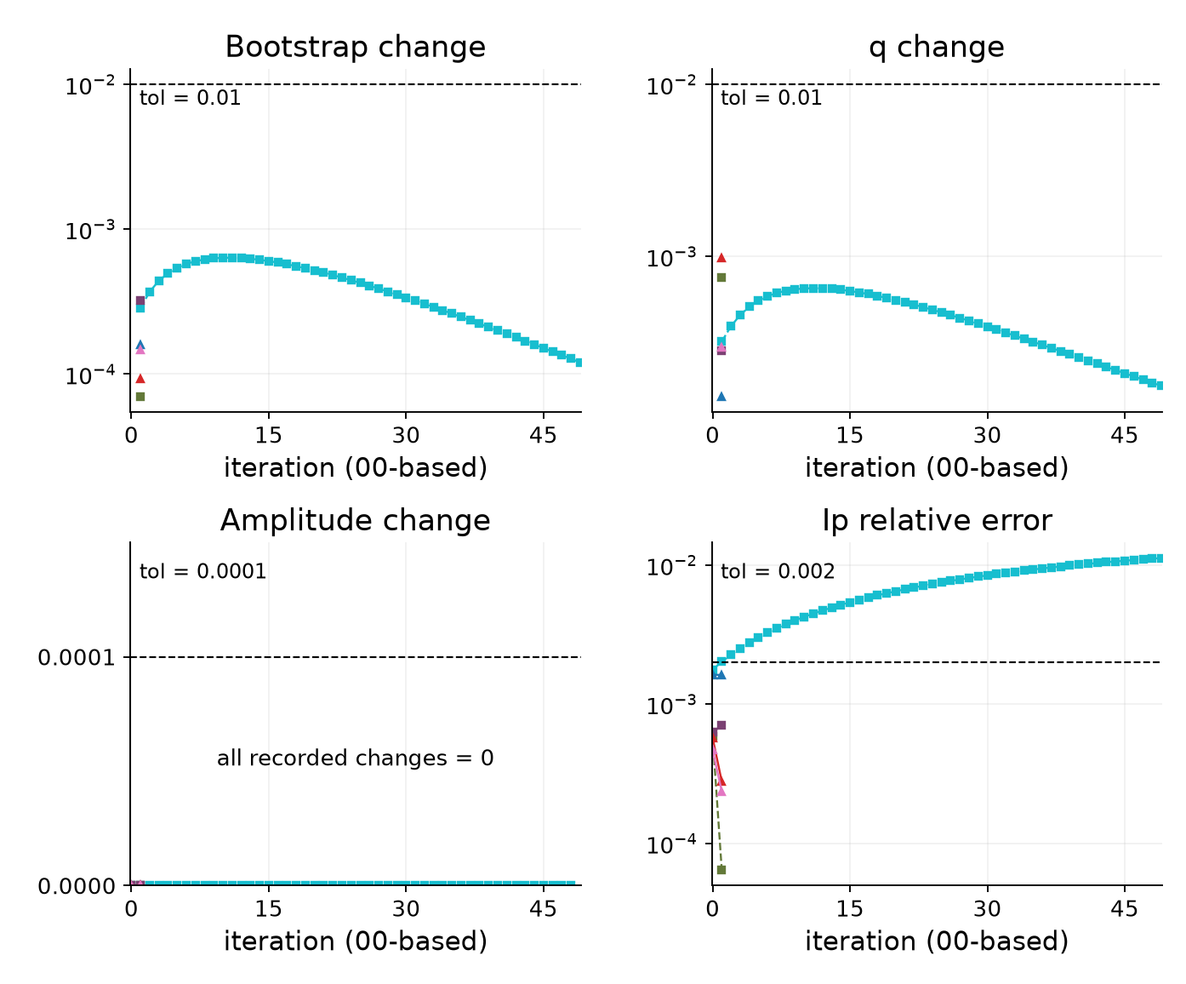
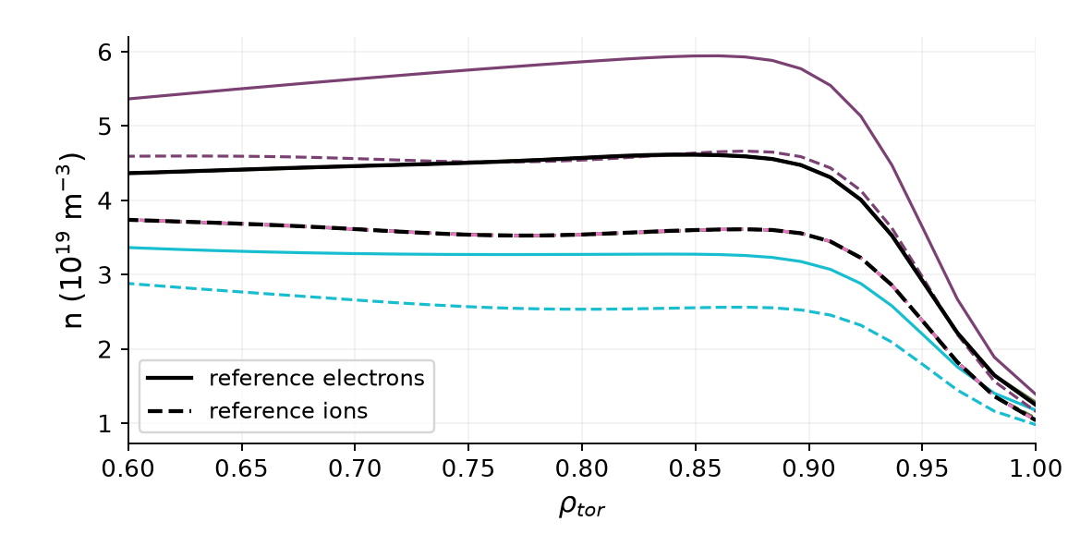
129015 mtanh NCSCAL = 4, warmup = 2
Transformations and error traces 6 runs I-star mix 0.05 Ip tolerance 0.2% BS/q tolerance 1%
Saved transformation profiles
Iteration errors (relative fractions)
One color per scaling type/factor across all plots. Profiles: solid electrons, dashed ions where shown. Black curves: reference profiles.
Amplitude change may be set to zero by the stopping rule. BS/q traces measure successive change.
5/14
Notes:
{
"family": "mtanh",
"part": "Transformations and error traces",
"variant": {
"id": "n4w2",
"title": "129015 NCSCAL = 4, warmup = 2",
"color": "#A23BB1",
"root": "C:\\Users\\joesc\\git\\cheaseBS_tests\\data\\pm0.3_ncscal4\\129015",
"original_profile_image": "C:\\Users\\joesc\\git\\cheaseBS_tests\\data\\pm0.3_ncscal4\\129015_mtanh_full_ped.png",
"n": 4,
"w": 2,
"count": 6,
"settings": {
"bootstrap_mix": 0.1,
"istar_mix": 0.05,
"tol_ip_rel": 0.002,
"tol_bs": 0.01,
"tol_q": 0.01,
"tol_a": 0.0001,
"max_iter": 50
},
"runs": [
{
"path": "C:\\Users\\joesc\\git\\cheaseBS_tests\\data\\pm0.3_ncscal4\\129015\\ne_ped_scale_0.700",
"axis": "ne_ped_scale",
"scale": 0.7,
"iterations": 50,
"converged": false,
"chain": [
{
"rho": 0.8425,
"point": "T_top",
"pressure_ratio": 0.7268291784534654,
"q": 6.8343775197239225,
"shear": 3.926476235034009
},
{
"rho": 0.8745,
"point": "n_top",
"pressure_ratio": 0.7200962636115038,
"q": 7.947639878399186,
"shear": 3.9572958968531777
},
{
"rho": 0.9515,
"point": "steep",
"pressure_ratio": 0.7629198612591727,
"q": 10.675994580511283,
"shear": 4.473722429693107
}
]
},
{
"path": "C:\\Users\\joesc\\git\\cheaseBS_tests\\data\\pm0.3_ncscal4\\129015\\ne_ped_scale_1.000",
"axis": "ne_ped_scale",
"scale": 1,
"iterations": 2,
"converged": true,
"chain": [
{
"rho": 0.8425,
"point": "T_top",
"pressure_ratio": 0.9813888315220717,
"q": 6.801420889287426,
"shear": 3.894493167080524
},
{
"rho": 0.8745,
"point": "n_top",
"pressure_ratio": 0.9809338009975517,
"q": 7.906940101804123,
"shear": 4.0082103889821505
},
{
"rho": 0.9515,
"point": "steep",
"pressure_ratio": 1.005600450155316,
"q": 10.522393769635086,
"shear": 4.412390906066833
}
]
},
{
"path": "C:\\Users\\joesc\\git\\cheaseBS_tests\\data\\pm0.3_ncscal4\\129015\\ne_ped_scale_1.300",
"axis": "ne_ped_scale",
"scale": 1.3,
"iterations": 2,
"converged": true,
"chain": [
{
"rho": 0.8425,
"point": "T_top",
"pressure_ratio": 1.2421457897601798,
"q": 6.81251022130032,
"shear": 3.927655589064903
},
{
"rho": 0.8745,
"point": "n_top",
"pressure_ratio": 1.240199953375471,
"q": 7.932105871804619,
"shear": 4.046125999087932
},
{
"rho": 0.9515,
"point": "steep",
"pressure_ratio": 1.2131433575545434,
"q": 10.640085761395644,
"shear": 4.674107370280973
}
]
},
{
"path": "C:\\Users\\joesc\\git\\cheaseBS_tests\\data\\pm0.3_ncscal4\\129015\\Te_ped_scale_0.700",
"axis": "Te_ped_scale",
"scale": 0.7,
"iterations": 2,
"converged": true,
"chain": [
{
"rho": 0.8425,
"point": "T_top",
"pressure_ratio": 0.8068497703383138,
"q": 6.831166154795651,
"shear": 3.883376214530984
},
{
"rho": 0.8745,
"point": "n_top",
"pressure_ratio": 0.8035805750039878,
"q": 7.933549454621382,
"shear": 3.957618220274256
},
{
"rho": 0.9515,
"point": "steep",
"pressure_ratio": 0.9078063580654069,
"q": 10.51400276271765,
"shear": 4.327978988010188
}
]
},
{
"path": "C:\\Users\\joesc\\git\\cheaseBS_tests\\data\\pm0.3_ncscal4\\129015\\Te_ped_scale_1.000",
"axis": "Te_ped_scale",
"scale": 1,
"iterations": 2,
"converged": true,
"chain": [
{
"rho": 0.8425,
"point": "T_top",
"pressure_ratio": 0.9882200644085564,
"q": 6.79957086799702,
"shear": 3.905786216177174
},
{
"rho": 0.8745,
"point": "n_top",
"pressure_ratio": 0.9811283089514407,
"q": 7.907300807525324,
"shear": 4.010108540345586
},
{
"rho": 0.9515,
"point": "steep",
"pressure_ratio": 1.0095496015708267,
"q": 10.519232032594322,
"shear": 4.39578800439352
}
]
},
{
"path": "C:\\Users\\joesc\\git\\cheaseBS_tests\\data\\pm0.3_ncscal4\\129015\\Te_ped_scale_1.300",
"axis": "Te_ped_scale",
"scale": 1.3,
"iterations": 2,
"converged": true,
"chain": [
{
"rho": 0.8425,
"point": "T_top",
"pressure_ratio": 1.1690904142199168,
"q": 6.7670435352357075,
"shear": 3.926303122403596
},
{
"rho": 0.8745,
"point": "n_top",
"pressure_ratio": 1.1578016684115655,
"q": 7.878906276954586,
"shear": 4.055765711318818
},
{
"rho": 0.9515,
"point": "steep",
"pressure_ratio": 1.1056303592543277,
"q": 10.561032509452145,
"shear": 4.585835937795514
}
]
}
],
"prefix": "mtanh_n4w2"
},
"chapman": [
{
"rho": 0.8425,
"point": "T_top",
"q": 6.886358711050888,
"shear": 3.849093755603565,
"fit_pressure_ratio": 0.99014717994203
},
{
"rho": 0.8745,
"point": "n_top",
"q": 8.008300508035049,
"shear": 3.9320542581423155,
"fit_pressure_ratio": 0.9886363282069752
},
{
"rho": 0.9515,
"point": "steep",
"q": 10.627539365150305,
"shear": 4.278473037196078,
"fit_pressure_ratio": 1.029936403893316
}
],
"limitations": "NCSCAL 1 inferred from the saved config reference to chease_namelist_nstx and the current preset. Original execution namelist unavailable. NCSCAL 4 is explicit in saved campaign namelists. Older/newer campaigns differ in mixing, tolerances and scale coverage. All runs use I-star. No new solves.",
"source": "prepare_split.py reuses the validated 46-run manifest. Pressure chains use the same TPED GFileData / shear interpolation as the prior review. Only this family is included. Transformation profiles replotted from the original saved files using the same fixed (scaling type, factor) color map as traces, bars and pressure points. Iteration counts use convergence_summary.json; traces use iteration_log.csv."
}

Slide 6
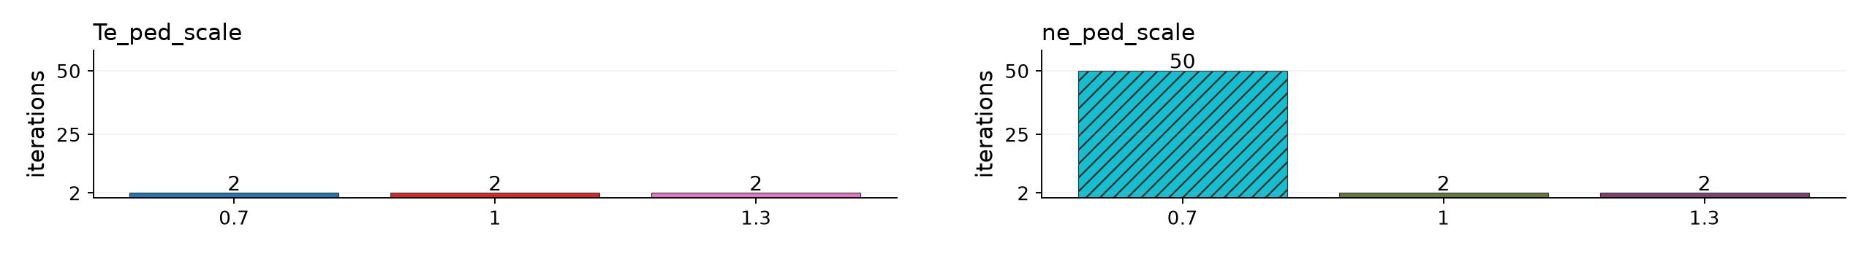
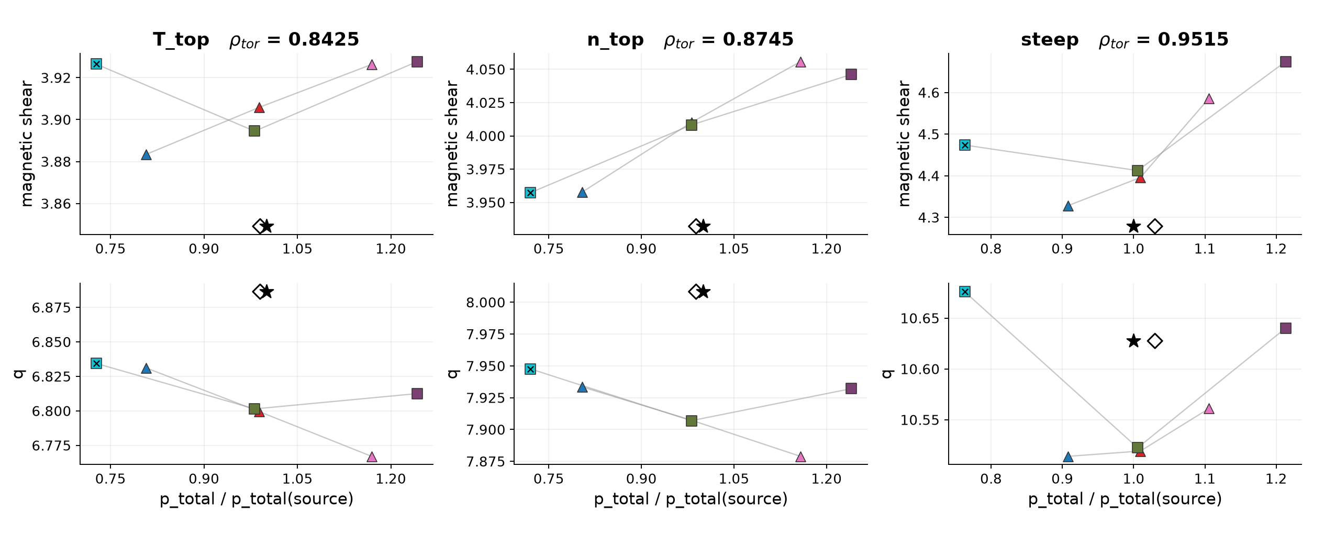
129015 mtanh NCSCAL = 4, warmup = 2
Iteration counts and pressure response 6 runs Bars label the number of iterations, including 00 Hatched bars / × = nonconverged
Pressure chains: q and shear versus solved pressure / source pressure at the three Chapman points. Lines join each scaling type separately.
Star: source equilibrium. Hollow diamond: fitted baseline pressure at source q/shear.
6/14
Notes:
{
"family": "mtanh",
"part": "Iteration counts and pressure chains",
"variant": {
"id": "n4w2",
"title": "129015 NCSCAL = 4, warmup = 2",
"color": "#A23BB1",
"root": "C:\\Users\\joesc\\git\\cheaseBS_tests\\data\\pm0.3_ncscal4\\129015",
"original_profile_image": "C:\\Users\\joesc\\git\\cheaseBS_tests\\data\\pm0.3_ncscal4\\129015_mtanh_full_ped.png",
"n": 4,
"w": 2,
"count": 6,
"settings": {
"bootstrap_mix": 0.1,
"istar_mix": 0.05,
"tol_ip_rel": 0.002,
"tol_bs": 0.01,
"tol_q": 0.01,
"tol_a": 0.0001,
"max_iter": 50
},
"runs": [
{
"path": "C:\\Users\\joesc\\git\\cheaseBS_tests\\data\\pm0.3_ncscal4\\129015\\ne_ped_scale_0.700",
"axis": "ne_ped_scale",
"scale": 0.7,
"iterations": 50,
"converged": false,
"chain": [
{
"rho": 0.8425,
"point": "T_top",
"pressure_ratio": 0.7268291784534654,
"q": 6.8343775197239225,
"shear": 3.926476235034009
},
{
"rho": 0.8745,
"point": "n_top",
"pressure_ratio": 0.7200962636115038,
"q": 7.947639878399186,
"shear": 3.9572958968531777
},
{
"rho": 0.9515,
"point": "steep",
"pressure_ratio": 0.7629198612591727,
"q": 10.675994580511283,
"shear": 4.473722429693107
}
]
},
{
"path": "C:\\Users\\joesc\\git\\cheaseBS_tests\\data\\pm0.3_ncscal4\\129015\\ne_ped_scale_1.000",
"axis": "ne_ped_scale",
"scale": 1,
"iterations": 2,
"converged": true,
"chain": [
{
"rho": 0.8425,
"point": "T_top",
"pressure_ratio": 0.9813888315220717,
"q": 6.801420889287426,
"shear": 3.894493167080524
},
{
"rho": 0.8745,
"point": "n_top",
"pressure_ratio": 0.9809338009975517,
"q": 7.906940101804123,
"shear": 4.0082103889821505
},
{
"rho": 0.9515,
"point": "steep",
"pressure_ratio": 1.005600450155316,
"q": 10.522393769635086,
"shear": 4.412390906066833
}
]
},
{
"path": "C:\\Users\\joesc\\git\\cheaseBS_tests\\data\\pm0.3_ncscal4\\129015\\ne_ped_scale_1.300",
"axis": "ne_ped_scale",
"scale": 1.3,
"iterations": 2,
"converged": true,
"chain": [
{
"rho": 0.8425,
"point": "T_top",
"pressure_ratio": 1.2421457897601798,
"q": 6.81251022130032,
"shear": 3.927655589064903
},
{
"rho": 0.8745,
"point": "n_top",
"pressure_ratio": 1.240199953375471,
"q": 7.932105871804619,
"shear": 4.046125999087932
},
{
"rho": 0.9515,
"point": "steep",
"pressure_ratio": 1.2131433575545434,
"q": 10.640085761395644,
"shear": 4.674107370280973
}
]
},
{
"path": "C:\\Users\\joesc\\git\\cheaseBS_tests\\data\\pm0.3_ncscal4\\129015\\Te_ped_scale_0.700",
"axis": "Te_ped_scale",
"scale": 0.7,
"iterations": 2,
"converged": true,
"chain": [
{
"rho": 0.8425,
"point": "T_top",
"pressure_ratio": 0.8068497703383138,
"q": 6.831166154795651,
"shear": 3.883376214530984
},
{
"rho": 0.8745,
"point": "n_top",
"pressure_ratio": 0.8035805750039878,
"q": 7.933549454621382,
"shear": 3.957618220274256
},
{
"rho": 0.9515,
"point": "steep",
"pressure_ratio": 0.9078063580654069,
"q": 10.51400276271765,
"shear": 4.327978988010188
}
]
},
{
"path": "C:\\Users\\joesc\\git\\cheaseBS_tests\\data\\pm0.3_ncscal4\\129015\\Te_ped_scale_1.000",
"axis": "Te_ped_scale",
"scale": 1,
"iterations": 2,
"converged": true,
"chain": [
{
"rho": 0.8425,
"point": "T_top",
"pressure_ratio": 0.9882200644085564,
"q": 6.79957086799702,
"shear": 3.905786216177174
},
{
"rho": 0.8745,
"point": "n_top",
"pressure_ratio": 0.9811283089514407,
"q": 7.907300807525324,
"shear": 4.010108540345586
},
{
"rho": 0.9515,
"point": "steep",
"pressure_ratio": 1.0095496015708267,
"q": 10.519232032594322,
"shear": 4.39578800439352
}
]
},
{
"path": "C:\\Users\\joesc\\git\\cheaseBS_tests\\data\\pm0.3_ncscal4\\129015\\Te_ped_scale_1.300",
"axis": "Te_ped_scale",
"scale": 1.3,
"iterations": 2,
"converged": true,
"chain": [
{
"rho": 0.8425,
"point": "T_top",
"pressure_ratio": 1.1690904142199168,
"q": 6.7670435352357075,
"shear": 3.926303122403596
},
{
"rho": 0.8745,
"point": "n_top",
"pressure_ratio": 1.1578016684115655,
"q": 7.878906276954586,
"shear": 4.055765711318818
},
{
"rho": 0.9515,
"point": "steep",
"pressure_ratio": 1.1056303592543277,
"q": 10.561032509452145,
"shear": 4.585835937795514
}
]
}
],
"prefix": "mtanh_n4w2"
},
"chapman": [
{
"rho": 0.8425,
"point": "T_top",
"q": 6.886358711050888,
"shear": 3.849093755603565,
"fit_pressure_ratio": 0.99014717994203
},
{
"rho": 0.8745,
"point": "n_top",
"q": 8.008300508035049,
"shear": 3.9320542581423155,
"fit_pressure_ratio": 0.9886363282069752
},
{
"rho": 0.9515,
"point": "steep",
"q": 10.627539365150305,
"shear": 4.278473037196078,
"fit_pressure_ratio": 1.029936403893316
}
],
"limitations": "NCSCAL 1 inferred from the saved config reference to chease_namelist_nstx and the current preset. Original execution namelist unavailable. NCSCAL 4 is explicit in saved campaign namelists. Older/newer campaigns differ in mixing, tolerances and scale coverage. All runs use I-star. No new solves.",
"source": "prepare_split.py reuses the validated 46-run manifest. Pressure chains use the same TPED GFileData / shear interpolation as the prior review. Only this family is included. Transformation profiles replotted from the original saved files using the same fixed (scaling type, factor) color map as traces, bars and pressure points. Iteration counts use convergence_summary.json; traces use iteration_log.csv."
}

Slide 7
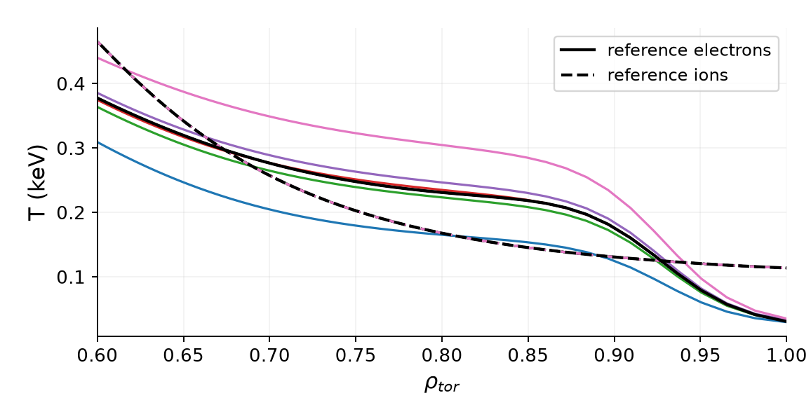
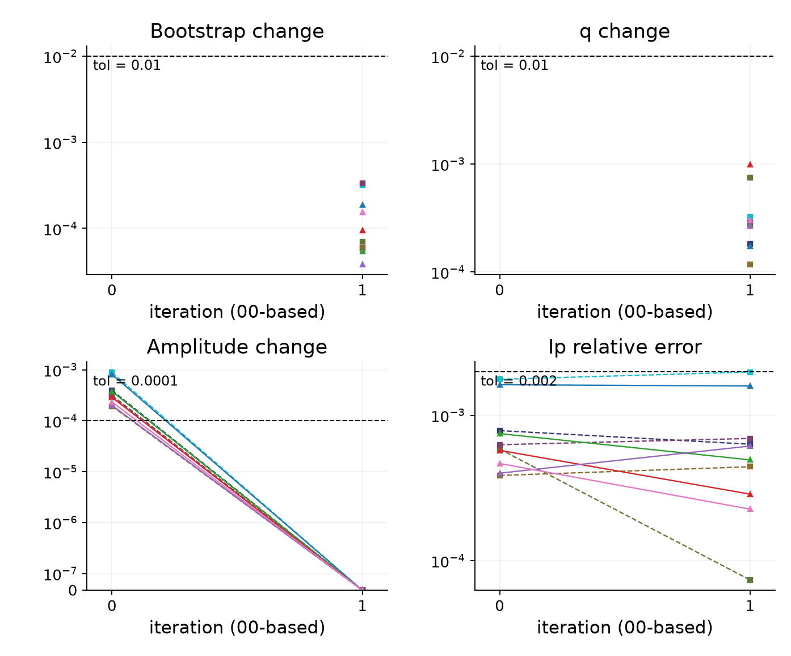
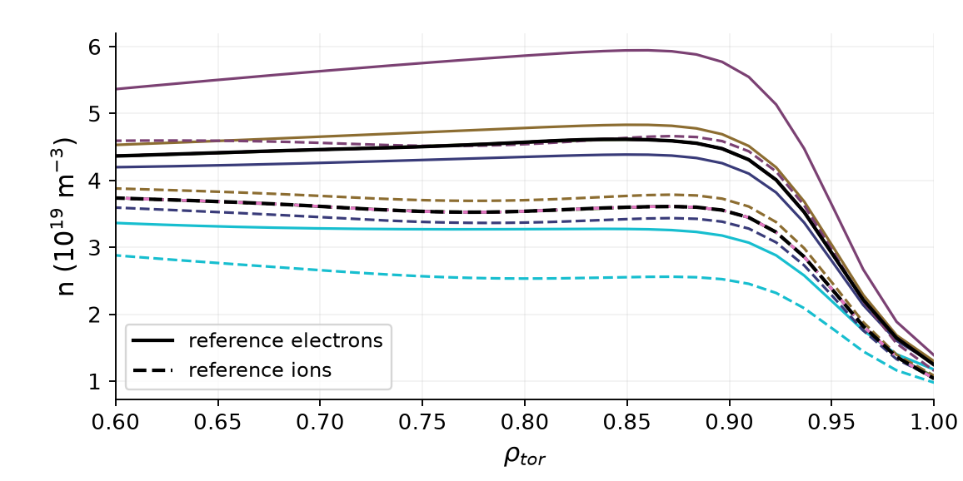
129015 mtanh NCSCAL = 4, warmup = 0
Transformations and error traces 10 runs I-star mix 0.05 Ip tolerance 0.2% BS/q tolerance 1%
Saved transformation profiles
Iteration errors (relative fractions)
One color per scaling type/factor across all plots. Profiles: solid electrons, dashed ions where shown. Black curves: reference profiles.
Amplitude change may be set to zero by the stopping rule. BS/q traces measure successive change.
7/14
Notes:
{
"family": "mtanh",
"part": "Transformations and error traces",
"variant": {
"id": "n4w0",
"title": "129015 NCSCAL = 4, warmup = 0",
"color": "#D55E00",
"root": "C:\\Users\\joesc\\git\\cheaseBS_tests\\data\\pm0.3_ncscal4_warmup0\\129015",
"original_profile_image": "C:\\Users\\joesc\\git\\cheaseBS_tests\\data\\pm0.3_ncscal4_warmup0\\129015_mtanh_full_ped.png",
"n": 4,
"w": 0,
"count": 10,
"settings": {
"bootstrap_mix": 0.1,
"istar_mix": 0.05,
"tol_ip_rel": 0.002,
"tol_bs": 0.01,
"tol_q": 0.01,
"tol_a": 0.0001,
"max_iter": 50
},
"runs": [
{
"path": "C:\\Users\\joesc\\git\\cheaseBS_tests\\data\\pm0.3_ncscal4_warmup0\\129015\\ne_ped_scale_0.700",
"axis": "ne_ped_scale",
"scale": 0.7,
"iterations": 2,
"converged": true,
"chain": [
{
"rho": 0.8425,
"point": "T_top",
"pressure_ratio": 0.7192984549260987,
"q": 6.784417939918811,
"shear": 3.8602131983584034
},
{
"rho": 0.8745,
"point": "n_top",
"pressure_ratio": 0.7193524363050984,
"q": 7.875215175262731,
"shear": 3.971823134561507
},
{
"rho": 0.9515,
"point": "steep",
"pressure_ratio": 0.7888806089605601,
"q": 10.429163703237545,
"shear": 4.258273479567649
}
]
},
{
"path": "C:\\Users\\joesc\\git\\cheaseBS_tests\\data\\pm0.3_ncscal4_warmup0\\129015\\ne_ped_scale_0.950",
"axis": "ne_ped_scale",
"scale": 0.95,
"iterations": 2,
"converged": true,
"chain": [
{
"rho": 0.8425,
"point": "T_top",
"pressure_ratio": 0.9379527898373232,
"q": 6.793946998227973,
"shear": 3.886840134129277
},
{
"rho": 0.8745,
"point": "n_top",
"pressure_ratio": 0.9378790451254123,
"q": 7.896131592385044,
"shear": 4.005718159110967
},
{
"rho": 0.9515,
"point": "steep",
"pressure_ratio": 0.9718751932375116,
"q": 10.507127193797002,
"shear": 4.425905320302754
}
]
},
{
"path": "C:\\Users\\joesc\\git\\cheaseBS_tests\\data\\pm0.3_ncscal4_warmup0\\129015\\ne_ped_scale_1.000",
"axis": "ne_ped_scale",
"scale": 1,
"iterations": 2,
"converged": true,
"chain": [
{
"rho": 0.8425,
"point": "T_top",
"pressure_ratio": 0.9814003899127556,
"q": 6.801325876744668,
"shear": 3.8944907369366315
},
{
"rho": 0.8745,
"point": "n_top",
"pressure_ratio": 0.9809448623384521,
"q": 7.906828829230068,
"shear": 4.008208040475365
},
{
"rho": 0.9515,
"point": "steep",
"pressure_ratio": 1.0056038071559168,
"q": 10.522307172088087,
"shear": 4.412599848501599
}
]
},
{
"path": "C:\\Users\\joesc\\git\\cheaseBS_tests\\data\\pm0.3_ncscal4_warmup0\\129015\\ne_ped_scale_1.050",
"axis": "ne_ped_scale",
"scale": 1.05,
"iterations": 2,
"converged": true,
"chain": [
{
"rho": 0.8425,
"point": "T_top",
"pressure_ratio": 1.0249065020966623,
"q": 6.802621134456635,
"shear": 3.8991999470697145
},
{
"rho": 0.8745,
"point": "n_top",
"pressure_ratio": 1.024197580920695,
"q": 7.910001030079433,
"shear": 4.013516717684429
},
{
"rho": 0.9515,
"point": "steep",
"pressure_ratio": 1.0394377325081128,
"q": 10.550625223810394,
"shear": 4.517976253650191
}
]
},
{
"path": "C:\\Users\\joesc\\git\\cheaseBS_tests\\data\\pm0.3_ncscal4_warmup0\\129015\\ne_ped_scale_1.300",
"axis": "ne_ped_scale",
"scale": 1.3,
"iterations": 2,
"converged": true,
"chain": [
{
"rho": 0.8425,
"point": "T_top",
"pressure_ratio": 1.2421295276361124,
"q": 6.812611757448568,
"shear": 3.9276552199314665
},
{
"rho": 0.8745,
"point": "n_top",
"pressure_ratio": 1.2401838303765012,
"q": 7.93222312288087,
"shear": 4.046110058705157
},
{
"rho": 0.9515,
"point": "steep",
"pressure_ratio": 1.2131302886967523,
"q": 10.640229522566102,
"shear": 4.6741064396567715
}
]
},
{
"path": "C:\\Users\\joesc\\git\\cheaseBS_tests\\data\\pm0.3_ncscal4_warmup0\\129015\\Te_ped_scale_0.700",
"axis": "Te_ped_scale",
"scale": 0.7,
"iterations": 2,
"converged": true,
"chain": [
{
"rho": 0.8425,
"point": "T_top",
"pressure_ratio": 0.8068764926329098,
"q": 6.830906606099416,
"shear": 3.8833804704557515
},
{
"rho": 0.8745,
"point": "n_top",
"pressure_ratio": 0.8036070969665237,
"q": 7.933251097960752,
"shear": 3.9576409201478544
},
{
"rho": 0.9515,
"point": "steep",
"pressure_ratio": 0.9078318402383487,
"q": 10.513645003409394,
"shear": 4.3278769615775365
}
]
},
{
"path": "C:\\Users\\joesc\\git\\cheaseBS_tests\\data\\pm0.3_ncscal4_warmup0\\129015\\Te_ped_scale_0.950",
"axis": "Te_ped_scale",
"scale": 0.95,
"iterations": 2,
"converged": true,
"chain": [
{
"rho": 0.8425,
"point": "T_top",
"pressure_ratio": 0.9579719538341308,
"q": 6.804272446237248,
"shear": 3.9015194993433795
},
{
"rho": 0.8745,
"point": "n_top",
"pressure_ratio": 0.95145052034898,
"q": 7.910749952295064,
"shear": 3.999916277502505
},
{
"rho": 0.9515,
"point": "steep",
"pressure_ratio": 0.9916209642557686,
"q": 10.525366595025599,
"shear": 4.424578659399233
}
]
},
{
"path": "C:\\Users\\joesc\\git\\cheaseBS_tests\\data\\pm0.3_ncscal4_warmup0\\129015\\Te_ped_scale_1.000",
"axis": "Te_ped_scale",
"scale": 1,
"iterations": 2,
"converged": true,
"chain": [
{
"rho": 0.8425,
"point": "T_top",
"pressure_ratio": 0.9882313722422658,
"q": 6.799477092080268,
"shear": 3.905782973218318
},
{
"rho": 0.8745,
"point": "n_top",
"pressure_ratio": 0.9811389344041063,
"q": 7.907190493343389,
"shear": 4.01010374778881
},
{
"rho": 0.9515,
"point": "steep",
"pressure_ratio": 1.009551035182769,
"q": 10.519160656586818,
"shear": 4.396067087615413
}
]
},
{
"path": "C:\\Users\\joesc\\git\\cheaseBS_tests\\data\\pm0.3_ncscal4_warmup0\\129015\\Te_ped_scale_1.050",
"axis": "Te_ped_scale",
"scale": 1.05,
"iterations": 2,
"converged": true,
"chain": [
{
"rho": 0.8425,
"point": "T_top",
"pressure_ratio": 1.0183024933541542,
"q": 6.7933146951640815,
"shear": 3.9082430553035703
},
{
"rho": 0.8745,
"point": "n_top",
"pressure_ratio": 1.0103944735590464,
"q": 7.901111578501799,
"shear": 4.015562972592553
},
{
"rho": 0.9515,
"point": "steep",
"pressure_ratio": 1.0236880872546197,
"q": 10.539495430159414,
"shear": 4.514237981555337
}
]
},
{
"path": "C:\\Users\\joesc\\git\\cheaseBS_tests\\data\\pm0.3_ncscal4_warmup0\\129015\\Te_ped_scale_1.300",
"axis": "Te_ped_scale",
"scale": 1.3,
"iterations": 2,
"converged": true,
"chain": [
{
"rho": 0.8425,
"point": "T_top",
"pressure_ratio": 1.1690789444500682,
"q": 6.767115870181568,
"shear": 3.9263018235230067
},
{
"rho": 0.8745,
"point": "n_top",
"pressure_ratio": 1.1577901714624483,
"q": 7.878989253275167,
"shear": 4.055751360803521
},
{
"rho": 0.9515,
"point": "steep",
"pressure_ratio": 1.1056194346426265,
"q": 10.561155772204287,
"shear": 4.585834231507878
}
]
}
],
"prefix": "mtanh_n4w0"
},
"chapman": [
{
"rho": 0.8425,
"point": "T_top",
"q": 6.886358711050888,
"shear": 3.849093755603565,
"fit_pressure_ratio": 0.99014717994203
},
{
"rho": 0.8745,
"point": "n_top",
"q": 8.008300508035049,
"shear": 3.9320542581423155,
"fit_pressure_ratio": 0.9886363282069752
},
{
"rho": 0.9515,
"point": "steep",
"q": 10.627539365150305,
"shear": 4.278473037196078,
"fit_pressure_ratio": 1.029936403893316
}
],
"limitations": "NCSCAL 1 inferred from the saved config reference to chease_namelist_nstx and the current preset. Original execution namelist unavailable. NCSCAL 4 is explicit in saved campaign namelists. Older/newer campaigns differ in mixing, tolerances and scale coverage. All runs use I-star. No new solves.",
"source": "prepare_split.py reuses the validated 46-run manifest. Pressure chains use the same TPED GFileData / shear interpolation as the prior review. Only this family is included. Transformation profiles replotted from the original saved files using the same fixed (scaling type, factor) color map as traces, bars and pressure points. Iteration counts use convergence_summary.json; traces use iteration_log.csv."
}

Slide 8
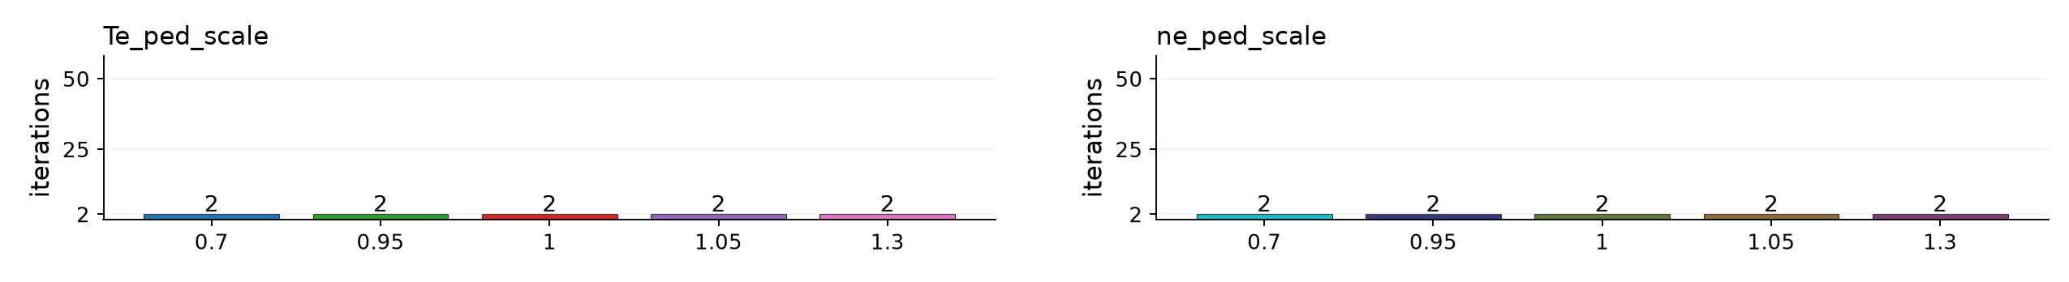
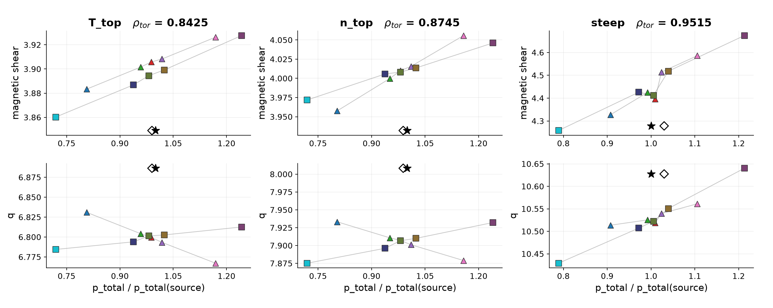
129015 mtanh NCSCAL = 4, warmup = 0
Iteration counts and pressure response 10 runs Bars label the number of iterations, including 00 Hatched bars / × = nonconverged
Pressure chains: q and shear versus solved pressure / source pressure at the three Chapman points. Lines join each scaling type separately.
Star: source equilibrium. Hollow diamond: fitted baseline pressure at source q/shear.
8/14
Notes:
{
"family": "mtanh",
"part": "Iteration counts and pressure chains",
"variant": {
"id": "n4w0",
"title": "129015 NCSCAL = 4, warmup = 0",
"color": "#D55E00",
"root": "C:\\Users\\joesc\\git\\cheaseBS_tests\\data\\pm0.3_ncscal4_warmup0\\129015",
"original_profile_image": "C:\\Users\\joesc\\git\\cheaseBS_tests\\data\\pm0.3_ncscal4_warmup0\\129015_mtanh_full_ped.png",
"n": 4,
"w": 0,
"count": 10,
"settings": {
"bootstrap_mix": 0.1,
"istar_mix": 0.05,
"tol_ip_rel": 0.002,
"tol_bs": 0.01,
"tol_q": 0.01,
"tol_a": 0.0001,
"max_iter": 50
},
"runs": [
{
"path": "C:\\Users\\joesc\\git\\cheaseBS_tests\\data\\pm0.3_ncscal4_warmup0\\129015\\ne_ped_scale_0.700",
"axis": "ne_ped_scale",
"scale": 0.7,
"iterations": 2,
"converged": true,
"chain": [
{
"rho": 0.8425,
"point": "T_top",
"pressure_ratio": 0.7192984549260987,
"q": 6.784417939918811,
"shear": 3.8602131983584034
},
{
"rho": 0.8745,
"point": "n_top",
"pressure_ratio": 0.7193524363050984,
"q": 7.875215175262731,
"shear": 3.971823134561507
},
{
"rho": 0.9515,
"point": "steep",
"pressure_ratio": 0.7888806089605601,
"q": 10.429163703237545,
"shear": 4.258273479567649
}
]
},
{
"path": "C:\\Users\\joesc\\git\\cheaseBS_tests\\data\\pm0.3_ncscal4_warmup0\\129015\\ne_ped_scale_0.950",
"axis": "ne_ped_scale",
"scale": 0.95,
"iterations": 2,
"converged": true,
"chain": [
{
"rho": 0.8425,
"point": "T_top",
"pressure_ratio": 0.9379527898373232,
"q": 6.793946998227973,
"shear": 3.886840134129277
},
{
"rho": 0.8745,
"point": "n_top",
"pressure_ratio": 0.9378790451254123,
"q": 7.896131592385044,
"shear": 4.005718159110967
},
{
"rho": 0.9515,
"point": "steep",
"pressure_ratio": 0.9718751932375116,
"q": 10.507127193797002,
"shear": 4.425905320302754
}
]
},
{
"path": "C:\\Users\\joesc\\git\\cheaseBS_tests\\data\\pm0.3_ncscal4_warmup0\\129015\\ne_ped_scale_1.000",
"axis": "ne_ped_scale",
"scale": 1,
"iterations": 2,
"converged": true,
"chain": [
{
"rho": 0.8425,
"point": "T_top",
"pressure_ratio": 0.9814003899127556,
"q": 6.801325876744668,
"shear": 3.8944907369366315
},
{
"rho": 0.8745,
"point": "n_top",
"pressure_ratio": 0.9809448623384521,
"q": 7.906828829230068,
"shear": 4.008208040475365
},
{
"rho": 0.9515,
"point": "steep",
"pressure_ratio": 1.0056038071559168,
"q": 10.522307172088087,
"shear": 4.412599848501599
}
]
},
{
"path": "C:\\Users\\joesc\\git\\cheaseBS_tests\\data\\pm0.3_ncscal4_warmup0\\129015\\ne_ped_scale_1.050",
"axis": "ne_ped_scale",
"scale": 1.05,
"iterations": 2,
"converged": true,
"chain": [
{
"rho": 0.8425,
"point": "T_top",
"pressure_ratio": 1.0249065020966623,
"q": 6.802621134456635,
"shear": 3.8991999470697145
},
{
"rho": 0.8745,
"point": "n_top",
"pressure_ratio": 1.024197580920695,
"q": 7.910001030079433,
"shear": 4.013516717684429
},
{
"rho": 0.9515,
"point": "steep",
"pressure_ratio": 1.0394377325081128,
"q": 10.550625223810394,
"shear": 4.517976253650191
}
]
},
{
"path": "C:\\Users\\joesc\\git\\cheaseBS_tests\\data\\pm0.3_ncscal4_warmup0\\129015\\ne_ped_scale_1.300",
"axis": "ne_ped_scale",
"scale": 1.3,
"iterations": 2,
"converged": true,
"chain": [
{
"rho": 0.8425,
"point": "T_top",
"pressure_ratio": 1.2421295276361124,
"q": 6.812611757448568,
"shear": 3.9276552199314665
},
{
"rho": 0.8745,
"point": "n_top",
"pressure_ratio": 1.2401838303765012,
"q": 7.93222312288087,
"shear": 4.046110058705157
},
{
"rho": 0.9515,
"point": "steep",
"pressure_ratio": 1.2131302886967523,
"q": 10.640229522566102,
"shear": 4.6741064396567715
}
]
},
{
"path": "C:\\Users\\joesc\\git\\cheaseBS_tests\\data\\pm0.3_ncscal4_warmup0\\129015\\Te_ped_scale_0.700",
"axis": "Te_ped_scale",
"scale": 0.7,
"iterations": 2,
"converged": true,
"chain": [
{
"rho": 0.8425,
"point": "T_top",
"pressure_ratio": 0.8068764926329098,
"q": 6.830906606099416,
"shear": 3.8833804704557515
},
{
"rho": 0.8745,
"point": "n_top",
"pressure_ratio": 0.8036070969665237,
"q": 7.933251097960752,
"shear": 3.9576409201478544
},
{
"rho": 0.9515,
"point": "steep",
"pressure_ratio": 0.9078318402383487,
"q": 10.513645003409394,
"shear": 4.3278769615775365
}
]
},
{
"path": "C:\\Users\\joesc\\git\\cheaseBS_tests\\data\\pm0.3_ncscal4_warmup0\\129015\\Te_ped_scale_0.950",
"axis": "Te_ped_scale",
"scale": 0.95,
"iterations": 2,
"converged": true,
"chain": [
{
"rho": 0.8425,
"point": "T_top",
"pressure_ratio": 0.9579719538341308,
"q": 6.804272446237248,
"shear": 3.9015194993433795
},
{
"rho": 0.8745,
"point": "n_top",
"pressure_ratio": 0.95145052034898,
"q": 7.910749952295064,
"shear": 3.999916277502505
},
{
"rho": 0.9515,
"point": "steep",
"pressure_ratio": 0.9916209642557686,
"q": 10.525366595025599,
"shear": 4.424578659399233
}
]
},
{
"path": "C:\\Users\\joesc\\git\\cheaseBS_tests\\data\\pm0.3_ncscal4_warmup0\\129015\\Te_ped_scale_1.000",
"axis": "Te_ped_scale",
"scale": 1,
"iterations": 2,
"converged": true,
"chain": [
{
"rho": 0.8425,
"point": "T_top",
"pressure_ratio": 0.9882313722422658,
"q": 6.799477092080268,
"shear": 3.905782973218318
},
{
"rho": 0.8745,
"point": "n_top",
"pressure_ratio": 0.9811389344041063,
"q": 7.907190493343389,
"shear": 4.01010374778881
},
{
"rho": 0.9515,
"point": "steep",
"pressure_ratio": 1.009551035182769,
"q": 10.519160656586818,
"shear": 4.396067087615413
}
]
},
{
"path": "C:\\Users\\joesc\\git\\cheaseBS_tests\\data\\pm0.3_ncscal4_warmup0\\129015\\Te_ped_scale_1.050",
"axis": "Te_ped_scale",
"scale": 1.05,
"iterations": 2,
"converged": true,
"chain": [
{
"rho": 0.8425,
"point": "T_top",
"pressure_ratio": 1.0183024933541542,
"q": 6.7933146951640815,
"shear": 3.9082430553035703
},
{
"rho": 0.8745,
"point": "n_top",
"pressure_ratio": 1.0103944735590464,
"q": 7.901111578501799,
"shear": 4.015562972592553
},
{
"rho": 0.9515,
"point": "steep",
"pressure_ratio": 1.0236880872546197,
"q": 10.539495430159414,
"shear": 4.514237981555337
}
]
},
{
"path": "C:\\Users\\joesc\\git\\cheaseBS_tests\\data\\pm0.3_ncscal4_warmup0\\129015\\Te_ped_scale_1.300",
"axis": "Te_ped_scale",
"scale": 1.3,
"iterations": 2,
"converged": true,
"chain": [
{
"rho": 0.8425,
"point": "T_top",
"pressure_ratio": 1.1690789444500682,
"q": 6.767115870181568,
"shear": 3.9263018235230067
},
{
"rho": 0.8745,
"point": "n_top",
"pressure_ratio": 1.1577901714624483,
"q": 7.878989253275167,
"shear": 4.055751360803521
},
{
"rho": 0.9515,
"point": "steep",
"pressure_ratio": 1.1056194346426265,
"q": 10.561155772204287,
"shear": 4.585834231507878
}
]
}
],
"prefix": "mtanh_n4w0"
},
"chapman": [
{
"rho": 0.8425,
"point": "T_top",
"q": 6.886358711050888,
"shear": 3.849093755603565,
"fit_pressure_ratio": 0.99014717994203
},
{
"rho": 0.8745,
"point": "n_top",
"q": 8.008300508035049,
"shear": 3.9320542581423155,
"fit_pressure_ratio": 0.9886363282069752
},
{
"rho": 0.9515,
"point": "steep",
"q": 10.627539365150305,
"shear": 4.278473037196078,
"fit_pressure_ratio": 1.029936403893316
}
],
"limitations": "NCSCAL 1 inferred from the saved config reference to chease_namelist_nstx and the current preset. Original execution namelist unavailable. NCSCAL 4 is explicit in saved campaign namelists. Older/newer campaigns differ in mixing, tolerances and scale coverage. All runs use I-star. No new solves.",
"source": "prepare_split.py reuses the validated 46-run manifest. Pressure chains use the same TPED GFileData / shear interpolation as the prior review. Only this family is included. Transformation profiles replotted from the original saved files using the same fixed (scaling type, factor) color map as traces, bars and pressure points. Iteration counts use convergence_summary.json; traces use iteration_log.csv."
}

Slide 9
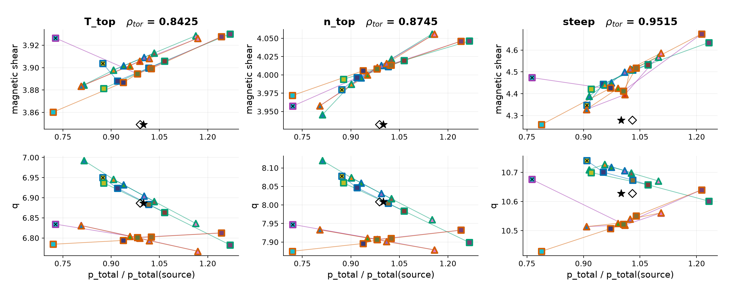
129015 mtanh pressure chains across solver variants
Marker border identifies the solver variant. Marker fill matches that scaling type/factor in every profile, trace and bar.
○ NCSCAL 1* / warmup 2
○ NCSCAL 1* / warmup 0
○ NCSCAL 4 / warmup 2
○ NCSCAL 4 / warmup 0
Star: source equilibrium. Hollow diamond: fitted baseline pressure at source q/shear. ×: solver reports nonconvergence.
*NCSCAL=1 inferred from preset. Mixing, tolerances and sampled scales also differ across campaigns.
9/14
Notes:
{
"family": "mtanh",
"part": "All variants, with marker-border coding",
"variant": null,
"chapman": [
{
"rho": 0.8425,
"point": "T_top",
"q": 6.886358711050888,
"shear": 3.849093755603565,
"fit_pressure_ratio": 0.99014717994203
},
{
"rho": 0.8745,
"point": "n_top",
"q": 8.008300508035049,
"shear": 3.9320542581423155,
"fit_pressure_ratio": 0.9886363282069752
},
{
"rho": 0.9515,
"point": "steep",
"q": 10.627539365150305,
"shear": 4.278473037196078,
"fit_pressure_ratio": 1.029936403893316
}
],
"limitations": "NCSCAL 1 inferred from the saved config reference to chease_namelist_nstx and the current preset. Original execution namelist unavailable. NCSCAL 4 is explicit in saved campaign namelists. Older/newer campaigns differ in mixing, tolerances and scale coverage. All runs use I-star. No new solves.",
"source": "prepare_split.py reuses the validated 46-run manifest. Pressure chains use the same TPED GFileData / shear interpolation as the prior review. Only this family is included. Transformation profiles replotted from the original saved files using the same fixed (scaling type, factor) color map as traces, bars and pressure points. Iteration counts use convergence_summary.json; traces use iteration_log.csv."
}

Slide 10
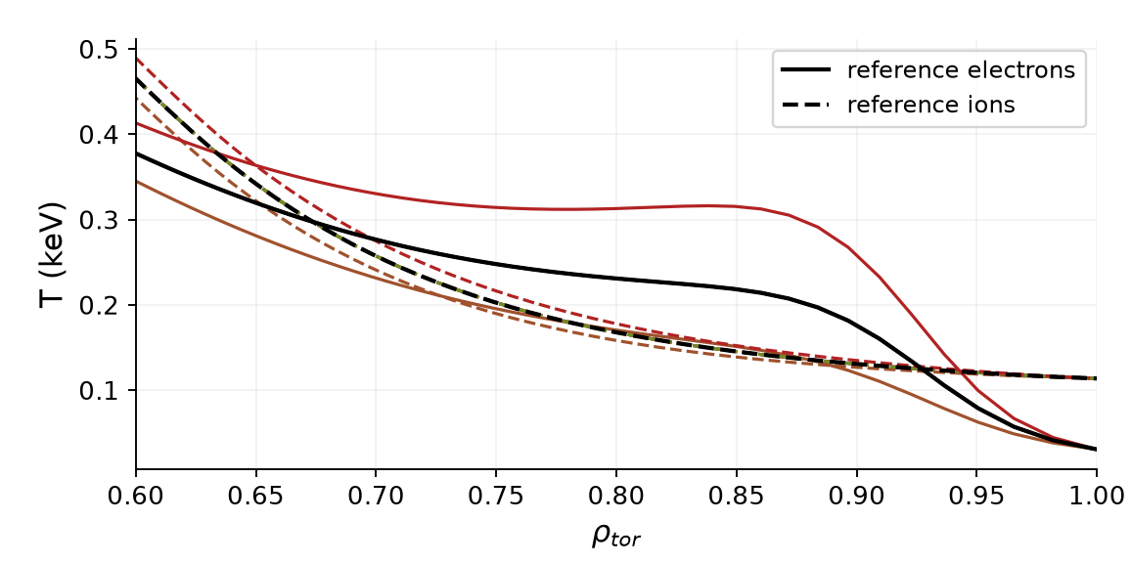
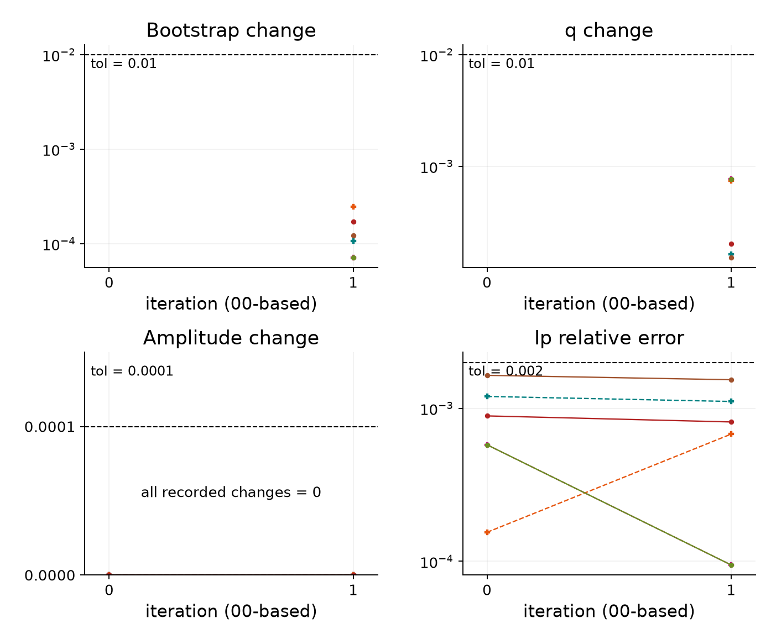
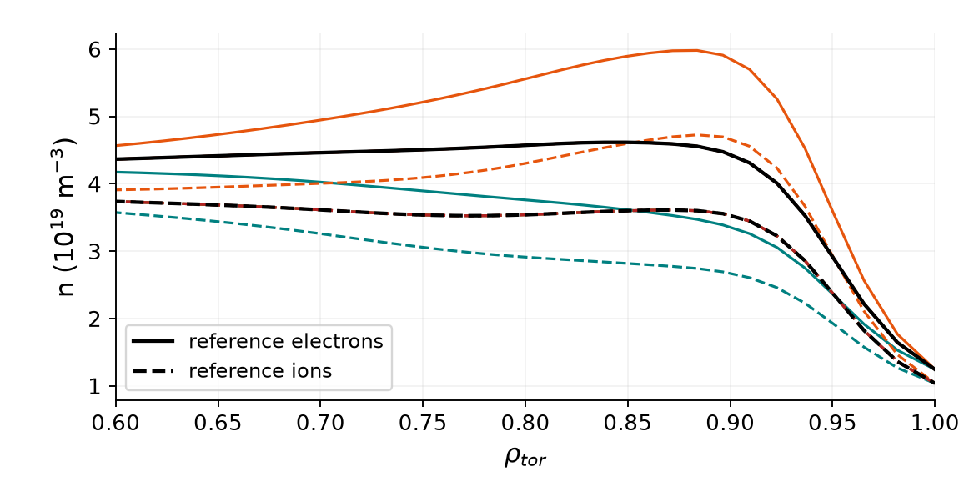
129015 apply_omX NCSCAL = 4, warmup = 2
Transformations and error traces 6 runs I-star mix 0.05 Ip tolerance 0.2% BS/q tolerance 1%
Saved transformation profiles
Iteration errors (relative fractions)
One color per scaling type/factor across all plots. Profiles: solid electrons, dashed ions where shown. Black curves: reference profiles.
Amplitude change may be set to zero by the stopping rule. BS/q traces measure successive change.
10/14
Notes:
{
"family": "apply_omX",
"part": "Transformations and error traces",
"variant": {
"id": "n4w2",
"title": "129015 NCSCAL = 4, warmup = 2",
"color": "#A23BB1",
"root": "C:\\Users\\joesc\\git\\cheaseBS_tests\\data\\pm0.3_ncscal4\\129015",
"original_profile_image": "C:\\Users\\joesc\\git\\cheaseBS_tests\\data\\pm0.3_ncscal4\\129015_mtanh_full_ped.png",
"n": 4,
"w": 2,
"count": 6,
"settings": {
"bootstrap_mix": 0.1,
"istar_mix": 0.05,
"tol_ip_rel": 0.002,
"tol_bs": 0.01,
"tol_q": 0.01,
"tol_a": 0.0001,
"max_iter": 50
},
"runs": [
{
"path": "C:\\Users\\joesc\\git\\cheaseBS_tests\\data\\pm0.3_ncscal4\\129015\\omne_0.700",
"axis": "omne",
"scale": 0.7,
"iterations": 2,
"converged": true,
"chain": [
{
"rho": 0.8425,
"point": "T_top",
"pressure_ratio": 0.7867563544870043,
"q": 6.847250916008155,
"shear": 3.9035523112962918
},
{
"rho": 0.8745,
"point": "n_top",
"pressure_ratio": 0.7647700892950507,
"q": 7.957424144864555,
"shear": 3.966456269629162
},
{
"rho": 0.9515,
"point": "steep",
"pressure_ratio": 0.8199056697138647,
"q": 10.540812338468212,
"shear": 4.27675590068881
}
]
},
{
"path": "C:\\Users\\joesc\\git\\cheaseBS_tests\\data\\pm0.3_ncscal4\\129015\\omne_1.000",
"axis": "omne",
"scale": 1,
"iterations": 2,
"converged": true,
"chain": [
{
"rho": 0.8425,
"point": "T_top",
"pressure_ratio": 0.9858989562413545,
"q": 6.80044334386391,
"shear": 3.8972219441120926
},
{
"rho": 0.8745,
"point": "n_top",
"pressure_ratio": 0.9836673095771666,
"q": 7.906543556845907,
"shear": 4.008555249877127
},
{
"rho": 0.9515,
"point": "steep",
"pressure_ratio": 1.0147977749987949,
"q": 10.521699060288627,
"shear": 4.41102845426577
}
]
},
{
"path": "C:\\Users\\joesc\\git\\cheaseBS_tests\\data\\pm0.3_ncscal4\\129015\\omne_1.300",
"axis": "omne",
"scale": 1.3,
"iterations": 2,
"converged": true,
"chain": [
{
"rho": 0.8425,
"point": "T_top",
"pressure_ratio": 1.2369801042855337,
"q": 6.736093085970909,
"shear": 3.875451006345
},
{
"rho": 0.8745,
"point": "n_top",
"pressure_ratio": 1.2687581722551315,
"q": 7.83289475281775,
"shear": 4.0522928187811305
},
{
"rho": 0.9515,
"point": "steep",
"pressure_ratio": 1.257837484407978,
"q": 10.503832355919593,
"shear": 4.720373454236804
}
]
},
{
"path": "C:\\Users\\joesc\\git\\cheaseBS_tests\\data\\pm0.3_ncscal4\\129015\\omt_0.700",
"axis": "omt",
"scale": 0.7,
"iterations": 2,
"converged": true,
"chain": [
{
"rho": 0.8425,
"point": "T_top",
"pressure_ratio": 0.7865923533999624,
"q": 6.840828256723431,
"shear": 3.892403381508061
},
{
"rho": 0.8745,
"point": "n_top",
"pressure_ratio": 0.7766872464343215,
"q": 7.946067089894879,
"shear": 3.9541926601085486
},
{
"rho": 0.9515,
"point": "steep",
"pressure_ratio": 0.9072347354718857,
"q": 10.523764312378415,
"shear": 4.307612196256843
}
]
},
{
"path": "C:\\Users\\joesc\\git\\cheaseBS_tests\\data\\pm0.3_ncscal4\\129015\\omt_1.000",
"axis": "omt",
"scale": 1,
"iterations": 2,
"converged": true,
"chain": [
{
"rho": 0.8425,
"point": "T_top",
"pressure_ratio": 0.9858989562413545,
"q": 6.80044334386391,
"shear": 3.8972219441120926
},
{
"rho": 0.8745,
"point": "n_top",
"pressure_ratio": 0.9836673095771666,
"q": 7.906543556845907,
"shear": 4.008555249877127
},
{
"rho": 0.9515,
"point": "steep",
"pressure_ratio": 1.0147977749987949,
"q": 10.521699060288627,
"shear": 4.41102845426577
}
]
},
{
"path": "C:\\Users\\joesc\\git\\cheaseBS_tests\\data\\pm0.3_ncscal4\\129015\\omt_1.300",
"axis": "omt",
"scale": 1.3,
"iterations": 2,
"converged": true,
"chain": [
{
"rho": 0.8425,
"point": "T_top",
"pressure_ratio": 1.2645968867927264,
"q": 6.734896814696426,
"shear": 3.8852618015830642
},
{
"rho": 0.8745,
"point": "n_top",
"pressure_ratio": 1.2834096189964188,
"q": 7.83669168831512,
"shear": 4.081558153417292
},
{
"rho": 0.9515,
"point": "steep",
"pressure_ratio": 1.151174508018525,
"q": 10.536049195963793,
"shear": 4.670703852305721
}
]
}
],
"prefix": "apply_omX_n4w2"
},
"chapman": [
{
"rho": 0.8425,
"point": "T_top",
"q": 6.886358711050888,
"shear": 3.849093755603565,
"fit_pressure_ratio": 0.99014717994203
},
{
"rho": 0.8745,
"point": "n_top",
"q": 8.008300508035049,
"shear": 3.9320542581423155,
"fit_pressure_ratio": 0.9886363282069752
},
{
"rho": 0.9515,
"point": "steep",
"q": 10.627539365150305,
"shear": 4.278473037196078,
"fit_pressure_ratio": 1.029936403893316
}
],
"limitations": "NCSCAL 1 inferred from the saved config reference to chease_namelist_nstx and the current preset. Original execution namelist unavailable. NCSCAL 4 is explicit in saved campaign namelists. Older/newer campaigns differ in mixing, tolerances and scale coverage. All runs use I-star. No new solves.",
"source": "prepare_split.py reuses the validated 46-run manifest. Pressure chains use the same TPED GFileData / shear interpolation as the prior review. Only this family is included. Transformation profiles replotted from the original saved files using the same fixed (scaling type, factor) color map as traces, bars and pressure points. Iteration counts use convergence_summary.json; traces use iteration_log.csv."
}

Slide 11
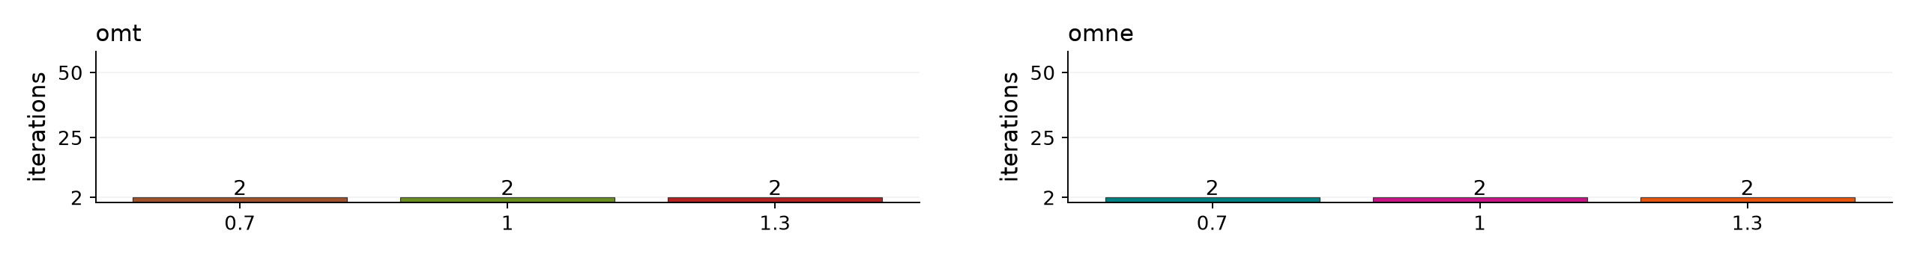
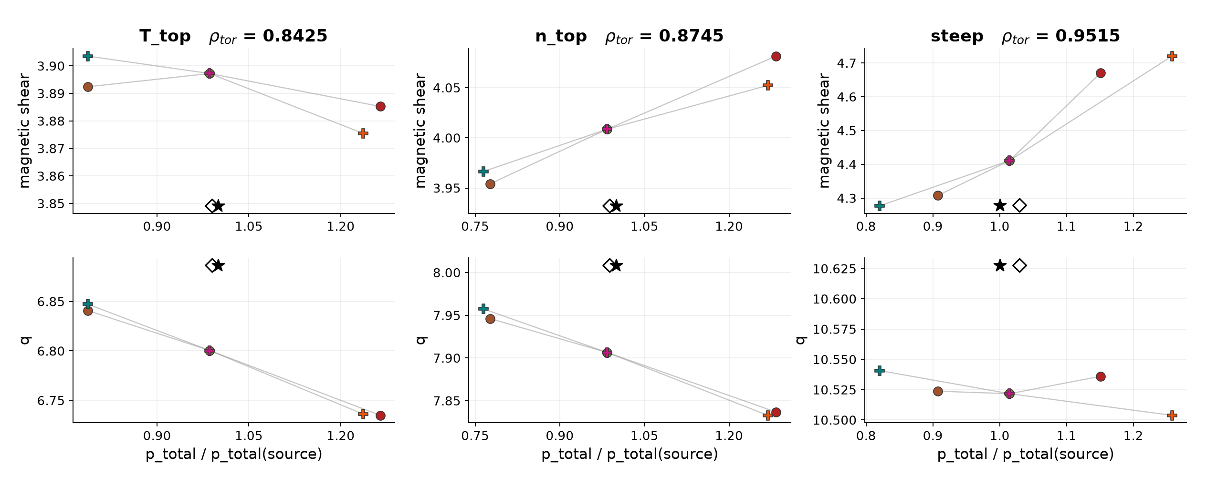
129015 apply_omX NCSCAL = 4, warmup = 2
Iteration counts and pressure response 6 runs Bars label the number of iterations, including 00 Hatched bars / × = nonconverged
Pressure chains: q and shear versus solved pressure / source pressure at the three Chapman points. Lines join each scaling type separately.
Star: source equilibrium. Hollow diamond: fitted baseline pressure at source q/shear.
11/14
Notes:
{
"family": "apply_omX",
"part": "Iteration counts and pressure chains",
"variant": {
"id": "n4w2",
"title": "129015 NCSCAL = 4, warmup = 2",
"color": "#A23BB1",
"root": "C:\\Users\\joesc\\git\\cheaseBS_tests\\data\\pm0.3_ncscal4\\129015",
"original_profile_image": "C:\\Users\\joesc\\git\\cheaseBS_tests\\data\\pm0.3_ncscal4\\129015_mtanh_full_ped.png",
"n": 4,
"w": 2,
"count": 6,
"settings": {
"bootstrap_mix": 0.1,
"istar_mix": 0.05,
"tol_ip_rel": 0.002,
"tol_bs": 0.01,
"tol_q": 0.01,
"tol_a": 0.0001,
"max_iter": 50
},
"runs": [
{
"path": "C:\\Users\\joesc\\git\\cheaseBS_tests\\data\\pm0.3_ncscal4\\129015\\omne_0.700",
"axis": "omne",
"scale": 0.7,
"iterations": 2,
"converged": true,
"chain": [
{
"rho": 0.8425,
"point": "T_top",
"pressure_ratio": 0.7867563544870043,
"q": 6.847250916008155,
"shear": 3.9035523112962918
},
{
"rho": 0.8745,
"point": "n_top",
"pressure_ratio": 0.7647700892950507,
"q": 7.957424144864555,
"shear": 3.966456269629162
},
{
"rho": 0.9515,
"point": "steep",
"pressure_ratio": 0.8199056697138647,
"q": 10.540812338468212,
"shear": 4.27675590068881
}
]
},
{
"path": "C:\\Users\\joesc\\git\\cheaseBS_tests\\data\\pm0.3_ncscal4\\129015\\omne_1.000",
"axis": "omne",
"scale": 1,
"iterations": 2,
"converged": true,
"chain": [
{
"rho": 0.8425,
"point": "T_top",
"pressure_ratio": 0.9858989562413545,
"q": 6.80044334386391,
"shear": 3.8972219441120926
},
{
"rho": 0.8745,
"point": "n_top",
"pressure_ratio": 0.9836673095771666,
"q": 7.906543556845907,
"shear": 4.008555249877127
},
{
"rho": 0.9515,
"point": "steep",
"pressure_ratio": 1.0147977749987949,
"q": 10.521699060288627,
"shear": 4.41102845426577
}
]
},
{
"path": "C:\\Users\\joesc\\git\\cheaseBS_tests\\data\\pm0.3_ncscal4\\129015\\omne_1.300",
"axis": "omne",
"scale": 1.3,
"iterations": 2,
"converged": true,
"chain": [
{
"rho": 0.8425,
"point": "T_top",
"pressure_ratio": 1.2369801042855337,
"q": 6.736093085970909,
"shear": 3.875451006345
},
{
"rho": 0.8745,
"point": "n_top",
"pressure_ratio": 1.2687581722551315,
"q": 7.83289475281775,
"shear": 4.0522928187811305
},
{
"rho": 0.9515,
"point": "steep",
"pressure_ratio": 1.257837484407978,
"q": 10.503832355919593,
"shear": 4.720373454236804
}
]
},
{
"path": "C:\\Users\\joesc\\git\\cheaseBS_tests\\data\\pm0.3_ncscal4\\129015\\omt_0.700",
"axis": "omt",
"scale": 0.7,
"iterations": 2,
"converged": true,
"chain": [
{
"rho": 0.8425,
"point": "T_top",
"pressure_ratio": 0.7865923533999624,
"q": 6.840828256723431,
"shear": 3.892403381508061
},
{
"rho": 0.8745,
"point": "n_top",
"pressure_ratio": 0.7766872464343215,
"q": 7.946067089894879,
"shear": 3.9541926601085486
},
{
"rho": 0.9515,
"point": "steep",
"pressure_ratio": 0.9072347354718857,
"q": 10.523764312378415,
"shear": 4.307612196256843
}
]
},
{
"path": "C:\\Users\\joesc\\git\\cheaseBS_tests\\data\\pm0.3_ncscal4\\129015\\omt_1.000",
"axis": "omt",
"scale": 1,
"iterations": 2,
"converged": true,
"chain": [
{
"rho": 0.8425,
"point": "T_top",
"pressure_ratio": 0.9858989562413545,
"q": 6.80044334386391,
"shear": 3.8972219441120926
},
{
"rho": 0.8745,
"point": "n_top",
"pressure_ratio": 0.9836673095771666,
"q": 7.906543556845907,
"shear": 4.008555249877127
},
{
"rho": 0.9515,
"point": "steep",
"pressure_ratio": 1.0147977749987949,
"q": 10.521699060288627,
"shear": 4.41102845426577
}
]
},
{
"path": "C:\\Users\\joesc\\git\\cheaseBS_tests\\data\\pm0.3_ncscal4\\129015\\omt_1.300",
"axis": "omt",
"scale": 1.3,
"iterations": 2,
"converged": true,
"chain": [
{
"rho": 0.8425,
"point": "T_top",
"pressure_ratio": 1.2645968867927264,
"q": 6.734896814696426,
"shear": 3.8852618015830642
},
{
"rho": 0.8745,
"point": "n_top",
"pressure_ratio": 1.2834096189964188,
"q": 7.83669168831512,
"shear": 4.081558153417292
},
{
"rho": 0.9515,
"point": "steep",
"pressure_ratio": 1.151174508018525,
"q": 10.536049195963793,
"shear": 4.670703852305721
}
]
}
],
"prefix": "apply_omX_n4w2"
},
"chapman": [
{
"rho": 0.8425,
"point": "T_top",
"q": 6.886358711050888,
"shear": 3.849093755603565,
"fit_pressure_ratio": 0.99014717994203
},
{
"rho": 0.8745,
"point": "n_top",
"q": 8.008300508035049,
"shear": 3.9320542581423155,
"fit_pressure_ratio": 0.9886363282069752
},
{
"rho": 0.9515,
"point": "steep",
"q": 10.627539365150305,
"shear": 4.278473037196078,
"fit_pressure_ratio": 1.029936403893316
}
],
"limitations": "NCSCAL 1 inferred from the saved config reference to chease_namelist_nstx and the current preset. Original execution namelist unavailable. NCSCAL 4 is explicit in saved campaign namelists. Older/newer campaigns differ in mixing, tolerances and scale coverage. All runs use I-star. No new solves.",
"source": "prepare_split.py reuses the validated 46-run manifest. Pressure chains use the same TPED GFileData / shear interpolation as the prior review. Only this family is included. Transformation profiles replotted from the original saved files using the same fixed (scaling type, factor) color map as traces, bars and pressure points. Iteration counts use convergence_summary.json; traces use iteration_log.csv."
}

Slide 12
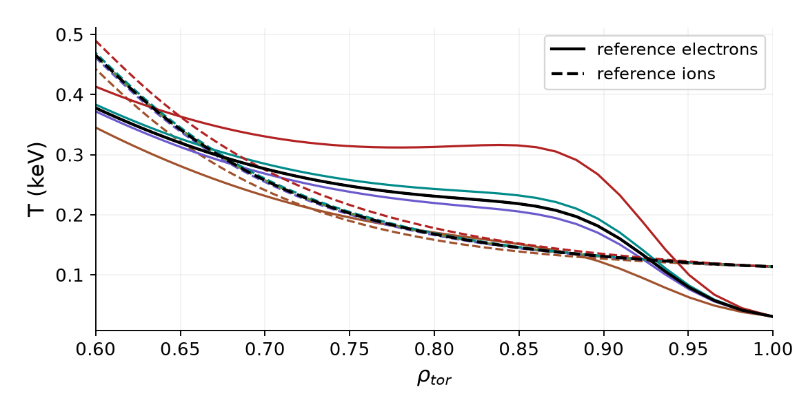
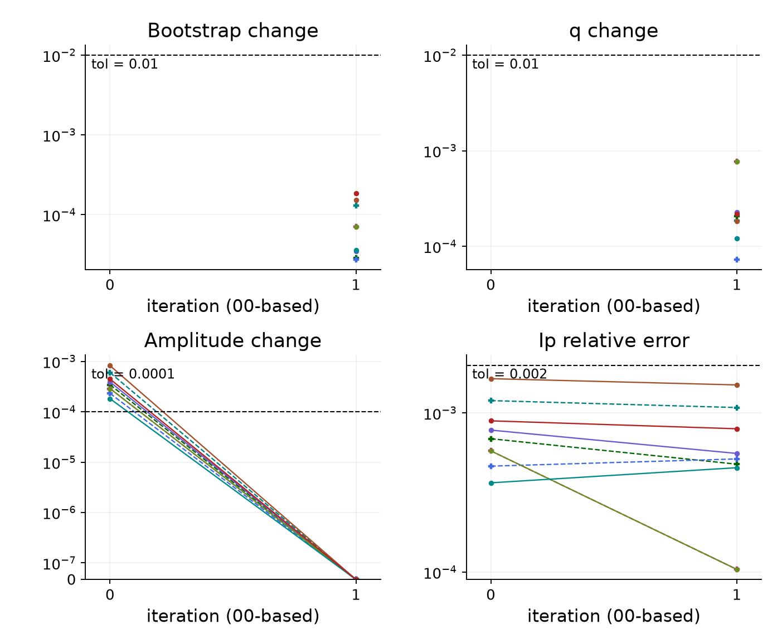
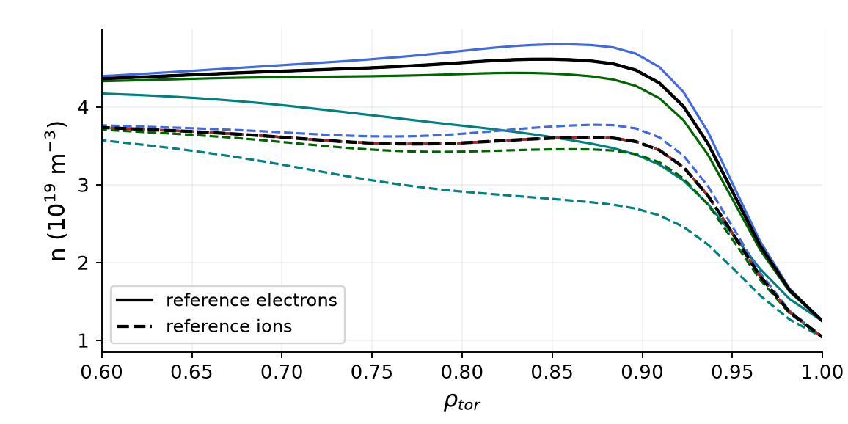
129015 apply_omX NCSCAL = 4, warmup = 0
Transformations and error traces 9 runs I-star mix 0.05 Ip tolerance 0.2% BS/q tolerance 1%
Saved transformation profiles
Iteration errors (relative fractions)
One color per scaling type/factor across all plots. Profiles: solid electrons, dashed ions where shown. Black curves: reference profiles.
Amplitude change may be set to zero by the stopping rule. BS/q traces measure successive change.
12/14
Notes:
{
"family": "apply_omX",
"part": "Transformations and error traces",
"variant": {
"id": "n4w0",
"title": "129015 NCSCAL = 4, warmup = 0",
"color": "#D55E00",
"root": "C:\\Users\\joesc\\git\\cheaseBS_tests\\data\\pm0.3_ncscal4_warmup0\\129015",
"original_profile_image": "C:\\Users\\joesc\\git\\cheaseBS_tests\\data\\pm0.3_ncscal4_warmup0\\129015_mtanh_full_ped.png",
"n": 4,
"w": 0,
"count": 9,
"settings": {
"bootstrap_mix": 0.1,
"istar_mix": 0.05,
"tol_ip_rel": 0.002,
"tol_bs": 0.01,
"tol_q": 0.01,
"tol_a": 0.0001,
"max_iter": 50
},
"runs": [
{
"path": "C:\\Users\\joesc\\git\\cheaseBS_tests\\data\\pm0.3_ncscal4_warmup0\\129015\\omne_0.700",
"axis": "omne",
"scale": 0.7,
"iterations": 2,
"converged": true,
"chain": [
{
"rho": 0.8425,
"point": "T_top",
"pressure_ratio": 0.7867755215761371,
"q": 6.847058925334028,
"shear": 3.9035554299416932
},
{
"rho": 0.8745,
"point": "n_top",
"pressure_ratio": 0.7647885470269432,
"q": 7.957203361809532,
"shear": 3.96647258894511
},
{
"rho": 0.9515,
"point": "steep",
"pressure_ratio": 0.8199209762658716,
"q": 10.540553183086129,
"shear": 4.276858594031663
}
]
},
{
"path": "C:\\Users\\joesc\\git\\cheaseBS_tests\\data\\pm0.3_ncscal4_warmup0\\129015\\omne_0.950",
"axis": "omne",
"scale": 0.95,
"iterations": 2,
"converged": true,
"chain": [
{
"rho": 0.8425,
"point": "T_top",
"pressure_ratio": 0.9493830382093142,
"q": 6.808675641620777,
"shear": 3.8986098630979003
},
{
"rho": 0.8745,
"point": "n_top",
"pressure_ratio": 0.9429873520521056,
"q": 7.915416635544586,
"shear": 4.000011552400203
},
{
"rho": 0.9515,
"point": "steep",
"pressure_ratio": 0.9785412219548653,
"q": 10.531154237580216,
"shear": 4.4157690807960925
}
]
},
{
"path": "C:\\Users\\joesc\\git\\cheaseBS_tests\\data\\pm0.3_ncscal4_warmup0\\129015\\omne_1.000",
"axis": "omne",
"scale": 1,
"iterations": 2,
"converged": true,
"chain": [
{
"rho": 0.8425,
"point": "T_top",
"pressure_ratio": 0.9859104208303776,
"q": 6.800349448933337,
"shear": 3.8972195309576088
},
{
"rho": 0.8745,
"point": "n_top",
"pressure_ratio": 0.9836782577496148,
"q": 7.906433560419086,
"shear": 4.008552799373367
},
{
"rho": 0.9515,
"point": "steep",
"pressure_ratio": 1.0148011077169925,
"q": 10.52161428168054,
"shear": 4.4112391362642684
}
]
},
{
"path": "C:\\Users\\joesc\\git\\cheaseBS_tests\\data\\pm0.3_ncscal4_warmup0\\129015\\omne_1.050",
"axis": "omne",
"scale": 1.05,
"iterations": 2,
"converged": true,
"chain": [
{
"rho": 0.8425,
"point": "T_top",
"pressure_ratio": 1.0237611978889476,
"q": 6.790656091612867,
"shear": 3.894183538982111
},
{
"rho": 0.8745,
"point": "n_top",
"pressure_ratio": 1.025891833460018,
"q": 7.895147097644217,
"shear": 4.013952392173345
},
{
"rho": 0.9515,
"point": "steep",
"pressure_ratio": 1.049644529450405,
"q": 10.530808061716192,
"shear": 4.515355667811019
}
]
},
{
"path": "C:\\Users\\joesc\\git\\cheaseBS_tests\\data\\pm0.3_ncscal4_warmup0\\129015\\omt_0.700",
"axis": "omt",
"scale": 0.7,
"iterations": 2,
"converged": true,
"chain": [
{
"rho": 0.8425,
"point": "T_top",
"pressure_ratio": 0.7866188532964474,
"q": 6.840565476928632,
"shear": 3.892409488042223
},
{
"rho": 0.8745,
"point": "n_top",
"pressure_ratio": 0.7767134045104899,
"q": 7.945765949078069,
"shear": 3.9542223500436964
},
{
"rho": 0.9515,
"point": "steep",
"pressure_ratio": 0.9072635186788592,
"q": 10.523399603358554,
"shear": 4.307388543678838
}
]
},
{
"path": "C:\\Users\\joesc\\git\\cheaseBS_tests\\data\\pm0.3_ncscal4_warmup0\\129015\\omt_0.950",
"axis": "omt",
"scale": 0.95,
"iterations": 2,
"converged": true,
"chain": [
{
"rho": 0.8425,
"point": "T_top",
"pressure_ratio": 0.9478721578529441,
"q": 6.807974963345341,
"shear": 3.8967078454410298
},
{
"rho": 0.8745,
"point": "n_top",
"pressure_ratio": 0.9436076223906784,
"q": 7.913843171436799,
"shear": 3.997124465418335
},
{
"rho": 0.9515,
"point": "steep",
"pressure_ratio": 0.9942558289599889,
"q": 10.527734856501501,
"shear": 4.421329092466225
}
]
},
{
"path": "C:\\Users\\joesc\\git\\cheaseBS_tests\\data\\pm0.3_ncscal4_warmup0\\129015\\omt_1.000",
"axis": "omt",
"scale": 1,
"iterations": 2,
"converged": true,
"chain": [
{
"rho": 0.8425,
"point": "T_top",
"pressure_ratio": 0.9859104208303776,
"q": 6.800349448933337,
"shear": 3.8972195309576088
},
{
"rho": 0.8745,
"point": "n_top",
"pressure_ratio": 0.9836782577496148,
"q": 7.906433560419086,
"shear": 4.008552799373367
},
{
"rho": 0.9515,
"point": "steep",
"pressure_ratio": 1.0148011077169925,
"q": 10.52161428168054,
"shear": 4.4112391362642684
}
]
},
{
"path": "C:\\Users\\joesc\\git\\cheaseBS_tests\\data\\pm0.3_ncscal4_warmup0\\129015\\omt_1.050",
"axis": "omt",
"scale": 1.05,
"iterations": 2,
"converged": true,
"chain": [
{
"rho": 0.8425,
"point": "T_top",
"pressure_ratio": 1.0262263586758031,
"q": 6.78638720054378,
"shear": 3.8943873426293147
},
{
"rho": 0.8745,
"point": "n_top",
"pressure_ratio": 1.0265461905121882,
"q": 7.8911378661679645,
"shear": 4.02283225509849
},
{
"rho": 0.9515,
"point": "steep",
"pressure_ratio": 1.0365118094712173,
"q": 10.528720094131451,
"shear": 4.521846912247405
}
]
},
{
"path": "C:\\Users\\joesc\\git\\cheaseBS_tests\\data\\pm0.3_ncscal4_warmup0\\129015\\omt_1.300",
"axis": "omt",
"scale": 1.3,
"iterations": 2,
"converged": true,
"chain": [
{
"rho": 0.8425,
"point": "T_top",
"pressure_ratio": 1.264573263881601,
"q": 6.735034269377236,
"shear": 3.8852612810293703
},
{
"rho": 0.8745,
"point": "n_top",
"pressure_ratio": 1.2833852552689118,
"q": 7.836850661344166,
"shear": 4.081557680546772
},
{
"rho": 0.9515,
"point": "steep",
"pressure_ratio": 1.1511540852425626,
"q": 10.536271736103318,
"shear": 4.670721198882429
}
]
}
],
"prefix": "apply_omX_n4w0"
},
"chapman": [
{
"rho": 0.8425,
"point": "T_top",
"q": 6.886358711050888,
"shear": 3.849093755603565,
"fit_pressure_ratio": 0.99014717994203
},
{
"rho": 0.8745,
"point": "n_top",
"q": 8.008300508035049,
"shear": 3.9320542581423155,
"fit_pressure_ratio": 0.9886363282069752
},
{
"rho": 0.9515,
"point": "steep",
"q": 10.627539365150305,
"shear": 4.278473037196078,
"fit_pressure_ratio": 1.029936403893316
}
],
"limitations": "NCSCAL 1 inferred from the saved config reference to chease_namelist_nstx and the current preset. Original execution namelist unavailable. NCSCAL 4 is explicit in saved campaign namelists. Older/newer campaigns differ in mixing, tolerances and scale coverage. All runs use I-star. No new solves.",
"source": "prepare_split.py reuses the validated 46-run manifest. Pressure chains use the same TPED GFileData / shear interpolation as the prior review. Only this family is included. Transformation profiles replotted from the original saved files using the same fixed (scaling type, factor) color map as traces, bars and pressure points. Iteration counts use convergence_summary.json; traces use iteration_log.csv."
}

Slide 13
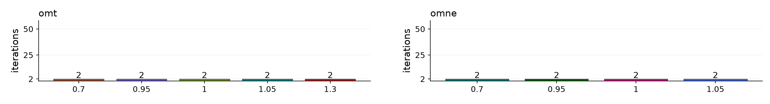
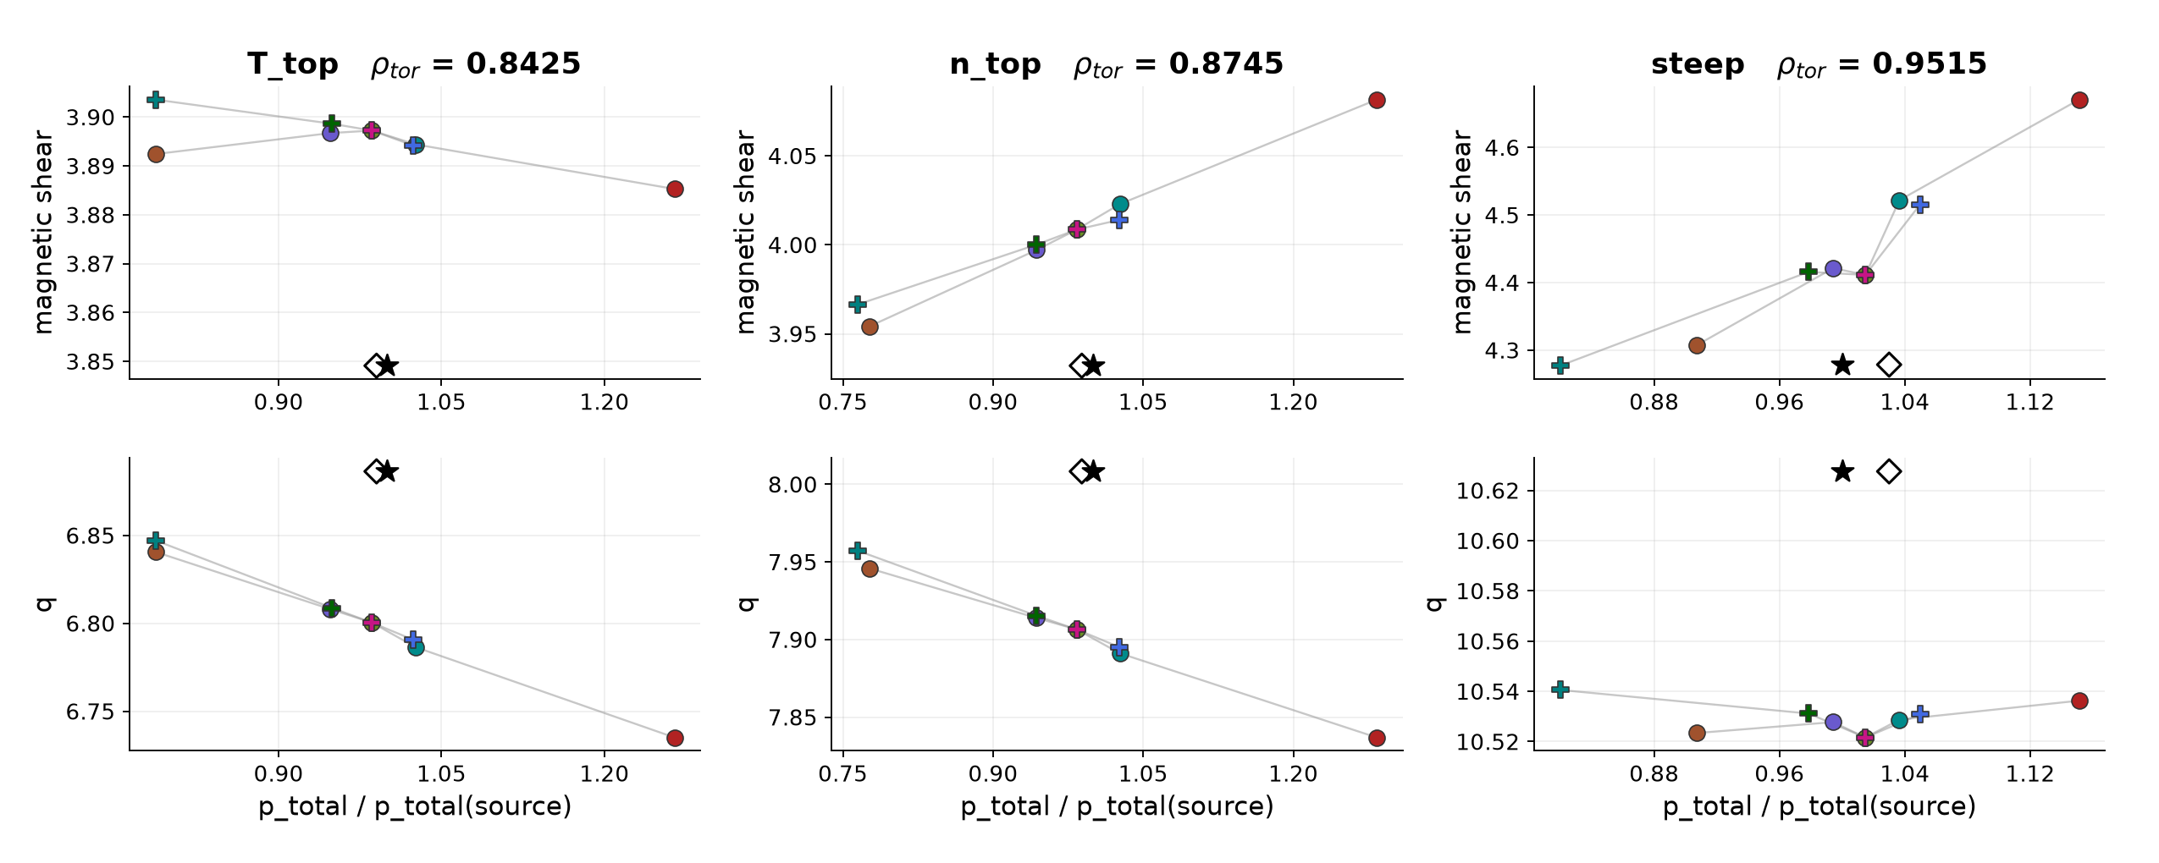
129015 apply_omX NCSCAL = 4, warmup = 0
Iteration counts and pressure response 9 runs Bars label the number of iterations, including 00 Hatched bars / × = nonconverged
Pressure chains: q and shear versus solved pressure / source pressure at the three Chapman points. Lines join each scaling type separately.
Star: source equilibrium. Hollow diamond: fitted baseline pressure at source q/shear.
13/14
Notes:
{
"family": "apply_omX",
"part": "Iteration counts and pressure chains",
"variant": {
"id": "n4w0",
"title": "129015 NCSCAL = 4, warmup = 0",
"color": "#D55E00",
"root": "C:\\Users\\joesc\\git\\cheaseBS_tests\\data\\pm0.3_ncscal4_warmup0\\129015",
"original_profile_image": "C:\\Users\\joesc\\git\\cheaseBS_tests\\data\\pm0.3_ncscal4_warmup0\\129015_mtanh_full_ped.png",
"n": 4,
"w": 0,
"count": 9,
"settings": {
"bootstrap_mix": 0.1,
"istar_mix": 0.05,
"tol_ip_rel": 0.002,
"tol_bs": 0.01,
"tol_q": 0.01,
"tol_a": 0.0001,
"max_iter": 50
},
"runs": [
{
"path": "C:\\Users\\joesc\\git\\cheaseBS_tests\\data\\pm0.3_ncscal4_warmup0\\129015\\omne_0.700",
"axis": "omne",
"scale": 0.7,
"iterations": 2,
"converged": true,
"chain": [
{
"rho": 0.8425,
"point": "T_top",
"pressure_ratio": 0.7867755215761371,
"q": 6.847058925334028,
"shear": 3.9035554299416932
},
{
"rho": 0.8745,
"point": "n_top",
"pressure_ratio": 0.7647885470269432,
"q": 7.957203361809532,
"shear": 3.96647258894511
},
{
"rho": 0.9515,
"point": "steep",
"pressure_ratio": 0.8199209762658716,
"q": 10.540553183086129,
"shear": 4.276858594031663
}
]
},
{
"path": "C:\\Users\\joesc\\git\\cheaseBS_tests\\data\\pm0.3_ncscal4_warmup0\\129015\\omne_0.950",
"axis": "omne",
"scale": 0.95,
"iterations": 2,
"converged": true,
"chain": [
{
"rho": 0.8425,
"point": "T_top",
"pressure_ratio": 0.9493830382093142,
"q": 6.808675641620777,
"shear": 3.8986098630979003
},
{
"rho": 0.8745,
"point": "n_top",
"pressure_ratio": 0.9429873520521056,
"q": 7.915416635544586,
"shear": 4.000011552400203
},
{
"rho": 0.9515,
"point": "steep",
"pressure_ratio": 0.9785412219548653,
"q": 10.531154237580216,
"shear": 4.4157690807960925
}
]
},
{
"path": "C:\\Users\\joesc\\git\\cheaseBS_tests\\data\\pm0.3_ncscal4_warmup0\\129015\\omne_1.000",
"axis": "omne",
"scale": 1,
"iterations": 2,
"converged": true,
"chain": [
{
"rho": 0.8425,
"point": "T_top",
"pressure_ratio": 0.9859104208303776,
"q": 6.800349448933337,
"shear": 3.8972195309576088
},
{
"rho": 0.8745,
"point": "n_top",
"pressure_ratio": 0.9836782577496148,
"q": 7.906433560419086,
"shear": 4.008552799373367
},
{
"rho": 0.9515,
"point": "steep",
"pressure_ratio": 1.0148011077169925,
"q": 10.52161428168054,
"shear": 4.4112391362642684
}
]
},
{
"path": "C:\\Users\\joesc\\git\\cheaseBS_tests\\data\\pm0.3_ncscal4_warmup0\\129015\\omne_1.050",
"axis": "omne",
"scale": 1.05,
"iterations": 2,
"converged": true,
"chain": [
{
"rho": 0.8425,
"point": "T_top",
"pressure_ratio": 1.0237611978889476,
"q": 6.790656091612867,
"shear": 3.894183538982111
},
{
"rho": 0.8745,
"point": "n_top",
"pressure_ratio": 1.025891833460018,
"q": 7.895147097644217,
"shear": 4.013952392173345
},
{
"rho": 0.9515,
"point": "steep",
"pressure_ratio": 1.049644529450405,
"q": 10.530808061716192,
"shear": 4.515355667811019
}
]
},
{
"path": "C:\\Users\\joesc\\git\\cheaseBS_tests\\data\\pm0.3_ncscal4_warmup0\\129015\\omt_0.700",
"axis": "omt",
"scale": 0.7,
"iterations": 2,
"converged": true,
"chain": [
{
"rho": 0.8425,
"point": "T_top",
"pressure_ratio": 0.7866188532964474,
"q": 6.840565476928632,
"shear": 3.892409488042223
},
{
"rho": 0.8745,
"point": "n_top",
"pressure_ratio": 0.7767134045104899,
"q": 7.945765949078069,
"shear": 3.9542223500436964
},
{
"rho": 0.9515,
"point": "steep",
"pressure_ratio": 0.9072635186788592,
"q": 10.523399603358554,
"shear": 4.307388543678838
}
]
},
{
"path": "C:\\Users\\joesc\\git\\cheaseBS_tests\\data\\pm0.3_ncscal4_warmup0\\129015\\omt_0.950",
"axis": "omt",
"scale": 0.95,
"iterations": 2,
"converged": true,
"chain": [
{
"rho": 0.8425,
"point": "T_top",
"pressure_ratio": 0.9478721578529441,
"q": 6.807974963345341,
"shear": 3.8967078454410298
},
{
"rho": 0.8745,
"point": "n_top",
"pressure_ratio": 0.9436076223906784,
"q": 7.913843171436799,
"shear": 3.997124465418335
},
{
"rho": 0.9515,
"point": "steep",
"pressure_ratio": 0.9942558289599889,
"q": 10.527734856501501,
"shear": 4.421329092466225
}
]
},
{
"path": "C:\\Users\\joesc\\git\\cheaseBS_tests\\data\\pm0.3_ncscal4_warmup0\\129015\\omt_1.000",
"axis": "omt",
"scale": 1,
"iterations": 2,
"converged": true,
"chain": [
{
"rho": 0.8425,
"point": "T_top",
"pressure_ratio": 0.9859104208303776,
"q": 6.800349448933337,
"shear": 3.8972195309576088
},
{
"rho": 0.8745,
"point": "n_top",
"pressure_ratio": 0.9836782577496148,
"q": 7.906433560419086,
"shear": 4.008552799373367
},
{
"rho": 0.9515,
"point": "steep",
"pressure_ratio": 1.0148011077169925,
"q": 10.52161428168054,
"shear": 4.4112391362642684
}
]
},
{
"path": "C:\\Users\\joesc\\git\\cheaseBS_tests\\data\\pm0.3_ncscal4_warmup0\\129015\\omt_1.050",
"axis": "omt",
"scale": 1.05,
"iterations": 2,
"converged": true,
"chain": [
{
"rho": 0.8425,
"point": "T_top",
"pressure_ratio": 1.0262263586758031,
"q": 6.78638720054378,
"shear": 3.8943873426293147
},
{
"rho": 0.8745,
"point": "n_top",
"pressure_ratio": 1.0265461905121882,
"q": 7.8911378661679645,
"shear": 4.02283225509849
},
{
"rho": 0.9515,
"point": "steep",
"pressure_ratio": 1.0365118094712173,
"q": 10.528720094131451,
"shear": 4.521846912247405
}
]
},
{
"path": "C:\\Users\\joesc\\git\\cheaseBS_tests\\data\\pm0.3_ncscal4_warmup0\\129015\\omt_1.300",
"axis": "omt",
"scale": 1.3,
"iterations": 2,
"converged": true,
"chain": [
{
"rho": 0.8425,
"point": "T_top",
"pressure_ratio": 1.264573263881601,
"q": 6.735034269377236,
"shear": 3.8852612810293703
},
{
"rho": 0.8745,
"point": "n_top",
"pressure_ratio": 1.2833852552689118,
"q": 7.836850661344166,
"shear": 4.081557680546772
},
{
"rho": 0.9515,
"point": "steep",
"pressure_ratio": 1.1511540852425626,
"q": 10.536271736103318,
"shear": 4.670721198882429
}
]
}
],
"prefix": "apply_omX_n4w0"
},
"chapman": [
{
"rho": 0.8425,
"point": "T_top",
"q": 6.886358711050888,
"shear": 3.849093755603565,
"fit_pressure_ratio": 0.99014717994203
},
{
"rho": 0.8745,
"point": "n_top",
"q": 8.008300508035049,
"shear": 3.9320542581423155,
"fit_pressure_ratio": 0.9886363282069752
},
{
"rho": 0.9515,
"point": "steep",
"q": 10.627539365150305,
"shear": 4.278473037196078,
"fit_pressure_ratio": 1.029936403893316
}
],
"limitations": "NCSCAL 1 inferred from the saved config reference to chease_namelist_nstx and the current preset. Original execution namelist unavailable. NCSCAL 4 is explicit in saved campaign namelists. Older/newer campaigns differ in mixing, tolerances and scale coverage. All runs use I-star. No new solves.",
"source": "prepare_split.py reuses the validated 46-run manifest. Pressure chains use the same TPED GFileData / shear interpolation as the prior review. Only this family is included. Transformation profiles replotted from the original saved files using the same fixed (scaling type, factor) color map as traces, bars and pressure points. Iteration counts use convergence_summary.json; traces use iteration_log.csv."
}

Slide 14
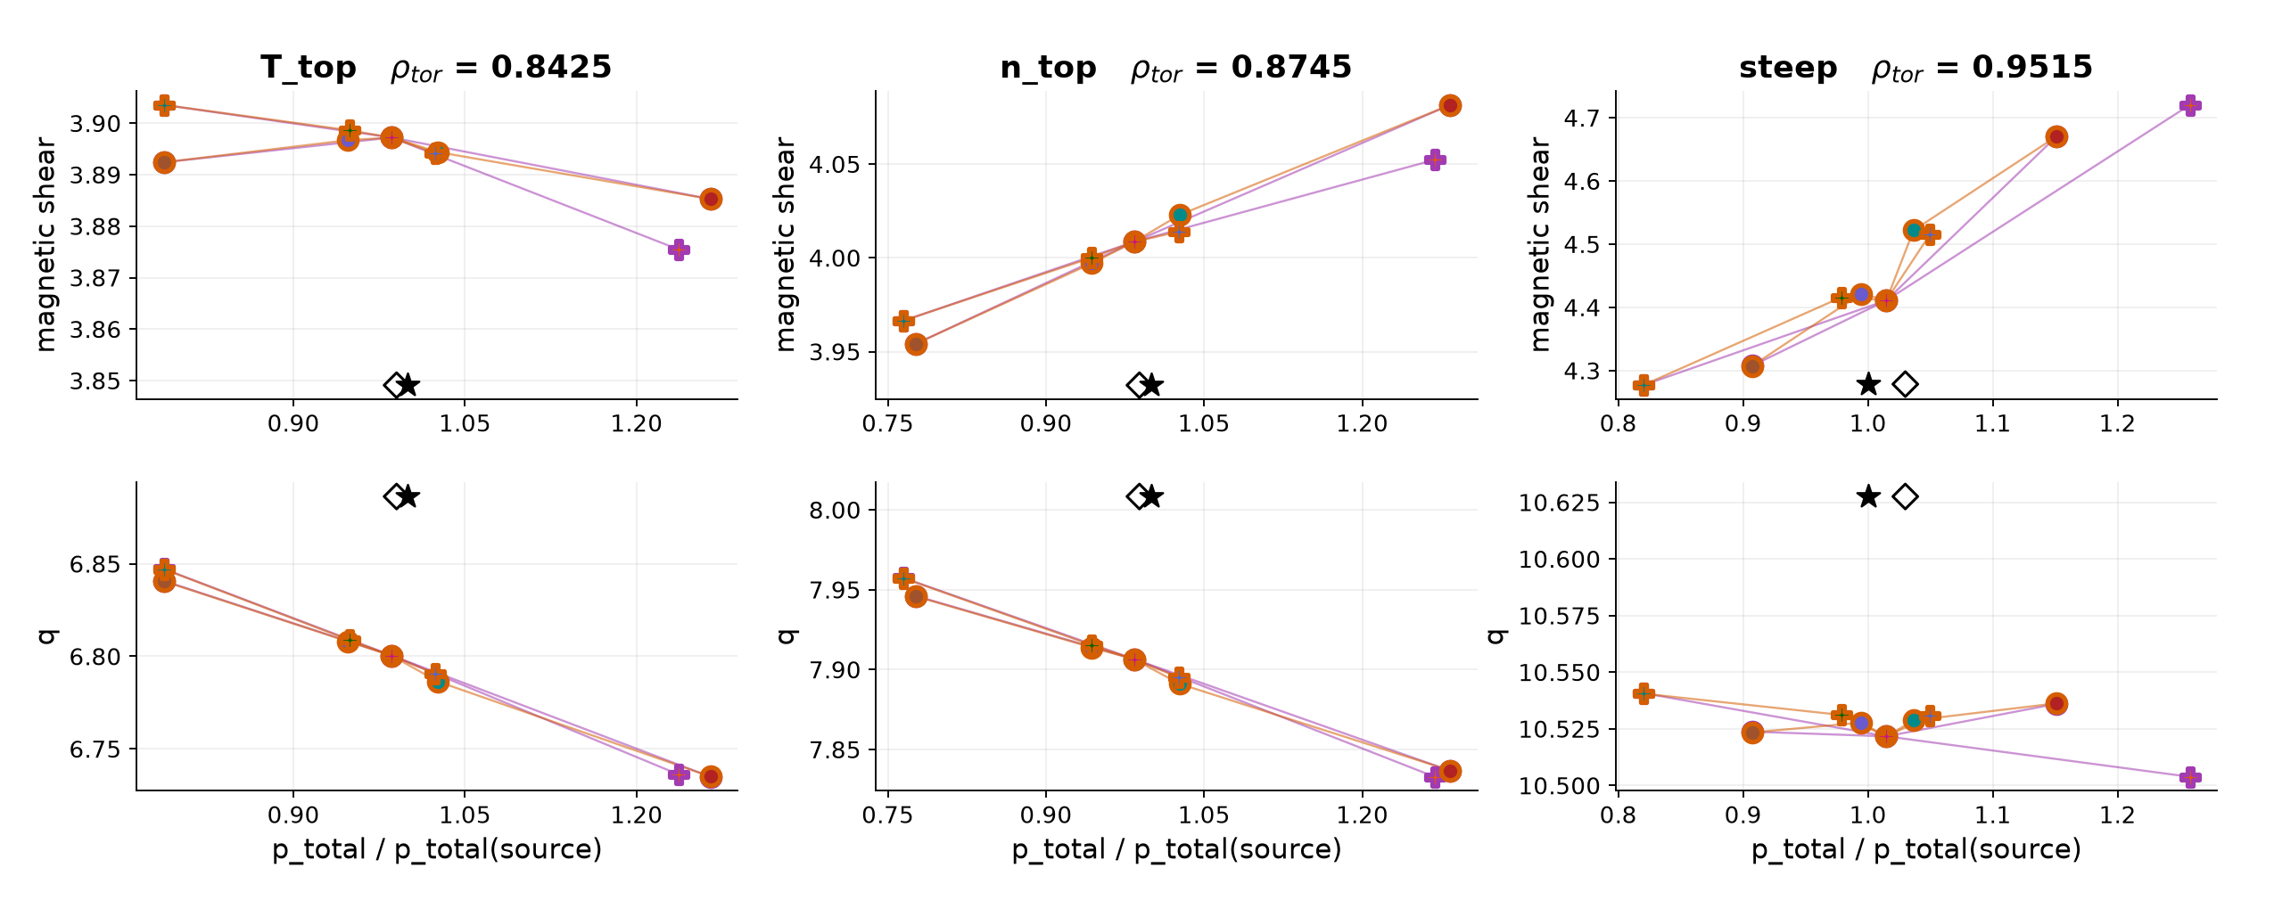
129015 apply_omX pressure chains across solver variants
Marker border identifies the solver variant. Marker fill matches that scaling type/factor in every profile, trace and bar.
○ NCSCAL 4 / warmup 2
○ NCSCAL 4 / warmup 0
Star: source equilibrium. Hollow diamond: fitted baseline pressure at source q/shear. ×: solver reports nonconvergence.
Saved apply_omX coverage is NCSCAL=4 only. No NCSCAL=1 apply_omX runs were available in these campaigns.
14/14
Notes:
{
"family": "apply_omX",
"part": "All variants, with marker-border coding",
"variant": null,
"chapman": [
{
"rho": 0.8425,
"point": "T_top",
"q": 6.886358711050888,
"shear": 3.849093755603565,
"fit_pressure_ratio": 0.99014717994203
},
{
"rho": 0.8745,
"point": "n_top",
"q": 8.008300508035049,
"shear": 3.9320542581423155,
"fit_pressure_ratio": 0.9886363282069752
},
{
"rho": 0.9515,
"point": "steep",
"q": 10.627539365150305,
"shear": 4.278473037196078,
"fit_pressure_ratio": 1.029936403893316
}
],
"limitations": "NCSCAL 1 inferred from the saved config reference to chease_namelist_nstx and the current preset. Original execution namelist unavailable. NCSCAL 4 is explicit in saved campaign namelists. Older/newer campaigns differ in mixing, tolerances and scale coverage. All runs use I-star. No new solves.",
"source": "prepare_split.py reuses the validated 46-run manifest. Pressure chains use the same TPED GFileData / shear interpolation as the prior review. Only this family is included. Transformation profiles replotted from the original saved files using the same fixed (scaling type, factor) color map as traces, bars and pressure points. Iteration counts use convergence_summary.json; traces use iteration_log.csv."
}

