Slide 1

So I Want To Use the TEI… Now What?
Joey Takeda
October 25th, 2018
UBC DH Pixelating Mixer

Slide 2
Hi!
Joey Takeda, MA Student, Dept. of English Language and Literatures (Science and Technology Studies Program)
Undergrad in English Honours and Gender Studies @ Uvic
Digital Humanities programmer for projects such as The Map of Early Modern London, Linked Early Modern Drama Online, and The Endings Project
Specialize in TEI, XHTML, and Digital Humanities project development
https://github.com/joeytakeda
This workshop: https://github.com/joeytakeda/teiworkshop

Slide 3
Overview
(Very quick) recap of XML and encoding
1
Introduction to our primary source
2
Introduction to the TEI Guidelines
3
Introduction to XML tools
4

Slide 4

WEBsite
https://joeytakeda.github.io/teiworkshop

Slide 5
XML Explained

Slide 6
XML Explained
The two pointy brackets is called an element
E.g. <book> would be called the book element

Slide 7
XML Explained
The two pointy brackets is called an element
E.g. <book> would be called the book element
All elements have start and end tags
E.g. <book> is the start tag and </book> is the end tag

Slide 8
XML Explained
The two pointy brackets is called an element
E.g. <book> would be called the book element
All elements have start and end tags
E.g. <book> is the start tag and </book> is the end tag

Slide 9
XML Explained
The two pointy brackets is called an element
E.g. <book> would be called the book element
All elements have start and end tags
E.g. <book> is the start tag and </book> is the end tag
Elements can also have attributes and each attribute must have a value
E.g. <book type= “primary”> has a type attribute with the value of primary
(Think of attributes as you would in everyday life; people don’t have “height” or “age” without a value)

Slide 10
XML Explained

Slide 11
XML Explained
Elements cannot overlap
<sentence><word>Word1</word></sentence> is right
<sentence><word>Word1</sentence></word> is wrong

Slide 12
XML Explained
Elements cannot overlap
<sentence><word>Word1</word></sentence> is right
<sentence><word>Word1</sentence></word> is wrong
Elements nest and use genealogical terms
I.e this bit of XML
<book>
<chapter></chapter>
</book>
Can be described as “chapter is a child of book” OR “book is a parent of chapter”

Slide 13
XML Explained
Elements cannot overlap
<sentence><word>Word1</word></sentence> is right
<sentence><word>Word1</sentence></word> is wrong
Elements nest and use genealogical terms
I.e this bit of XML
<book>
<chapter></chapter>
</book>
Can be described as “chapter is a child of book” OR “book is a parent of chapter”
There is always a root element
That is, there is always one element that encloses everything

Slide 14
Why do we encode?
Interpretation
Usability (text mining, et cetera)
Interoperability
Preservation

Slide 15
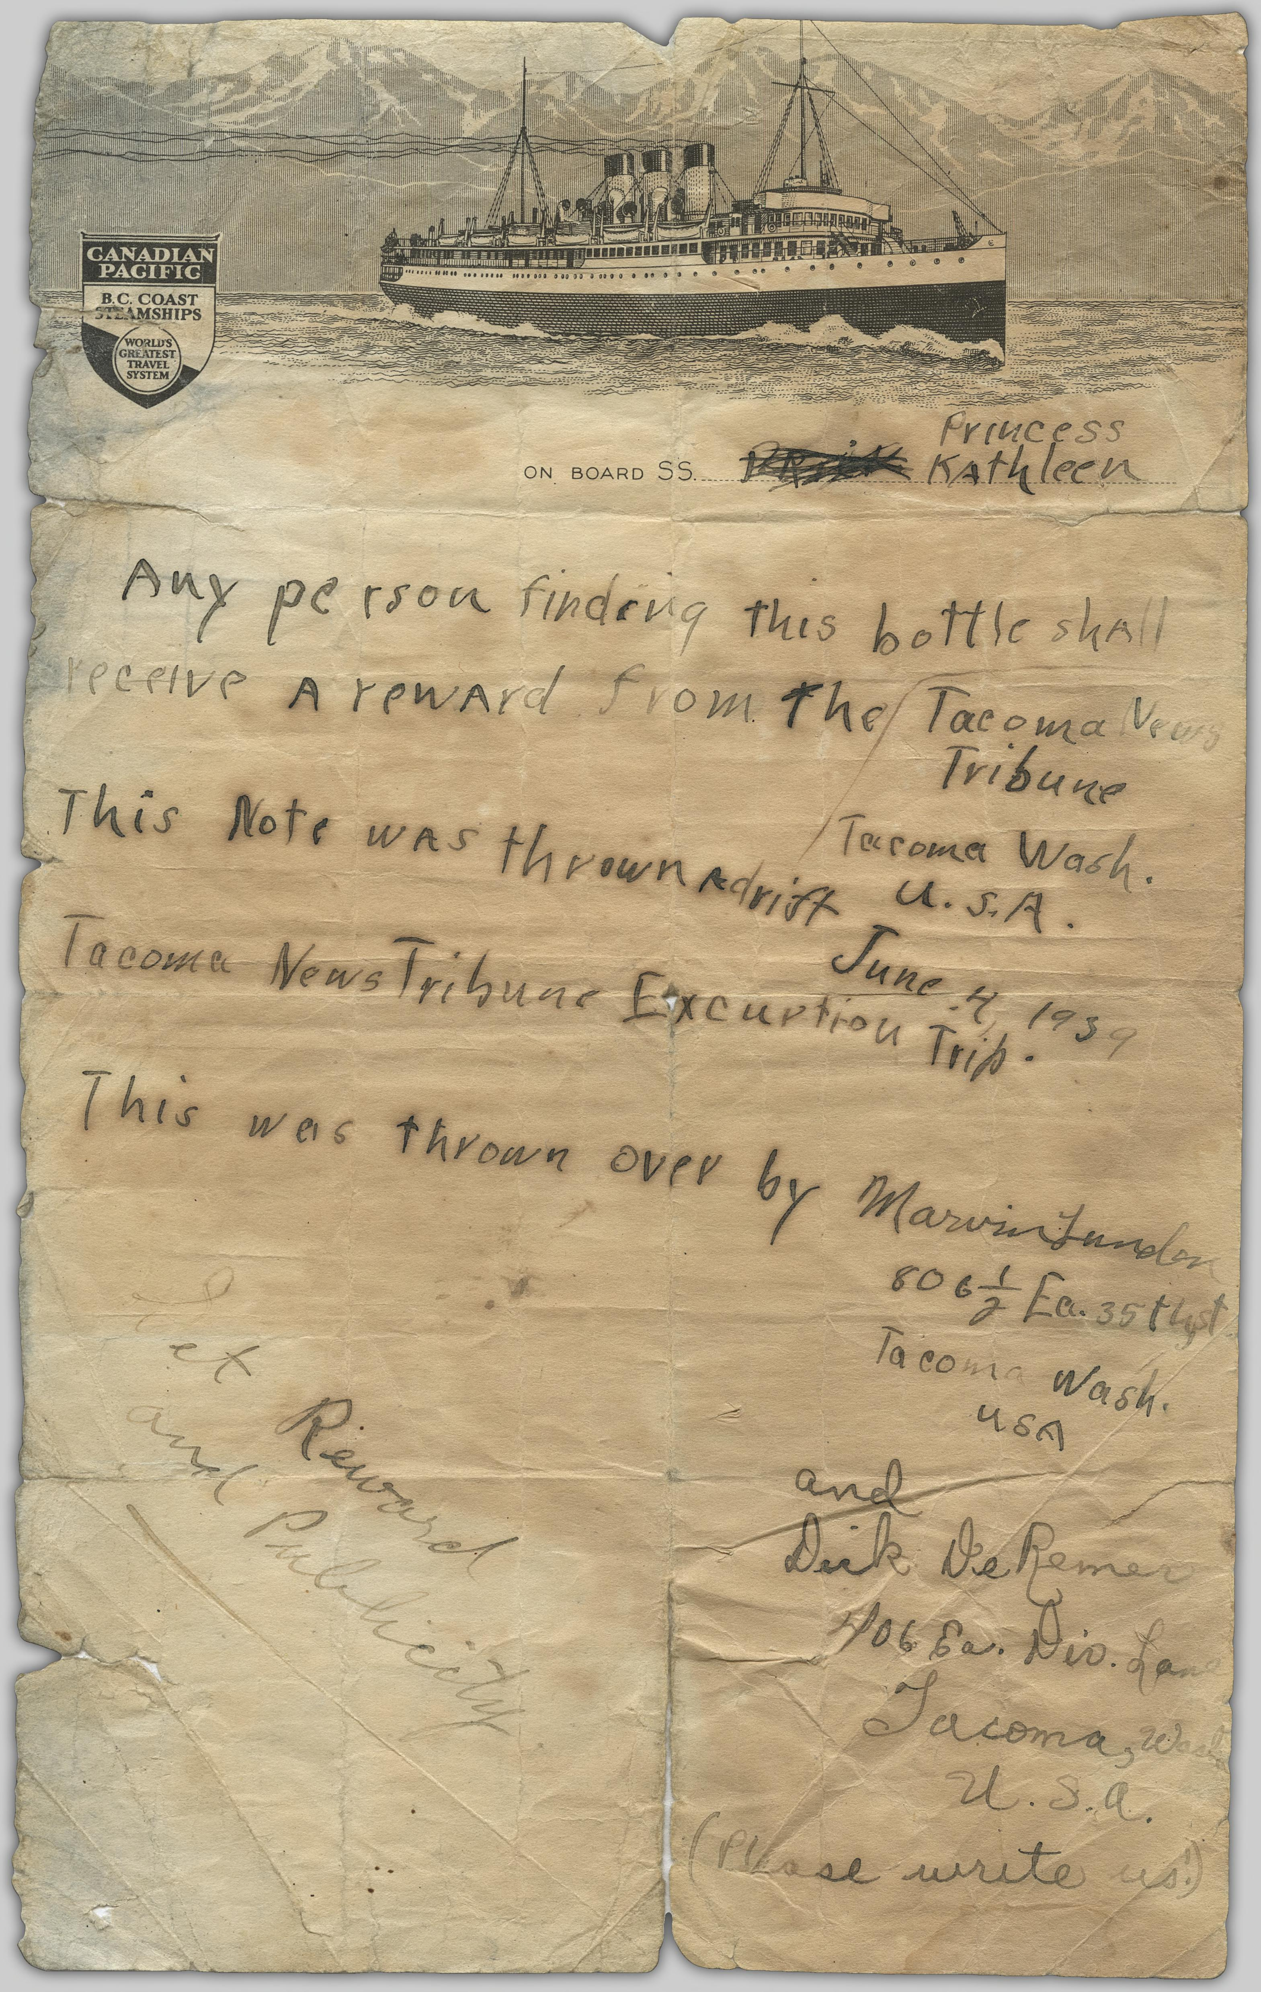
What are we encoding today?
Description: A letter thrown off of the Princess Kathleen in a bottle, June 4, 1939 by Marvin Lunder and Dick de Remer of Tacoma Washington, and found in October by W[illiam] B. D. Firmming on Whilby Island.
Source: Original Format: University of British Columbia. Library. Rare Books and Special Collections. The Chung Collection. CC-TX-151-18

Slide 16
What are some features of this text?
Blocks of text (are they paragraphs?)
Lines
Divisions?
Signatures
Opener/closer
Names
Dates
++++

Slide 17
The TEI guidelines
http://www.tei-c.org/release/doc/tei-p5-doc/en/html/

Slide 18
TEI is for Data and Metadata
<TEI>
<teiHeader>
</teiHeader>
<text> </text>
</TEI>
metadata
data

Slide 19
Elements
Each element has its own page in the guidelines that includes:
A definition of the element
Links to chapters in the TEI guidelines
What attributes are available on that element
What elements can contain that element
What elements can that element contain
Example uses of that element
+

Slide 20
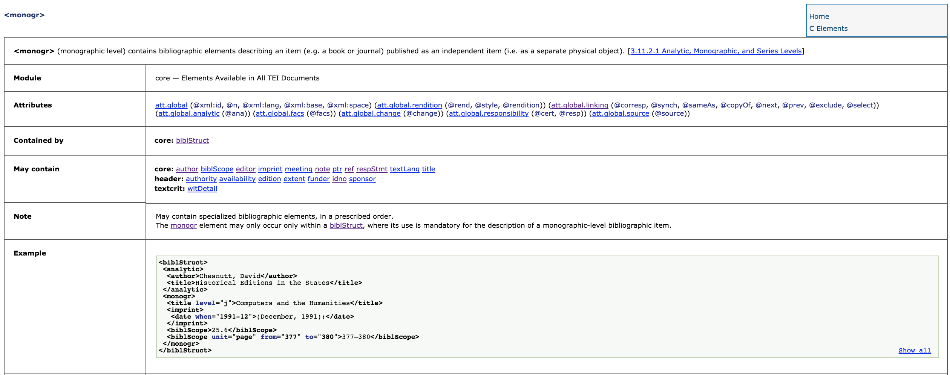
Example: the <monog> element:

Slide 21
Example: the <monog> element:
Definition
Definition chapters

Slide 22
Example: the <monog> element:
Definition
Definition chapters
Module

Slide 23
Example: the <monog> element:
Definition
Definition chapters
Module
Attributes
Contained by
Can contain

Slide 24
Example: the <monog> element:
Definition
Definition chapters
Module
Attributes
Contained by
Can contain
Special notes
Example TEI

Slide 25
Activity (5 min)
Look up the following elements:
<p>
<ab>
<opener>
<closer>
<msDesc>
<correspDesc>
Will they work for this? How can we use them?

Slide 26
Encoding
Open the text editor in one tab, the primary source transcription in another, and, if you want, the image from the UBC Repository

Slide 27
metadata
Include the title of this document
Include your name by using the <editor> element after the <title>
Put in a link to the source using a <ptr/>
What else could you do?

Slide 28
Data
Copy and paste the content into the document
What are the organizing divisions? Divs? Paragraphs? Floating text? Anonymous blocks?

Slide 29
What are some other features?
Names?
Dates
Notes
Editorial apparatus (if you want)
Hands
Etc

Slide 30
Tools
Download your XML file
And now, in the index page, look for the tools:
TEI Validator
TEI Toolkit
OxGarage

Slide 31
Validator
Validate your file

Slide 32
TOOLKIT
Check your encoding
Convert to a PDF

Slide 33
OXgarage
Convert to a word document
Convert to a PDF

Slide 34
Thanks!
UBC Libraries, esp. Allan Cho for the invitation!
Martin Holmes, Janelle Jenstad, The Endings Project, and Uvic’s Humanities Media and Computing Center

