Slide 1

So I Want To Use the TEI… Now What?
Joey Takeda
September 20th, 2018
UBC DH Pixelating Mixer

Slide 2
Hi!
Joey Takeda, MA Student, Dept. of English Language and Literatures (Science and Technology Studies Program)
Undergrad in English Honours and Gender Studies @ Uvic
Digital Humanities programmer for projects such as The Map of Early Modern London, Linked Early Modern Drama Online, and The Endings Project
Specialize in TEI, XHTML, and Digital Humanities project development
https://github.com/joeytakeda
This workshop: https://github.com/joeytakeda/teiworkshop

Slide 3
Overview
(Very quick) recap of XML and encoding
1
Introduction to our primary source
2
Introduction to the TEI Guidelines
3
Introduction to XML tools
4

Slide 4

WEBsite
https://joeytakeda.github.io/teiworkshop

Slide 5
XML
Elements have start and end tags:
<element>Word</element>
If elements have no textual content, then they can look like this (a self-closing element):
<element/>

Slide 6
Why do we encode?
Interpretation
Usability (text mining, et cetera)
Interoperability
Preservation

Slide 7
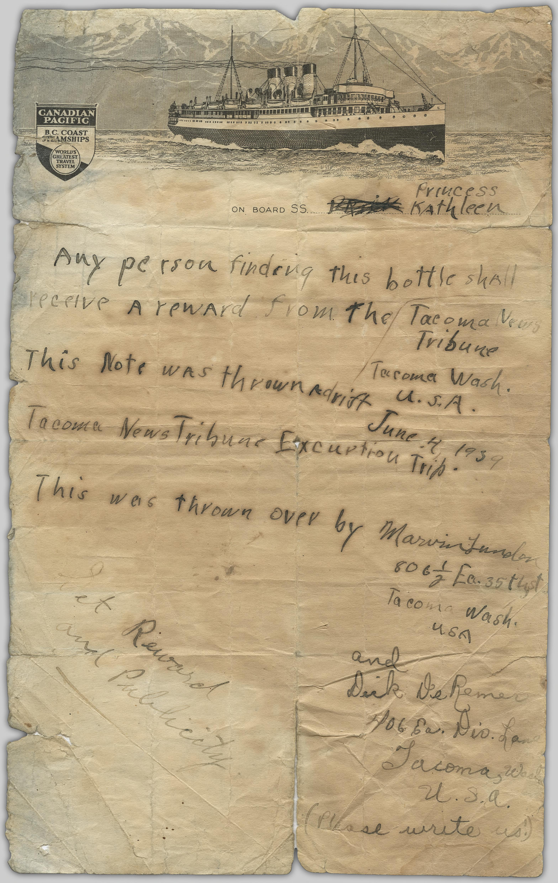
What are we encoding today?
Description: A letter thrown off of the Princess Kathleen in a bottle, June 4, 1939 by Marvin Lunder and Dick de Remer of Tacoma Washington, and found in October by W[illiam] B. D. Firmming on Whilby Island.
Source: Original Format: University of British Columbia. Library. Rare Books and Special Collections. The Chung Collection. CC-TX-151-18

Slide 8
What are some features of this text?
Blocks of text (are they paragraphs?)
Lines
Divisions?
Signatures
Opener/closer
Names
Dates
++++

Slide 9
The TEI guidelines
http://www.tei-c.org/release/doc/tei-p5-doc/en/html/

Slide 10
TEI is for Data and Metadata
<TEI>
<teiHeader>
</teiHeader>
<text> </text>
</TEI>
metadata
data

Slide 11
Elements
Each element has its own page in the guidelines that includes:
A definition of the element
Links to chapters in the TEI guidelines
What attributes are available on that element
What elements can contain that element
What elements can that element contain
Example uses of that element
+

Slide 12
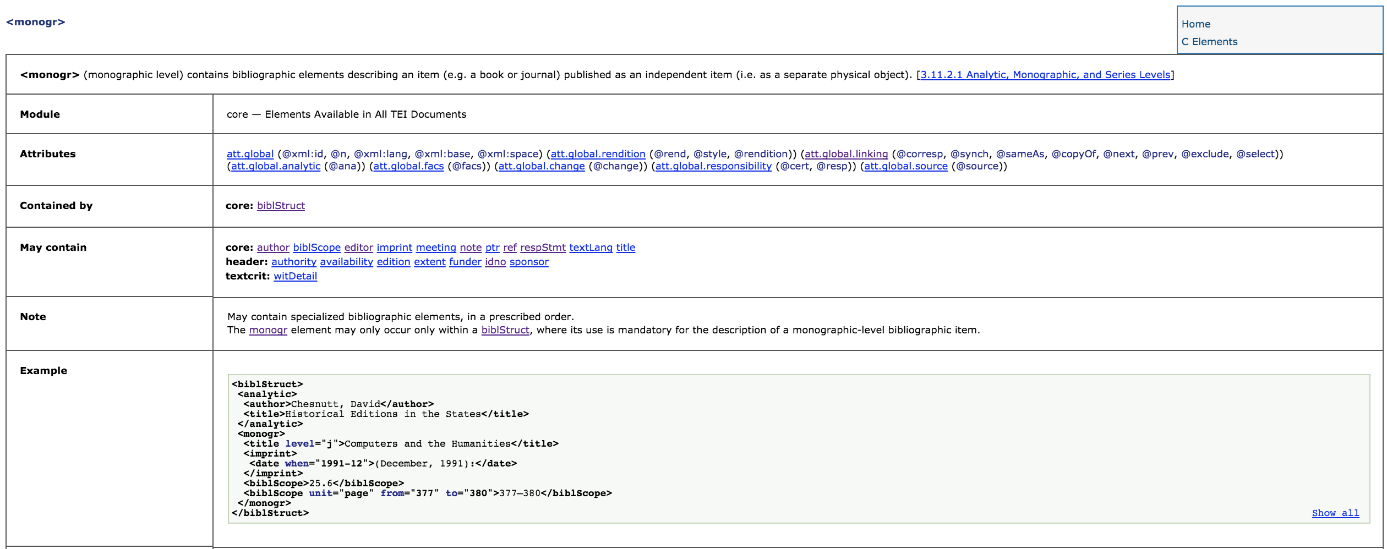
Example: the <monog> element:

Slide 13
Example: the <monog> element:
Definition
Definition chapters

Slide 14
Example: the <monog> element:
Definition
Definition chapters
Module

Slide 15
Example: the <monog> element:
Definition
Definition chapters
Module
Attributes
Contained by
Can contain

Slide 16
Example: the <monog> element:
Definition
Definition chapters
Module
Attributes
Contained by
Can contain
Special notes
Example TEI

Slide 17
Activity (5 min)
Look up the following elements:
<p>
<ab>
<opener>
<closer>
<msDesc>
<correspDesc>
Will they work for this? How can we use them?

Slide 18
Encoding
Open the text editor in one tab, the primary source transcription in another, and, if you want, the image from the UBC Repository

Slide 19
metadata
Include the title of this document
Include your name by using the <editor> element after the <title>
Put in a link to the source using a <ptr/>
What else could you do?

Slide 20
Data
Copy and paste the content into the document
What are the organizing divisions? Divs? Paragraphs? Floating text? Anonymous blocks?

Slide 21
What are some other features?
Names?
Dates
Notes
Editorial apparatus (if you want)
Hands
Etc

Slide 22
Tools
Download your XML file
And now, in the index page, look for the tools:
TEI Validator
TEI Toolkit
OxGarage

Slide 23
Validator
Validate your file

Slide 24
TOOLKIT
Check your encoding
Convert to a PDF

Slide 25
OXgarage
Convert to a word document
Convert to a PDF

