Slide 1





Short-Term Rental Market Analysis
for Watershed Property Management
Market Opportunity Assessment & Strategic Implementation
Prepared for: Watershed Property Management
October 17, 2025

Slide 2










Market Opportunity Assessment
Current Market Trends
Client Opportunity
Media consistently highlights lucrative potential of short-term rentals
244
Properties
Property owners increasingly interested in tapping into this market
Extensive portfolio available for strategic conversion
profit-sharing arrangement
Growing consumer preference for vacation rental options
Strategic Timing
Pivotal conversation between CEO Sally Rinehart and long-standing client
Key Insights:
Opportune moment to leverage our expertise with client's property portfolio
Client has successfully managed 244 properties to this point
Our company has the expertise to scale into this market
Now is the time to explore this promising new avenue
Phased pilot project can be implemented to test market response
Watershed Property Management

Slide 3





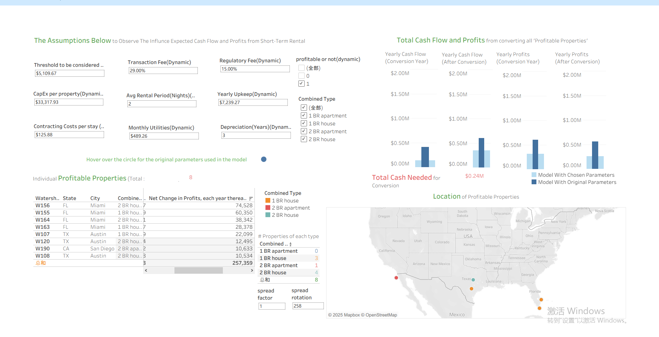
Sensitivity Analysis
Downside Scenario
Watershed Property Management

Slide 4
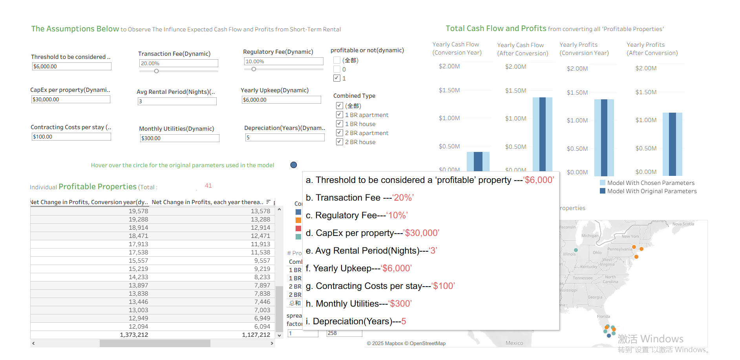
Sensitivity Analysis
Base Case
Watershed Property Management

Slide 5

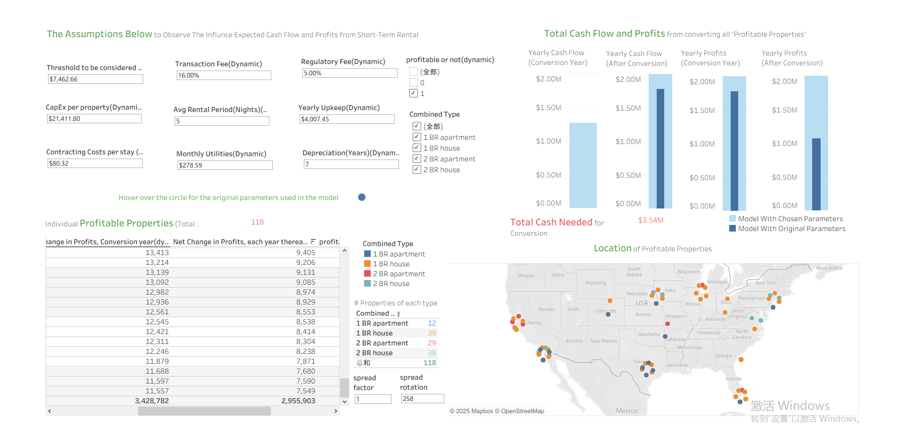
Sensitivity Analysis
Upside Scenario
Watershed Property Management

Slide 6





Strategic Implementation Plan
Phased Pilot Approach
Implementation Timeline
Convert a select number of the client's 244 properties to short-term rentals
Phase 1
Phase 2
Phase 3
Initial phase: Identify and convert 16 two-bedroom houses in high-demand urban areas
Current
Subsequent phases: Expand based on performance and market response
Operation &
Optimization
Full-Scale
Implementation
Pilot Planning &
Property Conversion
Leverage existing management expertise and client's property portfolio
Key Success Factors:
Performance metrics tracking and reporting system
Resource Allocation
Market response and occupancy rate monitoring
Quality control and guest satisfaction standards
Working Capital
Scalability assessment after each phase
$500K
Committed by Watershed executives for this pilot project
Regular review and adjustment of strategy
Furnishing Costs: 96%
Contingency fund: 4%
Watershed Property Management

Slide 7
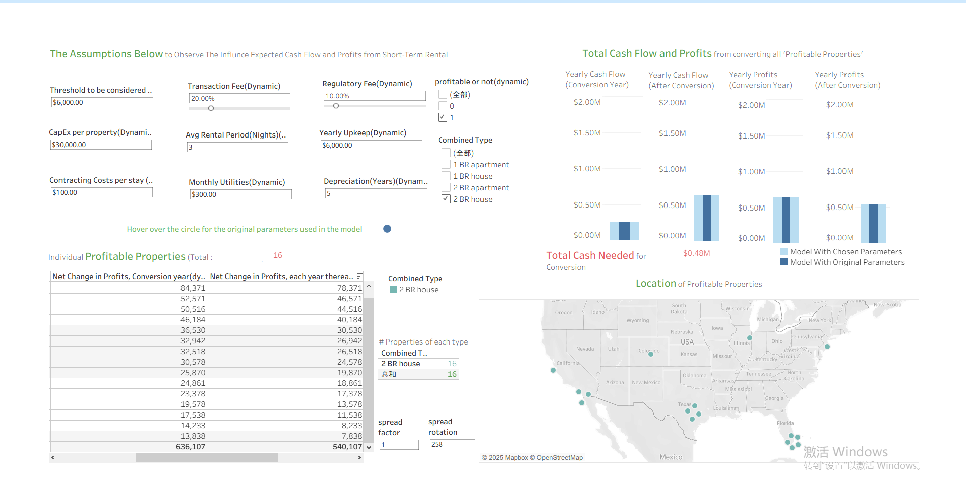
Watershed Short Term Profitability Dashboard
Watershed Property Management

Slide 8


















Financial Analysis & Risk Assessment
Revenue Potential
Risk Assessment
Cash Flow(Conversion Year)
Cash Flow(After Conversion)
Market Risk
Operational Risk
Seasonal demand fluctuations
Property management complexity
Competition from established players
$0.25M
$0.64M
Staffing and maintenance challenges
Profits(Conversion Year)
Profits(After Conversion)
Regulatory Risk
Capital Efficiency
$0.64M
$0.54M
Local zoning restrictions
Total capital: $500,000
Short-term rental regulations
Optimal property conversion: 16 units
Key Financial Metrics:
Yearly Upkeep: $6,000 per property
Monthly Utilities: $300 per property
Profitability threshold: $6,000 per property
Transaction fee: 20% of gross revenue
Regulatory fee: 10% of gross revenue
Capital expenditure costs: $30,000 per property
Watershed Property Management

Slide 9




















Recommendations & Next Steps
Core Recommendation
Action Items for Executives
Strategically enter the short-term rental market alongside our client through a phased pilot project.
Phase
1
Phase
2
Phase
2
Phase
3
Convert a select number of the client's 244 properties
Maximize potential profits while minimizing risks
Review Market Analysis
Optimize use of $500,000 working capital
Evaluate the current short-term rental market conditions and competitive landscape
Engage with Client
Schedule meeting with client to discuss partnership and property selection criteria
Expected Outcomes
Establish a foothold in the growing short-term rental market
Property Selection
Generate additional revenue streams for both parties
Identify and select optimal properties for the pilot program based on location, condition, and potential profits
Build expertise through hands-on experience
Finalize Agreements
Create a scalable model for future expansion
Draft and execute partnership agreement and investment allocation plan
Watershed Property Management

Slide 10
Recommendations & Next Steps
Core Recommendation
Action Items for Executives
Strategically enter the short-term rental market alongside our client through a phased pilot project.
Phase
1
Phase
2
Phase
3
Convert a select number of the client's 244 properties
Maximize potential profits while minimizing risks
Unit Launch & Onboarding
Optimize use of $500,000 working capital
Prepare and activate 16 pilot properties; ensure compliance, readiness, and system integration.
Trial Bookings & Market Testing
Open listings to guests; monitor occupancy, pricing response, and guest satisfaction.
Expected Outcomes
Establish a foothold in the growing short-term rental market
Process Optimization
Generate additional revenue streams for both parties
Refine operational workflows — cleaning, check-in, and guest support — for efficiency.
Build expertise through hands-on experience
Feedback Loop & Continuous Improvement
Create a scalable model for future expansion
Collect performance data and client feedback to guide refinements and inform scale-up decisions.
Watershed Property Management

Slide 11
Recommendations & Next Steps
Core Recommendation
Action Items for Executives
Strategically enter the short-term rental market alongside our client through a phased pilot project.
Phase
1
Phase
2
Phase
3
Convert a select number of the client's 244 properties
Maximize potential profits while minimizing risks
Scaled Rollout
Optimize use of $500,000 working capital
Expand operations beyond the pilot phase, applying proven models and best practices to additional properties and cities.
Performance Monitoring & KPI Tracking
Monitor occupancy, revenue, and ROI to ensure scalability and operational efficiency across all units.
Expected Outcomes
Establish a foothold in the growing short-term rental market
Regional Expansion Strategy
Generate additional revenue streams for both parties
Identify high-potential markets for phased regional growth and establish a replicable framework for new locations.
Build expertise through hands-on experience
Create a scalable model for future expansion
Watershed Property Management

