Slide 1

What is the difference in offensive power, throughout the years, for teams in the World Cup?
Jorge Sedano

Slide 2
Dataset
https://www.kaggle.com/datasets/abecklas/fifa-world-cup
A collection of World Cup results and stats from matches starting in 1930 and ending in 2014.

Slide 3
5 Variables
Year: The year in which the World Cup matches took place. This variable will help you understand the timeline and identify patterns or trends in the offensive capabilities of teams across different years.
Home Team Goals: The number of goals scored by the home team in the match. This variable will help you quantify the offensive capabilities of different teams and identify the teams with the highest goal-scoring abilities.
Away Team Goals: The number of goals scored by the away team in the match. Similar to the home team goals, analyzing the away team goals will help you assess the offensive capabilities of different teams and identify strong offensive performers.
Half-Time Home Team Goals: The number of goals scored by the home team in the first half. This variable will help you quantify the offensive capabilities of different teams and identify the teams with the highest goal-scoring abilities in the first half.
Half-Time Away Team Goals: The number of goals scored by the away team in the match. Similar to the home team goals, analyzing the away team goals will help you assess the offensive capabilities of different teams and identify strong offensive performers.

Slide 4
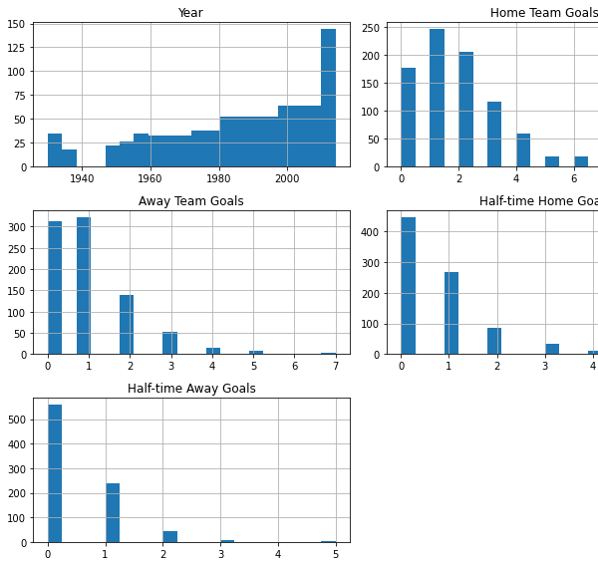
Histograms

Slide 5
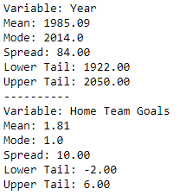
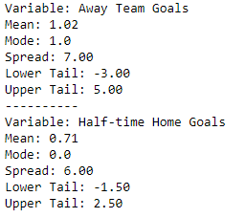
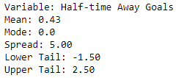
Descriptive Characteristics

Slide 6
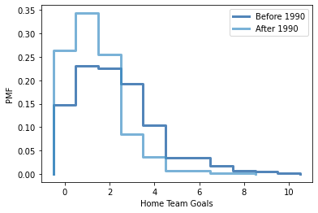
Comparing Goals before and after 1990

Slide 7
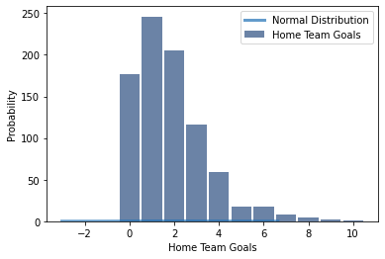
Analytical Distribution

Slide 8
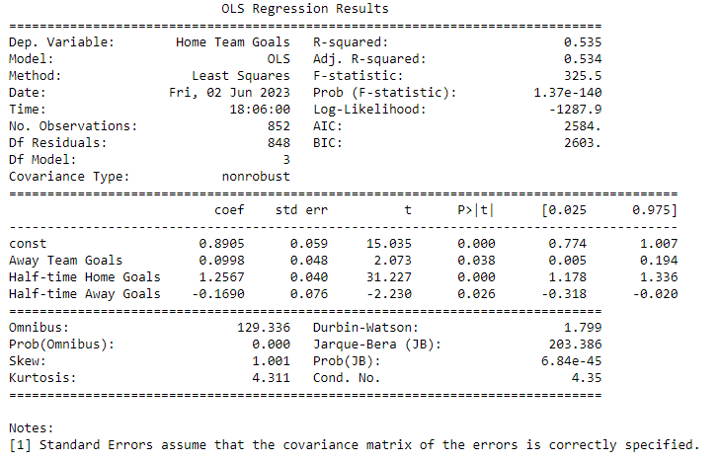
Regression Analysis

