Slide 1


BBB3
BBB2
BBB1
tr1
tr0
s4
s2
s5
s6
tu3
s0
s1
s7
s8
tu10
s9

Slide 2
tu2
s6
s5
tr1
s4
s8
s3
tr2
s7
s1
tu1
s2

Slide 3
Component database
Functional Architecture
Platform description
Allocation
Integrated System Model

Slide 4
Y
System specification
Acceptance test
Manual
processes
Design tasks
Testing tasks
Automated processes
Module implementation

Slide 5
BBB3
BBB2
BBB1
s4
s2
s5
s6
tu3
s0
s1
s7
s8
tu10
s9

Slide 6
BBB3
BBB2
BBB1
s4
s2
s5
s6
tu3
s0
s1
s7
s8
tu10
s9

Slide 7
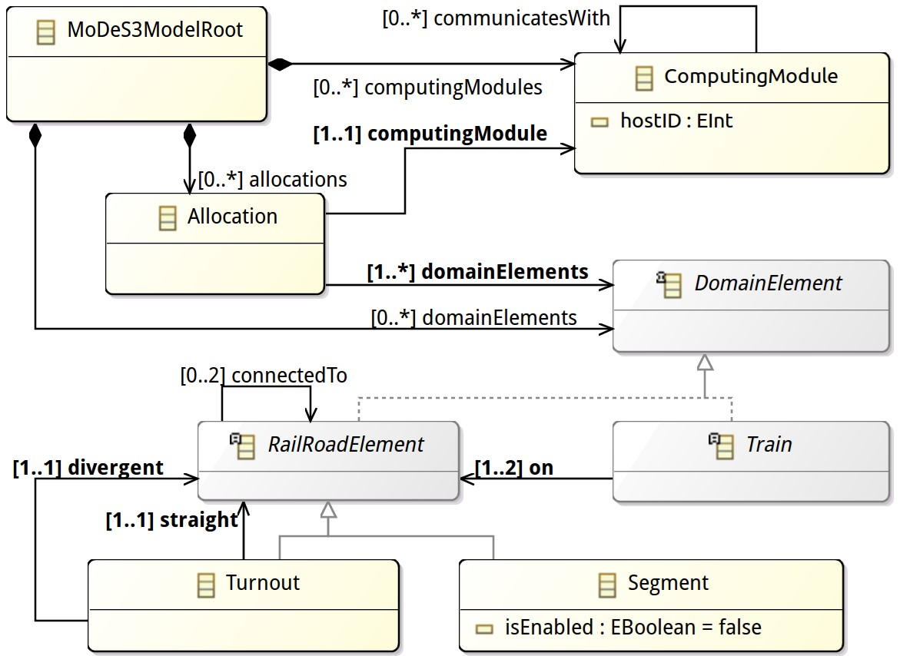
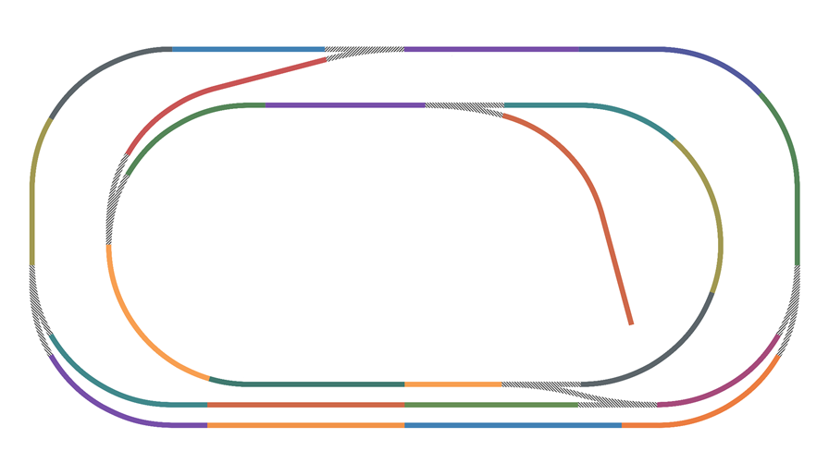

BBB1
BBB2
Cyber concepts
BBB3
sensor,
actuator
sensor,
actuator
Physical concepts
sensor,
actuator

Slide 8
BBB3
BBB2
BBB1
s2
s5
s4
s6
tu3
s0
s1
s7
s8
tu10
s9

Slide 9

BBB1
Cyber concepts
BBB2
BBB3
sensor,
actuator
Physical concepts
BBB
sensor,
actuator
sensor,
actuator

Slide 10
Design time modeling
Synthesizing executable monitors
Deploying binaries
Starting the system with monitors

Slide 11
Domain modeling
Specifying monitoring goals
Synthesizing executable monitors
Platform modeling
Allocation

Slide 12
Overview:
Design time modeling
Synthesizing executable monitors
Deploying binaries
Running and monitoring the system
Design time
Domain modeling
Specifying monitoring goals
Synthesizing executable monitors
Platform modeling
Allocation
Runtime – TODO?
Local evaluation
Resolve proxies
Global evaluation

Slide 13
