Slide 1


VIDUSH SOMANY INSTITUTE OF TECHNOLOGY AND RESEARCH ,KADI
FACE RECOGNITION SYSTEM
7th Semester
PROJECT
Department of IT/CE
Group No: 10
Internal Guide:
Prof. Amit Modi
VSITR
Prepared By:
Jogendra- (19BEIT54018)
Mohammed Vohra-(19BECE54038)

Slide 2
TABLE OF CONTENTS
Introduction
Requirement
01.
06.
Background
Proposal System Flow Chart
02.
07.
Problem Statement
03.
Aim And Objctive
04.
08.
Advantage And Disavangtage
Project Challenges
09.
05.
Project Life Cycle
Proposed System Outcome
10.
Reference
11.

Slide 3
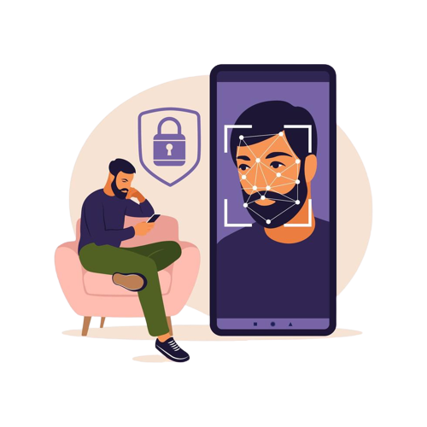
01.
INTRODUTION
The purpose of this system is to build a attendance system which is based on face recognition techniques. Here face of an individual will be considered for marking attendance.

Slide 4

02.
BACKGROUND
The work on face recognition began in 1960. Woody Bledsoe, Helen Chan Wolf and Charles Bisson had introduced a system which required the administrator to locate eyes, ears, nose and mouth from images
Nowadays, face recognition system is prevalent due to its simplicity and awesome performance. For instance, airport protection systems and FBI use face recognition for criminal investigations by tracking suspects, missing children and drug activities.

Slide 5



PROBLEM STATEMENT
Enhances security and speed in tracing student attendance and lecture time.
Easy to set up and use.
Convenient and inexpensive.
Helps in managing the time and attendance profiles of students.
Eliminates proxy punching.
Manages student attendance records.

Slide 6




AIM AND OBJECTIVE
Detect
Extract
Recognize
Record
To detect the face segment from the video frame.
To extract the useful features from the face detected.
To classify the features in order to recognize the face detected
To record the attendance of the identified student

Slide 7
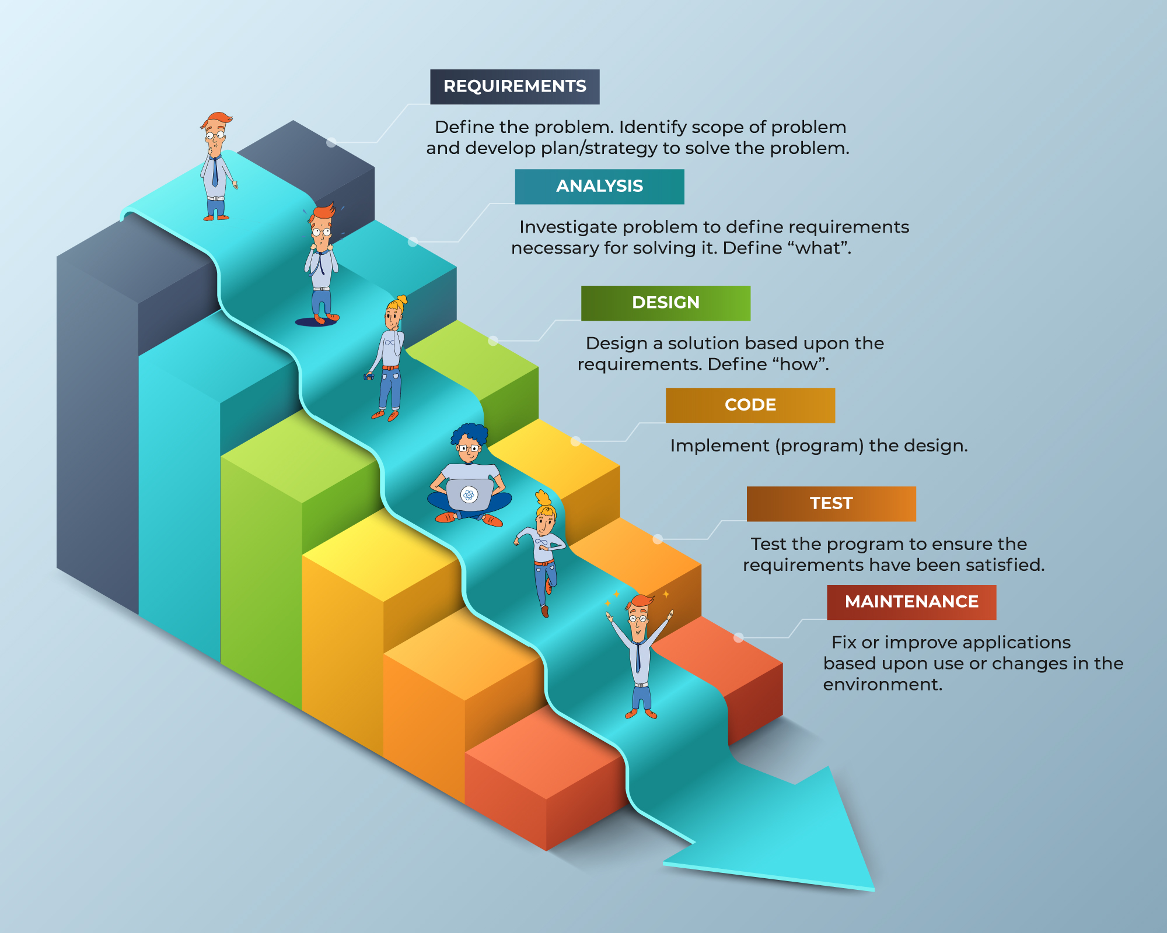
PROJECT LIFE CYCLE

Slide 8

REQUIREMENTS
HARDWARE REQUIREMENT
SOFTWARE REQUIREMENT
Windows 7 or higher
I3 processor system or higher
4 GB RAM or higher
100 GB ROM or higher
Python
Vs code
Open cv
Machine learning
Mysql
Tkinter

Slide 9
PROPOSED SYSTEM FLOW CHART
Start
camera
Capturing image
Face detection
Face database
Face Recognize
Face matched
Attendance server
Stop

Slide 10
ADVANTAGE
DISADVANTAGE
It’s easy to maintain.
It’s user-friendly.
No human intervention is required for marking attendance.
The system recognises faces and records attendance.
Threatens privacy.
Imposes on personal freedom.
Violates personal rights.
Data vulnerabilities.
Misuse causing fraud and other crimes.

Slide 11
PROJECT CHALLENGES
Illumination
Pose
01.
02.
Illumination stands for light variations
pose of a face varies when the head movement and viewing angle of the person changes
Expressions
Image Resolution
03.
04.
Varying situations cause different moods which result in showing various emotions and eventually change in facial expressions.
Another important issue with face recognition system is the varying quality and resolution of the images given as input.

Slide 12
﻿Proposed System Outcome
It will mark attendance of the students via face Id. It will detect the faces via webcam and then recognize the faces. After recognition, it will mark the attendance of the recognized student and update the attendance record. The admin will be able to print these record details afterward.

Slide 13
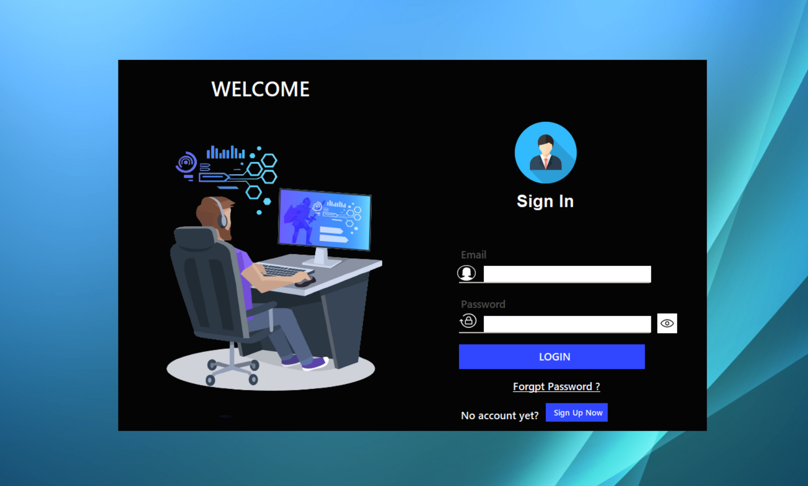
Reference:

Slide 14
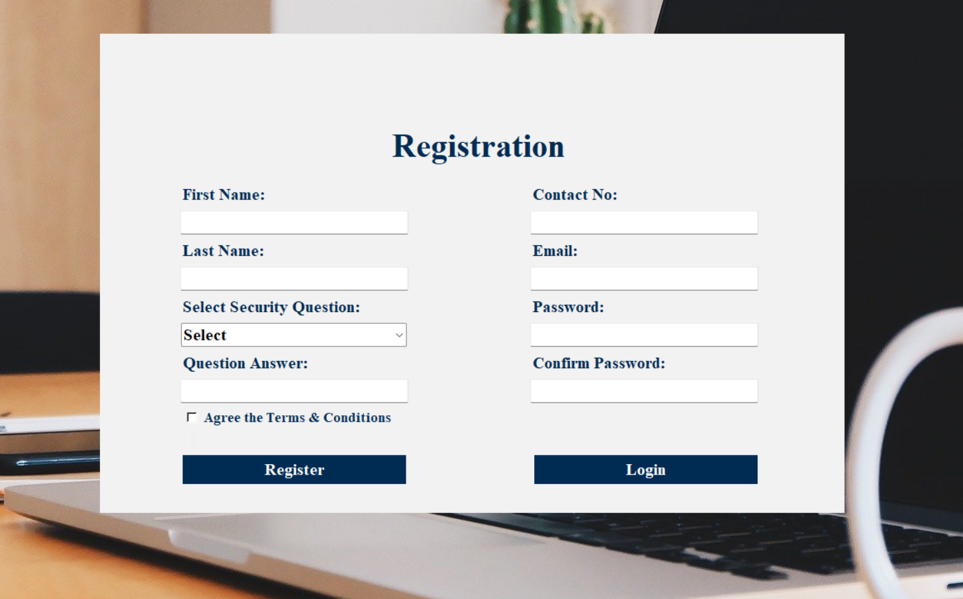

Slide 15
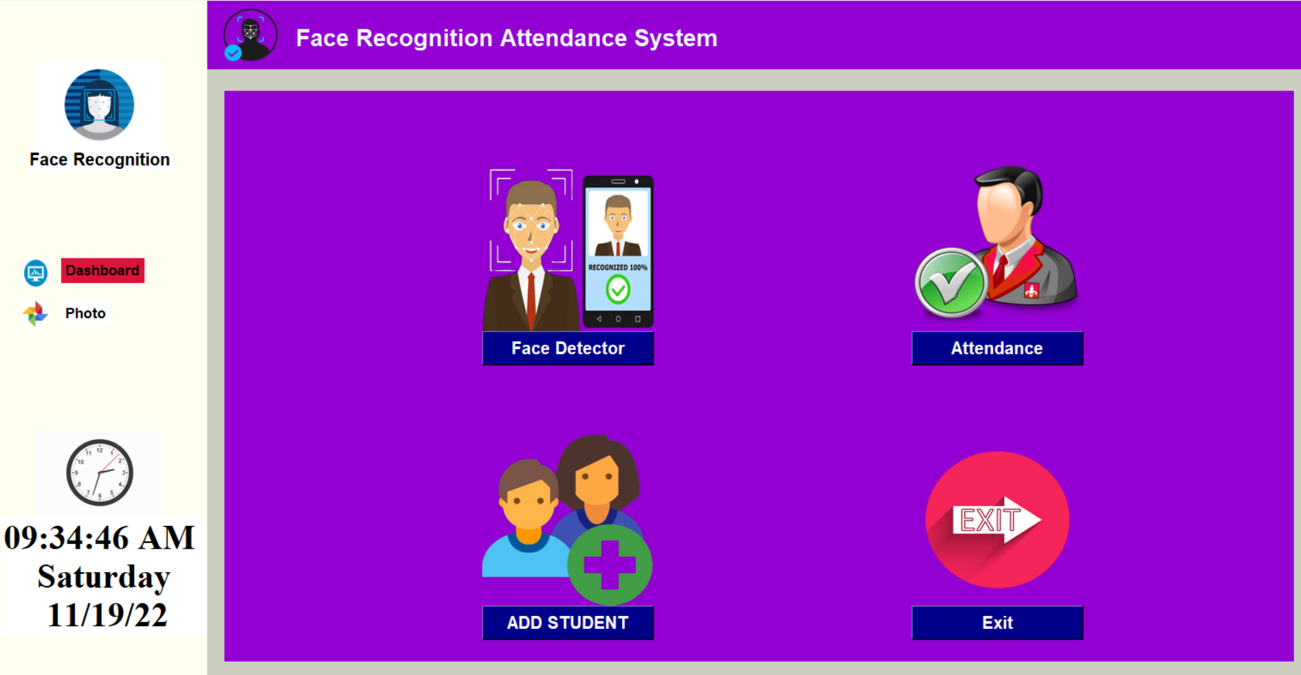

Slide 16
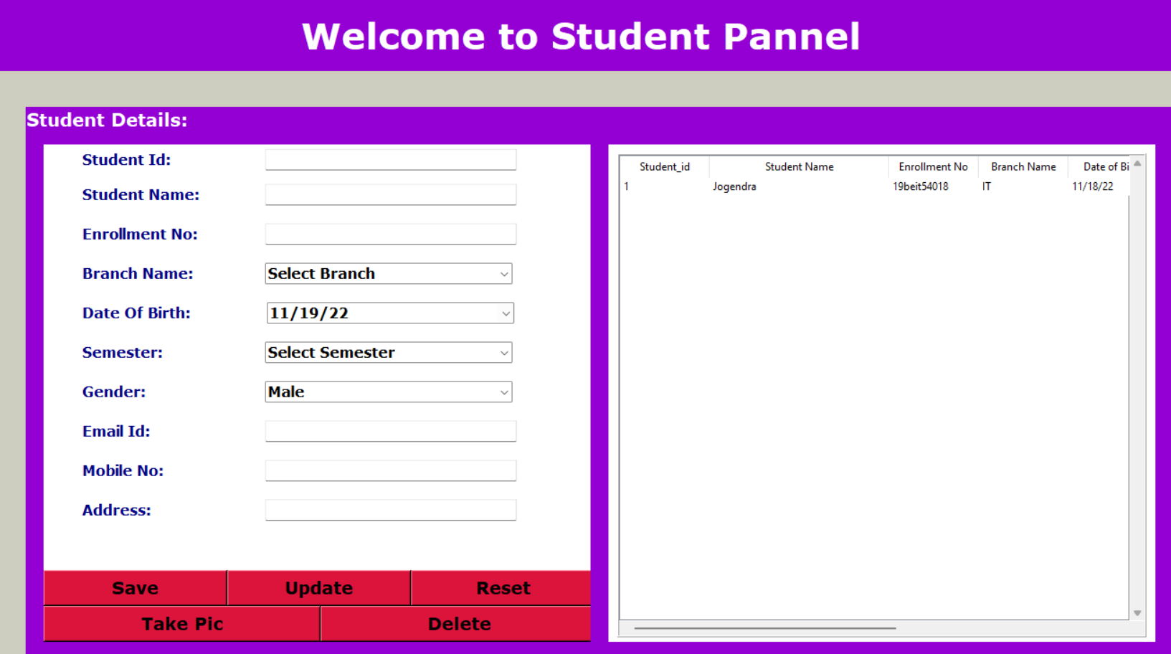

Slide 17
