Slide 1


Anthem Security Breach
Impacting Cost of Care

Slide 2
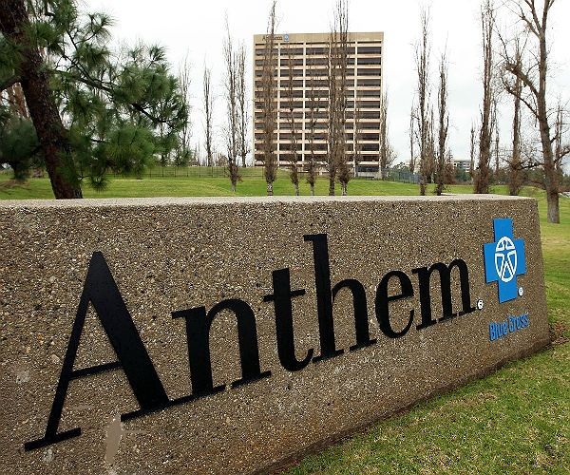




About Anthem Inc.
1940
2nd
$90bn
FOUNDED
LARGEST
REVENUE
WellPoint, Inc revived to Anthem in 2014
Health Insurance and Benefits company
Recorded steady increase in revenue since started
#29
73Mn
RANK
CUSTOMERS
Among the Fortune 500 companies
More than 56K employees

Slide 3
Anthem Breach
Query retrieving 80 million
records was initiated
Anthem alerted federal authorities & other entities
Apr 21, 2004
January 27, 2015
February 4, 2015
December 10, 2014
January 29, 2015
Attackers gained access to
Anthems Database
Database administrator discovered the compromise
Company disclosed the
breach to the public

Slide 4
Systems concerned
Confirmed Cyberattack (a phishing attack),
approximately, 80 million customers’ personal information have been compromised
Hacked 50 accounts, impacting 90+ systems
Unicare
Impacted
Branches
HealthLink
Anthem Blue Cross
Empire Blue Cross and Blue Shield
Blue Cross and Blue Shield Georgia
Anthem Blue Cross and Blue Shield

Slide 5

What was hacked?
Full names
05
Social Security numbers
01
02
Physical addresses
06
Insurance membership numbers
03
Email addresses
07
Medical IDs
04
Birthdates
08
Employment information

Slide 6


Business Considerations
DATA ENCRYPTION
NETWORK UPGRADES
AUTHENTICATION SYSTEM
ANTI VIRUS UPGRADES
BEHAVIOURAL ANALYSIS
TIMED MONITORING OF SYSTEM ACTIVITIES

Slide 7
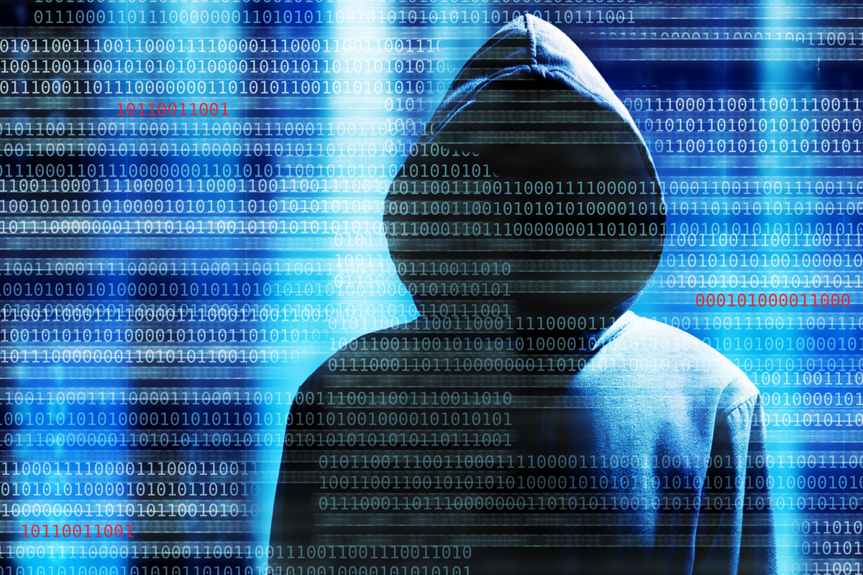




Actors Involved
01
Anonymous hackers
02
Panel of Insurance Commissioners
03
CrowdStrike (Cybersecurity)
04
Pre-breach, post-breach investigated

Slide 8
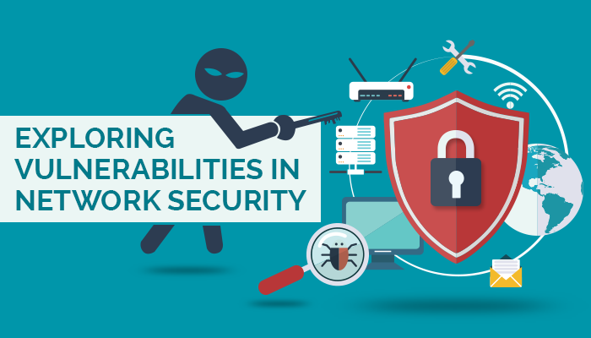
Vulnerabilities Exposed
Personally identifiable information revealed
Estimated value of $250/record
Data encryption failure
Identity thefts
Damages Caused
Insured amount entirely used for refunding

Slide 9





Liabilities faced
$16 Mn to US government for privacy violations
Civil cases involving privacy laws
Two years of Credit Monitoring and Identity
theft insurance to Customers
$260 Mn to insurance regulators for upgrading
its information security frameworks

Slide 10
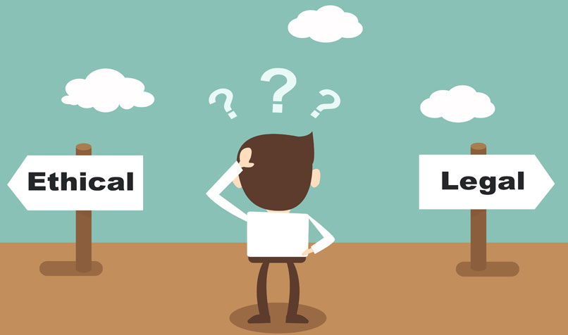
Ethical Considerations
The ethical risk arises when considering the potential breach of corporate and personal confidentiality
Socio-Techno Risk due to risk related partly to technology and partly to people involved
Data Privacy can be achieved through
- Technical
- Social &
- Complying with Data Protection Laws
Legal regulations are slow and not harmonized
Viewing privacy from the perspective of ethics helps organizations to improve their code of conduct

Slide 11




Findings and Conclusions
Neglected to deploy satisfactory requisites for
countering hackers
Organization deficit an enterprise-wide risk analysis
Lean procedures to monitor system activities
Failed to identify and respond to suspected
or known security incidents
No ‘adequate minimum access controls’ to shut down intrusions from as early as February 2014

Slide 12

Recommendations
01
03
05
Strengthen the security measures
Educate employees
Carry out frequent Risk Analysis
Periodic updates of firewalls and softwares
Systematic risk-based approach in addressing the vulnerabilities
02
04

Slide 13
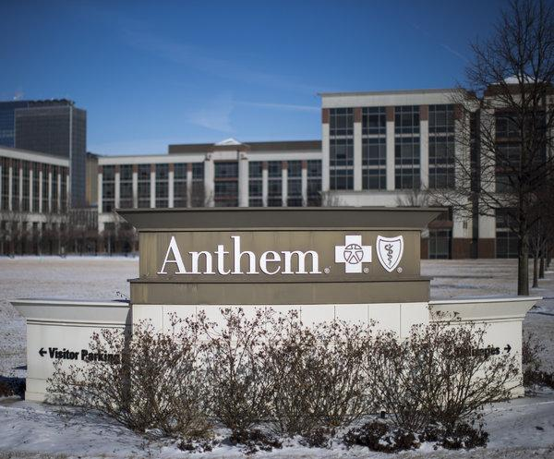
THANK YOU

