Slide 1




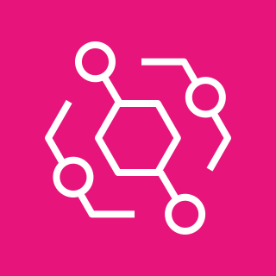





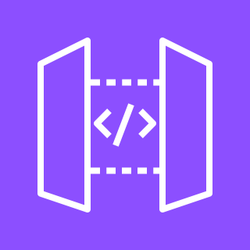
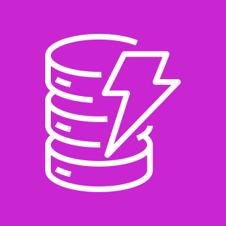


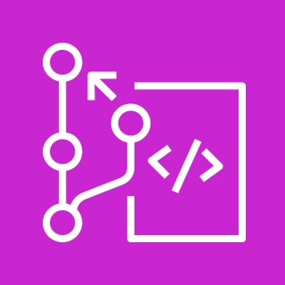

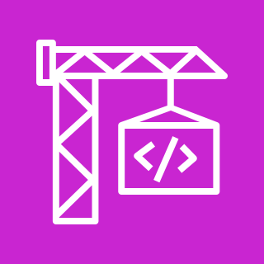
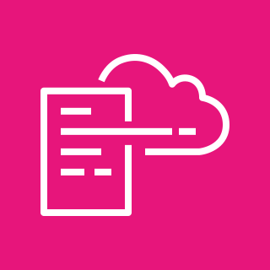


CloudOutcome Architecture
Serverless KPI platform with read-only cross-account collection
AWS Cloud - CloudOutcome account
Connected AWS accounts (up to 100)
Region (us-east-1)
Collection
3
Collector
Lambda
AssumeRole
read-only
EventBridge
(10 min / daily)
Read-only role
cloud_outcome_readonlyaccess
CloudWatch
+ Tagging API
Business owner
/ Judge
snapshot
AWS Price List
API
metrics
Serving
1
santacloth demo storefronts
HTTPS
Amplify Hosting
(React SPA)
API Gateway
(HTTP API)
API Lambda
(FastAPI)
DynamoDB
(workspaces, snapshots)
JWT
Coding agents
(Codex, Claude Code)
Cognito
(PKCE + MFA)
2
Synthetic
orders (5 min)
3 store
HTTP APIs
Checkout
Lambdas
Orders
tables
Delivery (CI/CD)
4
rollback
git push
CodeCommit
(3 repos)
CodePipeline V2
CodeBuild
(tests, package)
CloudFormation
(CDK)
CodeDeploy
(canary)
CloudWatch
Alarms
Flow
1
Serve the app
3
Collect and price
Request / workflow
Auth
2
Demo traffic
4
Ship safely
Data read / write
Schedule / alarm

Slide 2
STEP 1 – Serve the app
AWS Cloud - CloudOutcome account
Connected AWS accounts (up to 100)
Region (us-east-1)
Collection
Collector
Lambda
EventBridge
(10 min / daily)
Read-only role
cloud_outcome_readonlyaccess
CloudWatch
+ Tagging API
Business owner
/ Judge
AWS Price List
API
Serving
1
santacloth demo storefronts
HTTPS
Amplify Hosting
(React SPA)
API Gateway
(HTTP API)
API Lambda
(FastAPI)
DynamoDB
(workspaces, snapshots)
JWT
Coding agents
(Codex, Claude Code)
Cognito
(PKCE + MFA)
Synthetic
orders (5 min)
3 store
HTTP APIs
Checkout
Lambdas
Orders
tables
Delivery (CI/CD)
CodeCommit
(3 repos)
CodePipeline V2
CodeBuild
(tests, package)
CloudFormation
(CDK)
CodeDeploy
(canary)
CloudWatch
Alarms
Flow
The SPA on Amplify calls the HTTP API. Lambda (FastAPI) reads precomputed public snapshots or Cognito-protected workspaces from DynamoDB.
Request / workflow
Data read / write
1
Schedule / alarm
Auth

Slide 3
STEP 2 – Demo traffic
AWS Cloud - CloudOutcome account
Connected AWS accounts (up to 100)
Region (us-east-1)
Collection
Collector
Lambda
EventBridge
(10 min / daily)
Read-only role
cloud_outcome_readonlyaccess
CloudWatch
+ Tagging API
Business owner
/ Judge
AWS Price List
API
Serving
santacloth demo storefronts
Amplify Hosting
(React SPA)
API Gateway
(HTTP API)
API Lambda
(FastAPI)
DynamoDB
(workspaces, snapshots)
Coding agents
(Codex, Claude Code)
Cognito
(PKCE + MFA)
2
Synthetic
orders (5 min)
3 store
HTTP APIs
Checkout
Lambdas
Orders
tables
Delivery (CI/CD)
CodeCommit
(3 repos)
CodePipeline V2
CodeBuild
(tests, package)
CloudFormation
(CDK)
CodeDeploy
(canary)
CloudWatch
Alarms
Flow
EventBridge sends synthetic orders every 5 minutes to three tagged santacloth storefronts, producing real CloudWatch metrics.
Request / workflow
Auth
2
Data read / write
Schedule / alarm

Slide 4
STEP 3 – Collect and price
AWS Cloud - CloudOutcome account
Connected AWS accounts (up to 100)
Region (us-east-1)
Collection
3
Collector
Lambda
AssumeRole
read-only
EventBridge
(10 min / daily)
Read-only role
cloud_outcome_readonlyaccess
CloudWatch
+ Tagging API
Business owner
/ Judge
snapshot
AWS Price List
API
Serving
santacloth demo storefronts
Amplify Hosting
(React SPA)
API Gateway
(HTTP API)
API Lambda
(FastAPI)
DynamoDB
(workspaces, snapshots)
Coding agents
(Codex, Claude Code)
Cognito
(PKCE + MFA)
Synthetic
orders (5 min)
3 store
HTTP APIs
Checkout
Lambdas
Orders
tables
Delivery (CI/CD)
CodeCommit
(3 repos)
CodePipeline V2
CodeBuild
(tests, package)
CloudFormation
(CDK)
CodeDeploy
(canary)
CloudWatch
Alarms
Flow
The collector assumes the read-only role with an External ID, reads CloudWatch and tags across all Regions, prices usage with the Price List API and stores a snapshot.
Request / workflow
Auth
3
Data read / write
Schedule / alarm

Slide 5
STEP 4 – Ship safely
AWS Cloud - CloudOutcome account
Connected AWS accounts (up to 100)
Region (us-east-1)
Collection
Collector
Lambda
EventBridge
(10 min / daily)
Read-only role
cloud_outcome_readonlyaccess
CloudWatch
+ Tagging API
Business owner
/ Judge
AWS Price List
API
Serving
santacloth demo storefronts
Amplify Hosting
(React SPA)
API Gateway
(HTTP API)
API Lambda
(FastAPI)
DynamoDB
(workspaces, snapshots)
Coding agents
(Codex, Claude Code)
Cognito
(PKCE + MFA)
Synthetic
orders (5 min)
3 store
HTTP APIs
Checkout
Lambdas
Orders
tables
Delivery (CI/CD)
4
rollback
git push
CodeCommit
(3 repos)
CodePipeline V2
CodeBuild
(tests, package)
CloudFormation
(CDK)
CodeDeploy
(canary)
CloudWatch
Alarms
Flow
A push builds one immutable release that CloudFormation promotes dev to validation to prod; CodeDeploy canary rolls back on CloudWatch alarms.
Request / workflow
Auth
4
Data read / write
Schedule / alarm

