Slide 1
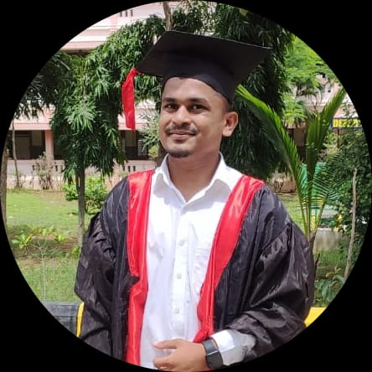
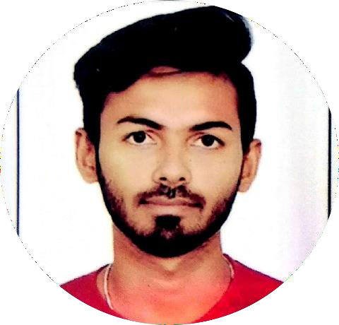





MAHESH V JOGI
Education and certificates
Bachelor of Engineering B.E(CSE): 2017 - 2021
Analyst/Software Engineer
Base Location:
Mumbai
Skills RDBMS UNIX/LINUX SQL
Email ID: Mobile No:
MAHESH.V-JOGI@capgemini.com
+917892721595
Grade:
A4
Database Oracle Database MongoDB PostgreSQL
Strengths
Software Engineer who is Strong in design and integration with intuitive problem-solving skills.
Achivement
I have attended Webinar on “Configuration of Network Element Using CISCO Packet Tracer” by Tontadarya College OF Engineering.
Add-ons
Data Science & Machine Learning Python
HTML
Core Java
Ready to learn new technologies and implement them to further improve my knowledge.
College Project :
Library Management System:
Completed end to end case study of Library Manage
system along with RDBMS , Data Base Designing Using Oracle SQL
Content Based Image Retrieval System This project (CBIR) used in medical field CBIR for knowledge discovery and similar image identification in massive medical image database have been explored .
Additional Details Excellent Communication Team Player
A team player with good communication skill always ready to work for the enrichment of knowledge.
Trained on RDBMS, Unix, SQL,core java
Hobbies Travelling Games Listening music
Working knowledge of software development and designing
Exposure to Data Science and ML.
Check out my Git Hub Profile and work

