Slide 1



Azure Subscription Overview
Understand the basics of Azure subscriptions, their purpose, and how they provide access to Azure services and resources.
by Joginder Tomar

Slide 2
Subscription Types and Features
Pay-As-You-Go
Enterprise Agreement
Sponsored
Flexible, no upfront commitment, pay only for what you use.
Discounted pricing for large organizations with volume licensing.
Subscriptions provided by partners or independent software vendors.

Slide 3
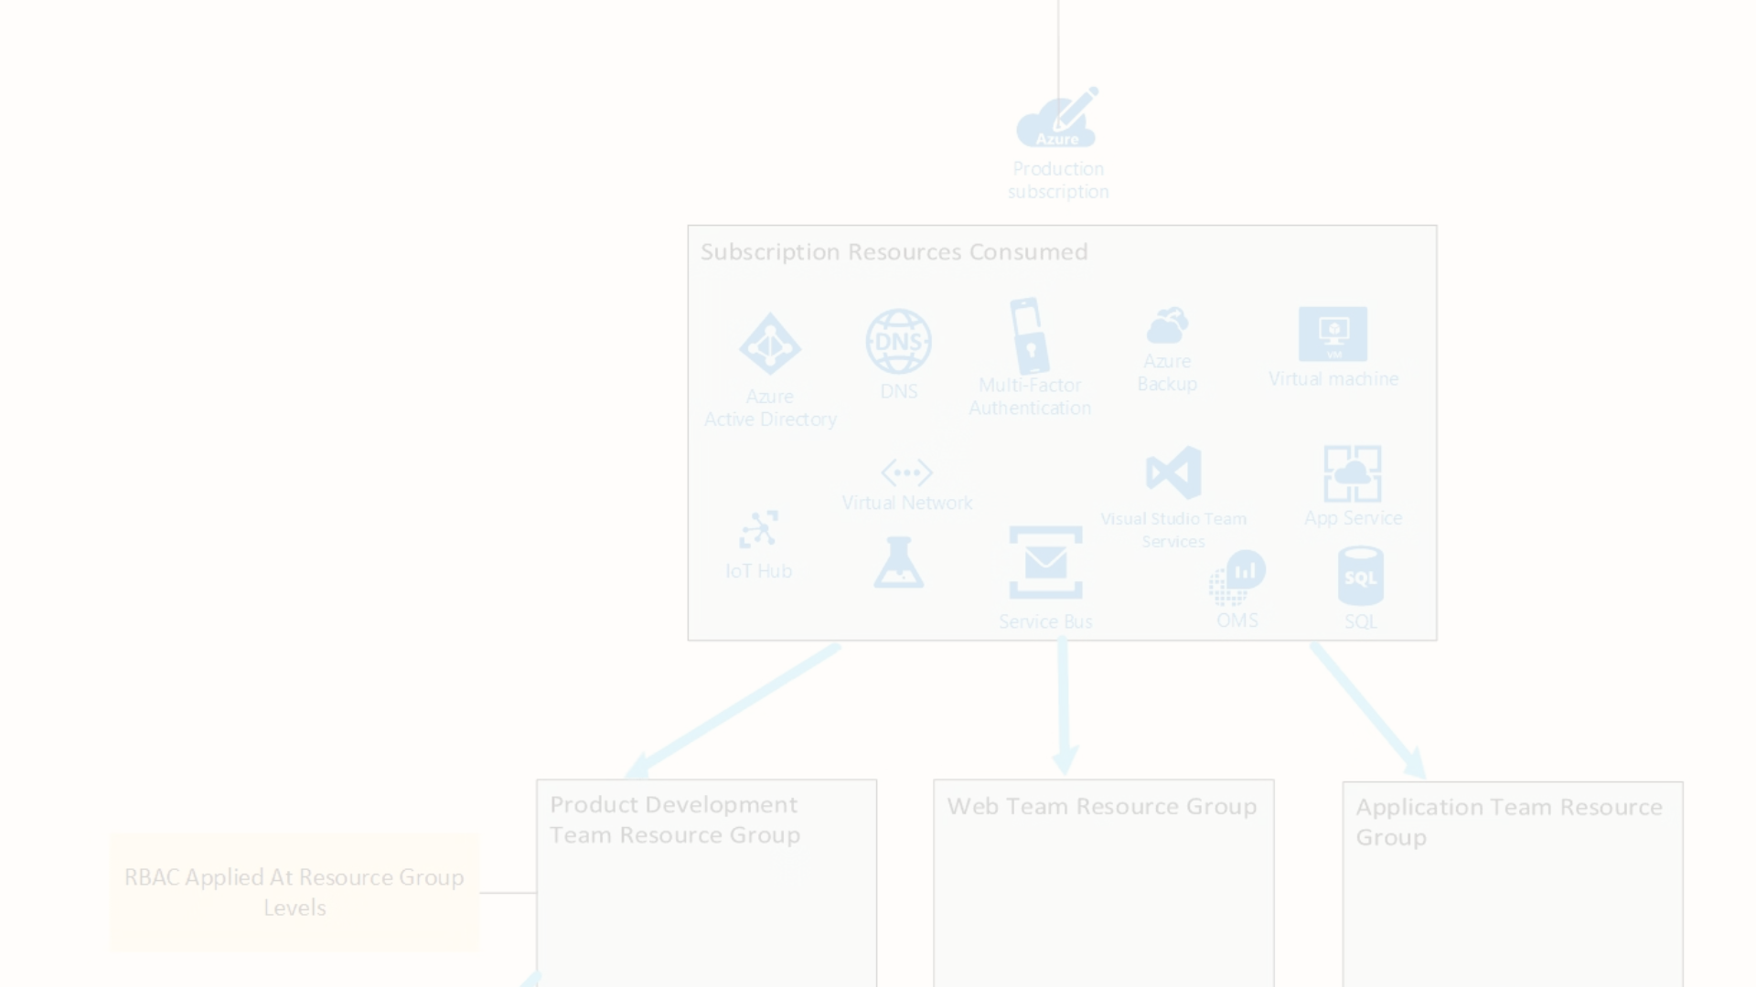
Subscription Management
Access Control
Resource Governance
Manage user permissions and roles for the subscription.
Apply policies to control the use of Azure resources.
1
2
3
Billing
Monitor costs, set budgets, and optimize spending.

Slide 4
Subscription Billing and Cost Optimization
Azure Reservations
Azure Hybrid Benefit
Prepay for resources to get discounted rates.
Save money by using existing software licenses.
Cost Monitoring
Optimization
Track spending, set budgets, and receive alerts.
Right-size resources, delete unused resources, and more.

Slide 5
Subscription Security and Compliance
1
Identity and Access Management
2
Encryption and Data Protection
Control who can access and manage the subscription.
Safeguard data with Azure security features.
3
Regulatory Compliance
4
Security Monitoring
Ensure your resources meet industry standards and regulations.
Detect and respond to threats with Azure Security Center.

Slide 6



Subscription Resource Management
Resource Groups
Azure Resource Manager
Resource Tagging
Logical containers for managing related Azure resources.
Apply labels to resources for organization and cost tracking.
Unified management layer for deploying and managing resources.

Slide 7
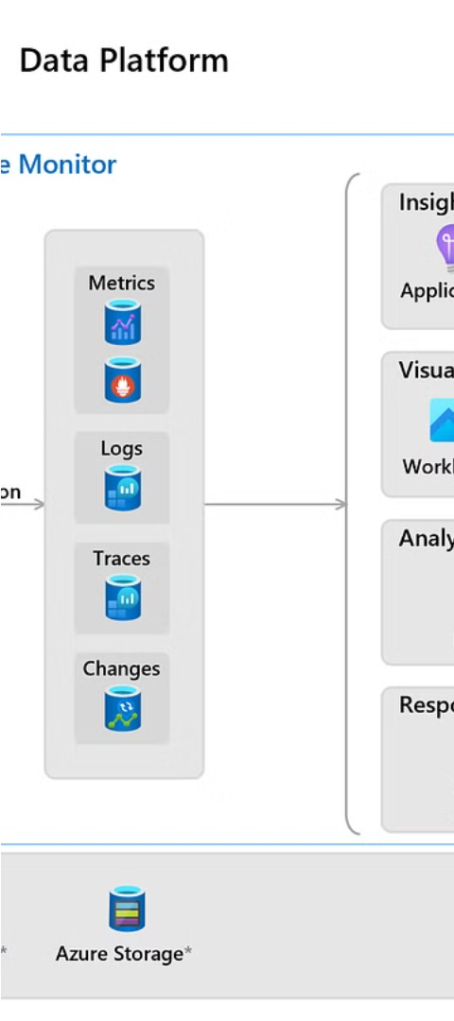



Subscription Monitoring and Reporting
Azure Monitor
Collect, analyze, and act on telemetry data from Azure.
Azure Advisor
Provides personalized recommendations to optimize Azure resources.
Azure Cost Management
Track, analyze, and optimize cloud spending over time.

Slide 8
Subscription Lifecycle and Support
Subscription Creation
Provisioning new subscriptions and setting up access.
Subscription Modification
Changing subscription properties, plans, or billing information.
Subscription Suspension
Temporarily disabling a subscription to prevent further usage.
Subscription Cancellation
Permanently closing a subscription and releasing its resources.

