Slide 1



Introduction to InterVLAN Routing
InterVLAN routing is a fundamental networking concept in CCNA that allows communication between devices in different virtual local area networks (VLANs). This slide introduces the key principles and benefits of implementing InterVLAN routing in a CCNA network.
by Joginder Tomar

Slide 2
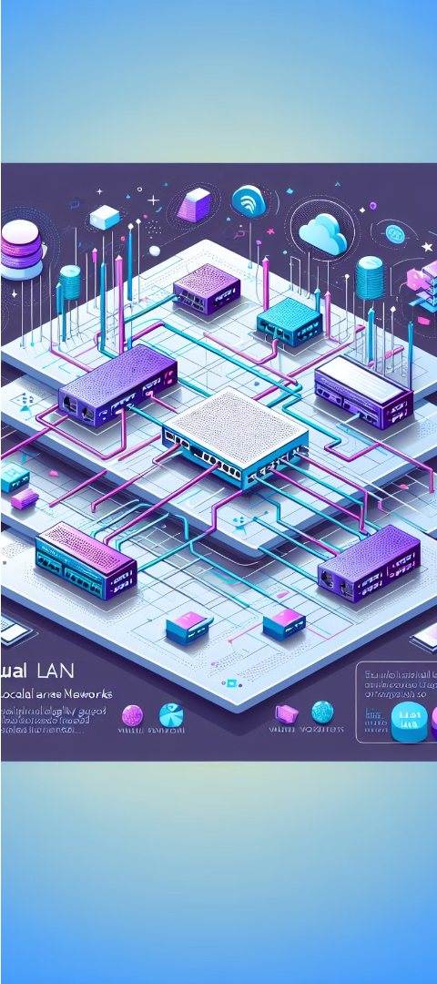
Understanding VLAN Concepts
VLAN Basics
VLAN Benefits
A VLAN, or Virtual Local Area Network, is a logical group of devices on one or more physical LANs that can communicate with each other as if they were on the same network, even if they are physically located on different segments of the LAN.
VLANs provide increased security, improved network performance, and better organization by segmenting the network into logical groups based on function, department, or other criteria.
VLAN Tagging
Ethernet frames are tagged with a VLAN ID to identify the VLAN they belong to, allowing switches to forward traffic to the appropriate VLAN.

Slide 3
The Need for InterVLAN Routing
Enabling Communication
Improved Security
Efficient Resource Utilization
Scalability and Flexibility
VLANs provide logical segmentation of the network, enhancing security by isolating traffic and limiting the spread of broadcasts and potential threats. InterVLAN routing allows controlled communication between these isolated segments.
In a network with multiple VLANs, hosts in different VLANs cannot directly communicate with each other. InterVLAN routing is required to allow these hosts to exchange data and share resources across VLAN boundaries.
As the network grows and evolves, InterVLAN routing enables the addition of new VLANs and the reconfiguration of existing ones without disrupting the overall network topology or connectivity.
By routing traffic between VLANs, network resources such as servers, printers, and other shared services can be accessed by hosts in different VLANs, improving overall resource utilization and reducing the need for duplicating services.

Slide 4



Router-on-a-Stick Topology for InterVLAN Routing
Router-on-a-Stick Topology
VLAN Subinterfaces
Router Configuration
The router interface is divided into logical subinterfaces, each assigned to a specific VLAN to route traffic between those VLANs.
The router is configured with VLAN subinterfaces, 802.1Q trunking, and routing protocols to enable communication between hosts in different VLANs.
In this common InterVLAN routing setup, a single router interface is used to connect to multiple VLANs over a trunk link, allowing communication between hosts in different VLANs.

Slide 5
Configuring Router-on-a-Stick InterVLAN Routing
Enable Trunking
1
Configure the router interface as a trunk to carry multiple VLAN traffic.
Assign Subinterfaces
2
Create logical subinterfaces on the trunk interface, one for each VLAN.
Configure Encapsulation
3
Set the encapsulation type (e.g., dot1Q) and assign the VLAN IDs to the subinterfaces.
The key steps to configure Router-on-a-Stick InterVLAN routing involve enabling trunking on the router interface, assigning logical subinterfaces for each VLAN, and configuring the appropriate encapsulation method to distinguish traffic from different VLANs. This setup allows the router to route traffic between the VLANs connected to its subinterfaces.

Slide 6



Example 1: InterVLAN Routing between two VLANs
VLAN 10
1
User Devices
Router
2
InterVLAN Routing
VLAN 20
3
Servers
In this example, we have two VLANs - VLAN 10 for user devices and VLAN 20 for servers. The router is configured to provide InterVLAN routing, allowing communication between devices in the two VLANs. This setup ensures segmentation and security while enabling necessary data flow between the user devices and servers.

Slide 7

Verifying InterVLAN Routing in Example 1
Checking VLAN Memberships
Inspecting Routing Table
Verify that the interfaces on the router are assigned to the correct VLANs. Ensure the VLAN IDs match the expected configuration.
Examine the routing table on the router to confirm that the correct VLAN subnetworks are present and routable.
Tracing Packet Flow
Use ping or traceroute to test connectivity between devices in different VLANs, verifying that the traffic is being routed properly.

Slide 8




Example 2: InterVLAN Routing between three VLANs
Configure Router Interfaces
Assign each VLAN to a different subinterface on the router's main interface. Configure the appropriate VLAN IDs and enable encapsulation.
Apply Routing Protocol
Enable a dynamic routing protocol, such as OSPF or EIGRP, to allow the router to learn routes between the VLANs.
Verify Connectivity
Test connectivity by pinging between hosts in different VLANs. Ensure the router is correctly routing traffic between the subnets.

Slide 9



Troubleshooting InterVLAN Routing Issues
Troubleshoot Configuration
Monitor Network Traffic
Check Access Control Lists
Use network analysis tools to capture and analyze traffic between the VLANs. Look for any dropped or misrouted packets that could indicate issues with the InterVLAN routing.
Verify the VLAN assignments, subinterface configurations, and routing table entries on the router. Ensure the physical connections and VLAN trunking are set up correctly.
Ensure there are no ACLs blocking the necessary traffic between VLANs. Review the ACL configurations and adjust them if needed to allow the required InterVLAN communication.

Slide 10



Conclusion and Best Practices
Key Takeaways
Collaboration
Continuous Learning
InterVLAN routing is a essential CCNA concept for connecting devices in different VLANs. Proper configuration and troubleshooting are crucial for optimal network performance.
Working closely with network architects and administrators is recommended to ensure a robust and secure InterVLAN routing deployment aligned with organizational requirements.
Stay up-to-date with the latest CCNA best practices and technologies to adapt to evolving network needs and maintain a competitive edge.

