Slide 1
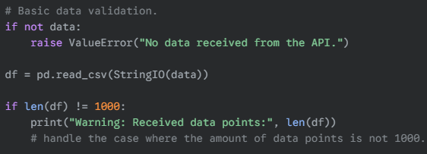
1. Ask the LLM to review your code.
Before
After

Slide 2
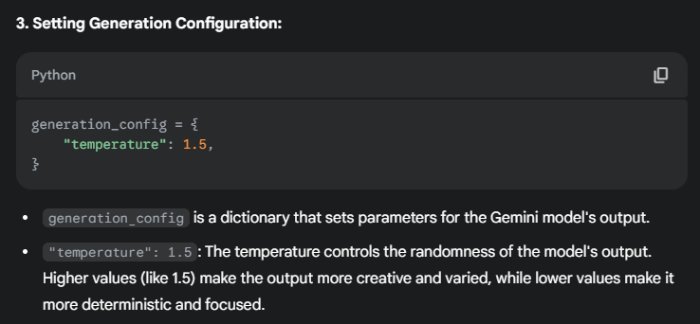
2. Ask the LLM to explain your code.

Slide 3


3. Ask the LLM to add comments to your code.
Before
After

Slide 4
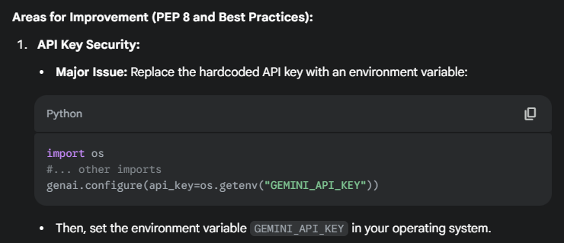
4. Ask the LLM to check if your code complies with the PEP8 coding style and highlight where it does not.
Before
After

Slide 5
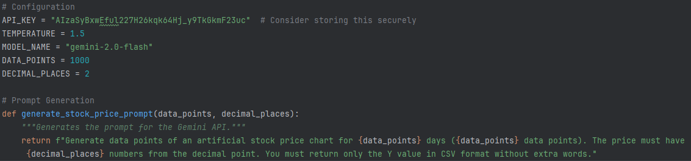
5. Ask the LLM to apply clean code principles to your code.
Before
After

Slide 6

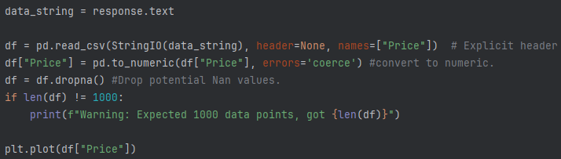
6. Ask the LLM to optimize your code and provide suggestions on how to make it more efficient or faster.
Before
After

