Slide 1
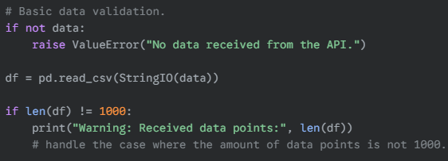
Before
After

Slide 2
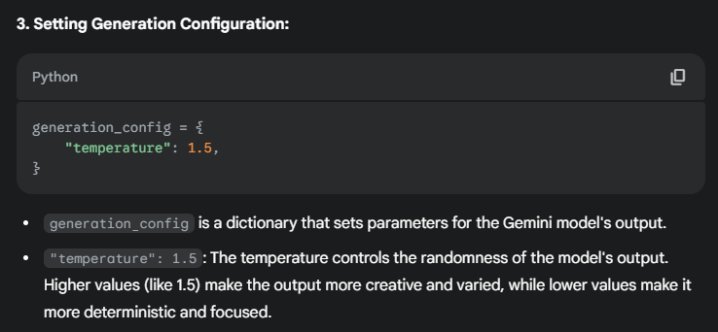

Slide 3


Before
After

Slide 4
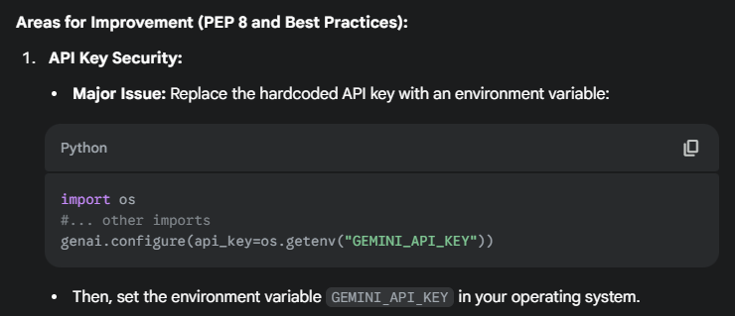
Before
After

Slide 5

Before
After

Slide 6


Before
After

