Slide 1
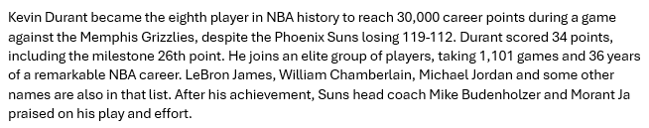

Text summarization
Summarize an article in 5 sentences, return only the summary
Mistral - 1
Concise and short, no extra words, to the point
Llama - 5
Skipped half of the article, not 5 sentences

Slide 2
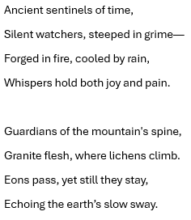
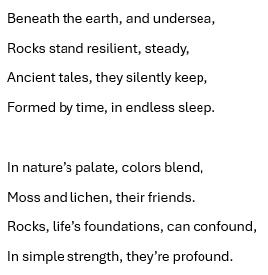
Text generation
Write an 8 line poem about rocks
DeepSeek - 1
Everything rhymes, the text is logical and fits the given theme
Mistral - 5
Some parts don’t rhyme as well as the other models’ texts

Slide 3
Question answering
Answer 4 questions about ASP.NET
DeepSeek, QwQ, Llama - first
Answered everything correct
Phi-4, Mistral - last
Answered 1 question incorrectly (last)
What ASP.NET object is used to get information about the web servers ?
What method(s) must be used with the Application object to ensure that only one process accesses a variable at a time ?
What HTML element is the asp:Label control rendered as when the target is Internet Explorer ?
Can two different .net programming languages be mixed in a single ASPX file ?

Slide 4
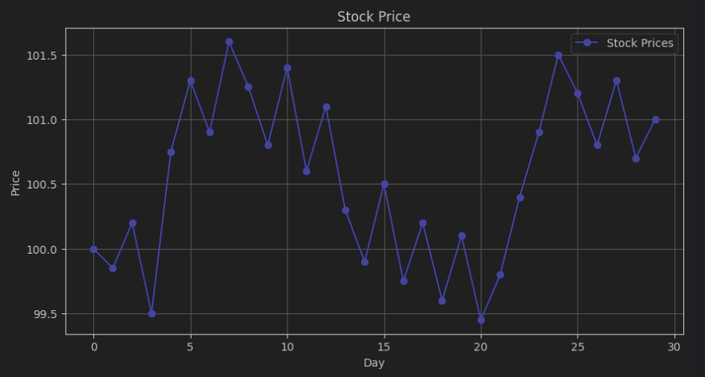
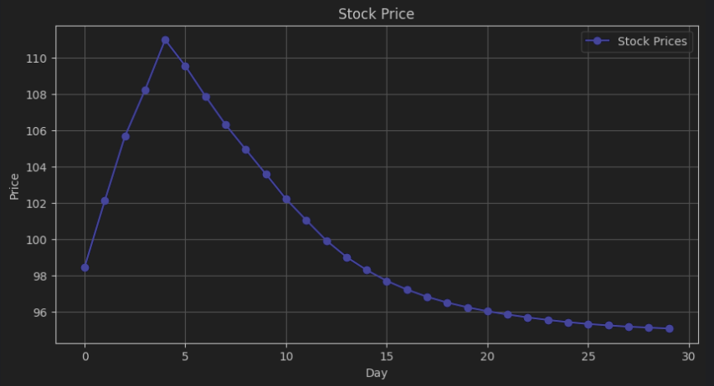
Data generation
Generate data points of an artificial stock price chart for 30 days
DeepSeek - 1
Stock price chart looks realistic, there’s volatility
Llama - 5
Chart looks unrealistic, there is little to no movement

Slide 5
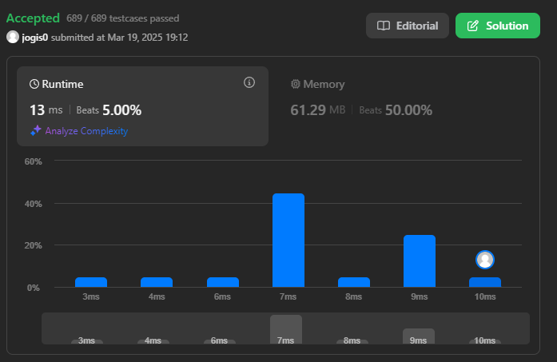
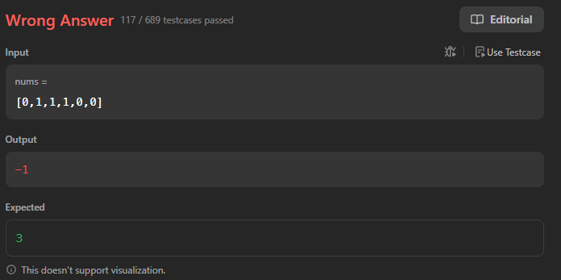
Code generation
Leetcode assignment
DeepSeek - 1
All test cases passed, close with QwQ, but 4 ms faster
Mistral - 5
117 / 689 testcases passed

Slide 6
Local model - Phi-3
Text summarization: less than 5 sentences, missed half of the article.
Text generation: more than 8 lines, got stuck repeating.
Question answering: Answered the first question wrong, everything else was correct.
Data generation: Got stuck thinking about the price of the price instead of returning values.
Code generation: Got stuck generating unusable code – did not complete the task.

Slide 7
Local model – gpt2
Text summarization: Started inventing information, got sidetracked and did not summarize the text.
Text generation: Wrote a story, not a poem, it did not make sense.
Question answering: Answered all questions wrong.
Data generation: Got stuck thinking about the price of the price instead of returning values.
Code generation: Got stuck generating unusable code – did not complete the task.

Slide 8
Local model - TinyLlama
Text summarization: made up information that was incorrect, did not fully summarize the text.
Text generation: Was 8 lines, but did not rhyme, no creativity.
Question answering: Only answered one question correctly.
Data generation: Started generating code that would generate the data.
Code generation: The code looked alright, but it had compilation errors and would not run.

