Slide 1

BIT N BUILD’26 • GUJARAT ROUND
SmartEve
AI Assist
Smart Anchor & Stage Flow Management System
PLACE APP ICON HERE
Team
Team Leader
BliXo.tech
Rana Chirag Ashokkumar
01

Slide 2
02 / PROBLEM
The event floor is still too manual
Anchors and organizers manage timing, speakers, transitions and audience engagement at the same time.
PROBLEM
1
Manual agenda management
2
No real-time anchor support
Errors and timing mismatches can accumulate during a live program.
Anchors need guidance while simultaneously hosting the stage.
Live events require anchors to manage multiple speakers, timings, transitions & audience engagement simultaneously without real-time assistance.
3
Schedule delays
4
Messaging consistency
Changes are handled manually and may not reach every role immediately.
Scripts and transitions are difficult to keep consistent across sessions.
TARGET USERS
College event organizers • anchors • speakers
Hackathons • seminars • workshops • competitions • cultural programs
BIT N BUILD’26 • Gujarat Round
02 / 08

Slide 3
03 / SOLUTION
One control layer for the live event
SmartEve connects organizers, anchors and event flow through one real-time workflow.
EVENT ORGANIZERS
ANCHORS / HOSTS
CO-ORGANIZERS
OUR SYSTEM
✓
AI Script Generation
✓
Live Dashboard
AI-powered platform for
real-time script assistance,
agenda management & live
stage coordination
Opening, intros, transitions and closing scripts.
Real-time activity and stage status.
✓
Anchor Assistance
✓
Event Management
On-demand AI help while hosting.
Agenda, speakers, roles and invitations.
RESULT
Professional execution • smooth transitions • confident hosting
BIT N BUILD’26 • Gujarat Round
03 / 08

Slide 4
04 / BUILD
Technology stack & system architecture
Only the technologies specified in the project deck are shown.
TECHNOLOGY STACK
SYSTEM ARCHITECTURE
FRONTEND
Flutter • Dart
USER
Browser / App
BACKEND
Express.js • TypeScript • Node.js
FRONTEND
UI + Input
AI
Claude API / SmartEve AI
BACKEND / API
Requests + Auth
DATA
PostgreSQL (Neon.tech) • Firebase Realtime
BUSINESS LOGIC
Core features
AUTH / MEDIA
Firebase Authentication • Cloudinary
DATA + SERVICES
Neon PostgreSQL + Firebase + External APIs
TOOLS
Git • VS Code
BIT N BUILD’26 • Gujarat Round
04 / 08

Slide 5
05 / APPROACH
From problem to working prototype
A six-step delivery flow keeps the build focused and demo-ready.
01
02
03
04
05
06
Problem
System
Develop-ment
Integra-tion
Testing
Working
Analysis
Design
Prototype
TECHNICAL APPROACH
INTEGRATION & TESTING
Claude AI API generates scripts from event context.
Flutter frontend ↔ Express backend ↔ Neon PostgreSQL + Firebase.
Firebase Realtime DB keeps organizer and anchor state synchronized.
API endpoint tests, UI regression testing and live-event simulation.
Multi-role access control: Admin, Organizer, Anchor.
Result: working prototype ready.
Data flow: Flutter → Express → Neon / Firebase services.
BIT N BUILD’26 • Gujarat Round
05 / 08

Slide 6
06 / BUILD STATUS
Implemented features
The demo focuses on working modules and the core event workflow.
✓
AI-Generated Scripts
✓
Live Event Dashboard
✓
Speaker & Anchor Management
Opening, intros, transitions and closing.
Real-time activity tracking and stage status.
Invitations and role-based coordination.
✓
Event Agenda Builder
✓
SmartEve AI Assistant
✓
Delay Reporting
Drag-and-drop session reordering.
On-demand help during event execution.
Dynamic schedule updates when timing changes.
ACHIEVEMENTS
3-role system designed & implemented • AI script generation tested • Live dashboard with real-time sync • Database schema & API endpoints ready
BIT N BUILD’26 • Gujarat Round
06 / 08

Slide 7
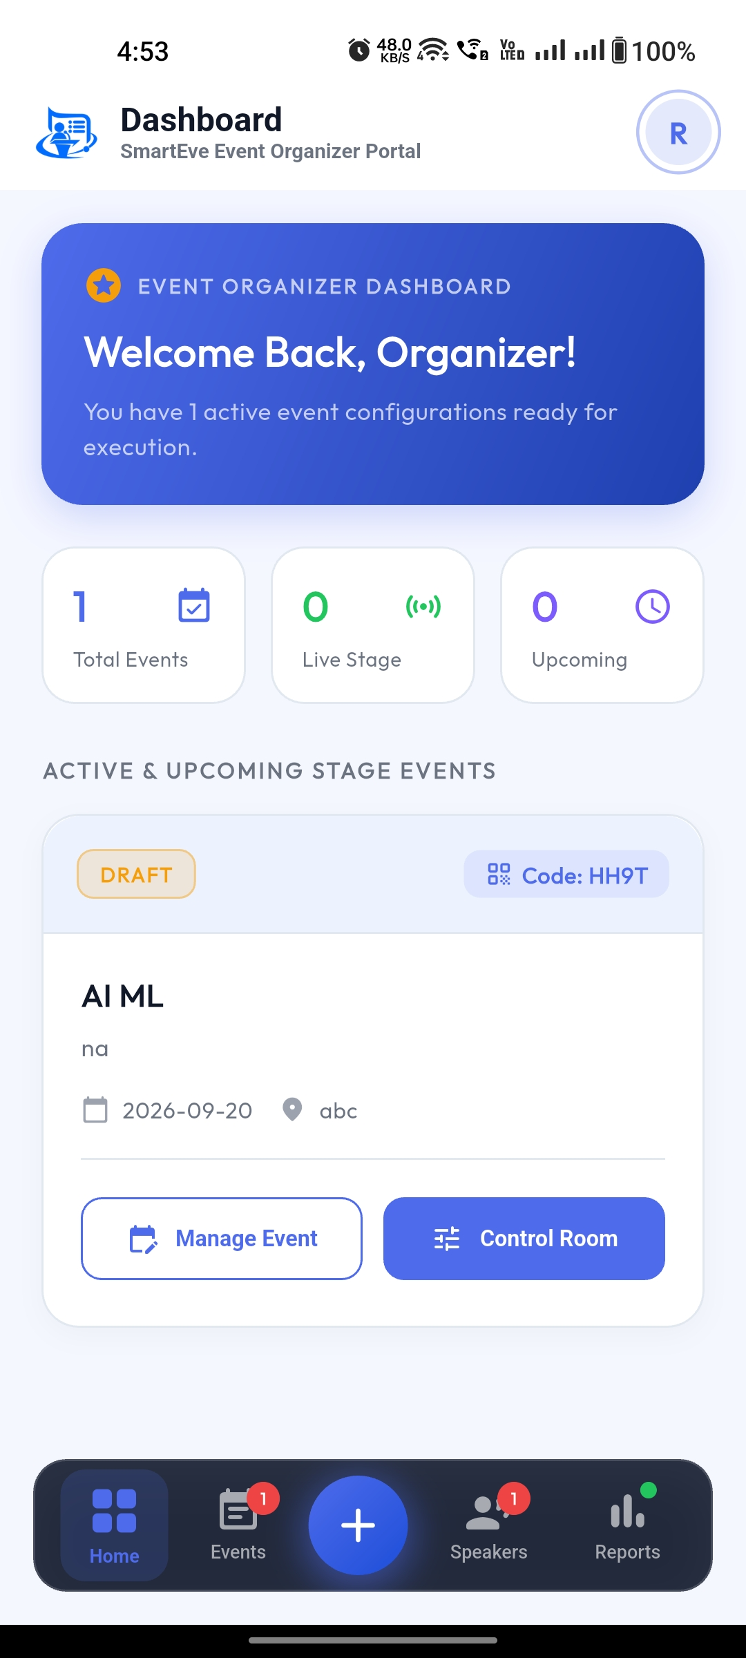
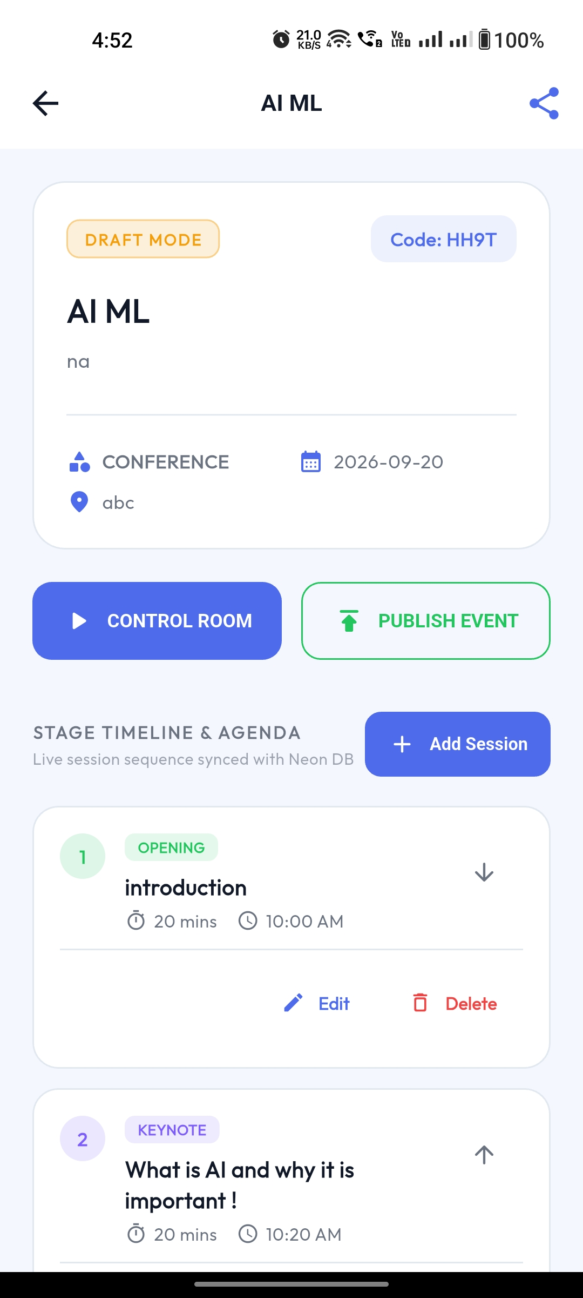
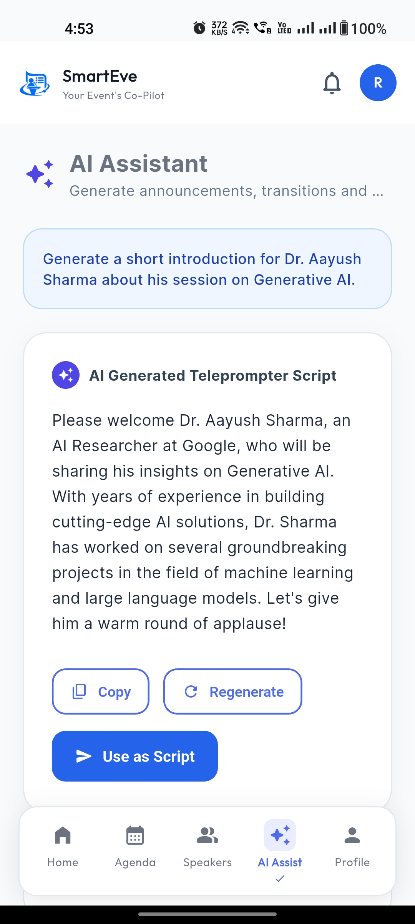
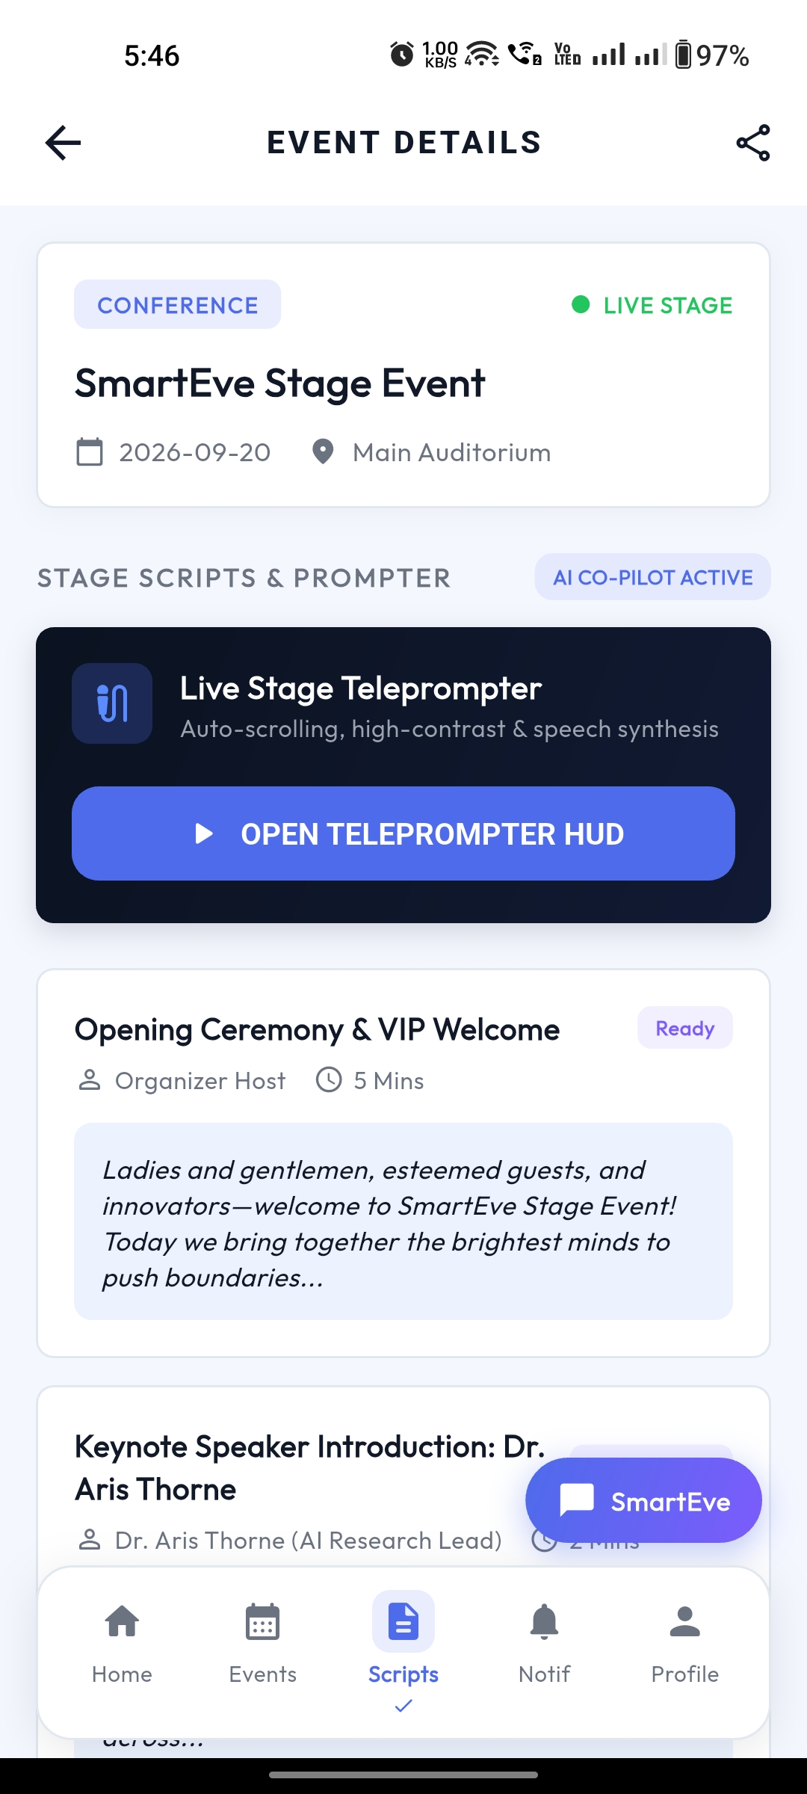
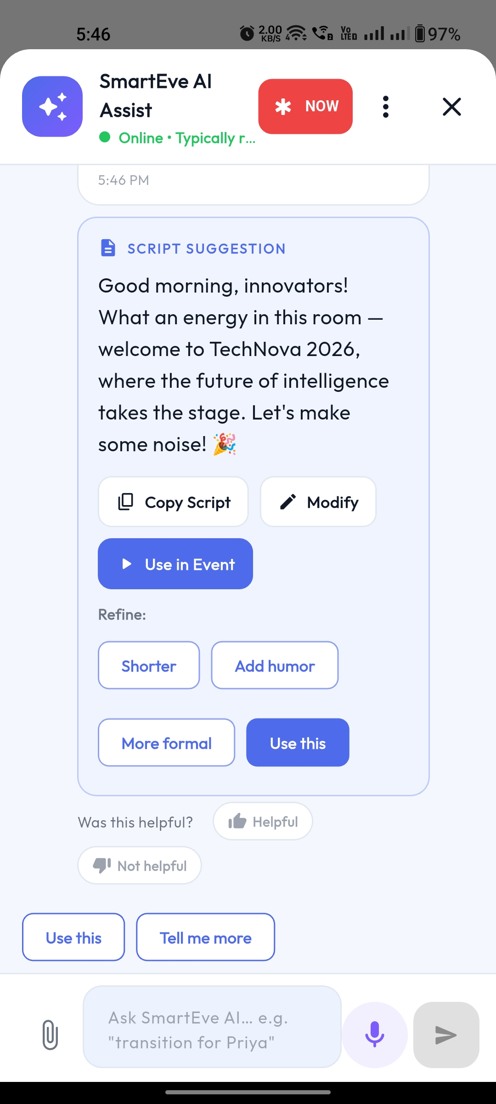
07 / DEMO
Team & product screens
BIT N BUILD’26 • Gujarat Round
07 / 08

Slide 8
08 / NEXT
Impact & future scope
Current prototype → next improvements → future integrations.
IMPACT
FUTURE SCOPE
Enables a more structured event-hosting workflow.
Working prototype • core modules • real-time sync
Clearly separated from the implemented prototype.
CURRENT
Reduces anchor stress with AI-powered assistance.
NEXT
Landscape optimization • analytics • multilingual scripts
Supports smoother transitions and timing.
Creates an efficient organizer workflow.
FUTURE
Streaming integrations • performance/certification features • new integrations
BIT N BUILD’26 • Gujarat Round
08 / 08

Slide 9
Thank You !!
BIT N BUILD’26 • Gujarat Round

