Slide 1
Practical Concurrent and Parallel Programming IX
Performance and Scalability
Jørgen Staunstrup

Slide 2
Agenda
Executor and Future
Scalability, speed-up and loss (of scalablity) classification
Example: QuickSort
Lock striping
A case study with Hash maps

Slide 3
Java Executors - Tasks
Thread:
threads[t] = new Thread( () -> {
...
for (int i=from; i<to; i++)
if (isPrime(i)) lc.increment();
});
Task:
public class countPrimesTask implements Runnable {
...
@Override public void run() {
if ((high-low) < threshold) {
for (int i=from; i<=to; i++)
if (isPrime(i)) lc.increment(); }
}

Slide 4
Prime counter task (skeleton)
public class countPrimesTask implements Runnable {
private final int low;
private final int high;
private final ExecutorService pool;
@Override public void run() {
int mid= low+(high-low)/2;
pool.submit( new countPrimesTask(low, mid, pool) );
pool.submit( new countPrimesTask(mid+1, high, pool) );
}
}
[low..high]
Shortcomings:
How to stop?
Will create too many "small" tasks
Returning result (# primes)

Slide 5
Splitting tasks
@Override
public void run() {
if ((high-low) < threshold) {
for (int i=low; i<=high; i++) if (isPrime(i)) lc.increment();
} else {
int mid= low+(high-low)/2;
pool.submit(new countPrimesTask(lc, low, mid, pool, threshold) );
pool.submit(new countPrimesTask(lc, mid+1, high, pool, threshold) );
}
}
Shortcomings:
How to stop?
Will create too many "small" tasks
Returning result (# primes)

Slide 6
Future
Futures are executors that deliver a result
T1
get
start
return result
T2
T2:
public Future<Integer> calculate(Integer input) {
return pool.submit(() -> {
... // compute result
return result;
});
}
}
T1:
Future<Integer> future = T2.calculate( ); // start
...
future.get();
get() is a blocking call !!!!

Slide 7
Splitting tasks
public void run() {
if ((high-low) < threshold) { ...
} else {
int mid= low+(high-low)/2;
Future<?> f1= pool.submit( new countPrimesTask(lc, low, mid, pool, threshold) );
Future<?> f2= pool.submit( new countPrimesTask(lc, mid+1, high, pool, threshold) );
}
}
But how do we get the results from a future?
T1
get
start
return result
T2

Slide 8
Combining tasks
public void run() {
if ((high-low) < threshold) { ...
} else {
int mid= low+(high-low)/2;
Future<?> f1= pool.submit( new countPrimesTask(lc, low, mid, pool, threshold) );
Future<?> f2= pool.submit( new countPrimesTask(lc, mid+1, high, pool, threshold) );
try { f1.get();f2.get(); }
catch (InterruptedException | ExecutionException e) { }
}
}
1: Does the order of f1.get and f2.get matter?

Slide 9
Combining tasks
public void run() {
if ((high-low) < threshold) { ...
} else {
int mid= low+(high-low)/2;
Future<?> f1= pool.submit( new countPrimesTask(lc, low, mid, pool, threshold) );
Future<?> f2= pool.submit( new countPrimesTask(lc, mid+1, high, pool, threshold) );
try { f1.get();f2.get(); }
catch (InterruptedException | ExecutionException e) { }
}
}
No

Slide 10
Splitting tasks
public void run() {
if ((high-low) < threshold) { ...
} else {
int mid= low+(high-low)/2;
Future<?> f1= pool.submit( new countPrimesTask(lc, low, mid, pool, threshold) );
Future<?> f2= pool.submit( new countPrimesTask(lc, mid+1, high, pool, threshold) );
try { f1.get();f2.get(); }
catch (InterruptedException | ExecutionException e) { }
}
}
Shortcomings:
How to stop?
Will create too many "small" tasks
Returning result (# primes)

Slide 11
Combining tasks
public void run() {
if ((high-low) < threshold) { ...
} else {
int mid= low+(high-low)/2;
Future<?> f1= pool.submit( new countPrimesTask(lc, low, mid, pool, threshold) );
Future<?> f2= pool.submit( new countPrimesTask(lc, mid+1, high, pool, threshold) );
try { f1.get();f2.get(); }
catch (InterruptedException | ExecutionException e) { }
}
}
Shortcomings:
How to stop?
Will create too many "small" tasks
Returning result (# primes)
How do we get the result
# primes ?

Slide 12
Counting the primes
public void run() {
if ((high-low) < threshold) { ... lc.increment();
} else {
int mid= low+(high-low)/2;
Future<?> f1= pool.submit( new countPrimesTask(lc, low, mid, pool, threshold) );
Future<?> f2= pool.submit( new countPrimesTask(lc, mid+1, high, pool, threshold) );
try { f1.get();f2.get(); }
catch (InterruptedException | ExecutionException e) { }
}
}
Shortcomings:
How to stop?
Will create too many "small" tasks
Returning result (# primes) Final value in lc

Slide 13
countPrimesTask
public class countPrimesTask implements Runnable {
private final int low;
...
private static boolean isPrime(int n) {
...
}
public countPrimesTask(PrimeCounter lc, int low, int high, ExecutorService pool, int threshold) {
this.lc = lc;
...
}
@Override
public void run() {
...
}
}

Slide 14
Java Executors - Tasks
Ideally, tasks should be independent i.e. not update shared variables
Notes:
Insert link to code for countPrimes

Slide 15
countPrimesTask class
public class countPrimesTask implements Runnable {
private final int low; private final int high; private final int threshold;
private final ExecutorService pool;
private final PrimeCounter lc;
private static boolean isPrime(int n) {...)
}
public countPrimesTask(PrimeCounter lc... ) {this.lc= lc;... }
@Override
public void run() {
if ((high-low) < threshold) {
for (int i=low; i<=high; i++) if (isPrime(i)) lc.increment();
} else {
int mid= low+(high-low)/2;
Future<?> f1= pool.submit( new countPrimesTask(lc, ... ) );
Future<?> f2= pool.submit( new countPrimesTask(lc, ... ) );
try { f1.get();f2.get(); }
catch (InterruptedException | ExecutionException e) { e.printStackTrace(); }
}
}
}
2: Are countPrimesTasks independent?
Code in countPrimesTask.java

Slide 16
countPrimesTask class
public class countPrimesTask implements Runnable {
private final int low; private final int high; private final int threshold;
private final ExecutorService pool;
private final PrimeCounter lc;
private static boolean isPrime(int n) {...)
}
public countPrimesTask(PrimeCounter lc... ) {this.lc= lc;... }
@Override
public void run() {
if ((high-low) < threshold) {
for (int i=low; i<=high; i++) if (isPrime(i)) lc.increment();
} else {
int mid= low+(high-low)/2;
Future<?> f1= pool.submit( new countPrimesTask(lc, ... ) );
Future<?> f2= pool.submit( new countPrimesTask(lc, ... ) );
try { f1.get();f2.get(); }
catch (InterruptedException | ExecutionException e) { e.printStackTrace(); }
}
}
}
Not really, they all update lc

Slide 17
PrimeCounter
class PrimeCounter {
private int count= 0;
public synchronized void increment() {
count= count + 1;
}
public synchronized int get() {
return count;
}
public synchronized void setZero() {
count= 0;
}
}

Slide 18
PrimeCountExecutor class
Kick-off class for the program
It initializes the Executor service
class PrimeCountExecutor {
private ExecutorService pool;
...
public PrimeCountExecutor () {
pool= new ForkJoinPool();
Future<?> done= pool.submit(new countPrimesTask( ... ));
try { done.get(); }
}
}
https://docs.oracle.com/javase/tutorial/essential/concurrency/forkjoin.html

Slide 19
Thread pools
class PrimeCountExecutor {
private ExecutorService pool;
...
public PrimeCountExecutor () {
pool= new ForkJoinPool();
...
}
CPU
ForkJoinPool
tasks
CPU
CPU

Slide 20
ForkJoinPool
import java.util.concurrent.ForkJoinPool;
import java.util.concurrent.ExecutorService;
import java.util.concurrent.Future;
class PrimeCountExecutor {
private ExecutorService pool;
...
public PrimeCountExecutor () {
pool= new ForkJoinPool( n );
...
}
}
n specifies the number of CPUs that will be used
default value:
Runtime.availableProcessors()
https://docs.oracle.com/javase/8/docs/api/java/util/concurrent/ForkJoinPool.html

Slide 21
Count prime results
Executor
1 120.6 s
2 68.0 s
4 37.7 s
8 32.2 s
16 32.4 s
1/8: 3.7
Threads
1 126.7 s
2 82.4 s
4 47.7 s
8 38.2 s
16 37.2 s
1/8: 3.9
range 2.. 1_000_000

Slide 22
Agenda
Executors and Future
Scalability, speed-up and loss (of scalablity) classification
Example: QuickSort
Lock striping
A case study with Hash maps

Slide 23
Quicksort
1 2 43 78 19 54 33 21 64 52 17 53
1 2 43 78 19 54 33 21 64 52 17 53
1 2 43 78 19 54 33 21 64 52 17 53
1 2 17 78 19 54 33 21 64 52 43 53
1 2 17 78 19 54 33 21 64 52 43 53
…
1 2 17 21 19 33 54 78 64 52 43 53
Two parts can be
sorted independently
1 2 17 21 19 33 54 78 64 52 43 53

Slide 24
Distributing work as tasks
1 2 17 21 19 33 54 78 64 52 43 53
…
No further splitting when the sorting problem is smaller
than a threshold (similarly to what we did for prime counting)
These tasks may differ in size !!

Slide 25
Quicksort executor (pseudo code)
class QuicksortTask implements Runnable {
Task p; // low and high boundaries
ExecutorService pool;
@Override public void run() { qsort(p, pool, ... ); }
public static void qsort(Task p, ExecutorService pool, ... ) {
//split task in two: Low and High as shown on previous slides
if (Low.size>= threshold) pool.submit( new QuicksortTask( pLow, pool, ... ))
else Quicksort(pLow); //sequential sort
if (High.size>= threshold) pool.submit( new QuicksortTask( pHigh, pool, ... ))
else Quicksort(pHigh);
}
}
Code in QuickSortTask.java

Slide 26
Termination (Quicksort)
…
How do we know when all task are done?

Slide 27
Termination
task a
3: When can task a finish?
task low
task high

Slide 28
Termination
task a
task a can finish when both task low and task high have finished
lowTask
highTask

Slide 29
Termination
task a
lowTask.get() returns when lowTask has finished
lowTask
highTask
highTask.get() returns when highTask has finished
@Override
public void run() { // modified Quicksort using Executor tasks
...
//Waiting for longest running subtask to finish
try {
lowTask.get();
highTask.get();
} catch (InterruptedException | ExecutionException e) { e.printStackTrace(); }
}

Slide 30
Quicksort Executor
Code in QuickSortTask.java
@Override
public void run() { // modified Quicksort using Executor tasks
int a= low; int b= high;
Future<?> lowTask= null; Future<?> highTask= null;
if (a < b) { … // split array in two independent part
if ((j-a)>= threshold)
lowTask= pool.submit(new QuickSortTask(arr, a, j, pool, threshold));
else // all remaining work done without starting more tasks
SearchAndSort.qsort(arr, a, j);
if ((b-i)>= threshold)
highTask= pool.submit(new QuickSortTask(arr, i, b, pool, threshold));
else // all remaining work done without starting more tasks
SearchAndSort.qsort(arr, i, b);
}
//Waiting for longest running subtask to finish
try {
if (lowTask != null ) lowTaskF.get();
if (highTask != null) highTaskF.get();
} catch (InterruptedException | ExecutionException e) { e.printStackTrace(); }
}

Slide 31
Benchmarking Quicksort
“Measure, don’t guess” Goetz p. 224
We use Mark8Setup to measure runtime
private static void runSize(ExecutorService pool, int pSize, int threshold, int n) {
final int[] intArray= fillIntArray(pSize);
Benchmark.Mark8Setup("Quicksort Executor", String.format("%2d", n),
new Benchmarkable() {
public void setup() {
shuffle(intArray);
}
public double applyAsDouble(int i) {
Future<?> done= pool.submit(new QuickSortTask(intArray, 0, pSize-1, pool, threshold));
PoolFinish(done);
//testSorted(intArray); //only needed while testing
return 0.0;
}
}
);
}
See benchmarkingNotes
in week8
Code in PoolSortingBenchmarkable.java

Slide 32
Sorting results
Does not scale perfectly
Executor
1 8.5 s
2 4.8 s
4 2.6 s
8 2.2 s
2.2 s
Speed-up
1/8: 3.9
Threads
1 11.2 s
2 6.4 s
4 3.8 s
8 3.2 s
3.5 s
Speed-up 1/8: 3.9
Sorting 100_000 numbers

Slide 33
What limits scalability?
Example: growing a crop
4 months growth + 1 month harvest if done by 1 person
Growth (sequential) cannot be speeded up
Using 30 people to harvest, takes 1/30 month = 1 day
Speed-up using many harvesters: 5/(4+1/30) = 1.24 times faster
Amdahl’s law (Goetz 11.2)
F = sequential fraction of problem e.g. 4/5 = 0.8
N = number of threads (people) e.g. 30
Speed-up <= 1/(F+(1-F)/N) = 1/(0.8+0.2/30) = 1.24

Slide 34
Maximum speed-up Quicksort
n
n/2
n/4
(n/8) log (n/8)
2
Best case
R(n) = n + n/2 + n/4 + (n/8)log (n/8)
2
1,75n + (n/8)log (n/8)
2
Amdahl: Starvation loss
n log (n)
Max speed-up=
2
1,75n + (n/8)log (n/8)
n= 100.000
Max speed-up ~ 4.8
2

Slide 35
Loss of scalability (much more than Amdahl)
Starvation loss (Amdahl)
Minimize the time that the task pool is empty
Separation loss (best threshold)
Find a good threshold to distribute workload evenly
Saturation loss (locking common data structure)
Minimize high thread contention in the problem
Braking loss
Stop all tasks as soon as the problem is solved
QuickSort
Prime count
String search
Notes:
Starvation loss: We should avoid having an empty task pool otherwise threads a idle and we are wasting computing resources
Braking loss: Workers should not work on tasks that have been solved by other threads
Separation loss: Finding a good threshold to split the tasks
Saturation loss: Many threads accessing the task pool at the same time (work stealing queues partially solve this problem)

Slide 36
Shut down
The ExecutorService can be shut down.
// Executor body
...
...
pool.shutdown();
The challenge is often when to shut down
After shutdown the pool cannot be reused, but you may assign it a new value (of type ExecutorService)

Slide 37
Thread pools
class PrimeCountExecutor {
private ExecutorService pool;
...
public PrimeCountExecutor () {
pool= newFixedThreadPool(3);
...
}
CPU
tasks
CPU
CPU
https://docs.oracle.com/javase/tutorial/essential/concurrency/pools.html

Slide 38
Thread pools
class PrimeCountExecutor {
private ExecutorService pool;
...
public PrimeCountExecutor () {
pool= newWorkStealingPool(x);
...
}
Quite a few more types of ExecutorService
CPU
tasks
CPU

Slide 39
Runnable vs. Callable
Both are used to specify the code of a task.
Runnable cannot return a result
Overrides run()
Callable returns a result (via a Future)
Overrides call()
As illustrated by the Quicksort and countPrimes examples, Runnables may use shared data (e.g., to deliver a result)

Slide 40
Submit vs Execute
Both are used to spawn a task
pool.execute does not return a result
pool.submit returns a result (via a Future)
may complicate determining when to finish
https://docs.oracle.com/javase/8/docs/api/java/util/concurrent/Executor.html

Slide 41
Agenda
Executors and Future
Scalability, speed-up and loss (of scalablity) classification
Example: QuickSort
Lock striping
A case study with Hash maps

Slide 42
Java Collections
A collection is simply an object that groups multiple elements into a single unit
Package: java.util
Examples: ArrayList, HashMap, TreeSet, …
https://docs.oracle.com/javase/tutorial/collections/intro/index.html
Methods: add, remove, size, contains, …
Many of the classes have thread-safe/concurrent implementations
https://www.baeldung.com/java-synchronized-collections

Slide 43
Example: synchronizedCollection
import java.util.*;
public class syncCollectionExample {
public static void main(String[] args) { new syncCollectionExample(); }
public String getLast(ArrayList<String> l) {
int last= l.size()-1;
return l.get(last);
}
public static void delete(ArrayList<String> l) {
int last= l.size()-1;
l.remove(last);
}
public syncCollectionExample() {
ArrayList<String> a= new ArrayList<String>(); // Collection
a.add("A"); ...
Collection<String> synColl = Collections.synchronizedCollection(a);
...
}
}
Thread-safe (but no locking !!!!)
Goetz p. 80
Notes:
Question: thread safe?
The two methods are not atomic

Slide 44
Example: synchronizedCollection
import java.util.*;
public class syncCollectionExample {
public static void main(String[] args) { new syncCollectionExample(); }
public String getLast(ArrayList<String> l) {
int last= l.size()-1;
return l.get(last);
}
public static void delete(ArrayList<String> l) {
int last= l.size()-1;
l.remove(last);
}
public syncCollectionExample() {
ArrayList<String> a= new ArrayList<String>();
a.add("A"); ...
Collection<String> synColl = Collections.synchronizedCollection(a);
...
}
}
4: Is this version thread-safe?
Goetz p. 80
Notes:
Question: thread safe?
The two methods are not atomic

Slide 45
Example: synchronizedCollection
import java.util.*;
public class syncCollectionExample {
public static void main(String[] args) { new syncCollectionExample(); }
public String getLast(ArrayList<String> l) {
int last= l.size()-1;
return l.get(last);
}
public static void delete(ArrayList<String> l) {
int last= l.size()-1;
l.remove(last);
}
public syncCollectionExample() {
ArrayList<String> a= new ArrayList<String>();
a.add("A"); ...
Collection<String> synColl = Collections.synchronizedCollection(a);
...
}
}
No
(because there is not a happens-before relation between the writes and reads in the two methods)
Goetz p. 80
Notes:
Question: thread safe?
The two methods are not atomic

Slide 46
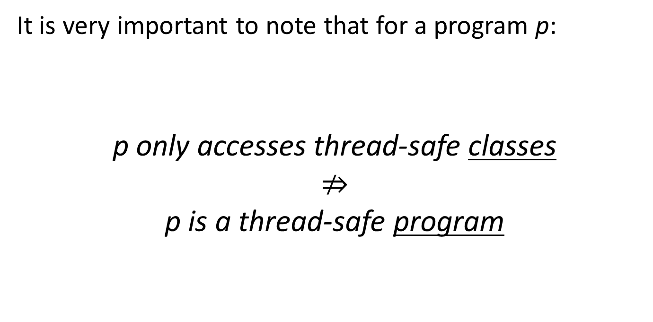
Thread-safety (from week 3)
It is very important to note that for a program p:
p only accesses thread-safe classes
$⇏$
p is a thread-safe program

Slide 47
Making the synchronized ArrayList thread safe
import java.util.*;
public class syncCollectionExample {
public static void main(String[] args) { new syncCollectionExample(); }
public String getLast(ArrayList<String> l) {
synchronized(l) {
int last= l.size()-1;
return l.get(last);
}
}
public static void delete(ArrayList<String> l) {
synchronized(l) {
int last= l.size()-1;
l.remove(last);
}
}
public syncCollectionExample() {
...
}
}
But then the advantage of the synchronized collections is lost !!
Goetz p. 80
Notes:
The two methods are not atomic

Slide 48
What if the data structure is huge?
and used by many threads?
for example:
a bank
Facebook updates
…
Would not work if everything is "synchronized"
What can we do?
Reduce locking !!
Notes:
And still be thread safe

Slide 49
Example: A huge HashMap
Key | Value
Peter | 20487612
Anna | 51251218
Lena | 34458318
Holger | 89545010
Lisa | 94959500
Key value pairs: <k1, v1>, <k2, v2>, …
class HashMap<K,V> {
... // data structure
public V get(K k) { ... }
public V put(K k, V v) { ... }
public boolean containsKey(K k) { ... }
public int size() { return cachedSize; }
public V remove(K k) { ... }
...
}
How to make it thread-safe?
(without making all the methods synchronized)
Notes:
How to make it thread safe?

Slide 50
HashMap implementation
35
buckets
0
ItemNode
1
k
57001
v
Mick
2
Example get(10406)
key k is 10406
k.hashCode() is 6
next
3
4
5
ItemNode
ItemNode
6
k
10406
k
21422
v
Joe
v
Sue
7
next
next

Slide 51
HaspMap put
buckets
put(59014,”Jeff”)
key k is 59014
k.hashCode() is 6
0
ItemNode
1
k
57001
v
Mick
2
next
3
4
5
ItemNode
ItemNode
ItemNode
6
k
59014
k
10406
k
21422
v
Jeff
v
Joe
v
Sue
7
next
next
next

Slide 52
Improving scalability – Lock striping
Guarding the table with a single lock works
... but does not scale well (actually very badly)
Idea: Each bucket could have its own lock
In practice
use fewer, to illustrate we use 4, locks
guard every 4th bucket with the same lock
locks[0] guards bucket 0, 4, 8, ... (stripe 0)
locks[1] guards bucket 1, 5, 9, ... (stripe 1) et
With high probability
two operations will work on different stripes
hence will take different locks
Less lock contention, better scalability
0
1
2
3
4
5
6
7
52

Slide 53
Bucket idea
buckets
0
ItemNode
1
k
57001
Locking one will not lock the other
v
Mick
2
next
3
In different stripes
In different stripes
4
5
ItemNode
ItemNode
ItemNode
6
k
59014
k
10406
k
21422
v
Jeff
v
Joe
v
Sue
7
next
next
next

Slide 54
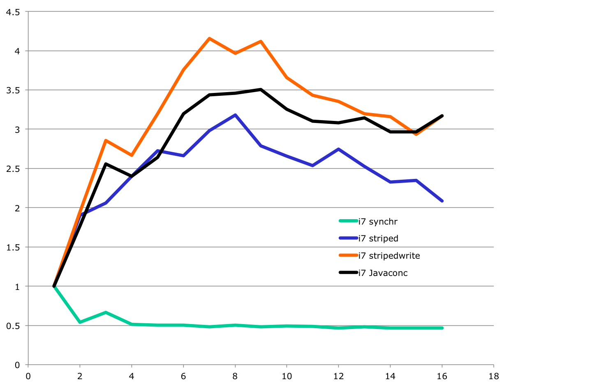
Reducing locking
speed-up
C: Striping and lock-free reads
D: Java’s smart conc. hash map
B: Striping
A: Very bad; too much locking
# threads

Slide 55
Ultimate scalability
A web-shop, Facebook, …
We must give up thread safety,
but still maintain some sort of consistency

