Slide 1
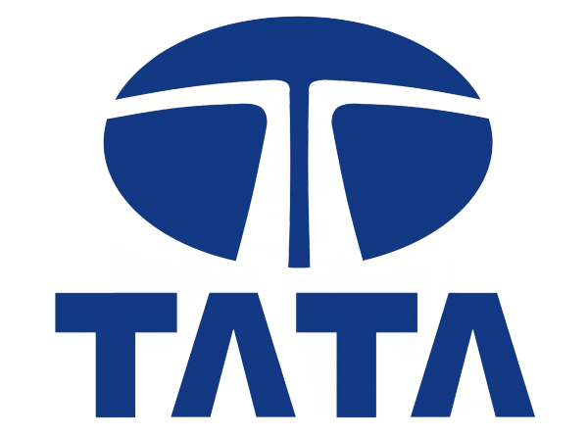
Tata Motors - Case Study 3
Diogo Costa
João Moreira
João Pinheiro
João Oliveira
Ricardo Cavalheiro
Group 22

Slide 2

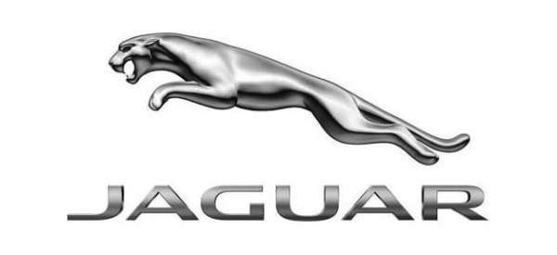

Tata Motors Case Study Introduction
Company Overview
Tata Motors Limited, established in 1945, is a leading global automobile manufacturer based in India and a part of the Tata Group.
Market Presence
With presence across various countries and with sales of over 1.2 million vehicles in FY 2018, Tata Motors offers a diverse range of products including passenger cars, utility vehicles, and commercial vehicles.
Brands included in Tata Motors subsidiaries

Slide 3
Main issues that Tata Motors was facing
Mounting Losses
Tata Motors reported a net loss in three consecutive quarters of FY 2019, with significant losses in Q3 FY 2019 . Management cited the primary reasons for the loss as the challenging market conditions in China, the muted demand scenario in other markets, and a one-time exceptional item of asset impairment in JLR in Q3 FY 2019.
Revenue Realization
There was a need for Tata Motors to improve its average revenue realization per vehicle.
Stock Performance
Tata Motors' stock was trading at lower price-to-book and price-to-earnings ratios compared to industry peers, causing concern among investors.
Market Share Decline
Tata Motors experienced a significant reduction in market share. In the Indian passenger vehicle segment, the company had ceded most of its market share to Maruti Suzuki India Limited.

Slide 4
Key Risks that endanger Tata Motors
Intense Competition
From both domestic and international markets, including major global brands with established market shares in premium segments, such as BMW, Mercedes-Benz, and Audi, as well as strong domestic competitors like Maruti Suzuki and Hyundai in the mass market segment.
Changing Regulatory Environments
The transition to Bharat Stage VI (BS-VI) emission standards represents a significant challenge, involving substantial investment in R&D to develop compliant vehicles.
Operational Inefficiencies
High fixed costs and underutilization of capacity will lead to reduced margins. Managing these operational inefficiencies while simultaneously investing in innovation and new technologies is a critical balance that Tata Motors needs to achieve to improve its financial health.

Slide 5
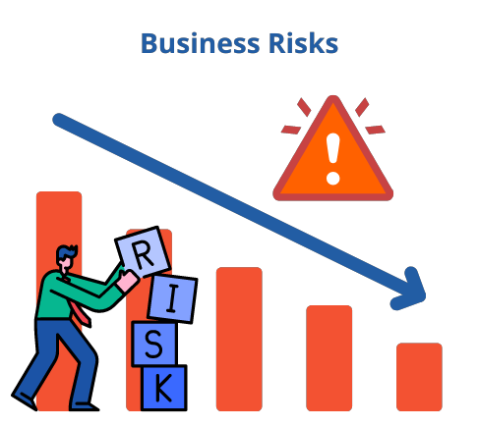
Key Risks that endanger Tata Motors
Economic Volatility
The automotive industry is susceptible to macroeconomic downturns that reduce consumer spending and disrupt manufacturing operations. Fluctuations in global markets, like the slowdown in China or trade tensions between major economies, further exacerbate these challenges.
Technological Disruption
The shift towards electric vehicles (EVs), driven by both regulatory changes and consumer preferences, requires a fundamental transformation in vehicle design, manufacturing processes, and sales strategies. Companies slow to adapt risk losing relevance.

Slide 6
Potential Opportunities
Market Shift
Despite the challenges, growing markets like electric and hybrid vehicles offer new market share opportunities. Tata Motors can capitalize on R&D in EVs to capture a significant position in this emerging sector.
Government Incentives
Automotive Mission Plan 2016–26, aim to support the growth and global competitiveness of India's automobile sector. These policies could provide financial and infrastructural support to companies transitioning to new technologies.
Focus on Commercial Vehicles
Tata Motors holds a dominant position in the Indian commercial vehicle segment. Further strengthening its portfolio by introducing new models in the class and expanding into niche segments could prove to be profitable.

Slide 7

Potential Opportunities
Global Presence
Tata Motors’ boasts a global network of operations in multiple countries offering diverse revenue streams and the potential to leverage different market dynamics. This can mitigate risks associated with dependency on a single market.
Export Potential
Given its established base in India, Tata Motors benefits from a relatively inexpensive and skilled workforce. This advantage could be leveraged to either improve profit margins by exporting mass-produced vehicles to developed countries, or increase sales volume by targeting emerging markets with more affordable options

Slide 8
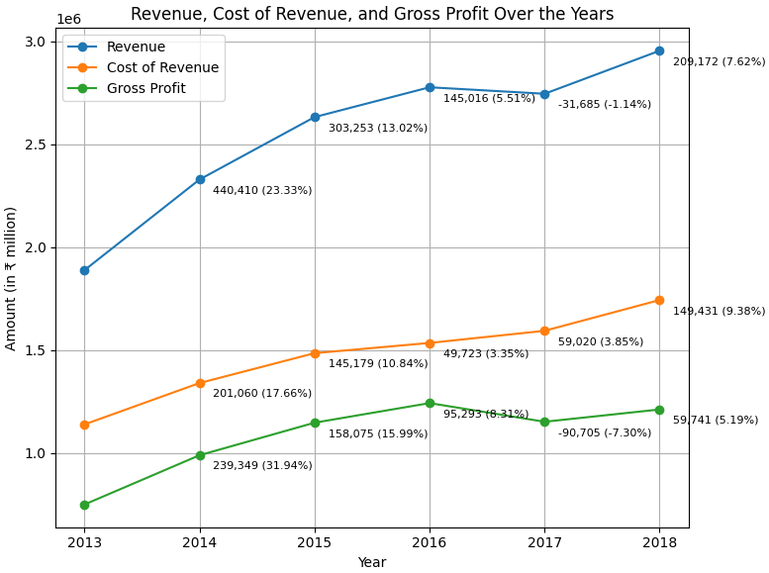
Tata Motors’ Financial Performance: Income Statement
Revenue
It generally showed an increasing trend, with notable growth over the years. However, there was a slight dip observed in 2017.
Cost of Revenue
It increased in abs. value over the years. However, looking at the values represented as percentages we see:
From 2013 to 2016, it dropped by about 5%, which was the biggest drop;
From 2016 to 2018, it went up by around 4%. (Still lower than 2013)
 | 2013 | 2014 | 2015 | 2016 | 2017 | 2018
Revenue Cost (%) | 60,30 | 57,53 | 56,42 | 55,26 | 58,05 | 59,00
Table 1 - Revenue Cost Over Time
Notes:
Revenue Growth: Revenue increased from ₹2,776 billion in FY 2016 to ₹2,954 billion in FY 2018, showing recovery after a dip in FY 2017.
Gross Margin: Consistently strong, peaking at 44.7% in FY 2016, but slightly declining to 41.0% in FY 2018.
EBITDA Margin: Varied between 9.9% and 14.9%, lower in 2017 and 2018, indicating pressure on core profitability.
Operating Margin: Declined from 9.8% in FY 2016 to 4.3% in FY 2018, reflecting increased operating costs.
Net Margin: Dropped from 6.9% in FY 2016 to 2.3% in FY 2018, significantly below industry median, indicating lower overall profitability.
Percentagens are over Revenue

Slide 9
Tata Motors’ Financial Performance: Income Statement
Gross Profit
It increased until 2016 but started to decline in 2017. This downturn is attributed to significant challenges the company faced that year, making 2017 a particularly difficult period for them.
 | 2013 | 2014 | 2015 | 2016 | 2017 | 2018
Gross Profit (%) | 39,70 | 42,47 | 43,58 | 44,74 | 41,95 | 41,00
Total Operating Exp (%) | 91,09 | 90,91 | 90,23 | 92,50 | 93,86 | 95,74
Net Income (%) | 5,24 | 6,01 | 6,85 | 4,17 | 2,72 | 3,04
Total Operating Expenses & Net Income
Operating Expenses rose by approximately 5% over the years, with the increase beginning notably in 2016.
Consequently, the Net Income followed the opposite distribution. Achieved its peak in 2015 (abs. and %) @ ~7% and then decreased until ~3%.
Table 2 - Gross Profit, Total Operating Expenses & Net Income Over Time
Notes:
Revenue Growth: Revenue increased from ₹2,776 billion in FY 2016 to ₹2,954 billion in FY 2018, showing recovery after a dip in FY 2017.
Gross Margin: Consistently strong, peaking at 44.7% in FY 2016, but slightly declining to 41.0% in FY 2018.
EBITDA Margin: Varied between 9.9% and 14.9%, lower in 2017 and 2018, indicating pressure on core profitability.
Operating Margin: Declined from 9.8% in FY 2016 to 4.3% in FY 2018, reflecting increased operating costs.
Net Margin: Dropped from 6.9% in FY 2016 to 2.3% in FY 2018, significantly below industry median, indicating lower overall profitability.
Percentagens are over Revenue

Slide 10
Tata Motors’ Financial Performance: Balance Sheet
Assets Analysis
There’s a huge increase in the assets value over the years.
Cash and Short-Term Investments had a significant rise in value, although percentage wise it dropped a bit in 2018.
In absolute terms, Accounts Receivable has no visible trend. However, in relative terms it decreased with the years. (13% to 9%) .
Both PP&E and Inventory increased with time, which may mean that company is expanding its operations or increasing its production capacity.
 | 2013 | 2014 | 2015 | 2016 | 2017 | 2018
Cash & Short-Term (%) | 13,10 | 13,55 | 18,58 | 18,41 | 18,59 | 14,87
Acc. Receivable (%) | 13,31 | 10,82 | 7,78 | 7,59 | 7,74 | 8,73
Inventory (%) | 12,35 | 12,40 | 12,45 | 12,57 | 13,07 | 13,40
PP&E (%) | 21,76 | 23,11 | 26,50 | 26,76 | 25,49 | 27,16
Table 5 - Assets Metrics Over Time
Notes:
PP&E - Property/Plant/Equipment, Net
Percentagens are over Total Assets

Slide 11
Tata Motors’ Financial Performance: Balance Sheet
Liability & Equity Analysis
Current Liabilities decreased 7%, which happened mainly due to a decrease in Accounts Payable & Accrued Expenses. Which may indicate that Tata Motors is paying its suppliers more promptly and that the company is managing its expenses more efficiently.
The fluctuation in Long-Term Debt may reflect changes in the company’s long-term financial obligations over the periods.
It seems like there’s a seasonality in Equity, as it fluctuates in the same way. Possibly due to annually dividend payments to shareholders.
 | 2013 | 2014 | 2015 | 2016 | 2017 | 2018
Total Current Liabilities (%) | 50,80 | 41,98 | 41,74 | 40,07 | 42,24 | 43,22
Long-Term Debt (%) | 18,87 | 20,57 | 22,93 | 18,91 | 22,15 | 18,47
Equity (%) | 22,09 | 29,82 | 23,21 | 29,55 | 21,21 | 28,80
Table 6 - Liability & Equity Metrics Over Time
Notes:
Percentagens are over Total Liabilities and Shareholders' Equity

Slide 12
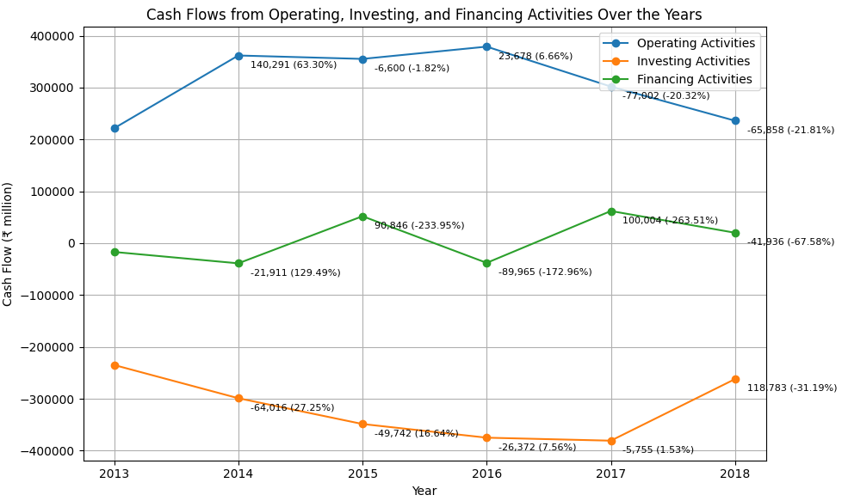
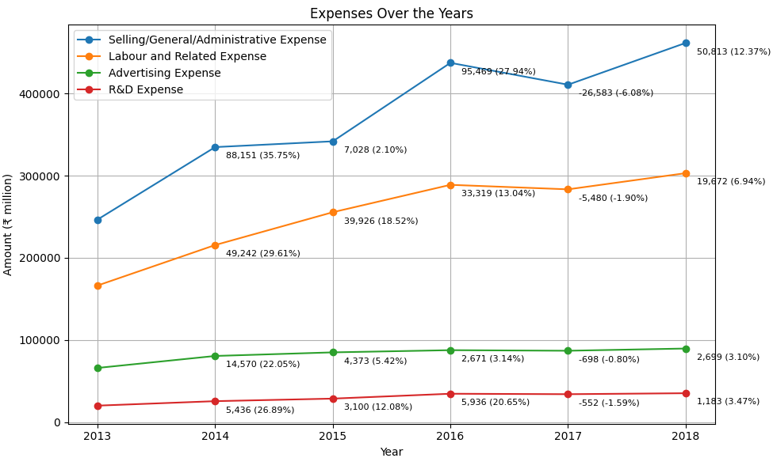
Tata Motors’ Financial Performance:
Cash Flow & Expenses
Cash Flow & Expenses Analysis
Positive cash flows from operating activities provide the company with the liquidity needed to fund investments in assets and growth initiatives (investing activities, e.g R&D) and to meet financing obligations or distribute returns to shareholders (financing activities).
Negative cash flows from Investing Activities isn’t necessarily bad, as they could be investments for the future (long-term).
The fluctuations in cash flows from financing activities reflect changes in the company's investment and financing strategies, as well as market conditions and business cycles.
Notes:
The reduction in expenses in 2017 stands out against the backdrop of previous years' spending patterns, indicating a significant shift in the company's financial management during that period.

Slide 13
Economic and Financial Evolution of Tata Motors: Profitability and Liquidity
Profitability
Liquidity
Low Liquidity
Tata Motors has faced challenges in meeting short-term obligations
Quick/Current Ratio remained around 0.6-0.7 (median 1.01)
Slight Improvement: There have been slight improvements over time, but liquidity remains below the industry median.
Strong production efficiency
Despite fluctuations
Gross Margin: Remained consistently above the industry median (23.9%)
Well above Industry: Tata Motors has historically demonstrated strong profitability metrics, outperforming industry peers in generating profits from its resources.
Crisis Year 2017
2017 marked a challenging period for Tata Motors, with operating margins dipping below the industry median.
Working Capital Cycle
Negative Cash Cycle: Tata Motors benefits from an extended payables period, resulting in a negative cash cycle, reducing the need for external financing.
Notes:
Profitability
Despite fluctuations, the gross margin remained robust, suggesting effective cost control and value addition.
Operating Margin: The consistent decline suggests increasing operating costs or reduced operational efficiency.
High Intangibles Assets, may be due to Tata Motors high investment in R&D)
Liquidity
Observation: Indicates insufficient current assets to cover current liabilities, implying liquidity risk.
Working Capital Cycle
Rising inventory days indicate slower inventory turnover, potentially leading to higher holding costs.
Average Accounts Payable Days: Increased from 142.0 days in FY 2013 to 158.9 days in FY 2018.
Negative cash cycle -> Efficient working capital management with a negative cash cycle, reducing the need for external financing.

Slide 14
Economic and Financial Evolution of Tata Motors: Efficiency and Financial Analysis
Efficiency
Leverage
Declining Fixed Asset Efficiency
Decreased efficiency in utilizing assets to generate sales.
Declined from 5.09% in 2013 to 3.28% in 2018.
Slowing Inventory Turnover:
leading to higher holding costs.
Decreased from 9.0 in 2013 to 6.7 in 2018.
High Fluctuation Levels
Increased risk and impact on its ability to meet long-term obligations
Risky Capital Structure
high level of debt relative to earnings
Net Debt to EBITDA: Peaked at 1.25 in 2013 and again at 1.23 in 2018
Significant Long-Term Debt
to Total Capital
Peaked at 44.4% in 2017
DuPont Analysis ROE (return on equity) Declined from 32.6% in 2015 to 9.4% in 2018
Reduced profitability and returns for shareholders.
Tata Motors shows strengths in profitability and efficiency but faces challenges in leverage and liquidity, requiring a balanced approach for sustained growth.
Notes:
Efficiency
Observation: Indicates declining efficiency in managing receivables.
Leverage
The company’s autonomy has been fluctuating across the 5 years, but there is a reduction on the weight of the loans to pay in 2018 (recovery year, new priorities defined by the new CEO)
The fact the company uses credits allows it to get an higher financial leverage (tax savings payable by paying interest)
Conclusion
Dupont Analysis -> ROE (Return on equity) Declined from 32.6% in FY 2015 to 9.4% in FY 2018. Observation: Indicates reduced profitability and returns for shareholders.
Tata Motors' financial and economic performance over the six-year period shows significant fluctuations, with notable declines in profitability, liquidity, and efficiency ratios. Despite maintaining a strong gross margin, the operating and net margins have declined, indicating increased operating costs and financial pressures. Liquidity ratios suggest potential short-term financial stress, while leverage ratios point to increased financial risk due to higher debt levels. Efficiency ratios indicate a decrease in asset utilization effectiveness. Overall, Tata Motors faces challenges in generating profits and maintaining financial stability, particularly in the later years of the analysis period.

Slide 15
SWOT Analysis
Strengths
Weaknesses
Opportunities
Threats
Strong Brand Recognition
International Presence
Liquidity Challenges
Low Operating Margins
Expansion into Emerging Markets
Cost Optimization and Innovation
Sustainable Practices
Economic Crises
Intense Competition
Regulatory Changes
Notes:
Strengths:
Strong Brand Recognition: Tata Motors is a well-established brand with a significant presence in the automotive industry, known for its reliability and diverse product portfolio.
International Presence: Ownership of Jaguar Land Rover (JLR) enhances its global market presence and provides access to premium segments.
Weaknesses:
High Leverage: The company relies heavily on debt, resulting in a risky capital structure with significant long-term debt impacting financial stability.
Operating Margins: Operating margins dipped below the industry median in 2017, indicating potential inefficiencies and cost management issues.
Opportunities:
Expansion into Emerging Markets: Expanding into emerging markets can tap new growth opportunities and diversify revenue sources.
Cost Optimization and Innovation: Implementing cost-cutting measures and investing in innovative technologies can improve operational efficiency and profitability.
Sustainable Practices: Integrating sustainable practices can enhance brand image and meet regulatory requirements, attracting sustainability-focused investors.
Threats:
Economic Downturns: Economic crises or downturns in key markets can adversely affect sales and profitability.
Intense Competition: The automotive industry is highly competitive, with pressure from both traditional automakers and new entrants, especially in the EV market.
Regulatory Changes: Stringent environmental and safety regulations can increase compliance costs and impact profitability.

Slide 16
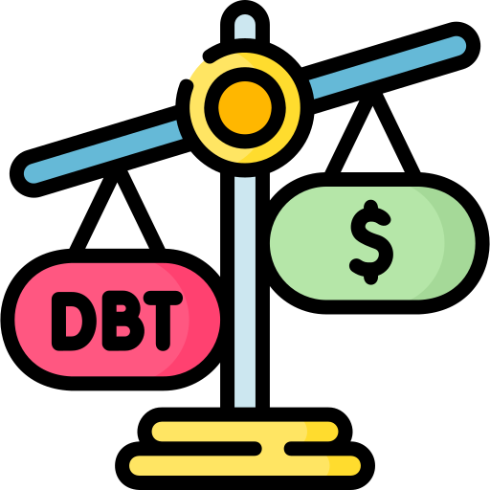

Strategies
Reduce Debt Levels
Debt Restructuring: Explore refinancing options to reduce interest costs and extend debt maturities.
Asset Sales: Consider divesting non-core assets to generate cash for debt repayment.
Enhance Profitability
Cost Optimization: Implement cost-cutting measures and improve operational efficiencies across the supply chain.
Product Mix Optimization: Focus on high-margin segments and innovate to meet consumer demand in growing markets.
Improve Liquidity:
Working Capital Management: Optimize inventory levels and improve receivables collection to enhance cash flow.
Short-Term Financing: Secure more favorable short-term credit lines to bridge liquidity gaps.
Notes:
Based on the analysis of Tata Motors' financial performance, the following strategies are recommended to improve the company's financial position:
Reduce Debt Levels:
Debt Restructuring: Explore refinancing options to reduce interest costs and extend debt maturities.
Asset Sales: Consider divesting non-core assets to generate cash for debt repayment.
Enhance Profitability:
Cost Optimization: Implement cost-cutting measures and improve operational efficiencies across the supply chain.
Product Mix Optimization: Focus on high-margin segments and innovate to meet consumer demand in growing markets.
Improve Liquidity:
Working Capital Management: Optimize inventory levels and improve receivables collection to enhance cash flow.
Short-Term Financing: Secure more favorable short-term credit lines to bridge liquidity gaps.

Slide 17


Strategies
Boost Operational Efficiency
Technology Investment: Invest in automation and advanced manufacturing technologies to increase productivity.
Supplier Relationships: Strengthen relationships with suppliers to negotiate better terms and reduce procurement costs.
Expand Market Presence
Geographical Diversification: Expand into emerging markets to tap new growth opportunities.
Electric Vehicles (EV): Accelerate the development and launch of EVs to capture market share in the growing green vehicle segment.
Strengthen Financial Management
Risk Management: Implement robust risk management practices to mitigate financial and operational risks.
Performance Metrics: Establish key performance indicators (KPIs) to regularly monitor financial health and operational efficiency.
Notes:
Boost Operational Efficiency:
Technology Investment: Invest in automation and advanced manufacturing technologies to increase productivity.
Supplier Relationships: Strengthen relationships with suppliers to negotiate better terms and reduce procurement costs.
Expand Market Presence:
Geographical Diversification: Expand into emerging markets to tap new growth opportunities.
Electric Vehicles (EV): Accelerate the development and launch of EVs to capture market share in the growing green vehicle segment.
Strengthen Financial Management:
Risk Management: Implement robust risk management practices to mitigate financial and operational risks.
Performance Metrics: Establish key performance indicators (KPIs) to regularly monitor financial health and operational efficiency.
Focus on Sustainability:
Sustainable Practices: Integrate sustainable practices into the business model to improve brand image and meet regulatory requirements.
Green Financing: Explore green financing options to fund eco-friendly projects and attract sustainability-focused investors.
By implementing these strategies, Tata Motors can strengthen its financial position, enhance profitability, and ensure long-term growth and stability.

