Slide 1
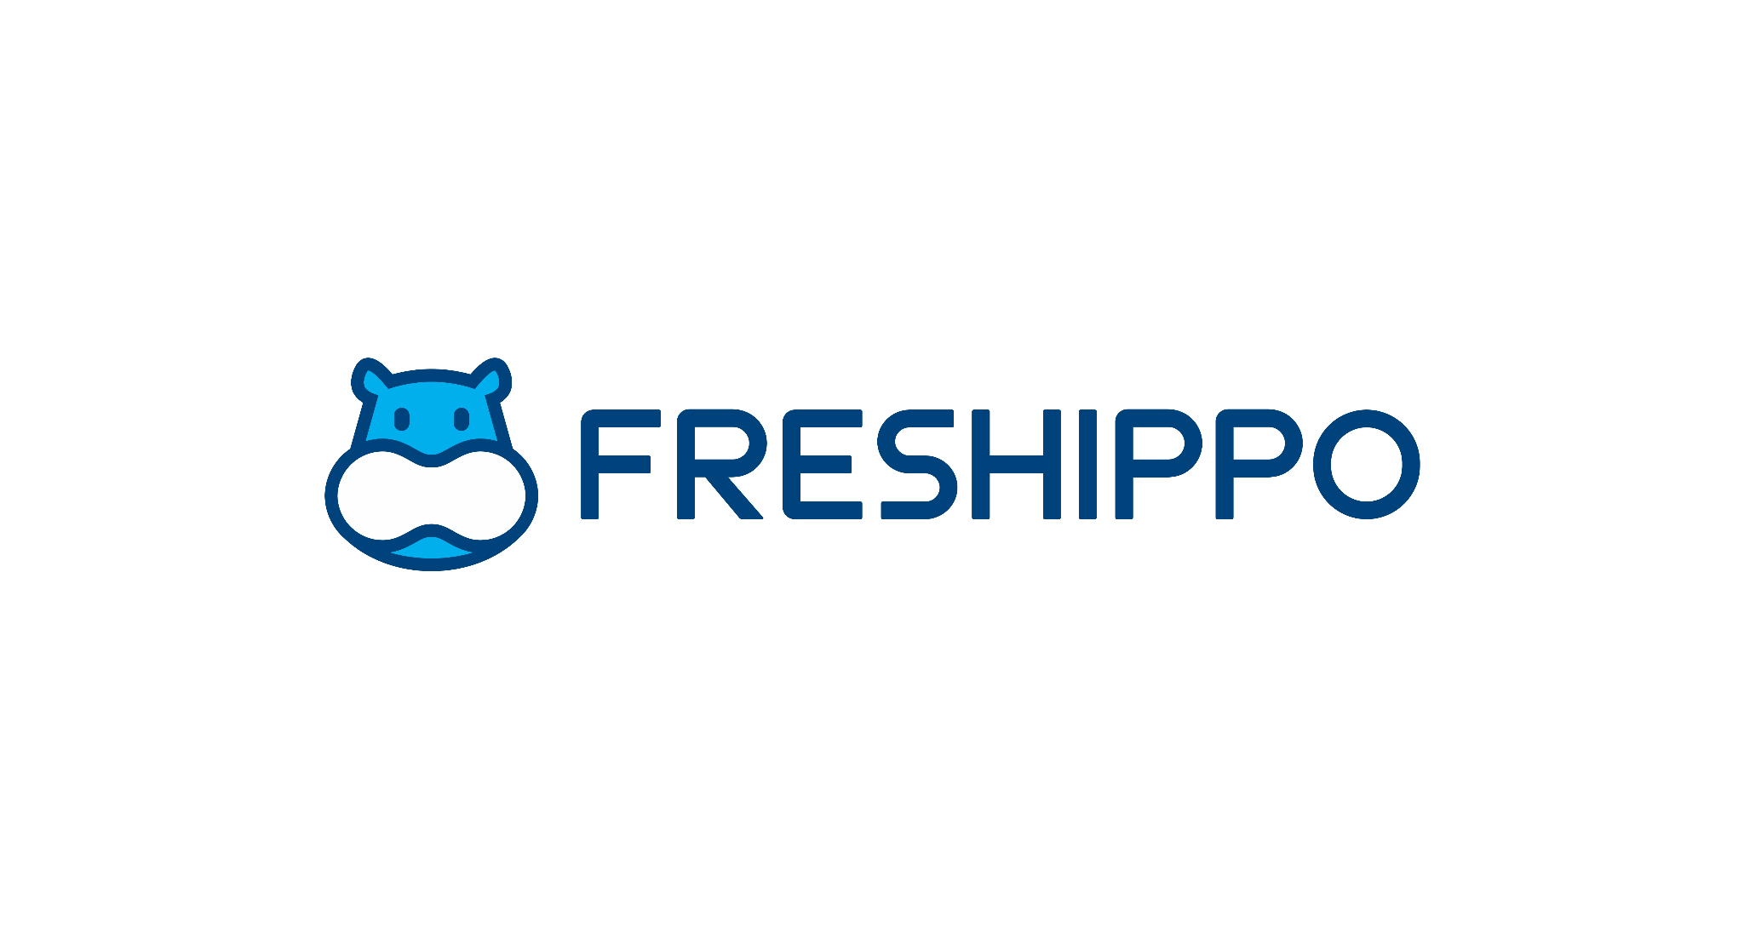
Freshippo Case Study
Diogo Costa
João Moreira
João Pinheiro
João Oliveira
Ricardo Cavalheiro
Group 22

Slide 2

Introduction
Foundation and Concept
Freshippo is a grocery store chain operated by the Alibaba Group
Launched in January 2016 in Shanghai, China, by Hou Yi, a former executive at Alibaba.
Rapid Expansion
Rapid growth from the second half of 2017, opening a new store approximately every six days.
By June 2018, expanded to 46 stores across 13 cities in China.
Introduced as a revolutionary grocery shopping platform blending online and offline retail.

Slide 3
Freshippo’s Success
Data-Driven Strategy
Leveraged Alibaba’s big data analytics for "top-level design" in business modeling and decision-making.
Set ambitious KPIs focusing on online transactions, daily orders, app independence, and logistics efficiency.
Market Differentiation and Extensions
Expanded the brand through the introduction of F2 (Fast & Fresh) convenience stores, Freshippo Cloud Supermarket, Hexiaoma stores and Nanxiang stores.
Developed proprietary technology for automated restaurant and supermarket services to address customer pain points.
Created private-label brands and established a fresh produce supply chain emphasizing quality and freshness.
Technological Backbone
Utilized mobile Internet, cloud computing, big data, and artificial intelligence to drive business innovation.
Built its IT architecture around Alibaba Cloud, adhering to Alibaba’s "One Data" Strategy.
Enhanced operational efficiency and customer interaction through real-time data collection and analytics.

Slide 4
Initial Market-fit
Age and Gender - Freshippo started by focusing specifically on women between the ages of 20 and 45 for a reason – this demographic is often the primary grocery shopper and decision-maker regarding household food purchases.
Professional Occupation - Targeting white-collar workers implied both a discretionary income level (willingness and ability to pay for quality and convenience) and time constraints that would make Freshippo's services attractive.
Alipay Users - This set them up for their app-centric vision. Alipay usage indicated technological comfort and a potential openness to online grocery shopping. It also allowed to gather a lot of useful information regarding user spending habits and demographics.
Lifestyle and Values - Target consumers prioritize quality of life and healthy diets, favoring fresh, premium, and unique food options over price sensitivity.

Slide 5
Matching Product Offerings
Seafood Focus - Not only is seafood a premium offering, but its emphasis on freshness created a strong point of differentiation from traditional supermarkets where quality could be inconsistent.
App-Based Convenience - The Freshippo app played a crucial role from the beginning. For a time-constrained audience, the ability to shop online (where product detail and origin information could be highlighted) and receive rapid delivery was highly attractive.
Hybrid Model - Brick-and-mortar stores were strategically essential alongside the app to:
Build brand trust: Customers could see the quality of seafood firsthand
Create a sensory experience: Clean, well-lit stores reinforced the emphasis on freshness
Value Proposition - Quality, Trust, Convenience, and Premium yet accessible prices

Slide 6
Evolving Product-Market Fit Through Data
Customer Segmentation
While the initial target market proved successful, data revealed additional profitable segments, which were taken advantage of with personalized marketing using extensive data profiles that derived from the massive amount of data collected on shopping habits (since even offline purchases were made through the app)
Identifying New Needs
Beyond fresh seafood, data helped Freshippo pinpoint gaps in their offering. For example:
Convenience meals for office workers (led to F2 Stores)
Demand for a wider selection of everyday (non-fresh) grocery items (led to Freshippo Cloud Supermarket)

Slide 7
Evolving Product-Market Fit Through Data
Pre-Launch Data - Before opening a store, a wealth of information was gathered to guide initial product choice:
Alipay User Profiles: Demographics, spending habits, and past purchases indicated likely preferences and price points.
Product Supplier Information: Availability, quality history, and alignment with Freshippo's value proposition
Post-Launch Data Collection - Once a store opened, Freshippo focused on gathering detailed sales and customer behavior data:
SKU-level Tracking: Which items sold well/poorly in the first two months were crucial indicators for keeping or dropping stock.
Customer Ordering Patterns: Category, frequency, and time of day all informed future procurement.
Customer Feedback: Reviews, app interactions, and in-store data (via Wi-Fi) yielded critical insights on product quality and specific customer desires.
The final piece in the puzzle is Iteration!

Slide 8

Customer Segmentation
20-45 year old female white-collar workers who use Alipay
Responsible for family care;
Live a fast-paced lifestyle;
Medium/High Spending Power;
Value quality in life & healthy diets;
High Spending Power (Executives from Fortune 500)
Fast delivery demand with no concern on the price;
Office workers
Mainly concerned with food hygiene & their own schedule;
Medium/Low Spending Power (Hexiaoma)
Still relative fast delivery with no added fees;

Slide 9
Customer Relationships
GET Customers
Through analysis of Alipay, WeChat & Weibo data. Place stores in areas with a high volume of online shoppers and specific demographic characteristics;
The uniqueness and cleanliness of Freshippo seafood that could not be found elsewhere;
Quick grocery delivery within a radius of 3 kilometers;
Promotions for first time customers (free delivery & within 1 hour) - Hexiaoma.

Slide 10
Customer Relationships
KEEP Customers
Freshippo offers personalized marketing efforts and tailored recommendations to enhance customer satisfaction and loyalty. (one-on-one marketing);
Freshippo fosters a sense of community among customers through events, promotions, and personalized marketing efforts, creating a connection beyond transactions and strengthening customer loyalty;
Freshippo prioritized customer experience and implemented innovative solutions to enhance efficiency and convenience, such as the introduction of automated restaurant features and seamless integration with its mobile app for ordering processes;
Overall smooth shopping experience.

Slide 11
Customer Relationships
GROW Customers
Promotional Events - Freshippo organizes regular promotional events such as sales, discounts, and limited-time offers to stimulate demand and encourage repeat purchases from existing customers;
Product Expansion - Freshippo started with focus on Fresh seafood and then continuously expanded its product range to cater to a wider range of customer needs and preferences. Freshippo can capture additional revenue streams from its existing customer base.

Slide 12


Channels
Offline Channels - physical stores with advanced technologies;
Online Channels - complement the physical stores. Customers can use the Freshippo app to make purchases, access personalized recommendations, and enjoy various services such as home delivery;
Social Media - Customers spread word-of-mouth on social media as well;
Marketing & Advertising.
Revenue Streams
Product Sales - either through physical stores or Freshippo application;
Membership System - through client recurrent subscriptions.

Slide 13

Value propositions
Premium yet accessible prices;
Freshness & Quality of their products;
Convenience - Whether customers prefer to shop in-store or online, Freshippo provides seamless options for browsing, ordering, and receiving products. Its fast delivery services, including the ability to fulfill orders quickly at a certain radius;
Technology Integration - Freshippo integrates advanced technologies into its stores and operations to enhance the shopping experience. Either in their online and offline shopping as in their restaurant;
All-in-one App - The company provides a comprehensive range of services through the Freshippo app, integrating grocery shopping, food preparation, and delivery. Customers can conveniently place orders via QR codes, receive groceries at their doorstep, and opt for freshly cooked meals.
Personalized Marketing - Through the Freshippo app, the brand engages in one-on-one marketing with customers, offering personalized recommendations and tailored promotions based on individual consumption needs and habits.

Slide 14

Key Resources
Physical:
Local stores;
Central Warehouses;
Cold-chain transportation vehicles;
Delivery vans;
Temperature Sensors, CCTVs, GPS;
Robots;
Real-Estate Companies & Local Property Management Companies.
Human:
Store Employees;
Software Engineers;
Delivery Employees;
R&D team.
Intelectual:
Big-Data;
Artificial Intelligence & Deep Learning;
Automated Systems;
Private Labels;
Cloud computing;
Application.

Slide 15
Key Activities
Product Sales
Distribution
Marketing and Promotions
Delivery
Quality inspection, Product standardization & Food safety
Inventory Management

Slide 16

Key Partners
Alibaba & E-commerce channels of Alibaba:
For example Taobao.com and Ele.me would push traffic to Freshippo;
Alibaba’s big data & technology (e.g recommender system);
Alibaba Cloud platform
Local Farms:
To purchase fresh products;
Third-Party Suppliers:
Products of third-party brands were selected as a result of data analysis. Freshippo did not charge any fees to third-party suppliers;
Real-Estate Companies & Local Property Management Companies
Offline Supermarkets:
Partnered with RT-Mart due to their experience in brick-and-mortar store management.

Slide 17

Cost Structure
Salaries:
Software development team, marketing team, employees & couriers;
Facilities:
Space Renting/Ownership for Local Stores and Central Warehouses.
Technology:
App development;
Artificial Intelligence & Cloud Computing;
Data Warehouses;
Hardware for Data Collection (GPS, Sensors, etc.)
Robots.
Distribution and Delivery:
Costs related to transporting goods from warehouses to local stores or distribution centers.
Expenses associated with fulfilling customer orders, including packaging, shipping.
Suppliers:
Costs related to purchasing goods and materials from suppliers or vendors.
Marketing & Advertising

Slide 18
How did data and emerging technologies drive the innovative business model of Freshippo?
Data Collection and Analysis:
Big data and AI technologies to collect, process, and analyze vast amounts of data that allowed the company to strengthen interactions between customers, products, and stores both online and offline;
Optimize algorithms and improve processes;
Real-time data enhanced decision-making process.
Data-driven site selection:
Big data analysis of active Alipay Users within a three-kilometer radius;
Located areas with more online shoppers spending more per order.
Operation Efficiency:
Attributed to data-processing and application technologies;
Supply chain fully managed using new technologies and equipment build around Alibaba Cloud;
Store operation system assigned tasks to employees to ensure not only a balanced distribution of work in stores but also optimal human efficiency.

Slide 19
How did data and emerging technologies drive the innovative business model of Freshippo?
Data-driven product Selection and Efficient stock:
Big data from Alibaba and its own customers allowed to make informed product selection and procurement plans for each store;
Allocate stock efficiently and tailor its product offerings to meet customer demand;
Products moving slowly in a store warehouse or on a shelf were automatically promoted.
Freshippo App:
Focus on converting offline traffic to online traffic
Customers use the app to most of their actions (scan product barcodes in-store, place orders for home delivery, pay to save time waiting in line).
Personalized Marketing:
Via the app Freshippo had full access to information on customers consumption needs and habits which allowed to create extensive profiles of its customers
Allowed one-to-one marketing and personalized recommendations

Slide 20
Freshippo operation shortcoming
Long waiting times
Problem:
Freshippo had been widely criticized for long wait times for meals.
Overcome:
In February 2018 Freshippo opened the Nanxiang Store;
It was a brick-and-mortar store that combined an automated restaurant and a supermarket in one.
Customers first chose their seats on the screen at the restaurant entrance, and then followed the instructions from the system to get seated.
Next, they scanned the QR code on the table with their Freshippo app to order dishes.
Beside the table, there was a track for robots to deliver dishes.
From customer ordering to preparation in the kitchen to dish delivery, all activities were managed by the system and displayed on the screen beside the table. In this store, it was robots that delivered dishes and even cooked some standard dishes
Despite all of these efforts, the issue persisted.

Slide 21
Freshippo operation shortcoming
Food quality
Problem:
The store had been receiving customer complaints, including some related to stale and lackluster food.
Overcome:
Freshippo invested in technology and equipment to support its quality control efforts.
This included the use of IoT devices, temperature sensors, and real-time monitoring systems to ensure the freshness and quality of products during transportation and storage;
Limit fresh food exposure to at most 18 hours;
Implement quality inspection and control measures throughout the supply chain.

Slide 22
Freshippo operation shortcoming
High cost of order fulfillment
Objective:
Reduce the cost of order fulfillment through data analysis.
Overcome:
Orders are accumulated to a certain quantity, and the best outbound route is determined based on order quantity and product types;
Orders on the same route are combined to maximize delivery efficiency. Integrated orders are transported from the central warehouse to stores overnight;
Delivery men pick up parcels during less busy store hours and sort them according to order information upon reaching customers.

Slide 23
Freshippo leverage emerging technologies to evolve into a more sustainable and profitable business
Green Technologies in Store Operations:
Energy-efficient technologies such as LED lighting and renewable energy sources;
Solar panels into store operations to reduce energy consumption and carbon emissions.
Efficient Last-Mile Delivery:
Utilize electric vehicles (EVs) or delivery drones for last-mile delivery to reduce carbon emissions and congestion in urban areas;
Offer incentives for customers to choose consolidated delivery options or pickup points to reduce the environmental impact of individual deliveries.

Slide 24
Customer Development Process
Customer Feedback and Validation:
Freshippo should actively seek feedback from customers at various touch points, including in-store interactions, online shopping experiences and post-purchase surveys.
Iterative Product Development:
Freshippo should adopt an iterative approach to product development, leveraging customer feedback to refine and improve its technology-driven offerings. Rather than launching large-scale initiatives all at once, Freshippo can release products in beta and gather feedback from early users.
Continuous Learning and Evolving:
Freshippo should continuously monitor customer feedback and market trends to stay agile and responsive to changing customer preferences.
Market Research and Area Study:
By involving customers in co-creation initiatives and conducting extensive market research in different regions, Freshippo can gain valuable insights to strategically determine where to launch new products or establish new stores.
Notes:
Customer development process can be pivotal in Freshippo's evolution as it ensures that technological innovations align with customer needs, preferences, and market dynamics, fostering engagement, loyalty and competitive advantage in the industry

Slide 25

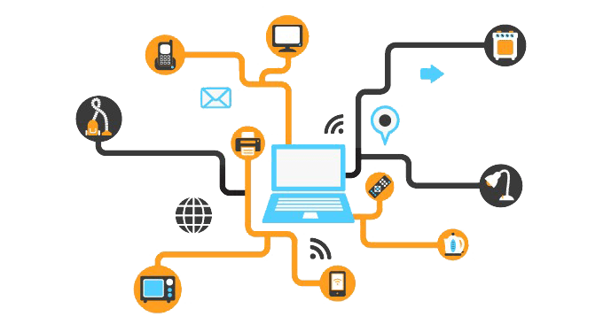
Next Steps
5G Implementation:
Leverage 5G technology for faster and more reliable data transmission, enabling real-time analytics, immersive customer experiences and better connectivity across all touchpoints.
Explore opportunities for augmented reality (AR) and virtual reality (VR) applications to create immersive shopping experiences.
IoT Integration:
Deploy IoT devices to collect data on temperature, humidity, shelf life and product movement, enabling inventory management and quality control.
Predictive maintenance of equipment and machinery, reducing downtime, minimizing operational disruptions.

Slide 26


Next Steps
Security and Privacy Measures:
Prioritize cybersecurity and data privacy to protect sensitive customer information;
Implement robust encryption protocols, multi-factor authentication and secure network architectures to safeguard data integrity and confidentiality.
Data Analytics and AI:
Identify patterns, trends, and insights and predict future consumer behaviors and preferences;
Implement AI-driven algorithms for dynamic pricing, personalized promotions and targeted marketing campaigns;
Use AI-powered chatbots and virtual assistants.

