Slide 1
ACADEMIC PROJECT
AI Study Material Generator
Generate exam-ready learning content from uploaded PDFs with Python, Streamlit, and Google Gemini AI.

Slide 2

THE CORE IDEA
From PDF to personalized preparation
One source. Several exam-ready outputs.
Generate on demand
Set the learner’s need
Generate notes, answers, MCQs, or revision material on demand.
Upload and extract
Choose a subject, topic, difficulty level, and output format.
Upload study material in PDF format and extract its text.
02

Slide 3
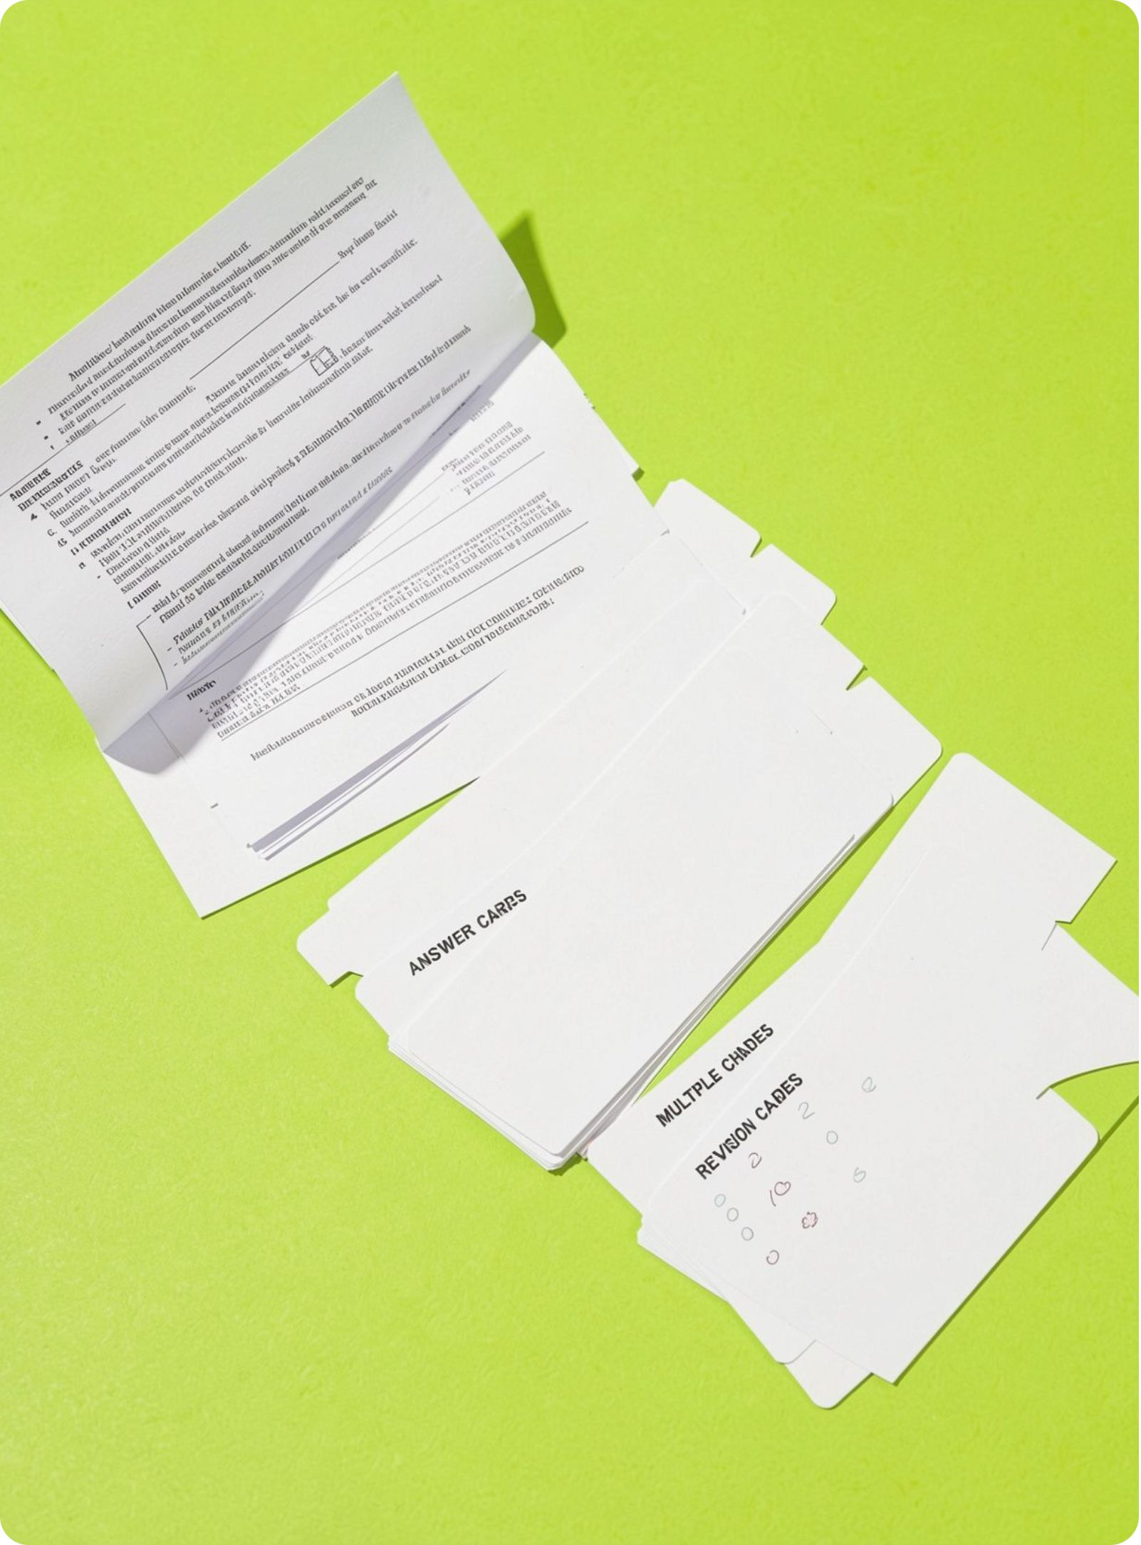

ABSTRACT
Source material becomes structured academic content.
The application uses an AI-powered workflow to convert source material into structured academic content tailored to a learner’s selected topic, difficulty, and exam format.
Designed for faster preparation and repeated revision.
Supports beginner, intermediate, and advanced difficulty levels.
Generated material can be downloaded for offline use.
03

Slide 4
PROJECT DEFINITION
Requirements and objectives
The system turns a simple web interface into a controlled generation pipeline.
01
02
Accept
Extract
Accept PDF-based study material through a simple web interface.
Extract usable text reliably before generation.
03
04
Structure
Protect
Produce clear, exam-oriented outputs with consistent structure.
Protect the Gemini API key through environment variables.
04

Slide 5
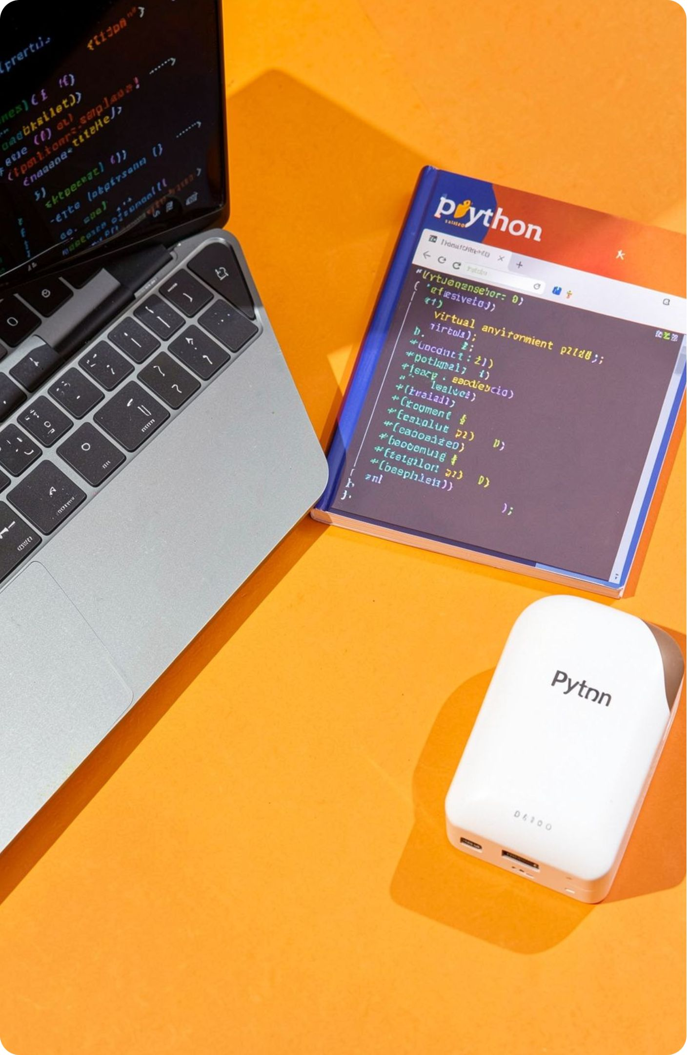
TECHNICAL FOUNDATION
Software and hardware requirements
Software
Python, Streamlit, Google Gemini AI, pypdf, python-dotenv, HTML/CSS.
Runtime
Virtual environment, requirements.txt, .env file, and a modern web browser.
Hardware
A basic computer capable of running Python and a browser, with internet access for Gemini API calls.
05

Slide 6
Modules used in the system
01
02
03
Input module
Extraction module
Prompt module
Subject, topic, difficulty, material type, and PDF upload.
Reads PDF pages and combines their text.
Maps the selected output type to a structured AI prompt.
04
05
Generation module
Output module
Sends the prompt and extracted content to Gemini.
Displays and downloads the generated material.
06

Slide 7
USER JOURNEY
Application workflow
Enter the subject and topic.
1
Select difficulty and material type.
2
Upload the PDF and extract its text.
3
Create a focused prompt from the selections.
4
Generate, review, and download the study material.
5
07

Slide 8


BEYOND THE DEMO
Real-world applications
Students can turn lecture notes and textbooks into quick revision packs.
Teachers can create practice questions and differentiated learning material.
Coaching centers can produce exam-specific notes at multiple difficulty levels.
Self-learners can convert long PDFs into focused summaries and MCQs.
08

Slide 9
ROADMAP
Future enhancements
Proposed extensions can widen the input formats, strengthen trust, and deepen revision.
01
02
Broader inputs
Personal history
Add support for DOCX, PPTX, scanned PDFs, and multilingual content.
Introduce user accounts, saved history, and personalized progress tracking.
03
04
More reliable answers
Richer revision
Add citation-aware answers, feedback loops, and hallucination checks.
Offer quizzes, spaced-repetition flashcards, voice input, and mobile access.
09

