Slide 1
Microsoft Movie Studio Project
Presentation by: John Kioko

Slide 2
Business Understanding
All the big companies are creating original video content microsoft wants to get in on the fun.
Microsoft is creating a new movie studio, but don’t know anything about creating movies.

Slide 3
Main Objective
Explore what types of films are currently doing the best at the box office

Slide 4
Project objective:
Determine the relationships between genres and various predictor variables(using rating, gross and numbers of votes)
Advise strategies for Microsoft movie studio production

Slide 5
Dataset used
Data set used was acquired from:
Box Office Mojo
IMDB
Data:
Imdb.title.basics
Imdb.title.ratings
bom.movie_gross

Slide 6
Understanding the market

Slide 7
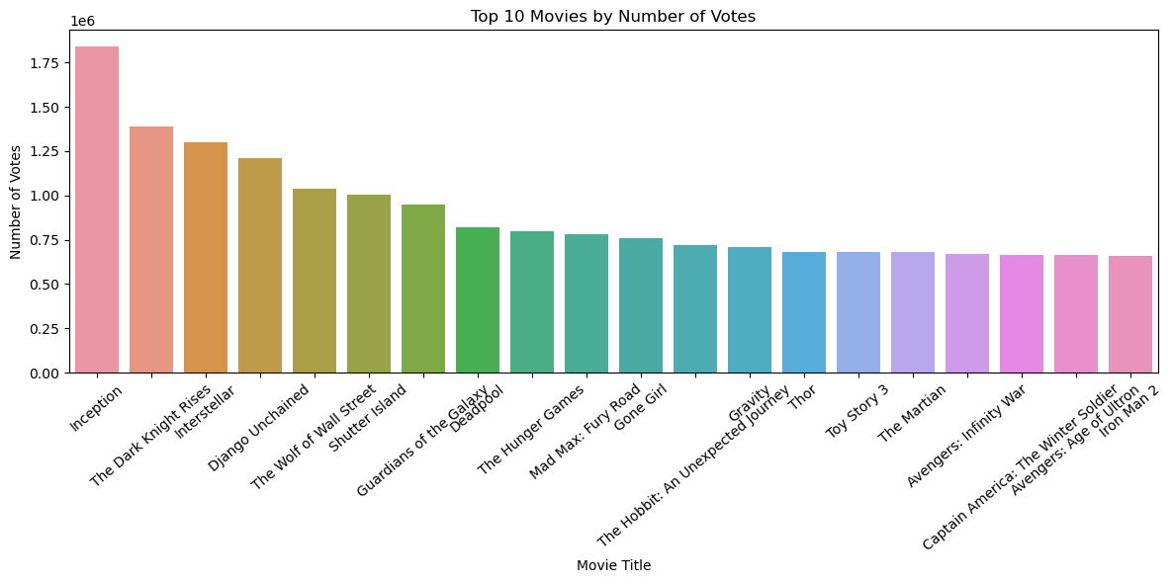
Movie Title vs Votes
Movie production has been on the increase over the years.
Now is a good time to get in on the fun.

Slide 8
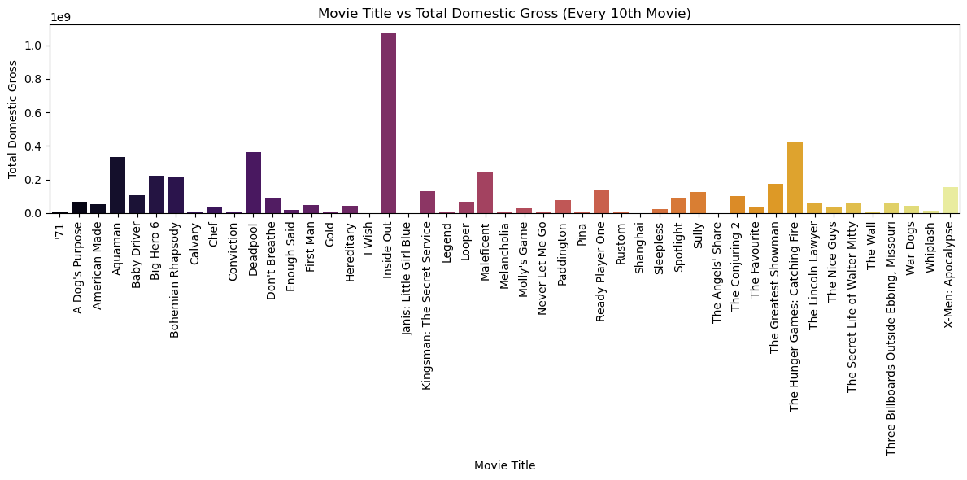
Movie Title vs Domestic Gross
Different Movies have different Gross values
In This case the Inside Out stands out to have the greatest Gross Locally

Slide 9
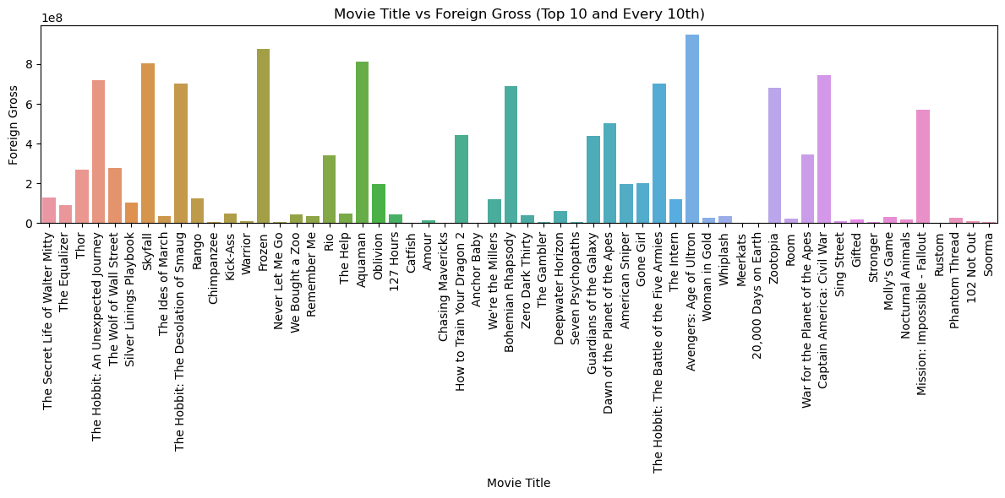
Movie Titles vs Foreign Gross
This Visualization shows how different movie titles amount to certain amounts of Gross Internationally

Slide 10
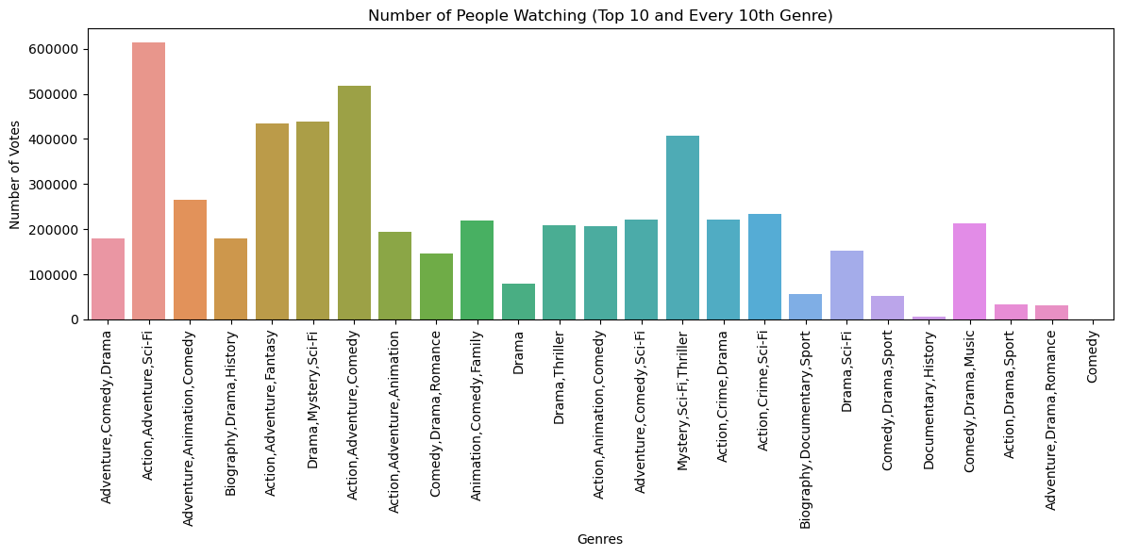
Votes vs Genres
The higher the votes for a movie the higher the likelihood of great ratings

Slide 11
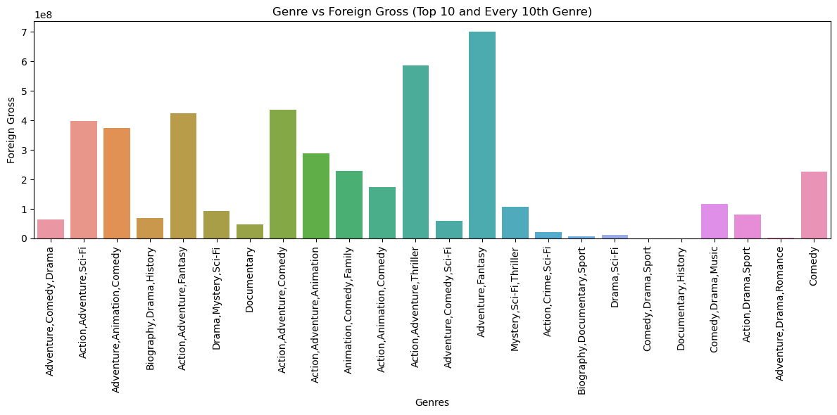
Genre vs Foreign Gross
If the Foreign Gross is Top this shows how the Genre is popular among people

Slide 12
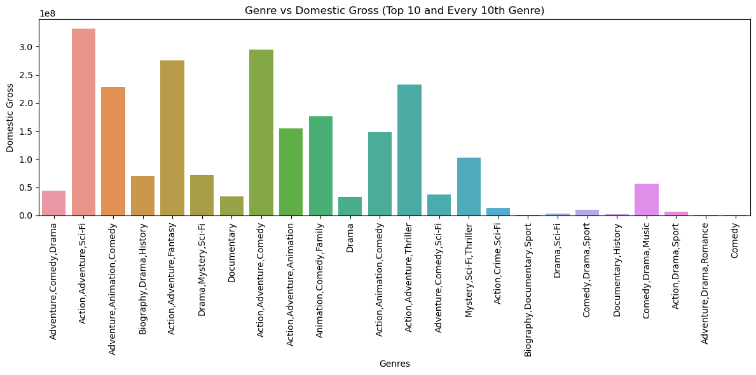
Genre vs Domestic Gross
A higher Amount of Gross shows how the Genre is popular locally

Slide 13
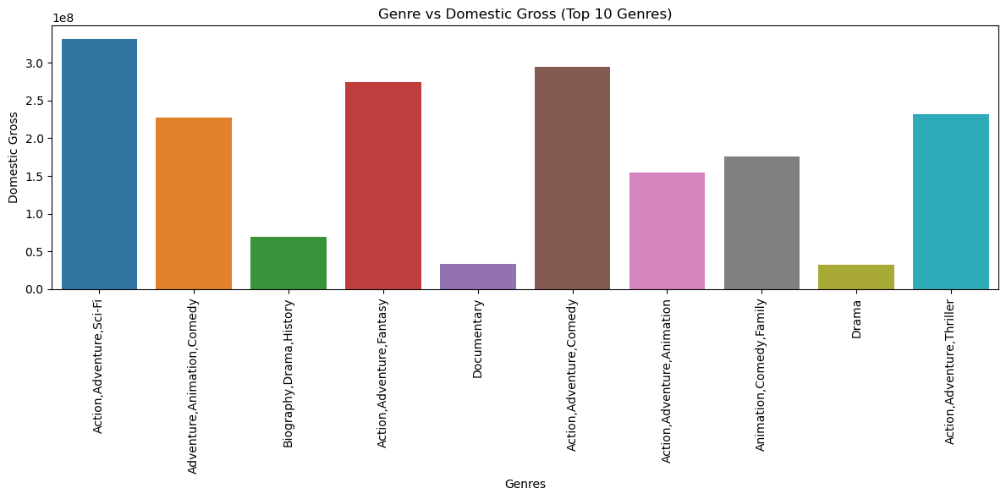
Top 10 Genres vs Domestic Gross
The chart shows the top 10 genres by their Gross domestically

Slide 14
Recommendations
Recommendation 1
The Studio should focus on High Gross Movies
Recommendation 2
The best entry market movie should have multiple genres within it.
Drama genre is a safe bet for single genre or in a multiple genre movie
Recommendation 3
Different movies should be made for different markets (domestic and foreign)
Each market could generate high Gross but not necessarily both
Recommendation 4
The Studio should focus on these Genres; Action, Adventure, Sci-Fi for domestic genres because of its high audience locally and it being voted alot

Slide 15
Conclusion
With the movie production increasing over the years now is the perfect time to hop in on the fun
Wendy Writer, CEO
Ronny Reader, CFO
Abby Author, CTO
Berry Books, CPO

