Slide 1
User Stories
Als User kann ich mehrere Konten besitzen, um die Verwaltung meiner Finanzen zu vereinfachen.
Als User kann ich Überweisungen tätigen, um meine Rechnungen zu begleichen.
Als User kann ich Beträge zwischen meinen eigenen Konten verschieben, um die Verwaltung meiner Finanzen zu vereinfachen.
Als User kann ich ein neues Konto anlegen oder ein bestehendes löschen, um die Verwaltung meiner Finanzen zu vereinfachen.
Als User kann ich eine Liste aller Kontobewegungen abrufen und filtern, um eine bessere Übersicht über meine Finanzen zu haben.
…

Slide 2
Anforderungen (KI gestützt)
Requirement | FURPS Category | MoSCoW
The system shall allow users to create and manage multiple accounts to simplify financial management. | Functionality | S
The system shall allow users to make transfers to pay bills. | Functionality | M
The system shall allow users to transfer funds between their own accounts to simplify financial management. | Functionality | S
The system shall allow users to create and delete accounts to simplify financial management. | Functionality | S
The system shall allow users to retrieve and filter a list of all account movements to gain a better understanding of their finances. | Functionality | M
The system shall provide a user-friendly interface to simplify financial management. | Usability | S
The system shall provide clear instructions to users on how to use the various features. | Usability | C
The system shall provide feedback to users on the status of their transactions. | Usability | S
The system shall ensure the accuracy of all financial transactions. | Reliability | M
The system shall ensure the security of user data and financial transactions. | Reliability | M
The system shall provide error handling and recovery mechanisms to ensure data consistency and integrity. | Reliability | C
The system shall provide fast and efficient processing of financial transactions. | Performance | S
The system shall provide scalability to handle a large number of users and transactions. | Performance | S
The system shall provide documentation and support to users to ensure they can effectively use the system. | Supportability | C
The system shall provide a mechanism for reporting and tracking issues and bugs. | Supportability | W
The system shall check transactions for validity (account sufficiently funded, no negative amounts, …) | Reliability | M

Slide 3
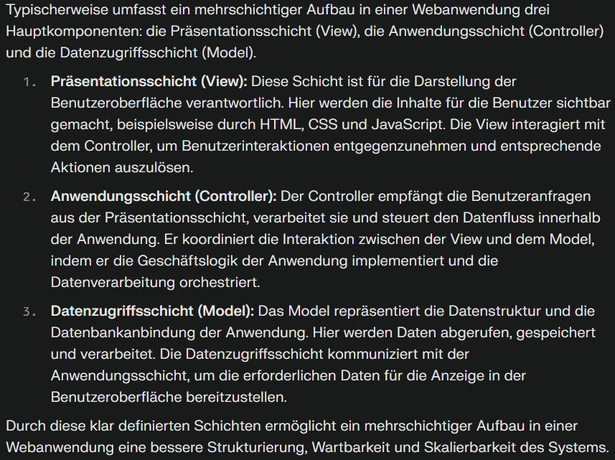

Slide 4
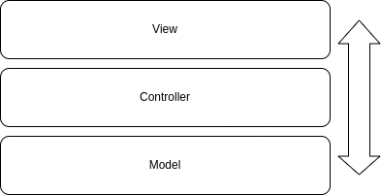
SvelteKit – Layouts/Pages/Components,
CSR im Browser des Benutzers
SvelteKit – API,
Server von Vercel
Supabase,
Server von Supabase

Slide 5
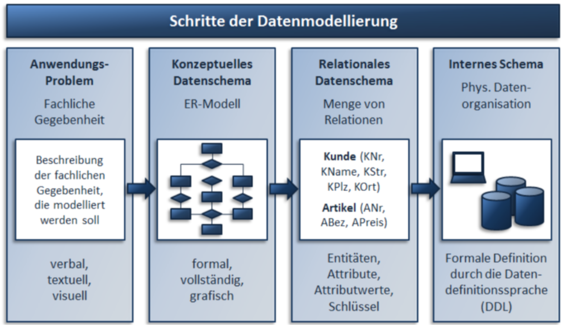

Slide 6
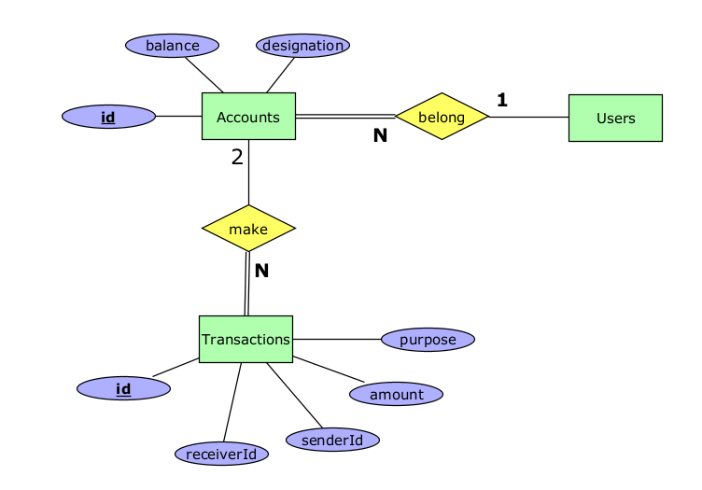
Datenmodellierung / ERD

Slide 7
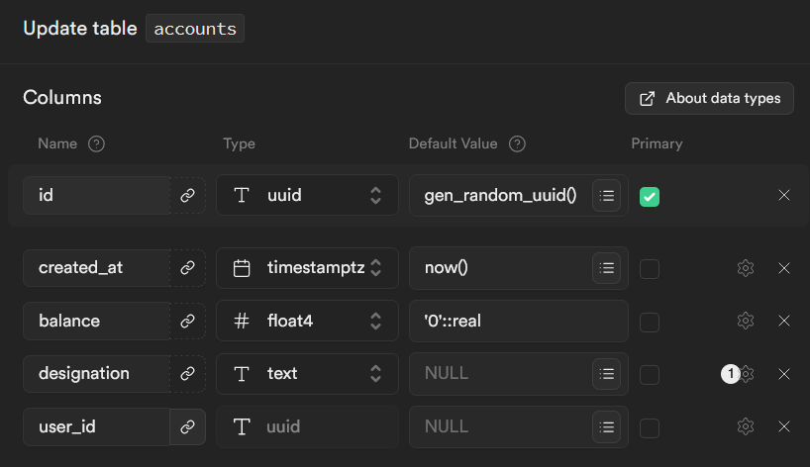

Slide 8
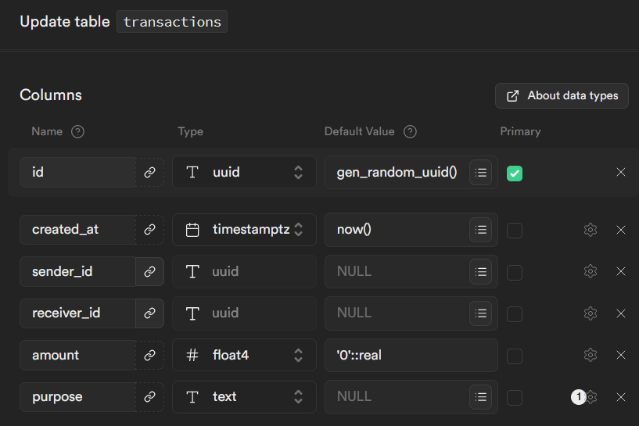

Slide 9
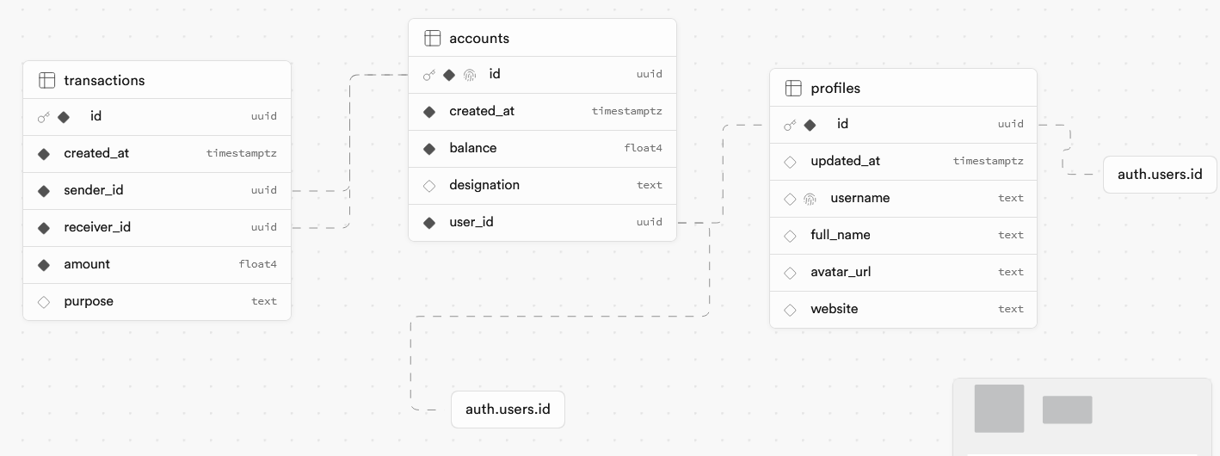

Slide 10
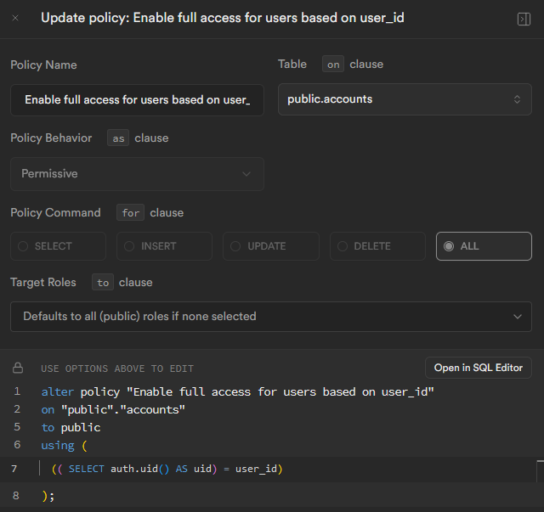

Slide 11
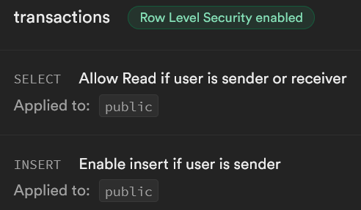
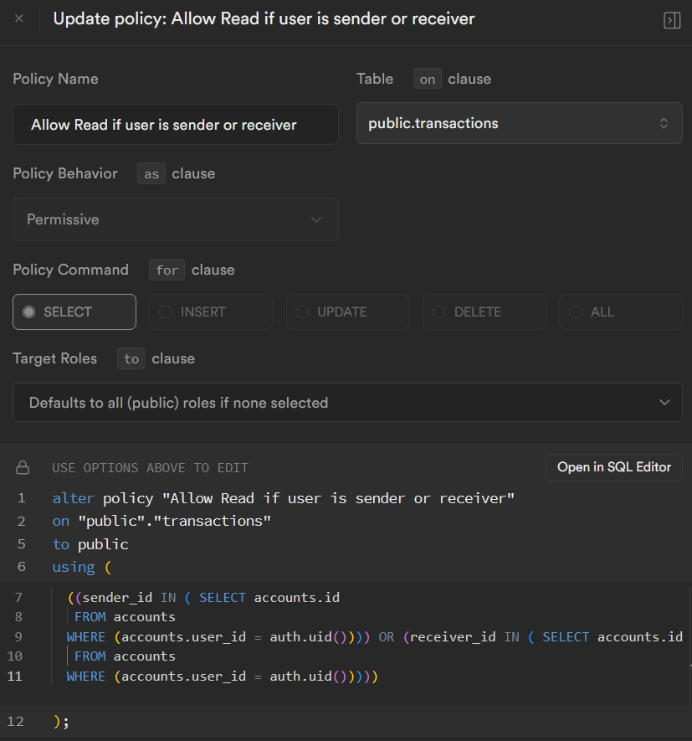

Slide 12
create or replace function update_account_balance()
returns trigger
language plpgsql
as $$
begin
update accounts
set balance = balance + new.amount
where id = new.receiver_id;
update accounts
set balance = balance - new.amount
where id = new.sender_id;
return new;
end;
$$;
create or replace trigger account_update_trigger
after insert on transactions
for each row
execute function update_account_balance();

