Slide 1


Slide 2
Use times new Roman, font size 26, black font, centered
Background color based on screen shot of calibration software, is
RGB (180,180,180)

Slide 3

Welcome to this experiment!
In this experiment, you will take the role of an oyster farmer in the land Donderia.
Oysters in Donderia are similar to oysters in our world, but there are some important differences. Those differences might seem hilarious to people from our world, and hard to understand.
We will thus walk you through this game step by step. You will practice the different aspects of the game first before the actual experiment starts.
Proceed by pressing any of the buttons.
Notes:
MGNGSearch_FreeView_Welcome01

Slide 4


Let’s start simple:
In Donderia, you have to feed oysters.
In Donderia, oysters grow pearls that look like this:
You can sell those pearls for money on the market!
The more pearls you farm, the more money you make!
However, sometimes, oysters grow tumors that look like the pearls, but have a different color and shape:
Tumors are poisonous and have to be disposed as hazardous waste, which costs you money.
The more tumors, the more disposal fees you need to pay…
Proceed by pressing any of the buttons.
Notes:
MGNGSearch_FreeView_Welcome02a

Slide 5


Let’s start simple:
In Donderia, you have to feed oysters.
In Donderia, oysters grow pearls that look like this:
You can sell those pearls for money on the market!
The more pearls you farm, the more money you make!
However, sometimes, oysters grow tumors that look like the pearls, but have a different color and shape:
Tumors are poisonous and have to be disposed as hazardous waste, which costs you money.
The more tumors, the more disposal fees you need to pay…
Proceed by pressing any of the buttons.
Notes:
MGNGSearch_FreeView_Welcome02b

Slide 6





You feed oysters like this:
Once the flood arrives, an oyster closes. Right before it closes, there is still a tiny gap open, either on the left or on the right .
You can only feed the oyster at the open end! To feed the oyster on the left, press the left button! To feed the oyster on the right, press the right button.
Above the oyster is a box with nutrients: If you press the left button, the box falls to the left: and if you press the right button, the box falls to the right: so you know you succeeded with feeding the oyster in time. THE OYSTER CLOSES QUITE FAST, SO HURRY!
If you feed it in time, you receive a pearl , otherwise a tumor .
Let’s try it out with a few practice trials.
Proceed any button to start the practice trials.
Notes:
MGNGSearch_FreeView_Welcome03a

Slide 7


You feed oysters like this:
Once the flood arrives, an oyster closes. Right before it closes, there is still a tiny gap open, either on the left or on the right .
You can only feed the oyster at the open end! To feed the oyster on the left, press the left button! To feed the oyster on the right, press the right button.
Above the oyster is a box with nutrients: If you press the left button, the box falls to the left: and if you press the right button, the box falls to the right: so you know you succeeded with feeding the oyster in time. THE OYSTER CLOSES QUITE FAST, SO HURRY!
If you feed it in time, you receive a pearl , otherwise a tumor .
Let’s try it out with a few practice trials.
Proceed any button to start the practice trials.
Notes:
MGNGSearch_FreeView_Welcome03b

Slide 8


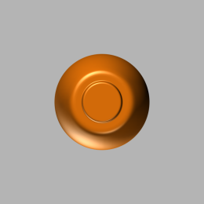
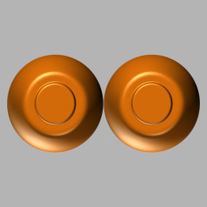
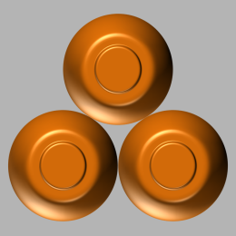
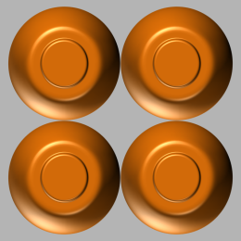
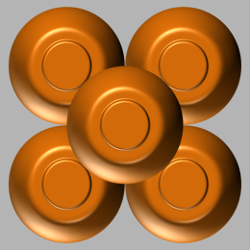

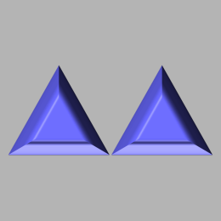
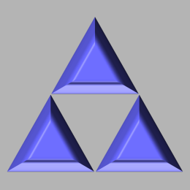
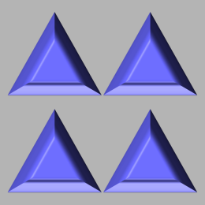

Well done!
These oysters are easy to handle, but not so good for your business: they can grow only 1 single pearl… You check out the internet whether there are oysters available than can grow more than 1 pearl…
And indeed you are successful: There are oysters that can grow 1–5 pearls!
But also 1–5 tumors…
Proceed by pressing any of the buttons.
Notes:
MGNGSearch_FreeView_Demand01a

Slide 9
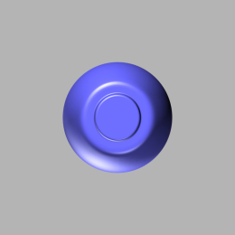
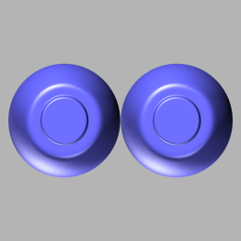
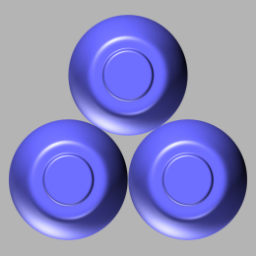
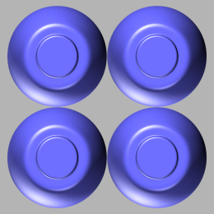
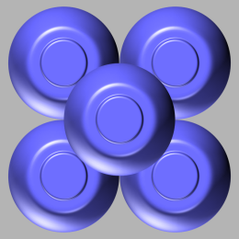


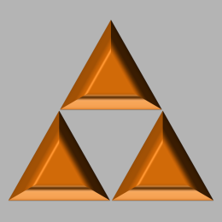


Well done!
These oysters are easy to handle, but not so good for your business: they can grow only 1 single pearl… You check out the internet whether there are oysters available than can grow more than 1 pearl…
And indeed you are successful: There are oysters that can grow 1–5 pearls!
But also 1–5 tumors…
Proceed by pressing any of the buttons.
Notes:
MGNGSearch_FreeView_Demand01b

Slide 10


There are two different sorts of oysters available on the internet:
High-demand oysters
As before, those oyster sorts need extra nutrients that you have to feed them.
Only with extra nutrients, they grow pearls; without extra nutrients, they grow tumors!
Low-demand oysters
They get enough nutrients from the sea, there is no need to feed extra!
They normally grow pearls, but too many nutrients actually hurt them, so they grow tumors!
Proceed by pressing any of the buttons.
Notes:
MGNGSearch_FreeView_Demand02

Slide 11
The task is slightly different now:
Now, first, you see the sort of oysters you are growing.
You should feed oysters (press the button on the end the oyster is still open).
You should not feed oysters (do not press any button).
However, while the symbol is visible, you cannot feed the oyster yet!
Once the flood arrives, the oyster closes, so you will see or .
If you want to feed the oyster, press the button on the side the oyster is still open!
Let’s try it out with a few more practice trials.
Proceed any button to start the practice trials.
Notes:
MGNGSearch_FreeView_Demand03

Slide 12
Seems like it you were correct:
oysters need special nutrients, while oysters don’t.
However, it seems like this does not always work:
With nutrients, oysters mostly develop pearls, but sometimes still tumors.
Without nutrients, oysters mostly develop pearls, but sometimes still tumors.
So the relationship between nutrients and oyster fruits is not perfect:
Making the right choice (nutrients vs. no nutrients) increases the chance for pearls, but there’s no guarantee that you will always grow pearls…
Proceed by pressing any of the buttons.
Notes:
MGNGSearch_FreeView_Stakes01

Slide 13


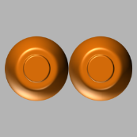
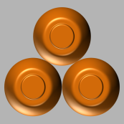
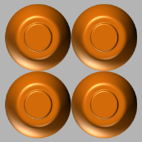
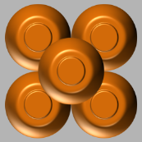



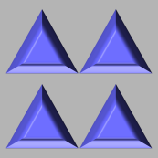

As you have seen, these new oysters can grow different numbers of pearls and tumors.
Because you’re a curious oyster farmer, you’d like to know in advance how many pearls and tumors you might get in the end…
And in fact, right before the oyster closes, if you watch closely, you can already see how many pearls and tumors an oyster is potentially growing, for example:
or or another combination.
Proceed by pressing any of the buttons.
Notes:
MGNGSearch_FreeView_Stakes02a

Slide 14

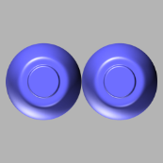
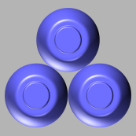
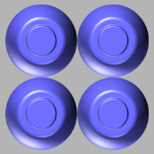
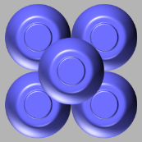






As you have seen, these new oysters can grow different numbers of pearls and tumors.
Because you’re a curious oyster farmer, you’d like to know in advance how many pearls and tumors you might get in the end…
And in fact, right before the oyster closes, if you watch closely, you can already see how many pearls and tumors an oyster is potentially growing, for example:
or or another combination.
Proceed by pressing any of the buttons.
Notes:
MGNGSearch_FreeView_Stakes02b

Slide 15


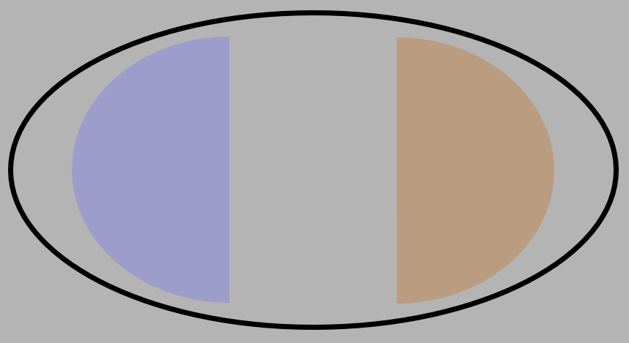
Note that oysters differ in where they pearls and tumors: some oysters pearls grow pearls on the left and tumors on the right, others the other way around:
or
You can see the side where oysters grow pearls and tumors already during the symbol that tells you whether to feed the oyster or not:
or
After the symbol disappeared, potential pearls and tumors appear:
Note that sometimes, pearls and tumors grow a bit further up, sometimes further down.
Proceed by pressing any of the buttons.
Notes:
MGNGSearch_FreeView_Stakes03a

Slide 16
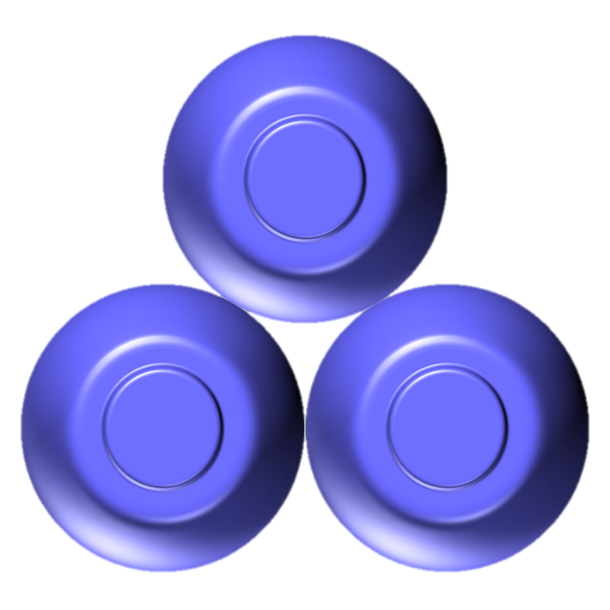

Note that oysters differ in where they pearls and tumors: some oysters pearls grow pearls on the left and tumors on the right, others the other way around:
or
You can see the side where oysters grow pearls and tumors already during the symbol that tells you whether to feed the oyster or not:
or
After the symbol disappeared, potential pearls and tumors appear:
Note that sometimes, pearls and tumors grow a bit further up, sometimes further down.
Proceed by pressing any of the buttons.
Notes:
MGNGSearch_FreeView_Stakes03b

Slide 17
Note that the side and position where pearls or tumors appear does not matter; only their number matters!
Also note that an oyster always starts growing both pearls and tumors— but by the end of each trial, it will have grown either pearls or tumors, not both.
Proceed by pressing any of the buttons.
Notes:
MGNGSearch_FreeView_Stakes04

Slide 18


From now on, you will be able to see how many pearls and tumors your oyster is about to grow already before it closes!
First, you see the symbol of the oyster sort that tells you whether to feed the oyster ( ) or not ( ).
Second, you will see how many pearls and tumors your oyster is about to grow, e.g. or or another combination.
Finally, the oyster closes and you will see or .
If you want to feed the oyster, press the button on the end the oyster is still open!
Let’s try it out with a few more practice trials.
Proceed any button to start the practice trials.
Notes:
MGNGSearch_FreeView_Stakes05a

Slide 19
From now on, you will be able to see how many pearls and tumors your oyster is about to grow already before it closes!
First, you see the symbol of the oyster sort that tells you whether to feed the oyster ( ) or not ( ).
Second, you will see how many pearls and tumors your oyster is about to grow, e.g. or or another combination.
Finally, the oyster closes and you will see or .
If you want to feed the oyster, press the button on the end the oyster is still open!
Let’s try it out with a few more practice trials.
Proceed any button to start the practice trials.
Notes:
MGNGSearch_FreeView_Stakes05b

Slide 20


Well done!
You now realized that you can inspect in advance how many pearls and tumors an oyster is potentially growing.
It is important to always keep track whether your oyster grows more potential pearls or more potential tumors!
Unfortunately, there are thieves active in Donderia who steal oysters! On some trials, even before oysters close, thieves take your oyster. Luckily, Donderia has a good police force. When the police catches a thief, farmers can pick up their oysters at the police department.
For identification, the police will ask you whether your oyster had more potential pearls or more potential tumors. Of course, you want to be an honest oyster farmer that has a good reputation with the police! You thus always need to tell the truth!
If the police gets the impression that you are systematically lying to them, they might give you a fine at the end… So pay attention!
Proceed by pressing any of the buttons.
Notes:
MGNGSearch_FreeView_Catch01

Slide 21
On most trials, the following will happen:
You see the sign of the oyster package and decide whether to give extra nutrients or not.
You see the number of pearls and tumors the oyster can grow.
The flood arrives and the oyster closes. If you decide to give extra nutrients, you should enter nutrients at the open end while the oyster is still open. Hurry because the oysters close quickly!
After the flood, you will receive the pearls or tumors the oyster has grown.
Proceed by pressing any of the buttons.
Notes:
MGNGSearch_FreeView_Catch02

Slide 22
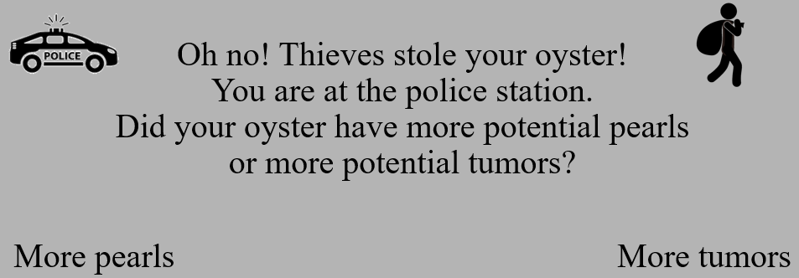
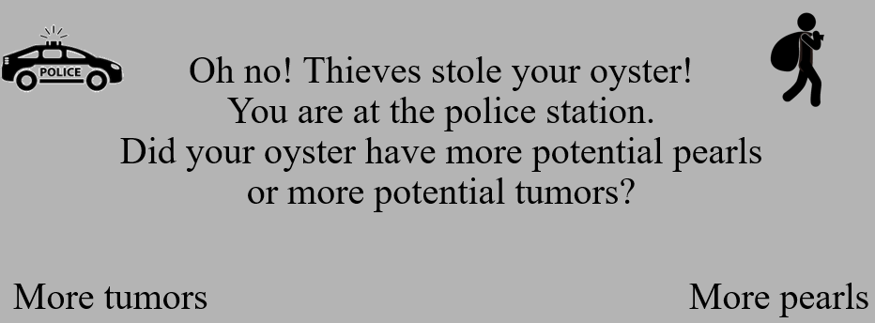
On some trials however, the following will happen:
Already before the flood arrives, thieves steal your oyster, but the police catches them. To get it back, you need to tell the police whether your oyster was growing more potential pearls or more potential tumors. The screen will look like this: Press the button on the side of the answer you want to select. You have 5 seconds to respond—otherwise, the police will make the decisions themselves, and might start thinking that you are an uncooperative oyster farmer…
Proceed by pressing any of the buttons.
Notes:
MGNGSearch_FreeView_Catch03

Slide 23
Let’s try it out!
Luckily, you still have some packages with and oysters lying around, so remember:
For oysters, you better give extra nutrients.
For oysters, you better not give extra nutrients.
Press any button to start the task.
Notes:
MGNGSearch_FreeView_Catch04

Slide 24
Oh no! Thieves stole your oyster! You are at the police station. Did your oyster have more potential pearls or more potential tumors?
More pearls More tumors
Notes:
MGNGSearch_FreeView_CatchQuestionA

Slide 25
Oh no! Thieves stole your oyster! You are at the police station. Did your oyster have more potential pearls or more potential tumors?
More tumors More pearls
Notes:
MGNGSearch_FreeView_CatchQuestionB

Slide 26
The police has gotten your response.
Get ready to continue.
Notes:
MGNGSearch_FreeView_CatchContinue

Slide 27
Too slow!
The police has given you a random oyster back.
Respond faster!
Notes:
MGNGSearch_FreeView_CatchTooSlow

Slide 28


Well done! One final thing:
Unfortunately, one the coast, it is often foggy. Thus, it can be hard to see how many pearls and tumors an oyster is growing. Instead of
you might just see:
You really have to look at the pearls and tumors to render them visible!
Let’s try it out with a few more practice trials! Luckily, there are still some and oysters left for practice…
Press any button to start the task.
Notes:
MGNGSearch_FreeView_Gaze01a

Slide 29
Well done! One final thing:
Unfortunately, one the coast, it is often foggy. Thus, it can be hard to see how many pearls and tumors an oyster is growing. Instead of
you might just see:
You really have to look at the pearls and tumors to render them visible!
Let’s try it out with a few more practice trials! Luckily, there are still some and oysters left for practice…
Press any button to start the task.
Notes:
MGNGSearch_FreeView_Gaze01b

Slide 30
Version 6 Cues

Slide 31






Well done!
You’re now ready for the actual experiment!
You ordered some new oysters on the internet, but the trader has send you different packages with different symbols… Here some examples:
No idea what language that is… Seems like you have to find out by trial-and-error which oyster sorts are high demand oysters that need extra nutrients, and which sorts are low demand oysters that you better not give extra nutrients!
Your goal is to collect as many pearls and as little tumors as possible! At the end of the experiment, based on how many pearls and tumors you collected, you will earn a monetary bonus of 0–2€ extra!
Proceed by pressing any of the buttons.
Notes:
MGNGSearch_FreeView_Test01

Slide 32
Remember:
For high-demand oysters, giving extra nutrients increases the chances that they grow pearls, but there is no guarantee: Sometimes, they still grow tumors!
For low-demand oysters, not giving extra nutrients increases the chances that they grow pearls, but there is no guarantee: Sometimes, they still grow tumors!
Your goal is to figure out for each oyster sort which action (giving nutrients or not) maximizes the chance for pearls and minimizes the chance for tumors.
For each oyster, there is one optimal action that is always the same and does not change over the course of the experiment.
Based on your pearls and tumors you collect, you will can gain an additional monetary bonus of 0–2€ extra!
Proceed by pressing any of the buttons.
Notes:
MGNGSearch_FreeView_Test02

Slide 33
You will play 4 rounds of this game.
Each round features the same 6 different oyster sorts.
Between rounds, there will be short breaks.
This is Round 1.
You will try to grow oysters from these 6 different sorts:
Proceed by pressing any of the buttons.
Notes:
MGNGSearch_FreeView_Round01Start

Slide 34
Congrats!
You are done with Round 1.
The first round is already over!
You can now take a short break to restore your attention.
If you experience problems concentrating, take at least a one-minute break.
Please do not move and stay in the chin rest!
Proceed by pressing any of the buttons.
Notes:
MGNGSearch_FreeView_Round01Stop

Slide 35
This is the Round 2.
You will just continue from where you have left off.
You will still try to grow oysters from these 6 different sorts:
Proceed by pressing any of the buttons.
Notes:
MGNGSearch_FreeView_Round02Start

Slide 36
Congrats!
You are done with Round 2.
Already half-way!
You can now take a short break to restore your attention.
If you experience problems concentrating, take at least a one-minute break.
Please do not move and stay in the chin rest!
Proceed by pressing any of the buttons.
Notes:
MGNGSearch_FreeView_Round02Stop

Slide 37
This is the Round 3.
You will just continue from where you have left off.
You will still try to grow oysters from these 6 different sorts:
Proceed by pressing any of the buttons.
Notes:
MGNGSearch_FreeView_Round03Start

Slide 38
Congrats!
You are done with Round 3.
Only one more round to go!
You can now take a short break to restore your attention.
If you experience problems concentrating, take at least a one-minute break.
Please do not move and stay in the chin rest!
Proceed by pressing any of the buttons.
Notes:
MGNGSearch_FreeView_Round03Stop

Slide 39
This is the Round 4.
You will just continue from where you have left off.
You will still try to grow oysters from these 6 different sorts:
Proceed by pressing any of the buttons.
Notes:
MGNGSearch_FreeView_Round04Start

Slide 40
Version 4 Cues

Slide 41
You will play 3 rounds of this game.
Each round features a new set of 4 different oyster sorts.
Between rounds, there will be short breaks.
This is Round 1.
Below are the symbols for which you have to learn what to do:
Proceed by pressing any of the buttons.
Notes:
MGNGSearch_FreeView_Block01Start

Slide 42
Congrats!
You are done with Round 1.
The first round is already over!
You can now take a short break to restore your attention.
If you experience problems concentrating, take at least a one-minute break.
Please do not move and stay in the chin rest!
Proceed by pressing any of the buttons.
Notes:
MGNGSearch_FreeView_Block01Stop

Slide 43


You will play 3 rounds of the game.
This is the Round 2.
Below are the symbols for which you have to learn what to do:
Proceed by pressing any of the buttons.
Notes:
MGNGSearch_FreeView_Block02Start

Slide 44
Congrats!
You are done with Round 2.
Only one more round to go!
You can now take a short break to restore your attention.
If you experience problems concentrating, take at least a one-minute break.
Please do not move and stay in the chin rest!
Proceed by pressing any of the buttons.
Notes:
MGNGSearch_FreeView_Block02Stop

Slide 45




You will play 3 rounds of the game.
This is the Round 3.
Below are the symbols for which you have to learn what to do:
Proceed by pressing any of the buttons.
Notes:
MGNGSearch_FreeView_Block03Start

Slide 46
This is the end of the task. Please contact the experimenter now.
Notes:
MGNGSearch_FreeView_End

Slide 47
REMEMBER:
You have to find out by trial and error which oyster sorts are high demand oysters and which sorts are low demand oysters.
For the high demand oysters, you better give extra nutrients!
For the low demand oysters, you better don’t!
If you decide to give extra nutrients, you still need to pay attention whether the oyster is open on the left end or on the right end!
Sometimes, thieves steal your oyster, and you need to get it back from the police. Thus, always remember whether your oyster was growing more potential pearls or more potential tumors!
Press any of the lower buttons to start the task.
Notes:
MGNGSearch_FreeView_Remember

