Slide 1
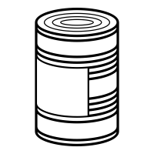
Notes:
can_up

Slide 2
Notes:
can_left

Slide 3
Notes:
can_right

Slide 4
Notes:
oyster_left

Slide 5
Notes:
oyster_right

Slide 6
Notes:
orange_fuzzy

Slide 7
Notes:
blue_fuzzy

Slide 8
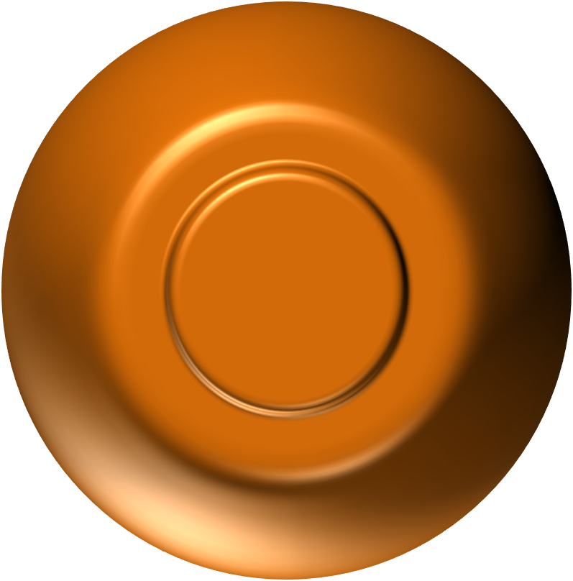
Notes:
orange_pearl_1

Slide 9
Notes:
orange_pearl_2

Slide 10
Notes:
orange_pearl_3

Slide 11
Notes:
orange_pearl_4

Slide 12
Notes:
orange_pearl_5

Slide 13
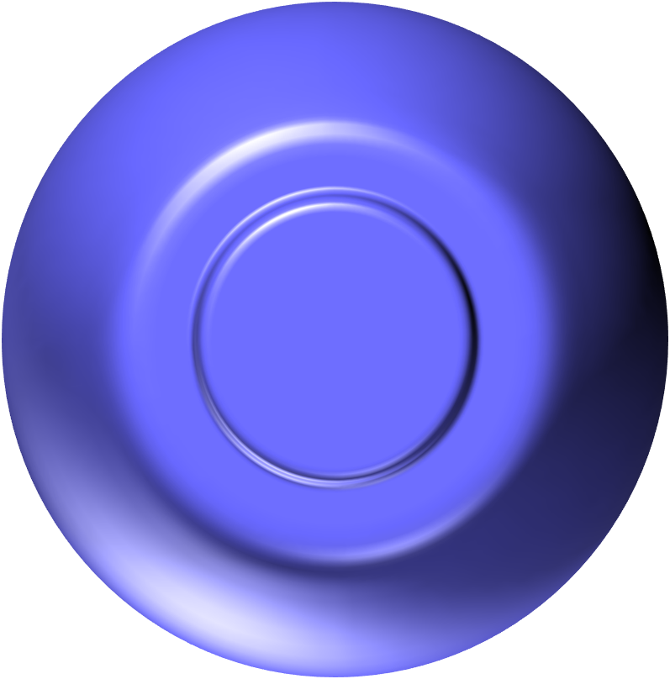
Notes:
blue_pearl_1

Slide 14
Notes:
blue_pearl_2

Slide 15
Notes:
blue_pearl_3

Slide 16
Notes:
blue_pearl_4

Slide 17
Notes:
blue_pearl_5

Slide 18
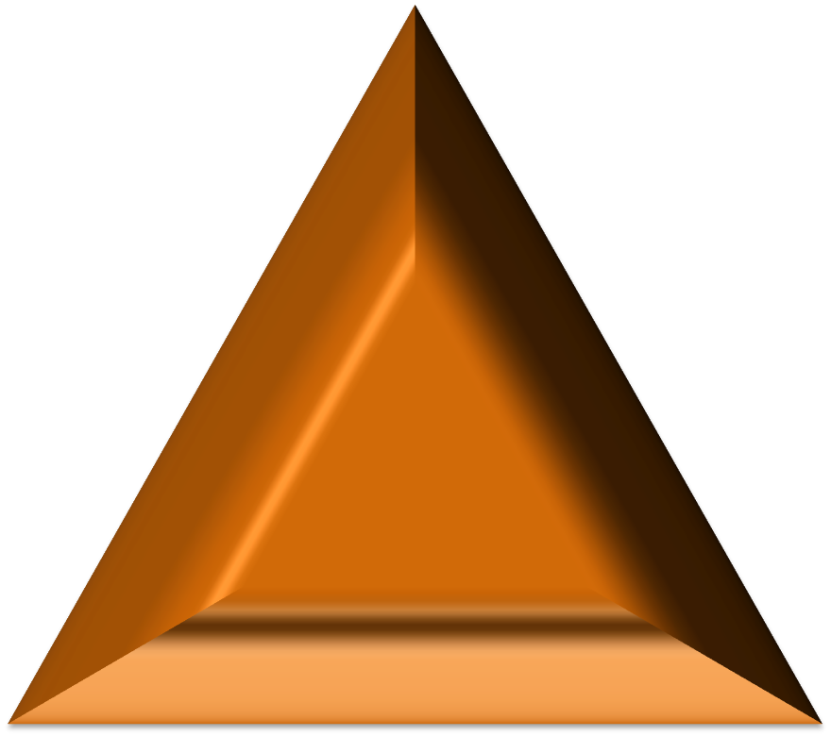
Notes:
orange_tumor_1

Slide 19
Notes:
orange_tumor_2

Slide 20
Notes:
orange_tumor_3

Slide 21
Notes:
orange_tumor_4

Slide 22
Notes:
orange_tumor_5

Slide 23
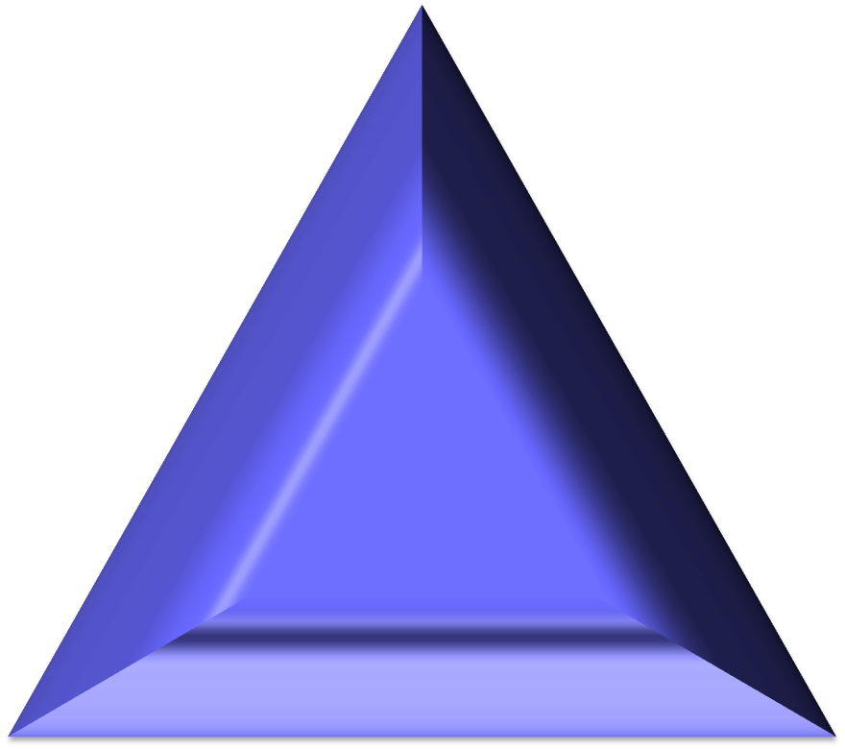
Notes:
blue_tumor_1

Slide 24
Notes:
blue_tumor_2

Slide 25
Notes:
blue_tumor_3

Slide 26
Notes:
blue_tumor_4

Slide 27
Notes:
blue_tumor_5

