Slide 1
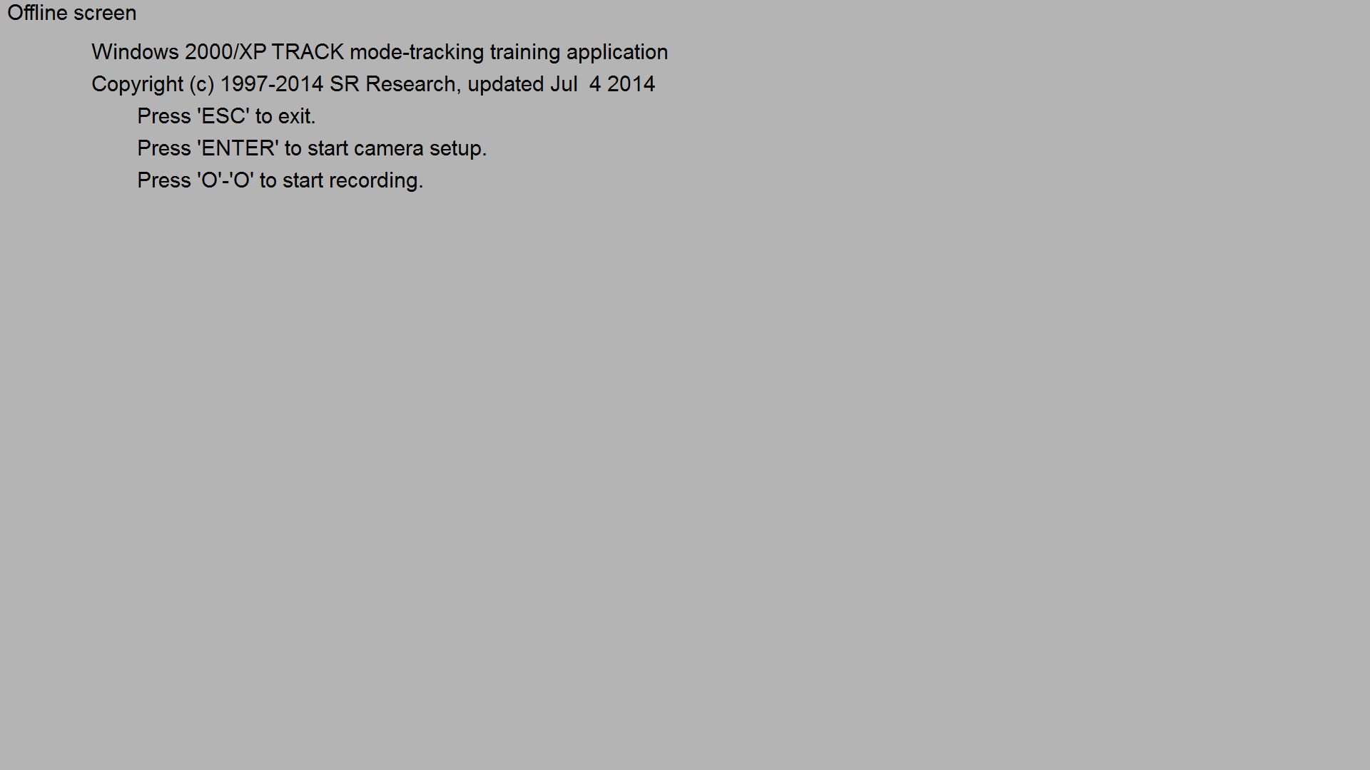

Slide 2
Notes:
Oyster_big

Slide 3
Notes:
Oyster_medium

Slide 4
Notes:
Oyster_small

Slide 5
Notes:
Oyster_verysmall

Slide 6
Notes:
OysterOrangeLeft.png

Slide 7
Notes:
OysterOrangeRight.png

Slide 8
Notes:
Oyster_small

Slide 9
Notes:
Oyster_small

Slide 10
Notes:
Oyster.png

Slide 11
Notes:
OysterOrangeLeft.png

Slide 12
Notes:
OysterOrangeRight.png

Slide 13
Notes:
OysterOrangeLeft.png

Slide 14
Notes:
OysterOrangeRight.png

