Slide 1

Welcome to the Gem Game. During the game you will be shown different gems. For example this one: Every time you see a gem, you can choose whether you want to collect the gem or not. You collect a gem by PRESSING the spacebar, or not collect the gem by WAITING until the gem disappears. You can only press the spacebar WHILE the gem is visible on the screen, not after it disappeared.
Proceed through the instructions with the spacebar.
Notes:
MGNGStakes_Instructions_General_01

Slide 2
So every time a gem appears on the screen you can decide to either: 1) Press 2) Wait
Proceed through the instructions with the spacebar.
Notes:
MGNGStakes_Instructions_General_02

Slide 3
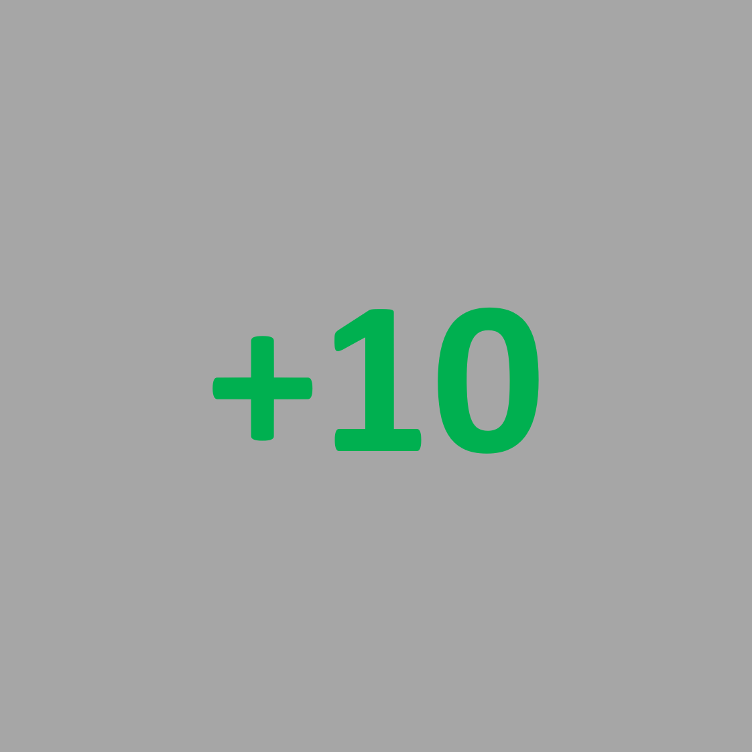

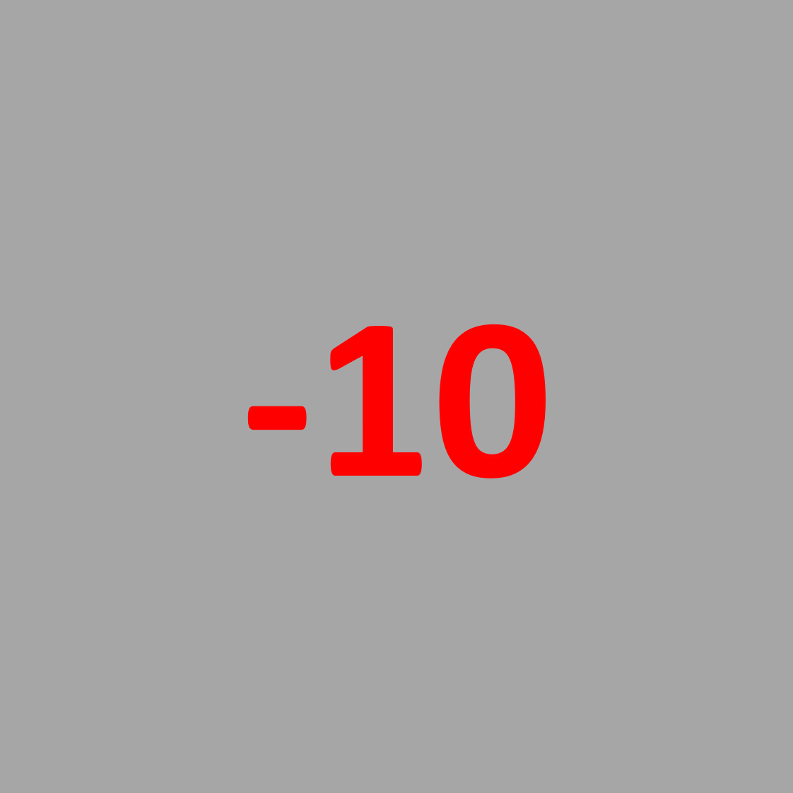
In the real game your choice to press or wait can lead to:
you win 10 points
zero points
you lose 10 points
Proceed through the instructions with the spacebar.
Notes:
MGNGStakes_Instructions_General_03

Slide 4

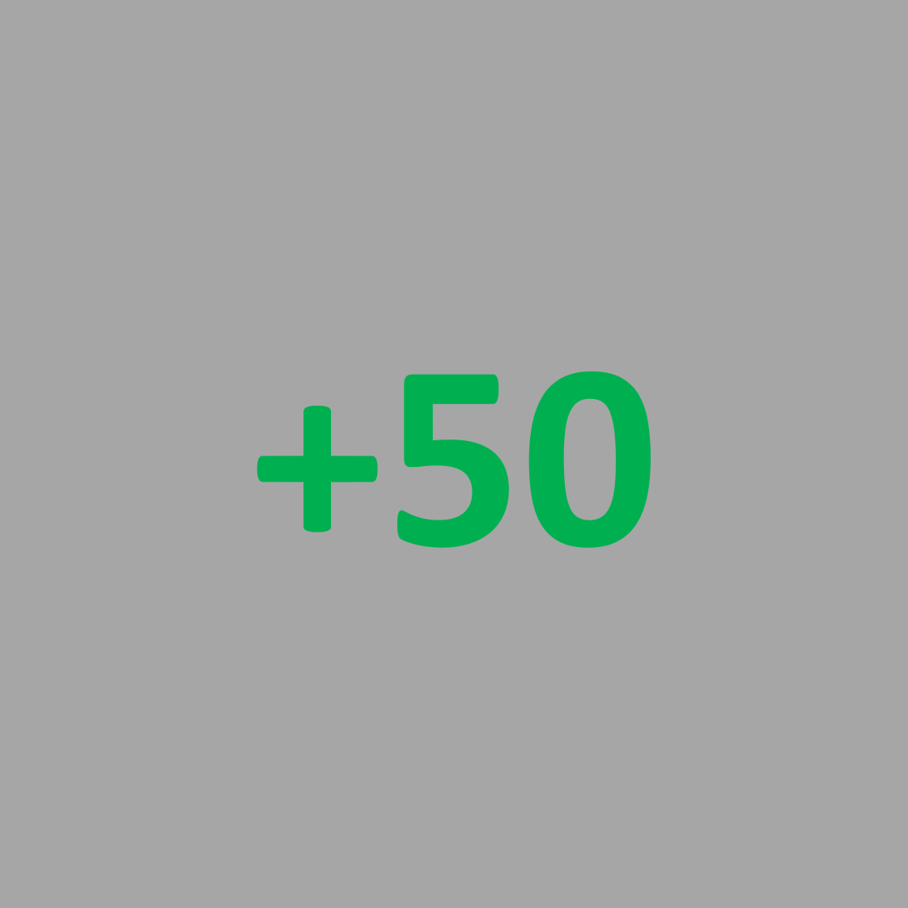

Sometimes, the gems have a red circle around them: Those are so called “high points” trials. In these trials, instead of +10 or -10 points, you will get +50 or -50 points.
Proceed through the instructions with the spacebar.
Notes:
MGNGStakes_Instructions_General_04

Slide 5

Different gems have different favorable outcomes. You want to win points (instead of zero points) for some gems. You want zero points (instead of losing points) for other gems. Below you can see an example:
Proceed through the instructions with the spacebar.
Notes:
MGNGStakes_Instructions_General_05

Slide 6
Each gem has one response (press or wait) that will give you the favorable outcome.
Your task is to learn by trial-and-error what the best response is for each gem. By choosing that best response for each gem, you can make the favorable outcomes most frequent.
If you collect more than 960 points,
you will receive an EXTRA REWARD at the end of the game!
Previous participants had to try hard to meet this threshold!
Proceed through the instructions with the spacebar.
Notes:
MGNGStakes_Instructions_General_06

Slide 7
To give you a feeling for the game,
we will walk you through the different kinds of gems separately.
During this practice phase, we will tell you want you have to do for each gem,
and what outcomes you can get.
During the real game later, we will not tell you what you have to do for each gem,
but you have to find this out yourself via trial-and-error.
Proceed through the instructions with the spacebar.
Notes:
MGNGStakes_Instructions_General_07

Slide 8
For this gem you can win points or get zero points. Here PRESSING for the gem makes you win points. But to make the game a little harder, sometimes you don’t get points even if you PRESS. Give it a try! You will now perform 4 practice trials with this gem. Press the spacebar to start.
Notes:
MGNGStakes_Instructions_Pract_G2W01

Slide 9
Well done! You probably noticed, you won points most of the time by PRESSING for this gem. But sometimes when you PRESSED, you got zero points. However, if you WAITED, you got zero points more often. So PRESSING was better for this gem. Press the spacebar to continue.
Notes:
MGNGStakes_Instructions_Pract_G2W02

Slide 10

For this new gem you can again win points or get zero points. Here WAITING for the gem makes you win points. But to make the game a little harder, sometimes you don’t get points even if you WAIT. Give it a try! You will now perform 4 practice trials with this gem. Press the spacebar to start.
Notes:
MGNGStakes_Instructions_Pract_NG2W01

Slide 11
Well done! You probably noticed, you won points most of the time by WAITING. But sometimes when you WAITED, you still got zero points. However, if you PRESSED, you got zero points more often. So WAITING was better for this gem. Press the spacebar to continue.
Notes:
MGNGStakes_Instructions_Pract_NG2W02

Slide 12
For this gem you can lose points or get zero points. Here PRESSING for the gem lets you avoid losing points. But to make the game a little harder, sometimes you still lose points even if you PRESS. Give it a try! You will now perform 4 practice trials with this gem. Press the spacebar to start.
Notes:
MGNGStakes_Instructions_Pract_G2A01

Slide 13
Well done! You probably noticed, you still avoided losing points most of the time by PRESSING. But sometimes when you PRESSED, you still lost points. However, if you WAITED, you lost points more often. So PRESSING was better for this gem. Press the spacebar to continue.
Notes:
MGNGStakes_Instructions_Pract_G2A02

Slide 14

For this gem you can lose money or get a neutral outcome. Here WAITING for the gem makes you avoid losing points. But to make the game a little harder, sometimes you don’t get points even if you WAIT. Give it a try! You will now perform 4 practice trials with this gem. Press the spacebar to start.
Notes:
MGNGStakes_Instructions_Pract_NG2A01

Slide 15
Well done! You probably noticed, you still avoided losing points most of the time by WAITING. But sometimes when you WAITED, you still lost points. However, if you PRESSED, you lost points more often. So WAITING was better for this gem. Press the spacebar to continue.
Notes:
MGNGStakes_Instructions_Pract_NG2A02

Slide 16
The practice sessions are over now. You will now play 4 rounds of the real gem game. Each round will contain 4 new gems. The trials with the different gems will now not be separated any more, but intermixed. Your goal is again to earn as many points as you can!
Proceed with the spacebar.
Notes:
MGNGStakes_Instructions_BeforeTest_01

Slide 17
In the real gem game, you have to learn again which response (press or wait) is best for each gem. The only difference now is that trials with the different gems will be intermixed. However, like in the practice trials, the best response will give you the favorable outcome most of the time, BUT NOT ALWAYS. Thus, by choosing the best response for each gem, you will get the favorable outcomes most frequently. The game is quite hard, so try to explore all options. At first you might be confused, but don’t worry, you will get plenty of practice!
Proceed with the spacebar.
Notes:
MGNGStakes_Instructions_BeforeTest_02

Slide 18

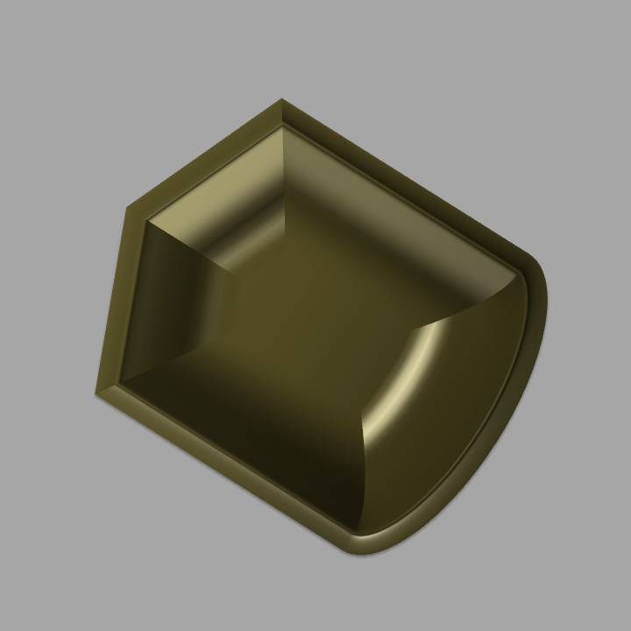
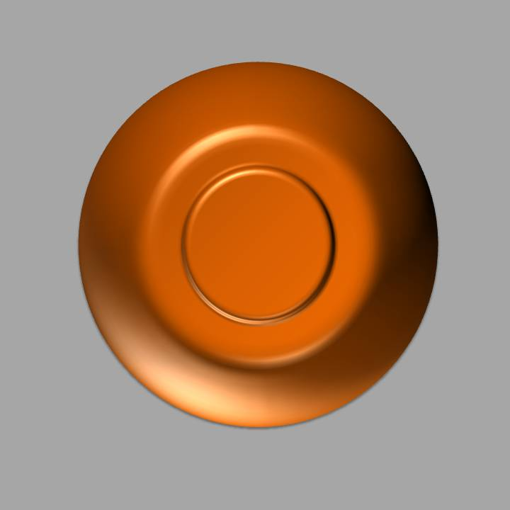
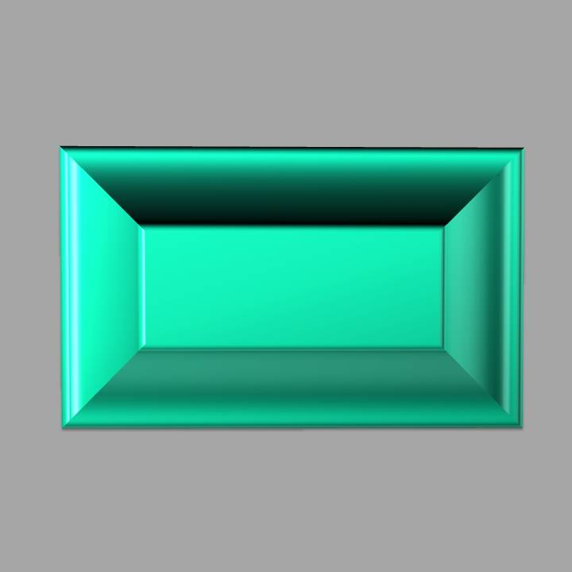
Welcome to the real Gem Game! You will play 4 rounds of the game. This is the 1st round. Below are the gems for which you have to learn what to do:
Proceed with the spacebar.
Notes:
MGNGStakes_Instructions_BeforeTest_Block01

Slide 19
Congrats! You are done with round 1. Only three more rounds to go! You can now take a short break to restore your attention.
Proceed with the spacebar.
Notes:
MGNGStakes_Instructions_Break_Block01

Slide 20
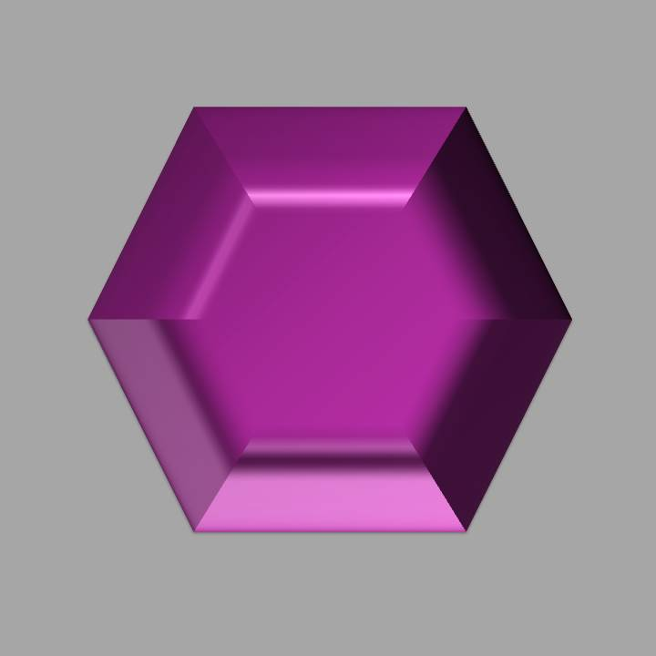
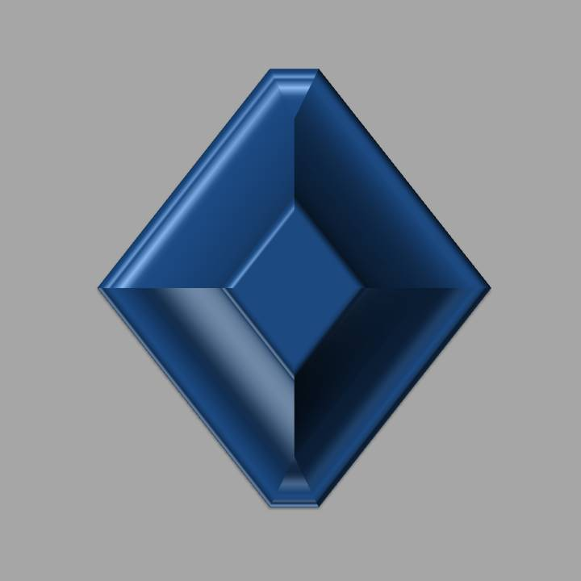
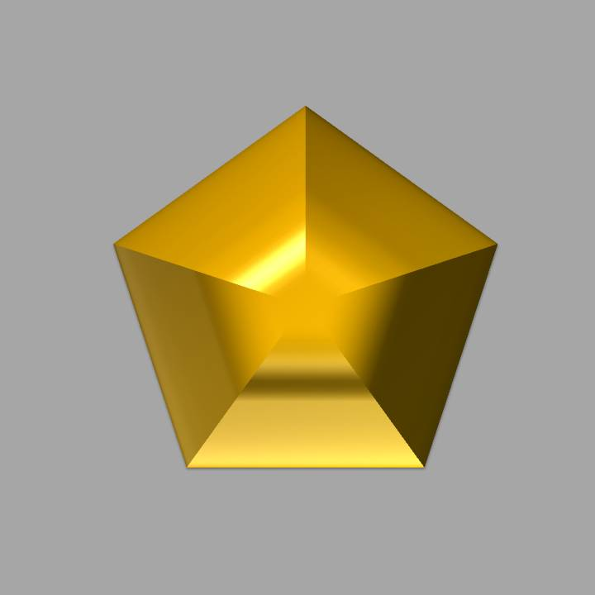
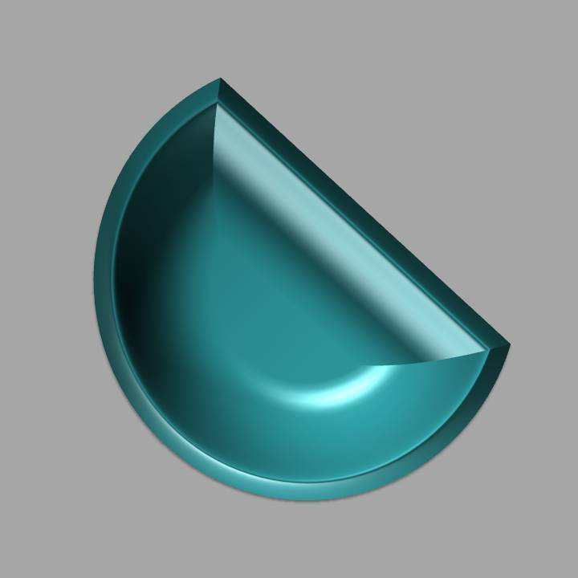
You will play 4 rounds of the game. This is the 2nd round. Below are the gems for which you have to learn what to do:
Proceed with the spacebar.
Notes:
MGNGStakes_Instructions_BeforeTest_Block02

Slide 21
Congrats! You are done with round 2. You are half-way through the task! You can now take a short break to restore your attention.
Proceed with the spacebar.
Notes:
MGNGStakes_Instructions_Break_Block02

Slide 22
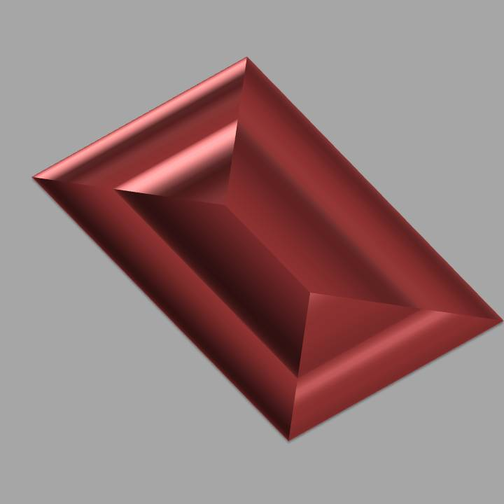
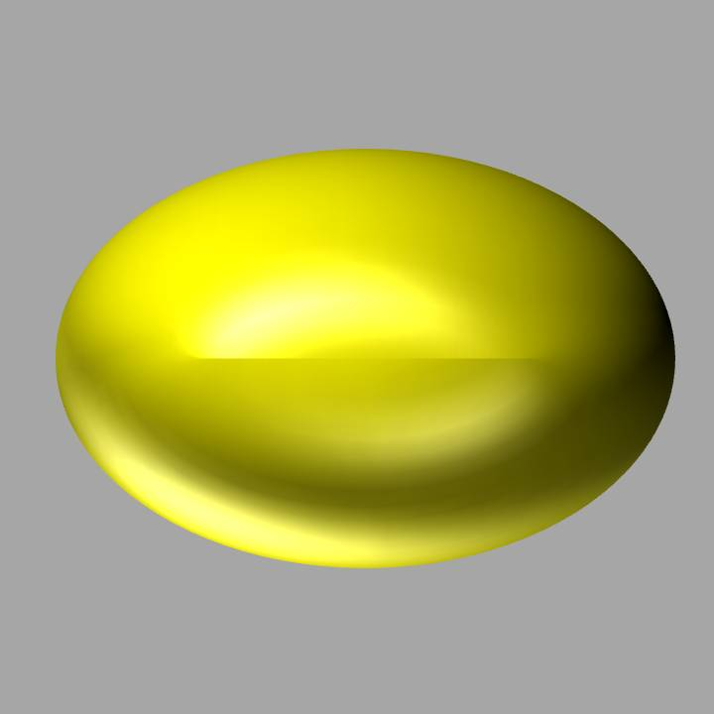
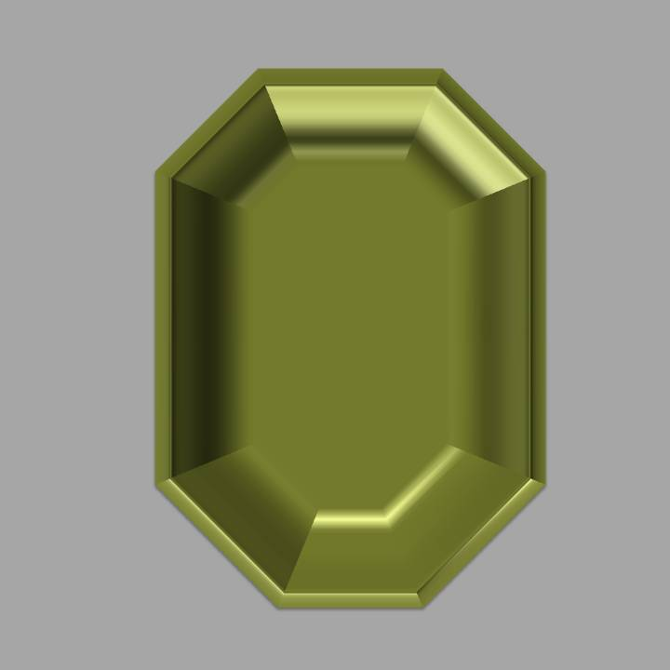
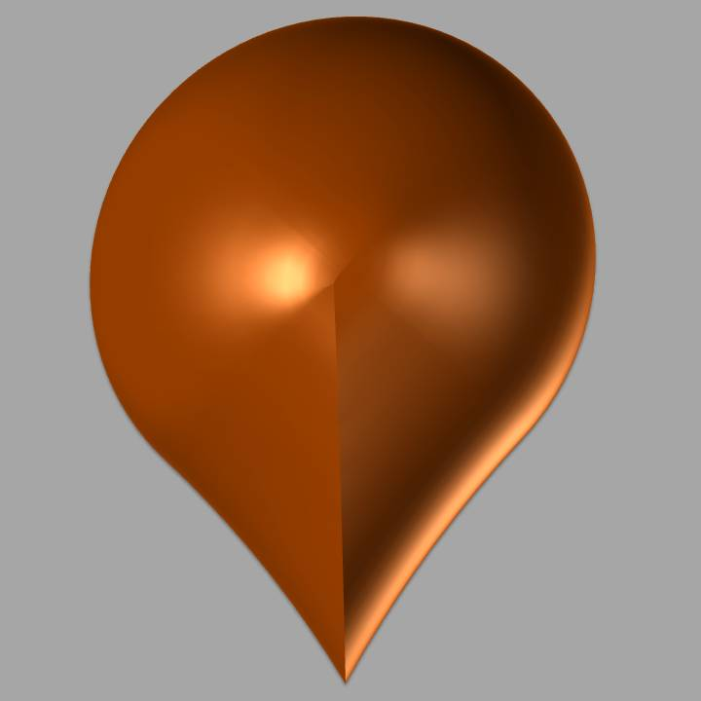
You will play 4 rounds of the game. This is the 3rd round. Below are the gems for which you have to learn what to do:
Proceed with the spacebar.
Notes:
MGNGStakes_Instructions_BeforeTest_Block03

Slide 23
Congrats! You are done with round 3. Only one round left! You can now take a short break to restore your attention.
Proceed with the spacebar.
Notes:
MGNGStakes_Instructions_Break_Block03

Slide 24
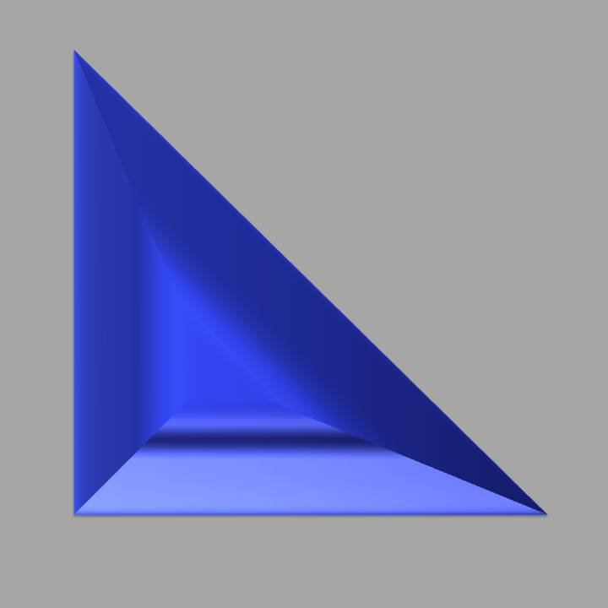
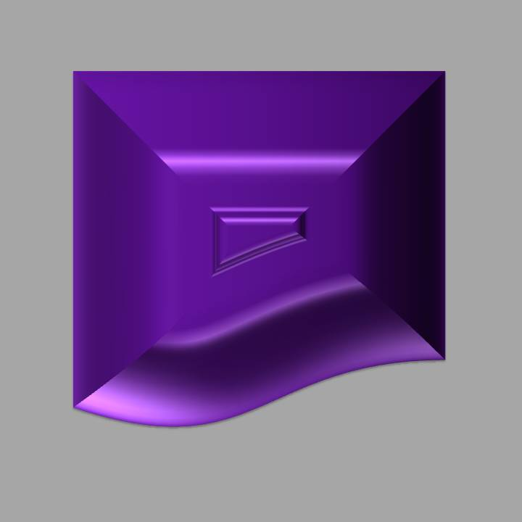
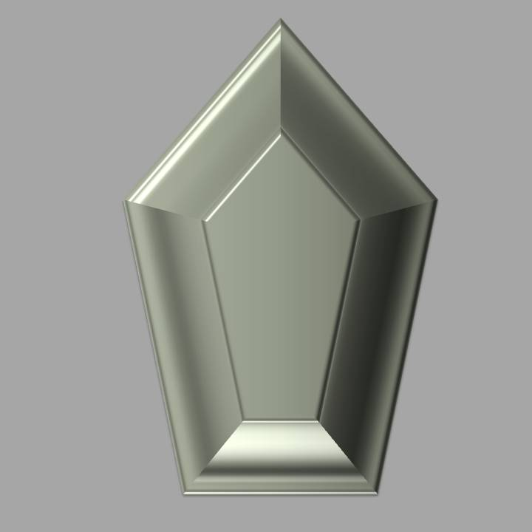
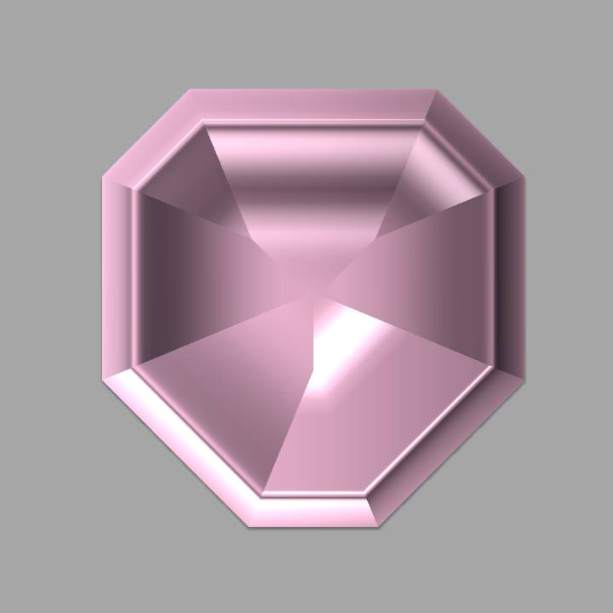
You will play 4 rounds of the game. This is the 4th round. Below are the gems for which you have to learn what to do:
Proceed with the spacebar.
Notes:
MGNGStakes_Instructions_BeforeTest_Block04

Slide 25
REMEMBER For each gem, you need to find out by trial-and-error whether to PRESS or WAIT in order to win or avoid losing points. You can only press WHILE the gem is visible. Sometimes, you might get a non-favorable outcome, even when you made the right response! Press the spacebar to start the task. Good luck!
Notes:
MGNGStakes_Instructions_Remember

Slide 26
This is the end of the final round. You will now fill in a brief questionnaire and answer some additional questions for about 10 minutes. Please contact the experimenter now.
Notes:
MGNGStakes_Instructions_End01

