Slide 1
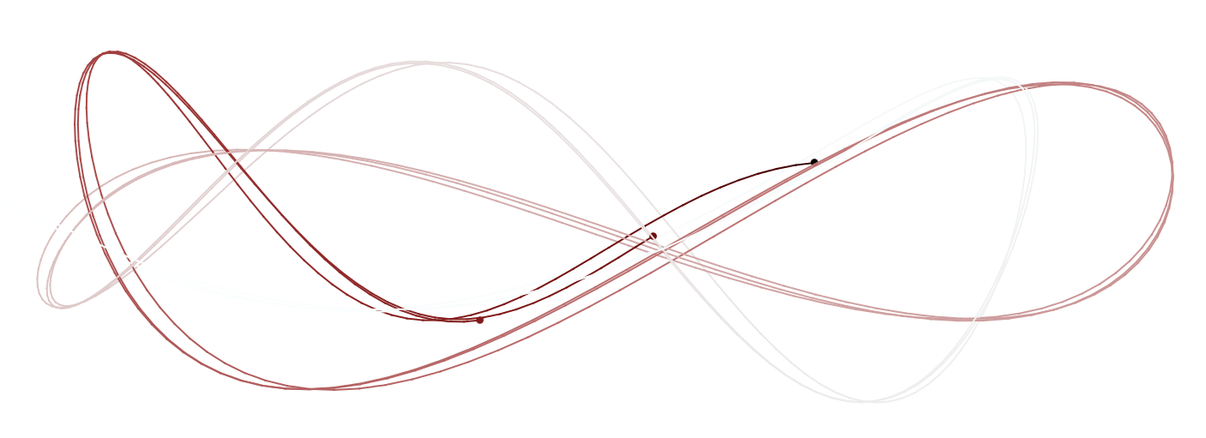

A practical primer on mixed-effects modelling in brms
M3 meeting @donders; Johannes Algermissen, Julian Quandt; 11-06-2019

Slide 2
Table of Content
Bayesian vs. Frequentist philosophy of statistics
Markov chain Monte Carlo (MCMC) algorithms
Brms Practical

Slide 3
Bayesian vs. Frequentist philosophy of statistics

Slide 4
Statistics as the science of dealing with uncertainty
Inference under uncertainty
Collect data to reduce uncertainty (learn from data, update your beliefs)
Uncertainty never really goes away

Slide 5

Hypothesis testing vs. parameter estimation
Assume some data generating process:
$$Y=a+b∗X+c∗Z+d∗X∗Z+e$$
Hypothesis testing | Parameter estimation
Can I reject some null hypothesis H₀: Θ = θ? | What are the best parameter estimates to predict Y?

Slide 6
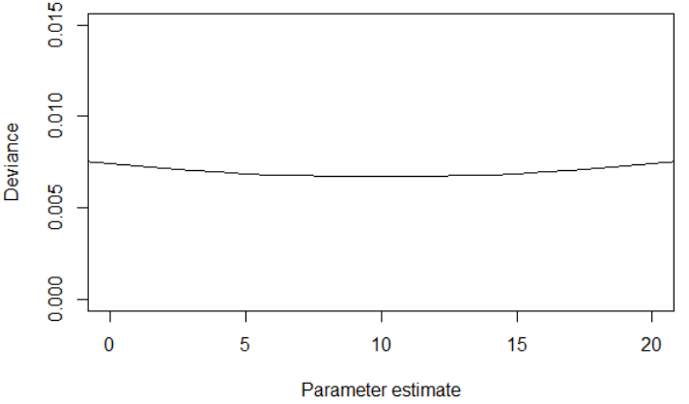
Hypothesis testing vs. parameter estimation
Hypothesis testing | Parameter estimation
This is the best estimate! Is it significantly different from zero? | This is the best estimate! Shall I use this value for prediction?
→ Both approaches need the surrounding distribution to reach their goal

Slide 7
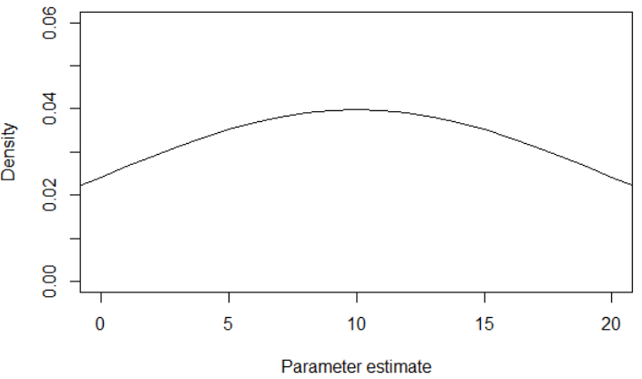
How do I get to the entire distribution?

Slide 8
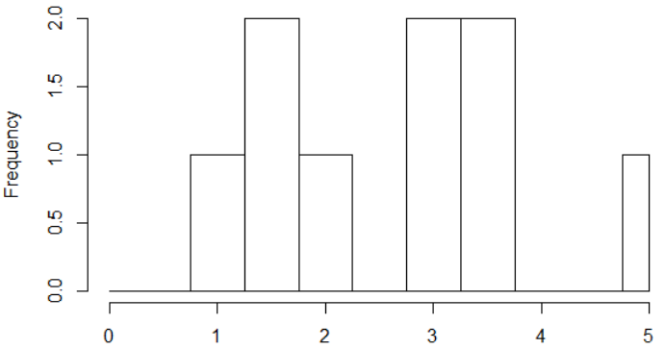
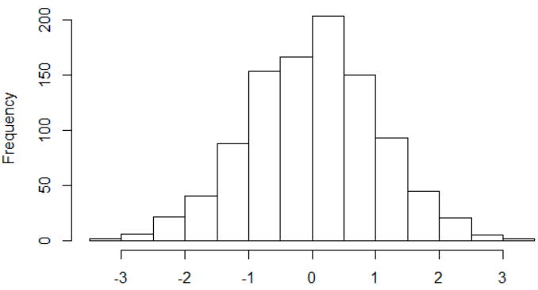
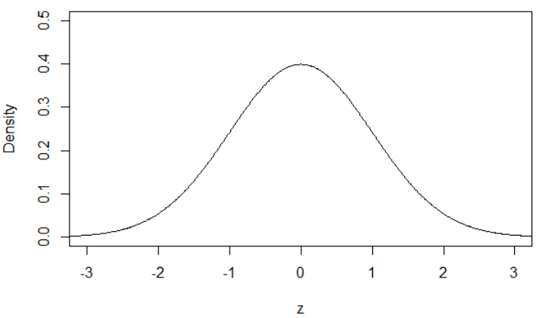
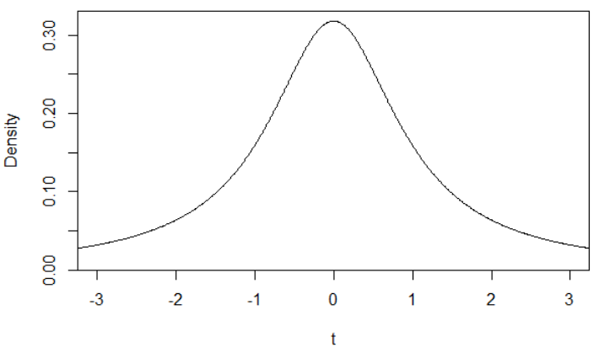
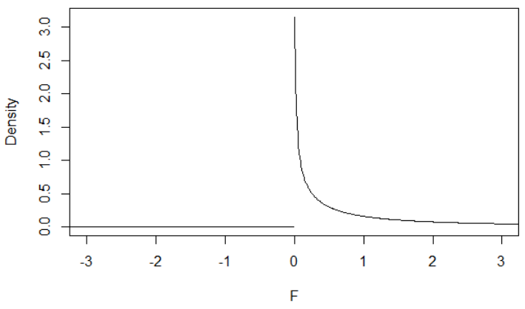
Approaches to dealing with distributions
 | Sample | Mean
1 | 1;1 | 1
2 | 1;2 | 1.5
3 | 1;5 | 3
4 | 2;1 | 1.5
5 | 2;2 | 2
6 | 2;5 | 3.5
7 | 5;1 | 3
8 | 5;2 | 3.5
9 | 5;5 | 5
Enumeration
Example: Population {1,2,5}, draw 2, p(mean > 3)?
Assumes that population is known
Only feasible for rather small samples
Simulation
Bootstrapping, permutation tests,…
Very flexible, have little (not no) assumptions
Computationally costly → more popular most recently
“Reasoning”: Rely on some (plausible) assumptions
z-distribution
Known population SD, or large sample, or normal distribution,…
t-distribution/ F-distribution
Estimate population SD from sample SD
focus on momenta of distributions (M, SD)
Interested only in point estimates

Slide 9
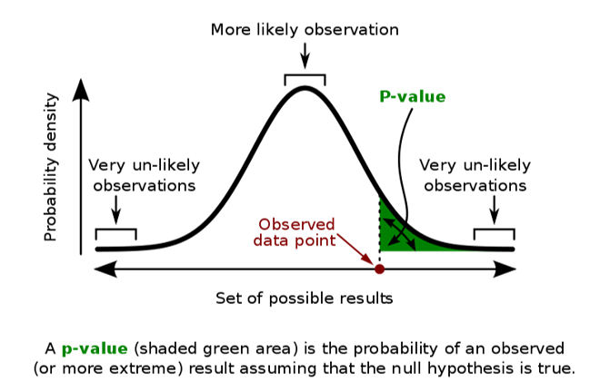
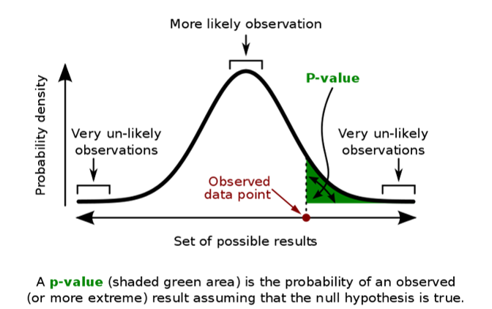


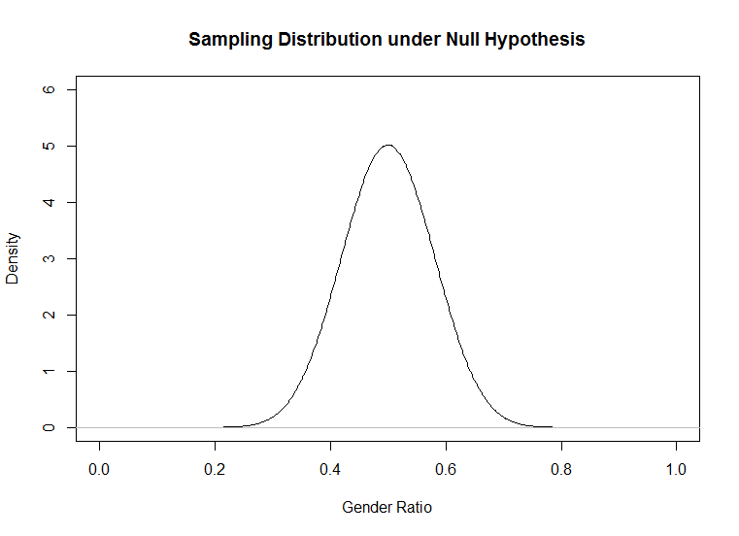

Frequentist scenario (“Reasoning”)
Statistical world
Example
Postulate a population with “true” parameter θ, hypothesize e.g. H₀: θ = .50
Draw empirical sample from population, measure summary statistic (mean)
Draw infinitely many imaginary samples given H₀: θ = .50 is true, take summary statistic of each sample
Compute frequency of how often certain summary statistic (or more extreme one) is observed
Draw inferences about population
Assume population of humans in NL has $≤$50% women
Obtain sample of 100 people, measure that 60 are women
Model distribution of sample means with H₀: θ = .50 as t-distribution with mean θ and SD based on sample SD (i.e. SE)
Compute t-statistic for 60% under H₀, compute p-value for observed t-statistic or more extreme one
Conclude women > men

Slide 10
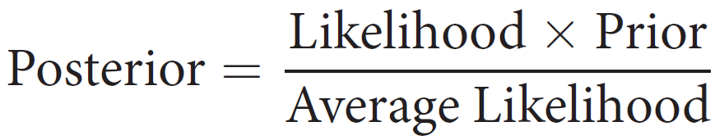
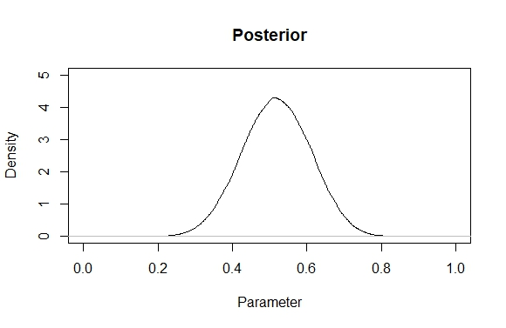
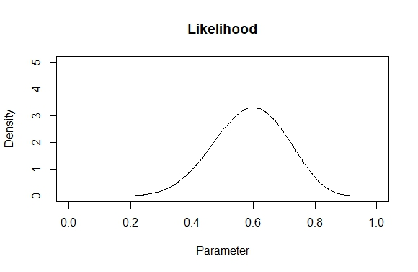
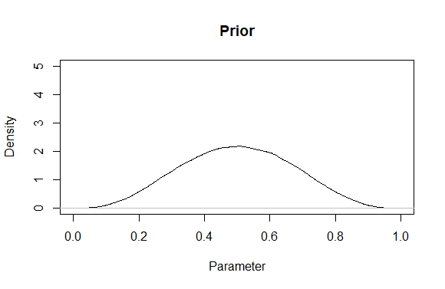
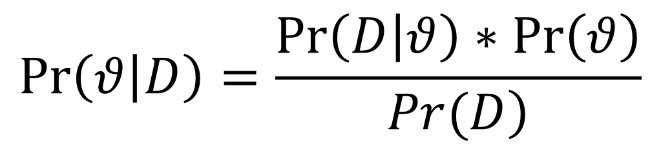
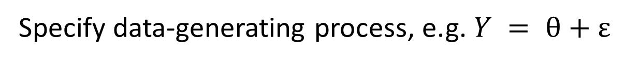
Bayes Theorem
$$\operatorname{Pr}\left(θ | D\right)=\frac{\operatorname{Pr}\left(D | θ\right)∗\operatorname{Pr}\left(θ\right)}{\left.Pr(D\right)}$$
Specify data-generating process, e.g. $Y = θ+ε$
Data: W,W,W,W,W,W,M,M,M,M

Slide 11
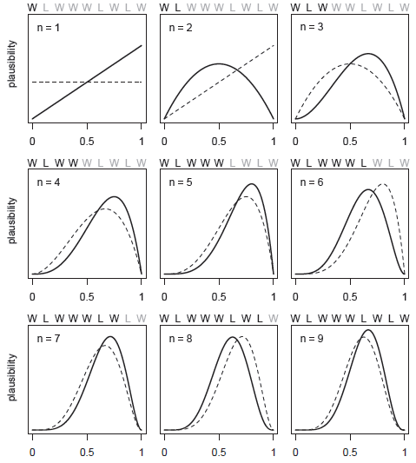
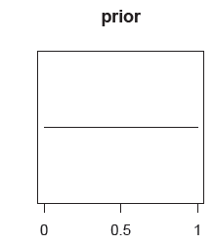

Slide 12
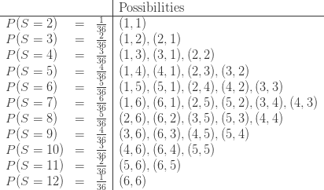

Bayesian scenario
Data: W,W,W,W,W,W,M,M,M,M
Statistical world
Example
Start with distribution of parameter θ (prior)
Obtain some data
Compute for each parameter value in how many ways data could have occurred (likelihood)
Compute distribution of θ conditional on data (posterior)
Start with distribution of gender ratio in NL
Ask 10 people for their gender
Update distribution on the fly, stop at some point when all data points have been accounted for
Compute final distribution of gender ratio NL
Population, sample, frequency, p-value,...

Slide 13
Markov chain Monte Carlo (MCMC) algorithms

Slide 14
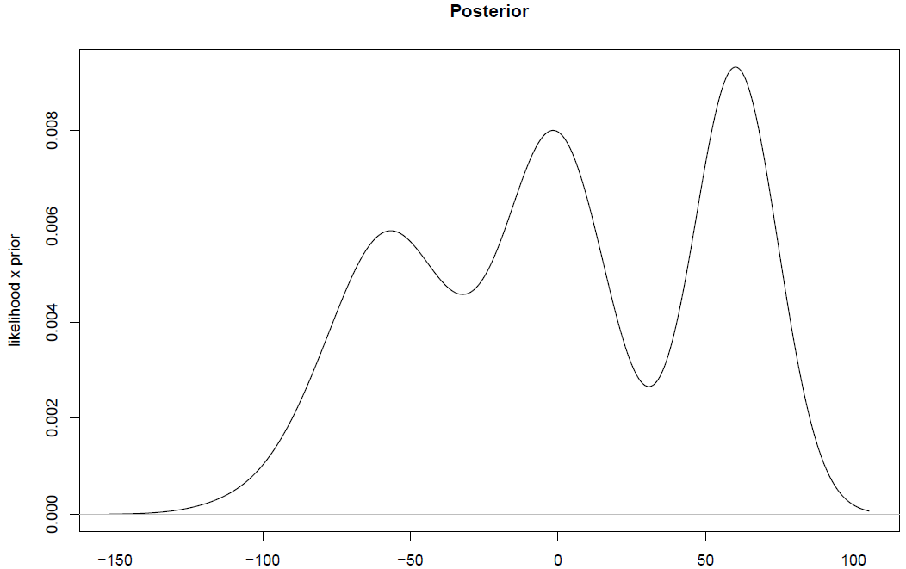
Problem of local minima

Slide 15
Metropolis algorithm – 1
Move to new location with
80% probability!
Ratio 0.80

Slide 16
Metropolis algorithm – 2
Move to new location with
100% probability!
Ratio 1.20

Slide 17
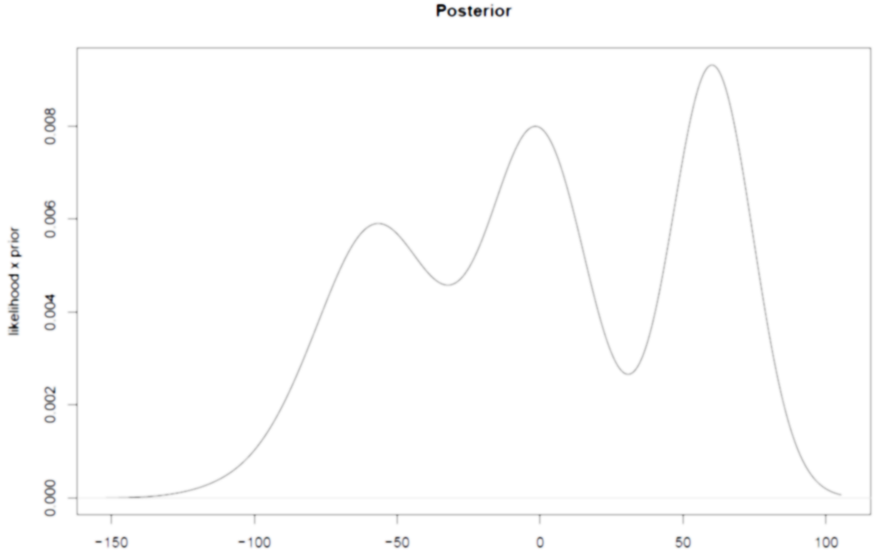
Problems with Metropolis algorithm
Very slow (proposals based on random walk)
High autocorrelation (due to random walk) → many redundant samples
Problems with finding complex patterns in high-dimensional distributions (e.g. hierarchical models)
Solution: Hamiltonian Monte-Carlo (HMC) as implemented in STAN

Slide 18
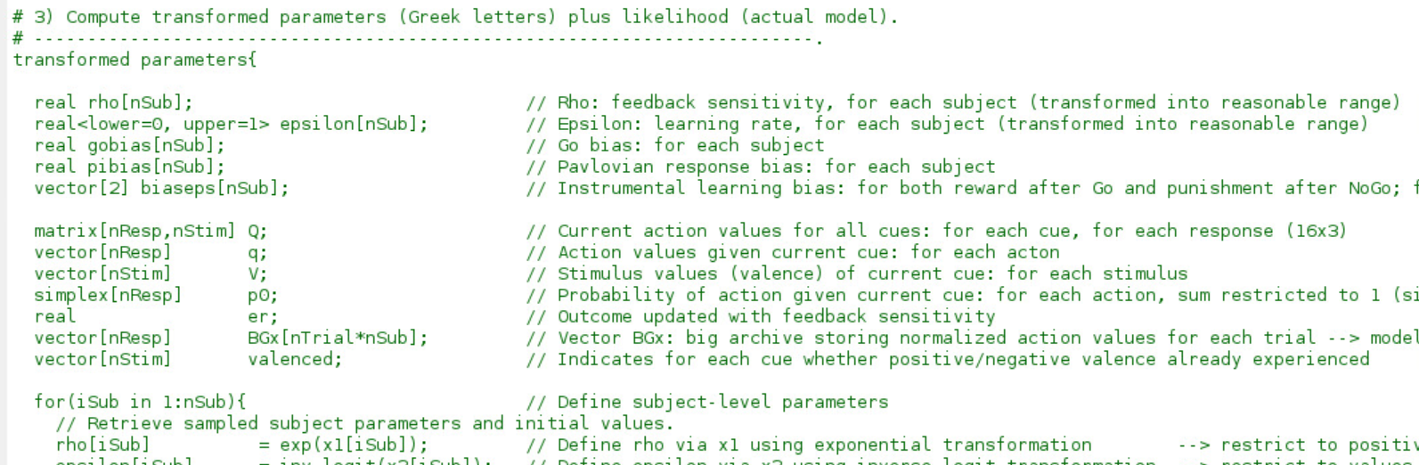
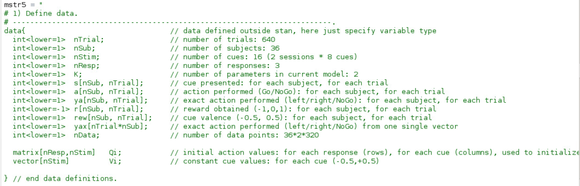
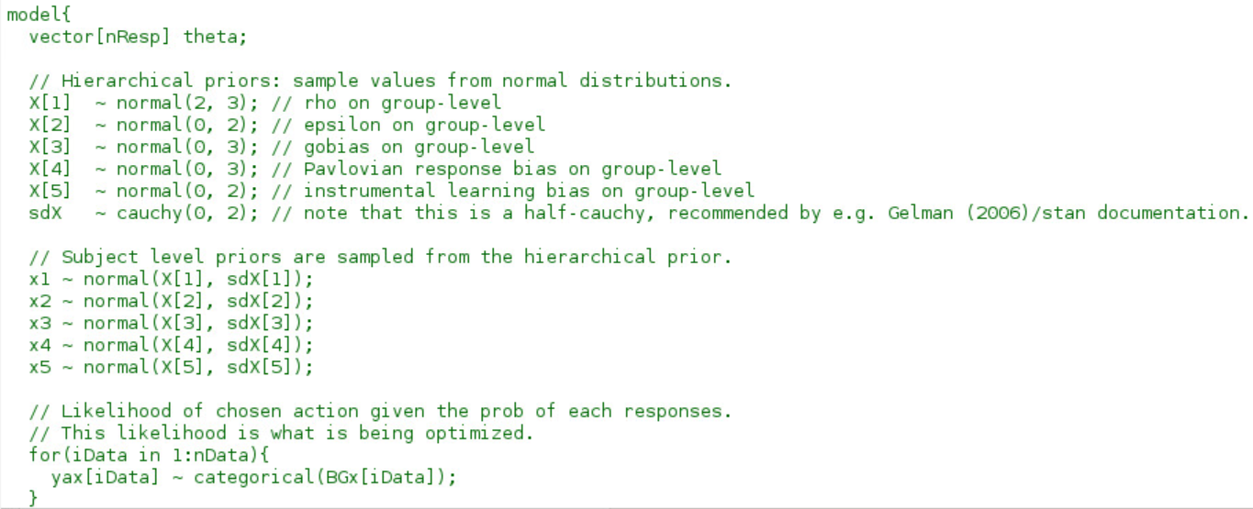
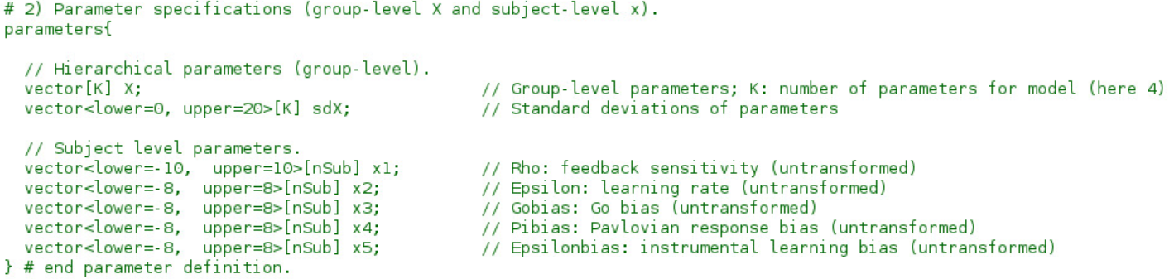
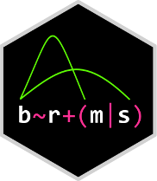
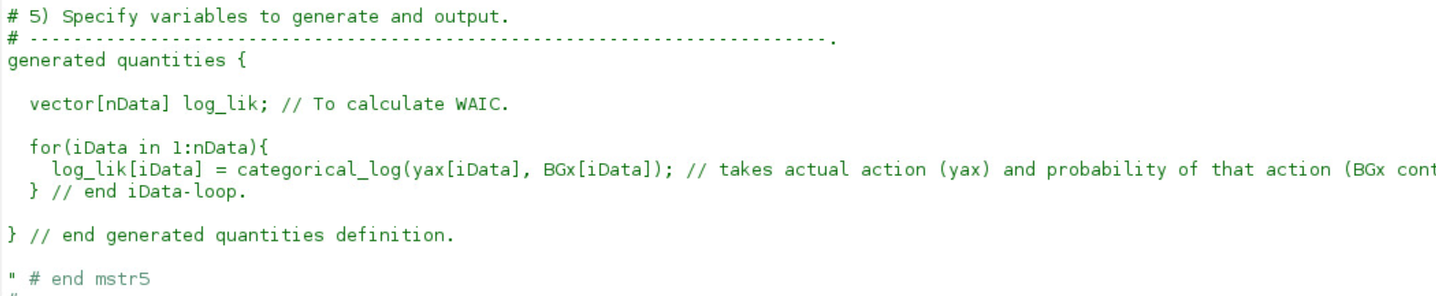
STAN
https://mc-stan.org/
Probabilistic programming language written in C++
Developed Andrew Gelman and Bob Carpenter (and many others) at Columbia University
Can be interfaced from many other languages (e.g. CmdStan, Rstan, PyStan, MatlabStan, Stan.jl, StataStan)
Implements Hamiltonian Monte-Carlo with No-U-Turn sampler (NUTS)
Write lme4-like models that get translated into Stan code: brms (“Bayesian Regression Models using 'Stan’”) package by Paul Bürkner

Slide 19
brms Practical

Slide 20
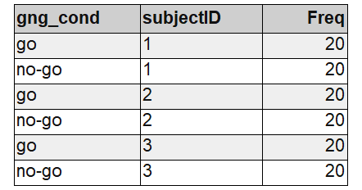
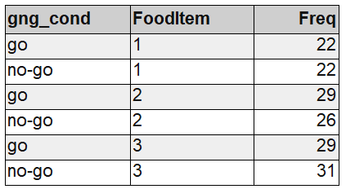
Example 1: Go/No-Go training data
Example data:
80 people rate 40 food items before and after an experimental (within-subject) manipulation (go/no-go training)
DV: difference score between ratings (post-pre)
IV: training condition of item (go / no-go)

Slide 21
lme4 vs. brms: few words on practical differences
Why brms:
- If you prefer a Bayesian philosophy over the frequentist one
- If you have domain-knowledge about the research-question and what you might expect, you can directly put it into the model via the priors
- The HMC sampler can handle increasingly complex models with thousands of parameters that would (probably) be very difficult to fit in maximum likelihood (lme4) → no need for simplifying a maximal model*
- brms is very flexible and can already handle various non-normal models, (negative; zero - inflated) binomial, cumulative, exponential, lognormal, multinomial, drift- diffusion/wiener and many more and it’s even possible to define custom model families in STAN!
Why not brms:
- the fitting time might be order of magnitudes slower than lme4 (not to mention MixedModels in Julia) as the model needs to be compiled first and the MCMC sampling itself takes more time than optimization in lme4 though for simple models estimates are often very similar numerically
- Even though the change is easy if you know lme4, model diagnostics and output interpretation vastly quite a lot
*technically this is the case but do not take this too serious (we’ll see later)

Slide 22
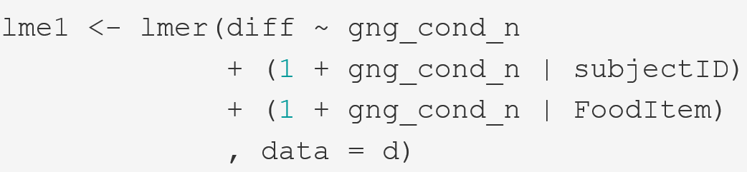
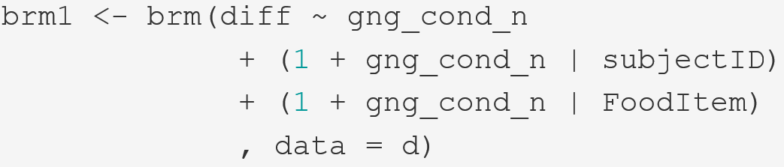

Making the switch: lme4 → brms
A few things are implicit here as they have a default setting that brm will fall back to if things are not specified:
What is the distribution of the response variable aka. model-family
- What are our priors?
How many MCMC samples do we want to collect?

Slide 23
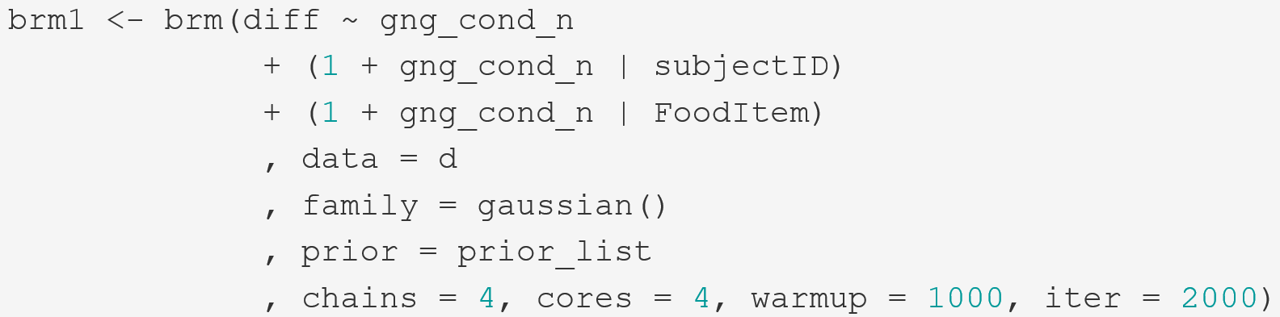
Making the switch: lme4 → brms
Fitting
Diagnostics
Evaluation

Slide 24
Priors

Slide 25
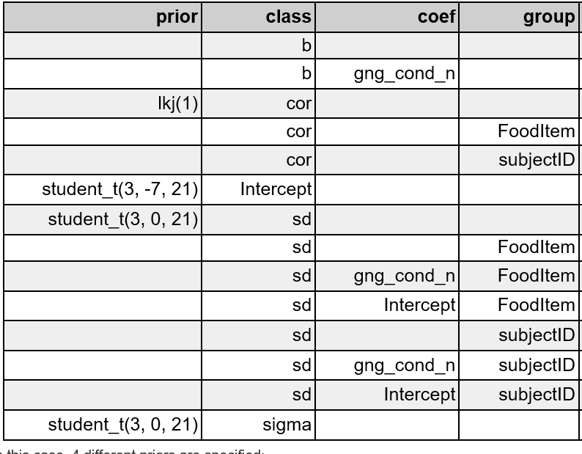
Fitting: priors
The defaults (get_prior(formula))
Fixed effects
Random Effects
Random Correlations
Residual standard deviation
The term ‘default’ is a bit confusing here as the priors actually depend on your data and the default is only conceptually the same each time but will not numerically be the same for different data-sets / models.
What default means here:
Priors are obligatory for Bayesian inference and if you don’t dare to make at least some prior predictions about the data, then someone else has to do it!

Slide 26

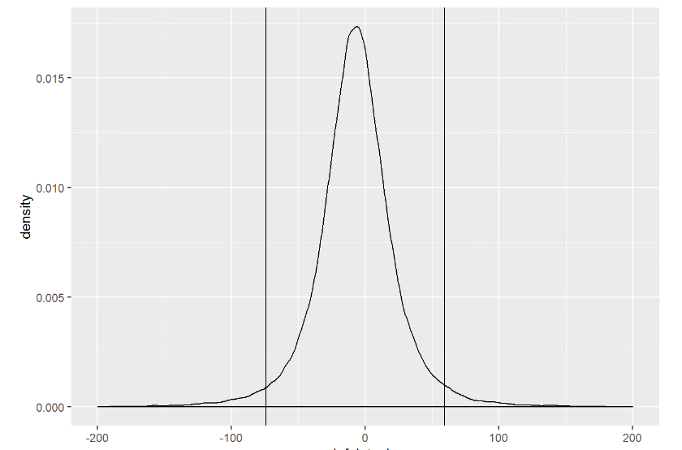
Fitting: priors
What do these priors (e.g. student-t distribution(df = 3, mean = -7, sd = 21) ‘mean’?
“before” seeing the data:
- most probable intercept value (i.e mean difference score) is -7 (i.e. the peak)
Most likely it is between ca. -75 and 60 (95% HDI)
However could also be -1000 or +1000 (not shown in graph)!
REALLY vague; We can do better than this in most cases!
E.g. we know that difference scores can only be between -200 and 200

Slide 27
Fitting: priors
Let’s do better: What do we know?
Intercept: most likely close to 0 as differences between pre- and post rating are mostly small. Can be -200 or 200 at max.
Fixed effect: go/no-go training does normally not have huge effect sizes on evaluation.
Random effects: there might be quite some individual variation between participants, probably less so for items. However, much more difficult to predict, so lets use a weakly regularizing prior (just as the default but not that weak).
Honestly, we have ran quite some GNG studies in the lab, I could me much more specific than this without making very bold claims (but lets use only the above for now)…
Specify:
Intercept: set_prior('normal(0, 50)', class = 'Intercept’)
Fixed effect: set_prior('normal(0, 10)', class = 'b’)
Random effects: set_prior('cauchy(0, 5)', class = 'sd')

Slide 28
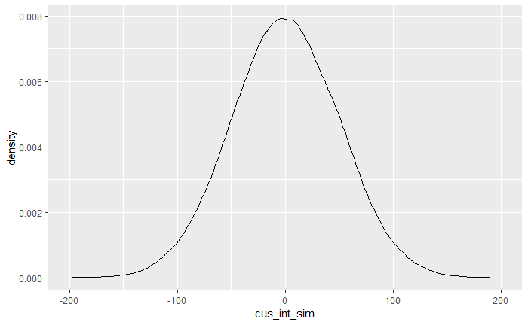
Fitting: priors
New intercept

Slide 29
Fitting
prior_list <- c(set_prior('normal(0, 50)', class = 'Intercept'),
set_prior('normal(0, 10)', class = 'b'),
set_prior('cauchy(0, 5)', class = 'sd')

Slide 30
Diagnostics

Slide 31
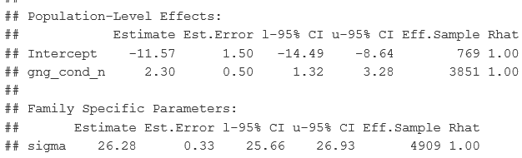
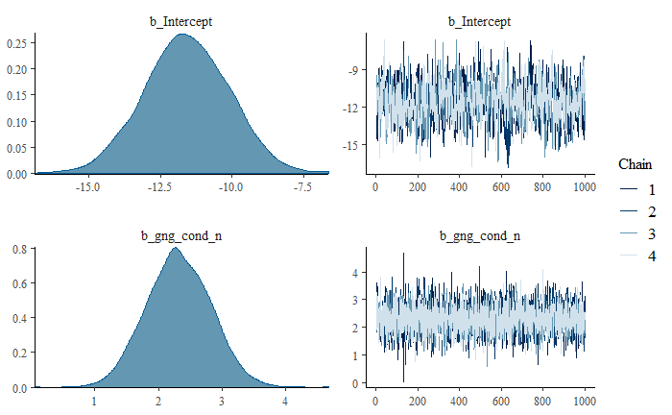
Diagnostics: Convergence
1. Did the chains mix well, i.e. did the MCMC sampling converge somewhere?
plot(brm1) summary(brm1)
Hairy caterpillars
Rhat < 1.1 (or better <1.02)
Eff.Sample size is “big enough”
No divergent transitions warnings
If all are a “yes” you should be good

Slide 32
Diagnostics: Convergence: What if it goes wrong?
Can mostly be resolved by 2 simple changes:
Increase chain-length
Increases the „resolution“ of the HMC-sampler as some features of the target distribution might be too small to detect for the default resolution of the sampler
You can find more information on https://mc-stan.org/misc/warnings.html#divergent-transitions-after-warmup

Slide 33
Evaluation 1 - Adequacy

Slide 34
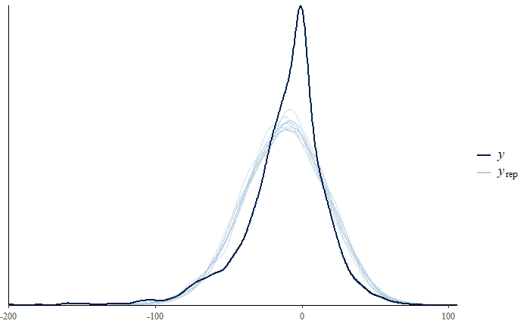
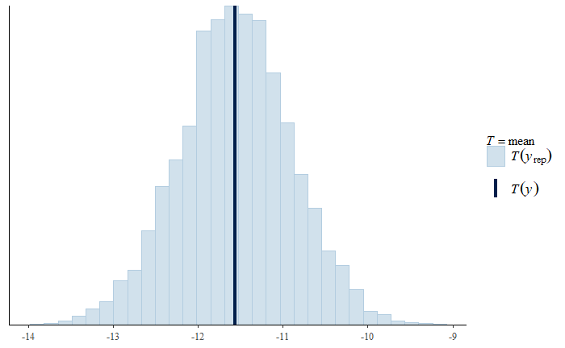
Evaluation: Adequacy – posterior predictive check
pp_check(brm1) pp_check(brm1, type = “stat”)
Looks ok. The estimate of the mean is very close to the observed mean, and the spread of the distribution is close to the observed distribution.
However, the peak in the middle is not so well-covered in this case.

Slide 35
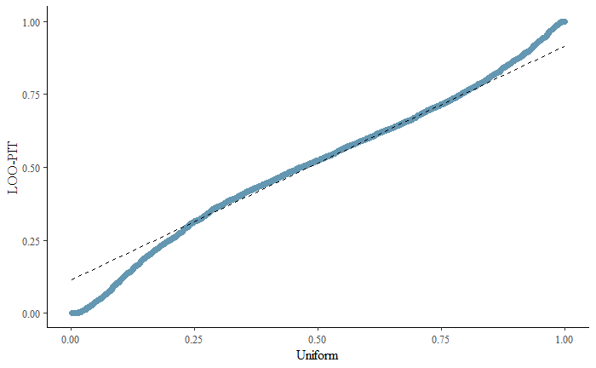
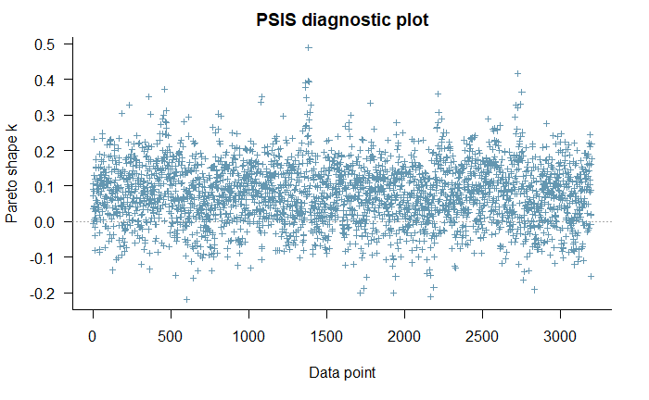
Evaluation: Adequacy
There is more we can do
- Check influential observations with loo and loo-pit qq-plot (see talk-notes)

Slide 36
Evaluation 2 - Estimation

Slide 37
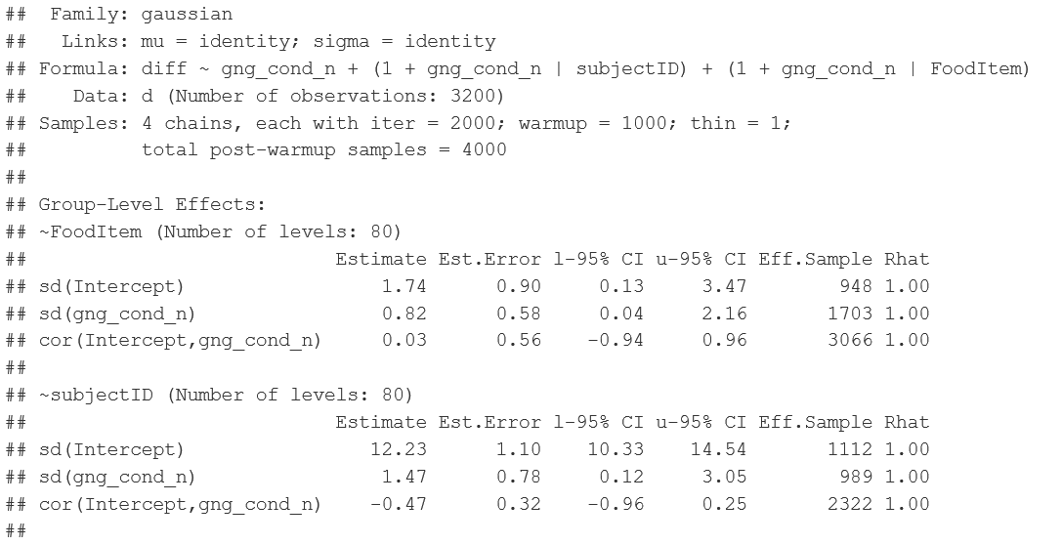
Evaluation: Estimates
Summary(brm1) #1 of 2

Slide 38
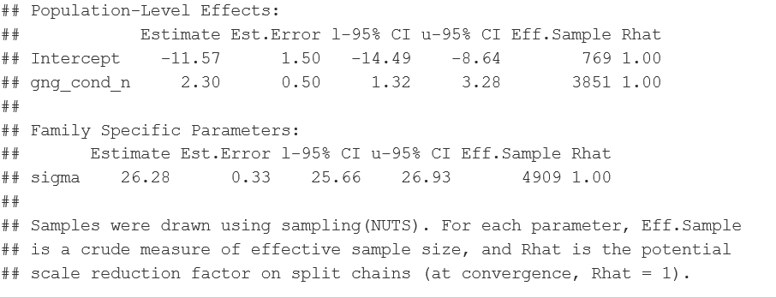
Evaluation: Estimates
Summary(brm1) #2 of 2

Slide 39
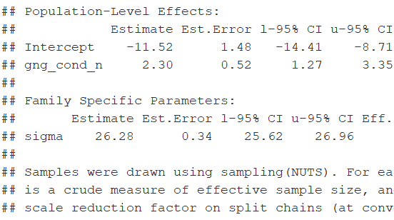
Back to priors quickly
Custom priors default priors
Almost identical!

Slide 40
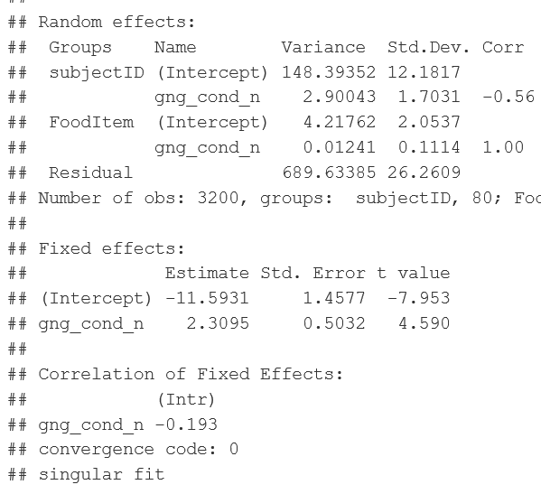
And what about lme4?
Custom priors lmer
Almost identical again…

Slide 41
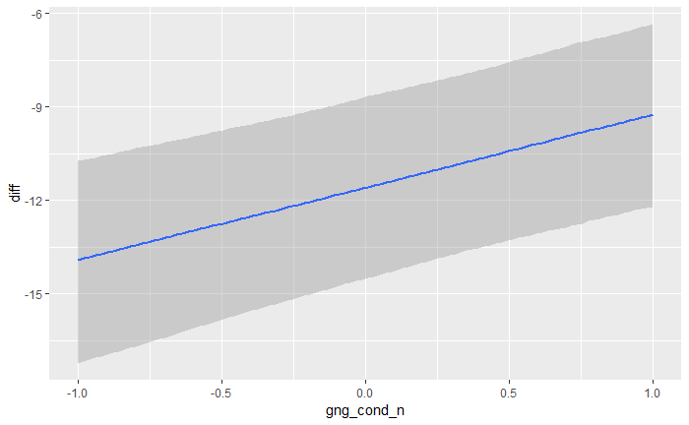
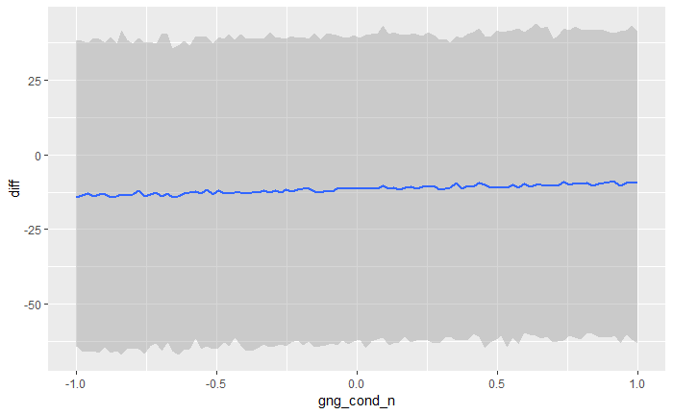
Evaluation: plot the effects
marginal_effects(brm1) marginal_effects(brm1, method=“predict”)

Slide 42
Evaluation 3 - Testing

Slide 43
Evaluation: Is there an effect of condition?
What are our options here? We do not get p-values (they don’t exist/make sense in the Bayesian framework)
We can get posterior probabilities sometimes called “Bayesian p-values” that describe the proportion of the posterior that are above/below a certain value (e.g. 0).
Advantages: easy to compute, easily interpretable
Disadvantages: not trivial to do with factors that have more than 2 levels their interactions.
We can do model comparisons based on information-criteria / quantifying predictive performance (e.g. AIC / WAIC / LOOIC / cross-validation)
Advantages: very flexible in terms of comparison (not only nested models)
Disadvantages: answering a slightly different question than what we normally want to know with significance tests (namely predictive performance)
We can calculate the Bayes-Factor (i.e. ratio of prior odds to posterior odds aka. the evidence ratio between two hypotheses)
Advantages: gives us overall “evidential value” statistic for an effect (as compared posterior probabilities)
Disadvantages: Take a lot of time and effort to compute (only stable if we increase iterations to > 10000), very dependent on prior with no clear standards of reporting yet.

Slide 44
Model Families

Slide 45
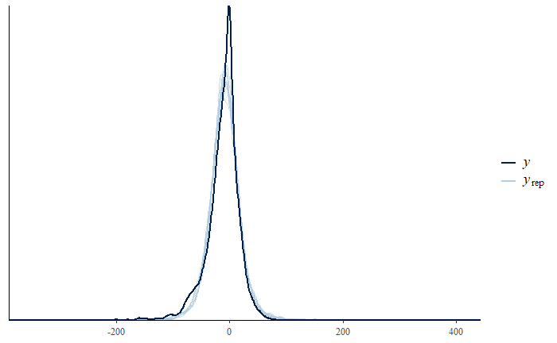
Beyond that: Model families
As said, we are not restricted to normal models, and can also e.g. fit a student-t distribution on the response data:
In this case, estimates do only change slightly but model-fit and predictive performance increase drastically (see notes).

Slide 46
Reading List
Bayesian Workflow: Toward a principled Bayesian workflow in cognitive science (Shad, Betancourt, & Vasishth, 2019) https://osf.io/xs4zg/
Model-families: https://cran.r-project.org/web/packages/brms/vignettes/brms_families.html#beta-models and https://rdrr.io/cran/brms/man/brmsfamily.html
Bayesian stats in general (great book!): http://xcelab.net/rmpubs/sr2/statisticalrethinking2.pdf
https://bookdown.org/ajkurz/Statistical_Rethinking_recoded/ provides the book code chunks and exercises recoded in tydiverse and brms
Stay tuned and ask questions: https://discourse.mc-stan.org/c/interfaces/brms
Andrew Gelman‘s blog: https://statmodeling.stat.columbia.edu/
Explanation and visualization of MCMCs by Richard McElreath: http://elevanth.org/blog/2017/11/28/build-a-better-markov-chain/
Visualization of MCMCs by Chi Feng: https://chi-feng.github.io/mcmc-demo/

