Slide 1
Tower of Babble? Predicting UN (in)action
Final Presentation
DAT7
Alex Kapitanskaya

Slide 2
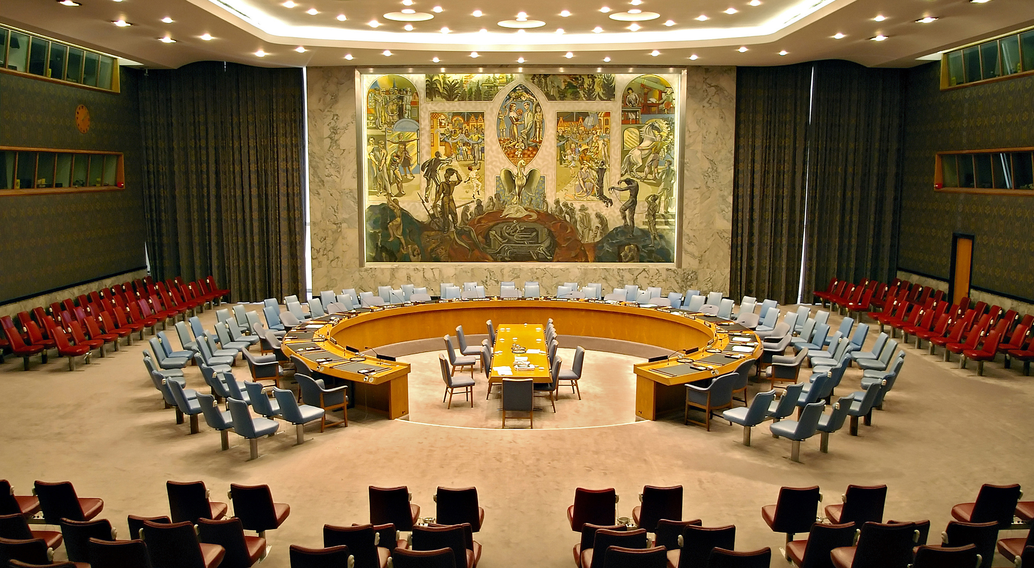
Can we predict what the UN Security Council will do?

Slide 3
Building a predictive model
Inputs: records of UN Security Council meetings
Outcomes: UN Security Council Resolutions
Timeframe: 1994 – 2014
Total observations: 1,236
Only considering matters of peace and security, not admission of new members, appointment of judges to international courts, etc.

Slide 4
Possible outcomes
Started with 6 categories…
… and ended with 2.
0 – no action
1 – soft measures (observers)
2 – prohibitive measures (embargoes)
3 – hard measures (peacekeeping missions)
4 – reversal of soft measures
5 – reversal of prohibitive measures
6 – reversal of hard measures
0 – soft action / no action
1 – intervention (mission, sanctions, embargoes)
→ Not enough observations for 6 categories, many fit into more than one

Slide 5
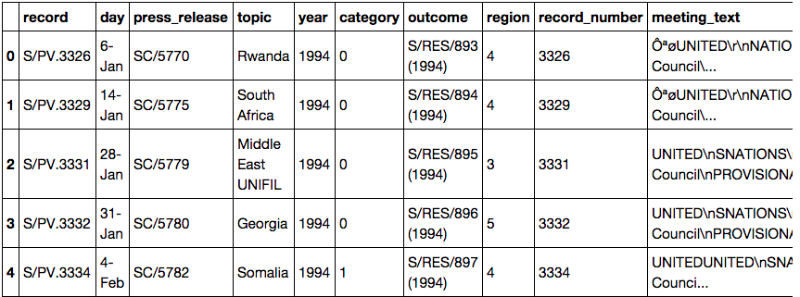
Dataframe

Slide 6
Naïve Bayes & Scikit-learn
Feature: meeting text
Response: category
ngram_range: 5
Accuracy: 75%
AUC: 0.82
More FN than FP → higher specificity, lower sensitivity

Slide 7
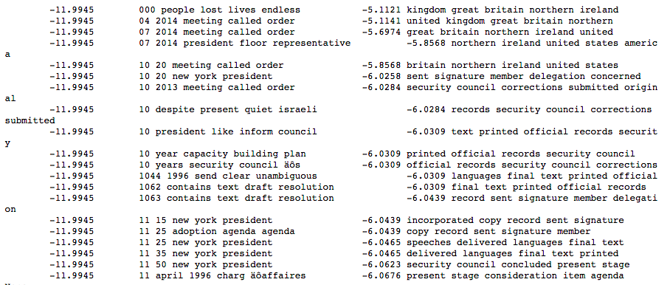
Naïve Bayes & Scikit-learn
Most informative for intervention Most informative for soft action
Most informative features:
All of this text is in every record… this list doesn’t really tell us much…

Slide 8
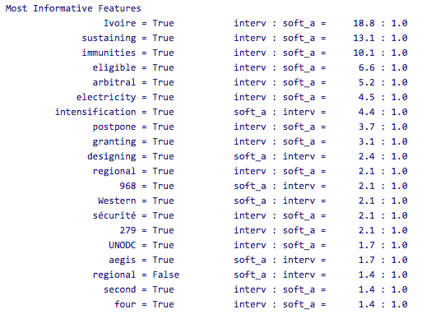
Naïve Bayes & NLTK: Outcomes
Accuracy: 58%

Slide 9
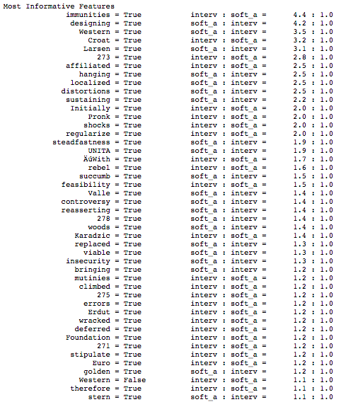
Naïve Bayes & NLTK: Inputs
Accuracy: 87%

Slide 10
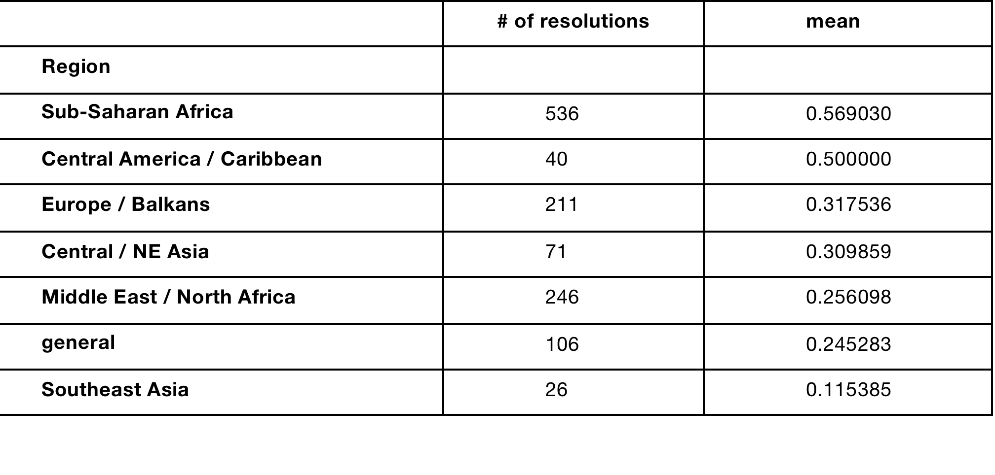
Pandas
Overall mean: 0.4
Regional data:

Slide 11
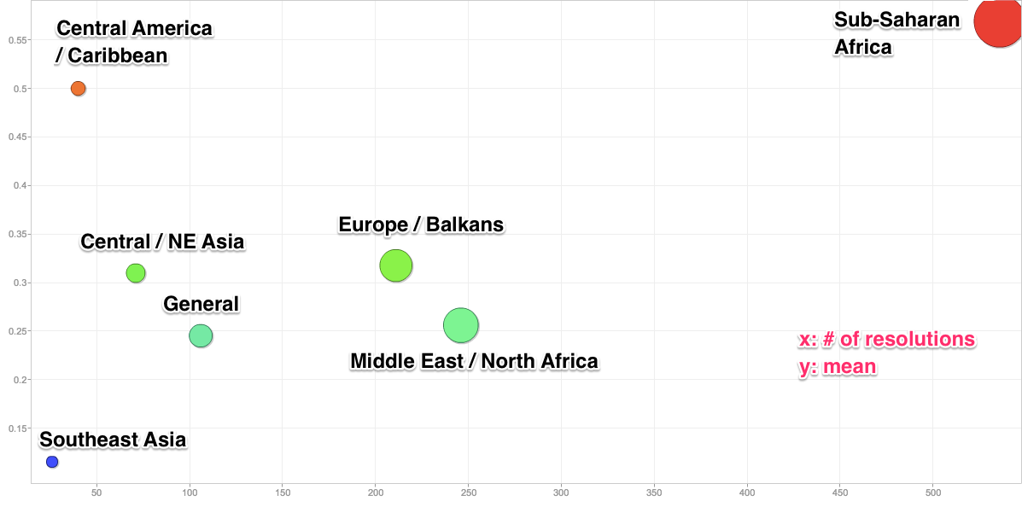
Pandas data in Google Motion Chart

Slide 12
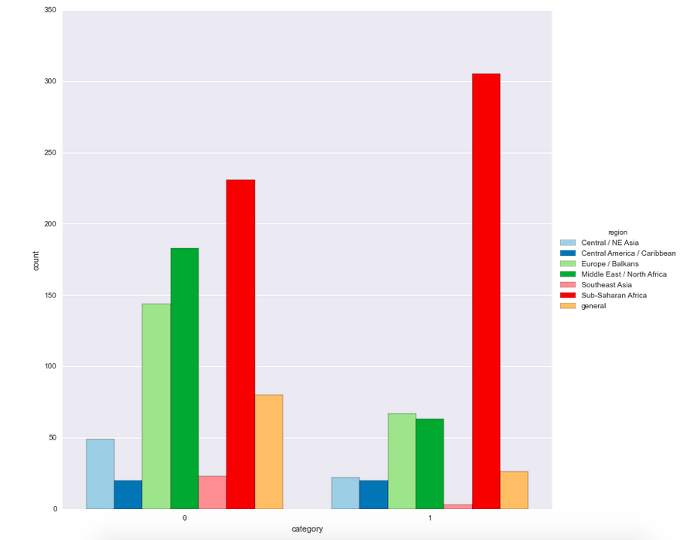
Pandas / Seaborn

Slide 13
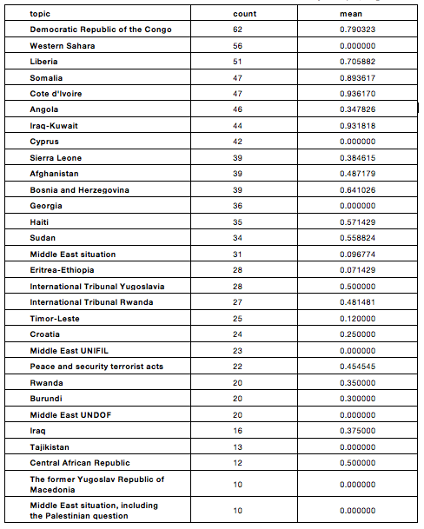
Top 30 by resolution count
Just because the SC
is talking about you
doesn’t mean it will
intervene…
High intervention
mean in DR Congo
No intervention
In Western Sahara

Slide 14
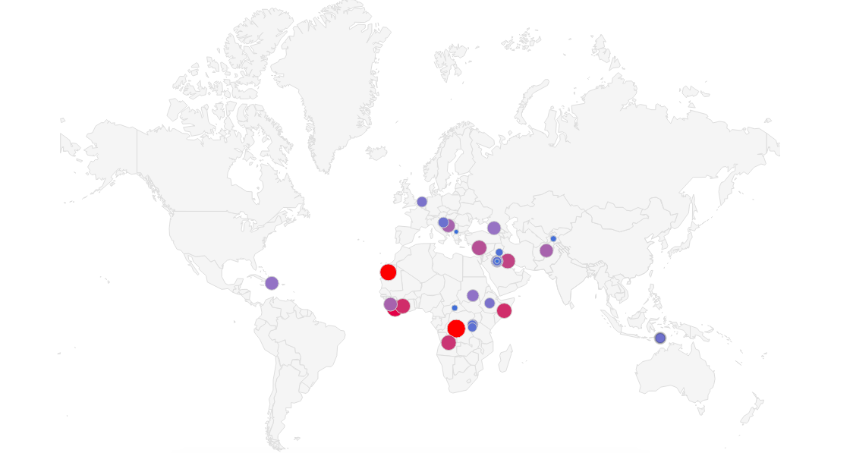
Top 30 by resolution count (Google Charts)

Slide 15
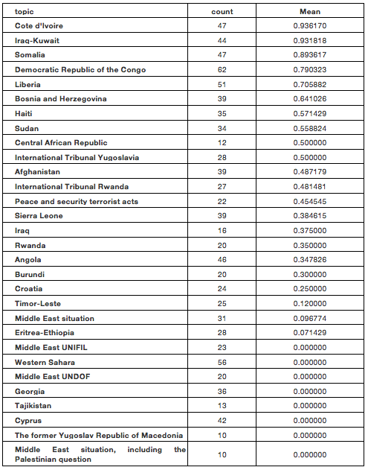
Top 30 by mean
Highest intervention
mean of all in Cote
d’Ivoire, which receives
very little coverage
Much lower mean
in Rwanda, Middle East
- constantly in the news

Slide 16
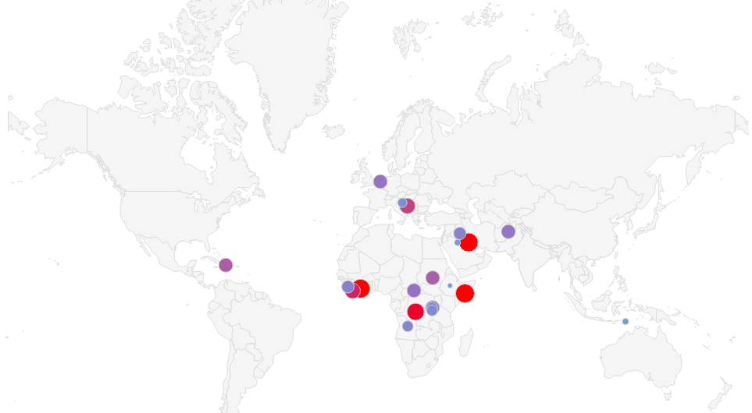
Top 30 by mean (Google Charts)

Slide 17
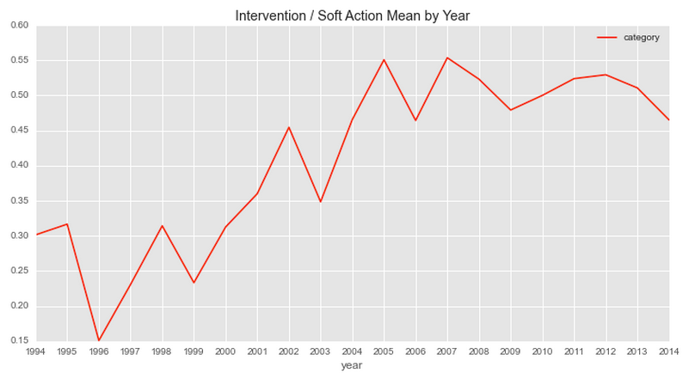
Time series / Seaborn
more interventions than soft actions
fewer interventions than soft actions
Counters hypothesis of “intervention fatigue”

Slide 18
Conclusions
Interesting experiment in the application of NLP and other methods to IR
Not a lot of useful predictive power
Decision-making in the Security Council is opaque, fundamentally unquantifiable
Unique sets of considerations and constraints that also change over time
Not like a regulator that will probably fine or shut down a business if it receives too many complaints
Possible expansions: adding (subjective) evaluations of whether there was a strong or weak position in favor of intervention on the part of a P5 state

