Slide 1
Beyond Compliance
Build a Privacy‑First Identity Wallet — Architecture Walkthrough
What you’ll build
OIDC4VCI issuance (SD‑JWT)
Unlinkable selective disclosure (BBS+)
OHTTP network privacy
iProov liveness gating
Bitstring status list revocation
RSA Conference • Learning Lab
Notes:
Session goal: build a privacy-first identity wallet that goes beyond baseline compliance.
Key defenses: correlation, phishing, revocation beacons, telemetry leakage (see LEARNING_LAB.md).
Roadmap: SD-JWT issuance, BBS+ unlinkable proofs, OHTTP network privacy, iProov liveness, Bitstring Status List revocation, aggregate telemetry.

Slide 2
End-to-end architecture
Issuer + wallet + verifier, with privacy and security guardrails.
Key flows
Issuance: OIDC4VCI offer → token (c_nonce) → credential (SD‑JWT or DI+BBS+).
Presentation: OIDC4VP (web) via Digital Credentials API where available.
Network privacy: OHTTP relay prevents origins from seeing client IPs.
Revocation: Bitstring Status List checks avoid per‑holder beacons.
Liveness: iProov gating before issuing or presenting sensitive attributes.
Beyond Compliance — Privacy-First Identity Wallet
RSA Conference • Learning Lab
Notes:
Walk the end-to-end flow: wallet ↔ issuer (OIDC4VCI), wallet ↔ verifier (OIDC4VP), OHTTP relay in the middle.
Components shown: iProov liveness gate, Bitstring Status List via CDN, DivviUp/DAP telemetry.
Callout: Digital Credentials API support varies; keep a fallback path (DEMO.md).

Slide 3
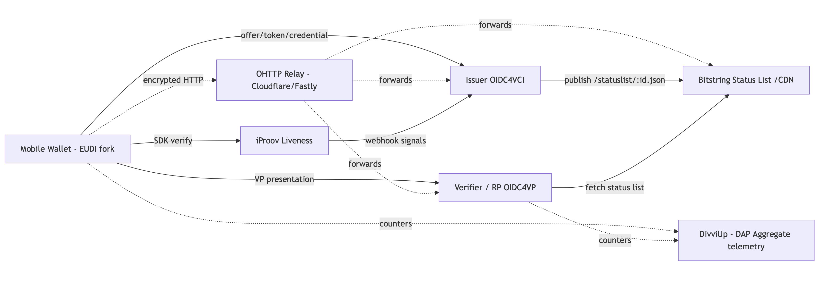

Slide 4
Component: Mobile wallet (EUDI fork)
Holder UX, key material, and protocol client — with optional privacy/security toggles.
Responsibilities
Stores issued credentials and disclosure material (SD‑JWT disclosures, BBS+ messages/proofs).
Uses a device‑bound holder key (Secure Enclave / StrongBox) for proof-of-possession.
Runs iProov liveness before releasing attributes (toggleable).
Routes issuance/presentation/status calls via OHTTP relay (toggleable).
Provides user consent UI for every attribute release.
Beyond Compliance — Privacy-First Identity Wallet
RSA Conference • Learning Lab
Notes:
Wallet is an EUDI fork with feature flags for BBS+, OHTTP, and iProov (wallet-ios/).
User consents, runs iProov liveness, then wallet sends OIDC4VCI/VP requests encrypted via OHTTP.
Device-bound keys and minimal data retention; store only iProov outcome/reference (DEMO.md).

Slide 5
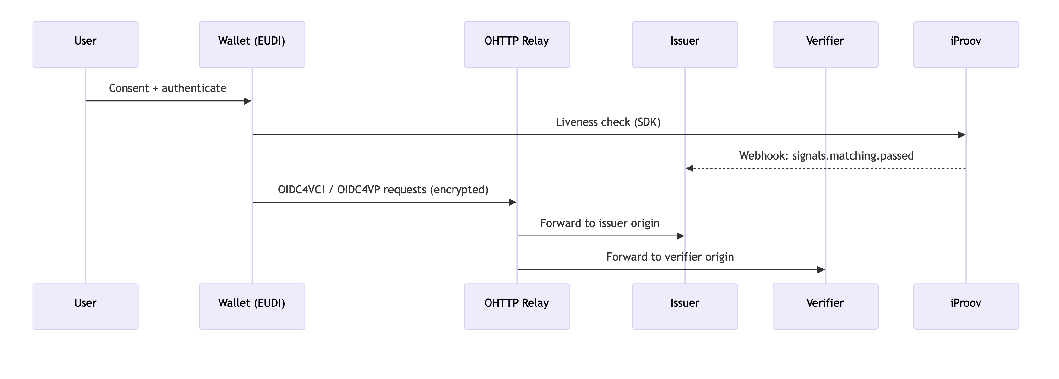

Slide 6
Component: Issuer service (OIDC4VCI)
Issues SD‑JWT VCs and DI+BBS+ credentials; publishes keys and status lists.
What it does
Publishes issuer metadata and keys (JWKS + BBS public key).
Implements pre‑authorized code offers and token exchange returning c_nonce.
Issues either SD‑JWT VCs (ES256) or DI+BBS+ credentials (unlinkable proofs).
Embeds credentialStatus as a BitstringStatusListEntry and serves /statuslist/:id.json.
Optional admin revocation flips bits; optional iProov gating blocks issuance until passed.
Beyond Compliance — Privacy-First Identity Wallet
RSA Conference • Learning Lab
Notes:
OIDC4VCI pipeline: credential offer → token (c_nonce + DPoP) → credential (SD-JWT or DI+BBS+).
Publish issuer metadata, JWKS, and BBS public key; embed credentialStatus with Bitstring Status List entry.
Revoke endpoint flips a bit; status list served at /statuslist/:id.json (README.md / DEMO.md).

Slide 7
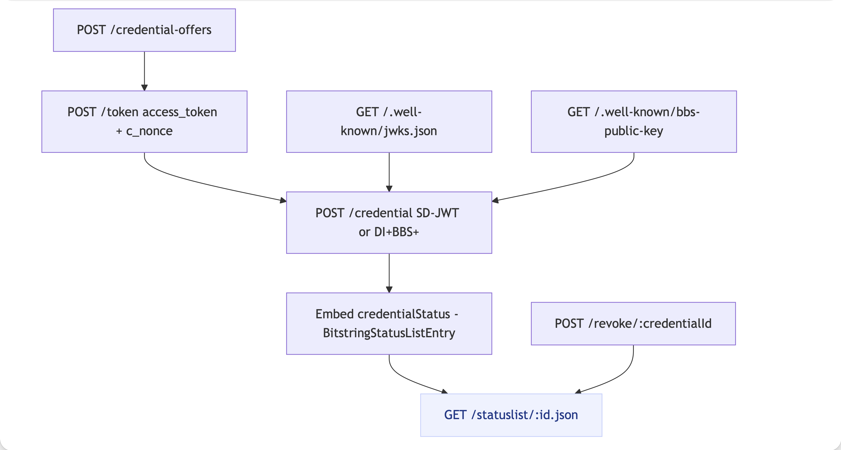

Slide 8
Component: Verifier / relying party (OIDC4VP)
Receives presentations, verifies proofs, enforces revocation; drives the web demo UI.
What it checks
Accepts SD‑JWT presentations or BBS+ derived proofs on /verify.
Validates signatures (issuer JWKS for SD‑JWT; issuer BBS key for BBS+ proofs).
Recomputes SD‑JWT disclosure hashes and reconstructs revealed claims.
Fetches Bitstring Status List and fails verification when the status bit is set.
Caches issuer keys and status list; can route outbound fetches via OHTTP.
Beyond Compliance — Privacy-First Identity Wallet
RSA Conference • Learning Lab
Notes:
Verifier flow: OIDC4VP request + Digital Credentials API, then verify SD-JWT signature or BBS+ proof.
Fetch issuer keys and status list; fail if revoked (credential_revoked).
Phishing resistance via nonce/aud binding, DPoP, optional WebAuthn (DEMO.md).

Slide 9
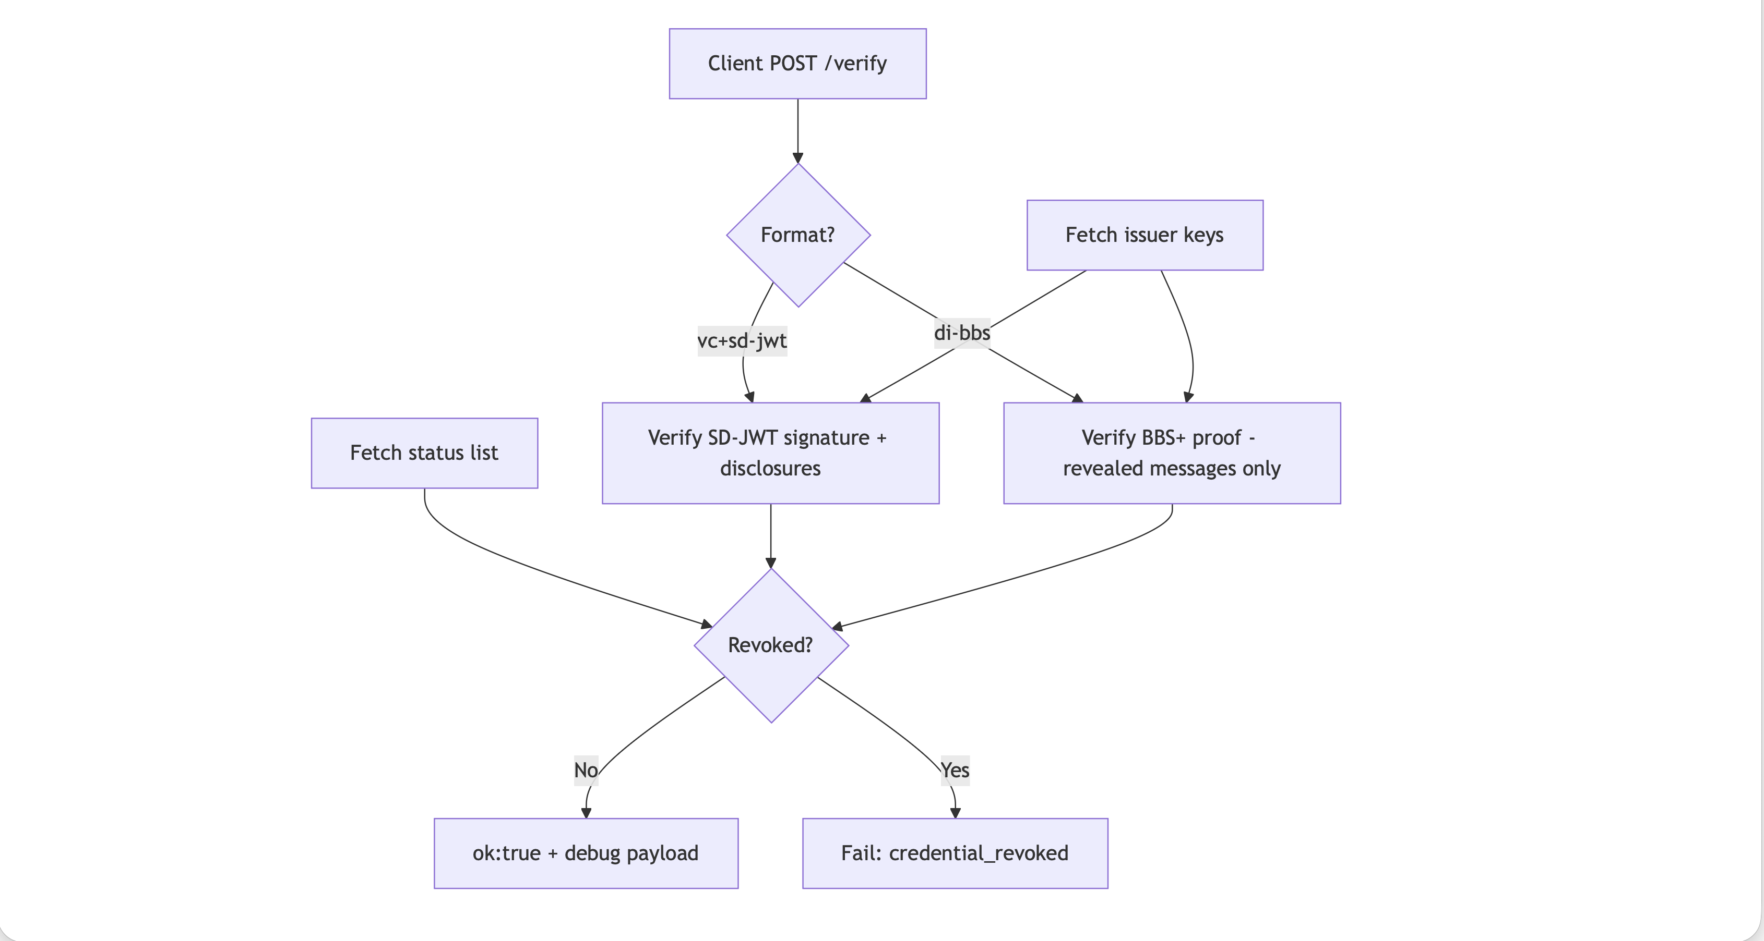

Slide 10
Component: OHTTP relay (network privacy)
Oblivious HTTP hides client identity from the origin (and origin identity from the client).
Why it matters
Prevents the issuer/verifier from logging or correlating client IP addresses.
Protects “status checks” from becoming revocation tracking beacons.
Used for outbound fetches too (JWKS, BBS keys, status list) when enabled.
Typically deployed as Cloudflare Privacy Gateway or Fastly OHTTP relay.
Enabled with USE_OHTTP + OHTTP_RELAY_URL toggles across services/wallet.
Beyond Compliance — Privacy-First Identity Wallet
RSA Conference • Learning Lab
Notes:
OHTTP path: client encrypts to relay → gateway → origin; origin never sees client IP (RFC 9458).
Use Cloudflare Privacy Gateway (preferred) or Fastly relay; toggle with USE_OHTTP env.
Apply to issuer, verifier, and status list fetches to avoid correlation (LEARNING_LAB.md).

Slide 11
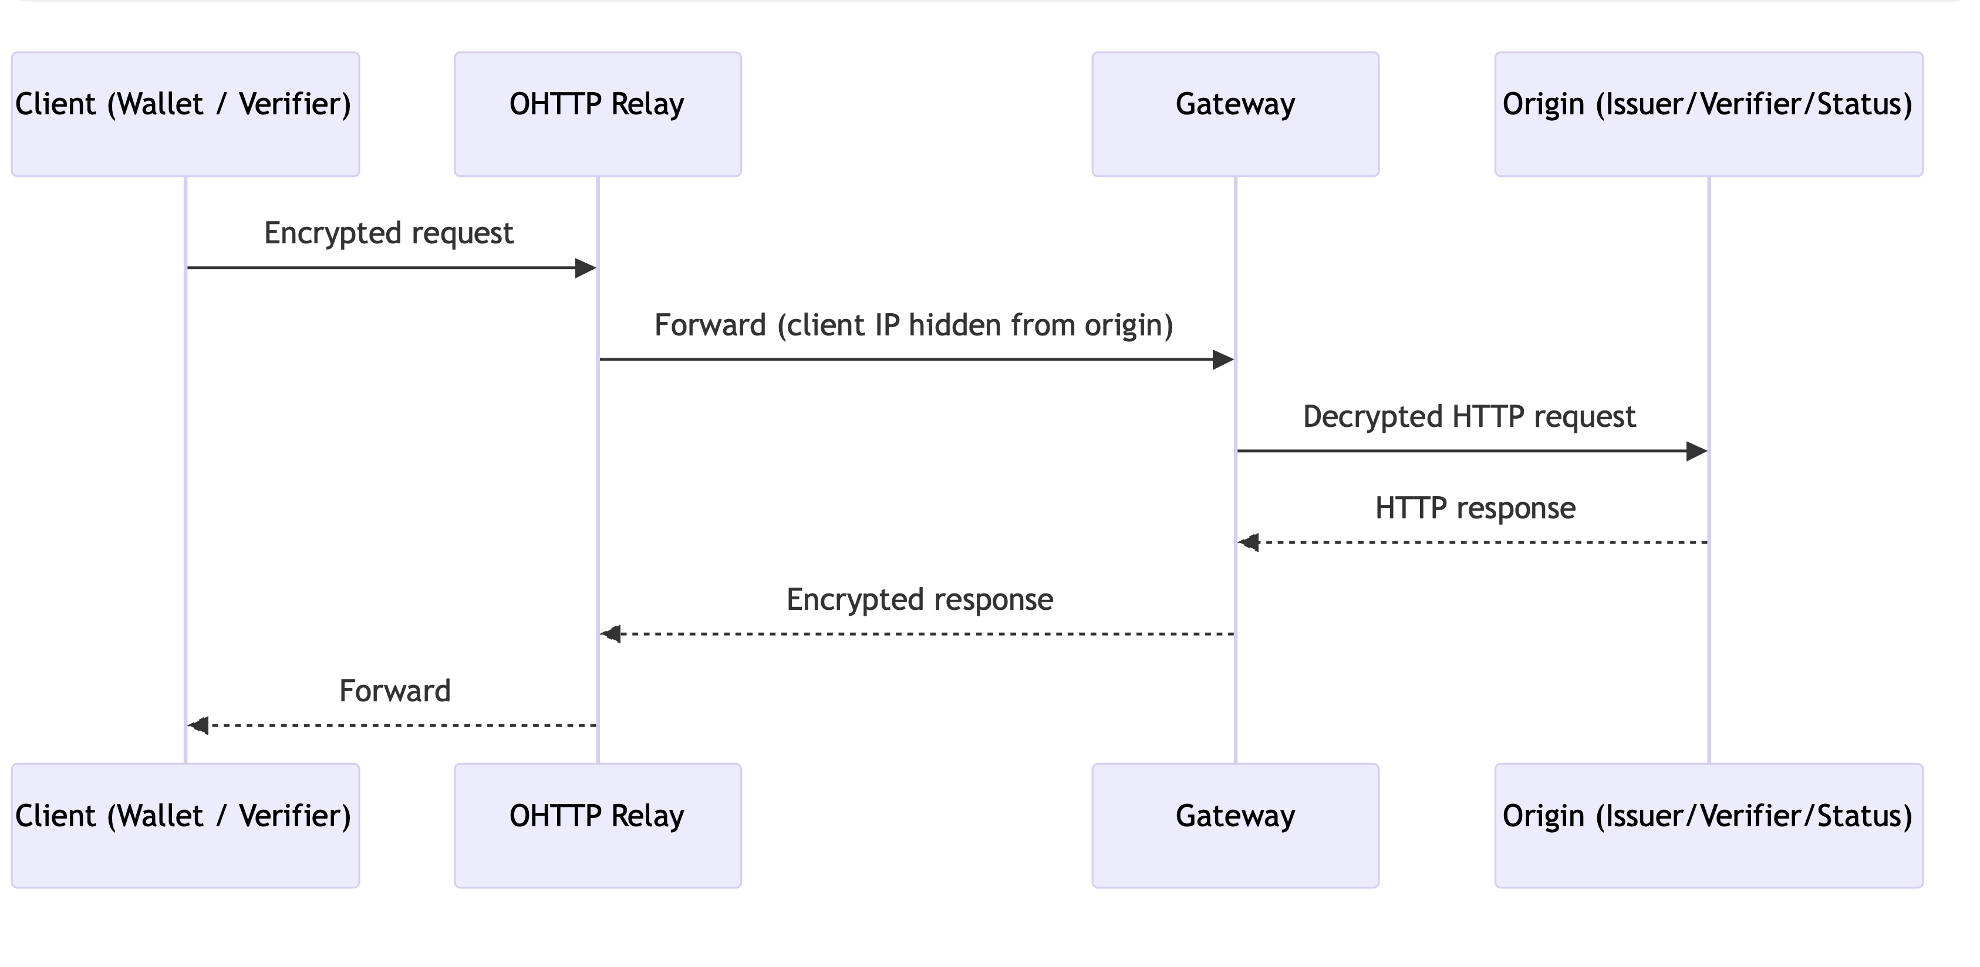

Slide 12
Component: iProov liveness gate
A “holder is present” check before issuing or presenting sensitive attributes.
How it’s used
Backend mints a claim/streaming token (or URL) for the wallet.
Wallet launches the iProov SDK and completes a liveness session.
iProov posts a webhook to the backend with pass/fail signals.
Issuer/verifier enforces gating: no issuance/presentation until passed.
Store only result references/booleans (no images or biometric templates).
Beyond Compliance — Privacy-First Identity Wallet
RSA Conference • Learning Lab
Notes:
iProov gate: wallet calls /iproov/claim, gets token, runs SDK; server receives webhook.
Only release attributes when signals.matching.passed = true; gate issuance/presentation.
No biometrics stored—keep only success boolean + audit reference (DEMO.md).

Slide 13
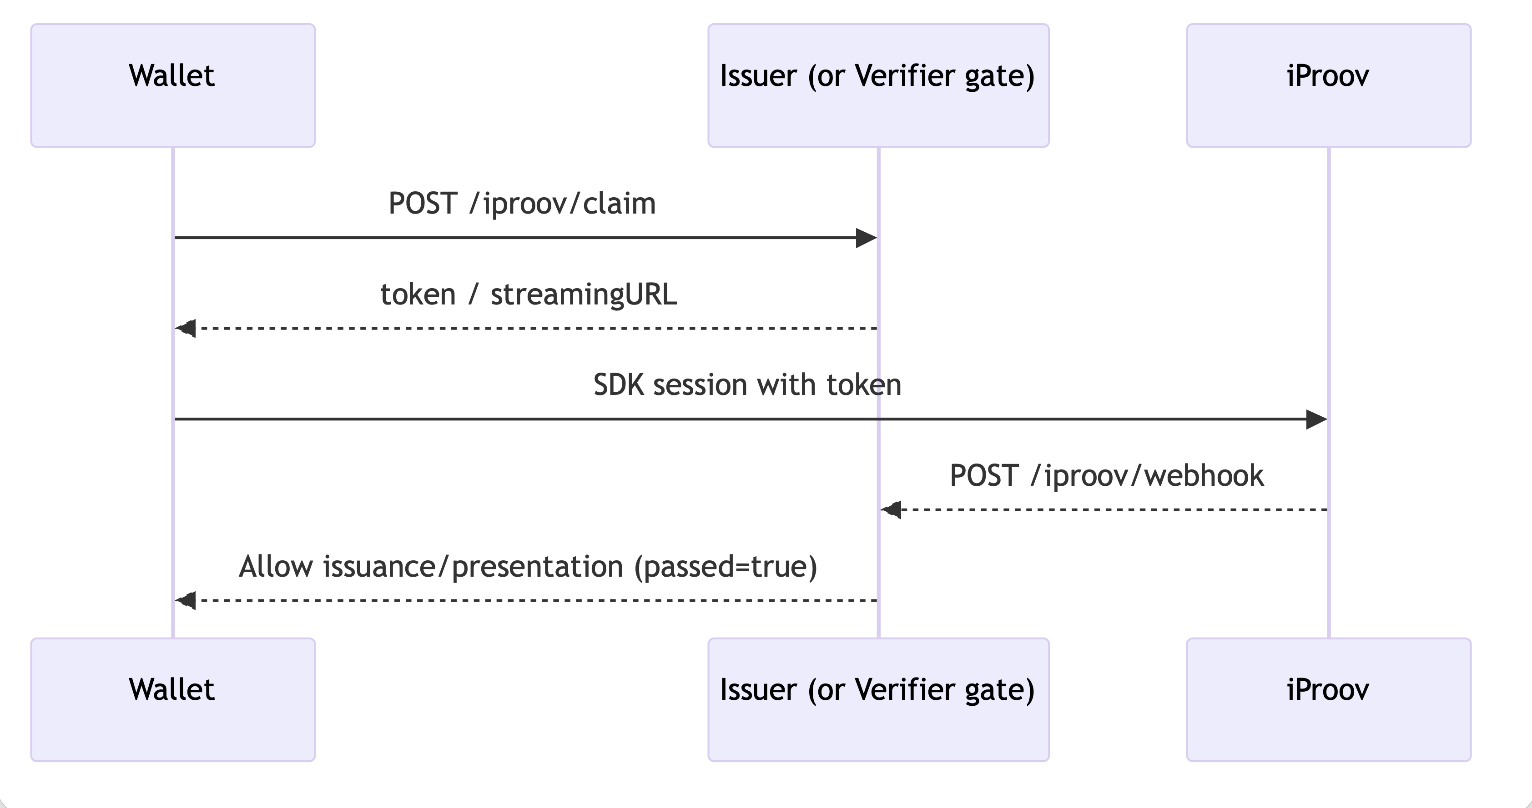

Slide 14
Component: Bitstring Status List (revocation)
Revocation checks without per-holder calls to the issuer.
Pattern
A base64-encoded bitstring represents revoked credentials by index.
Issuer embeds a BitstringStatusListEntry (index + list URL) in each VC.
Verifier fetches the status list (cache + TTL) and checks the bit.
Admin revoke flips a bit and persists the updated list.
Fetch via OHTTP to avoid turning revocation into a tracking beacon.
Beyond Compliance — Privacy-First Identity Wallet
RSA Conference • Learning Lab
Notes:
Bitstring Status List: base64 bitstring; credentialStatus carries list URL + index.
Verifier fetches list (cache/TTL) via OHTTP; bit=0 accept, bit=1 reject.
Admin revoke flips bit; avoids per-holder calls (LEARNING_LAB.md).

Slide 15
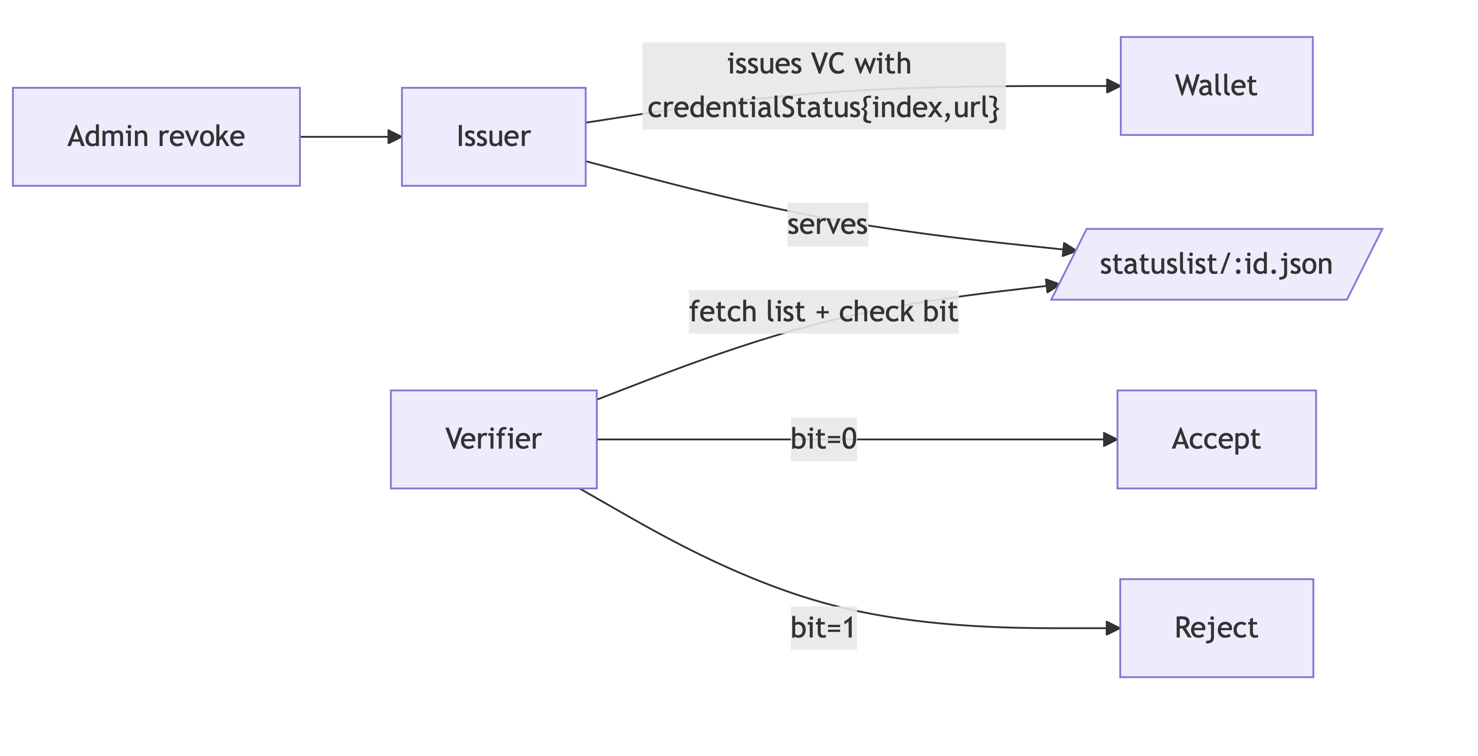

Slide 16
Component: BBS+ helper (bbs-lib)
Enables unlinkable selective disclosure proofs over an ordered list of messages.
Core ideas
Issuer signs an ordered message list (claims) with BBS+ over BLS12‑381.
Holder derives an unlinkable proof revealing only selected indices.
A per-session nonce binds the proof (prevents replay and linkability).
Verifier checks proof validity for revealed messages without learning hidden ones.
Kept as a small wrapper so participants can read the whole API surface.
Beyond Compliance — Privacy-First Identity Wallet
RSA Conference • Learning Lab
Notes:
BBS+ helper (bbs-lib): issuer signs ordered messages; holder derives unlinkable proof.
Reveal only selected indices (e.g., age_over), bound with nonce to prevent replay.
Verifier checks proof with public key; small wrapper so lab participants can read the API.

Slide 17
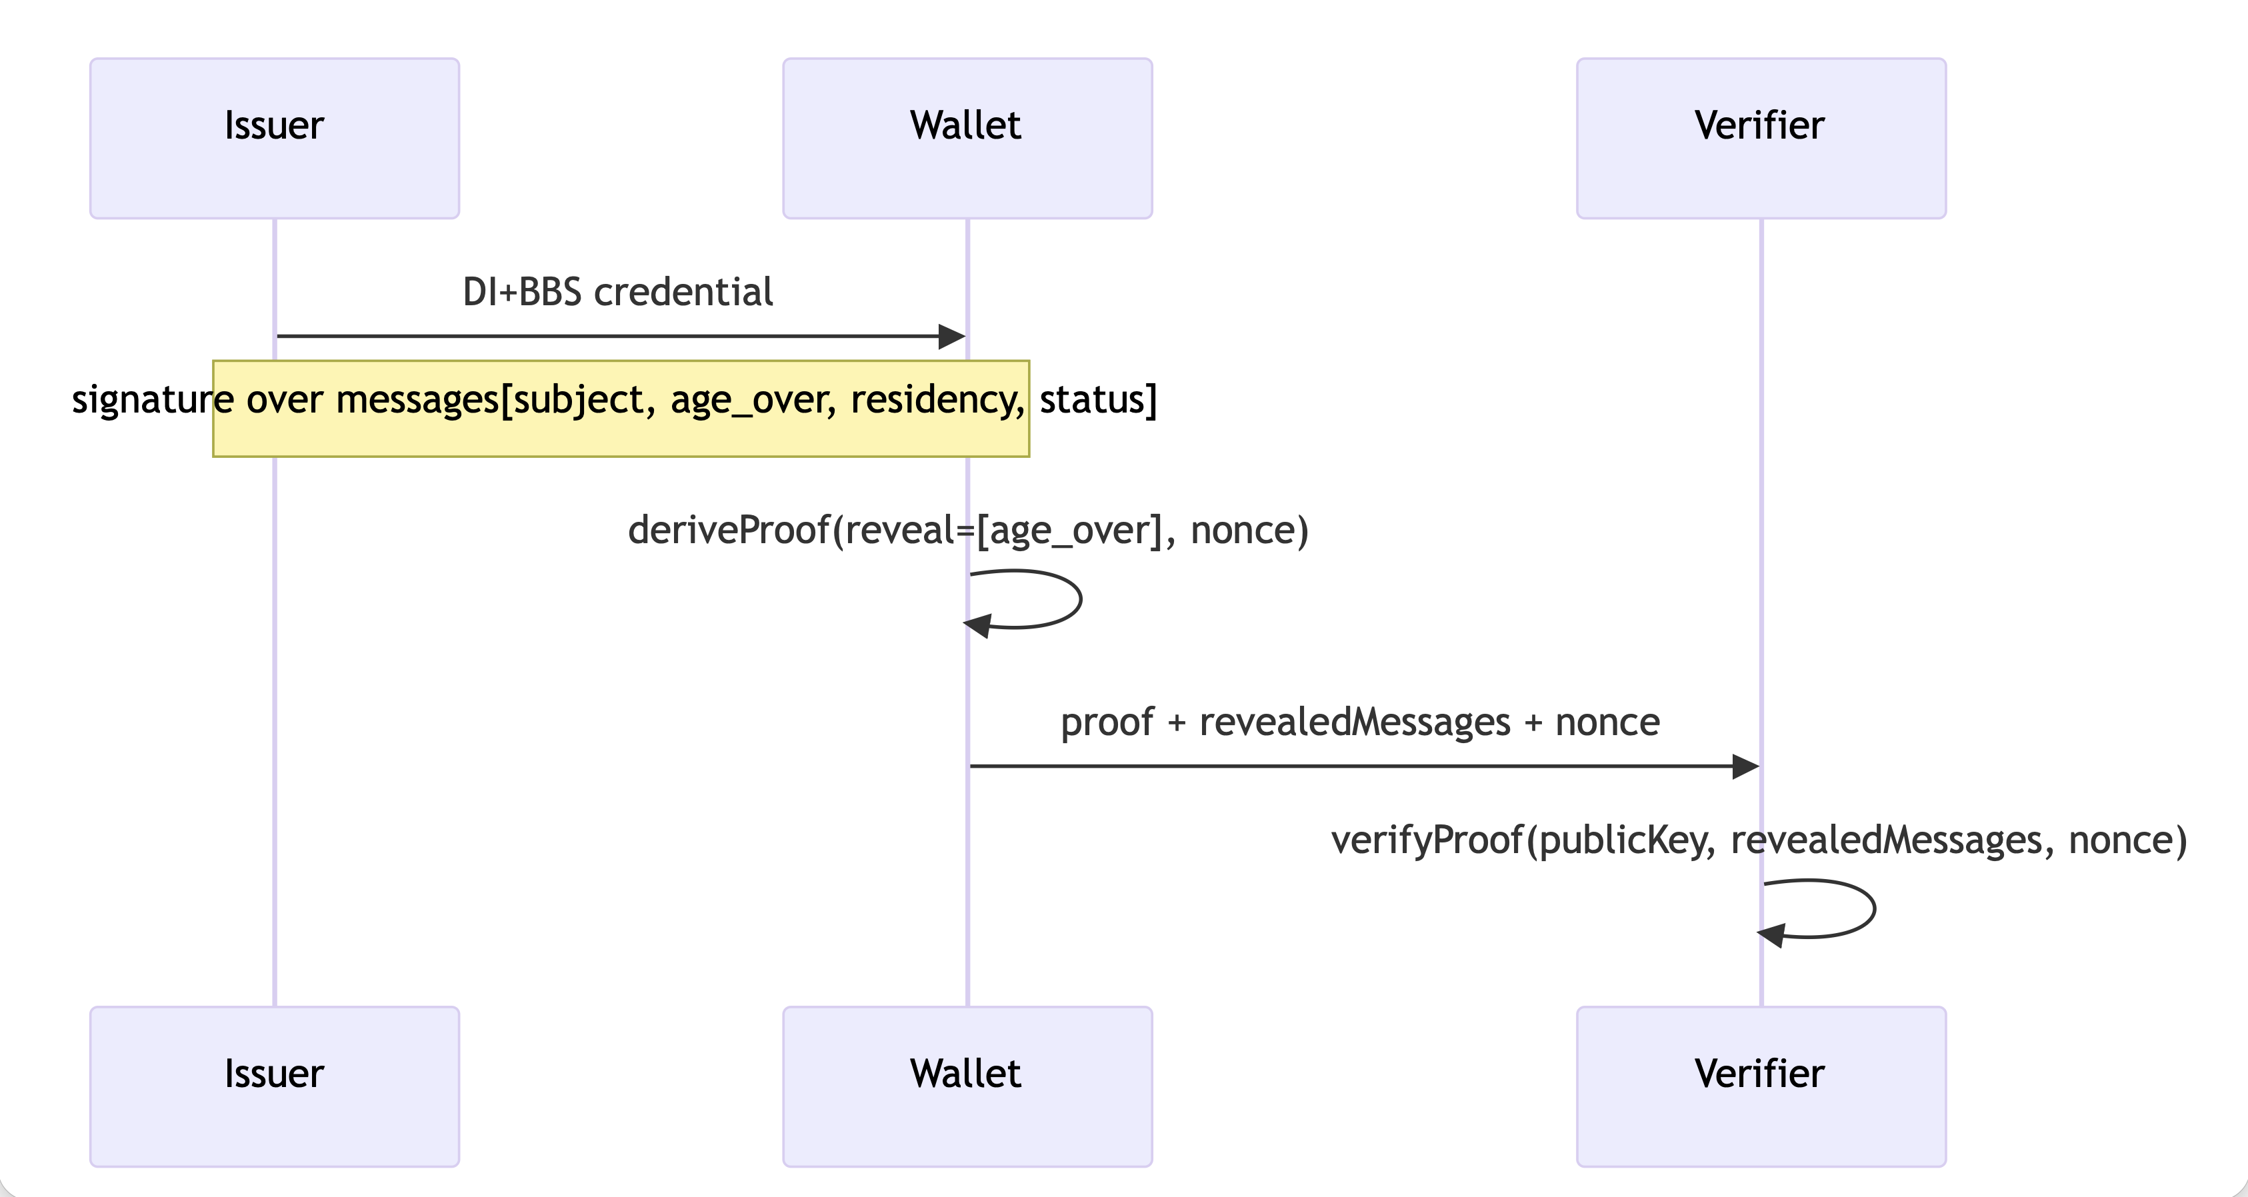

Slide 18
Component: Privacy-preserving telemetry (DivviUp / DAP)
Measure adoption and failures without collecting per-user event logs.
Approach
Only aggregate counters: issuance/presentation success/failure, retry counts.
In production: encrypted, batched reports to a DAP Leader/Helper (DivviUp).
In this lab repo: a stub logs counters locally to keep demos simple.
Avoids per-user identifiers and timing correlation in analytics pipelines.
Useful for “did it work?” metrics without privacy regressions.
Beyond Compliance — Privacy-First Identity Wallet
RSA Conference • Learning Lab
Notes:
Telemetry is aggregate-only via DAP/DivviUp: wallet & verifier send encrypted counters.
No raw per-user events; examples: presentations_succeeded, iproov_retry_count.
Optional module; verifier exposes /debug/telemetry in dev (README.md).

Slide 19
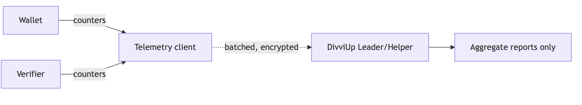

Slide 20
Cross-cutting: phishing-resistant bindings
Bind tokens and presentations to the right sender and the right origin.
Bindings to consider
Nonce + audience binding in proof material (prevents replay across contexts).
DPoP sender-constrained tokens for token exchange and verification APIs.
Optional WebAuthn step at the verifier origin before accepting a presentation.
Pairwise/ephemeral subject identifiers to reduce correlation surface.
Consent receipts and minimal disclosure as default UX posture.
Beyond Compliance — Privacy-First Identity Wallet
RSA Conference • Learning Lab
Notes:
Bind presentations to verifier origin: nonce + aud, DPoP sender-constrained tokens.
Optional WebAuthn step-up at verifier origin for phishing-resistant binding.
Goal: stop replay and credential phishing across origins (DEMO.md).

Slide 21
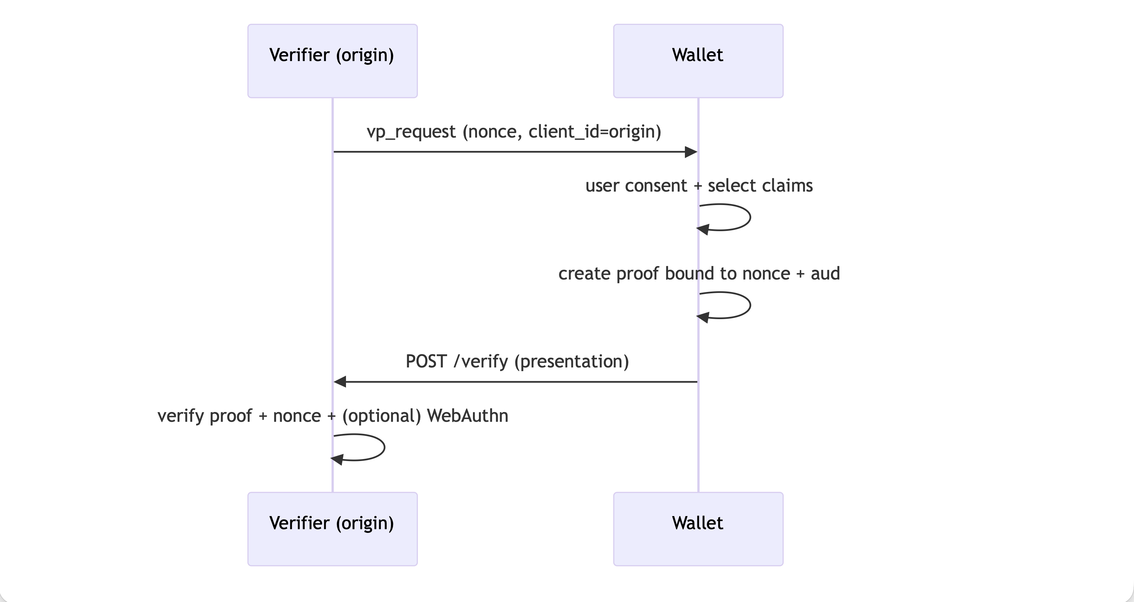

Slide 22
How the labs build the architecture
Each lab adds one capability; the full demo is the sum of the parts.
Lab progression
Scaffolding + health checks
Lab 00
Boot issuer/verifier; review annotated code paths.
SD‑JWT issuance (OIDC4VCI)
Lab 01
Offer → token (c_nonce) → credential; verify SD‑JWT.
BBS+ selective disclosure
Lab 02
Issue DI+BBS+ and verify unlinkable derived proofs.
OHTTP relay
Lab 03
Route outbound calls through relay; observe IP masking.
iProov liveness gate
Lab 04
Gate issuance/presentation on webhook-backed liveness.
Revocation via status list
Lab 05
Embed credentialStatus; enforce bit checks; flip bits to revoke.
Beyond Compliance — Privacy-First Identity Wallet
RSA Conference • Learning Lab
Notes:
Lab progression: Lab 01 SD-JWT issuance, Lab 02 BBS+, Lab 03 OHTTP, Lab 04 iProov, Lab 05 Status List.
Timing: 10–30, 30–55, 55–75, 75–95, 95–115 minutes (OUTLINE2.md).
Each lab has a branch + README with pass criteria; wrap-up checklist at end (LEARNING_LAB.md).

Slide 23
