Slide 1
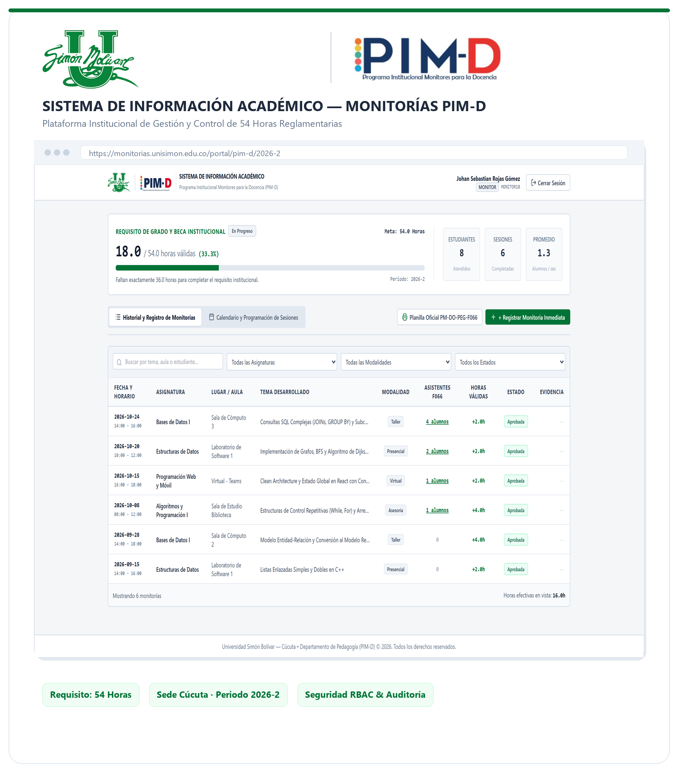
MONITORÍAS USB
PROJECT PROGRESS
Academic Tutoring Management
& Tracking Platform
A complementary web platform that centralizes academic tutoring records, tracks accumulated and pending hours, and gives authorized users clear access to monitoring information.
TEAM MEMBERS
Johan Sebastián Rojas Gómez
Andrés Felipe Peñaloza
Sebastian Beltran Peña
Johan Eduardo Polentino
PROFESSOR
Jover Alonso Cabrales
UNIVERSITY
Universidad Simón Bolívar
Notes:
SLIDE 1 — COVER (Estimated time: 20 seconds)
Good morning, professor and everyone.
Today, we are presenting Monitorías USB, an Academic Tutoring Management and Tracking Platform developed to improve the way academic monitoring activities are managed at Universidad Simón Bolívar.
We will explain the problem, our proposed solution, the current development progress, and the next steps.

Slide 2
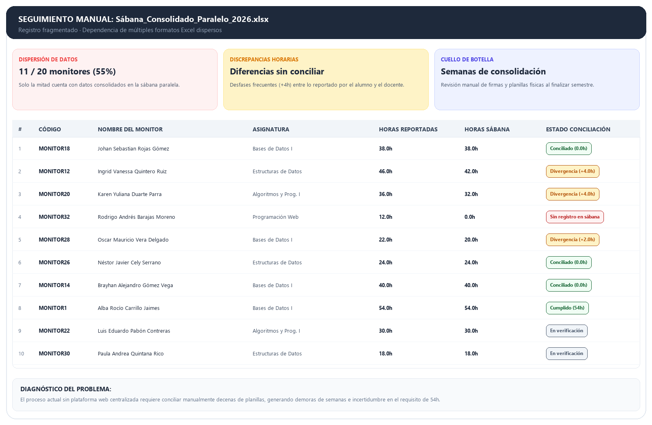
THE PROBLEM
Academic monitoring still relies on manual records.
Progress, history and reports are not easy to access.
54 HRS
Progress is hard to verify
FILES
Records are spread across files
REPORTS
Consolidation can take weeks
MONITORÍAS USB
2
Notes:
SLIDE 2 — THE PROBLEM (Estimated time: 22 seconds)
Currently, academic monitoring still relies heavily on manual records.
This creates three main problems: it is difficult to verify the fifty-four required hours, information is distributed across different files, and preparing consolidated reports can take several weeks.
Our project addresses these limitations.

Slide 3
PROJECT DIAGNOSIS
What the diagnosis shows
Baseline figures from the academic monitoring process.
20
11 / 20
55%
ACTIVE MONITORS
WITH CONSOLIDATED DATA
Approximate number of monitors per academic period.
Only 55% are represented in the parallel tracking file.
698
317
RECORDED HOURS
STUDENTS SERVED
Total hours contained in the consolidated records.
Students represented in those consolidated records.
These are diagnosis baseline figures, not live metrics from the V4 application.
MONITORÍAS USB
3
Notes:
SLIDE 3 — PROJECT DIAGNOSIS (Estimated time: 24 seconds)
Our diagnosis identified approximately twenty active monitors per academic period.
However, only eleven are represented in the consolidated tracking file, equivalent to fifty-five percent.
We also identified six hundred and ninety-eight recorded hours and three hundred and seventeen students.
These figures represent our initial diagnosis, not live application data.

Slide 4
WHY THIS SOLUTION?
Make existing monitoring data useful
A complementary platform makes records easier to access, verify and understand.
01
Faster access
02
Visible progress
Consult histories and reports without repeated manual requests.
Track accumulated and pending hours against the 54-hour requirement.
03
Reliable information
04
Responsible access
Validate imported records and identify duplicates or inconsistencies.
Give monitors, coordinators and directors role-appropriate information.
COMPLEMENTARY BY DESIGN
Uses periodic Excel/CSV exports; the university registration process remains unchanged.
MONITORÍAS USB
4
Notes:
SLIDE 4 — WHY THIS SOLUTION? (Estimated time: 22 seconds)
Our solution provides a complementary platform to make existing information more useful.
It offers faster access to monitoring histories, visual progress tracking, more reliable information through data validation, and responsible access according to user roles.
The institutional registration process remains unchanged.

Slide 5
PROJECT OBJECTIVES
What the MVP is designed to deliver
Six essential capabilities support better academic monitoring and follow-up.
GENERAL OBJECTIVE
Provide one place to consult monitoring histories, track the 54-hour requirement and review consolidated academic information.
SPECIFIC OBJECTIVES
01
History access
02
Hour tracking
03
Data centralization
Let each monitor review their own monitoring records.
Calculate completed and pending hours toward 54.
Import and validate exported SIA records.
04
Consolidated reports
05
Role-based access
06
Less manual work
Give coordinators and the director an overview.
Separate monitor, coordinator and director views.
Reduce parallel spreadsheets and repeated requests.
MONITORÍAS USB
5
Notes:
SLIDE 5 — PROJECT OBJECTIVES (Estimated time: 25 seconds)
Our general objective is to centralize monitoring histories, track accumulated and pending hours, and provide consolidated academic information.
To achieve this, we defined six specific objectives: history access, automatic hour tracking, data centralization, consolidated reports, role-based permissions, and reducing manual work.

Slide 6
TEAM & ROLES
A clear division of responsibilities
Four contributors working toward one academic monitoring platform.
Johan Sebastián Rojas Gómez
Sebastian Beltran Peña
JR
SB
DEVELOPER & PRODUCT OWNER
FRONTEND DEVELOPER
Leads product priorities and contributes directly to application development.
Builds the interface, dashboards and interactive user workflows.
Andrés Felipe Peñaloza
Johan Eduardo Polentino
AP
JP
BACKEND DEVELOPER
QA & DOCUMENTATION
Develops API services, business logic and database operations.
Supports functional checks, issue tracking and technical documentation.
PROPOSED ROLE DISTRIBUTION
Responsibilities can evolve as the MVP moves through development and validation.
MONITORÍAS USB
6
Notes:
SLIDE 6 — TEAM AND ROLES (Estimated time: 18 seconds)
Our team consists of four members with different responsibilities.
Johan Sebastián Rojas is the developer and product owner. Sebastian Beltran is responsible for frontend development. Andrés Felipe Peñaloza works on backend development, and Johan Eduardo Polentino supports quality assurance and documentation.

Slide 7
MVP scope and boundaries
Keep the first release small enough to validate.
IN SCOPE
OUT OF SCOPE
Excel/CSV import and basic validation
—
Replacing the institutional SIA portal
Individual monitoring history
—
Real-time API integration with SIA
Automatic accumulated / pending hours
—
Immediate institution-wide rollout
A 54-hour progress view for each monitor
—
Official approval of academic compliance
Consolidated coordinator and director views
Access permissions based on user role
—
Integration with unrelated systems
Note: V4 working prototype already includes session registration with Form F066 attendees, interactive calendar scheduling, and director cross-audit reconciler.
MONITORÍAS USB
7
Notes:
SLIDE 7 — MVP SCOPE AND BOUNDARIES (Estimated time: 28 seconds)
The MVP focuses on importing Excel and CSV files, monitoring histories, automatic hour calculations, progress dashboards, consolidated reports, and user permissions.
Additionally, our V4 prototype includes session registration using Form F066, interactive calendar scheduling, and a director cross-audit reconciler.
However, replacing SIA and real-time integration are outside the current scope.

Slide 8
How the solution works
A controlled data flow that complements the institutional platform.
Institutional SIA
Excel / CSV export
Validate & normalize
Web platform
User views
Monitoring sessions are recorded in the existing system.
Authorized users obtain periodic source files.
Check required fields, dates, hours and duplicates.
Store structured records and calculate progress.
Monitor history and academic dashboards.
Key boundary
The MVP imports exported data periodically; it does not replace SIA or synchronize with it in real time.
MONITORÍAS USB
Source: DERS, sections 3.2 and 5.2.
8
Notes:
SLIDE 8 — HOW THE SOLUTION WORKS (Estimated time: 22 seconds)
The process starts with the institutional SIA platform.
Authorized users export monitoring information in Excel or CSV format.
Our platform validates and normalizes the data, checks required fields and duplicates, and prepares structured records.
Finally, users can access monitoring histories and academic dashboards according to their permissions.

Slide 9
V4 software architecture
The repository has evolved into a separate frontend and API.
FRONTEND
REST API
CLEAN ARCHITECTURE
DATA LAYER
Next.js 14 · React · Tailwind
NestJS · TypeScript
Controllers · use cases · domain
Prisma ORM · PostgreSQL
USER PROFILES
MONITORING DOMAIN
SIA INGESTION
Monitor
Coordinator
Director / Admin
Sessions · attendees
54-hour progress
History and summary queries
Excel/CSV parser
Column mapping and validation
SHA-256 import fingerprint
V4 IMPLEMENTATION VIEW
This is the architecture reflected in the current repository, beyond the initial single-application proposal in the DERS.
MONITORÍAS USB
9
Notes:
SLIDE 9 — V4 SOFTWARE ARCHITECTURE (Estimated time: 26 seconds)
Our current architecture separates the frontend from the backend.
The frontend uses Next.js and React, while the REST API is developed with NestJS and TypeScript.
We apply Clean Architecture principles to organize controllers, use cases, and domain logic.
For data management, we use Prisma ORM and PostgreSQL.

Slide 10
Work plan
12-week delivery roadmap · Four focused phases across three implementation sprints.
01
02
03
04
BACKEND FOUNDATION
SIA DATA INGESTION
WEB PORTAL
PILOT & DEPLOYMENT
WEEKS 1–4
WEEKS 5–6
WEEKS 7–8
WEEKS 9–12
Secure backend core
Prepare source data
Connect user journeys
Validate the solution
Build the platform base and core services.
Turn exported records into validated data.
Make monitoring information useful to users.
Prepare a controlled institutional pilot.
Architecture & domain rules
Excel / CSV parser
Monitor history & progress
PDF certificates + QR / Excel export
PostgreSQL schema + Prisma
Flexible field mapping
Coordinator dashboard
Audit log + cloud CI/CD
JWT / RBAC + monitor API use cases
SHA-256 duplicate checks
Connect portal to imported data
Pilot with 20 monitors
Secure backend foundation
Validated import pipeline
Monitor and coordinator views
Pilot + validation results
Planning note: Sprint 02 (weeks 5–8) is shown as two workstreams; the repository groups both under one sprint.
MONITORÍAS USB
10
Notes:
SLIDE 10 — WORK PLAN (Estimated time: 30 seconds)
Our development roadmap covers twelve weeks, organized into four work phases.
First, we build the backend foundation, database, and security.
Second, we prepare the SIA data import process.
Third, we connect the web portal with the backend services.
Finally, we prepare certificates, audit logs, cloud deployment, and a pilot with twenty monitors.

Slide 11
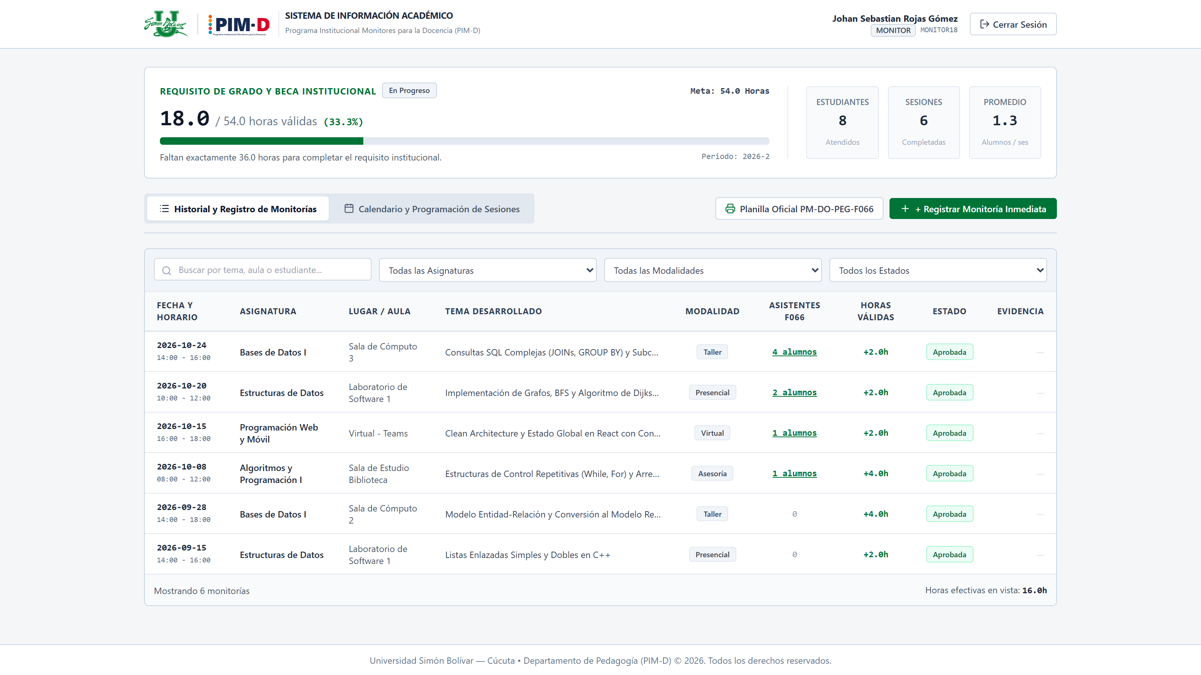
Implementation snapshot
A working interface concept supported by backend domain and API foundations.
FRONTEND · NEXT.JS / REACT
BACKEND · NESTJS / PRISMA
Monitor dashboard prototype
01
DOMAIN LOGIC
Core user journeys are represented in the current branch.
• Session duration rules
• 54-hour goal calculations
• Session and attendee entities
02
APPLICATION USE CASES
• Register session
• Monitor history and progress
• Coordinator summary
03
DATA & API
• Prisma + PostgreSQL model
• REST controllers and Swagger docs
• Excel/CSV parser and validation
INTEGRATION GAP · The UI still uses demo state; import rows are parsed, but full database insertion is not yet evidenced.
MONITORÍAS USB
11
Notes:
SLIDE 11 — IMPLEMENTATION SNAPSHOT (Estimated time: 25 seconds)
Regarding implementation, we already have a frontend dashboard prototype and important backend foundations.
These include session rules, fifty-four-hour calculations, application use cases, database models, REST controllers, and an initial Excel and CSV parser.
The main remaining gap is connecting the interface with the real API and completing database persistence for imported records.

Slide 12
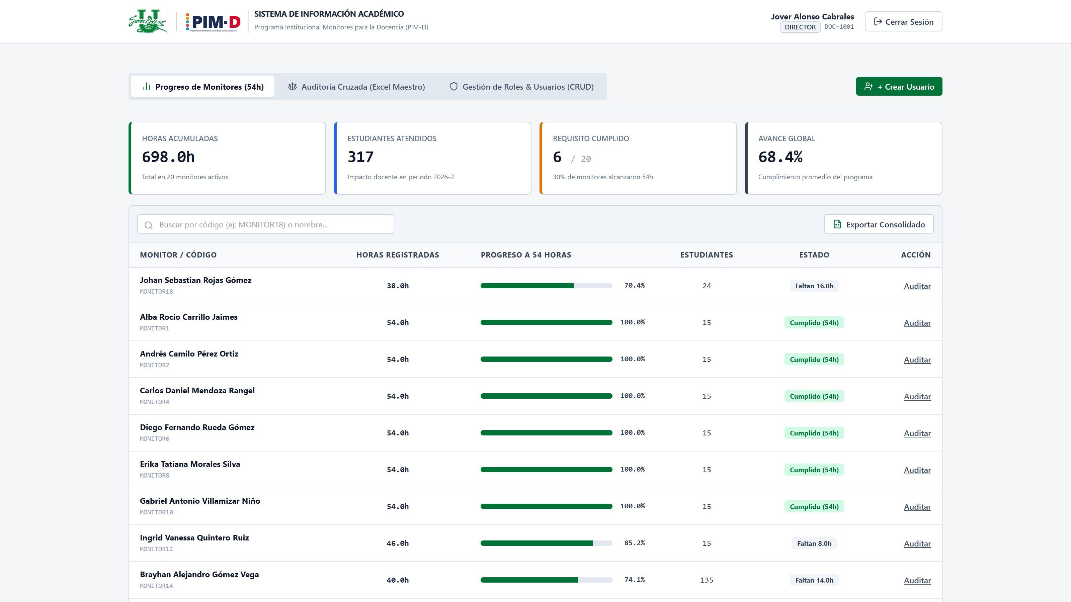
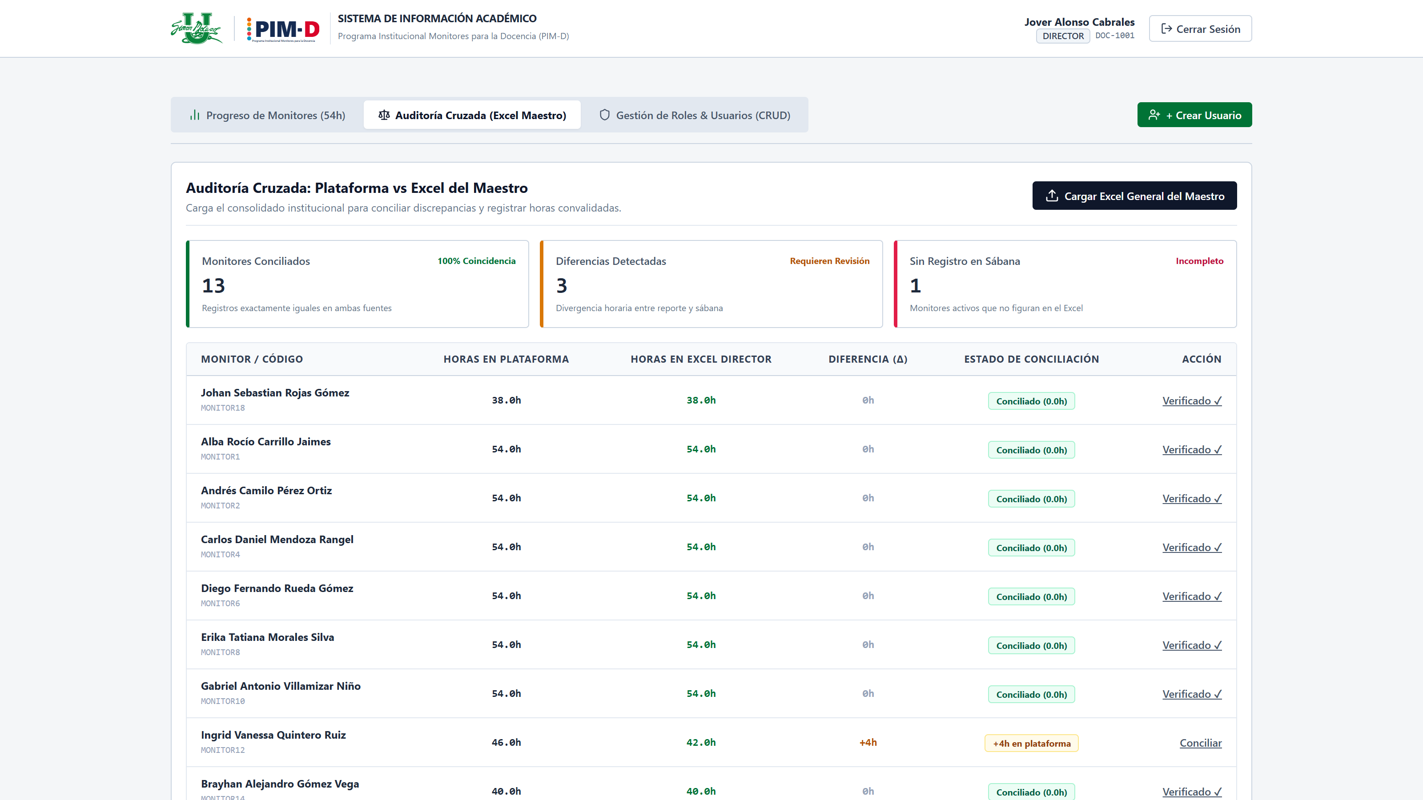
Director & Coordination capabilities
Real-time 54-hour progress matrix, cross-audit reconciler and institutional security.
SUPERVISION: 54-HOUR PROGRESS MATRIX
Live monitoring of all 20 active monitors, accumulated hours and student impact.
AUDIT: CROSS-RECONCILIATION ENGINE
Automated cross-check between platform sessions and teacher's master Excel.
• Instant status towards 54h requirement (scholarships & degree clearance).
• Quick audit action button per monitor with instant historical session breakdown.
• Highlights discrepancies (Δ hours) with 100% matched, divergent and missing tags.
• One-click alignment / reconciliation with immutable audit log recording.
MONITORÍAS USB
12
Notes:
SLIDE 12 — DIRECTOR AND COORDINATION CAPABILITIES (Estimated time: 25 seconds)
For coordinators and directors, we designed two important capabilities.
The first is a fifty-four-hour progress matrix to review monitors, accumulated hours, and student impact.
The second is a cross-reconciliation engine to compare platform records against the teacher's master Excel file.
These capabilities support better supervision, discrepancy detection, and more reliable auditing.

Slide 13
Project progress
Team-reported estimate across design, implementation and integration workstreams.
IMPLEMENTATION AREAS
CURRENT TEAM ESTIMATE
Requirements & design
100%
64%
Data model / persistence
90%
Backend use cases / API
85%
Frontend prototype
90%
Core design, interface and backend foundations are advanced; integration, security and validation remain in progress.
SIA import pipeline
65%
Authentication & RBAC
45%
Frontend–API integration
30%
Team estimate—not an automated repository metric. Workstream percentages are indicative assessments.
Testing / pilot / deployment
10%
PRIORITY: Secure access → API integration → persistent SIA import → end-to-end validation
MONITORÍAS USB
13
Notes:
SLIDE 13 — PROJECT PROGRESS (Estimated time: 25 seconds) [JOHAN]
Our team estimates that the project is currently sixty-four percent complete.
Requirements and design are complete, and the frontend prototype, backend use cases, and data model have advanced considerably.
Our main priorities are authentication, frontend and API integration, persistent SIA imports, and end-to-end testing.
This percentage is an internal team estimate.

Slide 14
From integration to pilot
Four actions will turn the current build into a testable MVP.
THE NEXT FOUR MOVES
01
02
03
04
Secure access
Connect app & API
Complete SIA import
Prepare the pilot
Enable login, JWT and server-side role checks.
Replace demo state with authenticated API requests.
Persist validated rows and block duplicate records.
Configure cloud services and run end-to-end checks.
NEXT MILESTONE
NEXT MILESTONE
NEXT MILESTONE
NEXT MILESTONE
Protected API
Live dashboard data
Stored, validated records
Pilot-ready environment
PILOT GATES
IMPORTS
HOURS
ACCESS
USERS
Verify before rollout
Match source records
Verify 54-hour totals
Enforce role permissions
Record pilot feedback
MONITORÍAS USB
14
Notes:
SLIDE 14 — FROM INTEGRATION TO PILOT (Estimated time: 22 seconds) [JOHAN]
To reach a testable MVP, we have identified four next steps.
First, secure access with authentication and role permissions.
Second, connect the frontend to the real API.
Third, complete persistent SIA imports and duplicate prevention.
Finally, prepare the environment and perform end-to-end testing before the pilot.

Slide 15
Challenges before the pilot
The remaining risks are specific — and each has a practical response.
The priority is a secure, reliable flow from source data to user-facing results.
CHALLENGE
RESPONSE
01
Source-data variability
→
Validate headers and map fields before import.
Exports may differ in columns and formats.
02
Access & privacy
→
Enforce and test JWT / RBAC on protected endpoints.
Server-side role guards still need completion.
03
Frontend–API integration
→
Connect API calls and persist valid imports.
Some screens still rely on demo data.
04
Schedule alignment
→
Confirm one baseline, scope and acceptance gates.
DERS: 16 weeks · V4 roadmap: 12 weeks.
IMMEDIATE FOCUS
Secure API → connect UI → persist imports → run end-to-end tests
MONITORÍAS USB
15
Notes:
SLIDE 15 — CHALLENGES BEFORE THE PILOT (Estimated time: 23 seconds) [JOHAN]
We have identified four main challenges.
These include differences between source file formats, access and privacy requirements, incomplete frontend and backend integration, and differences between the DERS and V4 schedules.
Our response is to strengthen validation, security, integration testing, and agreement on a single project baseline.

Slide 16
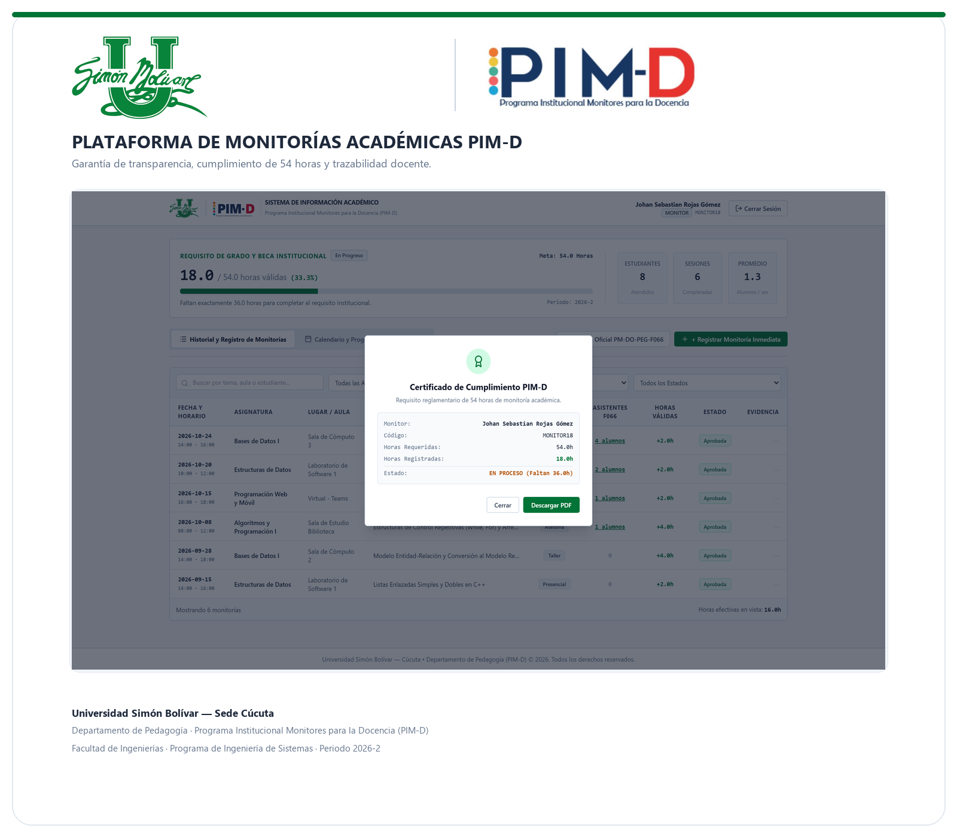
MONITORÍAS USB
Thank you!
Questions?
Academic Monitoring Management & Tracking Platform
Universidad Simón Bolívar · Cúcuta
Notes:
SLIDE 16 — THANK YOU (Estimated time: 13 seconds) [JOHAN]
This project represents an important step toward improving academic monitoring management through technology.
Thank you for your attention.
We are ready to answer your questions.

