Slide 1

The post-trade protocol
EDUMATCHER · RALF1
RALF
Reconciliation ALF — how clearing, risk and audit systems get the trade data they need, in plain text over TCP.
A beginner's guide · pm-ralf-gwy · TCP 5580

Slide 2
Eight questions this deck answers
ROADMAP
01
What is a gateway?
02
What is RALF for?
Why an exchange never lets you talk to the engine directly
The job the protocol exists to do
03
How is it used?
04
What can be sent?
The session, from connect to disconnect
Three channels, two event families
05
How is data shaped?
06
How do errors work?
The line format and its fields
Sequence gaps, replay and error codes
07
How do I build a client?
08
Where do I read more?
A checklist and working code
The reference map
EduMatcher · RALF post-trade protocol
2

Slide 3
RALF in one picture
THE BIG PICTURE
Trades happen inside the engine. RALF is how they leave the building.
CLEARING
pm-ralf-gwy
MATCHING ENGINE
internal events
THE GATEWAY
RALF1 text lines
DROP_COPY
Orders meet.
Trades are made.
Translates · sequences
authenticates · replays
TCP 5580
AUDIT
Three external audiences, one feed
Read-only: clients subscribe and receive. Nobody sends an order over RALF.
EduMatcher · RALF post-trade protocol
3

Slide 4

What is a gateway?
SECTION 01
Every exchange has a hard border. A gateway is the controlled doorway through it — and the reason external systems can be trusted with internal data.

Slide 5
The engine is not something you plug into
THE PROBLEM
Internal event buses are fast, fragile and unauthenticated. They are not built for outsiders.
!
!
!
!
Wrong transport
Wrong format
No identity
No recovery
The engine publishes on an internal ZeroMQ socket. Outside networks cannot and should not reach it.
Internal events are raw engine objects — they change whenever the engine changes.
The bus has no idea who you are, and no way to limit what you see.
Miss a message and it is simply gone. There is no journal to ask again.
A gateway solves all four at once — and that is the whole idea.
EduMatcher · RALF post-trade protocol
5

Slide 6
What a gateway actually does
CONCEPT
Four jobs, performed on every message, for every client.
TRANSLATE
Turns internal engine events into a stable, documented wire format that will not break when the engine changes.
1
AUTHENTICATE
Identifies the client, checks its declared role, and limits it to the data that role is entitled to see.
2
SEQUENCE
Numbers every message so a client can prove nothing was lost, and keeps a journal so gaps can be refilled.
3
PROTECT
Buffers slow consumers, heartbeats idle links, and disconnects anything that endangers the feed.
4
RALF is the wire format. pm-ralf-gwy is the process that performs all four jobs.
EduMatcher · RALF post-trade protocol
6

Slide 7
EduMatcher has four external protocols
ORIENTATION
They are siblings — same naming family, very different jobs.
ALF
BALF
CALF
RALF
Almost FIX
Binary ALF
Channel ALF
Reconciliation ALF
Human-readable order entry
Low-latency order entry
Market data (pre-trade)
Post-trade dissemination
pm-alf-console
pm-alf-gwy
pm-balf-gwy
pm-md-gwy
pm-ralf-gwy
They all share one style: uppercase message type, then FIELD=VALUE pairs separated by a pipe. Learn one, and the rest read easily.
EduMatcher · RALF post-trade protocol
7

Slide 8
Before the trade, and after it
WHERE RALF SITS
RALF only speaks about things that have already happened.
Order sent
Book updates
TRADE HAPPENS
Trade published
Cleared & audited
ALF / BALF
CALF
the moment
RALF
RALF
POST-TRADE — fact and obligation
PRE-TRADE — intention and quotes
If you need the current best bid and offer, RALF is the wrong protocol — use CALF. If you need to know what was actually executed, RALF is exactly right.
EduMatcher · RALF post-trade protocol
8

Slide 9
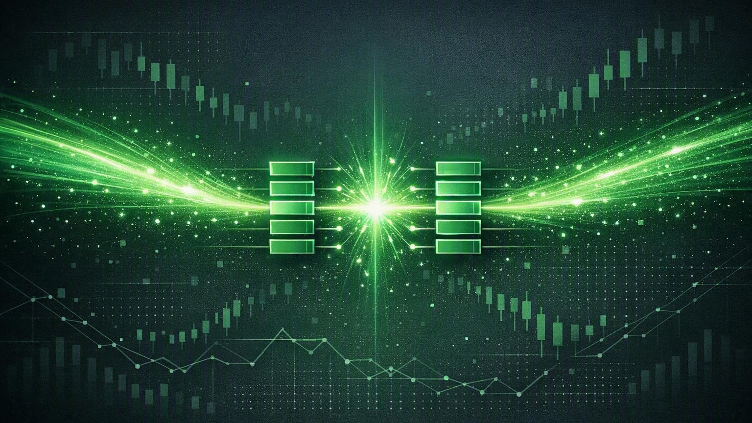
The purpose of RALF
SECTION 02
Post-trade systems do not care how a price was discovered. They care what was executed, by whom, and whether their copy of the record is complete.

Slide 10
RALF in one sentence
DEFINITION
RALF streams executed-trade and end-of-day events over plain-text TCP to external back-office consumers.
READ-ONLY
DERIVED
RECOVERABLE
Clients subscribe and receive.
They never submit orders.
Every line comes from an engine
event — never invented by the gateway.
Numbered and journalled, so a client
can always prove it saw everything.
Version token: RALF1 · Transport: TCP · Encoding: UTF-8 lines ending in a newline
EduMatcher · RALF post-trade protocol
10

Slide 11
Three kinds of system listen to RALF
AUDIENCE
Each has a different question, and each gets its own channel.
CLEARING
DROP_COPY
AUDIT
"Do our books match yours?"
"What is our exposure right now?"
"Can we reconstruct the day?"
Trade reconciliation
Real-time position risk
Regulatory reporting
Position keeping
Pre-trade limit monitoring
Trade reconstruction
Clearing obligations
Compliance surveillance
End-of-day audit files
EduMatcher · RALF post-trade protocol
11

Slide 12
Where the gateway sits
ARCHITECTURE
The engine's internal bus stays internal. Only the gateway crosses the border.
INTERNAL NETWORK
EXTERNAL CONSUMERS
pm-engine
Clearing & reconciliation
publishes trade.executed and system.eod
ROLE=CLEARING
ZMQ PUB :5556
Risk & compliance drop-copy
ROLE=DROP_COPY
pm-ralf-gwy
Audit & surveillance
subscribes, translates, sequences, journals
ROLE=AUDIT
TCP :5580
EduMatcher · RALF post-trade protocol
12

Slide 13
What the gateway does for you
RESPONSIBILITIES
Five guarantees you get for free by using RALF instead of the raw bus.
1
Translation
Engine events become RALF lines, one per subscribed channel.
2
Sequencing
A monotonic SEQ is assigned per channel, so gaps are detectable.
3
Replay journal
A time-bounded journal lets reconnecting clients recover what they missed.
4
Baseline snapshot
A SNAP is sent automatically on subscribe, giving you a starting sequence.
5
Access control
Roles are enforced per channel, and slow clients are dropped to protect the feed.
Without a gateway you would have to build all five yourself — and get them right.
EduMatcher · RALF post-trade protocol
13

Slide 14
When RALF is the right answer — and when it is not
CHOOSING
APPROACH
TRANSPORT
BEST FOR
NOT SUITABLE FOR
RALF (pm-ralf-gwy)
TCP text
External clearing, drop-copy and audit consumers
Pre-trade market data; top-of-book
CALF (pm-md-gwy)
TCP text
External market data: TOP, TRADE, STATE, INDEX
Post-trade events
Internal ZMQ PUB
ZMQ binary
Internal Python processes inside the engine host
External clients
REST / WebSocket
HTTP/JSON
Web dashboards and one-shot queries
High-frequency streaming
Rule of thumb: if the question starts with "what was executed", it is RALF. If it starts with "what is the price", it is CALF.
EduMatcher · RALF post-trade protocol
14

Slide 15

How the protocol is used
SECTION 03
A RALF session is a short conversation followed by a long silence-punctuated stream. Six steps, and you have seen all of them.

Slide 16
The whole conversation, at a glance
SESSION MODEL
One authenticated session per TCP connection, held open for as long as you need it.
1
2
3
4
5
6
CONNECT
HELLO
WELCOME
SUB
SNAP
STREAM
open TCP :5580
who I am, my role
accepted, here are the terms
what I want to see
your sequence baseline
EXEC · EOD · HB
client →
client →
← gateway
client →
← gateway
← gateway
Client may also send
Gateway may also send
UNSUB · PING · EXIT
HB · PONG · ERR · EXIT
HELLO must come first. Any other opening message is rejected with AUTH_REQUIRED.
EduMatcher · RALF post-trade protocol
16

Slide 17
HELLO — introduce yourself
STEP 1 OF 6
Declares who you are, which protocol version you speak, and what you are entitled to see.
HELLO
CLIENT=ext01
PROTO=RALF1
ROLE=CLEARING
LASTSEQ=0
message type,
always first
free-text id used
in gateway logs
must be exactly
RALF1
your access tier —
checked on every SUB
0 = start live.
Any other value replays
FIELD
REQUIRED
WHAT IT MEANS
CLIENT
yes
An identifier for you. Maximum 32 characters. It only appears in gateway logs.
PROTO
yes
The protocol version token. Anything other than RALF1 is refused.
ROLE
yes
One of CLEARING, DROP_COPY or AUDIT — and it must be in the gateway's allowed_roles.
LASTSEQ
optional
A replay checkpoint. Ask for everything after this sequence number.
Missing CLIENT, PROTO or ROLE gives AUTH_REQUIRED. A role outside allowed_roles gives ENTITLEMENT_DENIED.
EduMatcher · RALF post-trade protocol
17

Slide 18
WELCOME — the gateway states the terms
STEP 2 OF 6
Do not hard-code these values. Read them from WELCOME and let the gateway tell you.
WELCOME
PROTO=RALF1
GW=ralf-gwy01
ROLE=CLEARING
REPLAY=86400
HBINT=1
session accepted
negotiated version
which gateway you
reached
the role that was
accepted
seconds of journal
you can ask back for
heartbeat cadence
in seconds
REPLAY
default 86400 s
HBINT
default 1 s
How far back the journal reaches. Use it to decide whether a reconnect can be lossless — the default covers a full trading day.
How often the gateway will send a heartbeat while the stream is quiet. Use it to set your own liveness alarm.
If the gateway refuses you, it does not send WELCOME — it sends an ERR line or simply closes the connection.
EduMatcher · RALF post-trade protocol
18

Slide 19
SUB — say what you want to see
STEP 3 OF 6
A subscription is every channel you name, multiplied by every symbol you name.
CH × SYM = your streams
SUB|CH=CLEARING|SYM=*
SUB|CH=CLEARING,DROP_COPY|SYM=AAPL,MSFT
AAPL
MSFT
CLEARING
stream
stream
SYM defaults to * (all symbols). Multiple SUB lines are cumulative — they add to what you already have.
DROP_COPY
stream
stream
Two channels × two symbols = four independent streams, each with its own sequence number.
Two rules to remember
UNSUB is the mirror image
A role may only subscribe to its own channel — except AUDIT, which may subscribe to any.
Every new (channel, symbol) pair triggers one SNAP.
UNSUB|CH=DROP_COPY|SYM=AAPL removes exactly the pairs it names and leaves everything else running. It is idempotent, so it is always safe to send.
EduMatcher · RALF post-trade protocol
19

Slide 20
SNAP — your baseline, not your book
STEP 4 OF 6
The single most misunderstood message in RALF.
✓
WHAT IT IS
✗
WHAT IT IS NOT
A sequence baseline. It tells you the number your stream is currently at, so you know what to expect next.
A state dump. RALF's SNAP carries no book, no positions and no open trades — only CH, SYM, SEQ and TS.
SNAP
CH=CLEARING
SYM=*
SEQ=42
TS=2026-06-30T09:30:00.000Z
baseline marker
channels covered
symbol scope
store this —
your baseline
UTC, milliseconds, Z suffix
Store the SEQ per (channel, symbol). Everything you do later — gap detection, replay, reconnection — is measured from it.
EduMatcher · RALF post-trade protocol
20

Slide 21
The live stream
STEP 5 OF 6
After the snapshot, the gateway simply talks. Your job is to keep listening.
SNAP|CH=CLEARING|SYM=*|SEQ=0|TS=2026-06-30T09:30:00.000Z
EXEC|CH=CLEARING|SYM=AAPL|SEQ=1|TS=...|EXEC_ID=E001|SIDE=BUY|QTY=200|PX=150.12
EXEC|CH=CLEARING|SYM=AAPL|SEQ=2|TS=...|EXEC_ID=E002|SIDE=SELL|QTY=100|PX=150.14
HB|TS=2026-06-30T09:45:00.000Z
EOD|CH=CLEARING|SYM=AAPL|SEQ=3|TS=...|TRADE_COUNT=2|EXEC_COUNT=2
EXEC
One executed trade
EOD
End-of-day marker
HB
Heartbeat
Sent as each match occurs. This is the payload you came for.
One per symbol, summarising the session's trade counts.
Sent only when nothing else has been sent. Proof the link is alive.
EduMatcher · RALF post-trade protocol
21

Slide 22
Staying alive, and leaving cleanly
STEP 6 OF 6
The gateway will drop a client that goes quiet or falls behind. Both are avoidable.
UNSUB
UNSUB|CH=DROP_COPY|SYM=AAPL
THE THREE CLOCKS
Removes matching pairs. Idempotent — sending it twice is harmless.
1 s
heartbeat interval
PING / PONG
PING → PONG|TS=...
Your liveness probe. Also counts as inbound traffic, which resets the idle timer.
5 s
idle timeout
EXIT
EXIT|REASON=idle_timeout
10 000
max queued messages
Either side can end the session. The gateway sends it with a reason.
Defaults — the first two are advertised in WELCOME.
Two ways to get disconnected: send nothing inbound for the idle timeout, or let your outbound queue overflow (SLOW_CLIENT). Read fast, and ping when idle.
EduMatcher · RALF post-trade protocol
22

Slide 23

What information can be sent?
SECTION 04
Three channels carry two event families. That is the entire surface area of RALF1 — and it is deliberately small.

Slide 24
Three channels, one source of truth
CATEGORIES
The same trade appears on more than one channel — each copy with its own sequence number.
CLEARING
Primary consumer: clearing and reconciliation systems
EXEC + EOD
A trade
executes
DROP_COPY
Primary consumer: risk and compliance drop-copy
EXEC only
AUDIT
Primary consumer: audit and surveillance tooling
EXEC + EOD
Every channel sends a SNAP on subscribe, and every channel accepts SYM=* for all symbols.
EduMatcher · RALF post-trade protocol
24

Slide 25
CLEARING — the reconciliation feed
CHANNEL 1 OF 3
One EXEC line per matched trade, plus an EOD summary per symbol at end of day.
TYPICAL USES
HOW TO SUBSCRIBE
Trade reconciliation
SUB|CH=CLEARING|SYM=*
Position keeping
The gateway replies immediately with a SNAP baseline, then streams events as they occur.
Clearing obligation calculation
ON THE WIRE
SNAP|CH=CLEARING|SYM=*|SEQ=0|TS=2026-06-30T09:30:00.000Z
EXEC|CH=CLEARING|SYM=AAPL|SEQ=1|EXEC_ID=E001|BUY_GW=gw01|SELL_GW=gw01|SIDE=BUY|QTY=200|PX=150.12
EXEC|CH=CLEARING|SYM=AAPL|SEQ=2|EXEC_ID=E002|BUY_GW=gw01|SELL_GW=gw02|SIDE=SELL|QTY=100|PX=150.14
EOD |CH=CLEARING|SYM=AAPL|SEQ=3|TRADE_COUNT=2|EXEC_COUNT=2
This is the channel to start with. If you are building a back-office integration, CLEARING is almost certainly what you want.
EduMatcher · RALF post-trade protocol
25

Slide 26
DROP_COPY — the real-time risk feed
CHANNEL 2 OF 3
The same EXEC events, aimed at systems that must react to fills as they happen.
TYPICAL USES
HOW TO SUBSCRIBE
Real-time position risk
SUB|CH=DROP_COPY|SYM=AAPL,MSFT
Pre-trade limit monitoring
The gateway replies immediately with a SNAP baseline, then streams events as they occur.
Compliance surveillance
ON THE WIRE
SNAP|CH=DROP_COPY|SYM=AAPL|SEQ=0|TS=2026-06-30T09:30:00.000Z
EXEC|CH=DROP_COPY|SYM=AAPL|SEQ=1|EXEC_ID=E001|MATCH_ID=E001|BUY_ORDER_ID=O100
|SELL_ORDER_ID=O101|BUY_GW=gw01|SELL_GW=gw01|SIDE=BUY|QTY=200|PX=150.12
DROP_COPY carries EXEC only — no EOD. If you need the end-of-day marker as well, use CLEARING or AUDIT.
EduMatcher · RALF post-trade protocol
26

Slide 27
AUDIT — the complete trail
CHANNEL 3 OF 3
All post-trade events, for consumers who must be able to reconstruct the whole day.
TYPICAL USES
HOW TO SUBSCRIBE
Regulatory reporting
SUB|CH=AUDIT|SYM=*
Trade reconstruction
The gateway replies immediately with a SNAP baseline, then streams events as they occur.
End-of-day audit file generation
ON THE WIRE
SNAP|CH=AUDIT|SYM=*|SEQ=0|TS=2026-06-30T09:30:00.000Z
EXEC|CH=AUDIT|SYM=AAPL|SEQ=1|EXEC_ID=E001|SIDE=BUY|QTY=200|PX=150.12
EOD |CH=AUDIT|SYM=AAPL|SEQ=2|TRADE_COUNT=1|EXEC_COUNT=1
AUDIT is also the only privileged role: a client authenticated as AUDIT may subscribe to any channel, not just its own.
EduMatcher · RALF post-trade protocol
27

Slide 28
Roles decide what you may subscribe to
ACCESS CONTROL
Roles and channels share the same three names — but they are not the same thing.
CHANNEL →
ROLE ↓
CLEARING
DROP_COPY
AUDIT
CLEARING
allowed
denied
denied
DROP_COPY
denied
allowed
denied
AUDIT
allowed
allowed
allowed
AUDIT is the privileged role — it may subscribe to any channel. Everyone else is confined to their own. Subscribing outside your entitlement returns ENTITLEMENT_DENIED. Only roles listed in the gateway's allowed_roles may authenticate at all.
EduMatcher · RALF post-trade protocol
28

Slide 29
RALF1 has exactly two event families
SCOPE
Every data line you will ever receive is derived from one of two engine broadcasts.
engine event
engine event
trade.executed
system.eod
becomes
becomes
EXEC
EOD
One line per executed trade, emitted once per subscribed channel.
One per-symbol end-of-day marker, emitted on all three channels.
NOT IN RALF1 — reserved for future revisions
These families will appear only when the corresponding engine events exist. Write your parser so it ignores message types it does not know — that is how you stay forward-compatible.
CORRECT
BUST
ALLOC
SETTLE
EduMatcher · RALF post-trade protocol
29

Slide 30
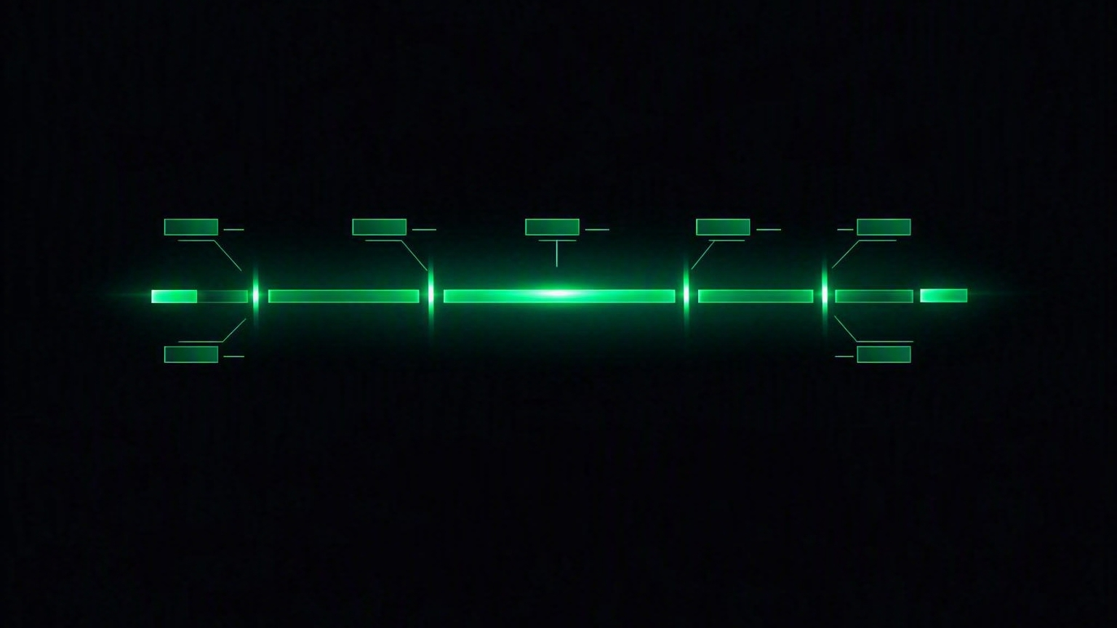
The structure of the information
SECTION 05
One message per line. A type, then key-value pairs. If you can split a string, you can parse RALF.

Slide 31
Anatomy of a RALF line
WIRE FORMAT
Every message — control or data — follows the same shape.
MSGTYPE|KEY=VALUE|KEY=VALUE|...\n
The type
The separator
Uppercase ASCII only — letters, digits and underscore. Always the first token on the line.
Fields are separated by a pipe. Values never contain a pipe or a newline.
The split
The terminator
Each field splits into key and value on the FIRST equals sign — later ones belong to the value.
A single newline ends the message. Nothing else terminates a line.
Unknown fields must be ignored, not rejected. That single rule is what lets the protocol grow without breaking your client.
EduMatcher · RALF post-trade protocol
31

Slide 32
The envelope: four keys on almost every message
COMMON FIELDS
Learn these once and every RALF message becomes readable.
CH
Channel
CLEARING, DROP_COPY or AUDIT. On control messages it is what you asked for; on data messages it is where the event came from.
SYM
Symbol
The instrument. On control messages it is a filter; on data messages it is the actual symbol. * means all.
SEQ
Sequence
A channel-local counter that increases by exactly one per emitted line. Your gap-detection anchor.
TS
Timestamp
UTC ISO-8601 with milliseconds and a Z suffix — for example 2026-06-30T09:30:01.100Z.
SEQ is per channel — never global. Two channels can both be at SEQ=42 and mean completely different things.
EduMatcher · RALF post-trade protocol
32

Slide 33
Inside an EXEC — one executed trade
DATA MESSAGE
The envelope, then everything you need to book the trade.
EXEC
CH=CLEARING
SYM=AAPL
SEQ=1
TS=...100Z
EXEC_ID=E001
SIDE=BUY
QTY=200
PX=150.12
envelope
payload
FIELD
MEANING
EXEC_ID
The execution identifier — the engine's trade id.
MATCH_ID
The match identifier. In RALF1 it is always identical to EXEC_ID.
BUY_ORDER_ID / SELL_ORDER_ID
The resting and aggressing order identifiers on each side.
BUY_GW / SELL_GW
Which gateway each side came through — how you attribute the trade to a participant.
SIDE
The aggressor side: BUY or SELL.
QTY / PX
Executed quantity and execution price, in display units.
A single trade is emitted once per channel — and each copy consumes its own sequence number on that channel.
EduMatcher · RALF post-trade protocol
33

Slide 34
EOD, and the small messages around it
DATA MESSAGE
Everything that is not an EXEC is short — and most of it carries only an envelope.
SNAP
Baseline. Envelope only — no book, no positions.
EOD — end of day, per symbol
HB
HB|TS=... — sent only when nothing else was sent.
EOD|CH=CLEARING|SYM=AAPL|SEQ=3
|TRADE_COUNT=2|EXEC_COUNT=2
PING / PONG
Your probe, and the gateway's reply.
TRADE_COUNT trades seen for that symbol this session. EXEC_COUNT is identical to it in RALF1.
EXIT
EXIT|REASON=idle_timeout|TS=... — session over.
EOD is emitted once per symbol on all three channels.
Reading an EOD line
It is a marker, not a report. It tells you the symbol's trading session is closed and how many executions you should have counted — which makes it an excellent self-check on your own tally.
EduMatcher · RALF post-trade protocol
34

Slide 35
Five parsing rules that will save you
IMPLEMENTATION
Most first-attempt RALF clients fail on one of these.
1
TCP is a byte stream
One recv() is not one message. Buffer bytes and split on newline — always.
2
Split on the FIRST equals
A value may legitimately contain an equals sign. Only the first one separates key from value.
3
Ignore unknown fields
New fields will appear. A parser that rejects them will break on the next release.
4
Ignore unknown message types
Future event families are coming. Skip what you do not recognise instead of failing.
5
Respect the line limit
A line longer than 4096 bytes is refused with BAD_MESSAGE. Frame properly and this never happens.
EduMatcher · RALF post-trade protocol
35

Slide 36
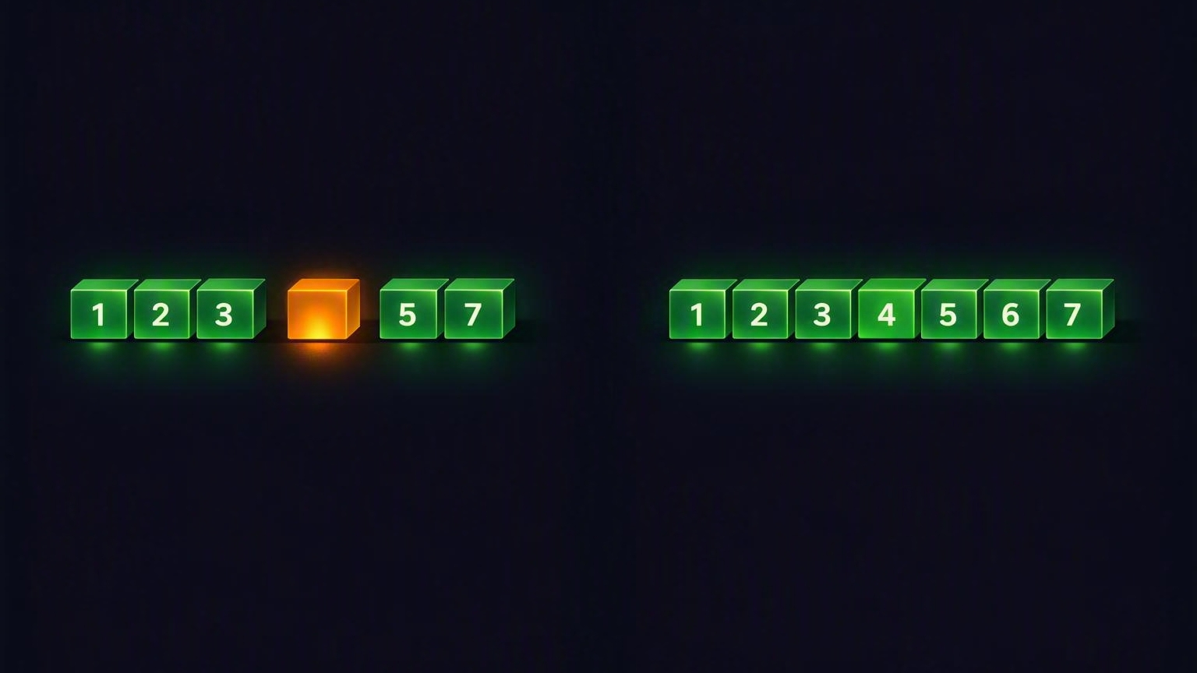
How errors are handled
SECTION 06
RALF assumes things will go wrong: messages get missed, clients fall behind, connections drop. Every one of those has a defined recovery.

Slide 37
Sequence numbers and gap detection
INTEGRITY
SEQ is how you prove — not hope — that your copy of the day is complete.
1
2
3
?
5
6
gap when:
received_seq != last_seq + 1
SEQ=4 never arrived — that is a gap
Per channel
Not global
Track per stream
Each channel keeps its own counter, strictly increasing by one per emitted line.
Sequence numbers from different channels are independent — never compare or merge them.
Keep last_seq keyed on (CH, SYM) and check every single message you receive.
Detecting a gap is not an emergency — it is the system working. The next slide is what you do about it.
EduMatcher · RALF post-trade protocol
37

Slide 38
Replay — asking for what you missed
RECOVERY
Reconnect with a checkpoint and the gateway resends from the journal.
HELLO|CLIENT=ext01|PROTO=RALF1|ROLE=CLEARING|LASTSEQ=1200
"Send me everything after 1200."
✓
REPLAY HIT
✗
REPLAY MISS
Your checkpoint is inside the retention window.
Your checkpoint is older than the journal.
Journalled events with SEQ > LASTSEQ are resent
ERR|CODE=REPLAY_MISS arrives first
The stream continues live, seamlessly
A fresh SNAP follows it
Nothing is lost
You MUST reset local state to that baseline
The default journal covers 86 400 seconds — one full trading day — which makes an intraday reconnect lossless in normal operation.
EduMatcher · RALF post-trade protocol
38

Slide 39
Every error code, and what to do about it
ERROR HANDLING
ERR carries a CODE and a human-readable DETAIL. The code is what you branch on.
ERR|CODE=REPLAY_MISS|DETAIL=requested seq outside retention
CODE
TYPICAL CAUSE
WHAT YOU DO
AUTH_REQUIRED
SUB sent before a successful HELLO
Send HELLO first — it must be the opening message
PROTO_MISMATCH
Wrong or missing PROTO value
Use PROTO=RALF1 exactly
ENTITLEMENT_DENIED
Role not permitted for that channel
Subscribe to the channel matching your role; AUDIT may access all
INVALID_CHANNEL
Unknown or empty CH value
Use CLEARING, DROP_COPY or AUDIT
REPLAY_MISS
LASTSEQ is outside the journal window
Accept the recovery SNAP and reset your local baseline
SLOW_CLIENT
You cannot drain the stream fast enough
Terminal — reconnect and process faster
BAD_MESSAGE
Malformed or oversized line (over 4096 bytes)
Fix your line syntax and framing
Two are terminal — SLOW_CLIENT and a failed handshake end the session. The rest you can recover from in place.
EduMatcher · RALF post-trade protocol
39

Slide 40
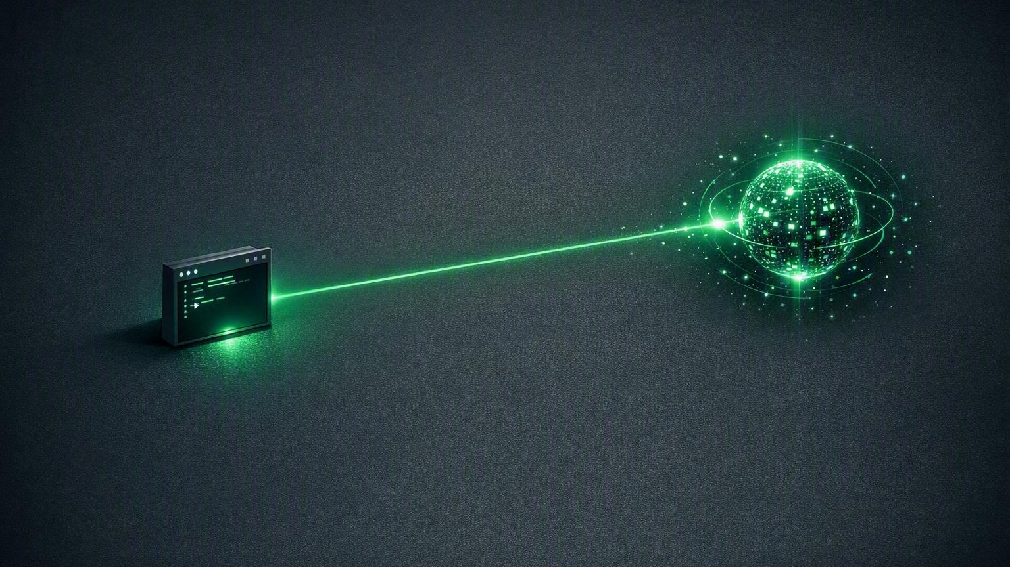
Using RALF as a client
SECTION 07
You can test the protocol by hand in under a minute, then build a robust subscriber in about forty lines.

Slide 41
The client checklist
BUILD GUIDE
Do these eight things and your client is production-shaped.
Open one long-lived TCP connection to port 5580
Send HELLO first — CLIENT, PROTO=RALF1, ROLE, and LASTSEQ
1
2
Wait for WELCOME; read REPLAY and HBINT from it rather than assuming
Subscribe only to channels your role is entitled to
3
4
Store the SNAP sequence per (CH, SYM) as your baseline
Buffer bytes and split on newline — never treat a read as a message
5
6
Check every SEQ for gaps and remember the last one you saw
On reconnect, send your last good SEQ as LASTSEQ and handle REPLAY_MISS
7
8
Everything else — heartbeats, entitlements, journalling — the gateway already does for you.
EduMatcher · RALF post-trade protocol
41

Slide 42
Try it in sixty seconds — no code required
FIRST CONTACT
Validate the line protocol by hand before you write a single line of client.
Option A — by hand
Option B — ready-made
nc 127.0.0.1 5580
HELLO|CLIENT=ops01|PROTO=RALF1|
ROLE=CLEARING|LASTSEQ=0
SUB|CH=CLEARING|SYM=*
pm-ralf-spy --role CLEARING
The protocol spy performs the handshake, subscribes, and pretty-prints every line for you — no hand-typed messages at all. It is read-only, so it is safe to point at a live gateway.
Expect WELCOME, then SNAP, then live EXEC and EOD lines, with HB while idle.
Before either works: pm-engine must be running and publishing, pm-ralf-gwy must be running, and your symbols must exist in engine_config.yaml.
EduMatcher · RALF post-trade protocol
42

Slide 43
A minimal client, with no dependencies
CLIENT CODE
Enough to prove the connection works. Note the buffering — that part is not optional.
import socket
sock = socket.create_connection(("127.0.0.1", 5580))
sock.sendall(b"HELLO|CLIENT=bot01|PROTO=RALF1|"
b"ROLE=CLEARING|LASTSEQ=0\n")
sock.sendall(b"SUB|CH=CLEARING|SYM=*\n")
buf = bytearray()
while True:
chunk = sock.recv(4096)
if not chunk:
break
buf.extend(chunk)
while b"\n" in buf:
idx = buf.index(b"\n")
line = buf[:idx].decode().strip()
del buf[:idx + 1]
if line:
print(line)
The one mistake everyone makes
Never assume one recv() returns exactly one message. TCP is a byte stream — it may hand you half a line, or three lines at once. Always buffer and split on newline.
Or use the bundled library
from ralf_parser import (
parse_ralf_line,
build_ralf_line)
EduMatcher · RALF post-trade protocol
43

Slide 44
The shape of a real subscriber
CLIENT CODE
Condensed from the bundled example — the four patterns that matter.
with socket.create_connection((HOST, 5580), timeout=5) as sock:
reader = LineReader(sock) # buffers, yields lines
send(sock, "HELLO", {"CLIENT": "mybot", "PROTO": "RALF1",
"ROLE": "CLEARING", "LASTSEQ": "0"})
welcome = parse_ralf_line(reader.recv_line())
assert welcome.msg_type == "WELCOME"
replay_sec = welcome.fields.get("REPLAY")
send(sock, "SUB", {"CH": "CLEARING", "SYM": "*"})
last_seq: dict[tuple[str, str], int] = {}
while True:
msg = parse_ralf_line(reader.recv_line())
if msg.msg_type in ("EXEC", "EOD", "SNAP"):
key = (msg.fields["CH"], msg.fields["SYM"])
seq = int(msg.fields["SEQ"])
prev = last_seq.get(key)
if prev is not None and seq != prev + 1:
handle_gap(key, prev, seq) # reconnect w/ LASTSEQ
last_seq[key] = seq
elif msg.msg_type == "ERR":
if msg.fields["CODE"] == "SLOW_CLIENT": break
1 Line buffering
A reader that turns bytes into whole lines.
2 Assert the handshake
Fail loudly if WELCOME does not arrive.
3 Per-stream sequence map
Keyed on (CH, SYM), checked on every message.
4 Terminal error branch
SLOW_CLIENT means reconnect — do not retry in place.
EduMatcher · RALF post-trade protocol
44

Slide 45
Gateway configuration you should know about
REFERENCE
The post_trade_gateway block in engine_config.yaml — read only by pm-ralf-gwy.
KEY
DEFAULT
PURPOSE
post_trade_gateway:
name: "ralf-gwy01"
bind_address: "0.0.0.0"
port: 5580
replay_retention_sec: 86400
heartbeat_interval_sec: 1
idle_timeout_sec: 5
max_client_queue: 10000
allowed_roles:
- CLEARING
- DROP_COPY
- AUDIT
name
ralf-gwy01
Gateway id, echoed in WELCOME|GW=
bind_address
0.0.0.0
TCP listen address
port
5580
TCP listen port
replay_retention_sec
86400
Journal window; advertised as REPLAY
heartbeat_interval_sec
1
HB cadence; advertised as HBINT
idle_timeout_sec
5
Inbound-idle disconnect
max_client_queue
10000
Backlog before SLOW_CLIENT
Generate it instead
allowed_roles
all three
Roles permitted to authenticate
pm-config-gen --post-trade-gateway writes this block alongside the main engine config, so you never hand-edit it.
For a single-host lab, bind to 127.0.0.1. For multi-host, use a controlled interface and restrict access at the network boundary.
EduMatcher · RALF post-trade protocol
45

Slide 46
Conformance, and one deviation to know
REFERENCE
What a conforming RALF1 implementation must do — and where the current gateway differs.
A CONFORMING RALF1 IMPLEMENTATION
!
KNOWN DEVIATION
Derives events solely from engine broadcasts — trade.executed becomes EXEC, system.eod becomes EOD
Replay is entitlement-filtered, but not subscription-filtered.
Sends HELLO and WELCOME before any data, and rejects pre-auth data with AUTH_REQUIRED
Replay happens during HELLO, before any SUB is processed — so it cannot know your subscriptions yet. You may receive replayed events for symbols and channels you did not ask for. Filter them yourself on the client side.
Enforces the role entitlement matrix on every SUB
Applies per-channel SEQ semantics — there is no global sequence stream
Advertises REPLAY and HBINT in WELCOME matching its own configuration
The normative reference is the RALF protocol appendix. Where the tutorial and the appendix disagree, the appendix wins.
EduMatcher · RALF post-trade protocol
46

Slide 47
Where to find more information
GOING FURTHER
Four documents, each answering a different kind of question.
Post-Trade Dissemination (RALF)
Appendix — RALF Protocol
250-ralf-gateway.md
930-app-ralf-protocol.md
The operational guide: quick start, configuration, channel descriptions, client examples and the operator runbook.
The normative wire reference: framing, message set, field tables, entitlements, sequencing and error codes.
"How do I run and use it?"
"What is the exact rule?"
External Protocols Overview
RALF Protocol Spy
210-protocols-overview.md
251-ralf-spy-cli.md
The map of ALF, BALF, CALF and RALF, with a quick selection guide for choosing between them.
A read-only CLI that watches the raw feed in human-readable or JSON form — the fastest way to see it working.
"Which protocol do I want?"
"Can I just look at it?"
Working code lives in examples/ralf/ — a Python parser and subscriber, plus a C implementation and Makefile.
EduMatcher · RALF post-trade protocol
47

Slide 48
Five things to remember
IN SUMMARY
A gateway is a controlled doorway
It translates, authenticates, sequences and protects — so the engine never has to talk to the outside world.
1
RALF is post-trade, and read-only
It answers "what was executed", never "what is the price", and no client ever sends an order over it.
2
Three channels, two event families
CLEARING, DROP_COPY and AUDIT carry EXEC and EOD. Your role decides which you may see.
3
One line, one message
Type, then FIELD=VALUE pairs, terminated by a newline. Buffer your bytes and split on the first equals.
4
SEQ is the safety net
Track it per channel and symbol, detect gaps, and reconnect with LASTSEQ to recover from the journal.
5
Next step: run pm-ralf-spy --role CLEARING against a live gateway and watch the lines arrive.
EduMatcher · RALF post-trade protocol
48

