Slide 1
Start pattern | Left row indicator | Data count | Datawords | Right row indicator | Stop pattern
Start pattern | Left row indicator | Datawords |  | Right row indicator | Stop pattern
... | ... | ... |  | ... | ...
Start pattern | Left row indicator | Datawords |  | Right row indicator | Stop pattern
Start pattern | Left row indicator | Datawords | Error correction | Right row indicator | Stop pattern

Slide 2
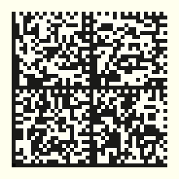
Synchronization
pattern
Finder
pattern
Quiet
Zone

Slide 4

Vertical & Horizontal
synchronization
Finder
Patterns
Finder
Patterns

Slide 5
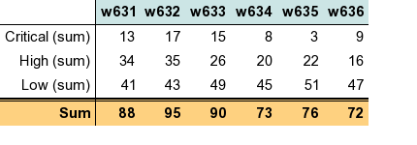
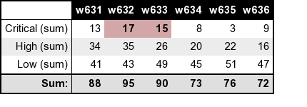
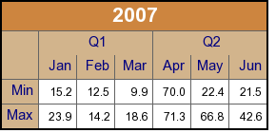


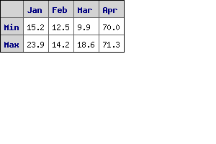
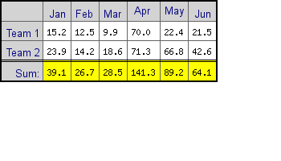
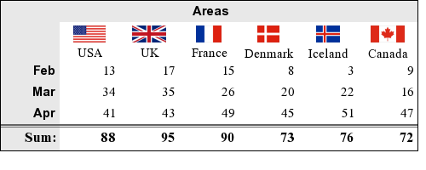
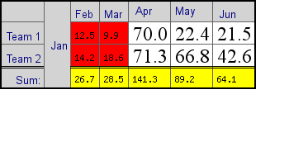

Slide 6
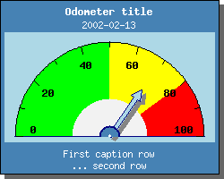
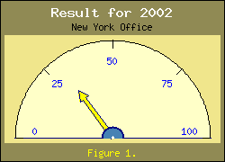
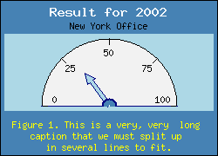
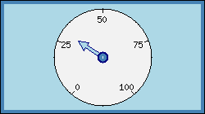
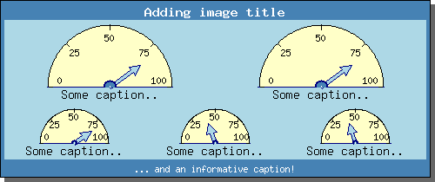

Slide 7


RANGE_OVERLAPPING
RANGE_DISCRETE

Slide 8
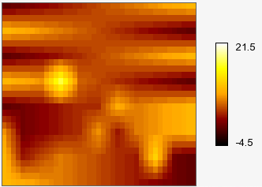
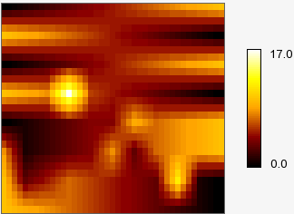
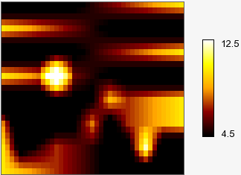
Decreasing contrast
(contrast=-0.5)
Original plot
(contrast=0)
Increasing contrast
(contrast=-0.5)

Slide 9











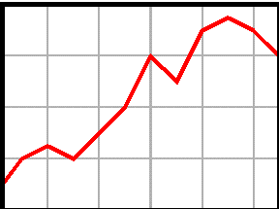
Manual
XML Source
fop
FO
FO
Section 1
DocBook5
Phing
Custom task
Chunk HTML
Section 2
xsltproc
ReplaceWithFile
Masterfile
Chunk HTML
Phing
Custom filt.
1-file HTML
Section N
HighlightSrc
Stylesheet options
xsltproc options
1-file HTML
GAWK
Extract
Examplefiles
PHP5
(cli)
Custom
JpGraph
CSS
PHP Example scripts
List of all graphs
To be rendered
Generated image files
From all examples in manual
Entire process controlled by ”build.xml” Phing build script

Slide 10
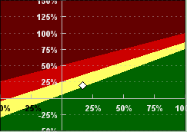
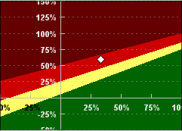
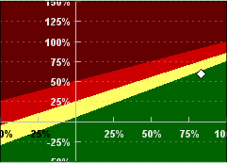
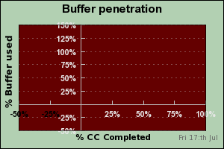
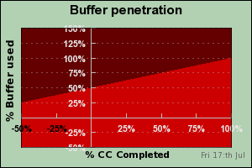
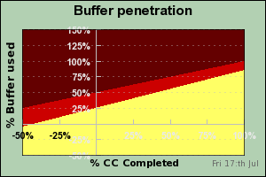
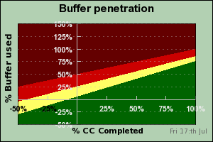
Buffer penetration chart for example
Day 2
Day 5
Day 8
Four steps to produce four color background by adding area plots

Slide 11
PHP Script
PHP
(scripts)
JpGraph
PHP5
PHP
(cli, sapi, cgi)
GD 2.x
Extension
PHP
Extensions
OS
Native
libraries
libgd.so, gd.dll

Slide 12
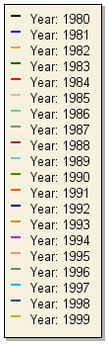
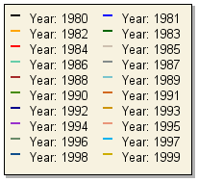
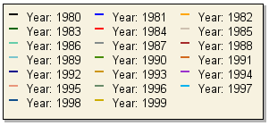
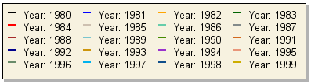
1-column layout
2-column layout
3-column layout
4-column layout

Slide 13
1.
ﾧ
Browser
Request
a.php
Server A
Execute
a.php
2.
POST request to b.php
Execute
ﾧ
Server B
b.php
<?php
foreach($_POST as $key => $val) {
// Extract all data
}
… Create graph and store on file
$graph->Stroke($filename);
return 1; // Success
?>
Server side
3.
4.

Slide 14
4.
ﾧ
Browser
Reply
a.php
Server A
Reply
a.php
Reply
3.
ﾧ
Server B
Reply
b.php
<?php
foreach($_POST as $key => $val) {
// Extract all data
}
… Create graph and store on file
$graph->Stroke($filename);
return 1; // Success
?>
Server side

Slide 15
header()
Browser
Server A
a.php
Post request
Browser
Server A
a.php

Slide 16
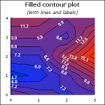
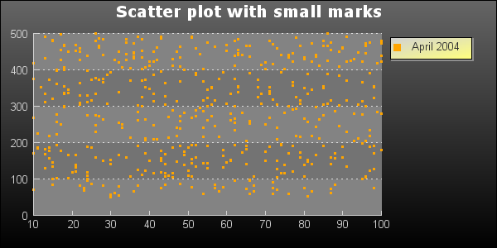
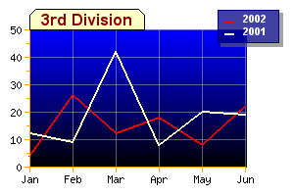
CACHE_DIR (/tmp/jpgraph_cache)
Does the graph
exists in the
cache and not
too old?
Yes
Read file from
cache
USE_CACHE=true
No
Graph::__construct()
Create the graph
Send back to client
Store the new image in cache
Create the graph
USE_CACHE=false

