Slide 1

JpGraph & DDDA
  Johan Persson,
  johanp@aditus.nu
  Aditus Consulting
  Sweden
  (This presentation available at http://www.aditus.nu/jpgraph/ )

Slide 2

Introducing JpGraph & DDDA
JpGraph
  ... a Fully Object Oriented (OO) class library for PHP 4.04 and above to help create “on-the-fly” high quality fully customizable scientific and business graphs.
DDDA
  ... Dynamic Database driven Documentation Architecture
  ... is both an architecture and application to help document, primarily, large scale OO PHP code.

Slide 3
Overview of this talk
PART I: JpGraph
  ... capabilities and examples of JpGraph
  ... high level architecture view of JpGraph
  ... elementary example
PART II: OO PHP Code
  ... hidden dangers
  ... some experience from developing JpGraph
PART III: DDDA
  ... objective and motivation
  ... architecture overview
  ... DDDA application and example usage

Slide 4
PART I : JpGraph
Feature summary ...
Exampel images (graphs) ....
Design goals and architecture ...
A detailed “Hello-world” example ...
Roadmap ...

Slide 5
JpGraph Feature Summary I
Multiple graph types
  Line plots
  Scatter plots
    Variants: Linked and balloon plots
  Error plots
  Bar plots
    Variants: Straight, grouped and stacked bars
  Pie plots
    Variants: 2D, 3D and “with-center-circle”
  Radar plots
  Gantt charts
  Direct canvas object plots

Slide 6
JpGraph Feature Summary II
Multiple scale types
  Linear scale
  Logarithmic scale
  Integer scales
  Text (ordinal) scale
Capability to mix multiple plots and multiple scales on the same graph
Automatic cache handling with time-out to reduce performance impact on HTTP server
Full support for client side image maps (a.k.a drill-down-graphs)
360 degrees rotation of graphs, texts and paragraphs

Slide 7
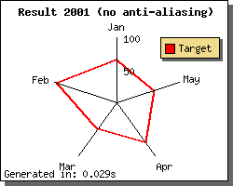
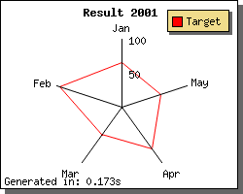
JpGraph Feature Summary III
Anti-aliasing for lines

Slide 8
JpGraph Feature Summary IV
Support for all available image formats (PNG, JPG, BMP, GIF*)
Web-friendly with small image sizes
Multiple Y-axis
Gradient fills
Background images (with several formatting options)
400 named colors
Automatic horizontal or vertical legends
Supports for both on-line and batch processing of images
Elementary image processing (contrast, brightness, color adjustments)

Slide 9
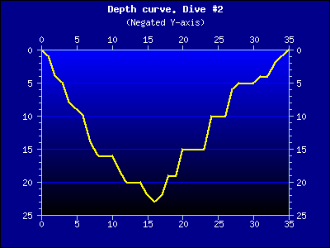
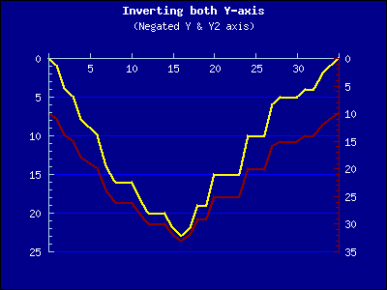
JpGraph Feature Summary V
Context sensitive default values
Custom positioning for axis and flexible axis formats
Supports advanced formatting of labels and tick marks with both format callbacks and format strings
Examples of how callback can be used to produce “inverted” graphs

Slide 10

JpGraph Feature Summary VI
230 Commented example graphs
Last but not least; Extensive documentation
  ... ~160 page user manual
  ... plus full API class reference (generated with DDDA architecture)
JpGraph Trivia:
  ~12,500 SLOC In core and plot extensions
  ~11,500 SLOC Of example scripts
  Release ver 1.0 in 5 Feb 2001
  Latest release ver 1.9.1 in 30 Oct 2002
  Defect density: 0.6% (Reported defects/SLOC)
  ~81,000 downloads since ver 1.0

Slide 11
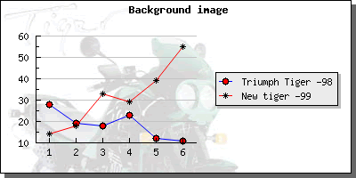
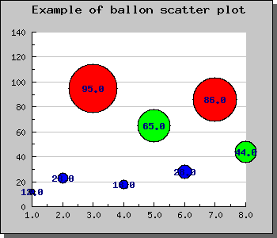
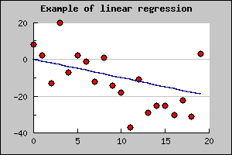
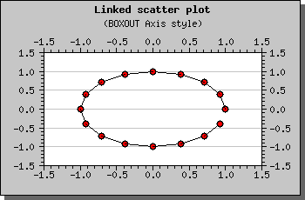
JpGraph Examples
Line & scatter plots plots I ...

Slide 12
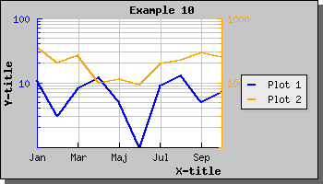
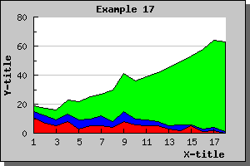
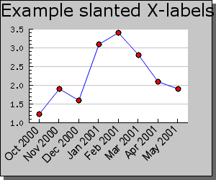
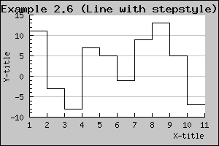
JpGraph Examples cont ...
Line & scatter plots plots II ...

Slide 13
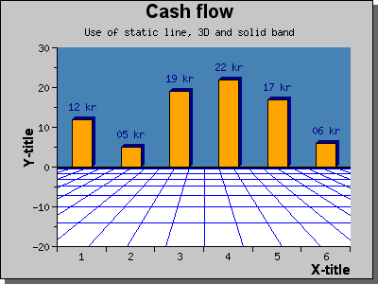
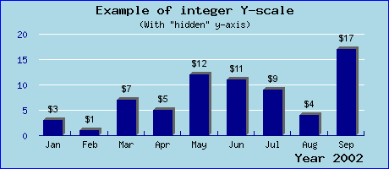
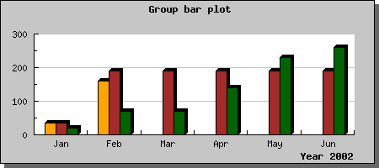
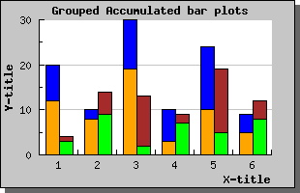
JpGraph Examples cont ...
Bar graphs I ...

Slide 14
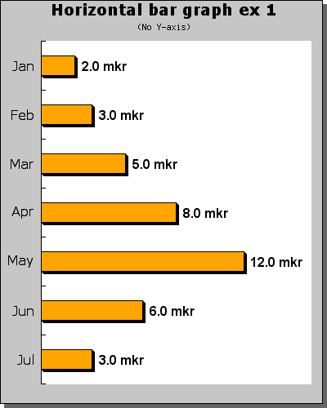
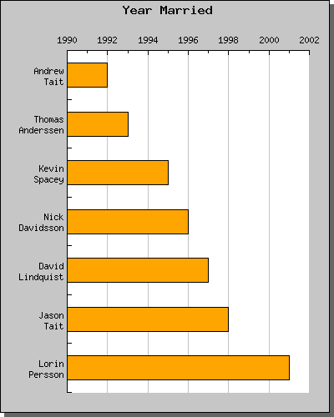
JpGraph Examples cont ...
Bar graphs II ...

Slide 15
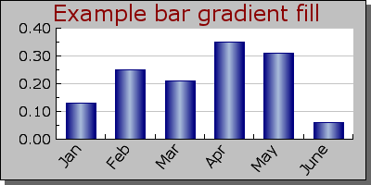
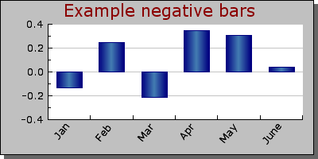
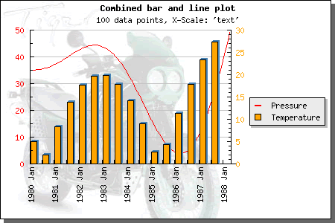
JpGraph Examples cont ...
Bar graphs III ...

Slide 16
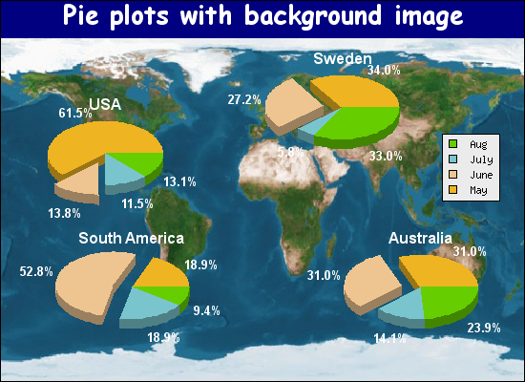
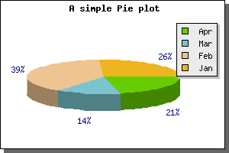
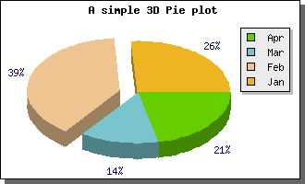
JpGraph Examples cont ...
Pie graphs I ...

Slide 17
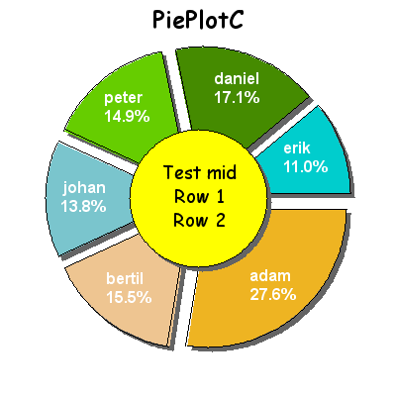
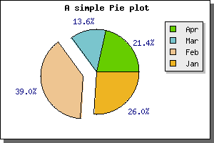
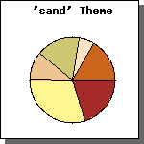
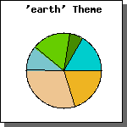
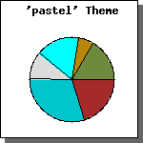
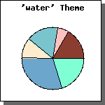
JpGraph Examples cont ...
Pie graphs II ...

Slide 18
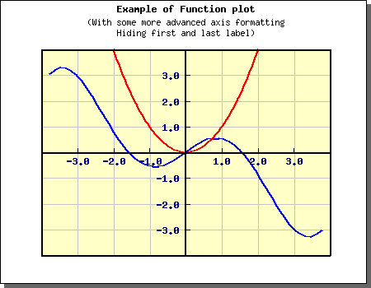
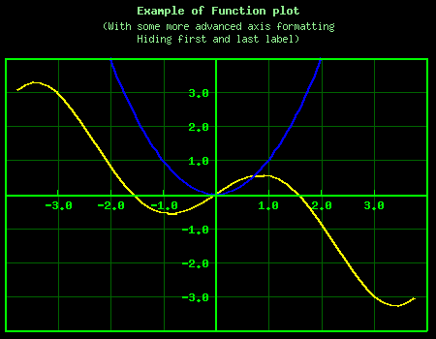
JpGraph Examples cont ...
Scientific graphs I ...

Slide 19
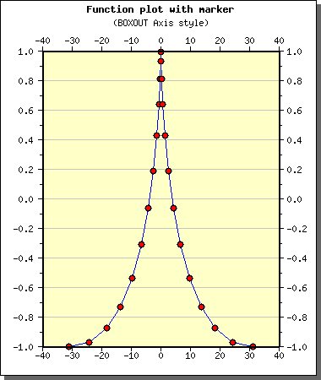
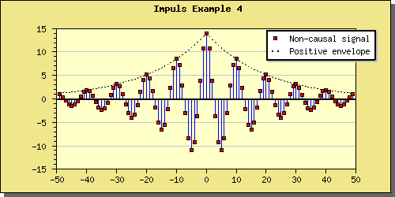
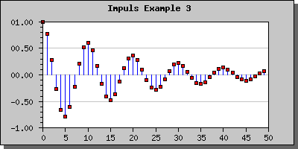
JpGraph Examples cont ...
Scientific graphs II ...

Slide 20
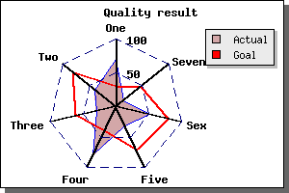
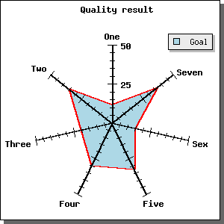
JpGraph Examples cont ...
Radar plots I ...

Slide 21
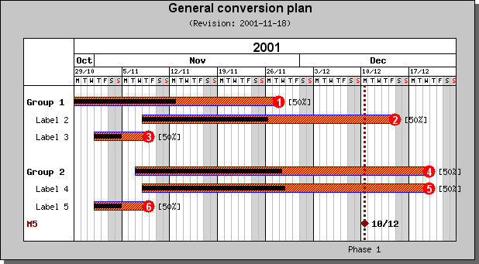
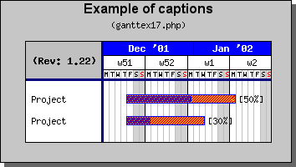
JpGraph Examples cont ...
Gantt charts I ...

Slide 22
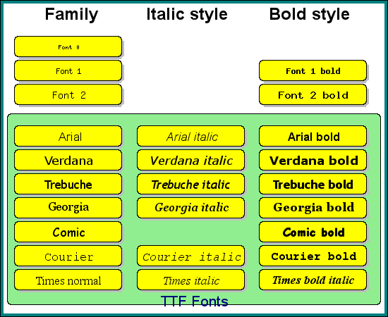
JpGraph text handling
Text layout engine I ...
  JpGraph supports as standard the core MS-WEB initiative TTF fonts shown to the left
  New fonts can easily be added
Note: Image generated with JpGraph

Slide 23
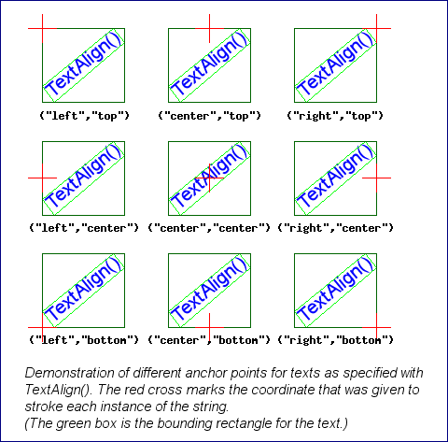


JpGraph text handling
Text layout engine II ...
  JpGraph contains an paragraph text layout engine
  Full paragraph (multi-line) support
  User selectable align and anchor-point for text

Slide 24
The design goals and architecture I
Well documented (libraries are particular unusable without high quality documentation)
Low leaning curve
Support for both GD 1.x and GD 2.x
High performance
Support for all common graph types
Easily extendible through a modular architecture
Fully customizable for power users
Low defect density and ease of maintenance

Slide 25

The design goals and architecture II
Use an OO approach ...
Make sure the API is orthogonal ...
Context sensitive default values ...
Modular design
  ... a core layout engine with plot extensions
Extensive error handling
  .. some special requirements for scripts that generate images
Develop a new architecture/application to document PHP OO code

Slide 26
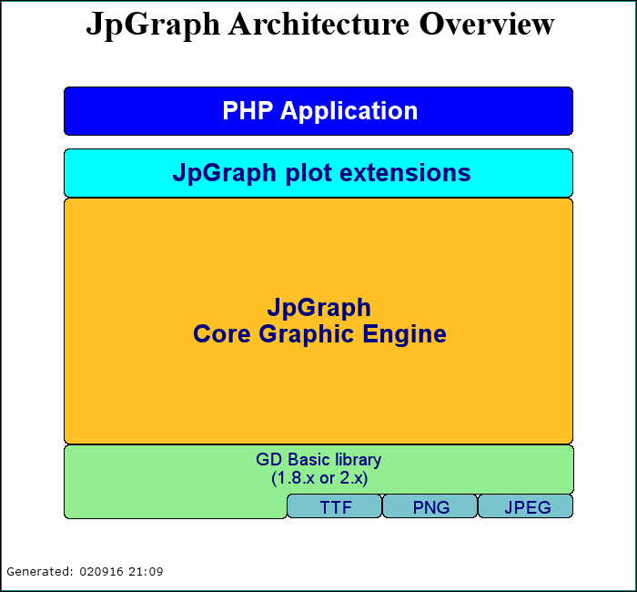
JpGraph Architecture Overview I
Note: This architecture overview is itself generated with JpGraph canvas extension

Slide 27
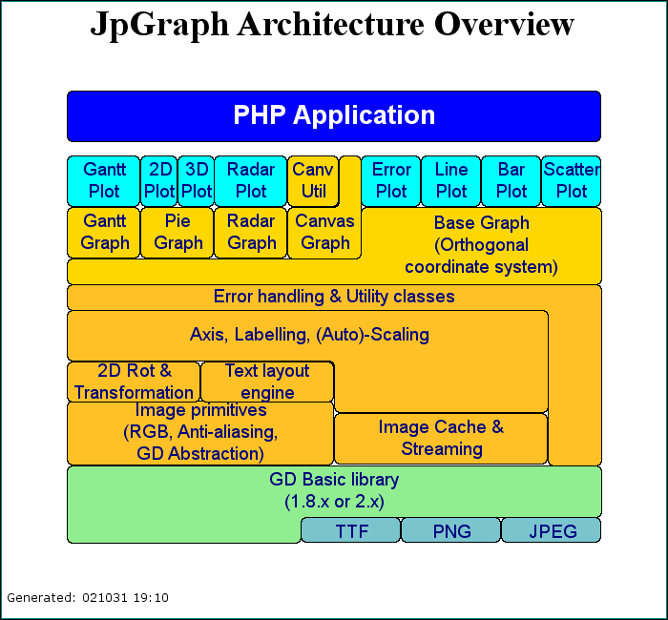
JpGraph Architecture Overview II
Note: This architecture overview is itself generated with JpGraph canvas extension

Slide 28
JpGraph Introductory example
Objective:
  Create an elementary line & bar graph from the same data.

Slide 29
JpGraph Introductory example cont ...
Include the needed libraries
  require_once 'jpgraph.php'
  require_once 'jpgraph_line.php'
Comment:
All scripts uses the pattern of including core engine + one or more plot extension.

Slide 30
JpGraph Introductory example cont ...
Define the data array
  $ydata = array(2,3,8,17,6,10);
Comment:
All plot data specified for use must be presented to JpGraph in the form of a 1xn vector

Slide 31
JpGraph Introductory example cont ...
Create the graph object, specify scale type and title
  $graph = new Graph(300,200);
  $graph->SetScale('textlin');
  $graph->title->Set('A first example');
Comment:
A 'text' scale is used when we only need an ordered sequence of values.

Slide 32
JpGraph Introductory example cont ...
Create the lineplot and add it to the graph
  $lplot = new LinePlot($ydata);
  $graph->Add($lplot);
( If we instead wanted ,say, a Bar plot )
  $bplot = new BarPlot($ydata);
  $graph->Add($bplot);
Comment:
A Graph might be thought of as a canvas where we can add multiple objects, plots, texts etc

Slide 33
JpGraph Introductory example cont ...
Send the graph to the browser
  $graph->Stroke();
Comment:
This sends back the image as an encoded HTTP stream with the correct header to the browser. As far as the browser is concerned the script is an image.

Slide 34
JpGraph Introductory example summary
require_once 'jpgraph.php'
require_once 'jpgraph_line.php'
$ydata = array(2,3,8,17,6,10);
$graph = new Graph(300,200);
$graph->SetScale('textlin');
$graph->title->Set('A first example');
$lplot = new LinePlot($ydata);
$graph->Add($lplot);
$graph->Stroke();

Slide 35
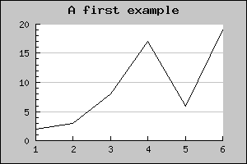
Introductory example cont ...
and the result is ...
  ... automatic scale and tick values
  ... default labels
  ... default gridlines
  ... “boring” standard colors
  ... automatic font and position for title

Slide 36
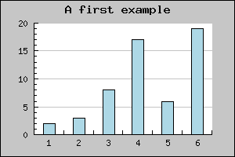
Introductory example cont ...
... using a bar plot the result would be ...
  ... automatic scale and tick values
  ... default labels
  ... default gridlines
  ... “boring” standard colors
  ... automatic font and position for title
  ... bars are by default centered
    $bplot = new BarPlot($ydata);
    $graph->Add($bplot);

Slide 37
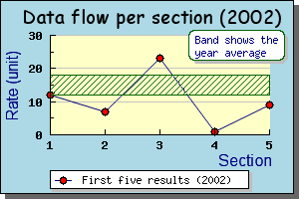
Introductory example cont ...
We can also make it a little bit more interesting ...
  ... adding drop shadow
  ... axis titles
  ... use TTF fonts
  ... added text box
  ... added pattern band
  ... added legend
  ... plot marks
  ... colors

Slide 38
Remainder: PHP and “On the fly images”
JpGraph is based on the core GD image library bindings available in all recent PHP versions.
GD comes in two flavors 1.x and 2.x Each with it's own problem... (in PHP 4.3 the GD will be maintained within PHP). GD 2.x is still considered beta and development seems to have stalled.
A JpGraph/PHP script is an image.
Any PHP script that creates an image sends back a properly encoded stream. The MIME type is determined by the HTTP header.
Any HTTP stream has one and only one type
  ... an image script can only return an image NO HTML !

Slide 39
How do I use image script on my site?
There are two basic ways :
Call the image script directly
  http://localhost/myimagescript.php
In a “wrapper” HTML script using an <img> tag
  <img src=”http://localhost/myimagescript.php” borded=0>
Comment:
You can pass parameters to an image script using standard HTTP GET/POST, e.g
<img src=”myimg.php?p1=10&p2=20” border=0>

Slide 40
Experience from developing JpGraph I
Need to support both GD 1.x and GD 2.x
  ... can be frustrating, different sets of bugs
  ... GD 1.x can only handle palette images
  ... development of GD 2.x seems to have stalled
  ... GD is bitmap based which limits quality (e.g. inluding dynamic images in PDF files lacks in quality)
External dependencies
  ... different behavior in OO PHP in Win2K+IIS and Linux+Apache
  ... many PHP installations have incorrectly installed GD and FreeType libraries
  ... older versions of FreeType is buggy for rotated text (RH 7.2 contains buggy version of FreeType)

Slide 41
Experience from developing JpGraph II
Evil semantics of empty()
  empty('0') == true
Remember comparison with type check
  '==' vs '==='
Number one stumble stone (for old dogs...)
  ... OO copy semantics in PHP !!

Slide 42
JpGraph Roadmap
Current stable version is 1.9.1
Version 1.10 (Feb 2003) will introduce financial plots
Version 2.0 (Summer 2003) will introduce architectural changes
  ... depend on the new in-built GD 2.x library in PHP 4.3 and higher
  ... (SC break) a few name changes to avoid name conflicts with new standard classes in PHP 4.3 and onwards
  ... introduce the possibility to use Java-style layout classes to combine several graphs in the same image
  ... investigation of adding pure PS/PDF output
See http://www.aditus.nu/jpgraph/ for details

Slide 43
PART II : OO Development in PHP
(Really, it can be done ... )

Slide 44
OO Development in PHP
It is possible to develop large scale OO code in PHP if some discipline is applied.
Will greatly help to maintain large baselines.
Quite efficient; only a minor performance hit compared to “quick-and-dirty”.
OO PHP code requires more design and thought upfront and takes longer time to develop
  ... but significantly helps maintain a clean baseline
  ... and significantly lowers the maintenance cost/time
Uses a different semantics compared to (for example) Java and C++.

Slide 45
PHP OO Semantic “gotchas”
Reference vs copying Semantics.
  Study the following code....
  What would a SW engineer with Java (or C++) assume?
function ModifyObject($aObj) {
$aObj->Modify(10);
}
$obj1 = new SomeClass();
ModifyObjct($obj1);

Slide 46
PHP OO Semantic gotchas (cont ... )
Reference vs copying Semantics.
  Study the following code....
  Wrong! The object parameter will be copied to a local copy and only the local copy (in the method) will be modified through the call to “Modify()” . The original $obj1 will be untouched.
  What needs to be done?
function ModifyObject($aObj) {
$aObj->Modify(10);
}
$obj1 = new SomeClass();
ModifyObject($obj1);

Slide 47
PHP OO Semantic gotchas (cont ... )
Reference vs copying Semantics cont ...
  Version 2 ....
  Can you spot the difference ?
  Call by reference operator '&'
Note: Will not save you in all cases....
Function ModifyObject(&$aObj) {
$aObj->Modify(10);
}
$obj1 = new SomeClass();
ModifyObjct($obj1);

Slide 48
PHP OO Semantic gotchas (cont ... )
Reference vs copying Semantics II
  Beware of implicit copying ...
  Will this code update the elements in the array ?
foreach( $this->plots as $p ) {
$p->Update();
}

Slide 49
PHP OO Semantic gotchas (cont ... )
Reference vs copying Semantics II
  Beware of implicit copying ...
  No! The object in the class will be copied to the '$p' variable in the statement and the 'Update()' method will act upon the local copy.
  Need to rewrite the above as
foreach( $this->plots as $p ) {
$p->Update();
}
$n = count($this->plots);
for( $i=0; $i<$n; ++$i ) {
$this->plots[$i]->Update();
}

Slide 50
PHP OO Semantic gotchas (cont ... )
Handling the observer pattern
  Study the following code.
  (Will the display be notified by the battery ?)
class Battery {
function Battery() {...}
function AddObserver($aMethod,&$aObj) {...}
}
class Display {
function BatteryNotify() {...}
function Display(&$aBattery) {
$aBattery->AddObserver('BatteryNotify',$this);
}
}
$myBattery = new Battery();
$myDisplay = new Display($myBattery);

Slide 51
PHP OO Semantic gotchas (cont ... )
Handling the observer pattern
  No! Our display will not be notified by the battery.
  $myDisplay is a copy of '$this' that was created in the constructor. To get hold of the same object as '$this' in the constructor we must modify the call.
  Not very nice... The client of must be aware of implementation details in the constructor !!
In JpGraph this is solved by using a 2 phase construction pattern (using an extra Init() method)
$myDisplay = new Display($myBattery);
$myDisplay =& new Display($myBattery);

Slide 52

2 Phase Object Construction
This pattern is applicable when an object needs to pass a self reference as a parameter, e.g. Observer pattern
  ... applying this to the previous example
class Battery {
function Battery() {...}
function AddObserver($aMethod,&$aObj) {...}
}
class Display {
function Display(&$aBattery) {...}
function BatteryNotify() {...}
function Init() {
$this->iBattery->AddObserver('BatteryNotify'
$this);
}
}
$myBattery = new Battery();
$myDisplay = new Display($aBattery);
$myDisplay->Init();

Slide 53
PART III: DDDA
DDDA
Dynamic Database driven Documentation Architecture

Slide 54
DDDA What ?
A documentation architecture with a reference implementation.
Originally developed to help document JpGraph
DDDA is a generic documentation architecture for (primarily) OO PHP script code.

Slide 55
DDDA Why?
Why re-invent the wheel (or why bother with yeat another documentation help system ?)
There are several short comings with existing system
  ... the documentation is stored with special markup code in the source itself
  ... current system offer no easy (and objective) way of measuring documentation progress and status
  ... existing PHP documentation system does not handle OO PHP code very well
Doing manual API documentation is painful and error prone and takes a lot of work to keep synchronized with the source, specially for an API reference.

Slide 56
Why storing user documentation in the code is a bad idea ...
Confuses user level documentation with system level documentation.
Updating documentation requires, what in effect is, code changes.
  ... may trigger a new release even for a spelling mistake !!
  ... requires new release validation.
The person writing user level documentation might not be a SW engineer but is still required to modify code!
  ... can lead to code corruption and time consuming code restores.
Can make the code harder to navigate in and may have a negative performance impact (size increases).

Slide 57
Why storing user documentation in the code is a bad idea ... (cont ...)
Each language translation requires that a separate baseline is kept in synch!!
Makes off-line processing of documentation harder
  ... always requires a parsing step

Slide 58
Goals for a new architecture
Keep user level docs separate from system level documentation
Extract needed code structure automatically
  ... class hierarchies
  ... method with arguments and default values
  ... instance variables
Support for weighted progress tracking
Support for multiple output formats
Support for multiple translations
... and as a bonus some elementary static code analysis

Slide 59

DDDA Overview
PHP Project
Scan project files to extract class information
Augument the extracted information
Invoke the formatting subsystem to generate the documentation according to the choosen formatter plugin
1.
2.
PHP Class
Parser
Augment class description
DB (MySQL)
3.
Formatting framework
Resulting Class Reference
Fmt Plugin

Slide 60
Plugin architecture
The output generation framework is generic and does not anything specific about the output format.
The actual fromat of the output is determined by the formatter plugin used
A standard HTML formatter plugin is supplied as standard.
DB
Framework
Formatter plugin

Slide 61
The DDDA in action...
Some examples taken from the documentation of JpGraph ...

Slide 62
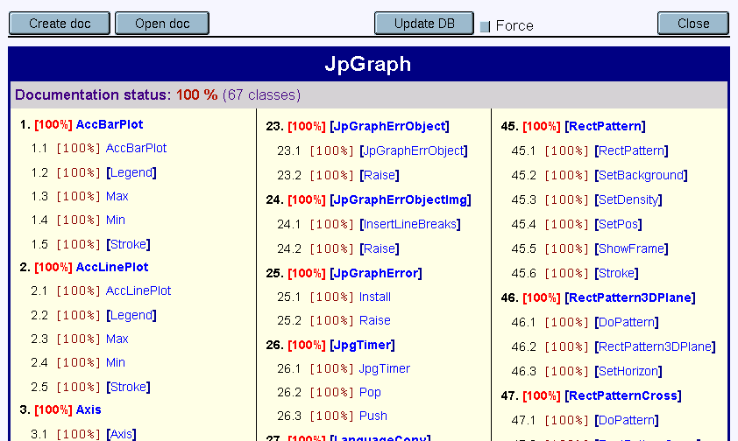
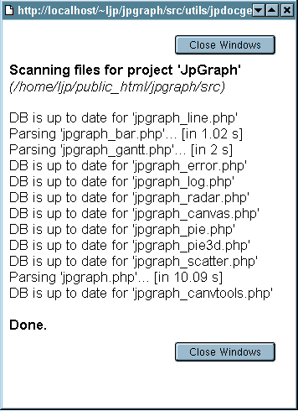
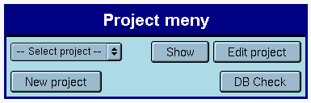
DDDA Application in action I

Slide 63

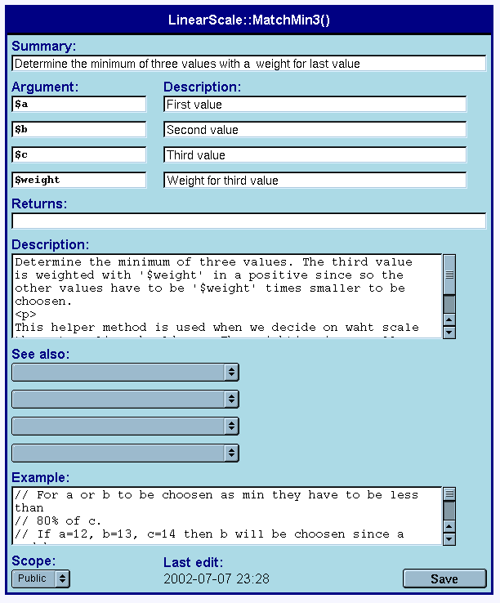

DDDA Application in action II
Editing class and method description ...
Arguments are extracted automatically

Slide 64

DDDA Example output I (std HTML plugin)

Slide 65

DDDA Example output II (std HTML plugin)

Slide 66

Questions

Slide 67

Contact details
Johan Persson
  johanp@aditus.nu
Main JpGraph and DDDA page
  http://www.aditus.nu/jpgraph/

