Slide 1

JavaScript – Zero to Mastery
All you need to know to become a JavaScript developer
To Become a Junior Front-end Developer
To Become a JavaScript Developer

Slide 2
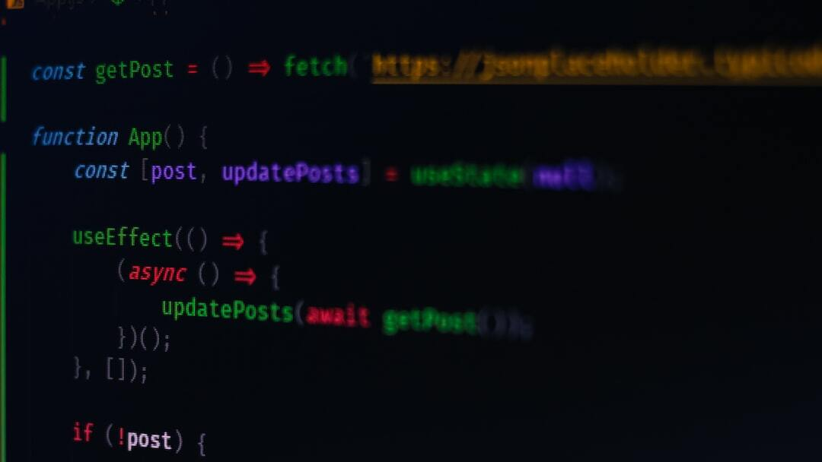
Introduction to JavaScript
Definition: JavaScript is a high-level, interpreted programming language that is one of the core technologies of the World Wide Web, alongside HTML and CSS.
Importance: JavaScript enables interactive web pages and is an essential part of web applications. It is used by the vast majority of websites and supported by all modern web browsers without the need for plugins.
Photo by Ferenc Almasi on Unsplash

Slide 3
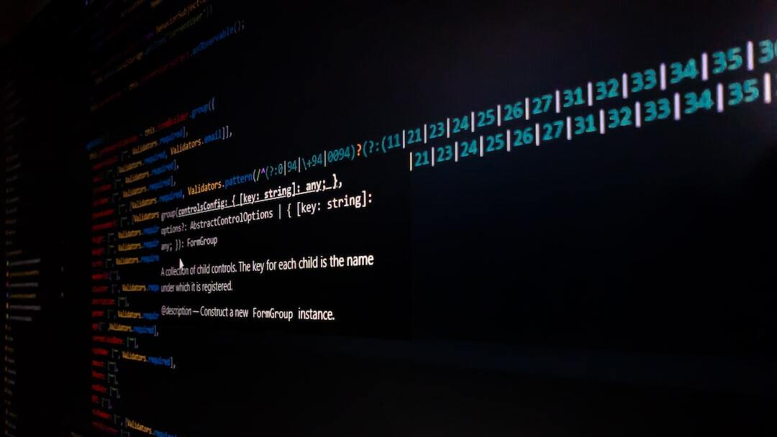
History of JavaScript
Creation: JavaScript was created in 1995 by Brendan Eich while he was working at Netscape Communications. Initially named Mocha, it was later renamed to LiveScript and finally JavaScript.
Standardization: In 1997, JavaScript was standardized under the name ECMAScript by the European Computer Manufacturers Association (ECMA).
Evolution: JavaScript has evolved significantly with multiple versions, adding features and capabilities to support modern web development.
Photo by Manoj Dharmarathne on Unsplash

Slide 4
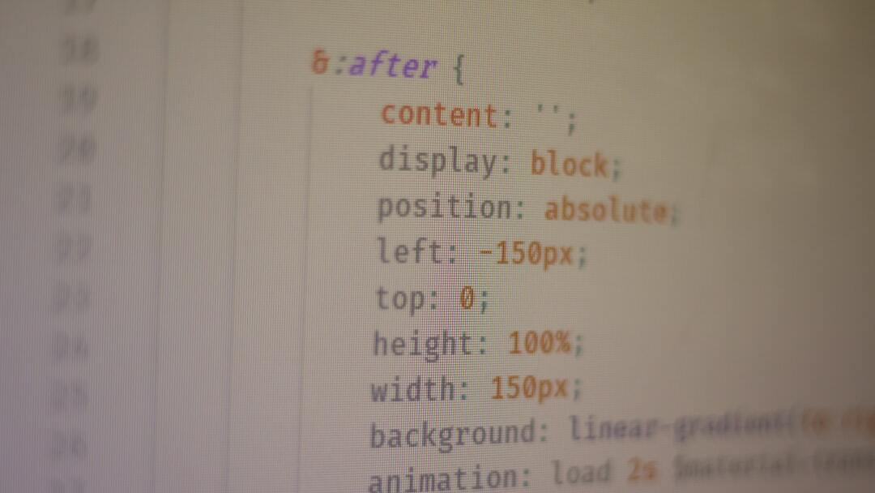
Core Features of JavaScript
Scripting Capabilities: JavaScript is primarily a scripting language, used to create dynamic and interactive effects within web browsers.
Dynamic and Weak Typing: Variables in JavaScript are not directly associated with any particular value type, allowing for more flexibility.
Prototype-based Inheritance: JavaScript uses prototypes instead of classes for inheritance, enabling objects to inherit directly from other objects.
Asynchronous Programming: JavaScript supports asynchronous programming, allowing for the execution of code without blocking the main thread, essential for responsive web applications.
Photo by Ferenc Almasi on Unsplash

