Slide 1
Database Design & Implementation Data Modeler & Database Developer
A walkthrough of BookLary's database design From concept to a working, queryable PostgreSQL system.

Slide 2
Requirements Specification
Books: title/author/ISBN, multiple copies, some never borrowed
Members: ID/name/phone, some never borrowed
Loans: one book per member at a time, shared due date, nullable return date
BookLary - Library
Member
Loan
Book

Slide 3

BookLary - Library
BookLary - Simplified

Slide 4

BookLary - Library

Slide 5
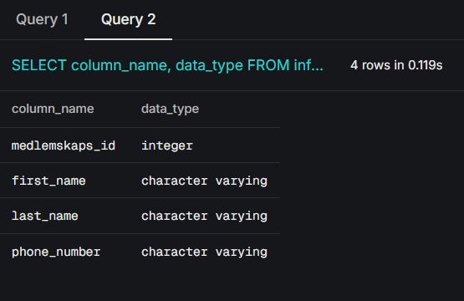
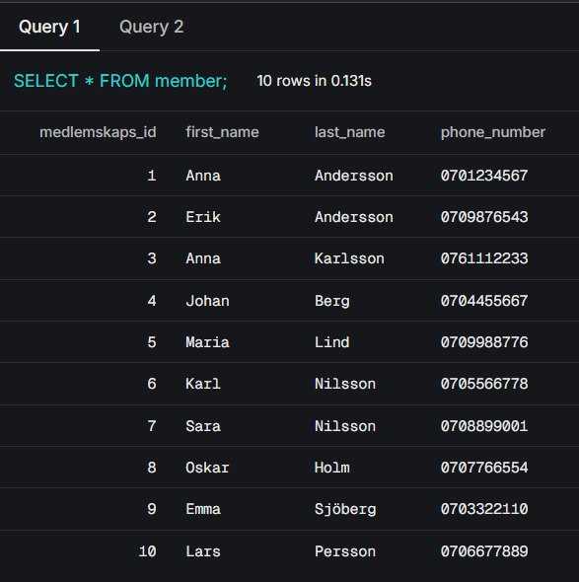
BookLary - Library
This is the member table showing the data is live
split for easier querying and more precise results

Slide 6
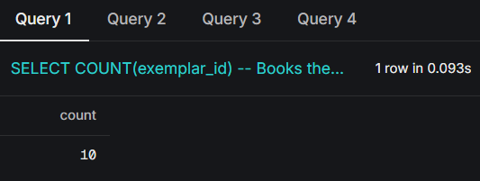
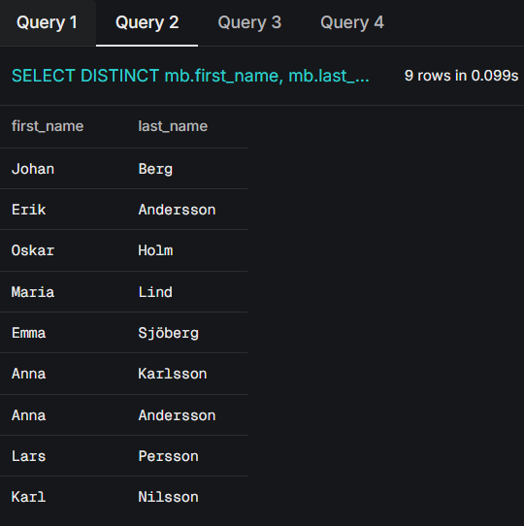
BookLary - Library
Who’s currently borrowing?
How many books do we own?

Slide 7
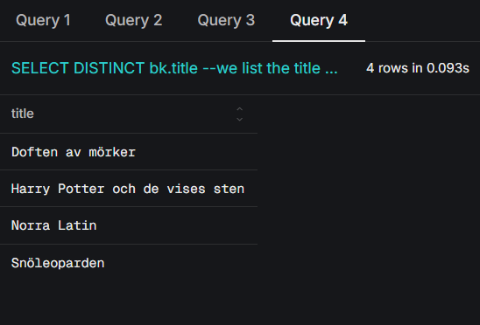
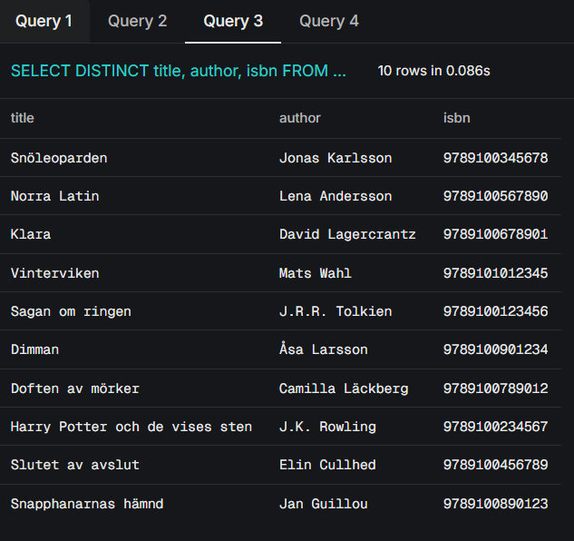
BookLary - Library
What's out on loan right now?
What's in our catalog?

Slide 8
BookLary - Library | 09-09-2026
Accurate view of inventory and loans
Scalable as the catalog/membership grows
And some future proofing
What do we gain from this?

