Slide 1
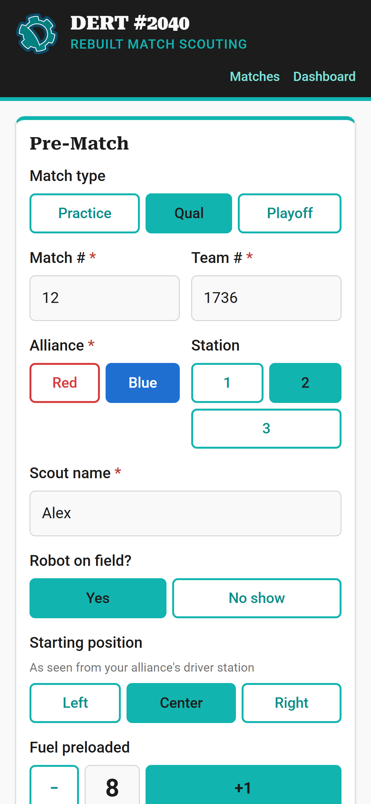
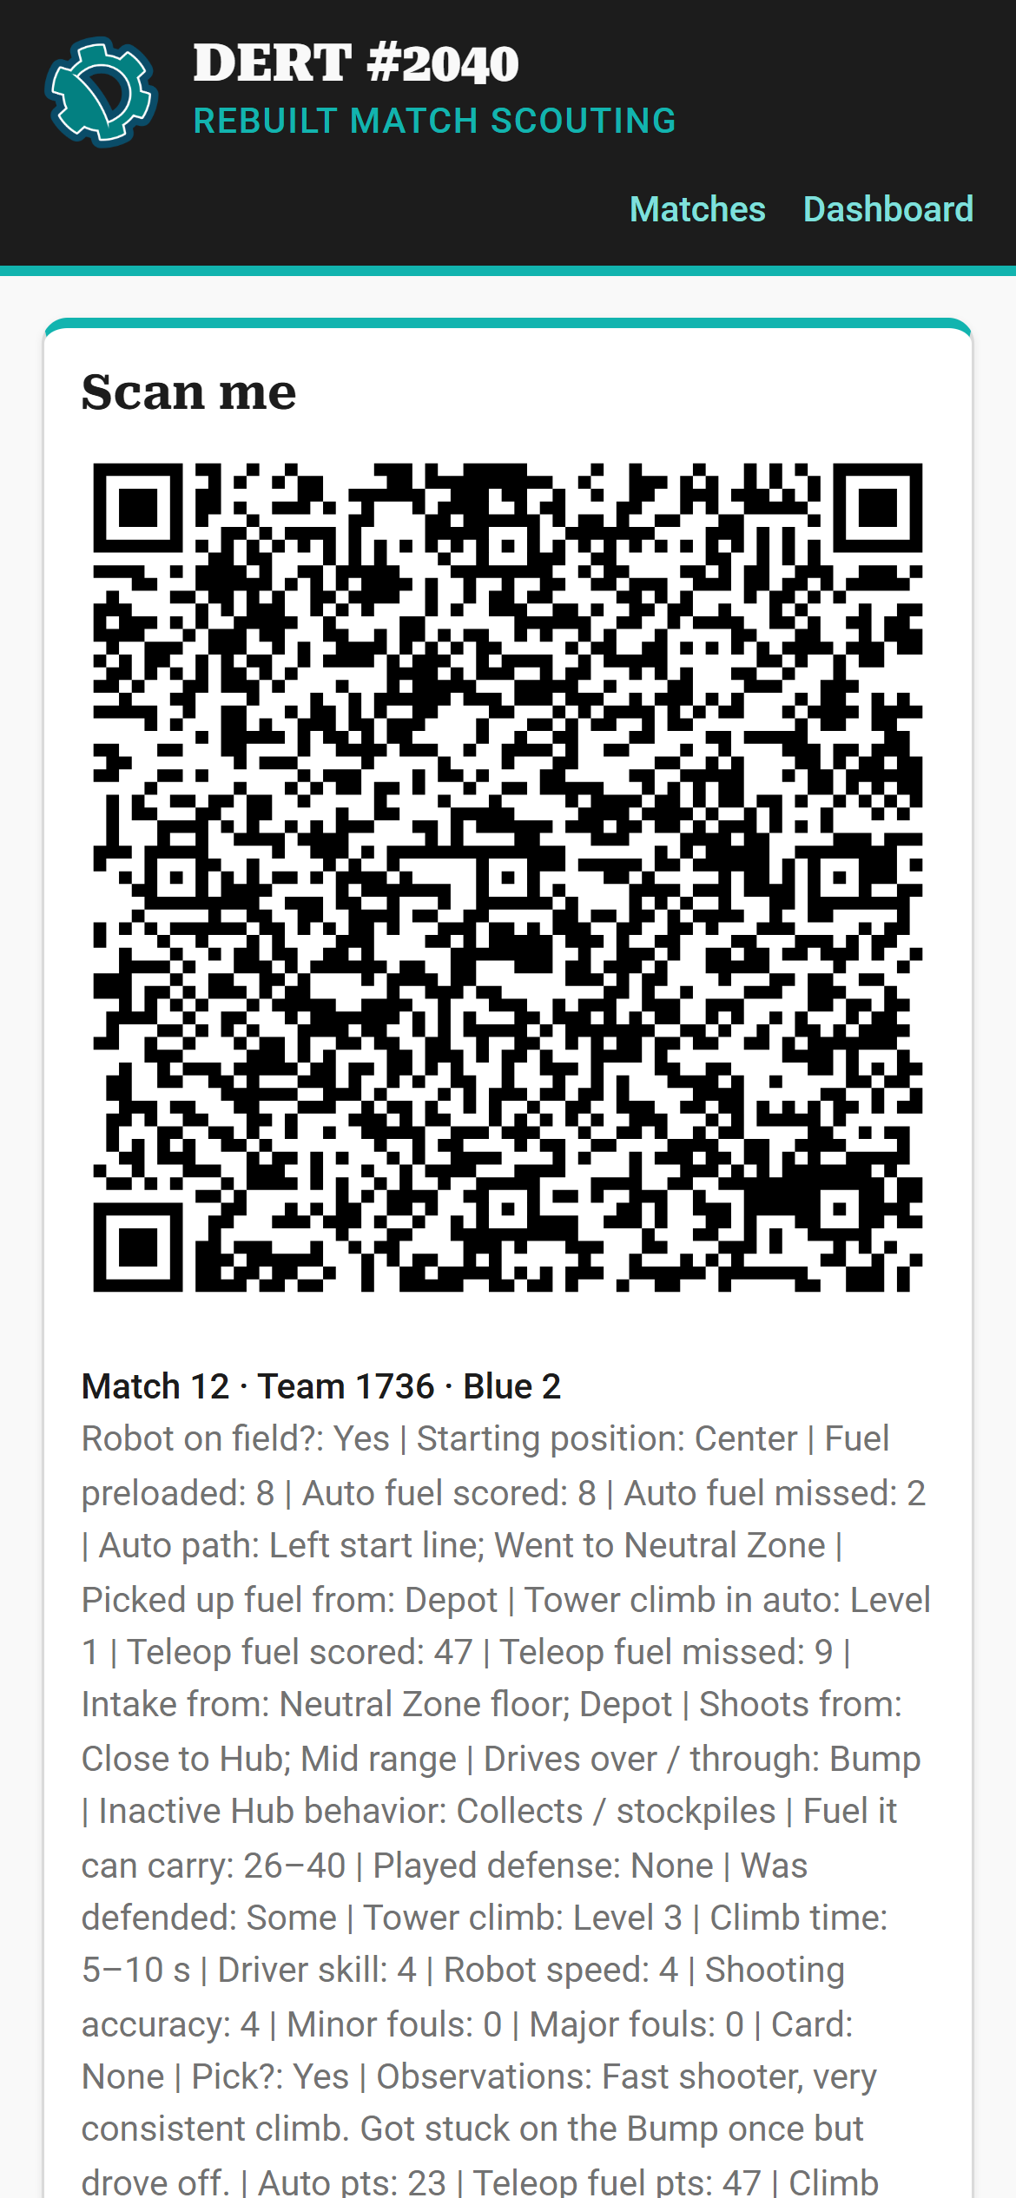
Scouting: from the stands to the pick list
DERT #2040 · REBUILT 2026
How to fill in the scouting form, scan QR codes into Excel and update the dashboard
Notes:
Welcome. This training covers the whole scouting chain: scouts fill in the form on their phones, the data lead scans the QR codes into Excel, and the strategy team uses the dashboard to build the pick list. It takes about 20 minutes. Everyone should watch Part 1; data leads and strategy should stay for Parts 2 and 3.

Slide 2








How our scouting works
1
2
3
4
Watch & record
Show the QR code
Scan into Excel
Pick the best
A scout watches one robot and fills in the form on a phone.
After the match the phone turns the answers into a QR code.
The data lead scans it. One row lands in the Excel workbook.
The dashboard turns all the rows into rankings and a pick list.
Who does what
Scouts
6 per match · Part 1
Data lead
1 per event · Part 2
Strategy team
Drive team & mentors · Part 3
Each scout watches one robot for the whole match and fills in the form.
Has the laptop, the QR scanner and the Excel workbook. Scans every phone after each match.
Loads the workbook into the dashboard and builds the pick list.
Notes:
Big picture first. Each robot on the field has one scout watching it, so six scouts per match. The phone turns the answers into a QR code. The data lead scans that QR code with a scanner and it becomes one row in Excel. The dashboard reads the Excel file and ranks every team. No internet needed in the stands.

Slide 3
The scouting form
PART 1 · SCOUTS
For everyone in the stands: get the app, fill it in during the match, and hand over your QR code.
Notes:
Part 1 is for every scout. By the end you should be able to install the app, fill in a match and hand over the QR code.

Slide 4
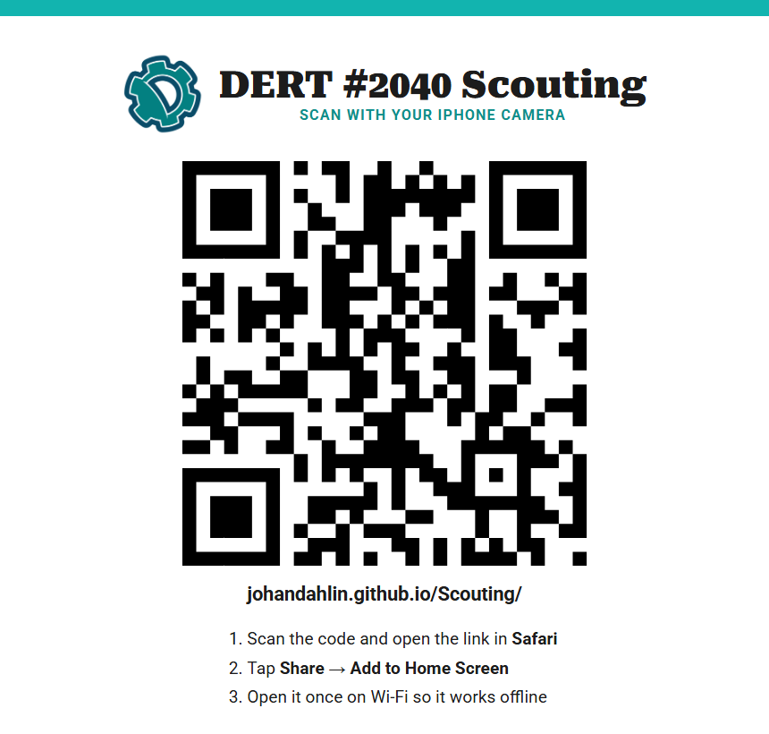

Put the form on your phone
1
Scan the poster's QR code with your camera
Or type johandahlin.github.io/Scouting in the browser.
2
Open the link
iPhone: Safari. Android: Chrome.
3
Add it to your home screen
iPhone: Share → Add to Home Screen
Android: three-dot menu → Add to Home screen
DERT Scout
4
Open it once on Wi-Fi
After that it works in the stands, even with no signal.
Notes:
Do this before the event, on Wi-Fi. The poster is in the pit. Adding it to the home screen makes it open like a normal app, and opening it once on Wi-Fi saves it on the phone so it works in the stands without signal. Android users: use Chrome and the three-dot menu.

Slide 5
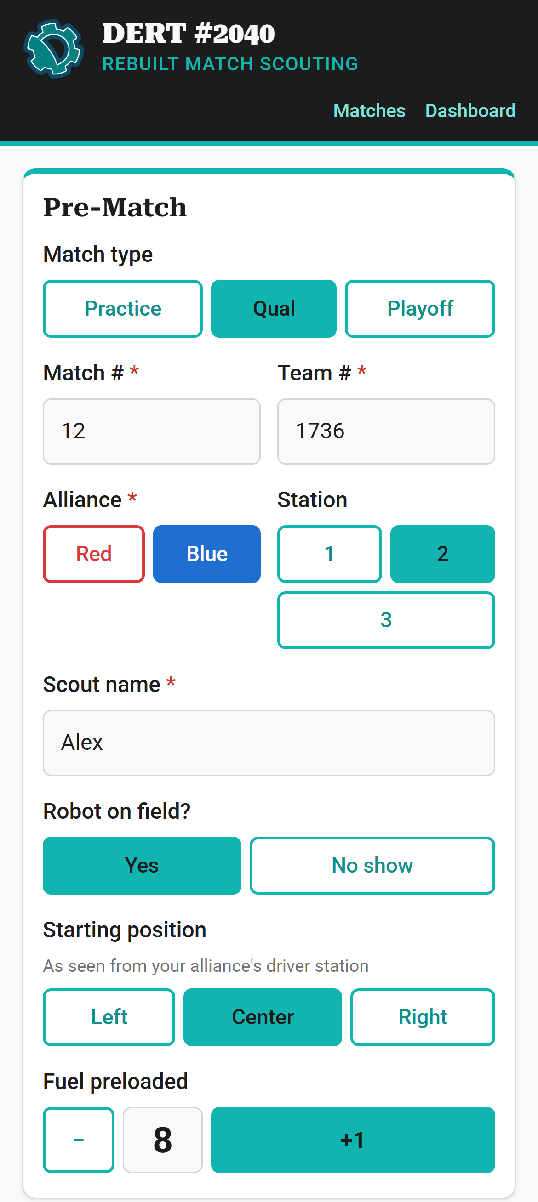
Before the match starts
1
Match type
Usually Qual. Stays for the next match.
2
Match # and Team #
From the schedule or the field screen. Red * = must fill in.
1
2
3
Alliance and Station
Your seat: Red or Blue, 1 to 3. Stays for the next match.
3
4
Scout name
Your name, so we know who to ask. Stays.
4
5
5
Robot on field?
Tap No show if the robot isn't there.
6
6
Starting position & preload
Where it starts (seen from your driver station) and how much fuel it holds.
Notes:
Fill in the top card while the robots are being set up. Match number and team number are on the match schedule and the field screen. Double-check the team number: a wrong team number puts the data on the wrong robot. The fields marked as staying are kept when you tap Next match, so you set them once.

Slide 6
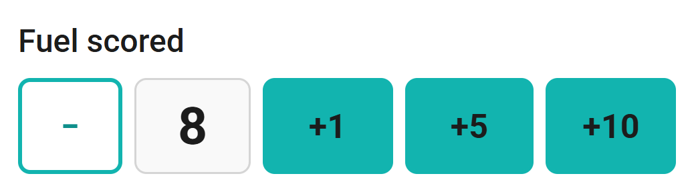
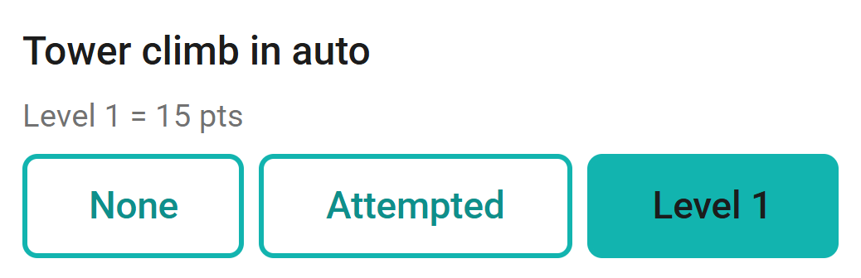
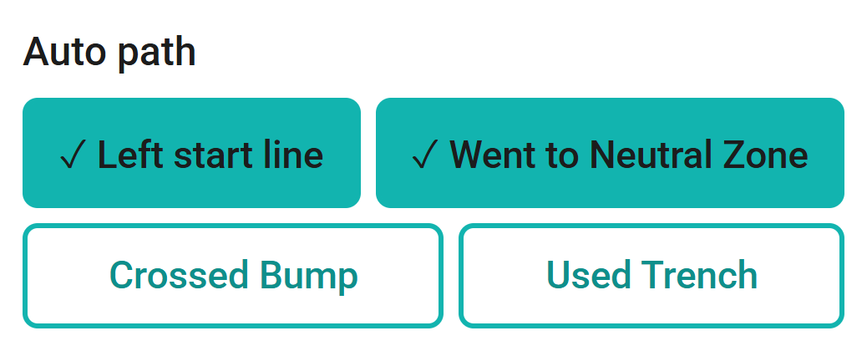
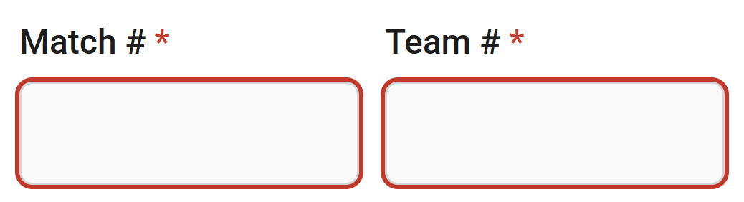
How the buttons work
Counters
Tap +1, +5 or +10 to add. Tap − to take one away.
Pick one
Tap one answer. Tap it again to unselect it.
Pick all that apply
Tap every answer that happened. A ✓ shows what's selected.
Required fields *
Must be filled in. If one is empty you get a red box and no QR code.
Notes:
Four kinds of answers. Counters for anything you count. Pick-one buttons: tapping the same answer again clears it. Pick-all buttons show a check mark. And the red star fields must be filled in, otherwise you get a red box and no QR code.

Slide 7




During the match: watch only your robot
AUTO
TELEOP · 2:20
ENDGAME
0:00
0:20
2:10
2:40
Autonomous
first 20 sec
Teleop
2:20
Endgame
last 30 sec
Fuel scored and missed
Its path: start line, Neutral Zone, Bump, Trench
Where it picked up fuel
Did it climb to Level 1? (15 pts)
Fuel scored, only while your Hub is active
Fuel missed
Where it gets fuel and shoots from
What it does while the Hub is inactive
Defense: played it or received it
Tower climb: None, Attempted, Level 1, 2 or 3
How long the climb took
Tip: keep your eyes on the field. Tap +1 as each fuel goes in, and use +5 or +10 to catch up after a burst.
Notes:
The match is 2 minutes 40 seconds: 20 seconds of autonomous, then 2:20 of teleop, and the last 30 seconds is endgame. The form has a card for each part. Keep your eyes on your robot and tap as things happen. In teleop, only count fuel that goes in while your alliance's Hub is active.

Slide 8
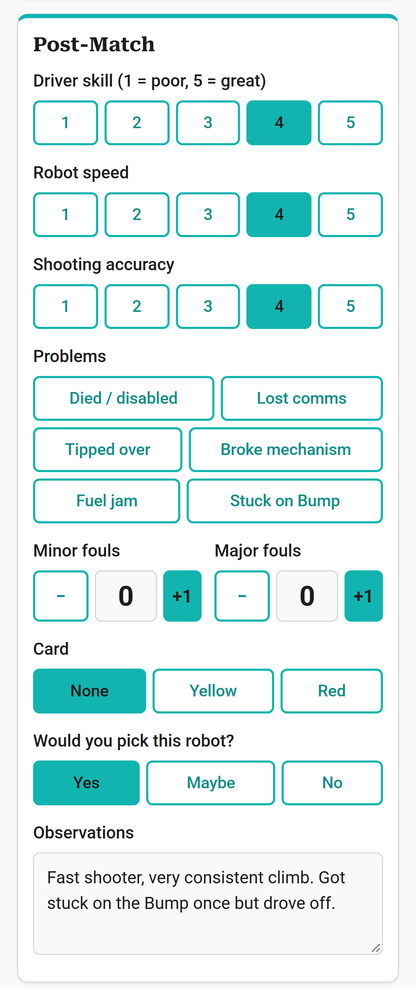
After the match: rate it and add notes
1
Ratings from 1 to 5
Driver skill, speed and accuracy. 1 = poor, 5 = great.
1
2
Problems
Tap everything that went wrong: died, lost comms, tipped, jams…
3
Fouls and cards
Count the fouls the refs called on this robot.
2
4
Would you pick it?
Your gut feeling: Yes, Maybe or No.
3
5
Observations
Good: "Fast shooter, always climbs L3." Not useful: "good".
4
5
Above the Submit button, black boxes add up the points for you. A quick way to spot a typo.
Notes:
Right after the buzzer, while you still remember. Ratings are compared to the other robots you've seen today. The observations box is the most valuable part for alliance selection: write something a number can't show.

Slide 9
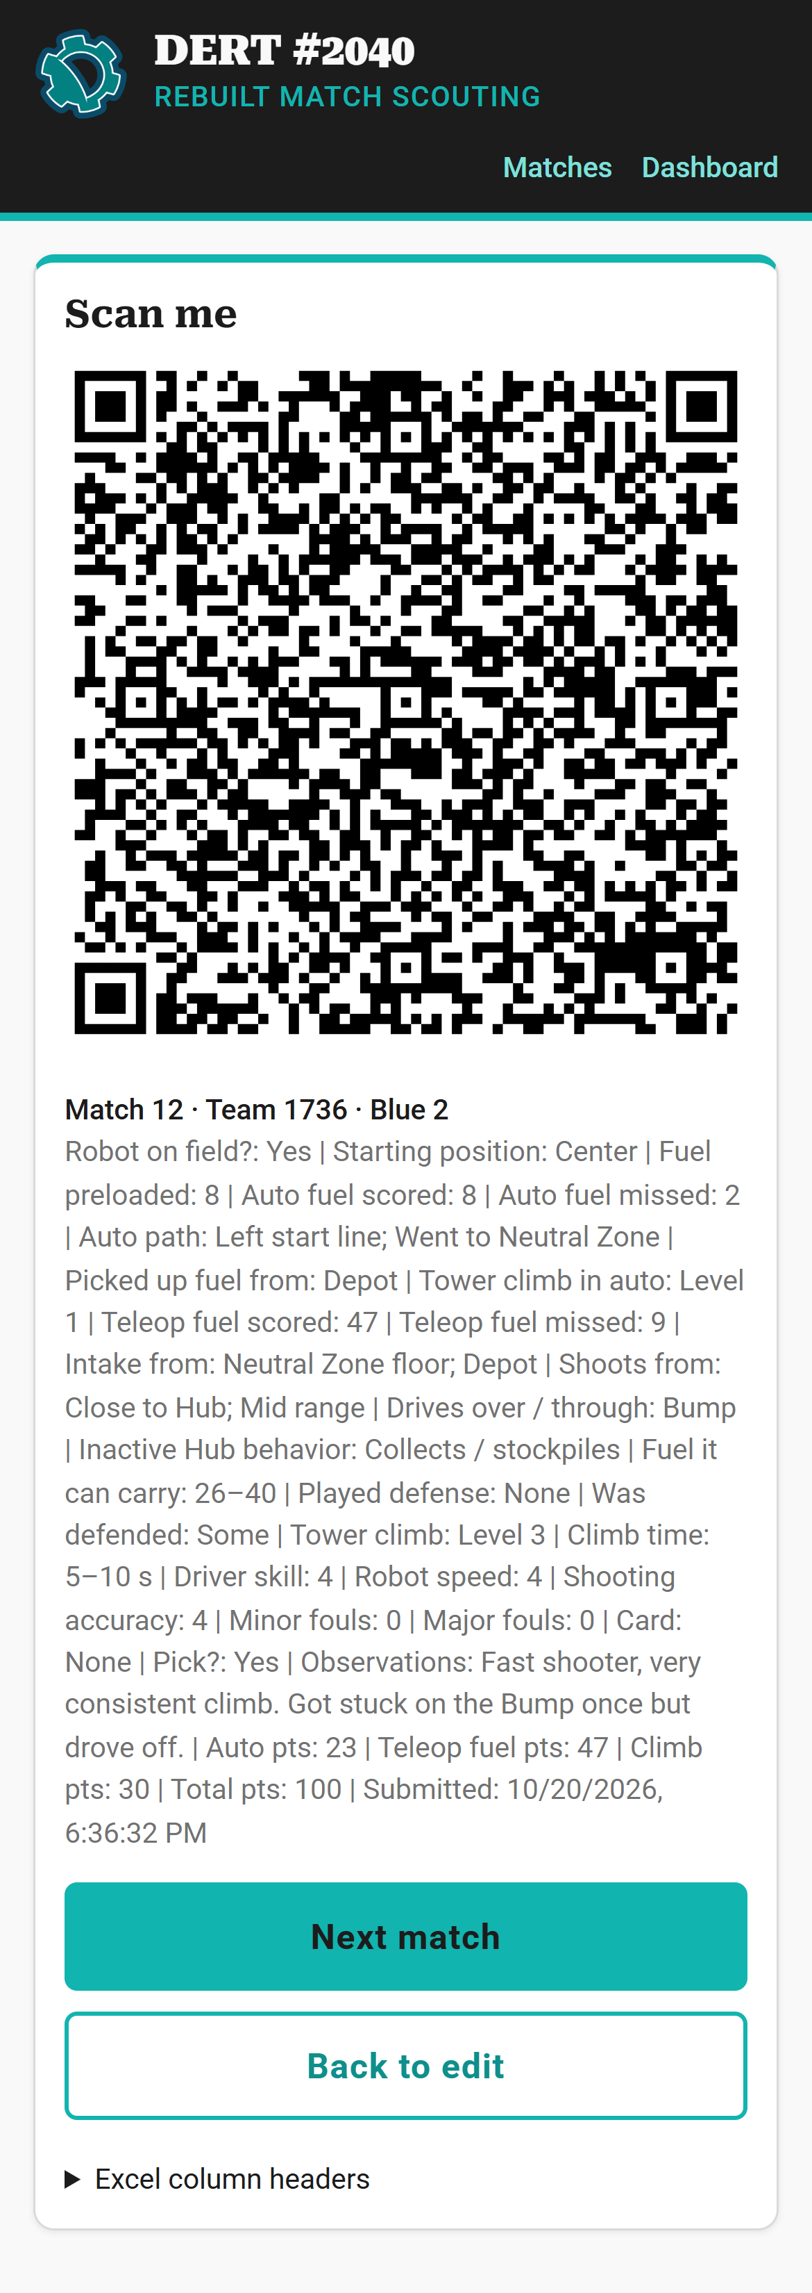
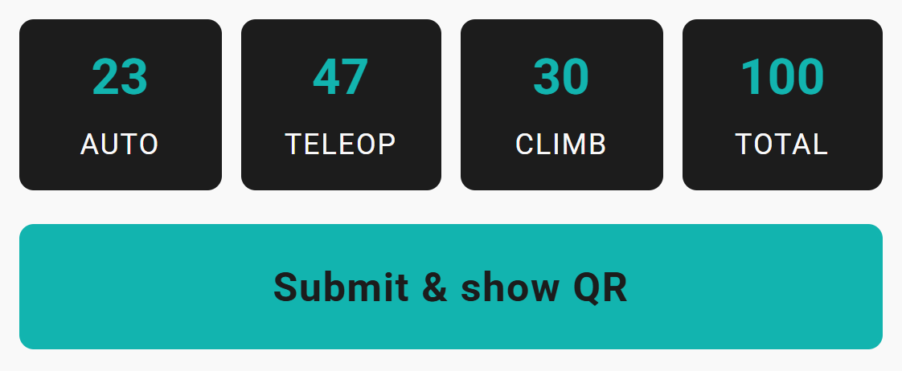
Submit and show your QR code
1
Tap Submit & show QR
If something is missing, the form shows you what.
2
Show the QR code to the
Strategy Lead
Turn your screen brightness up.
2
1
3
Wait for "got it"
Keep the code on screen until it's scanned.
Bottom of the form
4
Tap Next match
Name, alliance and station stay. Match # goes up by 1. Type the new Team #.
4
5
Made a typo?
Tap Back to edit, fix it and submit again.
5
Notes:
Tap Submit and show QR. Take the phone to the data lead and keep it on screen until they say got it. Only then tap Next match: it keeps your name, alliance and station, adds one to the match number and clears the rest, including the team number, which changes every match.

Slide 10



Scout do's and don'ts
Do
Don't
Watch only your robot, the whole match
Count fuel as it happens
Tap No show if the robot isn't on the field
Write real observations
Charge your phone before the event
App closed? Reopen it. Your answers are saved
Count fuel that went in while your Hub was inactive
Guess the team number. Check the schedule
Use Clear form unless you want to start over
Leave the stands without handing over your last match
The #1 mistake
Tapping Next match before your QR code was scanned. That match is gone for good.
Notes:
The most common mistake is tapping Next match before the QR code was scanned: that match is gone. Second most common: a wrong team number. If the app closes by accident, just open it again, the answers are saved on the phone.

Slide 11
Scanning into Excel
PART 2 · DATA LEAD
For the student with the laptop and the QR scanner. No Excel experience needed.
Notes:
Part 2 is for the data lead. If you've never used Excel, that's fine: you only need to click one cell and pull a trigger. We'll go through the setup, scanning, and fixing mistakes.

Slide 12


What the Strategy Lead needs
Laptop with Excel
Microsoft 365 or Excel 2021 or newer.
QR code scanner
USB or Bluetooth. It works like a keyboard.
The workbook
DERT_Scouting_REBUILT.xlsx. A fresh copy for each event.
Charger and a seat
Somewhere scouts can find you after every match.
What the scanner does
It types the answers for you, one after the other, as if someone typed really fast:
Qual
Tab ⇥
12
Tab ⇥
1736
Tab ⇥
Blue
Tab ⇥
2
Tab ⇥
Alex
Tab ⇥
…
Enter ⏎
A2
B2
C2
D2
E2
F2
next row
Tab moves one cell to the right. Enter goes to the next row. So one scan = one row in Excel.
Notes:
The scanner acts like a keyboard. When it reads the QR code it types each answer and presses Tab between them, and Enter at the end. In Excel, Tab moves one cell to the right and Enter goes to the next row, so one scan fills one row.

Slide 13
Excel in 60 seconds
DERT_Scouting_REBUILT.xlsx - Excel
— ☐ ✕
1
Ribbon
The menus. You only need File, for the setup.
1
File Home Insert Page Layout Formulas Data Review View
2
Name Box
Shows which cell is selected, here A5.
2
A5
fx
3
 | A | B | C | D | E | F | G | H
1 | Match type | Match # | Team # | Alliance | Station | Scout name | Robot on field? | Starting position
2 | Qual | 12 | 8719 | Red | 1 | Ava | Yes | Right
3 | Qual | 12 | 8020 | Red | 2 | Ben | Yes | Right
4 | Qual | 12 | 2039 | Red | 3 | Chloe | Yes | Right
5
6
7
8
9
10
11
3
Column letters
A, B, C… across the top. Each answer has its own column.
4
Row numbers
1, 2, 3… down the side. Each scan becomes one row.
5
4
5
Cell
One box. A5 = column A, row 5. The green border shows where the cursor is.
6
Sheet tabs
Switch pages here: Instructions, Scans, Team Summary, Team Lookup.
6
◀ ▶
Instructions
Scans
Team Summary
Team Lookup
⊕
Notes:
If you've never used Excel: it's a big grid. Columns have letters, rows have numbers, and each box is a cell, named by its column and row, like A5. The green border shows the selected cell, and the Name Box in the top-left tells you which one it is. The tabs at the bottom switch between the sheets in the workbook.

Slide 14
Set up Excel once, before the event
DERT_Scouting_REBUILT.xlsx - Excel
— ☐ ✕
Excel Options
? ✕
PROTECTED VIEW Be careful—files from the Internet can contain viruses.
1
Enable Editing
General
Editing options
Formulas
A1
fx
Data
✓
After pressing Enter, move selection
 | A | B | C | D | E | F
1
Proofing
Automatically insert a decimal point
Save
✓
Enable fill handle and cell drag-and-drop
◀ ▶
Instructions
Scans
Team Summary
⊕
Language
✓
Allow editing directly in cells
Accessibility
Extend data range formats and formulas
1
If you see a yellow bar, click Enable Editing
Excel blocks typing and scanning until you do.
Advanced
2
✓
Customize Ribbon
✓
Enable automatic percent entry
3
2
Click File → Options → Advanced
File is the first menu at the top-left.
Quick Access Toolbar
Enable AutoComplete for cell values
Add-ins
✓
Automatically Flash Fill
Trust Center
3
Untick "Enable AutoComplete for cell values"
It's under Editing options.
4
OK
Cancel
4
Click OK
Done. Excel remembers this on this laptop.
Why? With AutoComplete on, Excel may finish a scanned word for you: Depot becomes "Depot; Outpost".
Notes:
Two things to do once per laptop. First, files that came from email or the internet open in Protected View, where you can't type or scan: click Enable Editing. Second, turn off AutoComplete. Otherwise Excel tries to finish what the scanner types, for example Depot becomes Depot; Outpost, and the data is wrong without anyone noticing.

Slide 15
Test the scanner in Notepad
1
Open Notepad
Click Start, type Notepad, press Enter.
Untitled - Notepad
— ☐ ✕
File Edit View
Practice 1 1736 Blue 2 Alex Yes Center 8 8 2
2
Make a test QR code
On a phone: fill in a Practice match and tap Submit & show QR.
|
B
A
A gap = Tab B new line = Enter
3
Scan it
Point the scanner at the phone and pull the trigger.
Gaps between the answers
Those are Tabs (A). Good.
Cursor jumps to a new line
That's Enter (B). Good.
Strange letters or symbols
Set the scanner's keyboard language to match Windows (see its manual).
Nothing appears
Check the cable or Bluetooth pairing, and that it's in keyboard mode.
Notes:
Before the first match, test the scanner in Notepad, where nothing can go wrong. Make a practice match on any phone and scan it. You should see the answers with gaps between them, and the cursor should jump to a new line. If you see strange characters, the scanner's keyboard language doesn't match Windows: check the scanner manual.

Slide 16

Scan a QR code into Excel
1
Click the Scans tab
At the bottom of the window.
DERT_Scouting_REBUILT.xlsx - Excel
— ☐ ✕
File Home Insert Page Layout Formulas Data Review View
2
Click the first empty cell in column A
Here that's A5. Always column A!
A5
fx
 | A | B | C | D | E | F | G | H
1 | Match type | Match # | Team # | Alliance | Station | Scout name | Robot on field? | Starting position
2 | Qual | 12 | 8719 | Red | 1 | Ava | Yes | Right
3 | Qual | 12 | 8020 | Red | 2 | Ben | Yes | Right
4 | Qual | 12 | 2039 | Red | 3 | Chloe | Yes | Right
5
6
7
8
9
10
11
3
Scan the phone
Point the scanner at the QR code and pull the trigger.
2
the scan fills this row, then jumps to A6 →
4
4
Watch the row fill in
The cursor jumps to the next row by itself. Ready for the next phone.
Save every few scans: Ctrl + S
1
◀ ▶
Instructions
Scans
Team Summary
Team Lookup
⊕
Notes:
This is the whole job during the event. Go to the Scans sheet, click the first empty cell in column A, and scan. The scanner types the whole match into that row and Excel jumps to the start of the next row by itself, so you can scan the next phone straight away. Save every few scans with Ctrl+S.

Slide 17



Fixing mistakes
DERT_Scouting_REBUILT.xlsx - Excel
— ☐ ✕
Scanned into the wrong place?
Press Ctrl + Z right away. It undoes the last scan.
A4
fx
 | A | B | C | D | E | F
1 | Match type | Match # | Team # | Alliance | Station | Scout name
2 | Qual | 12 | 8719 | Red | 1 | Ava
3 | Qual | 12 | 8020 | Red | 2 | Ben
4 | Qual | 12 | 2039 | Red | 3 | Chloe
5
6
7
8
9
10
11
12
13
A bad row, or scanned twice?
Right-click the row number (1), click Delete (2). Then scan that QR code again.
1
Cut
Copy
Paste Options:
Answers in the wrong columns?
The cursor wasn't in column A. Delete the row, click column A, scan again.
Insert
Delete
2
Clear Contents
Format Cells…
Hide
Never change the teal header row
Excel and the dashboard find the data by those names.
◀ ▶
Instructions
Scans
Team Summary
Team Lookup
⊕
Notes:
Mistakes happen and they're easy to fix. Ctrl+Z undoes the last thing. To remove a whole row, right-click the grey row number on the left and choose Delete, then scan that phone again. Never change the teal header row: the formulas and the dashboard find the data by those names.

Slide 18
See the results in Excel
Team Summary
One row per team. Updates by itself after every scan.
Team Lookup
Every scan of one team, with all the notes.
DERT_Scouting_REBUILT.xlsx - Excel
— ☐ ✕
DERT_Scouting_REBUILT.xlsx - Excel
— ☐ ✕
A5
fx
B3
fx
 | A | B | C | D | E | F | G
1 | DERT #2040 - REBUILT Team Summary
2 | Updates automatically from the Scans sheet.
3
4 | Team # | Matches | Avg auto pts | Avg teleop fuel | Avg climb pts | Avg total pts | Best total
5 | 648 | 12 | 8.2 | 14.0 | 0.0 | 22.2 | 37
6 | 1625 | 12 | 26.4 | 70.6 | 0.0 | 97.0 | 137
7 | 1736 | 12 | 3.8 | 20.9 | 0.0 | 24.8 | 40
8 | 1756 | 12 | 19.2 | 144.2 | 0.0 | 163.3 | 261
9 | 2022 | 12 | 3.2 | 35.7 | 0.0 | 38.8 | 77
 | A | B | C | D | E
1 | DERT #2040 - Team Lookup
2 | Type a team number in the yellow cell.
3 | Team #: | 2040 | Avg total: 116.1 |  | Rank 4 of 31
4
5 | Match type | Match # | Team # | Alliance | Scout name
6 | Qual | 1 | 2040 | Blue | Ella
7 | Qual | 7 | 2040 | Red | Ava
8 | Qual | 12 | 2040 | Blue | Dev
9 | Qual | 18 | 2040 | Blue | Ella
1
2
◀ ▶
Instructions
Scans
Team Summary
Team Lookup
⊕
◀ ▶
Scans
Team Summary
Team Lookup
⊕
1 Green is better, red is worse. More columns and a pick list are further right.
2 Type a team number in the yellow cell and press Enter.
Notes:
You never type anything on these two sheets, they update by themselves after each scan. Team Summary has one row per team with averages, coloured from red to green. The pick list on the right of that sheet is sorted by average points. Team Lookup is the quickest way to answer what do we know about team X: type the number in the yellow cell.

Slide 19
From scans to a pick list
PART 3 · DASHBOARD
For the strategy team: load the workbook into the dashboard and rank the teams your way.
Notes:
Part 3 is for whoever builds the pick list. The dashboard reads the same Excel file, so the data lead and strategy team just need to agree on where the file is.

Slide 20


Update the dashboard
1
2
3
4
Save in Excel
Press Ctrl + S. The dashboard reads the saved file, not what's on screen.
Open the dashboard
Tap Dashboard at the top of the scouting form, or open dashboard.html.
Click Load Excel file…
Choose the workbook. You can also drag the file onto the page.
Check the count
The top bar shows the file name and how many scans it read.
4
3
Top-right corner of the dashboard, here with the sample data loaded.
It doesn't refresh by itself. After new scans: save in Excel, then click Load Excel file… again.
Notes:
The dashboard runs in a web browser and reads the saved Excel file. It does not update by itself: each time you want the latest data, save in Excel and load the file again. It's at johandahlin.github.io/Scouting/dashboard.html, or open dashboard.html from the Scouting folder if there's no internet.

Slide 21
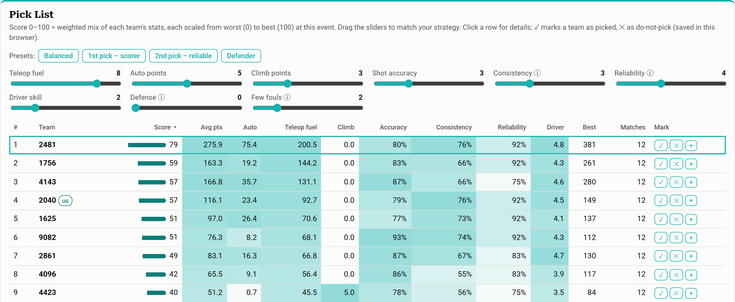

Read the pick list
1
Presets
1st pick scorer, 2nd pick reliable, or defender.
1
2
2
Sliders
Drag to say what matters most. The list re-sorts.
5
3
Score 0–100
Each stat scaled from worst (0) to best (100) at this event.
3
4
4
Marks
✓ picked, ✕ do not pick, + add to Compare.
Before alliance selection
Load the newest file, pick a preset, then move the sliders until the list matches what our robot needs from a partner.
5
Click a row
Opens that team's details below.
Notes:
Every team gets a score from 0 to 100. Each stat is scaled from the worst team at this event to the best, and the sliders decide how much each stat counts. Start with a preset, then adjust. The check and cross marks are saved in this browser, which is handy during alliance selection.

Slide 22
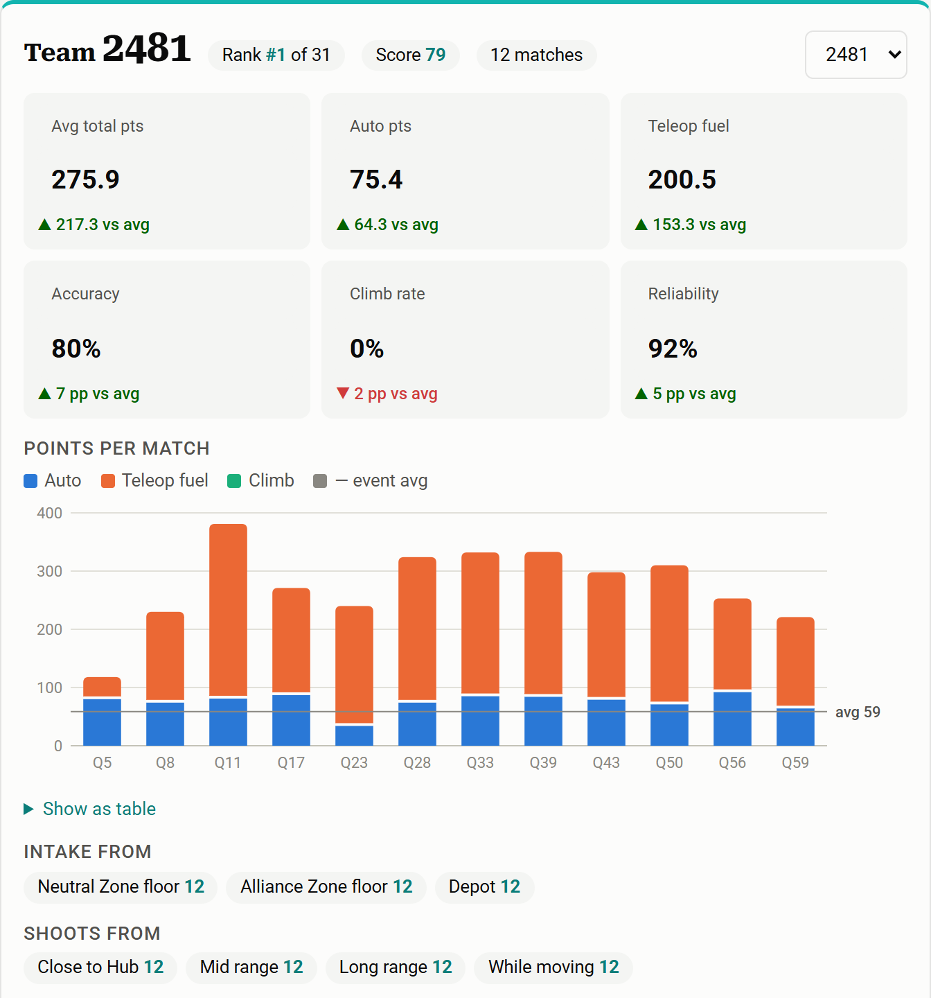
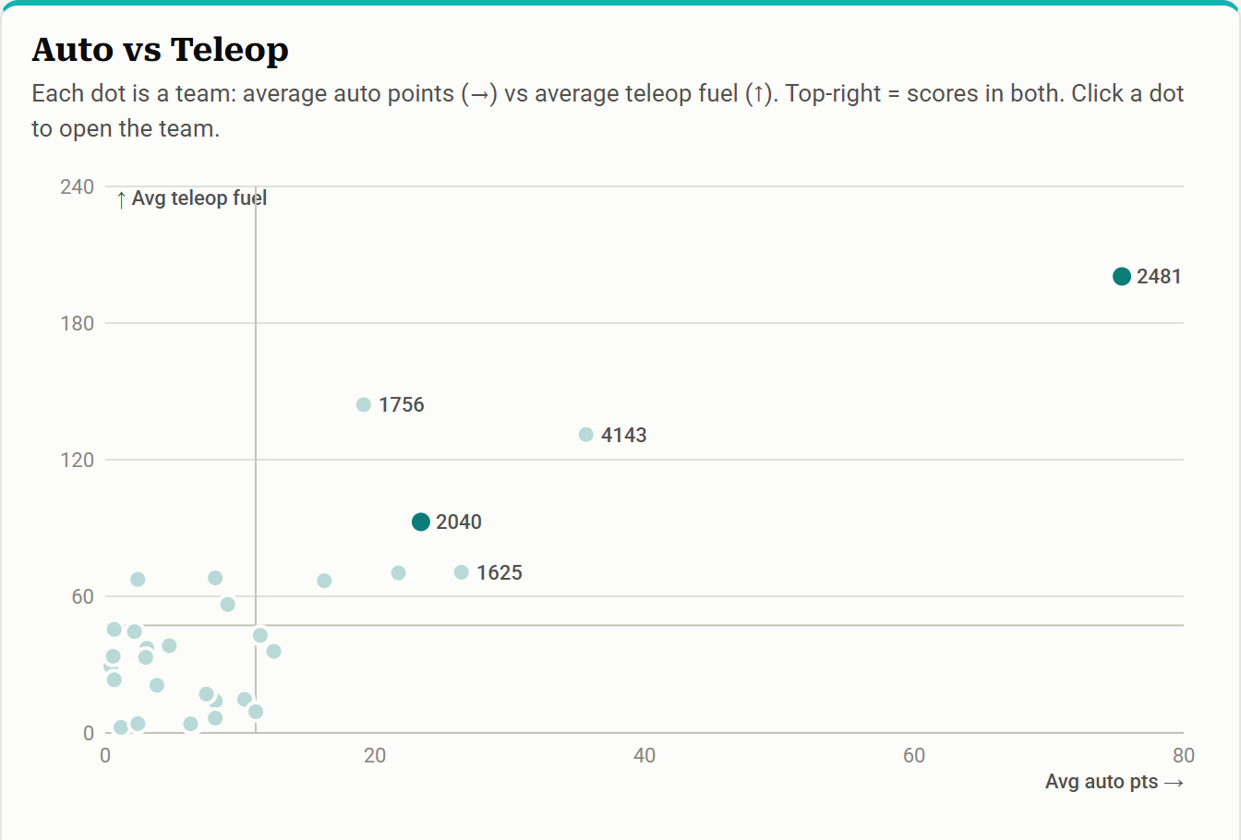

Look closer at one team
1
Compare Teams
Tap + in the pick list on up to 3 teams to see them side by side.
3
2
1
Compared to the event
▲ better or ▼ worse than the average team.
2
Points per match
Getting better? One bad match? Scout notes are under the chart.
3
Auto vs Teleop
Top-right = strong in both. Click a dot to open that team.
Notes:
Click a team in the pick list to open its card. The small boxes compare the team to the event average. The bar chart shows each match, so you can see if a team is getting better or had one bad match. Scout notes are listed under the chart. The scatter plot shows every team at once: top-right means strong in both auto and teleop.

Slide 23
Troubleshooting
If this happens… | Do this
The scanner won't read the QR code | Turn the phone's brightness up, hold it 10 to 20 cm from the scanner, and keep it still.
Answers landed in the wrong columns | The cursor wasn't in column A. Delete the row, click column A, scan again.
The scan typed into another window | The scanner types wherever the cursor is. Click into Excel first, then scan again.
Odd letters or symbols in the cells | Set the scanner's keyboard language to match Windows (see its manual).
Excel changed a word (Depot → Depot; Outpost) | AutoComplete is on. Turn it off and scan that row again.
Can't type or scan; yellow bar at the top | Click Enable Editing.
Dashboard: "no 'Team #' column" | Load the DERT workbook. Don't rename or move the teal headers on the Scans sheet.
Dashboard doesn't show the newest matches | Save in Excel (Ctrl + S), then click Load Excel file… again.
Notes:
Keep this slide handy at events. Most problems come from the cursor not being in column A or from AutoComplete. When in doubt: delete the row and scan again, the phone still has the QR code until the scout taps Next match.

Slide 24



Event-day checklist
Before the event
During matches
Alliance selection
App on every scout's phone, opened once on Wi-Fi
Scan every QR code right after the match
Save, then Load Excel file… in the dashboard
Laptop and scanner charged
Expect 6 QR codes per match: find any missing scout
Pick a preset and adjust the sliders
AutoComplete off, scanner tested in Notepad
Save with Ctrl + S every few scans
Mark teams ✓ or ✕ as they get picked
A fresh copy of the workbook
Notes:
Wrap-up. Before the event: phones, laptop and scanner ready. During matches: scan right away and save often. Before alliance selection: load the newest file into the dashboard. Questions?

