Slide 1
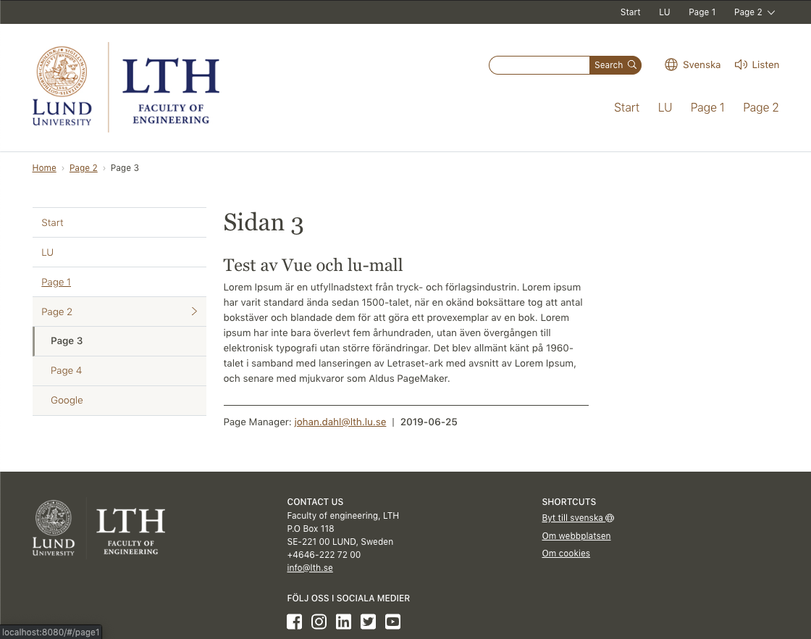
topmenu
LuHeader
navbarmenu
LuBreadCrumb
LuMain
LuRow
leftmenu
default slot
right-column slot
pageManager
lastUpdated
LuFooter
contact
social

