Slide 1
English 2100 Projects and Progress
By Johan Farfan.
Notes:
Hello, my name is Johan Farfan. This presentation is about part of my progress and accomplishments in English 2100, 2 projects that helped me to develop my communication skills
In 2 different ways.

Slide 2
Writing Project
Notes:
The first project I’d like to talk about is my Writing Project. Which involved research, interviews and engaging in all the writing involved. For this one, I wanted to take a serious approach even before I thought about a issue to work on. Let me tell you more about it.

Slide 3
Choosing the Topic
Pure Computer Science topics (disregarded)
General matter → Teach, Inform.
Ethics!
Notes:
Although it’s usually recommended to start thinking in an audience, as I said before I wanted to work on something I consider serious, important. So I decided to think about a matter that is
Common for any career, and then, what kind of audience I was going to work for.
So I decided to not take any CS related topics and taking a different topic for me. Ethics.

Slide 4

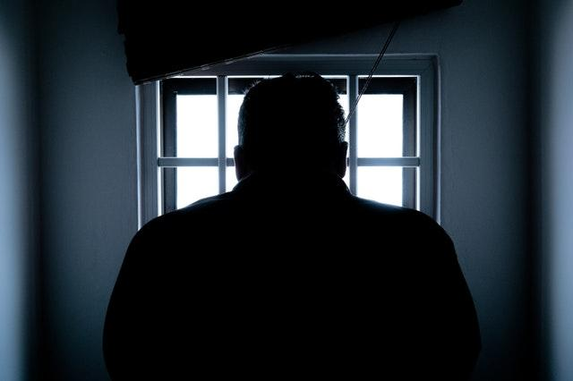
Photo by David McBee from Pexels
Photo by Donald Tong from Pexels
Is there any importance in the application of ethics?
Notes:
So why ethics? Is that something we should care about?
Depending on the case, people can have different opinions on what is morally correct, what is acceptable.
Because we all have our internal independent moral code and when analyzing situations we tend to make a balance of outcomes.
What could I gain? What are the consequences? If any.

Slide 5
VW
Ethics: Emissions Case.
Notes:
Probably many of you have at least heard about the Volkswagen emissions case, a violation against the Clean Air Act amendment. The EPA had to get involved, it was a massive scandal, mostly in America.
I chose this real life case because it has a bit of everything to talk about ethics, it can be dissected from so many angles to study and I think it’s interesting to know what people has to say about it.

Slide 6
Initial Intention
Final Work
Reflection and recapitulation of the events and consequences of VW emissions case.
Informing about how to denounce unethical corporate activities.
Notes:
I must say my final product ended up being way too different from my initial intention. I wanted to inform about how to deal with unethical corporate behavior using VW issue. It was supposed to be a document informing about to tools or procedures “available” in an easy practical way.
It turned out that I couldn’t find the existence of any state level institution dedicated to that, somewhere you could go and make your denounce.
Something didn’t change, I was sticking with informing my audience about this kind of issues and how it can affect millions that were not remotely involved in that issue.

Slide 7
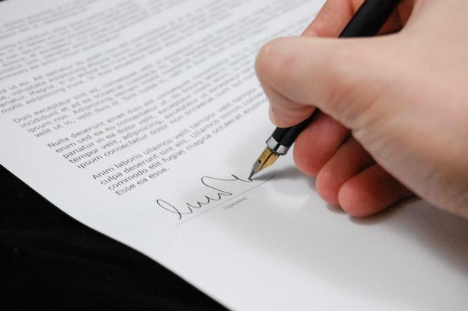
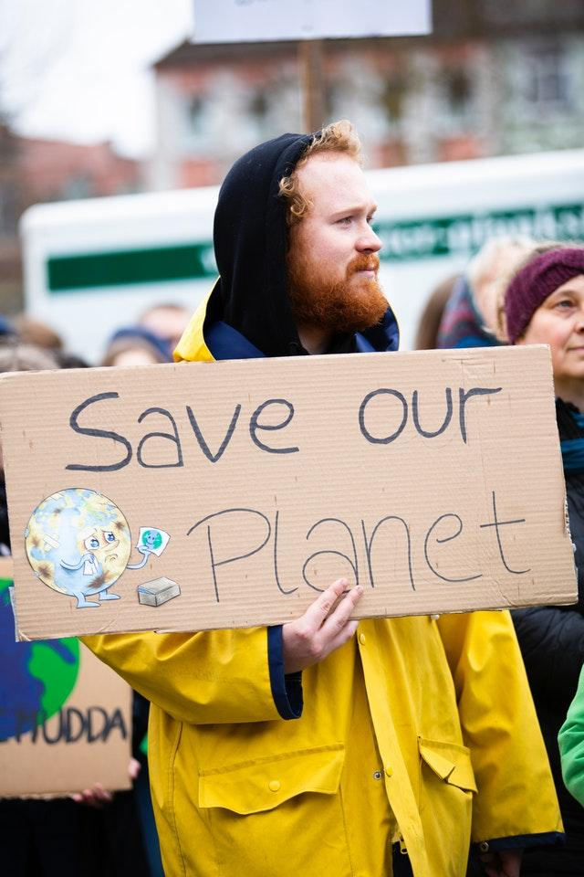
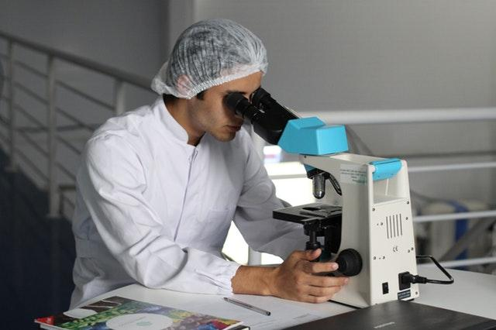
Interview
Who? → What
→ Using the extracted Info
Photo by Pixabay from Pexels
Photo by Markus Spiske from Pexels
Photo by Pixabay from Pexels
Notes:
An interview was part of this investigation, a personal way to collect information from a professional that could not only back up my research but give me another perspective or additional information I didn’t have at that time.
But, who to interview for a case like this? The first option I thought about was a juridical professional, but as I already knew my original intention was not going to be possible I started asking for opinions.
I was suggested to interview local protestants against anti environmental activities. I had no luck finding any.
Finally, my last suggestion was to ask someone with a more scientific view of the problem, whom might know better about the consequences and also to take some opinions from. A professor from the Biology faculty helped me with my investigation. I didn’t cite anything directly from him, I was rather influenced by his opinions in the way I reviewed my document. He was a great help.

Slide 8
Conclusions
Notes:
Having a broad topic to talk about is not always as easy as it seems. I found myself debating between focussing on one aspect of the consequences of the VW case, or just briefly mentioning all the involved aspects.
I wouldn’t say any of those choices are wrong, but depending on the path you want to follow you’ll have to consider more how extended your document should be and how to expose it.
The constant change in my ideas didn’t allowed me to keep a steady peace with this project, and it shouldn’t be like that. It’s actually good to be open to changes and try to assimilate new propositions to work with.
A minute ago I was asking about the importance of ethics. It does make a difference. The VW case shows us how laws are constantly violated to take a bigger part of the stake, the lack of limits a corporation might in their own behavior to make more profit, and how people that regardless being customers or loyals to the brand are affected in their health due to the multinational corp behavior.

Slide 9
Design Project
Notes:
This project had to be more relaxed than the last one, a design project to try the CRAP principles learned in class. Yet, nothing to be considered not important. I can tell you it was fun.

Slide 10
What to Talk About & How to Develop it
An Idea to Apply design Principles.
An Audience.
A Media.
Notes:
So, even if it was a design project I was supposed to communicate something. That something had to be addressed to an specific audience because this time, I chose something less broad so considering that audience was even more important. Finally, a media, the most effective one for my audience.
For the media I had a few options to choose from. Videos, Pamphlets or Posters, and a Web Page.
I ended up choosing the last one after debating in my head between a video and a web page.

Slide 11
How to put it Together?
- Preparing Written Content.
- Adding Pictures and Style.
- Re Organizing Content Blocks.
Notes:
It wasn’t too difficult. After having something to write about and apply CRAP to it.
The most difficult part is probably reviewing everything and reorganizing the information shown so it feels more natural and easy to follow.

Slide 12
The Webpage
Final decisions on Look, Tech and Behavior.
Notes:
My Web page is basically a guide (mostly thought for people who wants to become entrepreneur with web design or web developing) to manage medium-large web projects.
Sometimes planning and some other few aspects that seems to be obvious are skipped for many programmers, they just jump directly to design or to code and some things can actually help to follow up big projects.
Being a web page, there are some ideas that would immediately come to any web programmer or developer, what technologies to include, what kind of website to created and things like that.
As I just wanted to display information and use CRAP, I decided to go with something minimalistic. I thought about the look of something like a web article or a blog post, so no special tech to be included and just using basic Bootstrap plus some royalty free images and a set of icons that I bought to speed up the process.
This is what I made:

Slide 13
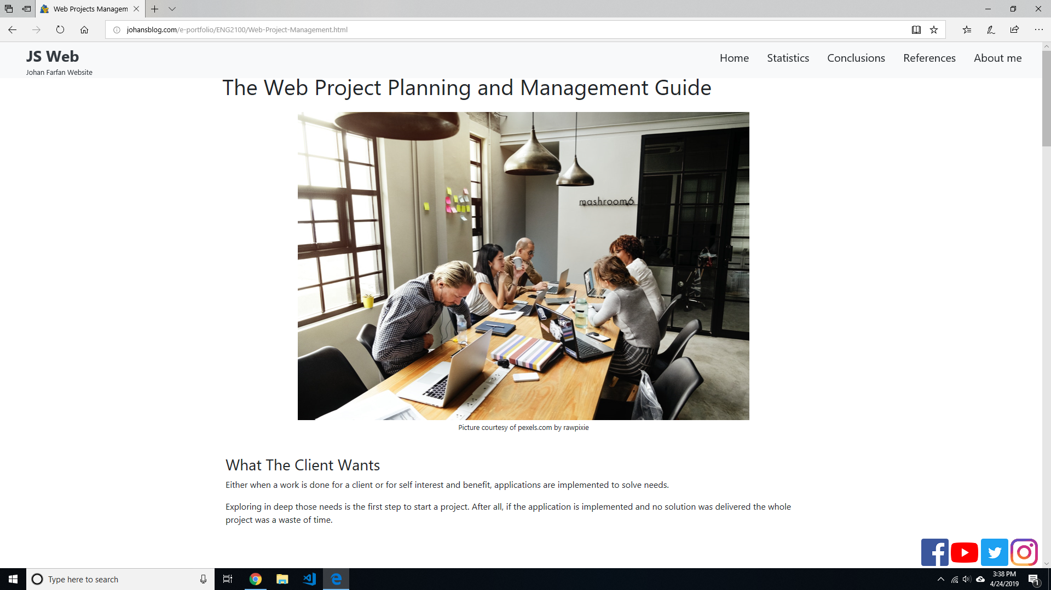

Slide 14
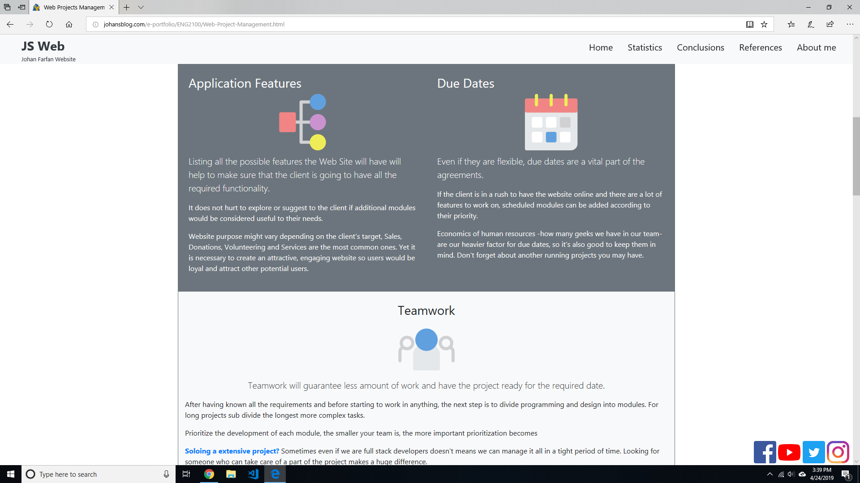

Slide 15
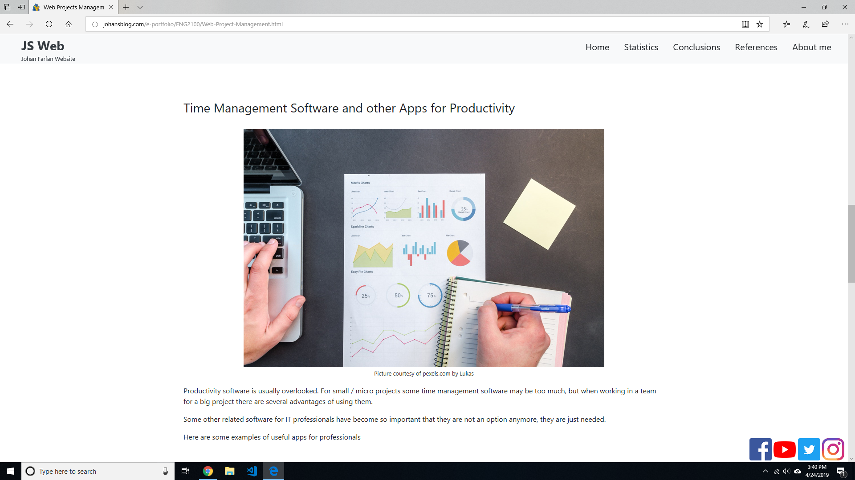

Slide 16
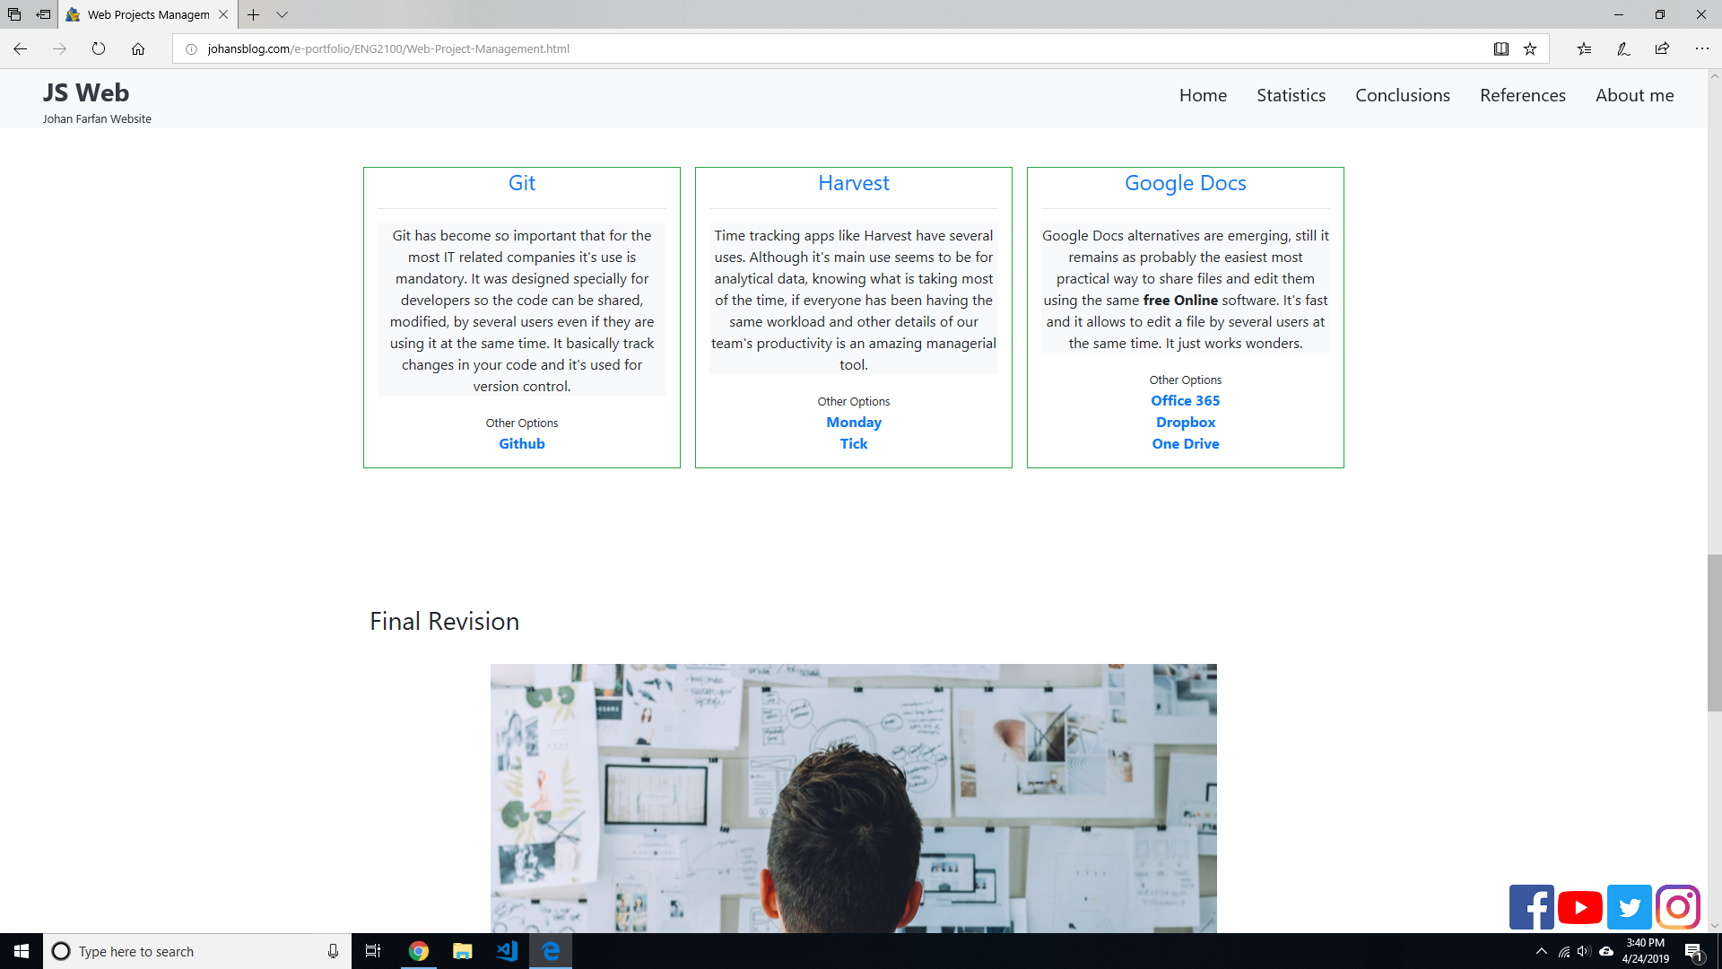

Slide 17
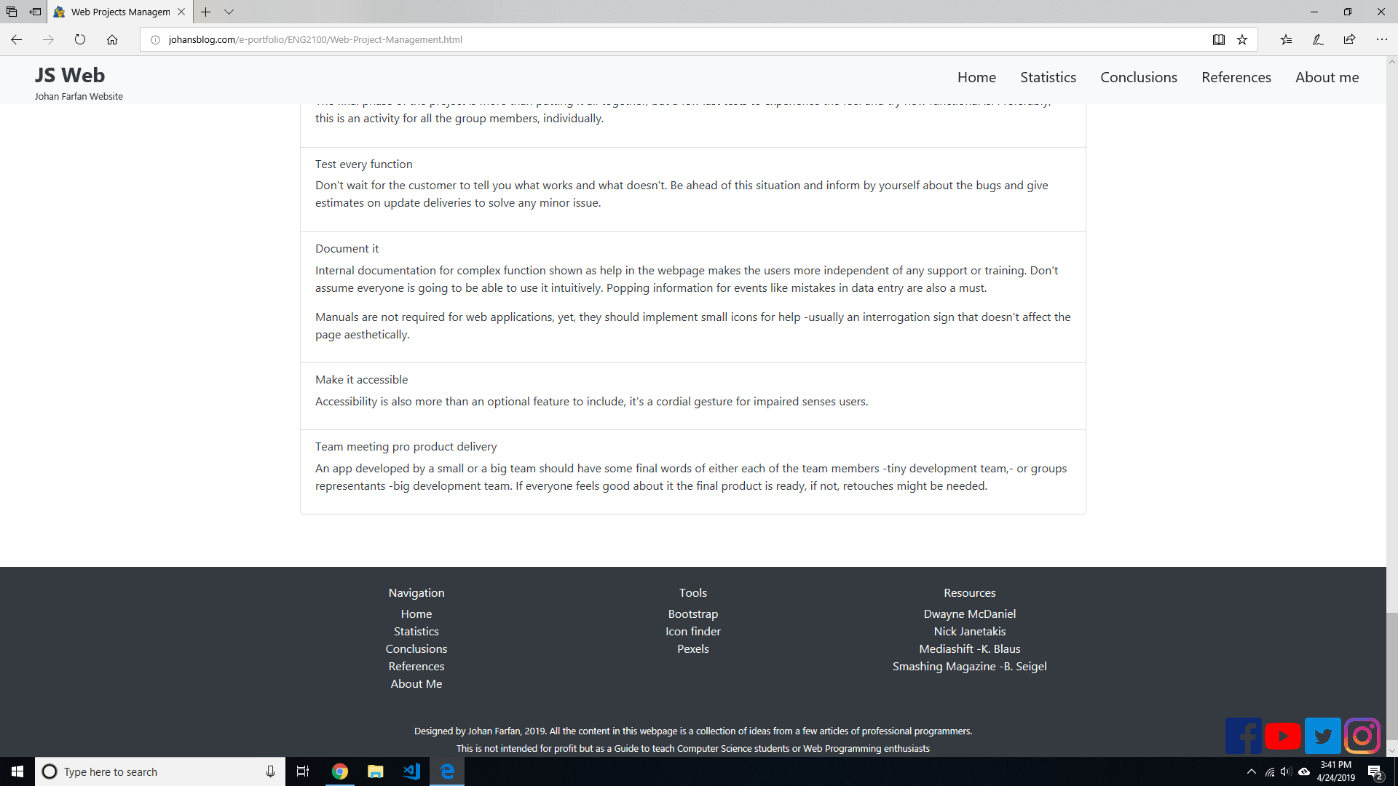

Slide 18
Conclusions
Notes:
I would say I was worried about overthinking or working too much on CRAP.
Doing the final review I realized that most of that stuff was already there, I didn’t feel like I have to work a lot on it. It’s like after understanding CRAP when you start doing something graphical you’ll start applying it even without noticing it, it might also be because I also followed some pre established standards that must have considered CRAP already.
Regarding my research on information, there are some new things I found that I can keep in consideration for the time I start working on my own projects. Because that was part of my initial idea, work on something that will purposely help to build my knowledge and skill for my goals.
Thank you.

Slide 19
?
Questions

