Slide 1
Cheddar Coin
July 8, 2018
David Nguyen
Sergey Plisov
Andrew Qian
Presented for:
AngelHack DC

Slide 2
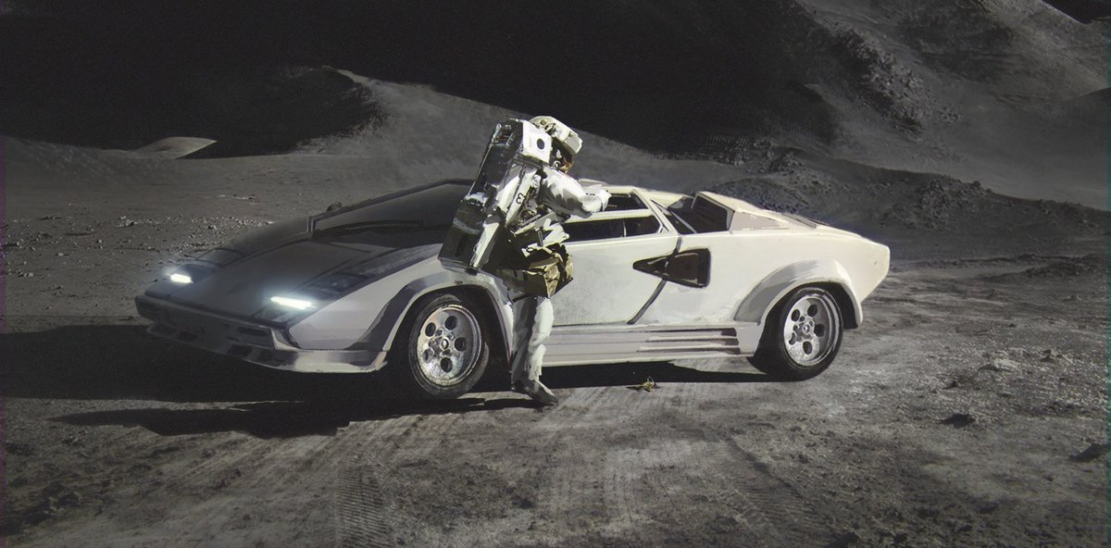
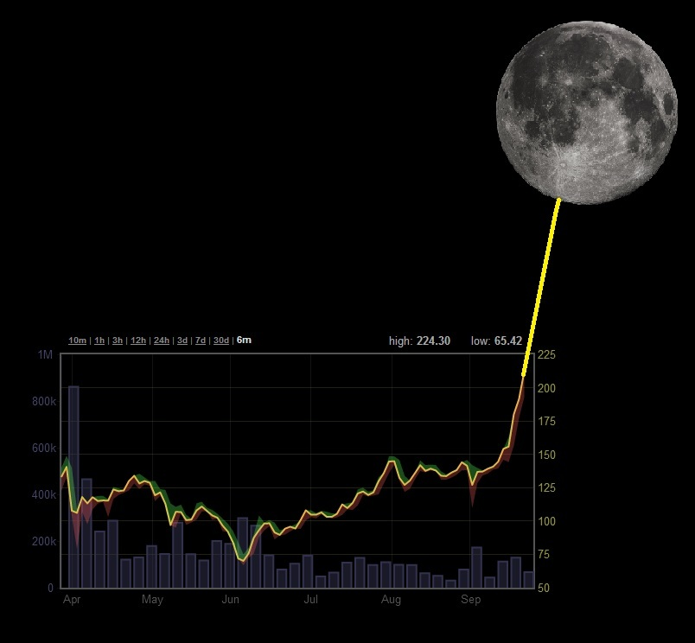
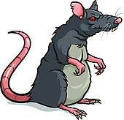
Problem
2017
Speculators
Hype > value
Non-compliant ICOs

Slide 3


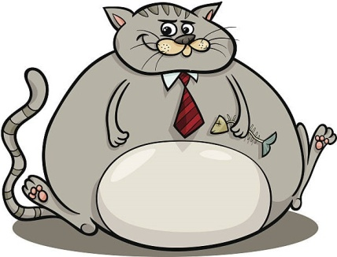
Solution
Issue stable tokens purely for utility
Shift the paradigm (value > spec)
Support compliant STOs (Reg A/CF/D)
Utility Token
Investors
Cheddar* Capital
Cheddar
Return on
Cheddar
Security Token

Slide 4
Thank You!

