Slide 1
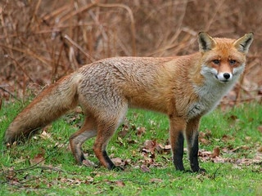
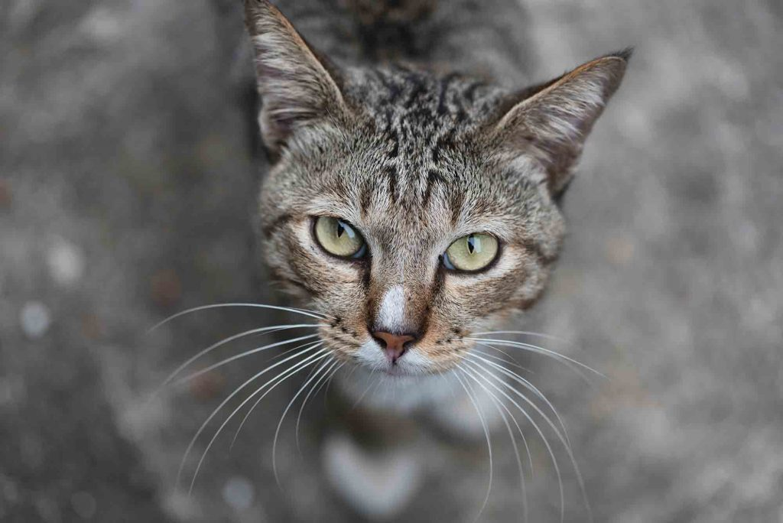
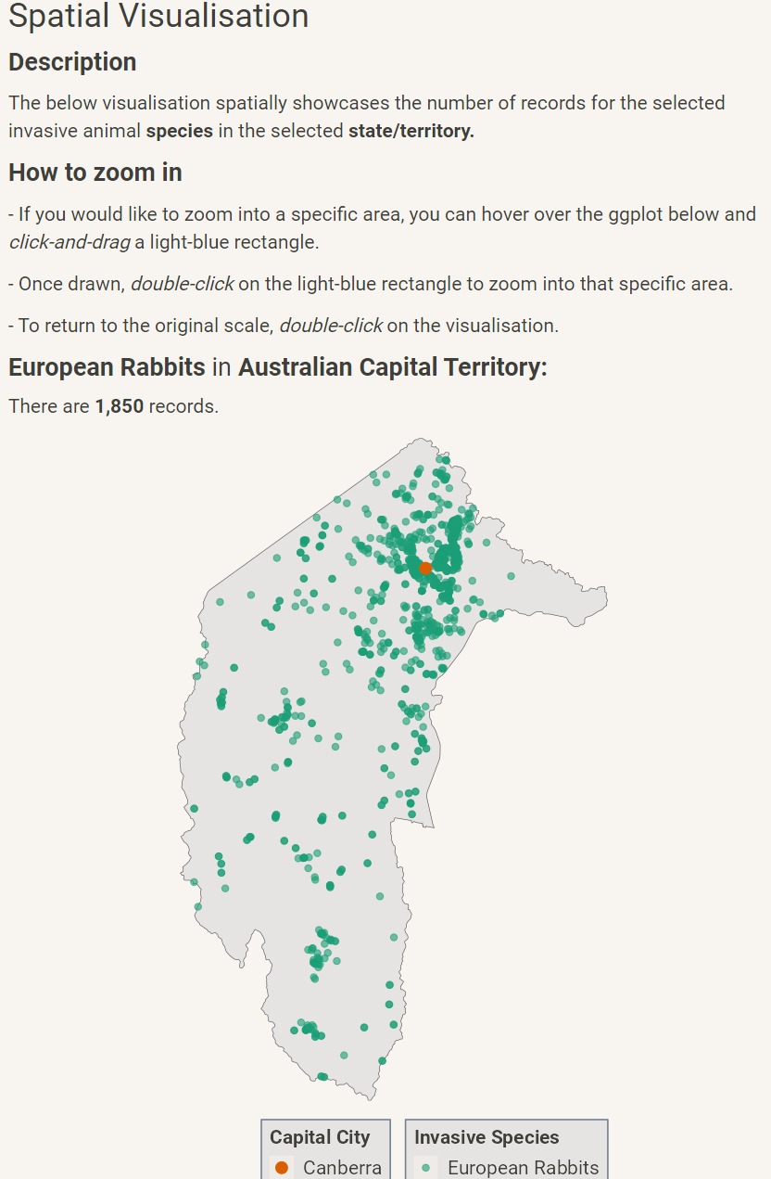
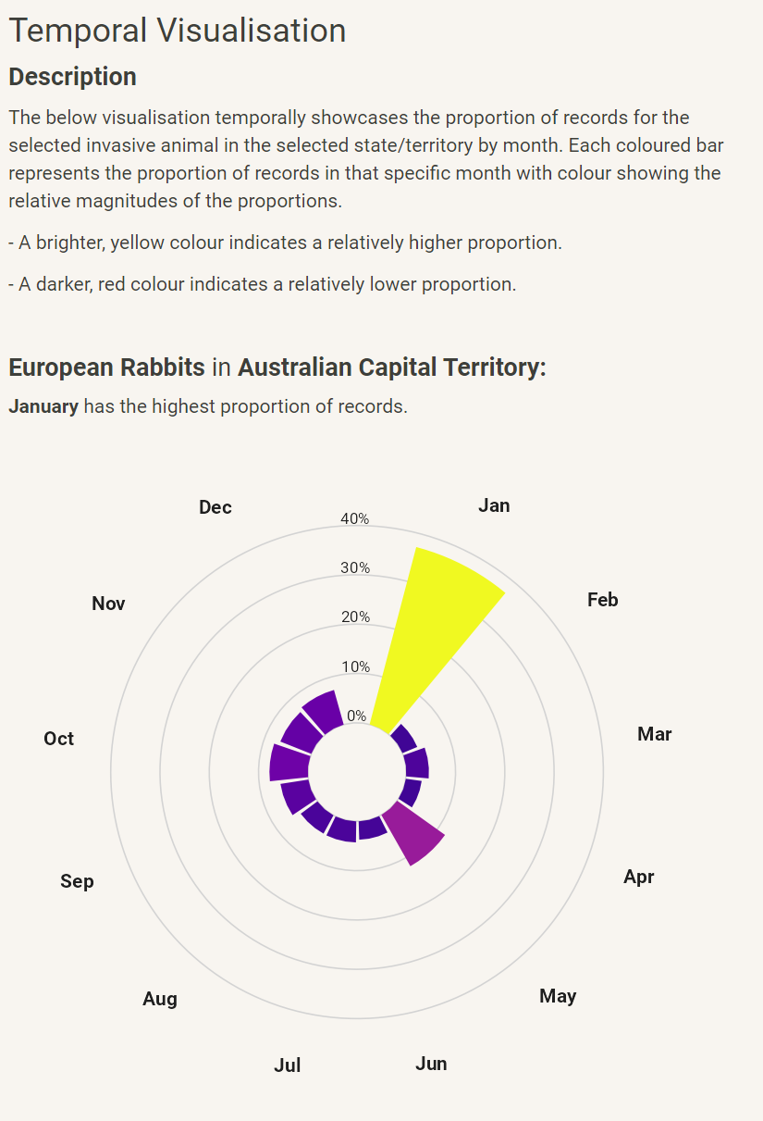
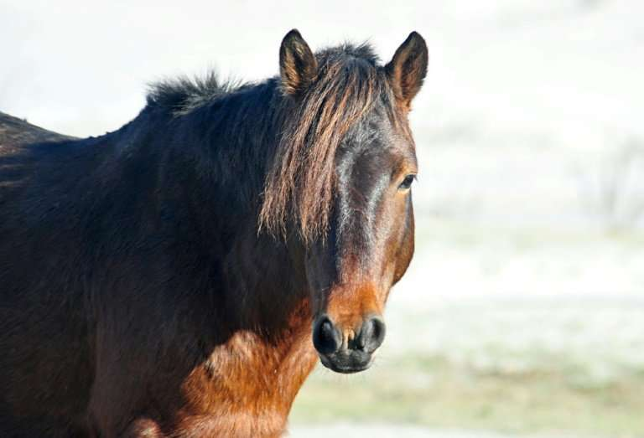
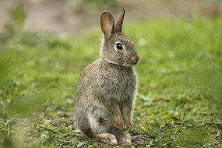
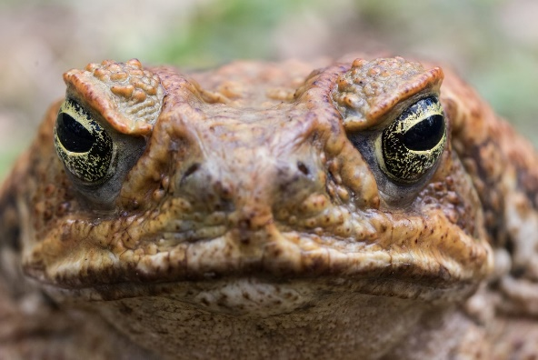

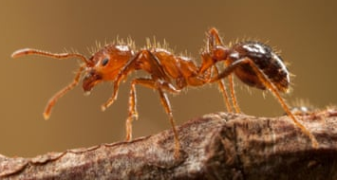
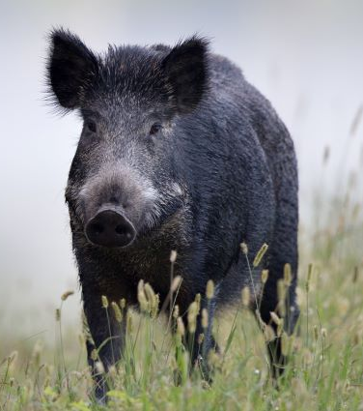
Invasive Species in Australia RShiny Dashboard
Johann Wagner – 20th October 2023
Dashboard: https://0uexv8-johann-wagner.shinyapps.io/invasive_species_dashboard
GitHub: https://github.com/johann-wagner/DS4B-final-project
Introduction
Main Aim
Invasive animal species negatively impact native fauna and flora (DCCEEW, 2021).
Decentralised species distribution data hinders informed decision-making and effective management policies (ABARES, 2023).
RShiny visualisations dynamically change by selecting one of seven species and one of eight state/territories.
Develop an RShiny app that showcases the spatial and temporal (monthly) occurrence of 7 invasive animal species in Australia by state/territory.
European Red Fox¹
Feral Cats²
Feral Horses³
European Rabbits⁴
Cane Toads⁵
Caveats / Conclusions
Red Imported Fire Ants⁶
Feral Pigs⁷
Spatial: Most of the seven species cluster around urban areas. Potentially, due to the measurement accessibility near urban areas/roads, rather than actual species behaviour.
Temporal: Similarly, uncertainty whether temporal patterns are due to human measurement frequency or actual temporal species behaviour. High variety of temporal distributions across state/territories.
References (Text)
Atlas of Living Australia website at http://www.ala.org.au. Accessed 2023-10-18.
DCCEEW, 2021. Feral animals in Australia. Department of Climate Change, Energy, the Environment and Water. https://www.dcceew.gov.au/environment/invasive-species/feral-animals-Australia. Accessed 2023-10-18.
ABARES, 2023. Distribution and impacts of established pest animals and weeds. Australian Bureau of Agricultural and Resource Economics and Sciences. https://www.agriculture.gov.au/abares/research-topics/invasive-species/distribution-and-impacts#national-vertebrate-pests-and-weeds-distributions. Accessed 2023-10-18.
References (Images)
https://www.weeklytimesnow.com.au/subscribe/news/1/?sourceCode=WTWEB_WRE170_a_GGL&dest=https%3A%2F%2Fwww.weeklytimesnow.com.au%2Fagribusiness%2Ffarm-magazine%2Fhow-to-fight-farm-pests%2Fnews-story%2Fd0c0d98397a1602a9aef1045a6ef187b&memtype=anonymous&mode=premium
https://www.dupontvet.com/blog/feral-cat-colonies/
https://phys.org/news/2018-05-brumby-reprieve-australia-wild-horses.html
https://www.abc.net.au/science/articles/2009/04/08/2538860.htm
https://lens.monash.edu/@science/2022/08/26/1384866/the-ultimate-invader-high-tech-tool-promises-scientists-an-edge-over-the-cane-toad-scourge
https://www.theguardian.com/environment/2023/sep/11/red-fire-ant-colonies-sicily-italy-europe-spread-study
https://www.feralscan.org.au/feralpigscan/

