Slide 1
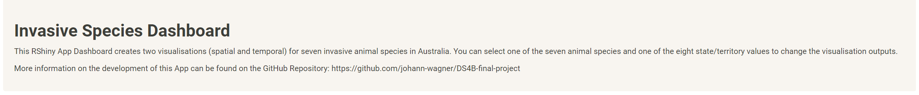
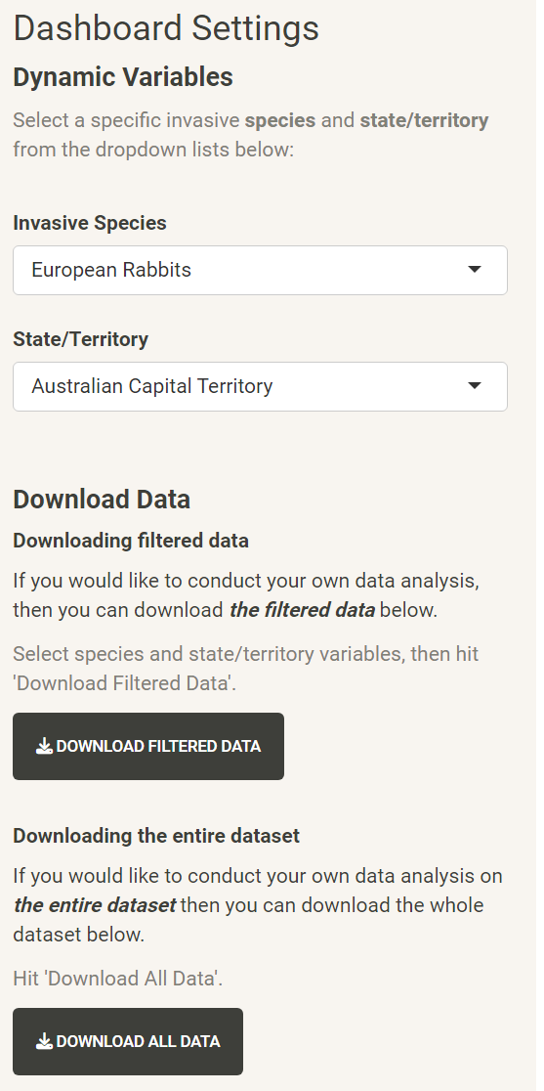
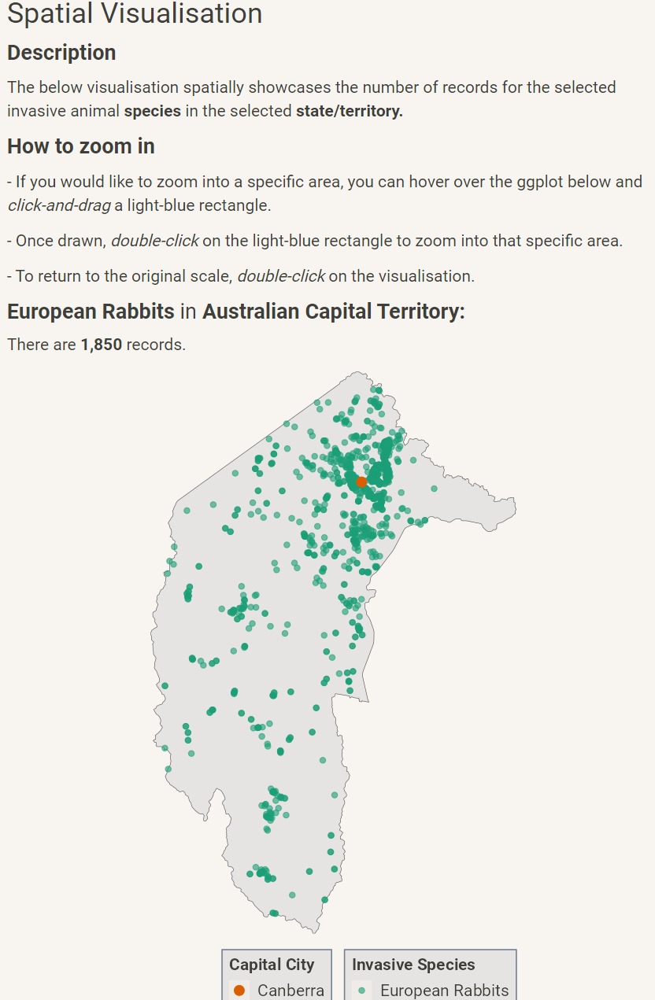
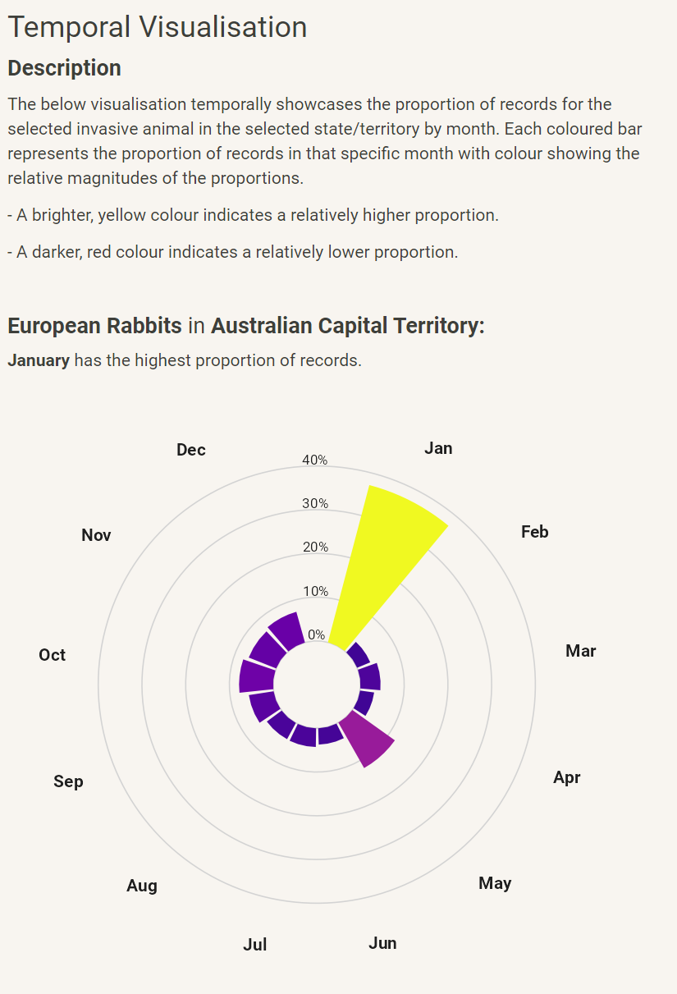

Invasive Species in Australia RShiny Dashboard
Johann Wagner – 20th October 2023
Introduction /
State the questions/aims clearly
Why Invasive Species?
How does Dashboard work?
What animals? (Scatter across poster with name)
fsdf
Concisely state the conclusions
References
A link to the github repository for the work
Contact Details

Slide 2


Invasive Species in Australia RShiny Dashboard
Johann Wagner – 20th October 2023
GitHub: https://github.com/johann-wagner/DS4B-final-project
Introduction
Aims
Invasive animal species negatively impact native fauna and flora (DCCEEW, 2021).
Decentralised species distribution data hinders informed decision-making and effective management policies (ABARES, 2023).
Visualisations dynamically change by selecting one of seven species and one of eight state/territories.
Develop an RShiny app that showcases the spatial and temporal (monthly) occurrence of 7 invasive animal species in Australia by state/territory.
Create a download option for users to download the cleaned dataset for the selected invasive animal species for a particular state/territory (see dashboard).
Caveats / Conclusions
Spatial: Most of the seven species cluster around urban areas. Potentially, due to the measurement accessibility near urban areas/roads, rather than actual species behaviour.
Temporal: Similarly, uncertainty whether temporal patterns are due to human measurement frequency or actual temporal species behaviour. High variety of temporal distributions across state/territories.
References
Atlas of Living Australia website at http://www.ala.org.au. Accessed 2023-10-18.
DCCEEW, 2021. Feral animals in Australia. Department of Climate Change, Energy, the Environment and Water. https://www.dcceew.gov.au/environment/invasive-species/feral-animals-Australia. Accessed 2023-10-18.
ABARES, 2023. Distribution and impacts of established pest animals and weeds. Australian Bureau of Agricultural and Resource Economics and Sciences. https://www.agriculture.gov.au/abares/research-topics/invasive-species/distribution-and-impacts#national-vertebrate-pests-and-weeds-distributions. Accessed 2023-10-18.

Slide 3

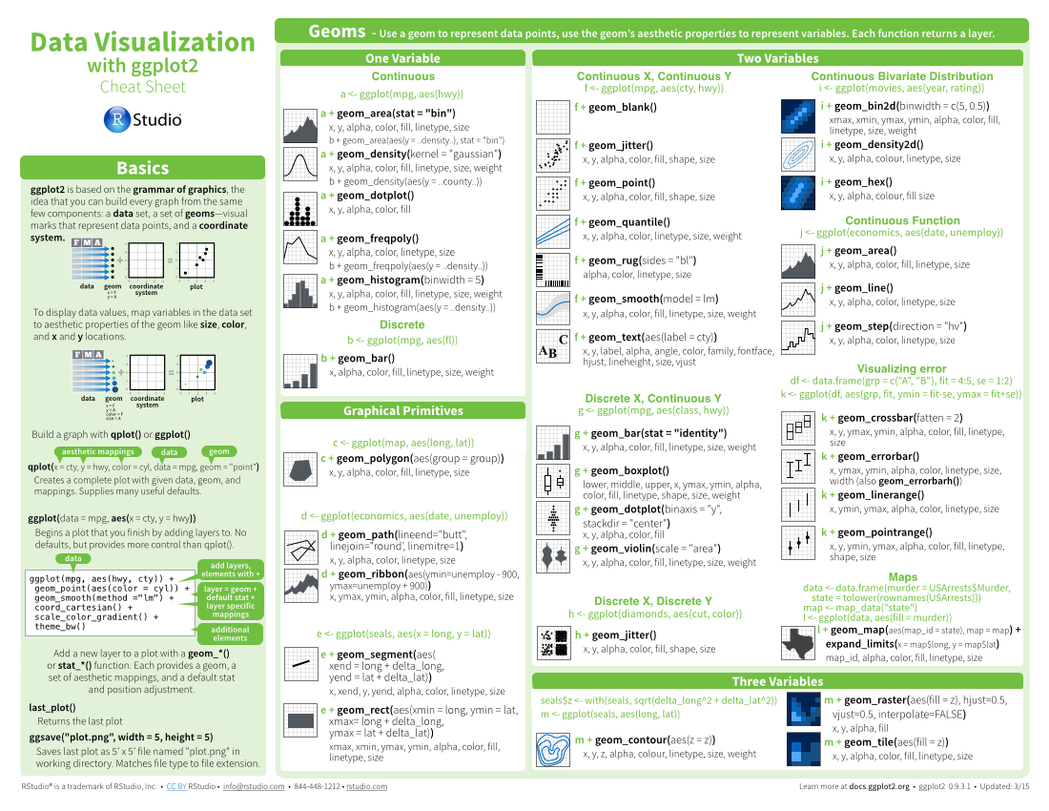





Invasive Species in Australia RShiny Dashboard
This template uses several fonts: Helvetica Neue, Menlo, Source Sans pro, which you can acquire for free here, www.fontsquirrel.com/fonts/source-sans-pro, and Font Awesome, which you can acquire here, fortawesome.github.io/Font-Awesome/get-started/
Basics
Layout Suggestions
ggplot(mpg, aes(hwy, cty)) +
geom_point(aes(size = fl)) +
geom_smooth(method ="lm")
Logistics
Useful Elements
Select multiple elements by holding down shift and then selecting each. Click on a selected element before letting go of shift to unselect it.
To group elements together. Select them all , then click Arrange > Group
To evenly space multiple objects, select them all then Right Click > Align objects or Right Click > Distribute objects
Click on a table, then visit Format >Table > Row and Column Size to make even width rows/columns.
Thank you for making a new cheatsheet for R! These cheatsheets have an important job:
Use headers, colors, and/or backgrounds to separate or group together sections.
Where possible, use code that works when run.
Section 1
Section 2
Section 3
CODE
FONTS
Cheatsheets make it easy for R users
to look up useful information.
To use a font awesome icon, copy and paste one from here https://fontawesome.com/v4/cheatsheet/ Then set the text font to font awesome.
Remember that the best cheatsheets are visual—not written—documents. Whenever possible use visual elements to make it easier for readers to find the information they need.
Create a visual hierarchy. Help users navigate the page with titles, subtitles, and subsubtitles
Word balloons
can help explain
code
Use a layout that flows and makes it easy to zero in on specific topics.
Title
These are just font awesome characters
SUBTITLE
ICONS
I make my cheatsheets in Apple Keynote, and not latex or R Markdown, because presentation software makes it much easier to tweak the visual appearance of a document
SUBSUBTITLE
Fit sections to content. Try several different layouts.
Use numbers or arrows to link sections if the order/flow is confusing.
Quickly identify content with a package hexsticker (if available)
MOCK TABLES
KEYNOTE
Use visualizations to explain concepts quickly and concisely.
summary function
Use visual elements to make the sheet scannable.
KEYNOTE TIPS
i + geom_area() x, y, alpha, color, fill, linetype, size
i + geom_line() x, y, alpha, color, group, linetype, size
MOCK GRAPHS
Copyright
Use visual emphasis (like color, size, and font weight) to make important information easy to find.
Each cheatsheet should be licensed under the creative commons license.
To license the sheet as creative commons, put CC'd by <your name> in the small print at the bottom of each page and link it to
http://creativecommons.org/licenses/by/4.0/
TABLES
dplyr::lag() - Offset elements by 1
dplyr::lead() - Offset elements by -1
sub-option | description
citation_package | The LaTeX package to process citations, natbib, biblatex or none
code_folding | Let readers to toggle the display of R code, "none", "hide", or "show"
colortheme | Beamer color theme to use
YOUR LOGO
(optional)
RStudio® is a trademark of RStudio, Inc. • CC BY SA Your Name • your@email.com • 844-448-1212 • your.website.com • Learn more at webpage or vignette • package version 0.5.0 • Updated: 2017-01

Slide 4

Three Column Layout: : CHEAT SHEET
Basics
Layout Suggestions
Manipulate Variables
Thank you for making a new cheatsheet for R! These cheatsheets have an important job:
Use headers, colors, and/or backgrounds to separate or group together sections.
Create a visual hierarchy. Help users navigate the page with titles, subtitles, and subsubtitles
Quickly identify content with a package hexsticker (if available)
Fit sections to content. Try several different layouts.
Use numbers or arrows to link sections if the order/flow is confusing.
Cheatsheets make it easy for R users
to look up useful information.
Section 1
Section 2
Section 3
Title
Remember that the best cheatsheets are visual—not written—documents. Whenever possible use visual elements to make it easier for readers to find the information they need.
SUBTITLE
This template uses several fonts: Helvetica Neue, Menlo, Source Sans pro, which you can acquire for free here, www.fontsquirrel.com/fonts/source-sans-pro, and Font Awesome, which you can acquire here, fortawesome.github.io/Font-Awesome/get-started/
SUBSUBTITLE
Use a layout that flows and makes it easy to zero in on specific topics.
Logistics
ggplot(mpg, aes(hwy, cty)) +
geom_point(aes(color = cyl)) +
geom_smooth(method ="lm")
Useful Elements
FONTS
Where possible, use code that works when run.
CODE
Word balloons
To use a font awesome icon, copy and paste one from here fortawesome.github.io/Font-Awesome/cheatsheet/. Then set the text font to font awesome.
can help explain
code
Use visualizations to explain concepts quickly and concisely.
ICONS
summary function
Select multiple elements by holding down shift and then selecting each. Click on a selected element before letting go of shift to unselect it.
To group elements together. Select them all , then click Arrange > Group
To evenly space multiple objects, select them all then Right Click > Align objects or Right Click > Distribute objects
Click on a table, then visit Format >Table > Row and Column Size to make even width rows/columns.
☞    
Use visual elements to make the sheet scannable.
I make my cheatsheets in Apple Keynote, and not latex or R Markdown, because presentation software makes it much easier to tweak the visual appearance of a document
These are just font awesome characters
i + geom_area() x, y, alpha, color, fill, linetype, size
i + geom_line() x, y, alpha, color, group, linetype, size
KEYNOTE
MOCK TABLES
Use visual emphasis (like color, size, and font weight) to make important information easy to find.
KEYNOTE TIPS
MOCK GRAPHS
dplyr::lag() - Offset elements by 1
dplyr::lead() - Offset elements by -1
COPYRIGHT
TABLES
Each cheatsheet should be licensed under the creative commons license.
To license the sheet as creative commons, put CC'd by <your name> in the small print at the bottom of each page and link it to http://creativecommons.org/licenses/by/4.0/
sub-option | description
citation_package | The LaTeX package to process citations, natbib, biblatex or none
code_folding | Let readers to toggle the display of R code, "none", "hide", or "show"
colortheme | Beamer color theme to use
YOUR LOGO
(optional)
RStudio® is a trademark of RStudio, Inc. • CC BY SA Your Name • your@email.com • 844-448-1212 • your.website.com • Learn more at webpage or vignette • package version 0.5.0 • Updated: 2017-01

