Slide 1

Sparkify

Slide 2

Business objective
To increase AY2021 Q1 profits by increasing percentage of paid subscribers

Slide 3
Understanding user’s preferences may give insights to their propensity to subscribe
1.5x
>80,000
550
Songs
More paid users than free users
Unique songs listened
Median songs per users
248
secs
~5 songs
17%
Average song length listened
Avg songs listened in a single sessions
More users that converted than non-converters

Slide 4




We built a robust classification model to identify potential subscribers
“High Propensity”
These category of users are likely to convert from “free” level to “paid” level. Targeted marketing efforts should be served to these users as they have a higher potential to subscribe
Features:
'itemInSession’ → Songs in current session
'location_state’ → State in USA
'userAgent_summarised’ → OS used
‘is_male’ → 1 if Male, 0 if Female
'length’ → length of song
'time_since_registered’ → duration on platform
Random Forest Classifier
F1 Score: 0.84
“Low Propensity”
These category of users are satisfied with the functions offered by the “free” level. They are unlikely to convert and Sparkify should minimise the ads targeted at them as it may lead to marketing fatigue

Slide 5



Predictions allow us to identify customers with higher propensity to convert
In-App Personalised discounts
Bundling with Partners
Surveys
Having identified the high propensity customers, we can serve them more prompts to subscribe for the upcoming month.
This can come in the form of personalised discounts and benefits. For example, a “20% off for the first month” discount can be offered to these customers that are likely to subscribe.
Sparkify can bundle its subscription offers with partners’ products (e.g. in Consumer Electronics, F&B, Telecommunications).
For example, an identified “free” level user will be offered a promo bundle when they re-contract with Singtel.
Sparkify can reach out to both groups to understand their preferences better through surveys and focused groups.
This has a multiplicative effect on the downstream profits as insights from these groups can be used to improve the design of the app and future marketing efforts.

Slide 6

Conclusion
By identifying which users to target, Sparkify can focus their marketing efforts and
prevent marketing fatigue

Slide 7
Annex

Slide 8
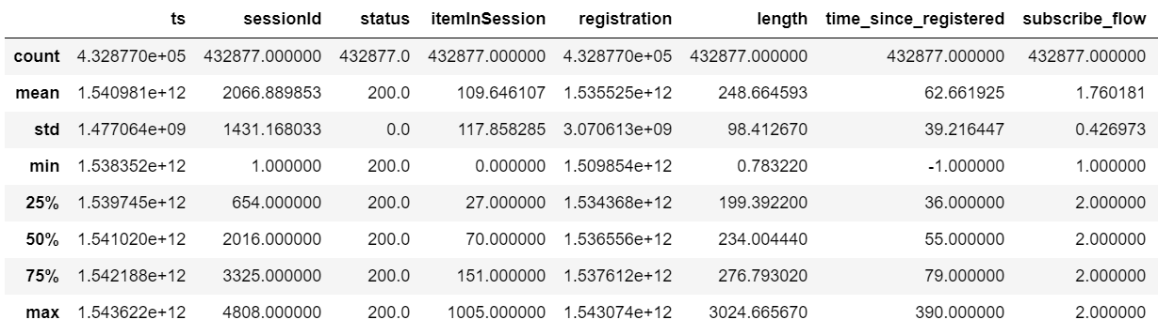
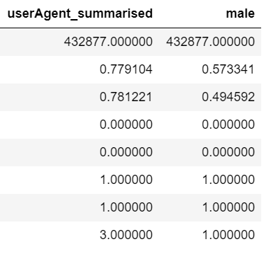
Data Summary

Slide 9
Pre-processing Steps
Dropping NA
Converting ts & registration columns to timestamp type
Create column for duration since they registered (in days)
Create target column for users that have converted (1 -> stayed at current level, 2 -> converted)
Summarise userAgent columns to macintosh, windows, linux or others
Reduce locations to only their states in USA and one-hot the column
Create “is_male” column and drop gender column

