Slide 1


CAP 4770 - FA 2025
ESTIMATION OF OBESITY LEVELS BASED ON EATING HABITS & PHYSICAL CONDITION
Exploring Neural Network Architectures and Optimization
(Group 11) Aaron Cole, Martin Patterson, Johanna Devilme

Slide 2

01
Visualization and Presentation
Aaron Cole
Efforts
02
Test Creation and Presentation
Martin Patterson
03
Code Organization and Presentation
Johnna Devilme

Slide 3
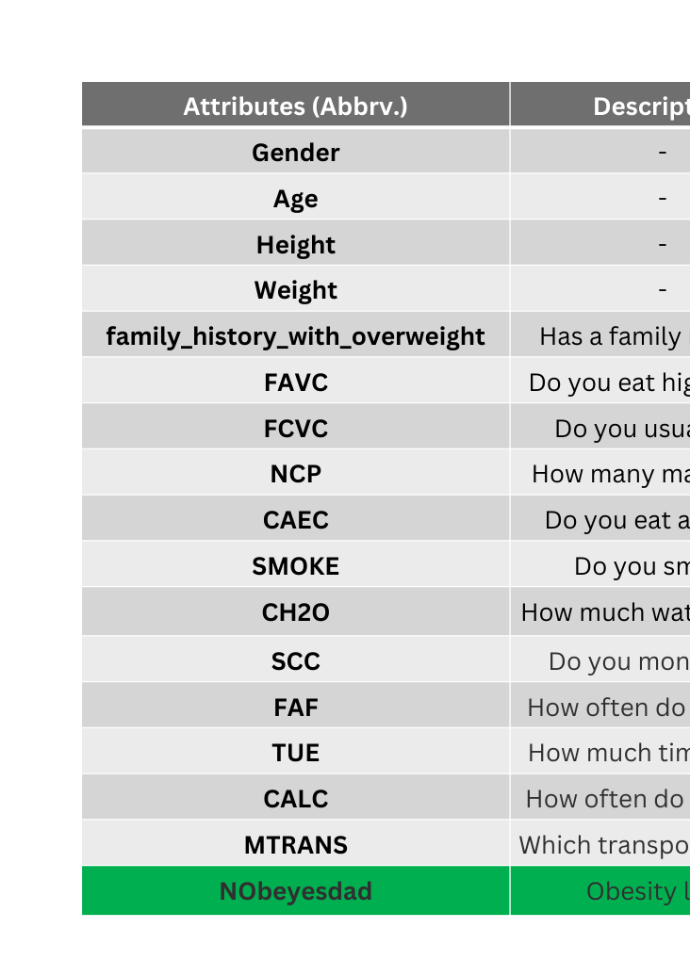
Goal: Predict specific obesity levels based on lifestyle factors
Dataset
Scikit Learn MPL Classifier
UCI ML Repository
80/20 Split
Features
Eating habits and Physical condition with target class.

Slide 4
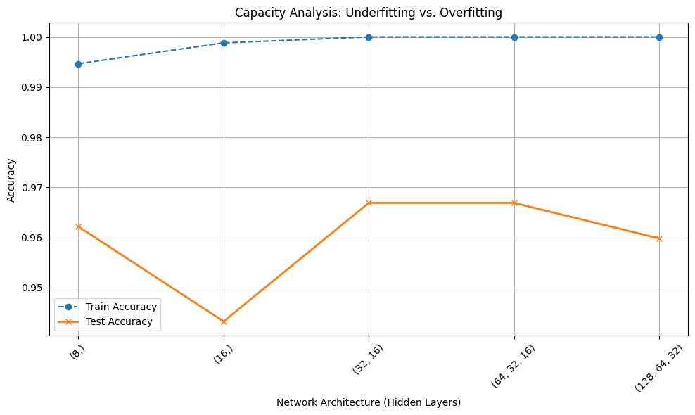
Capacity Test
How big does our capacity need to be?
Experiment
Tested layer sizes ranging from shallow (8,) to deep (128, 64, 32).
Findings
The medium sized architecture with (64, 32) hidden layer structure provided the best balance between too simple and over fitting.

Slide 5
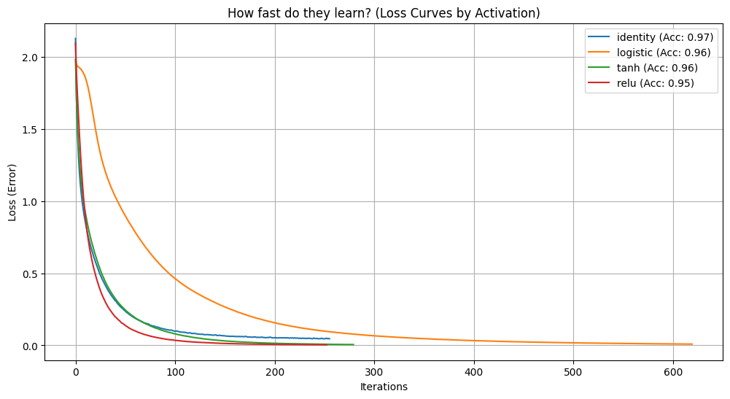
Non-Linearity
Is obesity a linear problem, or does it require complex curves?
Experiment
Compared Activation Functions: Identity (Linear), Logistic, Tanh, ReLU.
Findings
Identity performed poorly, proving obesity is a non-linear problem.
ReLU converged the fastest and achieved high accuracy, avoiding the vanishing gradient problem seen in Logistic.

Slide 6
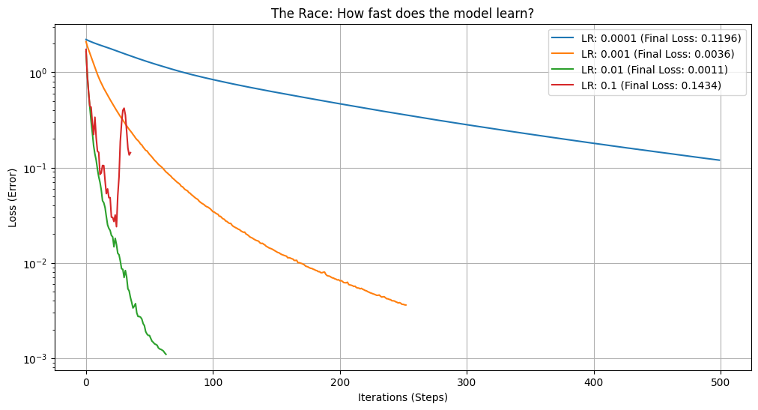
Convergence Speed
How fast should the model learn?
Experiment
Learning Rates (0.0001, 0.001, 0.01, 0.1).
Findings
Blue: 0.0001 Inefficient and slow learner
Orange: 0.001 Better than blue but more of the same
Green: 0.01 Learns fast and completes fast
Red: 0.1 Unstable

Slide 7
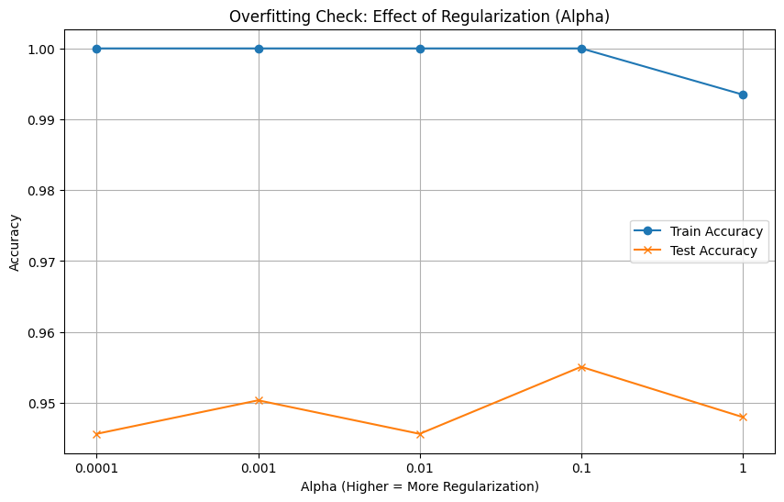
Convergence Speed
How fast should the model learn?
Experiment
Learning Rates (0.0001, 0.001, 0.01, 0.1).
Findings
Blue: 0.0001 Inefficient and slow learner
Orange: 0.001 Better than blue but more of the same
Green: 0.01 Learns fast and completes fast
Red: 0.1 Unstable

Slide 8
Generalization
Is the model memorizing patients?
Experiment
Adjusted alpha parameter. Compared Tran vs test split on adjusting alpha
Findings
An alpha of 0.1 provided the smallest gap between the train and test

Slide 9
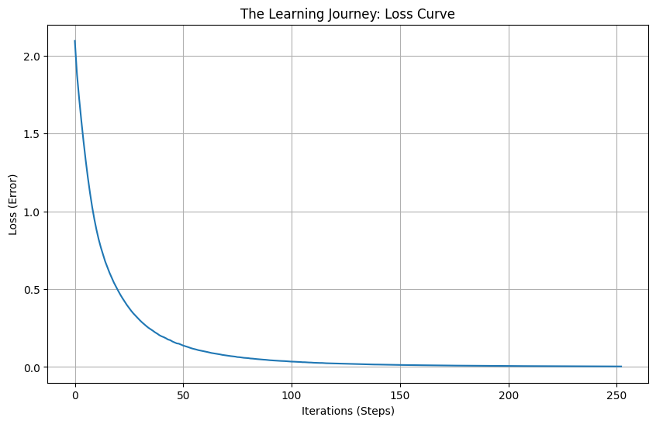
Loss Curve
Context
Performance of the final “Best Model” with optimized hyper parameter
Analysis
Smooth downward curve with stability. The model learned easily and successfully.

Slide 10
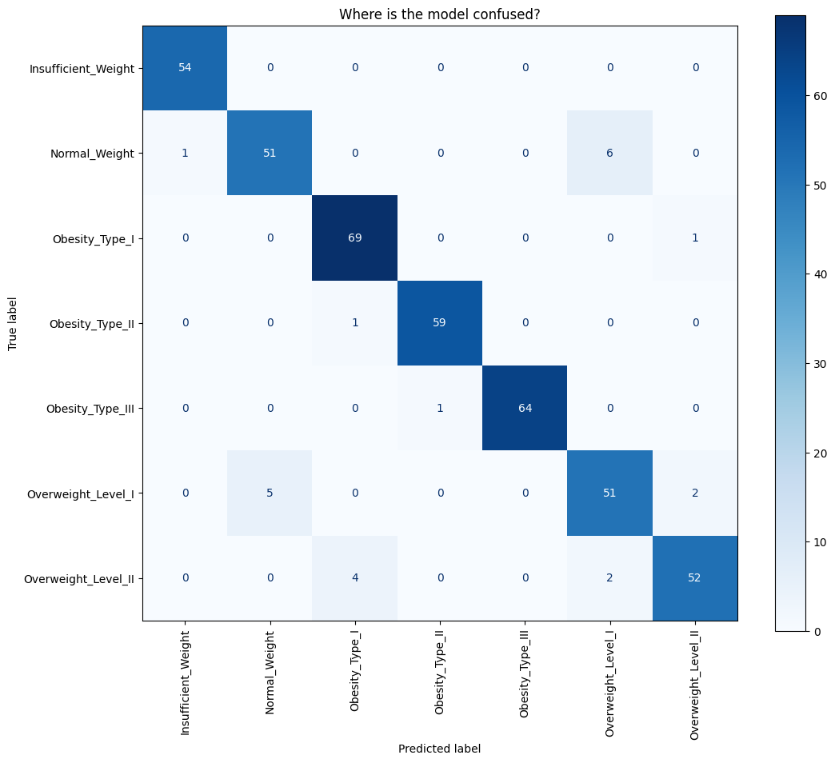
Confusion Matrix
Context
Where the model makes mistakes
Analysis
Smooth downward curve with stability. The model learned easily and successfully.

Slide 11
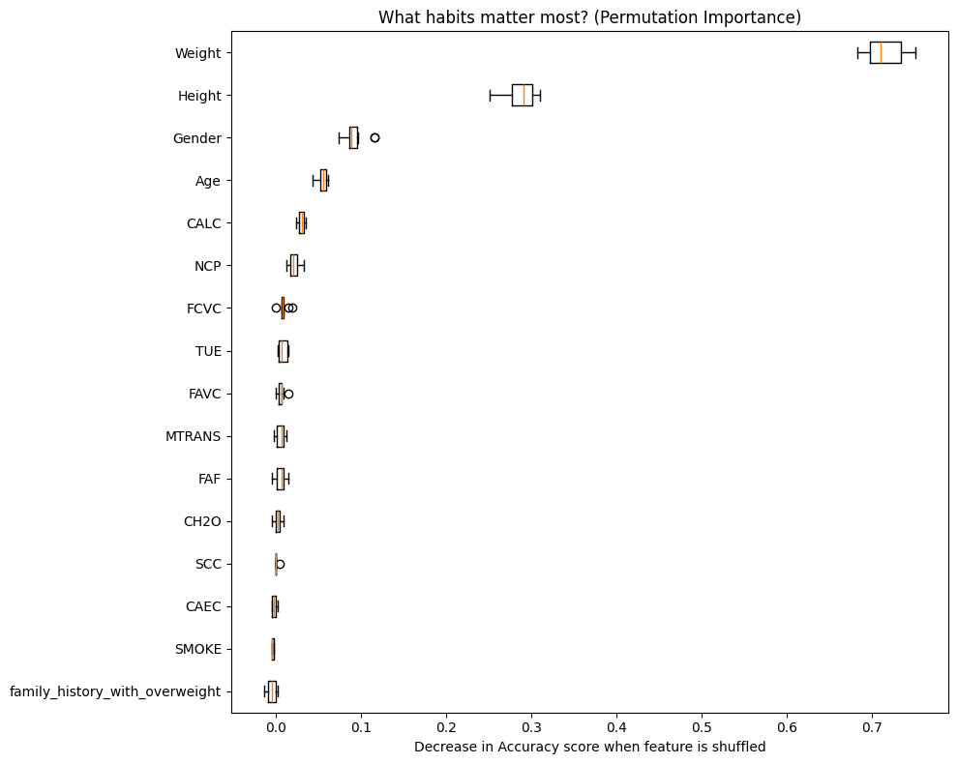
Feature Analysis
What features have the biggest impact on predictions?
Method
Shuffles data and sees how much accuracy drops. If it crashes, that feature was important.
Analysis
Correctly predicted that physical mass + genetics is the key metric for diagnoising obesity

Slide 12
Conclusion
Identity performed poorly and RelU performed well. Therefore, the relationship between eating habits obesity characterization is complex and curved.
Obesity Is Non-Linear
We successfully developed a machine learning model to categorize patient obesity levels.
Regularization was Required
The model was initally memorizing specific patients rather than general health data. The alpha parameter adjusted resulted in a smaller gap between training and test.
Based on the confusion matrix, this model can make medically reasonably classifications with little error.
Confusion Matrix
Efficient Architecture
We proved that a larger architecture was not necessary and found a balance between learning rate and capacity.

Slide 13
Thank you!
Questions?
Click here for a link to our Colab

